Slide 1
Cholera
Lecture objectives:
Know the epidemiology of cholera and history of cholera
Know the microbiological characteristic of cholera
Describe the pathogenesis of cholera
Describe the clinical features of cholera
Describe the methods for laboratory diagnosis
Know the management of cholera and control of outbreak
Color index:
Important
Found in Girls’ slides
Doctors’ note
Found in Boys’ slides
Extra
EDITING FILE

Slide 2
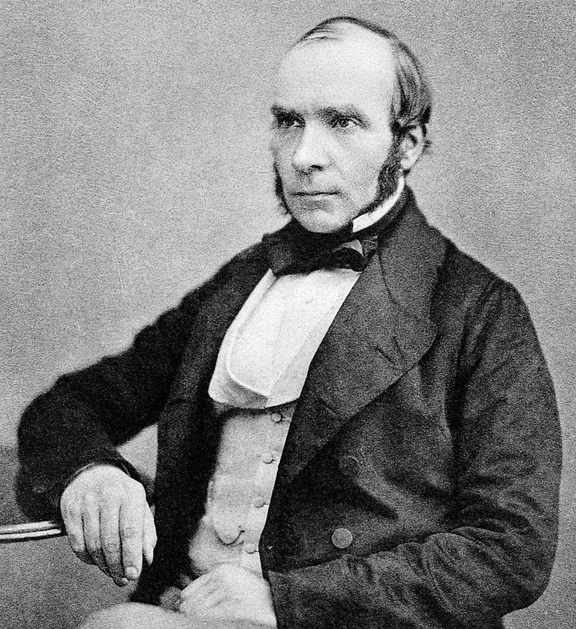
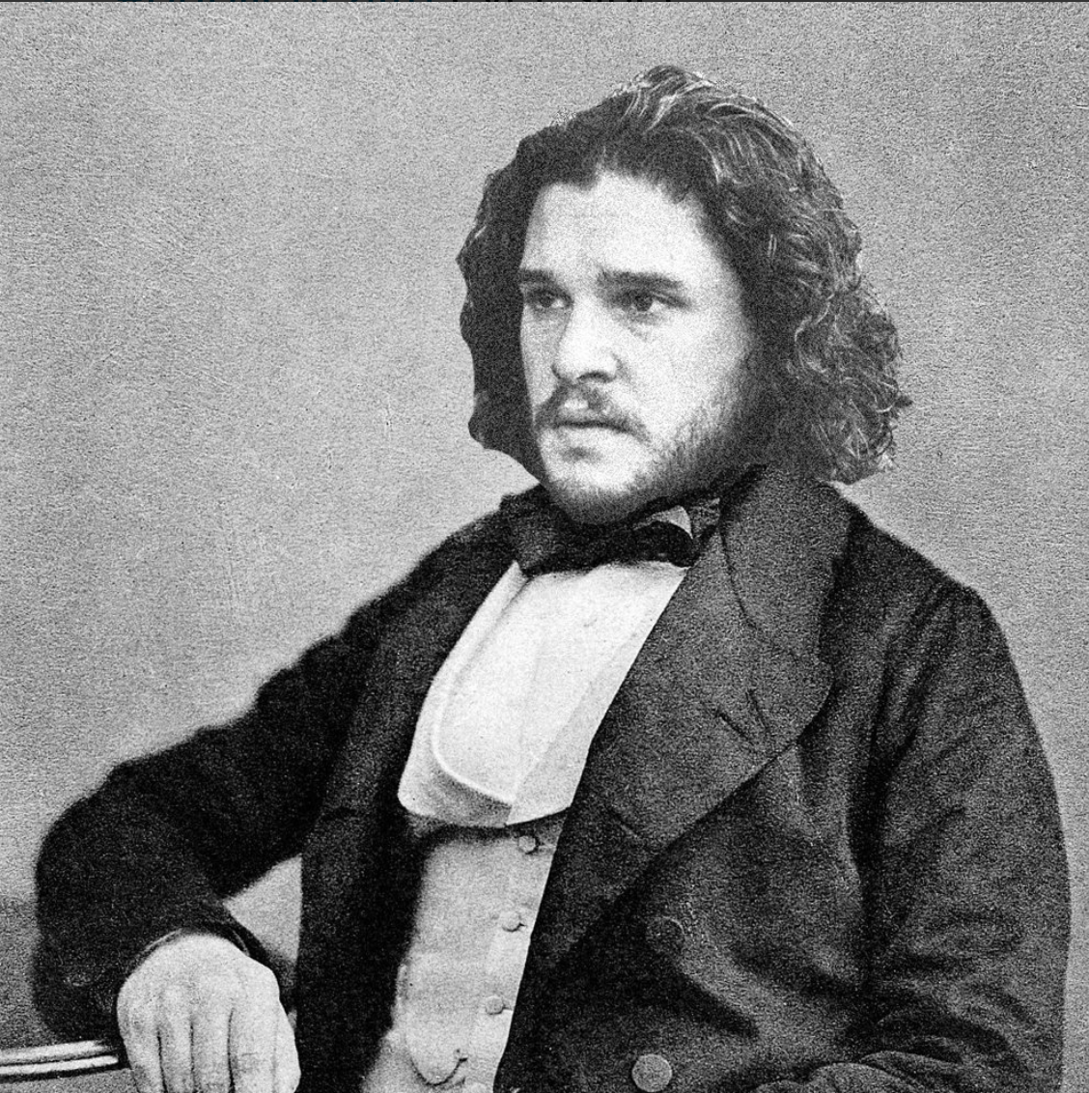
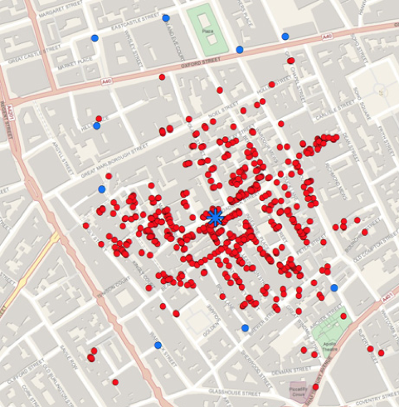
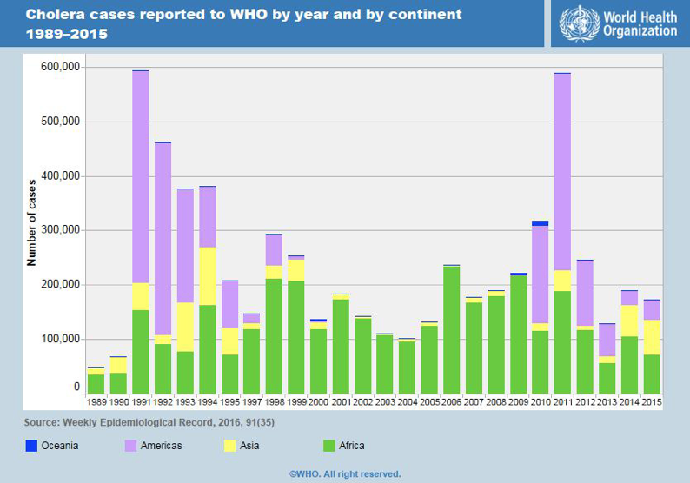
1
Introduction, Discovery & Epidemiology
Introduction:
Cholera
Definition | A waterborne life threatening diarrheal disease
Etiology | Vibrio Cholerae Comma shaped Gram negative rods¹ (oxidase positive)
Epidemiology | Found in salt and fresh water. leads to outbreak and epidemic.
Characteristics³ | Has many serotypes based on O-antigen O 1 and O 139². Produce a non-invasive enterotoxin. Can be prevented by good sanitation system.
Discovery:
○ John Snow discovered an outbreak in London 1854.
○ It was related to broad street pump sewage contamination.
○ Removal of the pump handle end of the outbreak.
John Snow
Jon Snow
Epidemiology
V. cholera O1 and O139 serogroup organisms are the causes of epidemic cholera.
O1 (from 1817 till now): - Classical: 1 case per 30-100 infections - El Tor⁴: 1 case per 2-4 infections (Seventh pandemic) | O139 (recently in 1992 in Asia only): - Contained in India, Bangladesh.
Seven major outbreaks. Majority in India, Sub-Saharan Africa, Southern Asia. Endemic in > 50 countries. Each year 3-5 millions cases result in 100,000 deaths.
In 2016 in Haiti after Hurricane Matthew, in South Sudan & Yemen and many other African countries
1- flagellated
2- other serotypes do not produce the toxin that causes the disease
3- mainly found in small intestine
4- less severe

Slide 3
2
Infectivity & Transmission
Infectivity
○ Period of infectivity during acute stage till recovery ( end one to three weeks )
○ Infected person can produce up to 20 L of 109 CFU/ml /day¹
○ Has high infectious dose NOT like Shigella, typhoidal Salmonella and Enterhemorrhagic E.coli
○ Infectious dose 10⁶-10¹¹ colony-forming units, Due to harsh environment of the intestine
i.e. temperature and stomach acidity, Bile salts and organic acids in the intestine
Fecal-oral transmission through contaminated food or water²
Sewage or infected person contaminate water supply, and Not well established sewage system and water.
Undercooked shellfish.
Transmission
Common in summer grows in brackish estuaries and coastal seawaters, often in close
association with copepods or other zooplankton.
Children, elderly and people with less gastric acidity are at higher risk than others.
Blood group
O>> B > A > AB
1- Very easy to contaminate the water
2- In polluted water the following organisms are common to find :
Cholera , poliovirus , hepatitis A and salmonella typhi

Slide 4
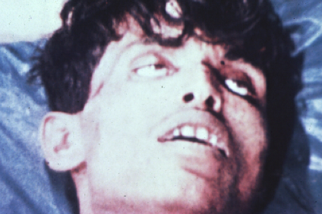
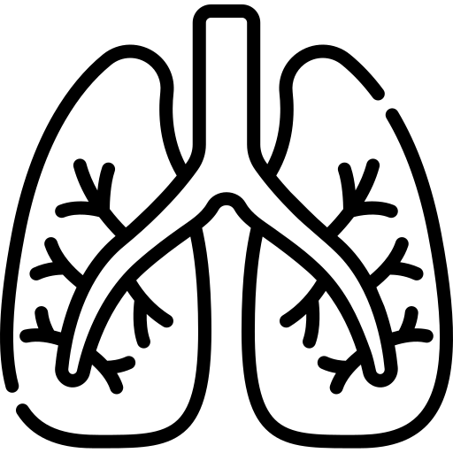
Pathogenesis & Clinical manifestations
3
Pathogenesis
Toxin | ○ Vibrio cholerae uses toxin-coregulated pili (TCP) to colonize the human intestine. ○ Cholera results from secretory diarrhea caused by the actions of cholera toxin (CT) on intestinal epithelial cells. ○ CT is an adenosine diphosphate – ribosylating enzyme that leads to chloride, sodium, and water loss from intestinal epithelial cells
Mechanism | 1. Cholera toxin binds to Monosialoganglioside (GM1) which is a glycosphingolipid on the surface of epithelial cells. 2. The toxin must undergo cleavage of the active, A1 component(CTA1), which goes on to constitutively activate the Gs protein 3. Nicotinamide adenine dinucleotide (NAD), mediated by CTA1 becomes Adenosine diphosphate (ADP)-ribose & binds to G protein 4. G protein regulates adenylyl (adenylate) cyclase activity (AC). 5. Elevation in the intracellular cyclic adenosine monophosphate (cAMP) concentration. 6. Water and electrolyte shift from the cell to the intestinal lumen, This results in extremely watery diarrhea accompanied by electrolyte imbalances
Clinical Manifestations¹
○ Ranges from a few hours to 5 days( range 1-3 days). ○ Depending on gastric acidity and initial infectious dose. ○ Majority have mild, or no symptoms at all: 75% asymptomatic 20% mild disease 2-5% severe
 | Mild disease | Cholera gravis¹
Symptoms | Vomiting. Cramps. Watery diarrhea (1L/hour): - with flecks of white mucus (rice water ostool) & a fishy odor. ↓ Ca++ and K can lead to ileus, muscle pain, spasm, & even hhtetany. | More severe symptoms due to Rapid loss of body fluids: Rapidly lose more than 10% of body weight. Dehydration and shock¹. Sunken eyes, and ↓skin turgor (tenting), cold ddand clammy. Anuric & lactic acidosis (Kussmual breathing). Hypoglycemia ➔ seizure or comma. Cardiac and Renal failure. Aspiration pneumonia.
Water Loss | 1 liter/hour. | 6 liters/hour (10⁷⁻⁹ vibrios CFU/mL).
Mortality | ○ Death occurred in (18 hours - several days) if not treated due to dehydration. | ○ Death within 2-12 hours or less. ○ Mortality 50-60% without treatment. ○ Mortality <1% with rehydration.
1-severe form of disease
2-what is the main cause of death in cholera? hypovolemic shock.

Slide 5
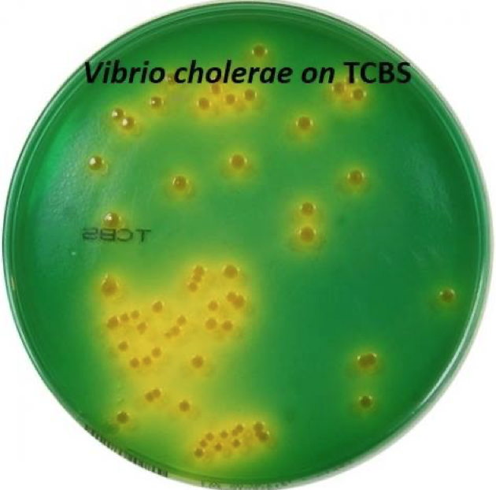
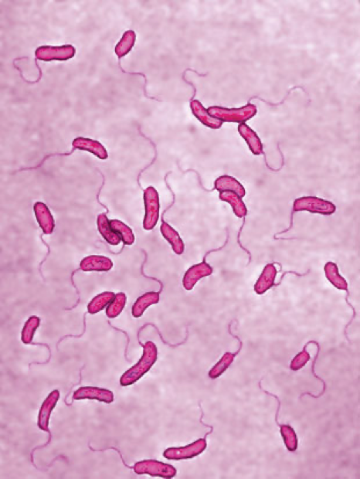
Diagnosis
4
Diagnosis:
Suspected in severe diarrhea with dehydration.
1- Complete history and physical examination.
2- Insert central line for IV fluid¹, collect blood² for basic routine tests (chemistry and hematology).
3- Stool:
○ Recovery of organisms can be enhanced by enrichment of stool in alkaline peptone water. (60-100%)
○ Send stool for smear and culture on special media.
- Microscopy:
○ Dark field microscopy (shooting stars).
○ Gram stain (curve Gram Negative bacilli
- Culture³:
○ Culture on thiosulfate citrate bile sucrose (TCBS) agar-yellow colonies⁴
○ Culture not routinely performed, you have to request it.
Other non-invasive bacterial, ETEC and viral gastroenteritis might have similar presentation.
Diagnosis / Microbiology
Vibrio cholera is highly motile, gram-negative, curved or comma-shaped rods with a single polar flagellum (oxidase positive)
Biotype 01 antigen | Serotype | Antigen
Classical | Ogawa | A,B
 | Inaba | A,C
 | Hikojima | A,B,C
El Tor | Ogawa | A,B
 | Inaba | A,C
 | Hikojima | A,B,C
O 139 serogroup antigen appeared in Bangladesh in 1992
Has polysaccharide capsule but does not have O1 antigen
Non-O1, Non-O139 Serogroup
Most are CT (cholera toxin) negative and are not associated with epidemic disease.
1- rehydration is the main treatment
2- To check creatinine for renal failure
3- Culture is not enough cause even if the culture is positive it’s not necessary that it will cause the disease
4- Indicates sucrose fermentation

Slide 6
Treatment & prevention
5
Treatment
○ Basically rehydration and antimicrobial therapy
Rehydration | Antibiotics¹
○ Should be started immediately before confirming the diagnosis. ○ Either: - Oral rehydration if the patient can tolerate (not vomiting) - IV rehydration. ○ Patients recovered within 3-6 days. ○ Decrease mortality from 50% to 1 %. ○ Give 1.5 time the amount lost ○ Start when 10% of total body weight lost. ○ Oral Rehydration Salt (ORS) by WHO & UNICEF: One pack in 1 liter contain NaCl, KCl, NaHCO3, glucose. ○ IV use either Ringer’s lactate, Saline or Sugar and water. | •Reduce the recovery time to 2-3 days. •Decrease infectivity •Azithromycin: Single-dose (preferred, especially in children) or Ciprofloxacin, or Tetracycline, Doxycycline
Prevention
Wash your hand frequently
Water Sanitation
Boil water and chlorination
Water treatment
Avoid salad, ice & iced food
Disrupt fecal-oral transmission
( if present)
 | Killed Whole-cell Vaccines | Live Attenuated Vaccines
Adult | 50% protection for 6 months | 60% protection for 2 years
Children (aged 2-5) | <25% protection | protection rapidly declines after 6 months
Doses | Multiple doses | -
Side effects | - | Mild diarrhea, abdominal cramping
1- The doctor said that you can use any of the mentioned drugs

Slide 7
Possible use in bioterrorism & International efforts
6
Can be a bioterrorism agent:
Silence and Ease of dissemination with low technology.
Ease of procurement
Simplicity of production in large quantities at minimal expense
Silent dissemination
International Efforts:
○ WHO: Global Task Force on Cholera Control:
- Reduce mortality and morbidity
- Provide aid for social and economic consequences of Cholera
○ CDC
○ U.N.: GEMS/Water
○ Global Water Quality Monitoring Project:
- Addresses global issues of water quality with monitoring stations on all continents

Slide 8
Vibrio Cholera
7
Dr.Khalifa’s notes:
Vibrio cholera
Curved Gram Negative bacilli
Campylobacter and vibrio cholera are highly motile organism.
Water-borne (Natural reservoir), infection is mainly through water supply contamination
Has a lot of serotypes based on O antigen but our concern are O1 and O139 which causes the disease in human. (Other serotypes don’t produce cholera toxin thus has no clinical significance)
Leads to outbreak and epidemic.
High infectious dose
Fecal-oral route
Children have higher risk for cholera.
Pathogenesis:
Through cholera toxin(enterotoxin) → activate the Gs protein → increase cAMP → which activate the CFTR (cystic fibrosis transmembrane conductance regulator) channel, leading to a large efflux of chlorine and other ions and water into the GI lumen →Watery diarrhea
Symptoms:
Watery diarrhea(rice water stool) because the small white flecks of mucus resemble grains of rice, vomiting.
Most are asymptomatic but some may develop symptoms depending on patient status and risk factors.
Cholera gravis:
Very severe disease, with a severe loss of water (Dehydration → shock) which requires immediate rehydration therapy or the patient may die.
Severe dehydration will affect cardiac, renal and different organs functions.
With vomiting the may develop aspiration pneumonia.
Diagnosis:
Selective media: Culture on thiosulfate citrate bile sucrose (TCBS) agar-yellow colonies (sucrose fermenter)
Prevention:
- Water sanitation, وأمور البلدية الباقية
- Vaccines(Used in cases of outbreaks not used routinely due to its protective rate):
A-Killed Whole-cell Vaccines
B- Live Attenuated Vaccines
Treatment: Rehydration with antimicrobial therapy( Ciprofloxacin or Azithromycin or Tetracycline and Doxycycline)

Slide 9
Quiz:
8
MCQ:
Q1:B, Q2:C, Q3:D, Q4:B, Q5:C
Q1: A 24-year-old American man is traveling in rural India during the monsoon season. Over the course of a few hours, he develops severe watery diarrhea. In the next 30 hours, he has approximately one episode per hour of liquid stools that appear clear with small white flecks of mucus. He also has occasional episodes of vomiting. He quickly becomes lethargic and generally ill with crampy abdominal pain but is afebrile. He attempts to rehydrate himself during the illness, and the symptoms resolve within approximately 48 hours. He was diagnosed with cholera. Which of the following Vibrio cholera serotypes has the highest potential causing the disease?
A- O1 & O138
B- O1 & O139
C- O40 & O130
D- O139 & O2
Q2: What is the mode of transmission of V. cholera?
A- Fecal - oral transmission through contaminated Animal & water
B- Oral- oral transmission through contaminated food & water
C- Fecal - oral transmission through contaminated food & water
D- Oral - oral transmission through contaminated Animal & water
Q3: Which of the following have high infectious dose?
A- Typhoidal salmonella
B- Shigella
C- Enterohemorrhagic E. coli
D- Vibrio cholera
Q4: What is the receptor that cholera toxin binds to on the surface of the epithelial cells leading to activation of Gs protein which leads to an increase in cAMP which will activate CFTR channel leading to a large efflux of chlorine and other ions into the GI lumen?
A- CTA-2
B- GM1
C- CTB
D- CTA-1
Q5: A 50-year-old man develops profuse, non-bloody, watery diarrhea while working as an aid worker in Bangladesh. He arrived in the area two days ago. A stool smear shows no WBCs. His mucous membranes are dry, and his skin shows signs of tenting. He subsequently develops electrolyte abnormalities that lead to cardiac and renal failure. What is the pathogenesis mediated by the most likely causative organism?
A- Cytotoxin
B- Invasion
C- Enterotoxin
D- None of the above
SAQ:
CASE: A fourth-year medical student is working in a medical relief group in Haiti for several months. Several parents bring their children to the clinic and explain that the children have had profuse, watery stool with flecks of white mucus and fishy odor along with watery vomiting. All of the children are afebrile, slightly hypotensive, and tachycardic but have a normal respiratory rate. Urine output is reduced. Biopsy is performed and the culture and microscopy showed gram negative curved or comma-shaped rods with single polar flagellum.
Q1: What is the most likely diagnosis?
A: Cholera
Q2: What is the most likely causative agent?
A: Vibrio cholera
Q4: What media is used for this organism?
A: Culture on thiosulfate citrate bile sucrose (TCBS) agar (Vibrio cholerae is sucrose fermenter)
Q5: What is the appropriate treatment for this patient?
A: Oral rehydration (if the patient can tolerate it. If not use IV) + Antimicrobial therapy (Azithromycin is often the preferred therapy especially in children. Or Ciprofloxacin Or Tetracycline, Doxycycline)
Q6: What is the main clinical manifestation of this condition?
A: the hallmark of cholera is rice-water stools, because the small white flecks of mucus resemble grains of rice

Slide 10
Members board:
Team Leaders:
Abdulaziz Alshomar Ghada Alsadhan
Team sub-leader:
Mohammed Alhumud
This lecture was done by:
Bader Alhammad
Hani Alhudhaif
Note takers:
Mashal Abaalkhail
Badr Alqarni
Leena Alnassar

