Slide 1
Shigella & Salmonella
Lecture objectives:
Develop an algorithm using biochemical tests to identify and classify Salmonella and Shigella
Describe the antigenic structures and virulence factors of Salmonella and Shigella.
Compare the pathogenesis of various species of Salmonella and Shigella.
Describe the clinical features and risk factors for the infection with the two organisms.
Describe the general concepts for the management of gastroenteritis caused by both organisms.
Discuss microbiological methods used for the diagnosis of common bacterial agents causing diarrheal infection.
Color index:
Important
Found in Girls’ slides
Doctors’ note
Found in Boys’ slides
Extra
EDITING FILE

Slide 2
Salmonella
1
Morphology
○ Gram negative, motile, facultative anaerobic bacilli.
○ Non-lactose fermenting colonies.
Classification
○ S.enterica (6 subspecies I, II, III, IV, V, VI).
○ S.bongori (rare).
Found in cold blooded animal, birds, rodents, turtles, snakes & fish.
Salmonella Species & Subspecies |  | No. Of Serotypes Within Subspecies | Usual Habitat
S. Enterica | S. Enterica subsp. enterica (I) | 1504 | Warm-blooded animals.
 | S. enterica subsp. salmae(II) S. enterica subsp. arizonae (IIIa) S. enterica subsp. diarizonae (IIIb) S. enterica subsp. houtenae (IV) S. enterica subsp. indica(VI) | 502 95 333 72 13 | Cold-blooded animals and the environment.
S. Bongori (V) |  | 22 | Cold-blooded animals and the environment.
Source
○ Water, food and milk contaminated with human or animal excreta.
○ S.typhi and S.paratyphi : the source is human.
○ Highest during the rainy season in tropical climates and during the warmer months in temperate climates.
Antigenic Structures
○ O. Somatic antigen : (Heat stable) is lipopolysaccharide in the outer membrane A, B, C1, C2, D, E.
○ H. Flagellar antigen: H-antigen (Heat labile).
○ K. Capsular antigen
○ V_{I} in Salmonella serotype typhi (virulence heat-labile capsular homopolymer of N-acetyl-galactosamino-uronic acid) vs phagocytosis.
Virulence factors
○ Fimbria -> Adherence
○ Endocytosis: 1. SPI 1 T3SS 2. TLR
○ Replication in macrophages.
○ Enterotoxin.

Slide 3
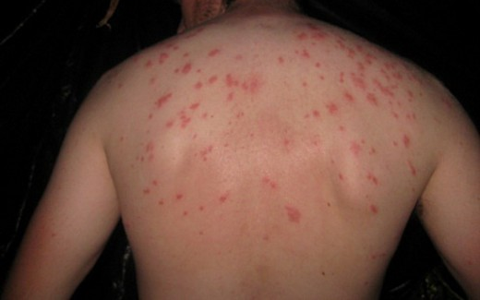
Salmonella
2
Clinical Diseases
Typhoid
fever
Acute Gastroenteritis
Nontyphoidal bacteremia
Carrier state following Salmonella infection
Enteric Fever (Typhoid Fever)
Causative Species | Salmonella serotype typhi or S.paratyphi A, B, C (less severe).
Source | ○ Contaminated food that is infected or carrier individual. ○ Common in tropical, subtropical countries and travelers (sewage, poor sanitation).
Clinical Features | ○ Prolonged fever¹, involves reticuloendothelial system (spleen, liver, intestine and mesentery). ○ Bacteremia ○ Dissemination to multiple organs.. ○ IP: 9 - 14 days.
First Week | Second & Third Week
- Fever, malaise, anorexia, myalgia and a continuous dull frontal headache → then the patient develops constipation. - Mesenteric lymph node → bloodstream liver, spleen and bone marrow. - Engulfment of Salmonella by mononuclear phagocytes. - Bacteria released into the bloodstream again and can lead to high fever. - Blood culture is positive. | - Sustained fever & prolonged bacteremia. - Invade gallbladder and Payer’s patches. - Rose spots 2 week of fever. - Biliary tracts → GIT². - Organism isolated from stool.
Rose spots
Treatment
- Ceftriaxone. - Ciprofloxacin. - Sulfamethoxazole. - Trimethoprim - Ampicillin. - Azithromycin or Ceftriaxone for patients from India and SE Asia due to strains resistant to Ciprofloxacin. Ciprofloxacin can be used for patients from other areas.
1-other illnesses with prolonged fever =brucellosis
2-so might also have mild diarrhea

Slide 4
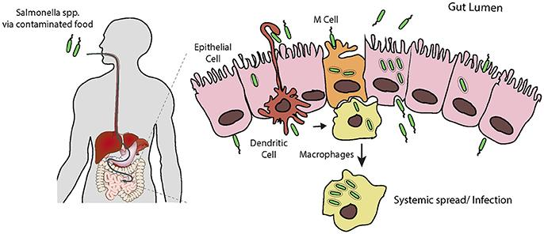
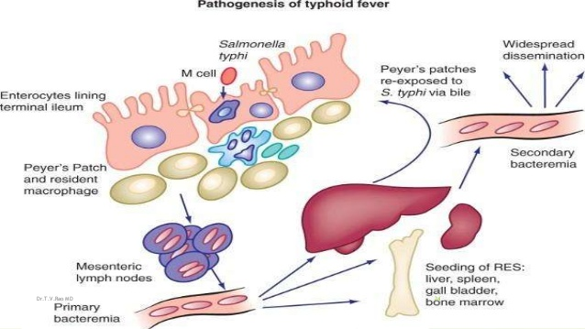
Salmonella
3
Salmonella Gastroenteritis
Causative species | S.enterica subsp. enterica common cause.
Source | Contaminated food (food poisoning). Poultry, milk, egg, egg products & handling pets.
Clinical Features | ○ Infective dose: 10⁶ bacteria. (high) ○ Incubation period : 8 – 36 hrs. ○ Symptoms: fever, chills, watery diarrhea & abdominal pain (Self limiting). ○ infection becomes severe in: Sickle cell, hemolytic disorders, ulcerative colitis, elderly or very young patients. ○ Patients with high risk for dissemination & antimicrobial therapy is indicated.
Treatment¹ | ○ Uncomplicated cases require fluid & electrolyte replacement only. ○ For patients with high risk for dissemination: antimicrobial therapy is indicated.
Salmonella Gastroenteritis
Enteric fever (Typhoid fever)
Complications³:
1
2
3
4
Necrotizing cholecystitis.
Bowel
hemorrhage
& perforation.
Pneumonia & thrombophlebitis
Meningitis², osteomyelitis, endocarditis & abscess.
1-in general their is no treatment needed for salmonella
2-especially in babies
3- it’s for both diseases

Slide 5
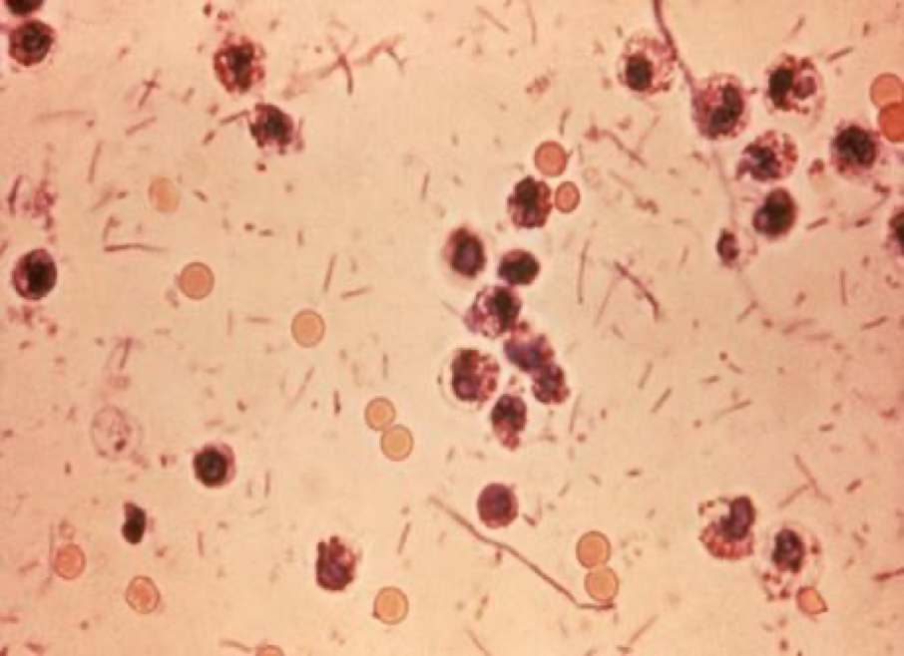
Morphology
Gram negative bacteria.bacilli
Non-lactose fermenting
Shigella
4
Introduction & Morphology:
○ Gram negative bacilli.
○ Non-lactose fermenting
○ Cause bacillary dysentery¹ (blood, mucus and pus in the stool).
Antigenic structure
○ Shigella has 4 species² and 4 major O antigen groups
○ All have O antigens some serotype have K antigen³ (heat labile, removed by boiling)
○ Shigella are non motile⁴, lack H antigen (antigen for flagella)
DYSENTRY STOOL
Species
- S.sonnei (group D1) most predominant in USA ( fever, watery diarrhea) - S.flexneri (group B15) 2nd most common, seen in Homosexual men (a man who has sex with another man) - S.dysenteriae (group A 6 ) and S. boydii (group C 20) are most common isolates in developing countries. - S.dysenteriae type 1 associated with morbidity and mortality.
Transmission & Pathophysiology
○ Human is the only reservoir. ○ Low infective dose < 200 bacilli, more infectious and more virulent than salmonella ○ Person to person through fecal-oral route. ○ Young children in daycare, people in crowded areas & anal oral sex in developed countries. ○ Food and water. ○ Flies, fingers (have a role in spread). ○ Incubation period : 24 - 48 hrs ○ Penetrate epithelial cells, leads to local inflammation, shedding of intestinal lining and ulcer formation.⁵
Symptoms:
High fever
chills
abdominal cramp and pain accompanied by tenesmus⁶
bloody stool with mucus & leukocytes
Can lead to rectal prolapse in children
Complications:
1
2
3
ileus, obstruction dilatation and toxic megacolon
Bacteremia in
4% of severely ill patient
Seizures, HUS⁷
Treatment:
○ Antibiotics are used to reduce duration of illness:
Ampicillin, IV ceftriaxone, oral TMP-SMX, Ciprofloxacin or Doxycycline.
1- type of gastroenteritis that results in diarrhea with blood, caused mainly by shigella unlike Amebic dysentery which caused by parasite.
2- A,B,C and D, each has its own O antigen.
3- it is the capsule (not important in diagnosis)
4-Used to differentiate between salmonella and shigella
5- (rarely go beyond the GIT unlike salmonella) 6- a continual or recurrent inclination to evacuate the bowels. 7- Hemolytic Uremic Syndrome

Slide 6
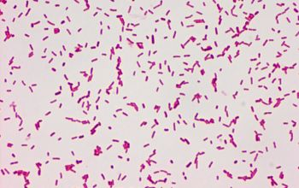
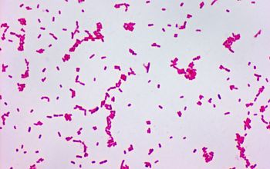
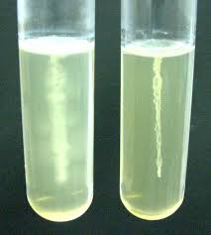
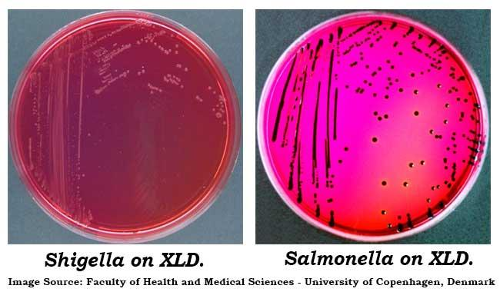
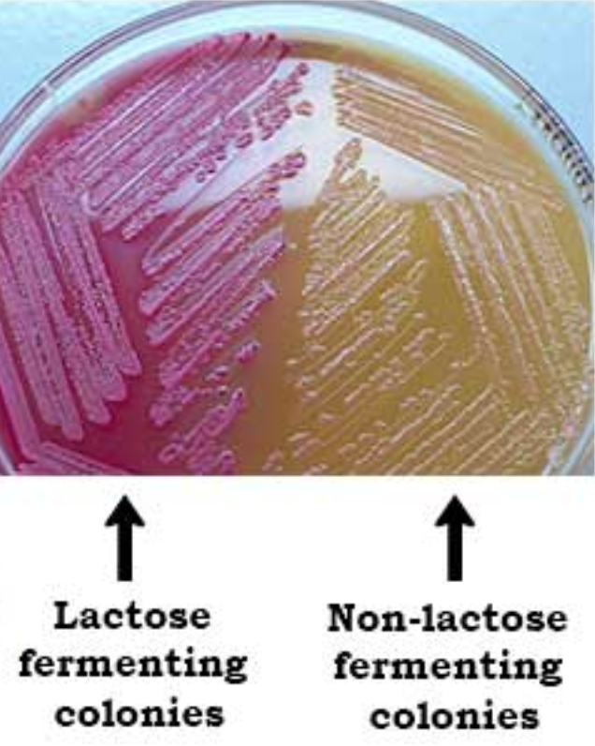
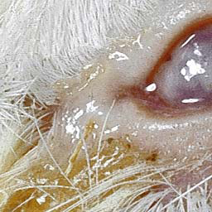
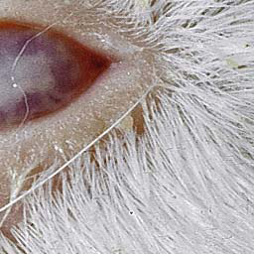
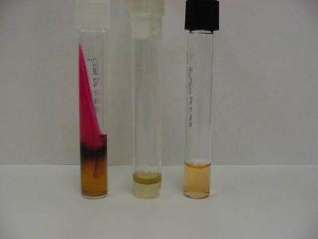
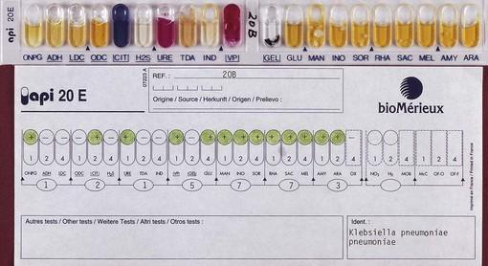
Lab Diagnosis of
Shigella & Salmonella
5
1- Gram stain
2- Motility test
Both are Gram negative bacilli
Salmonella has a flagellum, Shigella doesn’t.
Shigella is non-motile, Salmonella is motile
3- Culture
XLD¹
Salmonella will appear as black colonies due to production of H2S²
MacConkey agar.
Both will appear yellow (non-lactose fermenting)
other medias we can use:
- Selective Selenite Enrichment Broth Media.
- SS (Salmonella Shigella).
- HEA (Heckton enteric agar).
- BS (Bismuth sulfite).
4- Sereny test³
5- Serology tests
6- Biochemical tests
- Sero-grouping based on O and H antigen
- Usually in Salmonella, Shigella & E.coli the final detection is by serotyping using agglutination Ag+Ab test.
1- Xylose Lysine Deoxycholate agar
2- Hydrogen sulfide
3- inject the bacteria into animal’s eye :( (not commonly used)

Slide 7
Shigella & Salmonella
6
Dr.Khalifa’s notes:
Introduction:
Salmonella and campylobacter are the most common causes of community acquired GE.
Salmonella and shigella are both gram negative bacilli, non-lactose fermenting, the difference is that salmonella is motile while shigella is non-motile(Has no flagella due to its lack of H antigen).
A- Salmonella:
Causes disease by invasion, has fimbriae for attachment, it will be endocytosed into cells and replicate in macrophages, it also has an enterotoxin but it’s doesn’t play a main role in the disease.
Salmonella has 2 species: S.enterica (six subspecies I, II, III, IV, V, VI), S.borgori
Antigen structures: O(somatic) antigen found on the outer membrane of gram negative bacteria , H antigen related to flagella(most salmonella has 2 flagella thus has 2H antigens) and K for capsular antigen.
B- Shigella:
Mainly causes disease through invasion.
Causes blood and mucus in stool.
Has 4 species based on O antigen: S. dysenteriae(Causes invasion + Produce shiga toxin thus can lead to HUS), S. sonnei, S. flexneri, S. boydii
EHEC has higher risk for causing HUS than S. dysenteriae.
Human reservoir(Person to person through fecal –oral route)
Low infective dose.
Invades epithelial cells ,leads to local inflammation, shedding of intestinal lining and ulcer formation.
Symptoms: High fever, abdominal cramp, bloody diarrhea; Bacteremia is uncommon but can develop in severe disease.
Complications: ileus, obstruction dilatation and toxic megacolon.
Treatment: For severe diseases: Ampicillin(Not used much bcuz of resistance), IV ceftriaxone, oral TMP-SMX, Ciprofloxacin or Azithromycin
Laboratory diagnosis of salmonella & shigella from stool:
Gram stain: Negative
MacConkey agar: Non-lactose fermenter
Motility test: Non-motile> Shigella, Motile>Salmonella
Culture on selective media(H2S production): Salmonella produces H2S(Will appear as Black colonies on selective medias except MacConkey due to its lack of iron which is important for this reaction) while shigella doesn’t produce H2S.
Serology for serotypes
Typhoidal disease | Non-Typhoidal disease
Typhoid fever. Caused by Salmonella serotype typhi or S.paratyphi A(More common), B and C; (All are from S. enterica subsp. enterica) Source: Human(human-human transmission) Low infective dose Has high risk for bacteremia The disease has 2 phases: 1- First phase(First week): Fever, constipation Blood culture positive(Bacteremia). 2- Second phase(2nd and 3rd week): Sustained Fever and bacteremia Develop diarrhea It will also go to gallbladder which may lead to Necrotizing cholecystitis, Organism can be isolated from stool and positive blood culture. Rose spots 2nd week of fever.(faint salmon-colored ”pinkish-orange” macules on the trunk and abdomen) Treatment: Ceftriaxone(IV) is the drug of choice but other orals can be used too. | Caused by Non-typhoidal salmonella: All salmonellas except typhoidal :) Source: Mainly animals e.g. chicken. Mainly causes Gastroenteritis that is mainly related to poultry and eggs, especially raw eggs. High infective dose Symptoms: Abdominal pain, watery diarrhea. In sickle cell, hemolytic disorders, ulcerative colitis, elderly or very young patients; the infection may be very severe with bacteremia(sometimes). In general we don’t treat these patients bcuz its self-limiting unless the patient is at high risk for dissemination.

Slide 8
Quiz:
7
Q1:B, Q2:D, Q3:C, Q4:A, Q5:B
Q1: 28 year old male presented to ER with abdominal pain, chills and Fever. Upon taking history, the patient mentioned that he has Watery Diarrhea for the past 2 days. The doctor suspected a sample. So, she took a stool sample for the microbiology lab and requested special media and it showed a gram negative bacilli on gram stain. And the culture on XLD media showed black colonies. MacConkey agar showed no-lactose fermenting colonies. What is your diagnosis ?
A- Typhoid Fever
B- Salmonella Gastroenteritis
C- Shigella Gastroenteritis.
D- Hemolytic uremic syndrome
Q2: 6 years old child presented to the ER with her mother. The mother said that her child had Severe abdominal pain and that she noticed Bloody diarrhea. The examination showed Fever and Rectal prolapse. The doctor took blood and stool samples. Blood culture was negative. The stool sample showed gram negative bacilli. The motility test was negative and XLD media showed growth without black colonies. What is the most likely organism ?
A- Salmonella bongori
B- Enterhemorrhagic E.coli
C- Salmonella enterica
D- Shigella dysenteriae
Q3: Serology tests of a stool sample showed Vi antigen in a certain bacteria. What is the most likely organism?
A- Salamonella Enterica
B- Salmonella Arizonae
C- Salmonella. Typhi
D- Shigella
Q4: Which of the following conditions would show a positive blood culture ?
A- Typhoid fever.
B- Salmonella Gastroenteritis
C- Shigella Gastroenteritis
D- All of the above
Q5: a 17 years old female from India presented with bloody diarrhea, fever and abdominal pain. Special culture tests showed the growth of black colonies. What is the best course of treatment you would choose for this patient ?
A- Ciprofloxacin with rehydration
B- Ceftriaxone with rehydration
C- Rehydration only
D- No treatment is required
SAQ:
CASE: A 4 year old child presented with fever, diarrhea and skin rash her mother said that she has a fever, constipation and malaise last week. The doctor took stool and blood samples for culture ,gram stain and motility tests. The gram stain showed gram negative bacilli , the motility test was positive and the culture on XLD media showed the growth of black colonies.
Q1: What is your diagnosis?
A: Typhoid fever
Q2: What is the most likely causative organism?
A: S.Typhi
Q3: What do you expect the blood culture to show?
A: positive for salmonella typhi
Q4: what caused the growth of black colonies on XLD media?
A: H2S production by salmonella
Q5: name 2 complication of this disease?
A: Meningitis
bowl hemorrhage
necrotizing polycystitis
Pneumonia
Q6: How would you treat this patients?
A: ceftriaxone

Slide 9
Members board:
Team Leaders:
Abdulaziz Alshomar Ghada Alsadhan
Team sub-leader:
Mohammed Alhumud
This lecture was done by:
Jude Alotaibi
Note takers:
Mashal Abaalkhail
Badr Alqarni
Leena Alnassar

