Slide 1
Intestinal Helminthes
Lecture objectives:
Name the 3 main groups of parasitic Helminths and their characteristic morphological features.
Know the 5 common examples of Nematodes with their scientific and common names.
Describe the life cycle of these 5 examples of Nematodes with pathology, diagnosis and
treatment.
Describe the life cycle of Taenia saginata and T. solium and Hymenolepis nana
Describe the life cycle Echinococcus granulosus and diagnosis
Know treatment of Tapeworms.
Color index:
Important
Found in Girls’ slides
Doctors’ note
Found in Boys’ slides
Extra
EDITING FILE

Slide 2
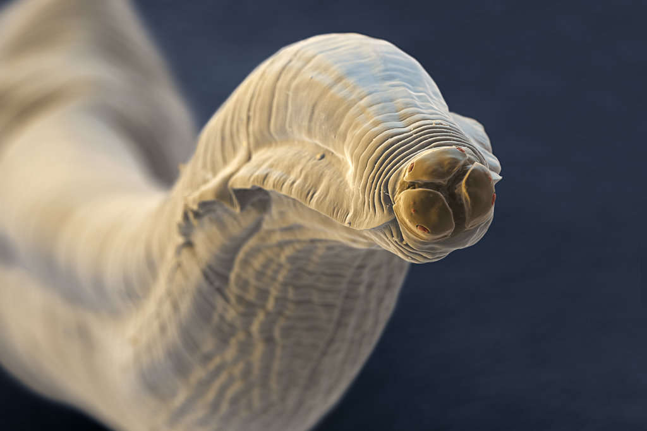
Introduction to Parasitology
1
EXTRA
Definition: the study of the invertebrate animals and the diseases they cause.
Parasites are classified as:
Human parasites‘ family tree
Protozoa
Complexity: Single-celled.
Onset of symptoms: days-weeks
Diagnostic forms: Cysts and trophozoites
Elevated immune cells: Typically Neutrophils
Helminths (Metazoa)
Complexity: Multi-cellular
Onset of symptoms: >1 month
Diagnostic forms: Eggs/Larvae
Elevated immune cells: Eosinophils
ديدان
Amebae
Flagellates
Flatworms
(Platyhelminthes)
Roundworms
(Nematodes)
Apicomplexa(Sporozoa)
Ciliates
Cestodes
Trematodes
Important Terminology:
Vectors
Vectors are living transmitters (e.g., a fly) of disease and may be:
Mechanical: transport parasite but there is no development of parasite in the vector
Biologic: some stages of life cycle occur
Life Cycle Forms
Life cycle forms may be:
Infectious: The stage in the life cycle of an endoparasite in which it can initiate infection to its host e.g., cysts in protozoan infections, eggs in helminth infections
Diagnostic, e.g., trophozoite in protozoan infections, eggs/worm in helminth infection
Others:
Obligatory: They are always in contact with host and cannot survive without them.
Free living: They can live independently of their host, partially on soil.
Direct life cycle: When parasite requires only one host to complete its life cycle.
Indirect life cycle: When two or more hosts are required to complete its life cycle
Definitive host: It is the host in which the sexual reproduction (adult) takes place or most highly developed form exists (usually humans)
Intermediate host: It is the host in which asexual reproduction takes place.
Reservoir: This is an animal host which serves as the source from which other animal are infected.
Gravid worms: Carrying eggs.
Embryonated egg(Also called a "Larvated egg"): A nematode egg with a developed larva inside it. Most nematode eggs leave the host in the morula stage and develop in the environment to the embryonated stage (the stage just before hatching).A few nematode eggs are embryonated at the time they leave the host.
Unembryonated egg: Egg without an embryo, due to a lack of fertilization or to zygotic lethality.
Zoonosis: refers to animal’s diseases which can be transmitted to humans.
Larva migrans: Means that the larvae(يرقة) living in their abnormal hosts in which they can not grow into adults but can wander everywhere and cause the local and systemic pathological lesions of the hosts.
Life cycle: Is the process of a parasite’s growth, development and reproduction, which proceeds in one or more different hosts depending on the species of parasites.
Trophozoites :a growing stage in the life cycle of some
sporozoan parasites, when they are absorbing nutrients
from the host.
Cysts: a stage in the life cycle of certain parasites, during
which they are enveloped in a protective wall, facilitates
their survival during unfavorable environmental conditions.
Oocyst(كيسة بيض): a cyst containing a zygote formed by a parasitic protozoan.
Sporozoite: a motile spore-like stage in the life cycle of some parasitic sporozoans.
Yes, it’s a 🐛 in her lips!
Have time and want to know more about it? Click here

Slide 3
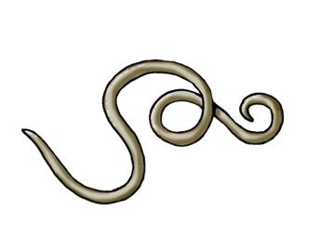
Introduction
2
Difference between protozoa and helminths:
Pathogen | Protozoa | Helminths
Features | Unicellular Single cell for all functions | Multicellular Specialized cells
Location | Intestinal, blood & tissue. | Intestinal and tissue
types | Aoebae: move by pseudopodia. | Flatworms Trematodes: leaflike & unsegmented Cestodes: tapelike & segmented
 | Flagellates: move by flagella.
 | Ciliates: move by cilia | Roundworms (nematodes) Elongated, cylindrical, & unsegmented
 | Apicomplexa(Sporozoa) tissue parasites
Nematodes (roundworms)
Location in body
General features
Common intestinal infections
○ Intestinal nematodes
○ Tissue nematodes
○ Elongated worm
○ cylindrical
○ Unsegmented
○ tapering at both ends.
○ Variable in size, measure <1 cm to about 100cm.
○ Sex separate, and male is smaller
than female
1- Enterobius (Oxyuris) vermicularis (Pinworm,seatworm, threadworm)
2- Trichuris trichiura (whipworm)
3- Ascaris lumbricoides (roundworm)
4- Ancylostoma duodenale & Necator Americanus (hookworms)
5- Strongyloides stercoralis

Slide 4
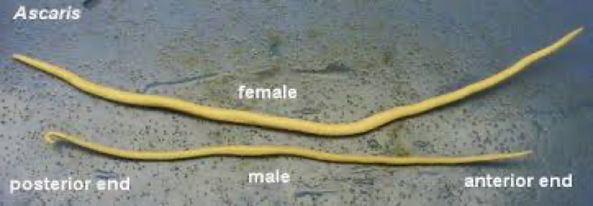
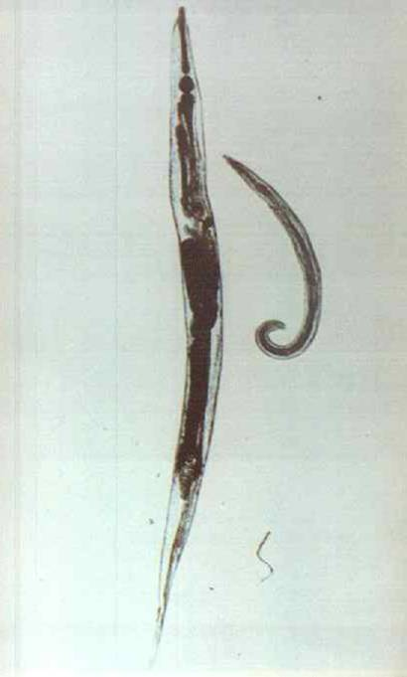
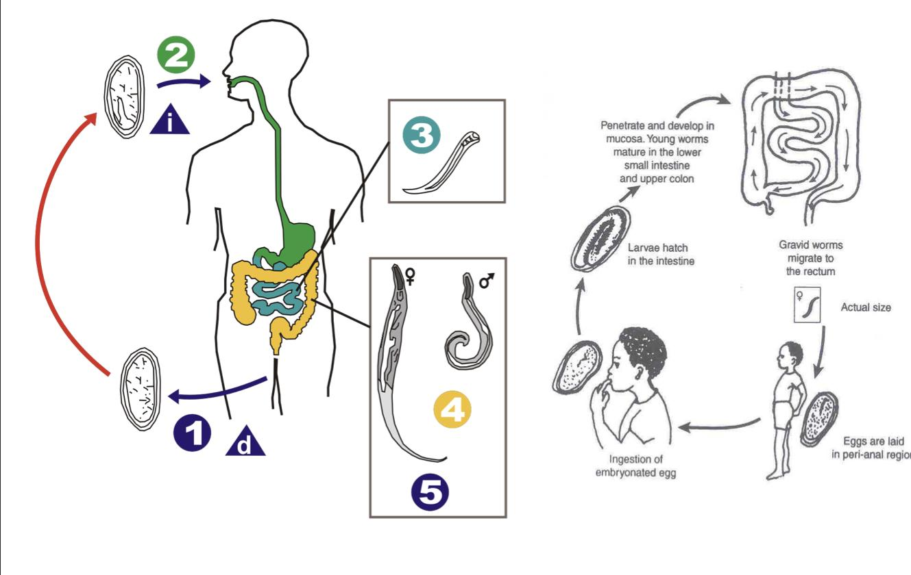
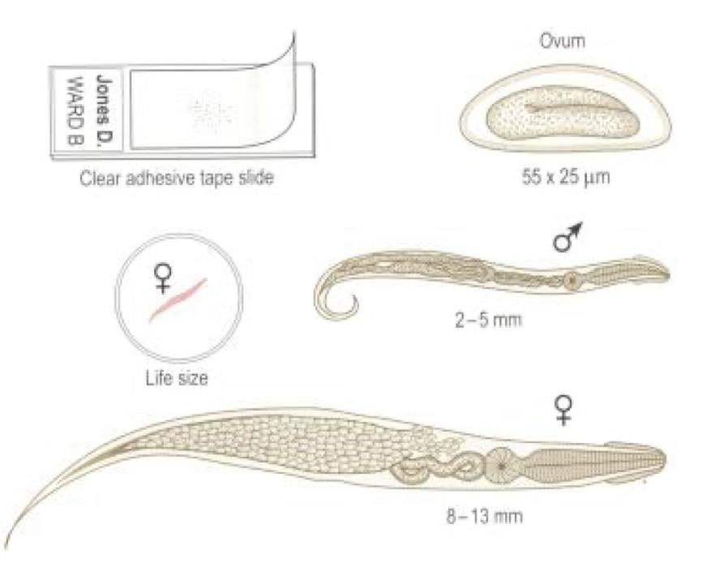
1- Enterobius vermicularis (thread worm)
3
General information
○ Common names : Pinworm & Seat worm.
○ Found all over the world but more common in temperate regions And in Saudi Arabia
○ Children are more often evolved than adults, it tends to occur in groups living together such as families, darmy camps or nurseries.
○ Adult worms are mainly located in lumen of cecum and the female migrate to rectum to deposit her deggs on perianal skin.
○ Direct human to human infection occurs mainly by swallowing the eggs .¹
○ Autoinfection² occurs by contamination of the fingers.
○ It can be seen by naked eye as white thread ± 1cm.
○ Male is smaller than female ± 0.5cm, with coiled end.
Life cycle
○ Diagnostic stage: Unembryonated eggs
○ Infective stage : Embryonated egg
○ What causes the disease : adult worms
Clinical presentation
d= Diagnostic stage i= Infective stage
○ Majority of symptoms are asymptomatic
01
○ Main clinical presentation is pruritus ani which can be very troublesome.
- Occurs more often during the night,
- Persistent itching may lead to inflammation and secondary bacterial infection of the peri-anal region.
02
○ Ectopic³ enterobiasis occurs in infected adult female when invade vulva and vagina result in vulvovaginitis, salpingitis.
03
○ Adult worm can lodge in the lumen of appendix cause appendicitis.
04
○ Infected children may suffer from:
- Emotional disturbances - Insomnia
- Anorexia - Weight loss
- Loss of concentration - enuresis.
Diagnosis
○ Unlike other intestinal Nematodes, the eggs are not usually found in feces.
○The best method is to look for them around the anus by taking an anal swab
or by using Cellulose adhesive tape⁴.
- The examination should be done before defecation or bathing.
Treatment
Albandazole or Mebendazole for whole family.
1- After fecal-oral transmission, the eggs hatch in the small intestine. Adults mature in the ileum and large intestine and mate in the colon. Females exit the rectum at night to lay eggs in the perianal area. This irritates the perianal area, inducing the host to scratch. Scratching transfers eggs into hands, greatly increasing the likelihood of transmission to another host
2-reinfection by a pathogen that is already in the body
3-the anal area is close to the vagina
4- The physician places adhesive tape over the perianal area and then removes and examines the tape. The presence of eggs under LM indicates pinworm infection.

Slide 5
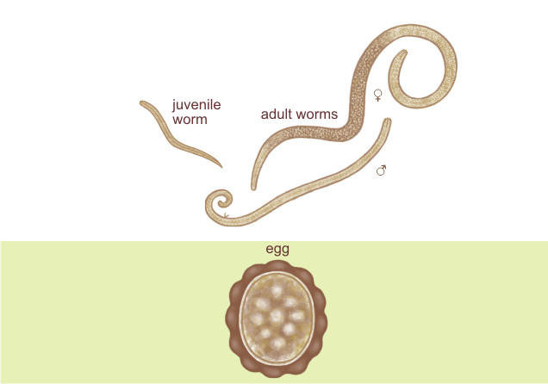
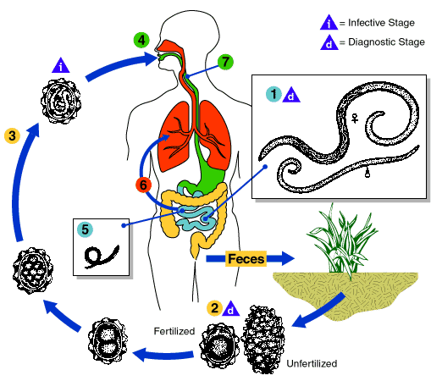
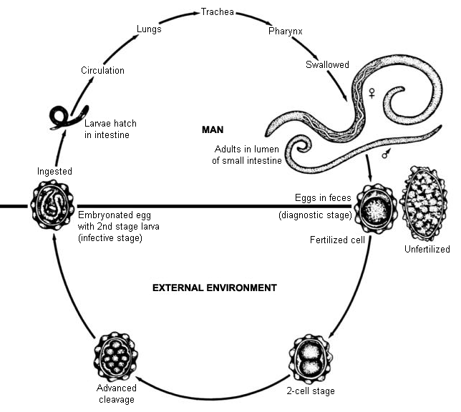
2- Ascaris Lumbricoides (roundworm)
4
General information
○ The commonest human helminths infection all over the world.
○ The large round worm which is normally located in the small
Intestine (jejunum and upper part of ileum)
○ Female ± 20 cm -longer than- males ± 10 cm.
○ Feed on semi digested food¹
○ Mode of transmission: Fecal-oral route.
Life cycle
Ascaris parasite infects the human after ingestion of
food or water contaminated with Embryonated egg
(infective stage).
The Embryonated egg then passes to the duodenum and become a Larva.
The Larva penetrates the wall of the duodenum and enters the bloodstream to the heart & liver to then enter the pulmonary circulation and stay in the alveoli, where it grows and molts for three weeks.
○ Infective stage:
embryonated egg
○ Diagnostic stage: unembryonated egg
Fertilization then takes place producing fertilized²
and unfertilized eggs (diagnostic stage) which pass in stool.
The Larva then passes from respiratory system to
be coughed up, swallowed & returned to the small
intestine where it matures to adults male & female.
1-results in malabsorption
2-Only fertilized eggs can survive in the soil for 2 weeks to become an embryonated egg ready to infect human with contaminated food.

Slide 6
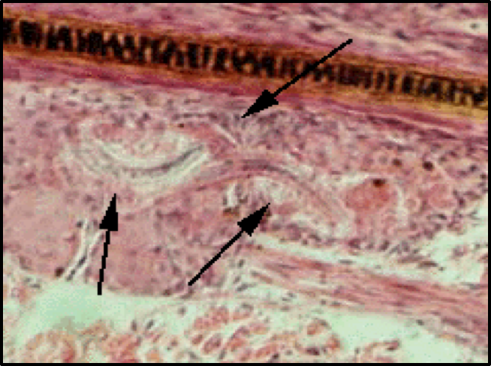
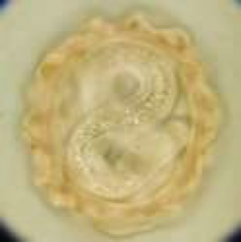
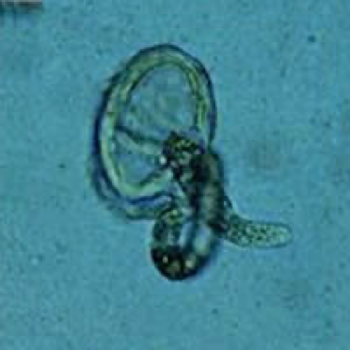
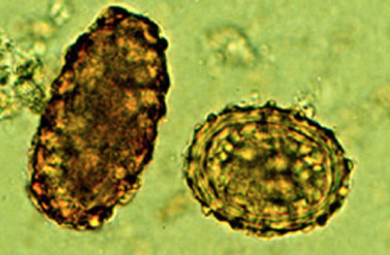
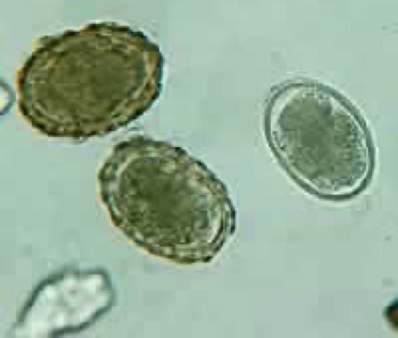
2- Ascaris Lumbricoides cont’
5
Clinical picture
Larvae | - Loeffler’s syndrome: Pneumonitis & Bronchospasm, cough with bloody sputum¹, Eosinophilia², urticaria.
Adult worm (Small intestine) | 1- Light infection: asymptomatic.
 | 2- Heavy infection: intestinal obstruction.
 | 3- Migrating adult: to bile duct-jaundice.
Diagnosis
Treatment
○ Eggs in stool (Fertilized or unfertilized)
○ larvae in sputum.
○ Adult may pass with stool³
○ Albandazole or Mebendazole for whole family.
Loeffler's syndrome:
Ascaris Larvae in lung (pneumonia, cough & bloody sputum).
Ascaris Embryonated egg - infective stage: enters
the body with food contaminated in the soil.
Ascaris larva emerging from egg (hatch from small intestine to circulation go to the lungs causing LOEFFLER`S SYNDROM)
Ascaris eggs:
Diagnostic stage pass in the stool
1- Because it affects the lungs too.
2- Due to the increased need for eosinophilic release of major basic protein (which is toxic to helminths).
3- If its dead.

Slide 7
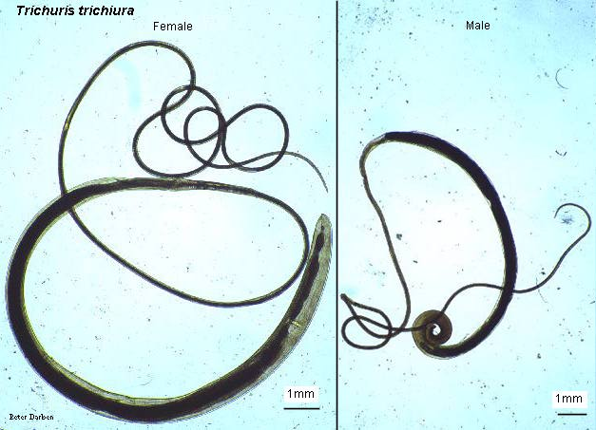
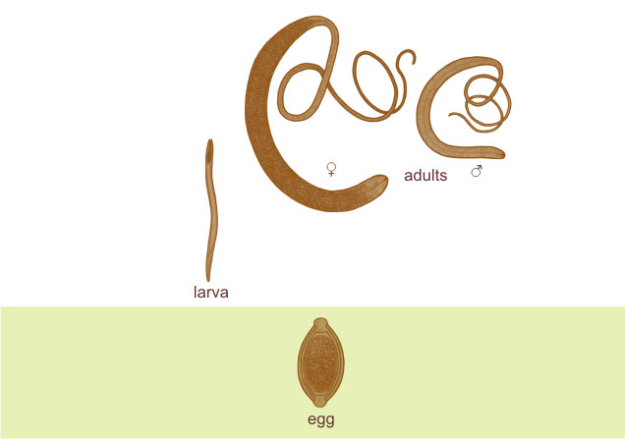
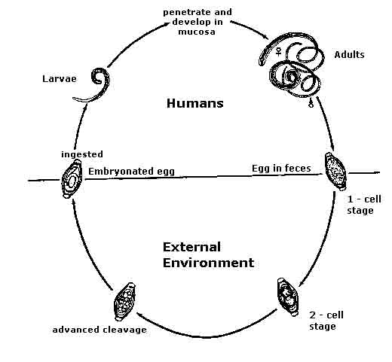
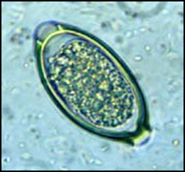
3- Trichuris Trichiura(whipworm)
6
General information
○ World wide, common in poor sanitation.
○ It coexists with Ascaris because of similar requirement (the eggs needs 3 weeks in the soil to be embryonated which is the infective stage).
○ Adult live in large intestine especially caecum and appendix.
- In heavy infections the whole length of large intestine affected.
○ Male and female worm have narrow anterior portion penetrate the intestinal mucosa.
Life cycle
○ Infective stage: embryonated egg
○ Diagnostic stage:
Fertilized egg¹ in stool
Clinical findings
1. Light infection: asymptomatic
2. Heavy infection: abdominal pain, bloody diarrhea.
○ Rectal prolapse in children is a common complication.
Diagnosis
Egg in stool characterized by its barrel shape with
mucoid plugs at each pole.
Treatment
Albendazole.
The difference between Trichuris Trichiura and Ascaris Lumbricoides:
In Trichuris Trichiura the adult worm lives in the large intestine, where in Ascaris it lives in the small intestine.
In ascaris the larva migrate to the lung, while in Trichuris Trichiura there is no lung involvement.
1-aka embryonated

Slide 8
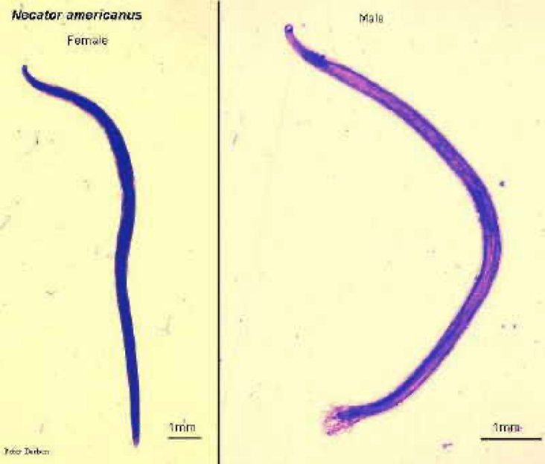
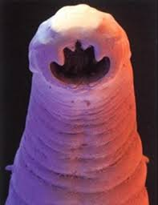
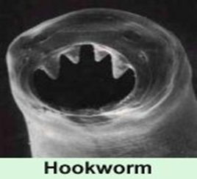
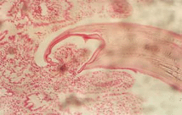
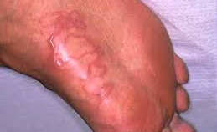
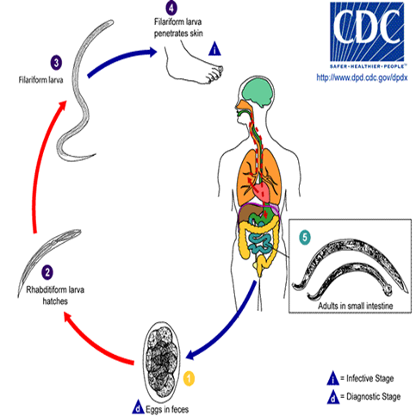
4- Hookworm
7
General info
○ It has two species:
- Ancylostoma duodenale¹
- Necator americanus²
○ A common cause of anemia in endemic areas,
○ found in small intestine mainly jejunum.
○ Its buccal capsule (mouth) lined with hard hooks, triangular cutting plates and anticoagulant glands.
Buccal cavity attached to intestinal mucosa
Life cycle:³
Filariform Larval (infective stage) invasion of the skin can produce a skin disease called:
cutaneous larva migrans (creeping eruption)
this is commonly caused by walking barefoot through areas contaminated with fecal matter.
Filariform Larva (infective stage) penetrate the skin cause itching and dermatitis
The larva then goes to the circulation (in lungs it causes slight pneumonitis and bronchitis) the larva is then swallowed and go to small intestine⁴
○ Infective stage: Filariform Larva
○ Diagnostic stage: eggs
The eggs need to be in soil for about one week to become Filariform Larva (infective stage)
In the small intestine it attaches to the mucous membrane where it matures into adult and the female starts laying eggs up to 30,000 eggs/day to be passed in stool
(not infective)
(diagnostic stage)
cutaneous larva migrans
1- Old world hookworm/ dog and cat hookworms.
2- New world hookworm
3- Same as ascaris doesn’t go directly to small intestine has a migration phase.
4- When it is swallowed it then passes down the esophagus and enters the digestive system, finishing its journey in the small intestine.

Slide 9
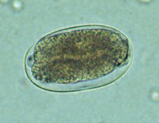
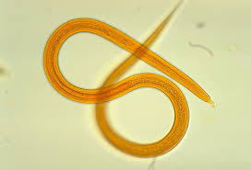
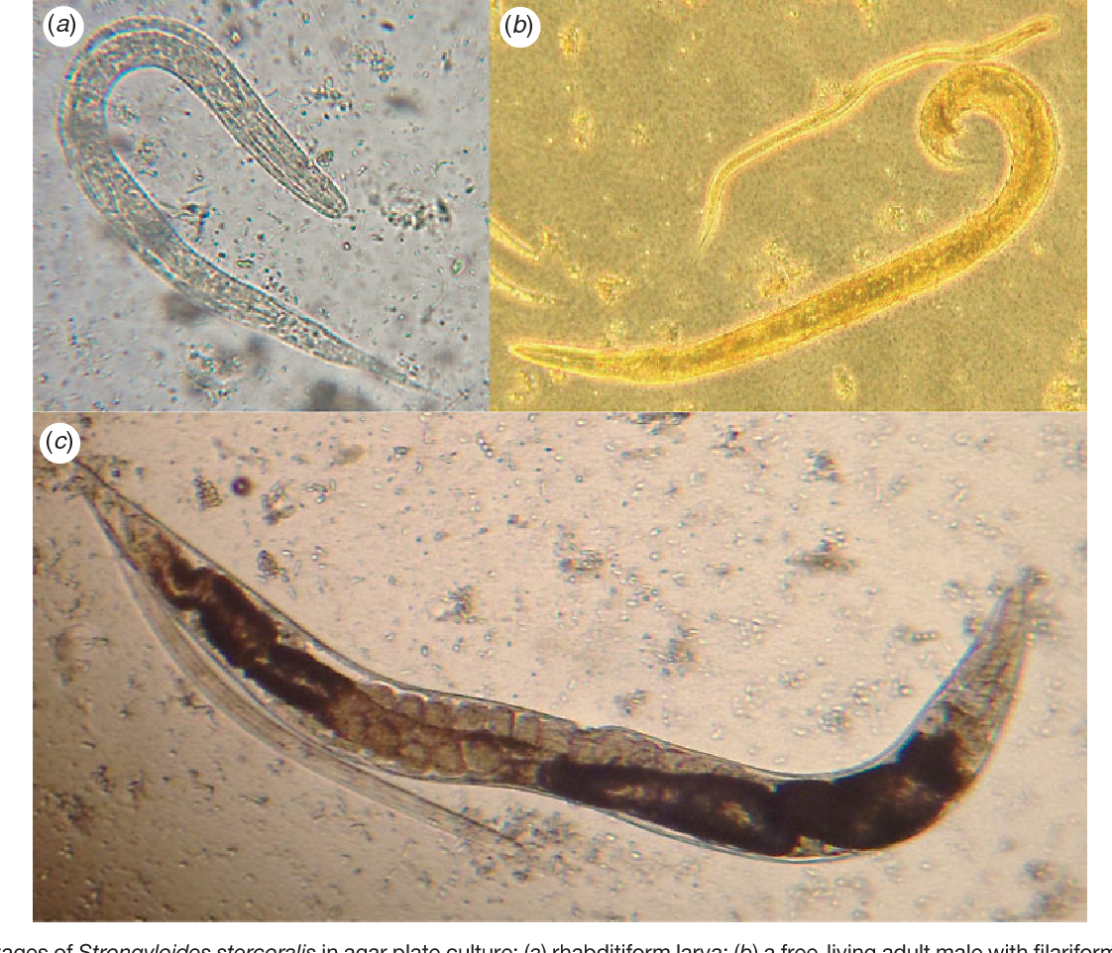
4- Hookworm Cont’
8
Pathology & Clinical picture
There are no specific symptoms or signs of hookworm infection but they give rise to a combination of: - Intestinal inflammation, Progressive iron-deficiency anemia & Protein deficiency
Larvae | 1- At the site of entry: larvae intense itching (ground itch) and dermatitis.
 | 2- Migration phase:¹ - Cough with bloody sputum - Pneumonitis and bronchitis but less severe than Ascaris & eosinophilia urticaria.
Adult worm | 1- low worm burden (infection): no symptoms
 | 2- Moderate to heavy burden: - Epigastric pain, vomiting , hemorrhagic enteritis. - Protein loss: hypoproteinemia & edema.
 | 3- Anemia²: due to withdrawal of blood by parasites and hemorrhage from punctured sites lead to severe anemia (microcytic hypochromic anemia)
Diagnosis
Treatment
○ Eggs in stools
○ occult blood (+)³
Albendazol, Mebendazole
5- Strongyloides Stercoralis
General info
○ Widely distributed in tropical area at Asia, Africa & South America .
○ Fatal dissemination in immunocompromised host.
○ It is smallest pathogenic nematodes ± 2.5mm.
○ Adult live in mucous membrane of duodenum jejunum rarely mucous membrane of bronchus.
○ Autoinfection is a very important criteria.
1- Before reaching small intestine.
2- Anticoagulant glands —> the adults “hook” onto the mucosa and feed on the host’s blood with the help of an orally secreted factor X inhibitor —> Anemia
3- They call it in arabic “الدم الخفي” because sometimes the stool is so dark that the physician may suspect “occult blood” that we can’t see with naked eyes so he will perform this procedure to check for any hidden blood by microscope or certain chemicals, which may indicate hookworm infection.

Slide 10
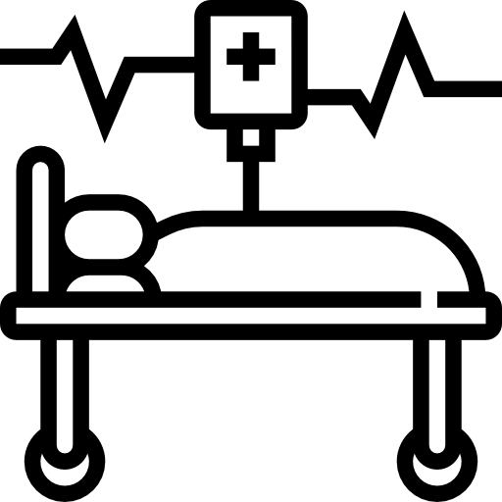
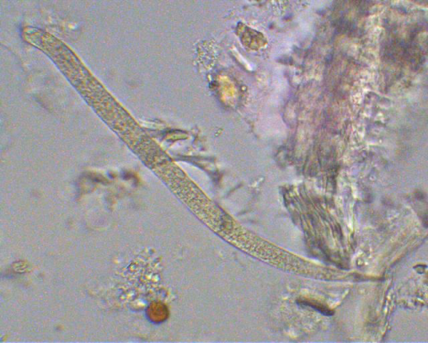
5- Strongyloides Stercoralis cont’
9
Life cycle
The parasite shows 3 different modes of development:
01
Direct development:
02
Indirect development :
The rhabditiform larva pass from stool and become directly a Filariform larva if the
environment of the soil is suitable .
in external environment rhabditiform larva becomes free living adults, produce eggs ,rhabditiform larva Filariform larva(Infective stage).
03
Autoinfection:
• Internal : when the rhabditiform larva become a filariform larva in the intestine and penetrate the intestine
• External : fecal contamination of skin Rhabditiform larva → filariform penetrates the skin
Clinical features
Cutaneous:
little reaction on penetration. Severe dermatitis at perianal region in case of external autoinfection.
Migration:
pneumonitis during larval migration.
Intestinal: inflammation of upper intestinal mucosa, bloody diarrhea, upper abdominal pain in the colicky in nature.
Disseminated strongyloidiasis :
in patient with immunodeficiency, uncontrolled diarrhea, necrosis, perforation, peritonitis & death¹.
Diagnosis
Treatment
Rhabditiform larvae (diagnostic stage) in:
Stool examination
Duodenal aspirate
Albendazol, Mebendazole

Slide 11
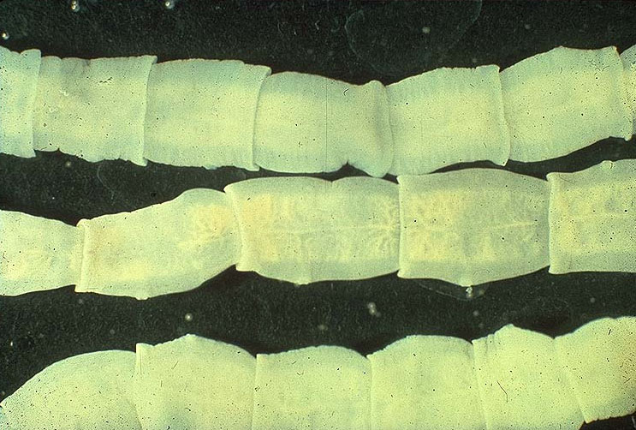
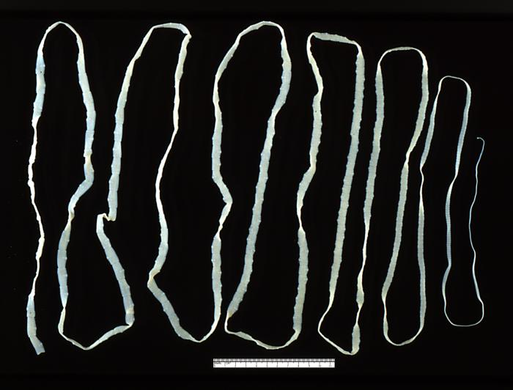
Common intestinal Nematodes
10
Parasite | Enterobius vermicularis¹ | Ascaris lumbricoide² | Trichuris trichiura^{1 / 2} | Hookworm Ancylostoma Duodenale Necator Americanus | Strongyloides Stercoralis
Transmission | -Swallowing the eggs, -Autoinfection | Swallowing of Embryonated egg | Swallowing of Embryonated eggs | Larval penetration of skin³ | Larval penetration of skin³ Autoinfection
Location of adult in human | Large intestine cecum | Small intestine duodenum | Large intestine | Small intestine | Small intestine
Infective stage | eggs | Embryonated eggs food contaminated | Embryonated eggs | Filariform Larva | Filariform larva
Diagnostic stage | -Adult pass in anus at midnight -Cellulose adhesive tape we detect adult worm | - Fertilized & unfertilized egg in the stool. - Adult worm in stool. - larve in sputum | Unmbryonated eggs | Eggs in stool | Rhabditiform Larva
Clinical picture | 1- pruritus ani during night 2-persistent itching 3-inflammation around the anus | Adult worms: -Asymptomatic -Intestinal obstruction in heavy infection larvae: -pneumonitis & bloody sputum (loeffler's syndrome) | - Asymptomatic in light infection - Rectal prolapse in children | -Itching & pruritus at sight of entry. -Cough and blood in the sputum at larval migration stage. -Loss of blood MICROCYTIC HYPOCHROMIC ANEMIA | -Pruritus at the site of larval penetration. -Inflammation in the small intestine. -Disseminated strongyloidiasis and Autoinfection: in patient with immunodeficiency, uncontrolled diarrhea, granulomatous changes, necrosis, perforation, peritonitis ,death
Cestodes tape like segmented parasite
1- Taenia saginata
2-Taenia solium
3- Echinococcus granulosus
1- both common in children
2- both need soil
3- not by eating

Slide 12
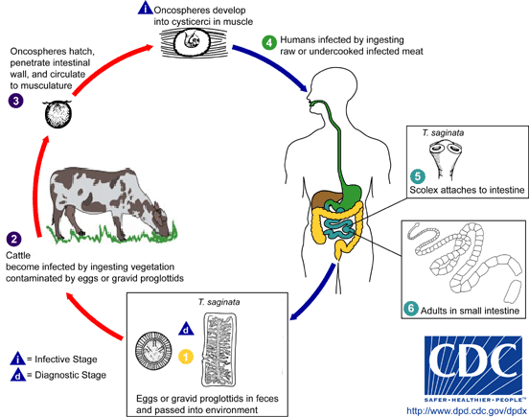
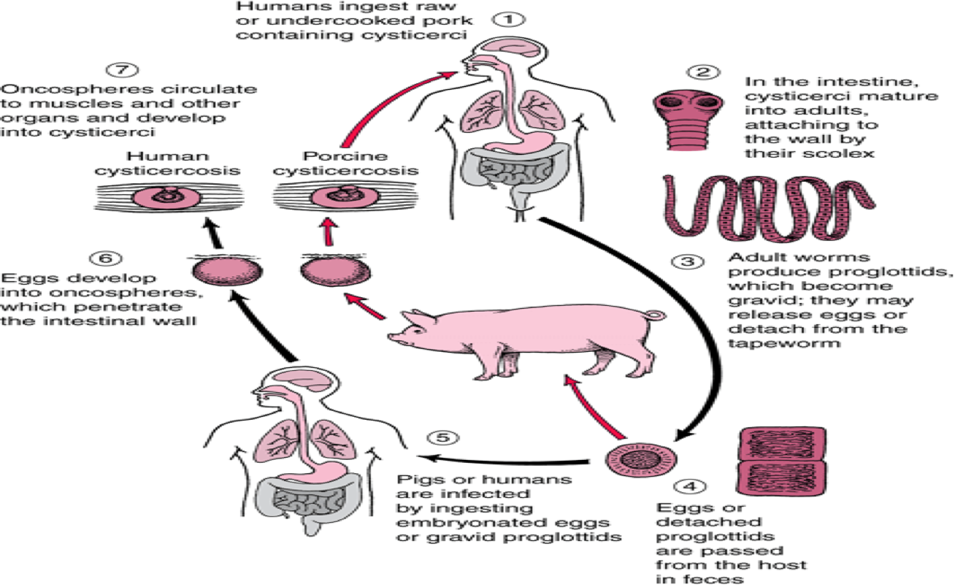
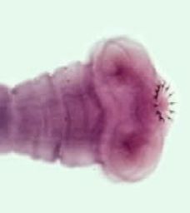
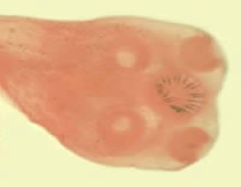
Taenia Saginata (Beef tapeworm)
11
General info
○ definitive host :Human
○ intermediate host: cattle
○ infective stage : cyst
○ diagnostic stage : eggs and
gravid proglottids
○ Is an obligatory parasite of humans.
○ Adult worm lives in the small intestine.
Life cycle
Cattle become infected by ingesting grass contaminated with eggs or gravid segments which passed from human faeces.
In the cattle the oncosphere hatches out go to circulation and transformed to cysticercus stage in the muscle known as cysticercus bovis
Person becomes infected by eating undercooked or improperly cooked beef , the adult worm lives in small intestine of man passing eggs and gravid proglottids to the environment.
Disseminated strongyloidiasis :
in patient with immunodeficiency, uncontrolled diarrhea, necrosis, perforation, peritonitis & death¹.
Clinical Findings
○ The majority of cases are Asymptomatic
○ Some patients have vague intestinal discomfort,
vomiting and diarrhea.
Taenia Solium (Pork tapeworm)
Life cycle
Humans can be infected by 2 ways:
1- Eating eggs:
Cysts travel to various part of the body (cysticercosis)
in eye & brain can be very dangerous.
2-Eating undercooked pork: Patient will have adult worm in the small intestine
○ Humans can be definitive or intermediate (reservoir) hosts

Slide 13
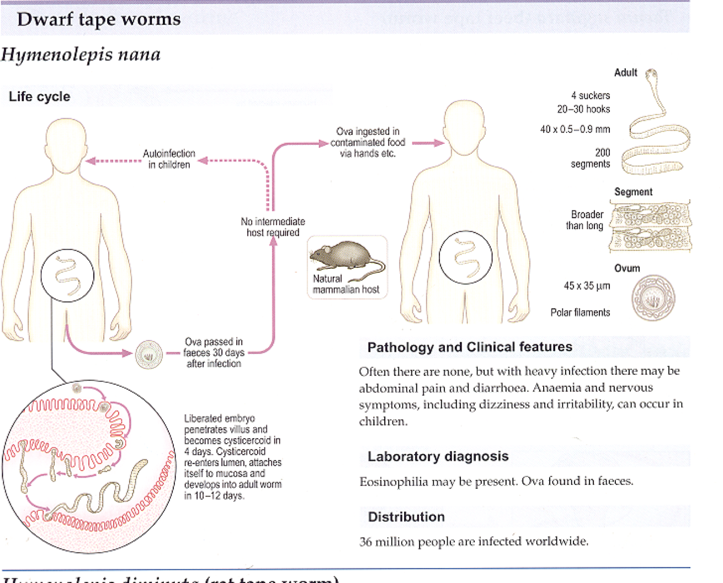
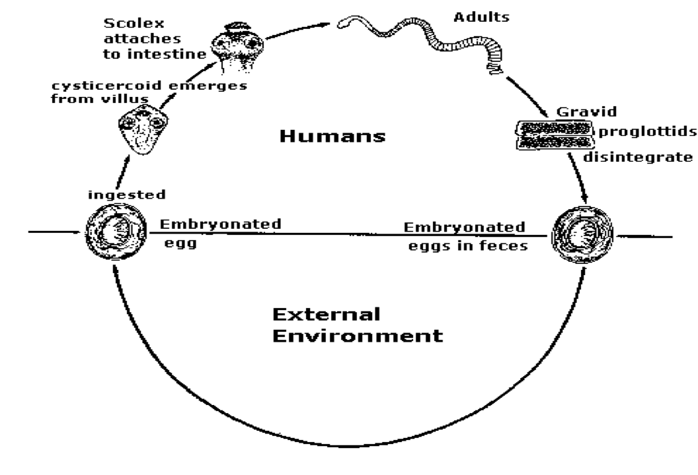
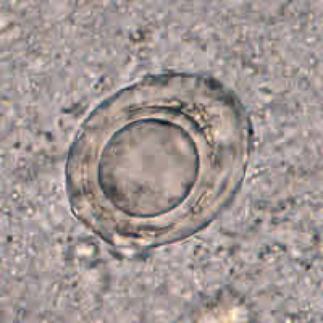
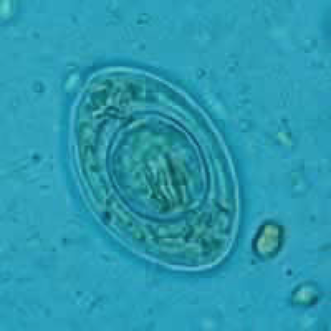
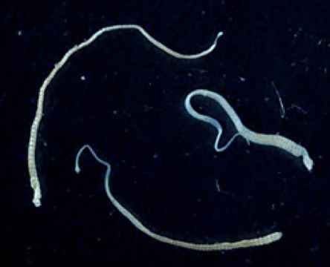
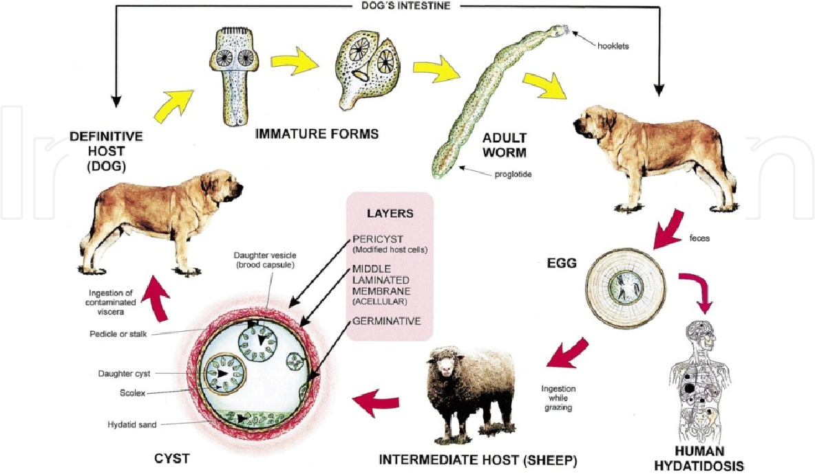
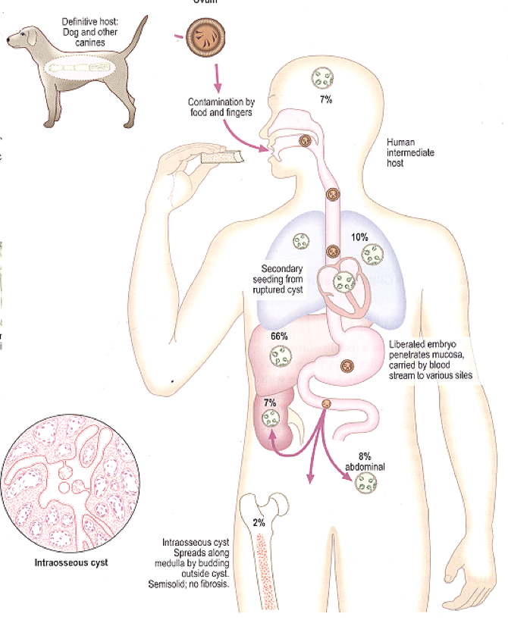
Hymenolepis nana
12
might develop epilepsy.
Echinococcus granulosus
General info
○ E. granulosus requires two host types:
1- Definitive host: Dogs
2- Intermediate host: most commonly sheep, cattle, pigs, goats, and camels and also Humans.
Life cycle
E. Granulosus cyct is ingested and attaches to the mucosa of the intestines in the definitive host and there the parasite will grow into the adult stages
Dog become infected by eating sheep, cattle muscle having hydated cyct which become in the intestine of the Dog as an adult and start releasing eggs witch excreted in the faces .
The ingested eggs migrate to the various body tissues, and produce hydatid cysts.
The life cycle is terminated at this point
Human become infected by ingestion of Echinococcus Granulosus eggs, usually by hand-to-mouth contact with infected dog feces.
Symptoms vary, depending on the location of the cyst in tissues. Although cysts may form in many areas of the body, the lung and the liver are most commonly affected. One serious complication of hydatid cyst disease is the risk of anaphylactic shock, following rupture of the cyst.

Slide 14
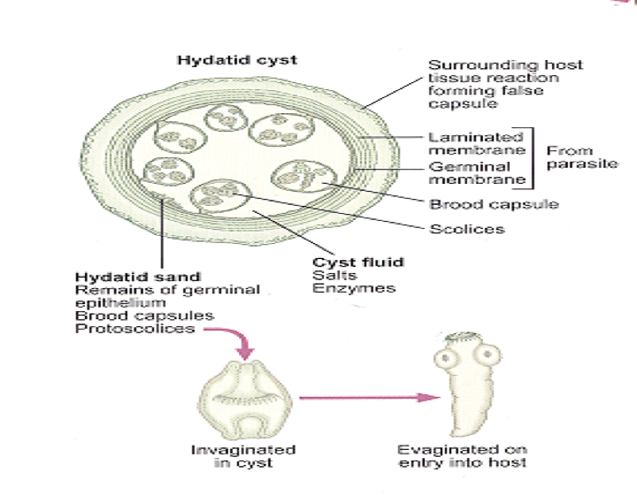
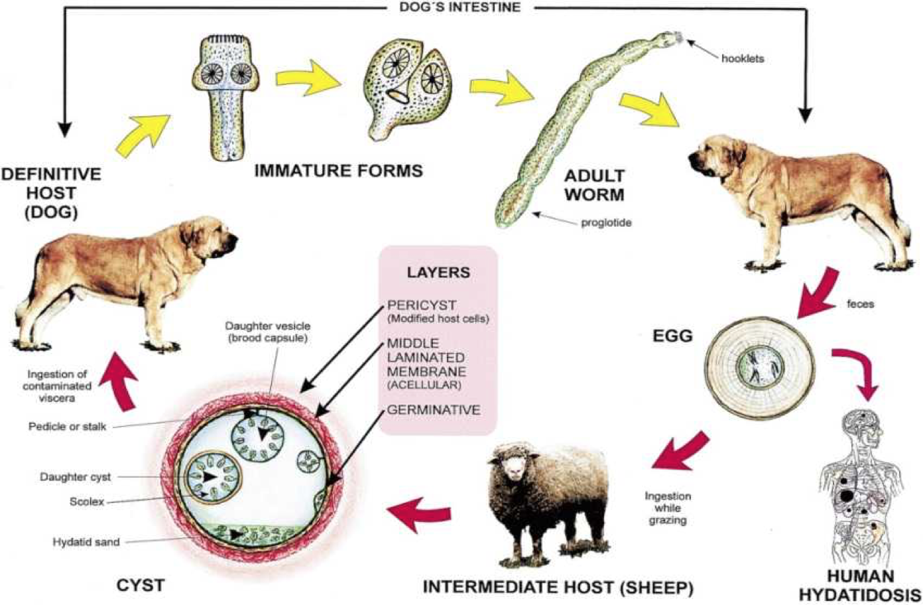
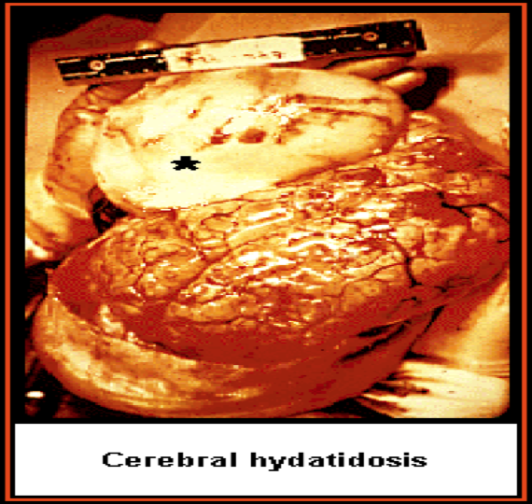
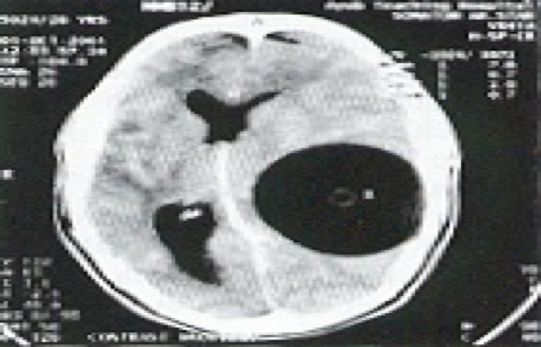
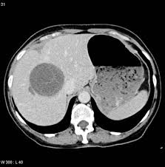
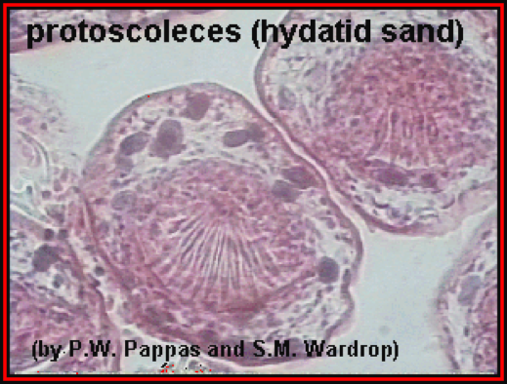
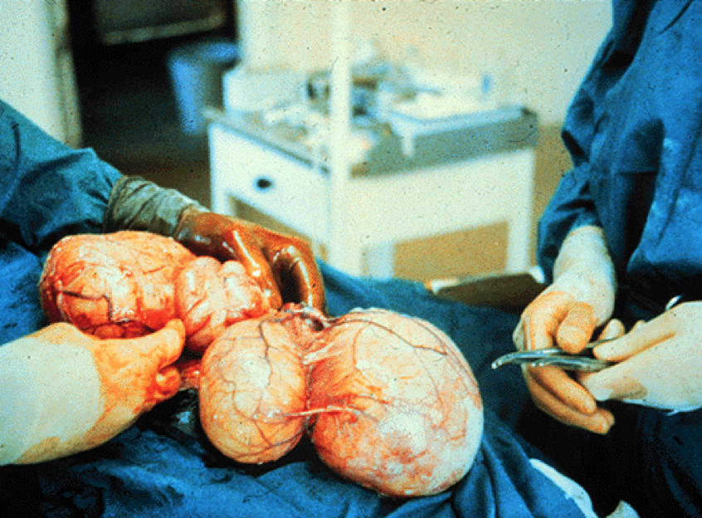
Echinococcus granulosus
13
Hydatid Cyst
Hydatid cyst, which may reach a large size, has laminated outer layer, and an inner layer of germinal tissues from which the daughter cysts and brood capsules (smaller cysts containing several developing inverted scolices) bud. The cyst also contains loose pieces of germinal tissue and scolices. This is known as hydatid sand. In addition, there is a great deal of fluid inside the cyst.
Symptoms :
○ vary,depending on the location of the cyst in tissues.
○ Although cysts may form in many areas of the body, the lung , the liver and brain are most commonly affected.
○ One serious complication of hydatid cyst disease is the risk of anaphylactic shock, following rupture of the ocyst.
Diagnosis
○ Radiological examination: computed tomography (CT), magnetic resonance imaging (MRI) revealed Oa cystic swelling with smooth outline.
○ Serological examination: to detect specific antibodies ELIZA,CFT.
○ Casoni`s test: it is an intradermal test used to detect immediate hypersensitivity in hydatid disease.
○ Microscopical examination: hydatid sand
○ Hydatid fluid may be withdrawn by the fine needle aspiration and examined under the microscope Ofor scolices or hooklets. THIS IS A DANGEROUS PROCEDURE.
Treatment
○ Intestinal stages: Praziquantel
○ Tissue stages (hydatid & cysticercosis)
Depends on clinical condition:
Surgical and/or Albendazole
Location of hydatid cysts

Slide 15
Common Tapeworm(Cestodes) Infections
14
Tapeworm | Disease | Transmission of infection | Location of adult in human | Location of Larva (cyst) in human | Clinical picture | Lab diagnosis
Taenia saginata | taeniasis | ingestion of cyst in undercooked beef contain cyst (larva) | Small intestine | Not present | Vague digestive disturbances | Eggs or proglottids ( gravid segments) in stools
Taenia solium adult | taeniasis | ingestion of larva in undercooked pork | Small intestine | Not present | Vague digestive disturbances | Eggs or proglottids ( gravid segments) in stools
Taenia solium larva (cysticercus cellulosae) | Cysticercosis | ingestion of eggs in food contaminated with human feces | Not present (except in autoinfection: small intestine) | - Sub- cutaneous Muscles Brain,eye. - Cyst (cysticercosis) especially in the brain and eyes. | Depending on locality: from none to epilepsy¹ - In eye blindness | -Eggs or proglottids ( gravid segments) in stools -Xray,CT,MRI,serology
Hymenolepis nana | Hymenolepiasis | ingestion of egg | Small intestine | Intestinal villi | Enteritis diarrhoea | Eggs in stools
Echinococcus granulosus | Hydatid disease | ingestion of egg in food contaminate with dogs feces | Not present | -Liver,lung, bones ect - Hydatid cyst in liver and lung can be fatal | - Depending on locality. -Depending on location of the cyst can be fatal. | X-ray,CT,US serology Hydatid sand
1-How to diagnose it? CT, where you will find Cyst in the brain causing pressure

Slide 16
Quiz:
15
MCQ:
Q1:C, Q2:D, Q3:B, Q4:A, Q5:B
Q1: Infective stage of Enterobius vemicularis
A- Larva.
B- Adult worm.
C- Embroyonated egg.
D- Fertilized egg.
Q2: Penetrates skin and goes to circulation (lung) then swalllowed back to small intestine
A-Tricguris trichiura.
B- Ascaris lumbricoides.
C-Enterobius vermicularis.
D- Hook worm.
Q3: Can cause rectal prolapse in children
A-Strogyloids Stercolaris.
B-Trichuris trichura.
C- Hook worm.
D- Enerobius vemicularis.
Q4: Is located in subcutaneous, brain and eye
A-Taenia solium(larva).
B- Taenia solium(adult).
C- Taenia Saginata.
D-Echinococcus granlosus.
Q5: Definitie host in Echiococcus granulosus is
A- Human.
B- Dog.
C- Sheep.
D- Pig.
SAQ:
CASE: A 20 years old female came to the ER. She presented with abdominal discomfort, cough and constipation. On history she told you she visited her grandparents in their farm 2 weeks age. CBC show high WBC, sputum Analysis shows larvae.
Q1: What is the most likely pathogen?
A: Ascaris lumbricoides
Q2: What is the diagnostic stage? And what is the Infectious stage?
A: Fertilized or unfertilized eggs in stool, Embryonated egg
Q3: What further test would you order ?
A: -Stools analysis looking for Fertilized or unfertilized egg
Q4: 3-what is the proper way to treat him?
A: Albendazole, Mebendazole
Q5: What are the complication of the pathogen?
A: Loeffler's syndrome, Pneumonitis and bronchospasm, cough with bloody sputum intussusception, intestinal ulcers
and in massive infection can cause intestinal obstruction.

Slide 17
Members board:
Team Leaders:
Abdulaziz Alshomar Ghada Alsadhan
Team sub-leader:
Mohammed Alhumud
This lecture was done by:
Alhanouf Alhaluli
Rema Alkahtani
Note takers:
Mashal Abaalkhail
Badr Alqarni
Leena Alnassar

