Slide 1
Intestinal Protozoa
Lecture objectives:
Know morphology of cysts and trophozoites of Giardia lamblia parasites
Describe life cycle of Giardia parasites
Describe Giardia trophozoites in tissue sections
Discuss the clinical picture of Giardia parasites (Typical and Atypical).
How to diagnose Giardia in the labs
Know the chemotherapy against Giardia parasites.
Summarize general features of Intestinal Entamoeba.
Know the six types of Entamoeba.
Compare between E. histolytica and E. dispar.
Describe Life cycle of E. histolytica
Discuss Pathology of E. histolytica (intestinal and extraintestinal).
Diagnosis and treatment of Amoebae
Life cycle of Cryptosporidium and diagnosis
Color index:
Important
Found in Girls’ slides
Doctors’ note
Found in Boys’ slides
Extra
EDITING FILE

Slide 2
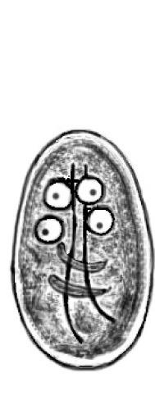
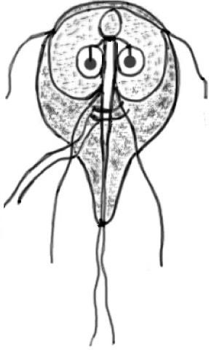
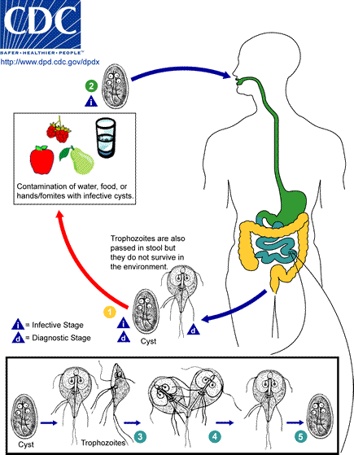
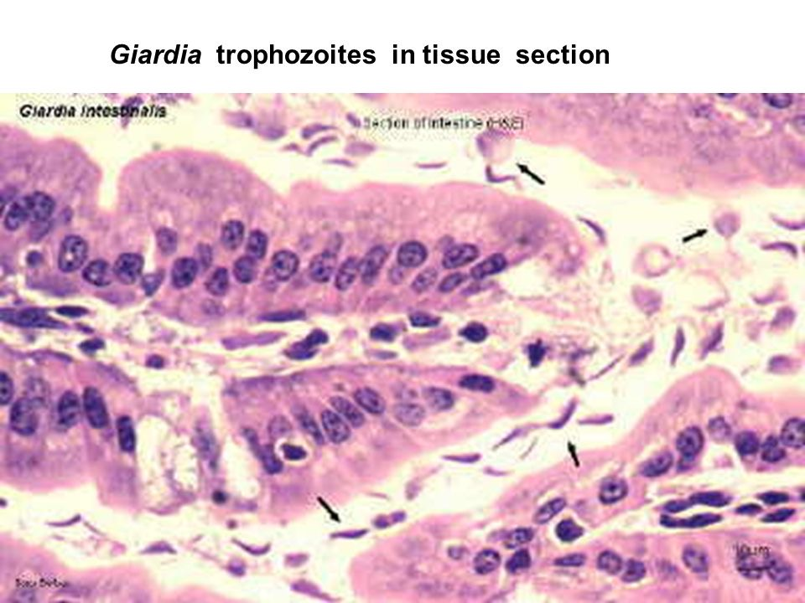
Giardia lamblia
1
Classification of parasites
Protozoa
Helminths
Unicellular, a single cell for all functions.
Amoebae: moves by pseudopodia
Flagellates: moves by flagella
Ciliates: moves by cilia
Apicomplexa (Sporozoa): tissue parasites
Multicellular, specialized cells.
Round worms (nematodes):
Elongated, cylindrical, unsegmented
Flat worms:
Trematodes: leaf like,unsegmented
Cestode: tape-like, segmented
Introduction
Giardia lamblia is a protozoan parasite capable of causing sporadic or epidemic diarrheal illness.
Giardiasis is an important cause of waterborne and foodborne disease, daycare center outbreaks, and illness in international travelers,
Giardiasis is especially common in areas with poor sanitary conditions and limited water-treatment facilities, Water is a major source of giardiasis transmission.
Giardia species have two forms, cysts & trophozoites:
Cysts
infectious¹ and diagnostic³ stage
Resists gastric acidity
Survives the environment
Multinucleated (4)
Non-flagellated
Trophozoites
Replicative² and diagnostic³ stage
Can’t resist gastric acidity
Can’t Survive the environment
Pear-shaped
2 nuclei & adhesive disc
Multi-flagellated (8)
Divides by binary fission
Life cycle
Cyst ingestion (resist acidity) → excystation occurs in the small intestine → with release of trophozoites(pear-shaped) → replicate by binary fission→Trophozoites are then localized in the small intestine, they attach to the mucosal surface of the duodenum⁴ and jejunum. However, the trophozoite does not invade the mucosal epithelium → excretion in the stool as cyst or trophozoite.
Following cyst ingestion, infections have an incubation of a week or more before symptoms of acute giardiasis may develop.
Cysts Survive in the environment and stay infectious in the environment for more than 3 months
1: Infectious: the active form that causes the disease
2: Replicative: the form that multiplies
3: Diagnostic: Seen under microscope.
4: Especially in the duodenum causing diarrhea

Slide 3
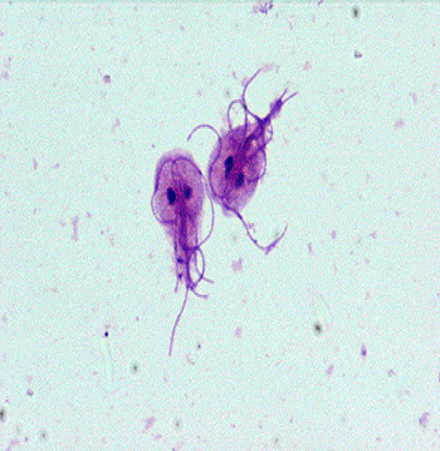
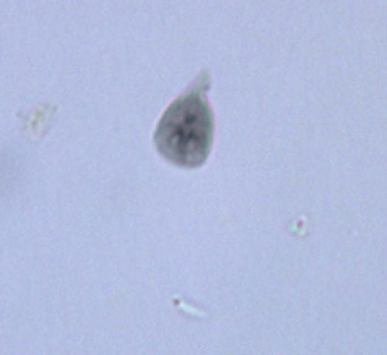
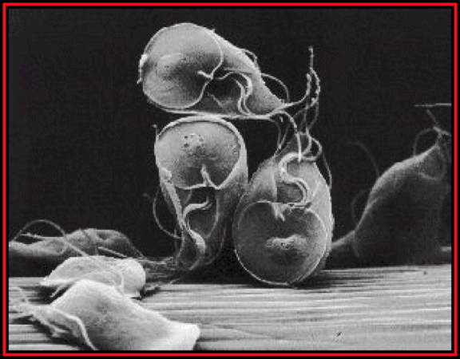
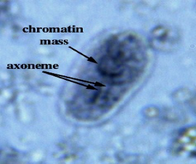
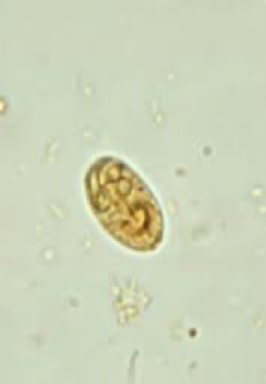
Giardia lamblia
2
Clinical manifestations
○ It is mainly an asymptomatic infection that occurs in both children¹ and adults
○ Asymptomatic cyst & trophozoites shedding can last six months or more
○ If symptoms occur, they include diarrhea, malaise, abdominal cramps, flatulence, weight loss & vomiting .
Complications
○ In a small number of patients
○ persistent infection is associated with development of malabsorption and weight loss
○ Chronic giardiasis may affect growth and development in children² .
Diagnosis
Antigen detection assays
Stool examination
a number of immunoassays using antibodies against cysts or trophozoites antigens have been developed for stool analysis.
Microscopy for cysts & trophozoites.
Examination of duodenal contents for trophozoites.
Treatment
Drug of choice is Metronidazole.
Giardia trophozoites
(Electron Microscopy)
Giardia trophozoites
(Trichrome stain)
Giardia trophozoites
(Light Microscopy)
Giardia Cyst
(Light Microscopy)
1- Mainly affects children
2-Due to malabsorption

Slide 4
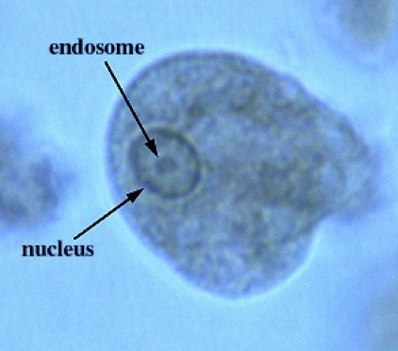
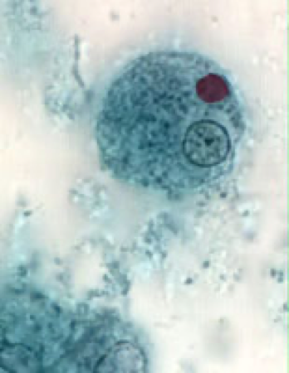
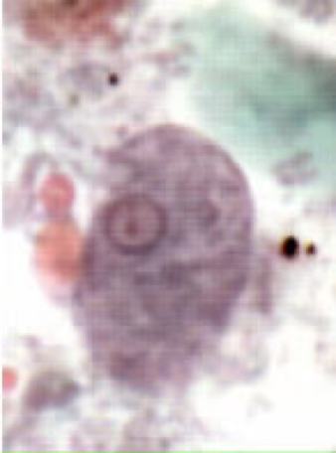
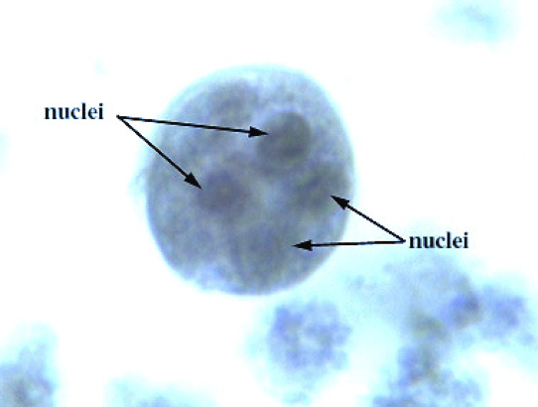
Intestinal Amoebae
3
Entamoeba histolytica
○ Amebiasis occurs worldwide; the prevalence is increased in developing countries
because of poor socioeconomic conditions and sanitation levels.
○ It is a waterborne infection.
500 million people worldwide are infected.
100,000 deaths per year.
○ There are 6 species of Entamoeba :
E.Histolytica amoebae are pathogenic & invasive.
E.dispar is non-pathogenic, non-invasive form.
E.coli¹
E.gingivalis
E.hartmanni
E.polecki
○ E. histolytica and E.dispar can’t be distinguished by microscopic observation.
The parasite exists in two forms:
Cysts
Trophozoites
Infective and diagnostic stage
Resist to the harsh conditions of the environment².
Has 4 nuclei
Vegetative and diagnostic stage
causes invasive disease.
fragile structure.
must encyst to survive.
Has 1 nucleus.
Consumes RBCs
Modes of transmission
Fecal-oral route, Water & Food.
Flies can act as vector
Can be sexually transmitted person - to - person contacts (homosexual)
Not a zoonosis⁴
Entamoeba histolytica (Trophozoite)
Entamoeba histolytica
(Cyst)
1: Entamoeba coli
2: Like the stomach acidity
3: Making it easier to control

Slide 5
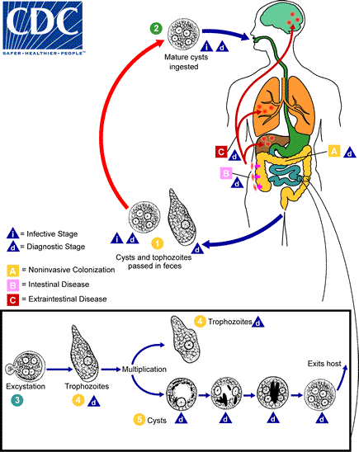
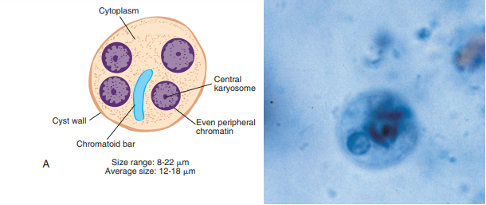
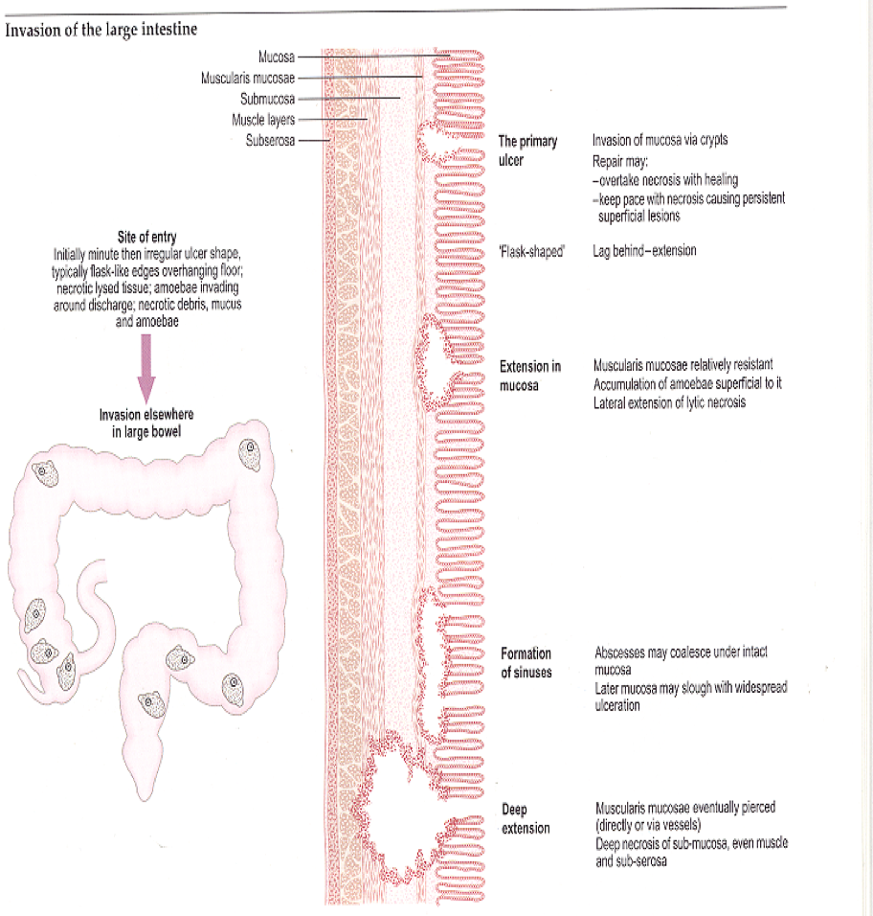
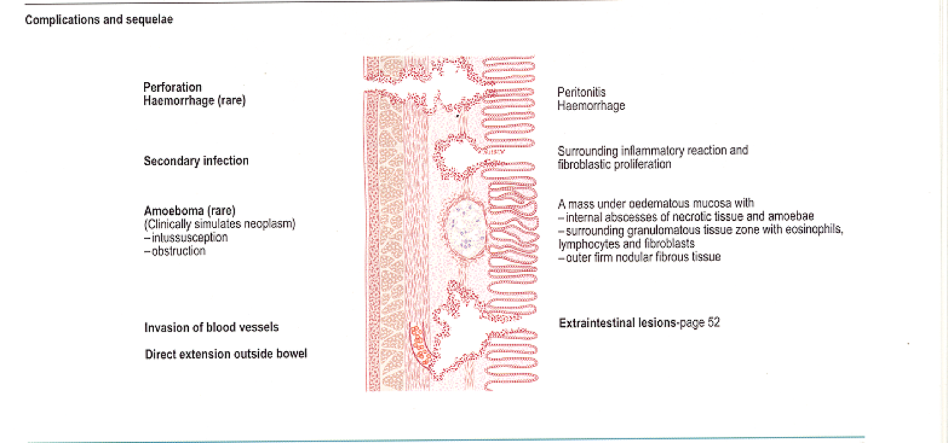
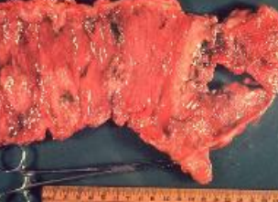
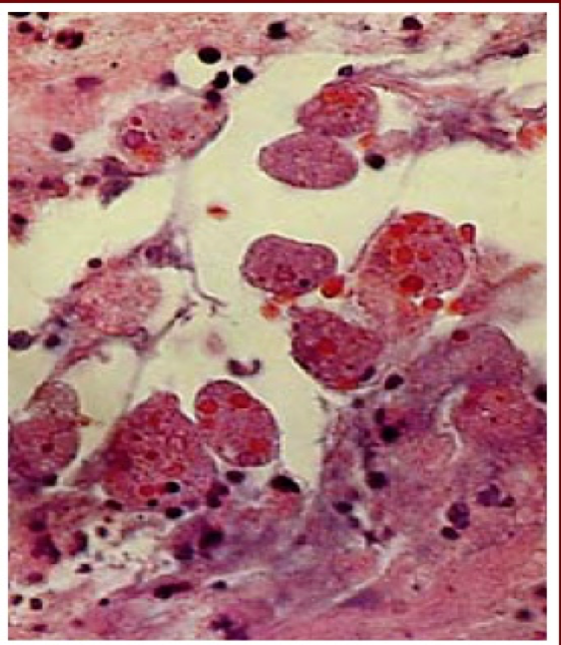
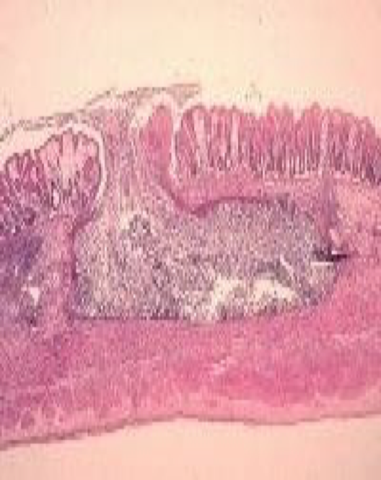
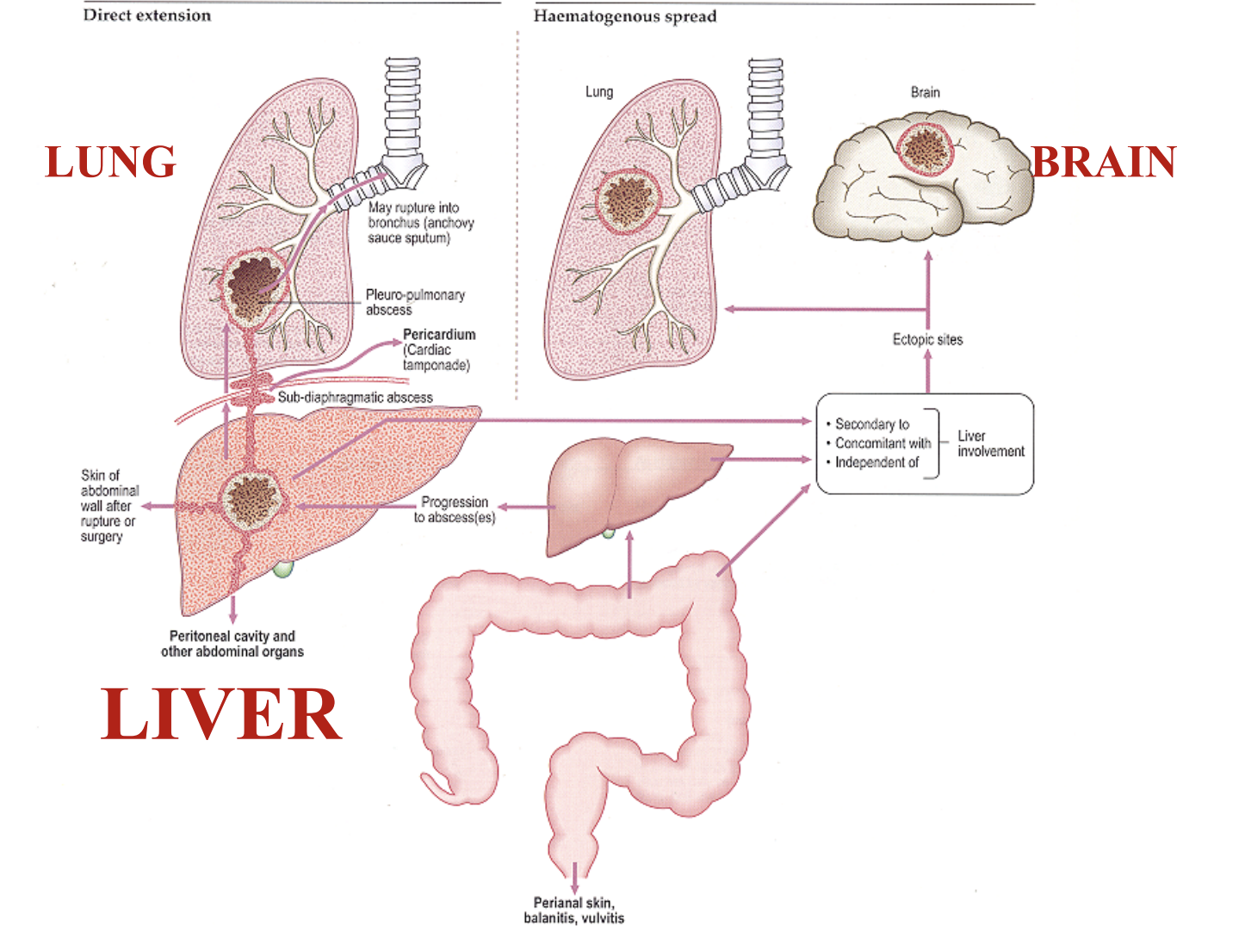
Entamoeba histolytica
4
Life cycle
○ The cysts pass through the stomach → to the small intestine, where
they excyst to form trophozoites → The trophozoites can invade and
penetrate the mucous barrier of the colon (large intestine) → causing
tissue destruction colitis and increased intestinal secretion and can
thereby ultimately lead to bloody diarrhea .
○ The infective dose can be as little as 1 cyst (very virulent).
○ The incubation period can be from few days to few weeks
depending on the infective dose
○ Cysts can survive for weeks at appropriate temperature and humidity.
The cyst has 4 nuclei, while trophozoites has 1 nucleus.
Clinical outcomes of infection
Intestinal
Symptomatic
Extra-intestinal
Infected
Asymptomatic
Carrier
Pathology
Intestinal amoebiasis¹:
Remarkable and unique ability to produce enzymes that lyse host issues.
Lesions are found mainly in the colon and they may heal or cause serious complications:
1- Perforation of the colon.
2- Amoeboma: Granulomatous mass obstructing the bowel
3- Blood invasion; Amoebic liver abscess, lung, brain.
4- Direct extension
Extra - intestinal amoebiasis:
Spreading:
- Direct extension: To liver (progress to abscesses) → Subdiaphragmatic abscess → To lung (as pleuro-pulmonary abscess).
- Haematogenous spread: Through liver (progress to abscesses) → To ectopic sites (Brain and Lung).
E. Histolytica in mucosa.
Numerous trophozoites can be seen with ingested erythrocytes
Most common site: Liver
1-they cause conical flask shaped ulcers in the large intestine

Slide 6
Entamoeba histolytica
5
Clinical manifestations
Majority are asymptomatic but some may have:
mild diarrhea
severe amebic dysentery (abdominal pain, bloody diarrhea, mucus in stools)
Weight loss occurs in about half of patients, fever.
fulminant amebic colitis:
Fulminant colitis with bowel necrosis leading to perforation and peritonitis has been observed in approximately 0.5 percent of cases; associated mortality rate is more than 40 percent
Diagnosis
Serology antigen detection
(Mainly for invasive infections)
1. IHA 2. ELISA
Stool Examination (Microscopy)
Molecular testing
Wet mount (cysts and trophozoites¹)
Concentration methods (only cysts)
Detection of parasitic DNA or RNA in
feces via probes, can also be used to diagnose amebic infection & differentiate between the different strains.
For Extra-intestinal infections:
Serology: IHA, ELISA.
Surgical aspirate (not done as a diagnostic procedure due to risk of extension): Trophozoite.
Sigmoidoscopy and/or colonoscopy and taking biopsy: Trophozoite.
Treatment
○ Intestinal:
Asymptomatic (cysts only): diloxanide furoate (Furamide).
Symptomatic (cysts and trophozoites): Metronidazole.
○ Extra-intestinal:
Metronidazole.
1- With engulfed RBCs in the cytoplasm, remember Entamoeba Eats Erythrocytes

Slide 7
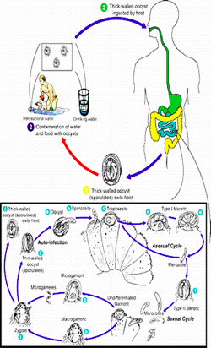
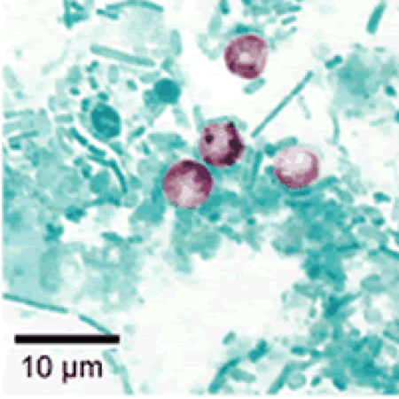
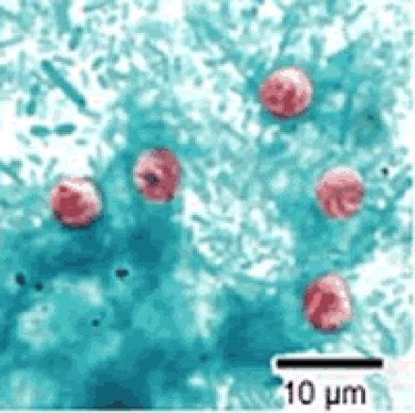
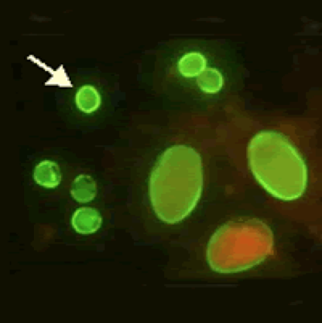
Cryptosporidium Parvum
6
Introduction
○ An intracellular protozoan parasite that is associated with:
Self-limited diarrhea in normal immunocompetent hosts.
Severe debilitating diarrhea with weight loss and malabsorption in HIV-infected patients.¹
Life cycle
Drs explanation:
Before the parasite was not known because it didn’t cause diseases,but with the spreading of HIV especially when in reaches the end stage (AIDS) it caused infection through the cyst entering the small intestine
Infective stage: Oocyst
Diagnostic stage: Oocyst
Modes of transmission
○ Spread from an infected person or animal, by fecal-oral route.
○ From a contaminated environment, such as food or water source contamination.
Diagnosis
○ Cryptosporidium species cannot be cultivated in vitro. (so diagnosis of cryptosporidiosis is generally based upon microscopy).
From stool
From duodenal aspirates
The diagnosis of cryptosporidiosis is made by finding oocysts in:
fecal smears when using modified acid –fast stain(ZN)
by Antigen detection by using ELIZA,IF.
+ Bile secretions & biopsies from
affected gastrointestinal tissue:
Polymerase Chain Reaction(PCR)
Enzyme immunoassays: (ELIZA) & IF.
Treatment
○ Self-limited in immunocompetent patients.
○ In AIDS patients: Paromomycin.
Cryptosporidium Parvum
acid-fast stain ZN.
Cryptosporidium Parvum
Safranin
Cryptosporidium Parvum
Immunofluorescence (IF)
1- Opportunistic infection

Slide 8
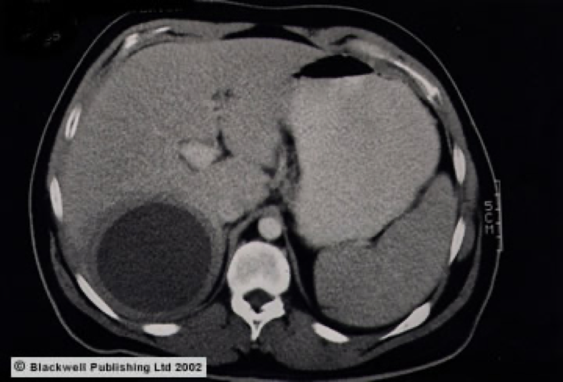
7
MCQ:
Q1:A, Q2:B, Q3:B, Q4:B, Q5:D
Q1: What form of Giardia lamblia is considered an Infective stage?
A- cyst.
B- trophozoites.
C- both.
D- none of the above
Q2: Which one of the following organisms is the most invasive?
A- Giardia lamblia.
B- Entamoeba histolytica.
C- Cryptosporidium Parvum.
D- all of the above
Q3: Cryptosporidium Parvum can cause Severe debilitating diarrhea with weight loss in which of the following?
A- immunocompetent hosts.
B- HIV-infected patient.
C- old people.
D- All.
Q4: 30 Year old patient came to the hospital complaining of severe weight loss, fever and bloody diarrhea upon examination, the colonoscopy revealed fulminant colitis that lead to perforation of the colon. What other extra-intestinal manifestation could he also have?
A- anemia .
B- Liver abscess.
C- osteomyelitis.
D- Esophagitis.
Q5: Metronidazole is the drug of choice in Entamoeba histolytica infection when it is?
A- Asymptomatic infection.
B- symptomatic infection.
C- Extra-intestinal infection .
D- B and C.
SAQ:
CASE: A 3 year-old child came to the clinic complaining of diarrhea, malaise, abdominal cramps, flatulence, weight loss & vomiting for the past 2 weeks. The doctor noticed that the patient’s growth and development is affected. Stool examination microscopy showed cysts & trophozoites, and examination of duodenal contents showed trophozoites. He attends the daycare regularly and lives in a poor village.
Q1: What is the most likely diagnosis?
Giardiasis infection
Q2: What is the infective stage of this disease?
Cysts
Q3: What is a major source of giardiasis transmission?
Water and food
Q4: What is the treatment?
Metronidazole
CASE (from dr’s slides): A 30-year-old male experienced diarrhea for two weeks with
fever of 39° C, nausea,vomiting, malaise and right upper abdominal pain. Physical
examination revealed hepatomegaly 6 cm below the right costal margin.
CT scan showed a single hypodense mass in the right lobe of 7.8 x 5.2 cm,
round, with well defined borders. Serology was positive for Entamoeba histolytica at 1/512.
What is the most likely diagnosis?
Amebic liver abscess

Slide 9
Members board:
Team Leaders:
Abdulaziz Alshomar Ghada Alsadhan
Team sub-leader:
Mohammed Alhumud
This lecture was done by:
Dana Alhalees
Reem Aljabr
Note takers:
Mashal abaalkhail
Badr alqarni
Leena alnassar

