Slide 1
Viral hepatitis
A and E & others
Lecture objectives:
Distinguish the etiology of enteric viral hepatitis (HAV, HEV) from other viruses causing hepatitis such as EBV, CMV, Yellow fever virus.
Describe the main characteristics of HAV ,HEV,EBV, CMV, and Yellow fever virus
Describe the epidemiology and the mode of transmission of these viruses.
Describe the clinical manifestations of enteric viral hepatitis.
Describe the laboratory methods used to diagnose enteric hepatitis.
Describe the treatments and the prevention measures available for these viral infection
Color index:
Important
Found in Girls’ slides
Doctors’ note
Found in Boys’ slides
Extra
EDITING FILE

Slide 2
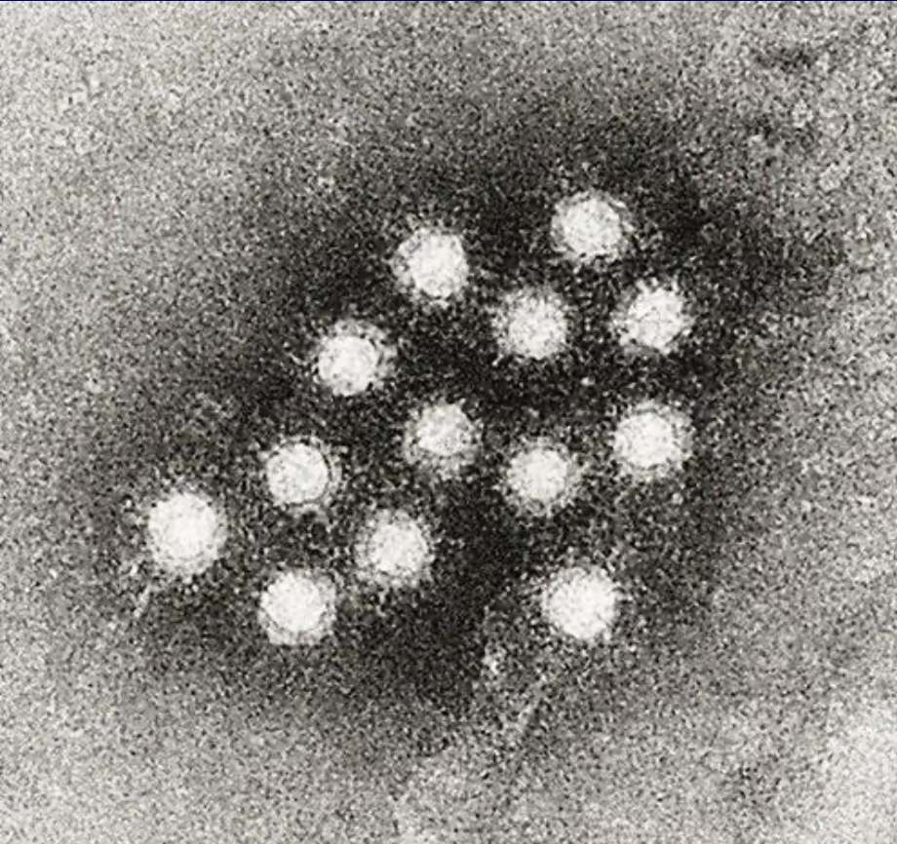
Hepatitis
1
Definition:
Is inflammation of the liver.
Etiology:
Hepatitis F has been reported in the literature but not confirmed.
Viral hepatitis is divided into two large groups, based on the mode of transmission:
Enterically transmitted hepatitis or water borne hepatitis. This group includes hepatitis A and E viruses.
Parenterally transmitted hepatitis or blood borne hepatitis. This group includes hepatitis B, C, D & G viruses.
Primary infections:
Hepatitis A virus (HAV).
Hepatitis B virus (HBV).
Hepatitis C virus (HCV), was known as non-A non-B hepatitis.
Hepatitis D virus (HDV) or delta virus.
Hepatitis E virus (HEV).
Hepatitis F virus (HFV).
Hepatitis G virus (HGV).
As part of generalized infection:
CMV.
EBV.
Yellow fever virus.
Hepatitis A
Characteristics:
Family: Picornaviridae.
Genus: Hepatovirus.
Non-enveloped¹ virion consisting of:
• Icosahedral capsid.
• Positive sense ss-RNA.
Presentation:
- Short incubation hepatitis²
- Infectious hepatitis³
- Epidemic hepatitis⁴
Nonenveloped → more resistance to the harsh environment
Due to its short incubation period
Transmitted easily
Causes outbreaks

Slide 3
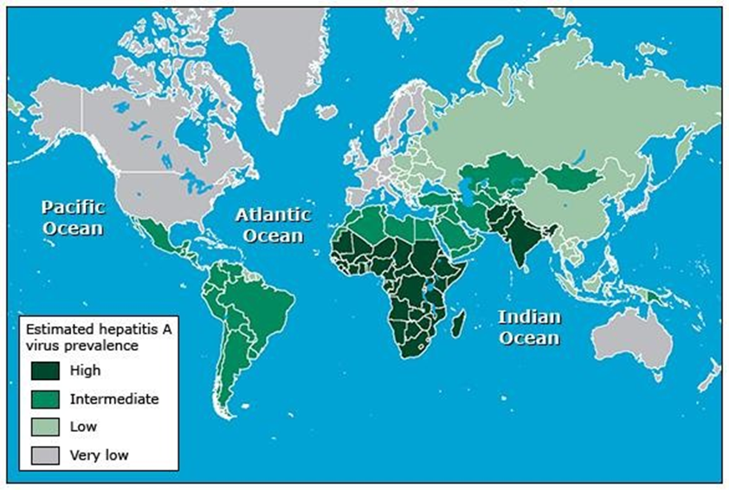
Hepatitis A
2
Epidemiology:
Distribution:
Worldwide, endemic in tropical countries
Age:
In developing countries; children
In developed countries; young adults
Geographic Distribution of HAV Infection
Transmission
Faecal-oral route [major route] :
E.g. Contaminated food & water
Sexual contact (homosexual men)
Blood transfusion (very rarely)¹
Pathogenesis:
The virus enters the body by ingestion of contaminated food
It replicates in the intestine (epithelium)
then spreads to the liver where it multiplies in the hepatocytes.²
Cell mediated immunity → Damage of virus-infected hepatocytes³ → increase ALT, AST & Bilirubin
Manifestations:
Incubation Period (IP): 2-6 weeks.
Pre-icteric phase: Fever, Fatigue, Nausea, Vomiting, & Right upper quadrant pain (RUQP).
Icteric phase: Dark urine, Pale stool & Jaundice.
Asymptomatic & Anicteric infection⁴: Common (more in children)
Symptomatic illness: Increases with age (more in adult)
Because HAV don’t cause chronic infection ( short/ transient viremia )
The virus is present in the stool two weeks before the symptoms and one week after the symptoms → spreading the infection before the symptoms even begin
Rather than complications of the virus itself (no cytopathic change), thereby antiviral are not effective.
Presenting with symptoms of pre-icteric phase

Slide 4
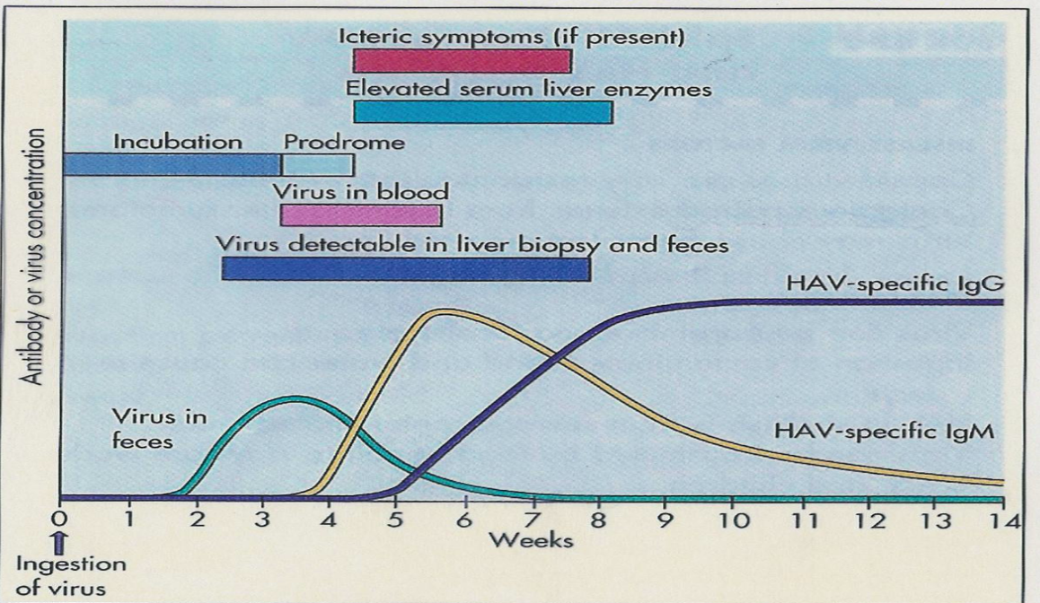
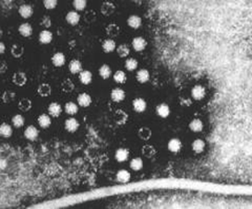
Hepatitis A
3
Diagnosis & Management
Lab Diagnosis | Serology: Detection of anti-HAV IgM Indicates Current infection Detection of Anti-HAV IgG Previous infection Immunity (Vaccinated patients )
Treatment | Supportive therapy (self-limiting)
Prevention | Sanitation & hygiene measures
 | Hig (human immunoglobulin):¹ Given before or within 2 Weeks of exposure (shorter immunity²) Indication: travellers, unvaccinated, exposed patients.
 | Vaccine:¹ - Inactivated (killed) | - Given IM in two doses | - >1 Y of age - Side effects: mild local reaction - Indication: Patients at high risk of infection and severe disease³ - Combination vaccine (HAV & HBV)
Prognosis:
Self-limited disease
Fulminant hepatitis rare (severe necrotic infection of liver lead to liver failure)
Mortality rate ~ 0.1 - 0.3% (low)
No chronicity or malignancy changes
Hepatitis E
Characteristics of HEV:
Family: Hepeviridae.
Genus: Hepevirus.
Non-enveloped virion consisting of:
• Icosahedral capsid.
• Positive sense ss-RNA.
Epidemiology
Outbreak of water-borne & sporadic cases of viral hepatitis.
Age; young adults.
If someone is living with a person who has been diagnosed with Hepatitis A, will you give him vaccine or Hig? Hig, because it gives immunity against HAV faster than the vaccine, but only for a short-term. Unlike vaccines which will provide long-term protection.
3-6 months.
E.g. Chronic liver diseases
Epidemiology
Outbreak of water-borne & sporadic cases of viral hepatitis
Age; young adults

Slide 5
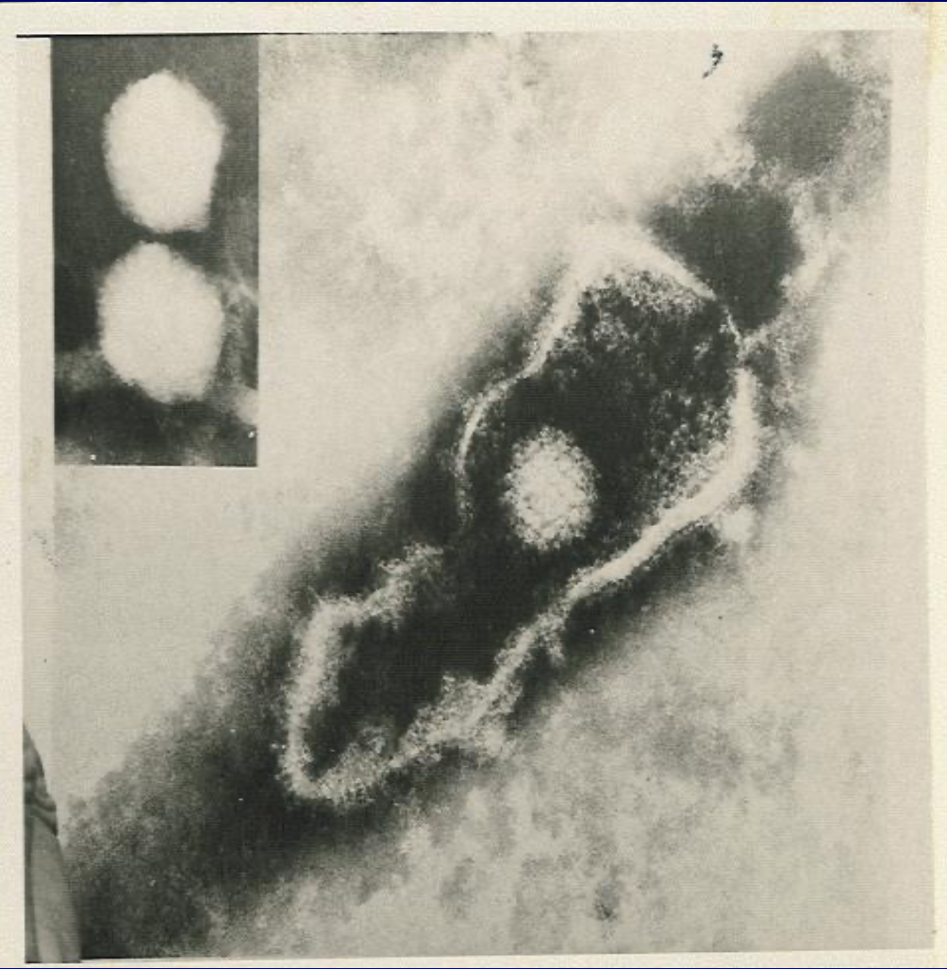
Hepatitis E
4
routes of transmission
Transmission
Water-borne
Zoonotic food-borne¹
Perinatal
Blood-borne
Clinical Features:
Similar to HAV infection with exceptions:
Longer IP =4-8 Ws
Chronic hepatitis, cirrhosis, but not HCC².
Fulminant disease
Mortality rate ~10 times higher than HAV
~ 1-3% [20% in pregnancy]
Chronic hepatitis, cirrhosis, but not HCC.
Fulminant disease
Diagnosis & Management
Lab Diagnosis | Serology: Detection of anti-HEV IgM by ELISA
Treatment | Not specific
Prevention | Sanitation & hygiene measures No Immunoglobulin No vaccine (remember HAV/HBV)
4 routes of transmission;
Herpesviridae³
General features:
dsDNA , Icosahedral & Enveloped Viruses:
1- Herpes simplex virus type-1 HSV-1
2- Herpes simplex virus type-2 HSV-2
3- Varicella –Zoster virus VZV HSV
4- Epstein-Barr virus EBV HSV
5- Cytomegalovirus CMV HSV
6- Human herpes virus type-6 HHV-6
7- Human herpes virus type-7 HHV-7
8- Human herpes virus type-8 HHV-8
causes symptoms above the waist (e.g. meningitis)
→
→
causes symptoms below the waist
→
causes chicken pox
→
cause mild skin rash
→
can cause Kaposi sarcoma in patients
with AIDS
Unlike HAV, HEV can be transmitted from animal to human especially through uncooked pork or beef,
MAY cause in immunocompromised. However, benign self limiting in immunocompetent.
Herpesviridae is family of 8 viruses that cause infections in humans and share some features. EBV & CMV cause hepatitis as part of their systemic infections ,and they establish latency .

Slide 6
Epstein – Barr Virus EBV
5
Characteristics:
It’s lymphotropic.¹
it has oncogenic properties: :
- Burkitt’s lymphoma
- Nasopharyngeal carcinoma
Epidemiology:
Distribution: Worldwide
Age: Depends on SE (Socio-Economic status)
1- Low SE : early childhood (developing countries)
2- High SE : adolescence (developed countries)
Transmission:
1- Saliva (kissing disease)
2-blood (rare)
Clinical Features
1- Immunocompetent host: Asymptomatic (usually). Infectious mononucleosis (or glandular fever). ○ Mainly in teenagers & young adults ○ IP= 4-7 weeks ○ Fever, pharyngitis, malaise, lymphadenopathy hepatosplenomegaly, abnormal LFT & hepatitis. ○ Complications (rare but serious): acute airway obstruction², splenic rupture, CNS eddinfection - Chronic EBV infection³ | 2- Immunocompromised host: Lymphoproliferative disease (LD) Oral hairy leukoplakia (OHL)⁴
Diagnosis
Hematology: - Increased WBC: ○ Lymphocytosis (atypical lymphocytes 20-30%) |  | Serology: 1. Non-specific AB test via Paul-Bunnell or Monospot test: - Heterophile Abs +ve⁵ 2. EBV-specific AB test: IgM Abs to EBV capsid antigen
Treatment and vaccines
Treatment : Antiviral drug is not effective in Infectious mononucleosis⁶ No Vaccine
Attracted to lymph cells and become latent in the B-lymphocytes.
Due to the enlargement of the cervical lymph nodes
If the symptoms lasts for more than 6 months
White patches on the tongue, The patches may look hairy.
Important feature to differentiate EBV from CMV (Heterophile Abs -ve).
Because the symptoms are not due to the viral replication, it’s due to the immunological Attack.

Slide 7
Cytomegalovirus (CMV)
6
Special features
1- Its replication cycle is longer
2- Infected cell enlarged and multinucleated. [cyto=cell, megalo=big]
3- Resistant to acyclovir¹
4- Latent in monocyte(Mostly), lymphocyte & other.
Epidemiology
Distribution: Worldwide
Transmission
Early in life
Young children:
Later in life
1- Transplacental
2- Birth canal
3- Breast milk
Saliva
1- Sexual contact
2- Blood transfusion
3- Organ transplant
Clinical Features
1- Acquired infections
2-Congenital infections
A- Immunocompetent host:
Asymptomatic
Self-limited illness
1-Hepatitis
2-Infectious mononucleosis- like syndrome
[Heterophile AB is –ve]
B- Immunocompromised host:
- Encephalitis - Retinitis
- Pneumonia - Hepatitis
- Esophagitis - Colitis
In contrast to other herpes viruses
Found in all the body fluids → different ways of transmission ( but not airborne )

Slide 8
Cytomegalovirus (CMV) cont’
7
Diagnosis & Management
Lab Diagnosis | Histology: Intranuclear inclusion bodies [Owl’s eye] ( sight-o-megalo virus) | Culture: - In human fibroblast 1-4 weeks: CPE¹ - Shell Vial Assay²: 1-3 days | Serology : - Antibodies: IgM: current infection³ IgG: previous exposure - Antigen: CMV pp65 Ag by IFA | PCR
Treatment | Ganciclovir: effective in the treatment of severe CMV infection Foscarnet: the 2nd drug of choice
Prevention | • Screening: Organ donors, Organ recipients & Blood donors. • Leukocyte-depleted blood. (CMV replicate in the leukocytes) • Prophylaxis: Ganciclovir, CMV IG. (for immunocompromised) • No vaccine
Arthropod –borne Viruses (Arboviruses)⁴
Yellow Fever virus
Characteristics
• Family: Flaviviridae (enveloped, ss RNA +ve polarity, icosahedral)
• Asymptomatic to Jaundice (hepatitis) + Fever ± hemorrhage ± renal failure
Epidemiology:
Distribution: Tropical Africa & South America.
1- jungle yellow fever
2- Urban yellow fever
Jungle Yellow Fever: | Urban Yellow Fever
Vector: Aedes mosquito⁵ Reservoir: monkeys Accidental host: humans It is a disease of monkeys | Vector: Aedes mosquito⁵ Reservoir: human It is a disease of humans
Cytopathic effect
Modified cell culture
Diagnosis in immunocompetent only, because immunocompromised may be unable to produce detectable Antibody. (thus detecting for the antigen is needed)
arthropod-borne viruses (arboviruses) are transmitted between vertebrate hosts by hematophagous (blood-feeding) arthropod vectors, including mosquitoes and ticks
It’s also vector for zika virus

Slide 9
Arthropod - borne Viruses (Arboviruses)
8
Yellow Fever virus
Diagnosis & Prevention
Lab Diagnosis | A- Isolation (Gold standard) B - IgM-Ab - ELISA, IF: (most used) C - Arbovirus RNA by RT-PCR
Prevention | 1-Vector Control: Elimination of vector breeding sites Using insecticides Avoidance contact with vectors ( repellants , net ) |  | 2-Vaccine: Yellow Fever vaccine: - (LAV¹, one dose /10 yrs) - recommended for travelers.
Summary(with Hep B lecture)
1- Live attenuated vaccine thus it’s contraindicated in immunocompromised and pregnancy

Slide 10
Dr.Malak’s Notes
9
Hepatitis A and E
What is the most common cause of Waterborne outbreak? Hepatitis E virus
What are the viruses that cause zoonotic disease ? HEV & yellow fever virus
What are the fecal borne hepatitis viruses? HAV and HEV ( the have similar structure but they are from different families)
HAV → more seen in children
HEV → more seen in Adult
Epidemiology: mainly poor hygiene and sensitization.
HEV and HAV mostly cause Benign self limiting disease (low risk for chronic or malignancy)
HEV → high mortality in pregnancy and may cause chronic disease in immunocompromised.
Diagnosis for HEV, HAV, & yellow fever: by specific IgM
No treatment for HEV and HAV
Prevention:
HAV → vaccine (killed) and HIg
Yellow fever virus → Live attenuated vaccine
What are the viruses that transmit through saliva ? CMV and EBV
Mosquito is the vector in yellow fever virus
Viruses can be prevented by screening the blood before transfusion:
CMV
HAV
HCV
What is the disease caused by EBV ? Infectious mononucleosis
Immunoglobulin for the immunocompromised → HAV and CMV

Slide 11
Quiz:
10
MCQ:
Q1: B; Q2: D; Q3:D; Q4:B
Q1: Which of the following is available and effective for HAV?
A- Acyclovir
B- Killed virus vaccine
C- Live virus vaccine
D- Recombinant viral vaccine
Q2: Which of the following is transmitted by the fecal-oral route; can be acquired from shellfish; and often causes acute jaundice, diarrhea, and liver function abnormalities?
A- Rotavirus
B- Adenovirus 40/41
C- Norwalk virus
D- Hepatitis A virus
Q3: Malaise and hepatosplenomegaly with increased “atypical” lymphocytes and a reactive heterophil antibody test is most commonly caused by:
A- HAV
B- HEV
C- HBV
D- Epstein-Barr virus
Q4: Burkitt’s lymphoma is characterized by elevated “early antigen” tests with a restricted pattern of fluorescence. This disease is caused by:
A- Cytomegalovirus
B- Epstein-Barr virus
C- HAV
D- HEV
SAQ:
CASE: A 19-year-old college sophomore presents to the university health center with a 7-day history of sore throat, headache, and fatigue. He has a temperature of 37.70C. Physical examination reveals enlarged, tender cervical lymph nodes in both the anterior and posterior cervical chain. The spleen is found to protrude 5cm under the costal margin with inspiration. Upon examination of his oropharynx, gray-green tonsillar exudate is noted.
Q1: What’s the most likely diagnosis?
Infectious mononucleosis
Q2: What’s the most likely causative agent?
Epstein-Barr virus
Q3: Which malignancies are associated with this infection?
Burkitt’s lymphoma, Nasopharyngeal carcinoma
Q4: How is this organism transmitted?
Saliva (kissing disease) , blood (rare)
Q5: What are the main laboratory findings in this disease?
Heterophile Abs +ve, increased atypical lymphocytes

Slide 12
Members board:
Team Leaders:
Abdulaziz Alshomar Ghada Alsadhan
Team sub-leader:
Mohammed Alhumud
This lecture was done by:
khyal alderaan
Saud Alaqeel
Note takers:
Mashal Abaalkhail
Razan Alrabah

