Slide 1
Malaria
Lecture objectives:
Know the 5 species of malaria that infect humans
Describe the life cycle of malaria, morphology and clinical picture
Compare pathogenesis of different malaria species
Know endemic countries of malaria species
Know malaria paroxysm
Know complications of malaria
Describe methods for laboratory diagnosis of malaria
Know action of anti malarial drugs in different life stages of malaria parasite
Color index:
Important
Found in Girls’ slides
Doctors’ note
Found in Boys’ slides
Extra
EDITING FILE

Slide 2
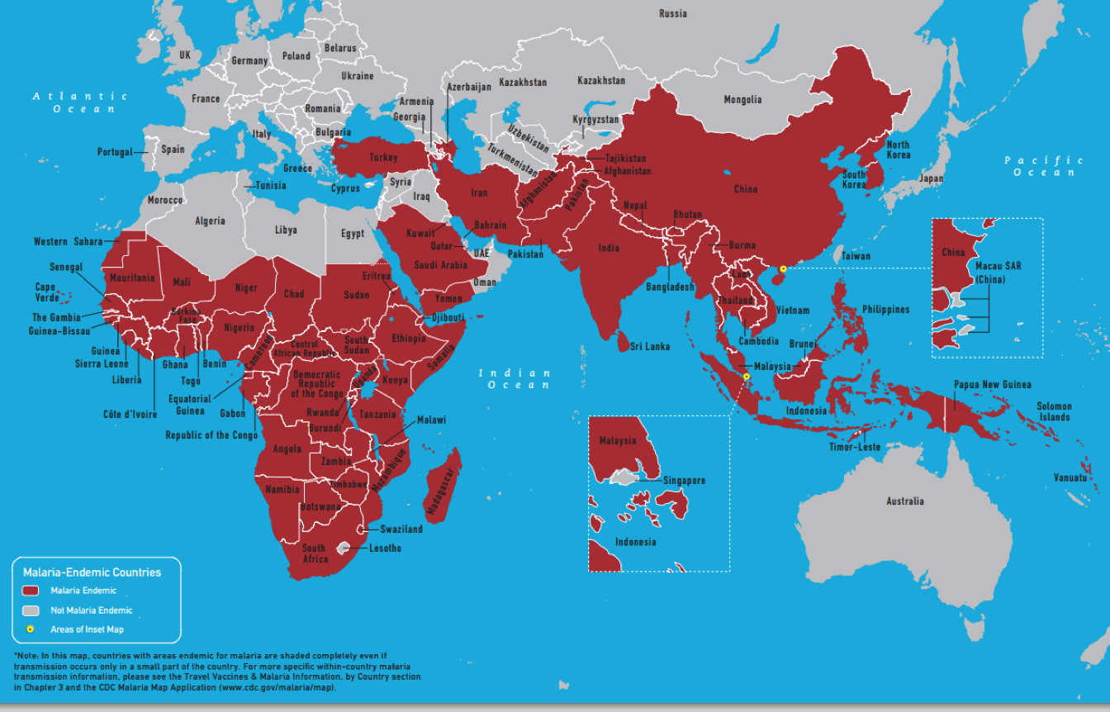
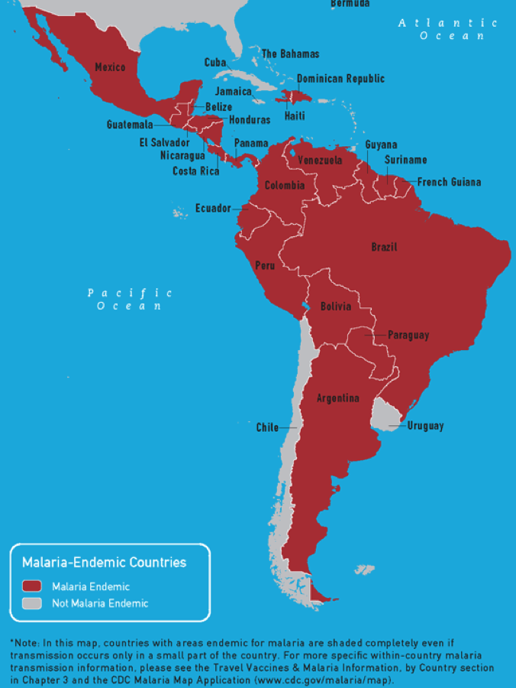
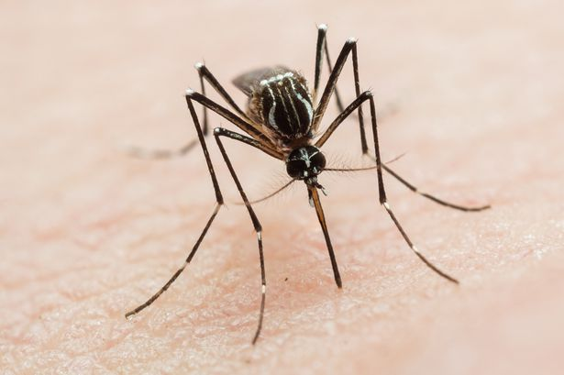
Malaria
1
Overview
Malaria is the most important of all tropical parasitic disease ,causes death and debility and is endemic throughout the tropics and subtropics.
The main symptoms and signs are periodic fever, headache ,anorexia and anemia.
Plasmodium falciparum
the most dangerous one
Plasmodium vivax
Plasmodium ovale
Five species of malaria infect humans
Plasmodium malaria
Plasmodium knowlesi
Epidemiology (explained better in the next slides)
Asexul stage²
Sexual stage³
Sporozoites are injected by an infected Anopheles Mosquito into the blood of human and enter liver cells and will become schizonts then become Merozoites which are released in the circulation and penetrate the Red Blood Cell and cause the main pathology of the disease hemolysis and anemia . Some parasites develop into male and female Gametocyte.
Male and female Gametocyte are taken up from the blood of an infected human by biting mosquito. Further sexual development takes place in the mosquito gut to produce SPOROZOITES.
∘ Human to human transmission can occur by blood transfusion or vertical transmission across the placenta.
Anopheles Mosquito
The devil itself
Malaria –Endemic Countries
The most dangerous species, causing severe illness
Inside the human body
Inside the mosquito

Slide 3
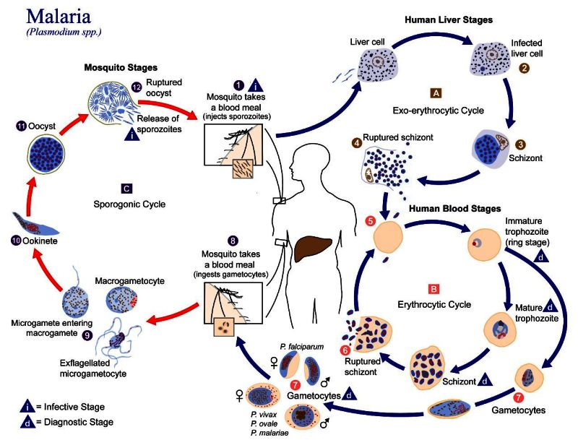
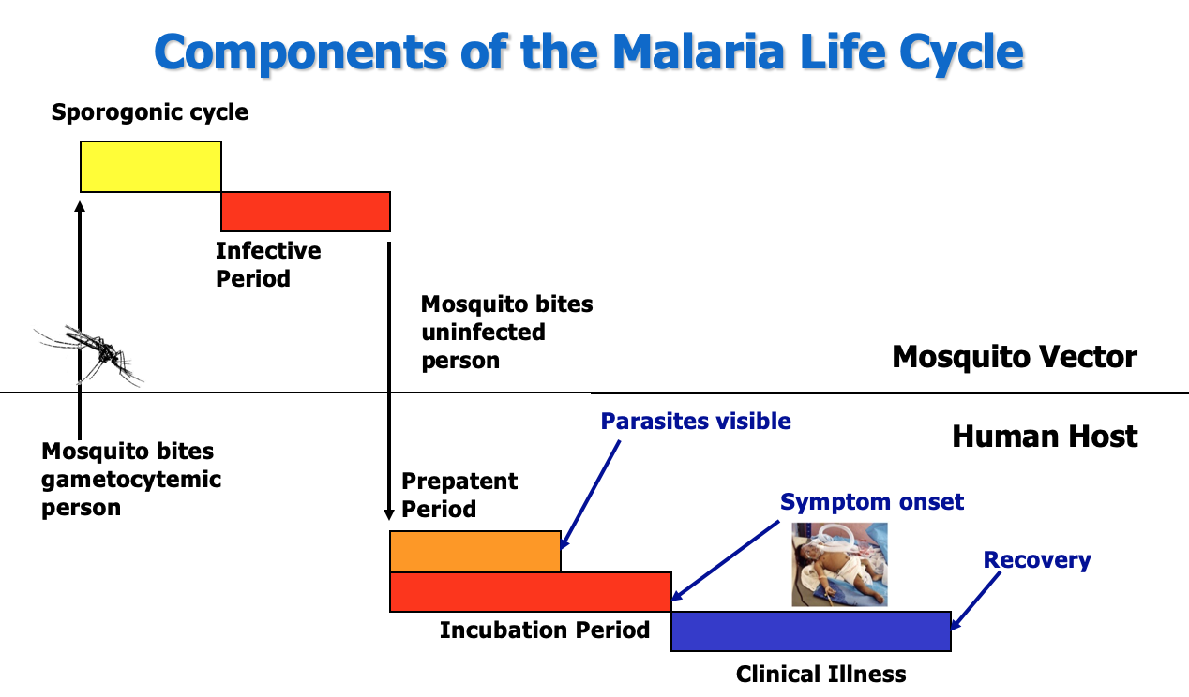
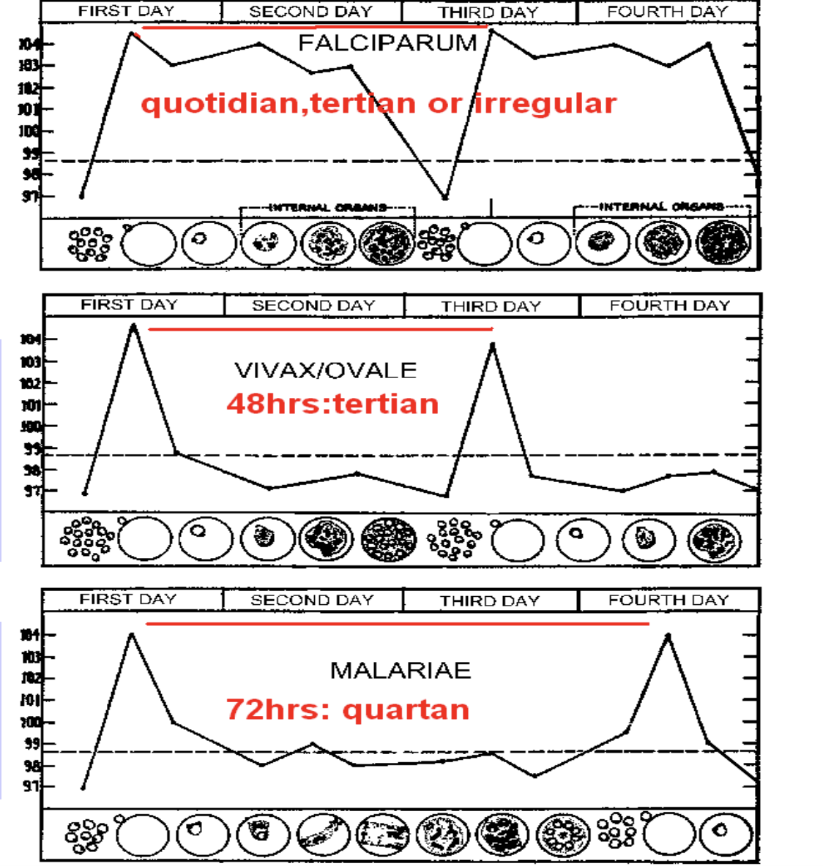
Malaria
2
Life Cycle of Malaria
Explanation for the picture:
Malaria is mainly carried by female anopheles mosquito.
The infected mosquito will bite and inject sporozoites from it salivary gland into the bloodstream of human.
Which then will travel through blood until it reaches the liver and enter the hepatocytes where it will multiply asexually to form merozoites inside the schizont (Exoerythrocytic schizont).
When the hepatic schizont rupture the merozoites will be released into blood, then it will enter the erythrocytes forming immature trophozoites (ring stage) which will have 2 pathways:
First pathway: It goes through the erythrocytic cycle starting from ring stage then into Mature trophozoites, then the merozoites will multiply inside the RBCs forming schizont (Erythrocytic schizont), which will rupture (hemolysis) and release the merozoites into the bloodstream (Clinical attack of malaria is due to this stage) and the cycle will repeat over and over again.
Second pathway: Some immature trophozoites will become gametocytes (male and female) those gametocytes will be ingested by another mosquito; in the mosquito:
There are Micro(Male) and Macro(Female) gametocytes, the microgametocytes will enter into the macrogametocytes in which they will form Ookinete then it will develop into Oocyst which will rupture releasing sporozoites in mosquito, then the cycle will go over and over again.
The pattern of fever in different species of malaria:
plasmodium Vivax¹
Occurs every
48hrs - tertian
plasmodium Ovale¹
Time to rupture
quotidian, tertian, irregular
Plasmodium Falciparum
Occurs every
72hrs - quartan
Plasmodium Malariae
Can stay latent in the hepatocytes (Hypnozoites) thereby causing chronic/recurrening infection.

Slide 4
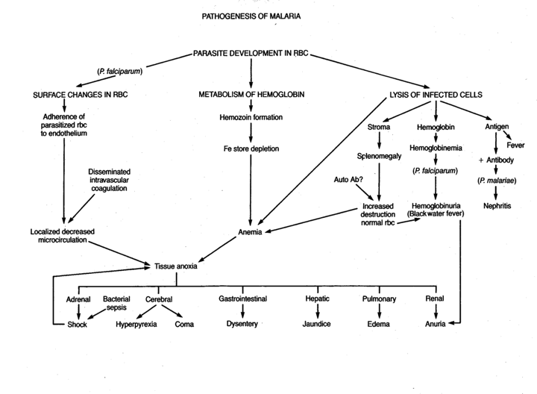
Malaria
3
Malarial Paroxysm
Cold stage:
feeling of intense cold
vigorous shivering
lasts 15-60 minutes
Hot stage:
due to rupture blood schizonts.
intense heat
dry burning skin
throbbing headache
lasts 2-6 hours
sweating stage:
profuse sweating
declining temperature
exhausted and weak → sleep
lasts 2-4 hours
Then the cycle starts again
Chills
Fever
Sweating
Pathogenesis of malaria
∘ Symptoms are due to:
Hemolysis of Red Blood Cells :
with release of metabolites and pigments from Malaria parasite.
Plugging of capillaries by parasitized erythrocytes:
In cerebral malaria there is sequestration of parasites in central nervous system capillaries caused by Plasmodium Falciparum.

Slide 5
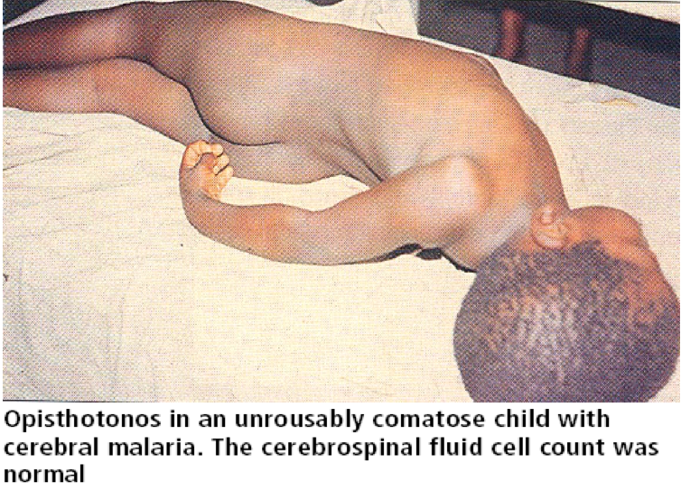
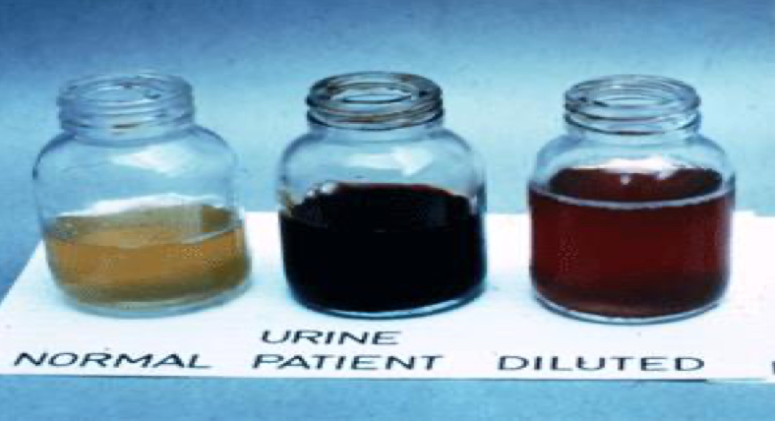
Malaria
4
Clinical picture
Acute
Chronic
Non-severe Acute Febrile disease
Chronic Asymptomatic Infection
Infection During Pregnancy
Severe malaria
e.g.Cerebral Malaria
Anemia
Placental Malaria
Death
Developmental Disorders,
Transfusions & Death.
Low Birth weight
Increased Infant Mortality
Complication of severe Malaria:
Severe malaria is defined as: symptomatic malaria in a patient with P. falciparum¹ with one or more of the following complications:
Opisthotonos
1-Cerebral malaria (unrousable coma not attributable to other causes).
2-Generalized convulsions (> 2 episodes within 24 hours).
3-Severe normocytic anaemia (Ht<15% or Hb < 5 g/dl).
4-Hypoglycemia (blood glucose < 2.2 mmol/l or 40 mg/dl) and pulmonary edema in pregnancy can
lead to abortion and stillbirth,seen in Tropical contrary.
5-Metabolic acidosis with respiratory distress (arterial pH < 7.35 or bicarbonate < 15 mmol/l)h
6-Fluid and electrolyte disturbances
7-Acute renal failure (urine <400 ml/24 h in adults; 12 ml/kg/24 h in children) (blackwater fever )
8-Acute pulmonary edema and adult respiratory distress syndrome
9-Abnormal bleeding
10-Jaundice
11- Hemoglobinuria associated with malaria (blackwater fever):
Uncommon and usually presents in adults as severe disease with anemia and renal failure.
12-Circulatory collapse, shock, septicaemia (algid malaria)
13-Hyperparasitaemia (>10% in non-immune; >20% in semi-immune)
14-Tropical splenomegaly
Uncomplicated malaria is defined as: Symptomatic infection with malaria parasitemia without signs of severity and/or evidence of vital organ dysfunction.
Infection during pregnancy is seen in HEV ( high mortality rate 20%) and malaria.
The only strain of plasmodium that has cerebral involvement.

Slide 6
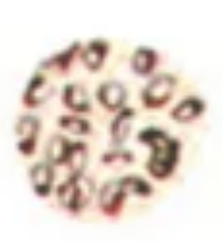
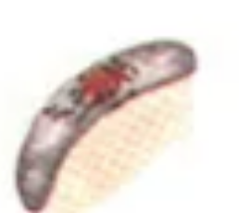
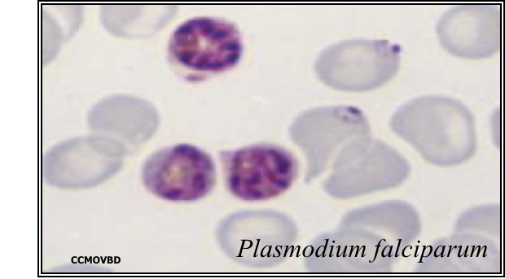
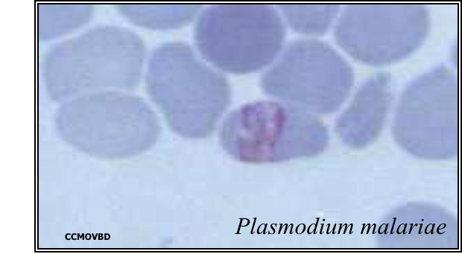
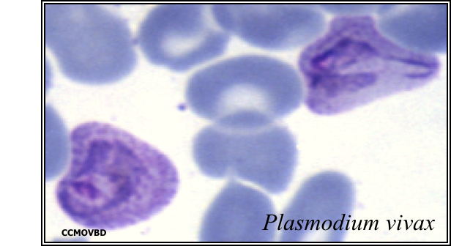
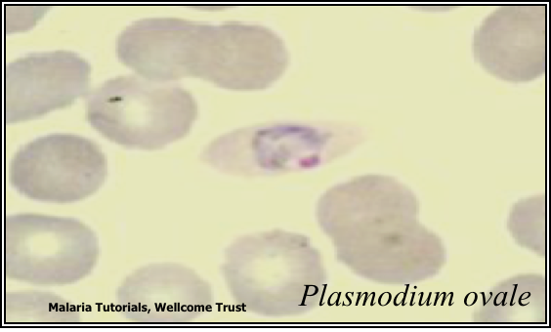
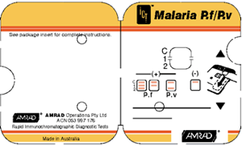
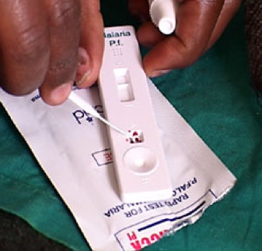
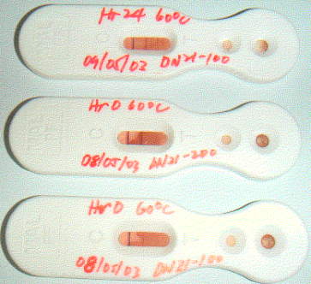
Malaria
5
Diagnosis
1-Light microscopy; The gold standard
Thin¹ film & thick² film
can be used to look for parasite density,species diagnosis and monitoring response to treatment
∘ Three developmental stages seen in blood:
Trophozoite
schizont
Gametocyte³
01
02
03
2-Rapid diagnostic tests (RDTs):
detect malaria antigens
The product comes in a number of formats:
1-Plastic Cassette
2-Card
3-Dipstick
4-Hybrid Cassette-dipsticks
Plastic cassette format of RDT
Treatment
Sporontocides
Tissue Schizontocides
Blood Schizontocides
- Chloroquine
-Sulfadoxine/
Pyrimethamine
- Quinine
- Artemisinins
Gametocyide
- Primaquine
Anti-relapse (P.vivax)
- Primaquine
- Primaquine
-Pyrimethamine
- Proguanil
- Primaquine
- Pyrimethamine
- Tetracycline
- Proguanil
Click here for a summary from Kaplan
Thin film: is a drop of blood that is spread across a large area of the slide. Useful in discovering what species of malaria is causing the infection.
Thick film: is a drop of blood. Thick blood smears are useful for detecting the presence of parasites, because they examine a larger sample of blood.
Banana like shape

Slide 7
Dr.Mona’s Notes
6
Main symptoms: periodic fever, headache, anorexia, and anemia.
Species of malaria:
Plasmodium falciparum (irregular tertian fever)
Plasmodium vivax (tertian fever)
Plasmodium ovale (tertian fever)
Plasmodium malariae (quartan fever)
Life Cycle:
Asexual stage: sporozoites are injected by an infected Anopheles Mosquito into the blood of human → hepatocytes → schizonts → Merozoites → released in the circulation → penetrate the red blood cells.
Sexual stage: male and female gametocyte are taken up from the blood of an infected human by biting mosquito → sexual development takes place in the mosquito gut to produce sporozoites.
Pathogenesis:
Hemolysis of Red Blood Cells
Plugging of capillaries by parasitized erythrocytes (P.falciparum)
Complications of Severe malaria by P.falciparum:
Cerebral malaria
Hypoglycemia and pulmonary edema in pregnancy → abortion
Acute Renal failure (Blackwater fever)
Diagnosis:
Light microscopy (gold standard): thick and thin film
Rapid diagnostic test
Doctor’s Questions:
Q1: What causes tertian fever ? Plasmodium vivax & ovale
Q2: What causes irregular tertian fever and severe illness ? Plasmodium falciparum
Q3: A patient with malaria, presented with plugging of capillaries and ischemia. What is the most likely causative species ? Plasmodium falciparum
Q4: A patient with malaria, presented with hemolytic anemia. What is the most likely causative species ? All the species

Slide 8
Quiz:
7
Q1: A, Q2: A, Q3: C
MCQ:
For Q3 explanation CLICK HERE
Q1: A woman, recently returned from Africa, complains of having paroxysmal attacks of chills, fever, and sweating; these attacks last a day or two at a time and recur every 36 to 48 h. Examination of a stained blood specimen reveals ringlike and crescent-like forms within red blood cells. The infecting organism most likely is:
A- Plasmodium falciparum
B- Trypanosoma gambiense
C- Wuchereria bancrofti
D- Schistosoma mansoni
Q2: A 38-year-old man comes to the emergency department complaining of cyclic fevers and headaches. The fevers began about one week ago; two weeks ago the patient returned from a trip to Africa. Physical examination reveals hepatosplenomegaly. Imaging of the brain shows signs of significant cerebral involvement. Which of the following parasites most likely caused this patient’s symptoms?
A- Plasmodium falciparum
B- Plasmodium malariae
C- Plasmodium ovale
D- Plasmodium vivax
Q3: A 44-year-old woman returns home to New York after a 2-week camera safari to East Africa. She started chloroquine antimalarial prophylaxis 2 weeks prior to her departure for Kenya and continued throughout her foreign travel. She stopped taking the pills on her arrival home because they made her nauseated. Two weeks after her return, she develops paroxysmal fever and diaphoresis and is quickly hospitalized with febrile convulsions, jaundice, and anemia. Blood smears reveal red blood cells multiply infected with delicate ring-like trophozoites and rare sausage-shaped gametocytes.The stage of the parasite life cycle that is responsible for the appearance of the parasites 2 weeks after departure from the malarious area is the:
A- Hypnozoite
B- Sporozoite
C- Exoerythrocytic schizont
D- Erythrocytic schizont
SAQ:
CASE: While doing a rotation in Ghana, a medical student encounters a patient who has been having nearly continuous high-grade fevers with occasional chills and sweats. Physical examination reveals a palpable spleen. A drop of the patient’s blood placed in a copper sulfate solution reveals anemia. Over the next few days, while waiting for medication to arrive, the patient’s level of consciousness waxes and wanes, and he is somnolent at times.
Q1: What’s the most likely diagnosis?
Malaria
Q2: What’s the most likely organism?
Plasmodium falciparum. Explanation: The patient’s altered mental status (level of consciousness waxes and wanes) is consistent with a diagnosis of P.falciparum malaria, since this is the only strain that commonly has cerebral involvement.
Q3: Mention 3 complications for this disease.
Cerebral malaria, Severe normocytic anemia, Hypoglycemia
Q4: What are the common methods for diagnosis of this disease?
Light microscopy, Rapid diagnostic tests

Slide 9
Members board:
Team Leaders:
Abdulaziz Alshomar Ghada Alsadhan
Team sub-leader:
Mohammed Alhumud
This lecture was done by:
Tariq Aloqail
Abdulrahman Alsayed
Note takers:
Mashal Abaalkhail
Razan Alrabah

