Slide 1
GNT Pathology Cases
Sources:
1- Males doctor revision files.
2- Females slides.
This file was done by:
Lama Alzamil & Khalid Alkhani

Slide 2
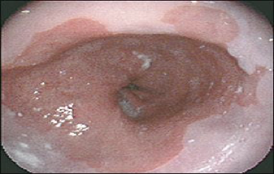
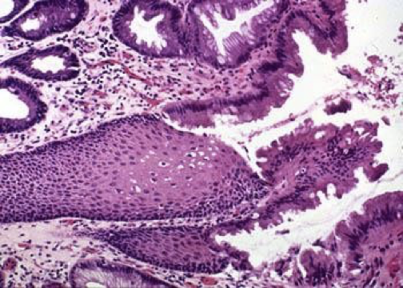
Gastroesophageal Reflux Disease
Scenario 1
A 57-year-old presents with a history of a retrosternal burning sensation, particularly after large meals, and often on retiring to bed at night. Treatment with antacids has had little effect and he has been referred for endoscopy.
Upper gastrointestinal tract endoscopy reveals reddening of the lower esophageal mucosa There is no evidence of a hiatus hernia. The proximal border of the reddened area is irregular, and this area is biopsied.
1- What is the likely cause of the symptoms?
The symptoms of ‘heartburn’ are suggestive of
gastroesophageal reflux disease (GERD), with or without
the presence of a hiatus hernia.
Other important causes of retrosternal pain:
cardiovascular causes, especially myocardial ischaemia.
pneumothorax and musculoskeletal pain.
2- What is the final diagnosis?
Barrett’s oesophagus. This is a metaplastic process which
develops as a result of persistent reflux of gastric contents into
the esophagus, the normal squamous mucosa being replaced by
glandular mucosa of intestinal type.
3- What further information do you require from the biopsy report?
It is important to look for dysplastic change in the biopsy which may herald the development of adenocarcinoma.
4- What are the major causes of reflux esophagitis?
Reflux of gastric contents is the major cause of reflux esophagitis. Many factors play a role:
(a) the presence of a sliding hiatal hernia is the most
common
(b) heavy alcohol and tobacco use
(d) increased gastric volume
(e) decreased efficacy of LES
(f) pregnancy
(g) CNS depressants
(h) hypothyroidism
A 57-year-old presents with a history of a retrosternal burning sensation, particularly after large meals, and often on retiring to bed at night. Treatment with antacids has had little effect and he has been referred for endoscopy.
Upper gastrointestinal tract endoscopy reveals reddening of the lower esophageal mucosa There is no evidence of a hiatus hernia. The proximal border of the reddened area is irregular, and this area is biopsied.
intestinal-type glandular mucosa

Slide 3
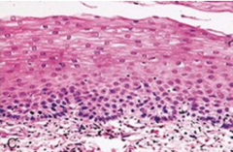
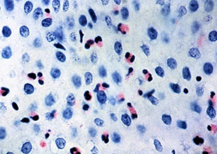
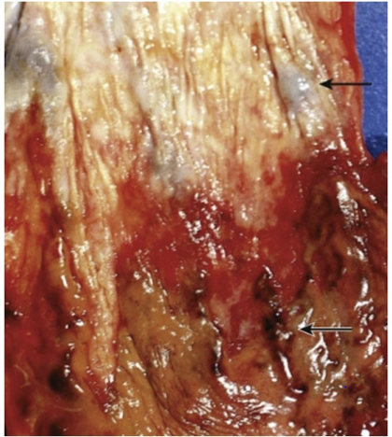
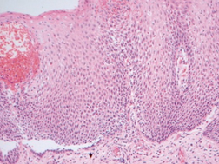
5- What are other causes of esophagitis?
Ingestion of irritants (eg, alcohol, corrosive acids); infections in
immunosuppressed hosts by fungi (eg, Candida) or viruses (eg, CMV, herpes);
uremia; radiation therapy; graft-versus-host disease; and cytotoxic anticancer
therapy.
6- What are the gross and microscopic features of reflux esophagitis?
Gross features: - Simple hyperemia - Erosion - Ulceration - Stricture -
Development of Barrett esophagus - Development of mass: adenocarcinoma
Microscopic features:
Basal zone hyperplasia.
Eosinophils and neutrophils.
Elongation of lamina propria papillae.
7- What are the major complications of reflux esophagitis?
The potential complications of severe reflux esophagitis are
(a) Ulcer, Bleeding, Development of stricture, Development
of Barrett esophagus and adenocarcinoma.
(e) Esophageal varices: linear-oriented dilated and tortuous
Veins (arrows) in the submucosa of the distal esophagus.
A
B
C
MCQs
A 52-year-old male presents with epigastric pain that improves with meals. Endoscopy demonstrates a 2 Cm ulcerated area located 3 cm distal to the pyloric junction. Which of the following is most likely to have made the strongest contribution to the development of this disease?
Aspirin use
Chronic antacid use
Drinking alcohol
Helicobacter pylori infection
Smoking
The correct answer is D. The patient has a duodenal peptic ulcer. The strongest risk factor for duodenal peptic ulcer is Helicobacter pylori infection, which is found in almost 100% of these cases (contrast to 70% Infection rate in gastric peptic ulcer).
All of the following are Defensive Factors against gastric ulcer development except
Mucus
Bicarbonate
Bile salts
Prostaglandins
Phospholipid

Slide 4
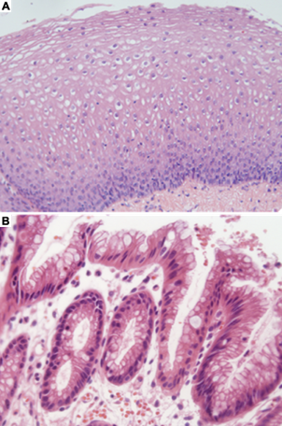
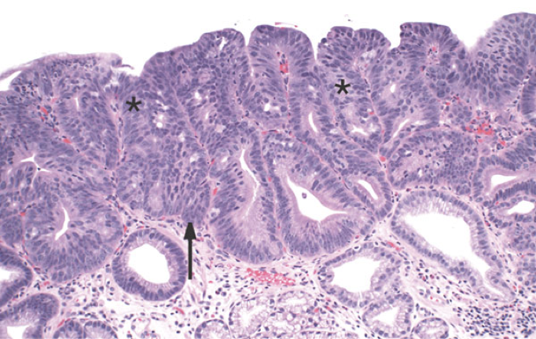
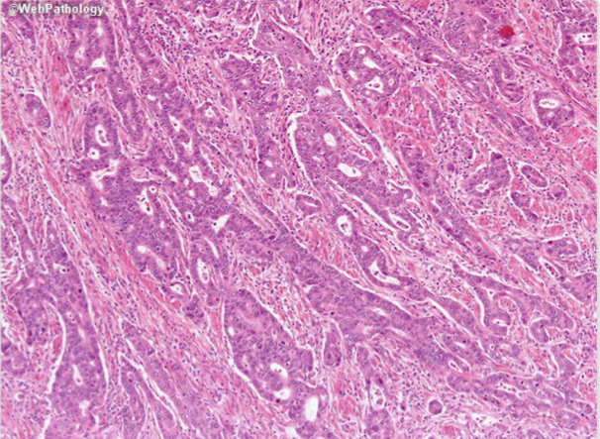
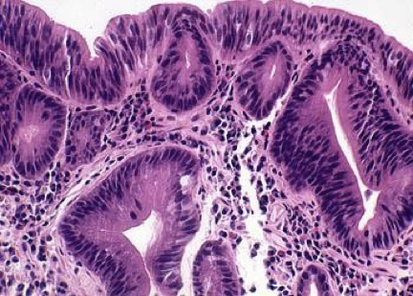
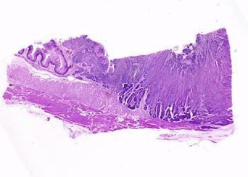
Scenario 2
The patient is a 51-year-old white man who presented 10 years before surgery with a history of heartburn, regurgitation, and epigastric pain. Endoscopy was performed, and a large erythematous area involving the distal esophagus was noted. Biopsy specimens were taken.
The patient was treated with antireflux drugs and given a follow-up appointment in 1 year. The patient returned 3 years later, complaining of dysphagia, heartburn, and epigastric pain.
Endoscopy was performed again and revealed that the normal white squamous mucosa lining the distal esophagus was replaced by pink mucosa. Biopsy specimens were taken.
Because of the diagnosis of Barrett esophagus, the patient was enrolled in a surveillance program, and yearly endoscopic procedures were recommended. Endoscopy showed extensive Barrett esophagus 6 years before surgery, and biopsy specimens showed features of dysphagia.
He failed to return for subsequent surveillance endoscopy. The patient was admitted with increasing dysphagia 1 month before surgery. An upper GI series (radiographs) revealed distal narrowing of the esophagus. Endoscopic examination of the esophagus revealed an ulcerating mass in the distal esophagus. A biopsy specimen was obtained.
The patient was taken to surgery, where an esophagogastrectomy was performed.
Barrett esophagus without dysplasia
Barrett esophagus
with dysplasia
Adenocarcinoma in Barrett Esophagus

Slide 5
Peptic Ulcer
Scenario 1
A 49-year-old secretary presents to medical outpatients with a 7- month history of epigastric pain. She has been treated with antacids by her GP, but this has not controlled the symptoms. In the clinic, she complains of epigastric pains which are sharp and burning and radiate her subcostal margin to the right. The pain is worse at night and is relieved by food. On examination, there is epigastric tenderness and clinical signs of anaemia.
1- What is the possible cause of this clinical presentation?
Duodenal Peptic ulceration
2- What are the predisposing causes?
1. H pylori infection 2. Acid hypersecretion
3- What are the major complications?
The major complication is perforation of a vessel with subsequent gastrointestinal haemorrhage. This can present as either hematemesis, melena or iron deficiency anemia. Other complications include fibrosis and adhesions..
4- What investigations should be performed?
Endoscopy
5- What is the treatment?
Proton pump inhibitors.
H2 receptor antagonists.
H. pylori eradication therapy.
6- What changes might an endoscopic biopsy show if there was ulceration of the
gastric or duodenal mucosa?
The histological features include:
An acute and/or chronic inflammatory cell infiltrate with lymphoid aggregate formation.
Regenerative changes in the surface epithelium.
In the stomach, small intestinal metaplasia and goblet cells.
Gland atrophy, especially when H. pylori infection is identified.
Dysplasia.
Finally, presence of H. pylori in the surface mucosa.

Slide 6
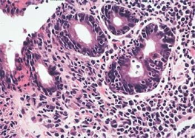
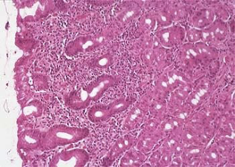
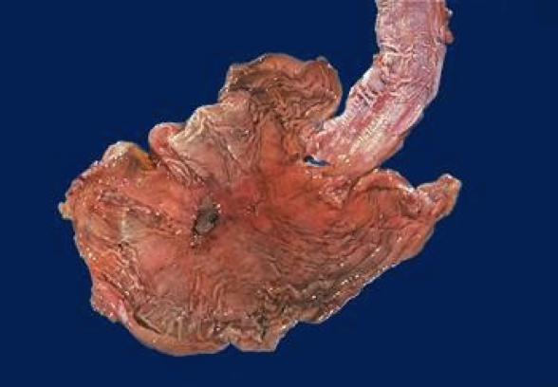
Scenario 2
The patient is a 72-year-old white man with a history of homelessness, chronic obstructive pulmonary disease, chronic alcohol abuse, chronic dementia, and multiple episodes of upper GI bleeding.
He was admitted to the hospital with complaints of dizziness, syncope,
and abdominal pain.
The abdominal examination revealed mild epigastric pain on palpation.
The rectal examinations shows black stool.
The patient was admitted to the medical intensive care unit, where a nasogastric tube lavage produced coffee ground gastric contents that tested positive for blood.
He was transfused with 6 U of packed RBCs, which increased his hematocrit to 38% (normal 40% to 52%).
An upper GI tract endoscopy was performed, which showed a large (5 _ 5 cm) gastric ulcer in the antrum along the lesser curvature. Biopsy specimens were taken of the ulcers and surrounding mucosa.
Helicobacter pylori

Slide 7
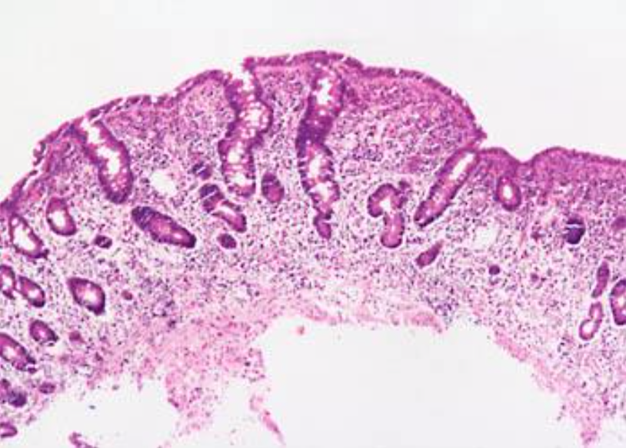
Malabsorption and Diarrhea
Scenario 1
A 44-year-old white male presented with a seven-month history of diarrhea. The frequency of his bowel movements had increased to 5-7 per day, and his stools were yellow and floated at the top of the water in the toilet. He had occasional abdominal cramping, but no tenesmus, melena, or bleeding. His appetite was good, but he had experienced gradual weight loss. His bowel movement frequency would decrease upon fasting and would increase with food intake.
Stool tests revealed a stool output of 4128 g/d (nl 100-200 g/d) with fat excretion of 17 g/d (nl <5 g/d).
Microscopic examination for ova and parasites and cultures for bacterial pathogens and acid-fast bacilli were negative.
Blood testing showed mild anemia , hypoproteinemia (4.9 mg/dL), and hypoalbuminemia (3.4 mg/dL).
Duodenal biopsy:
1- Exposure to what dietary antigen is thought to be the cause of these
changes?
Exposure to gluten (specifically, the gliadin constituent of this protein)
2- What food components contain this antigen?
Wheat, barley, flour, and possibly oats contain gluten.
3- Would these histologic changes resolve with dietary modification?
Yes
Scenario 2
A 44 year-old man is admitted to the hospital with an acute upper GI bleeding due to several gastric and duodenal ulcers seen on an urgent upper endoscopy. One of the duodenal ulcers is in the 3rd portion of the duodenum. The patient also complains of a 1 year history of frequent non-bloody diarrhea. A fecal osmotic gap is very low.
1- What type of diarrhea does his patient have?
Secretory
2- What is the most likely cause?
Zollinger-Ellison syndrome due to gastrinoma.
3- What is the mechanism to explain the diarrhea?
1- Acid inactivation of pancreatic enzymes and bile salts
2- Excess intestinal fluid
4- What blood test can you check to make the diagnosis?
Gastrin level

Slide 8
Scenario 3
A 6-year-old boy has been brought to outpatients by his mother because he has abdominal pain after some meals. This has been getting increasingly frequent and it sounds, from his description, somewhat colicky in nature. You discover that he has always had very smelly, loose, pale bulky stools, which his parents have put down to the fact that he likes milk. On examination, he is pale, underweight, and of short stature.
1- What are the important differential diagnoses on presentation?
Celiac disease is the most likely diagnosis. Parasitic infection (e.g. giardiasis) and pancreatic insufficiency (e.g. due to chronic pancreatitis or cystic fibrosis) may give rise to a similar presentation, but these are not supported by the results of the investigations.
2- Blood tests reveal a mild macrocytic anemia. There is a low level of vitamin B12, and folate is at the lower end of normal. Autoantibody screens reveal a positive reaction to antigliadin antibodies. Do these tests help to narrow down the diagnosis?
These results are very suggestive of celiac disease due to the low levels of vitamin B12 and the hypersensitivity reaction to α-gliadin, a component of gluten. The finding of villous atrophy would support the diagnosis, and this is achieved by endoscopic biopsy of the first part of the duodenum.
3- What treatment options are available?
Treatment is by adhering to a strict gluten-free diet.
The final diagnosis is celiac disease, provided the patient’s symptoms respond to a gluten- free diet and the histological changes relapse on re-challenge. Such criteria are necessary before confining a patient to a lifelong gluten- free diet.
A 10-month-old, previously healthy male infant develops a severe, watery diarrhea 2 days after visiting the pediatrician for a routine checkup. The most likely diagnosis is:
Rotavirus infection
Enterotoxigenic E. coli infection
Entamoeba histolytica infection
Lactase deficiency
Ulcerative colitis
MCQ

Slide 9
Inflammatory bowel disease
Scenario 1
A 25-year-old man experiences the gradual onset of intermittent diarrhea, which over years, progresses to severe diarrhea, alternating with constipation, rectal bleeding, and passage of mucus.
On physical examination, the abdomen is tender over the colon.
Stool examination fails to reveal no parasites or bacteria
Colonoscopy demonstrates inflammation limited to the rec
Biopsy showed: Active chronic colitis.
Colonoscopy demonstrates inflammation limited to the rec
Biopsy showed: Active chronic colitis.
1- what histological feature is seen in crohn’s disease and not in ulcerative colitis?
Granuloma and transmural inflammation in resected specimen
2- what are the complications of Ulcerative colitis?
Carcinoma is the most serious, it is preceded by dysplasia
Severe diarrhea
Electrolyte disturbance
Toxic megacolon cause for functional obstruction
Potential for peritonitis and perforation
Massive hemorrhage
MCQ
A 25-year-old man presents to a rheumatologist with complaints of joint pain involving the large joints of the legs. On questioning, the patient indicates that exacerbations in the joint pain are frequently accompanied by diarrhea. Which of the following gastrointestinal diseases is most likely to be implicated as the cause of the patient's joint problems?
Amebic colitis
Chronic appendicitis
Diverticulosis
Pseudomembranous colitis
Ulcerative colitis

Slide 10
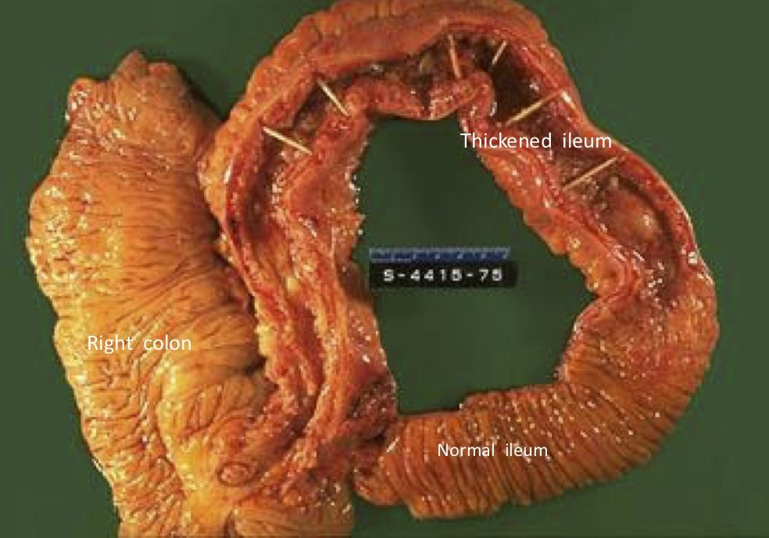
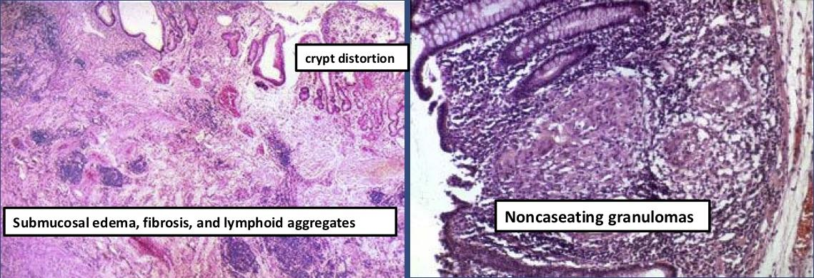
MCQ
A patient has had years of intermittent diarrhea and abdominal pain, but has never consulted a physician. Eventually, he begins to pass fecal material in his urine and he seeks medical attention. Which of the following diseases is most likely to cause this complication?
Celiac disease
Crohn's disease
Diverticulitis
Ulcerative colitis
Whipple's disease
Senario 2
35 y/o male, known case of inflammatory bowel disease, presented in ER with severe colicky abdominal pain. Barium enema study show features of intestinal obstruction
He was taken to OR, and Excision of terminal ileum and proximal colon was performed.
The specimen is a section of normal ileum, thickened ileum, and right colon.
The intestinal wall is thick, the result of
edema,
inflammation
fibrosis
hypertrophy of the muscularis propria.
Linear ulcers are typically present in the diseased segment of bowel. In diseased bowel segments, the serosa is thickened and fibrotic, and often the mesenteric fat wraps around the bowel surface (creeping fat)
What are the complications of Crohn disease?
Fissures in the mucosa can extend through the wall and form sinus tracts, resulting in fistula formation to other loops of bowel, urinary bladder or vagina; there may be localized peritonitis and abdominal abscesses;
Fibrosis of the gut wall may lead to strictures and obstruction.
Extensive involvement of the small bowel may cause marked loss of albumin (protein-losing enteropathy) or malabsorption.

Slide 11
Senario 2
A 39-year-old male presents with bloody diarrhea. Multiple stool examinations fail to reveal any ova or parasites. A colonoscopy reveals the rectum and sigmoid portions of the colon to be unremarkable. A biopsy from the terminal ileum reveals numerous acute and chronic inflammatory cells within the lamina propria. Worsening of the patient’s symptoms results in emergency resection of the distal small intestines. Gross examination of this resected bowel reveals deep, long mucosal fissures extending deep into the muscle wall. Several transmural fistulas are also found. What is the best diagnosis for this patient?
a. Ulcerative colitis
b. Lymphocytic colitis
c. Infectious colitis
d. Eosinophilic colitis
e. Crohn’s disease
A 22-year-old woman has had recurrent episodes of diarrhea, crampy abdominal pain, and slight fever over the last 2 years. Other symptoms have included mild joint pain and sometimes red skin lesions. On at least one occasion, her stool has been iron-positive, indicating the presence of occult blood. Colonoscopy reveals several sharply delineated areas with thickening of the bowel wall and mucosal ulceration. Areas adjacent to these lesions appear normal. Biopsies of the affected areas show full- thickness inflammation of the bowel wall and several noncaseating granulomas.
What is the most likely diagnosis?
Crohn’s disease
What are the common complications of this disease?
Malabsorption & malnutrition
Fibrous stricture within intestine
Fistula to other organs (bowel to skin, bowel to bladder)

Slide 12
Colonic Polyps and tumors
A 68-year-old woman presents with intermittent constipation, weight loss, and a swollen abdomen. She has had two previous polypectomies: one showed a tubular adenoma and the other was a tubulovillous adenoma. Double-contrast barium enema shows an irregular stricture 4 cm long in the ascending colon. A tumor is diagnosed and surgery is advised. The tumor is resected and is found to have invaded through the thickness of the bowel wall, but is completely excised. Three of 15 lymph nodes identified contained metastatic tumor.
What is the most likely diagnosis with this presentation?
The most likely diagnosis is colorectal adenocarcinoma
What stage is this tumor and what is the prognosis?
This is a Dukes’ C carcinoma (T3, N1, MX)
What is the association between adenoma and carcinoma?
there is much evidence to suggest that most carcinomas of the colon arise in pre-existing adenomas (adenoma → carcinoma sequence). Patients with familial adenomatous polyposis (FAP) have a very high risk of developing colorectal carcinomas.
Where is the metastatic spread most likely?
Colorectal carcinomas metastasize mainly to regional lymph nodes and liver, less commonly developing other systemic metastases such as brain, bone and lung.
52 y/o female presented with fatigue and weakness. She experienced 6 kg wt loss in a 6 six months
CBC:
Hg: 7.5 g/dl
Hematocrit: 26%
Serum ferritin: 8 ng/dl
Iron deficiency anemia
Treatment: iron oral supplements
Stool analysis: blood in stool
Colonoscopy: 6cm mass in ascending colon
Biopsy: adenocarcinoma
A 26-year-old man presents with intermittent crampy abdominal pain, diarrhea without noticeable blood, and weight loss of 15 lb over 10 months. The bowel symptoms, including the diarrhea, wake him from sleep; he resumed smoking cigarettes a year ago. His older brother has had similar symptoms but has not yet been evaluated. Stool leukocytes are present. Results of examination with sigmoidoscopy are normal.
A. Irritable bowel syndrome
B. Acute appendicitis
C. Crohn disease
D. Ulcerative colitis
E. Colon cancer

Slide 13
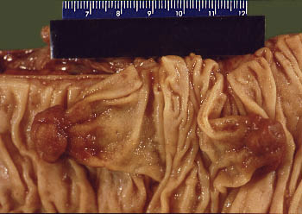
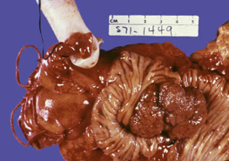
Females slides
Based on the biopsy, Did this patient have familial polyposis syndrome?
No. there are two isolated polyps.
Patients with familial adenomatous polyposis syndrome have at least 100 polyps, and usually many more polyps, carpeting their colonic mucosa.
Colon; pedunculated adenomatous polyp
Can isolated polyps like the ones illustrated develop into colonic ca?
Yes. Although all polyps do not progress to carcinoma, it is thought that most colonic carcinomas start as polyps.
Are all polyps neoplastic?
No. Polyps can result from focal hyperplasia of the mucosa.
Hyperplastic polyps do not have malignant potential.
What variables determine the likelihood of malignant change in a polyp?
Three interrelated features determine the risk of cancerous transformation: polyp size, histologic architecture, and severity of dysplasia.
(1) Cancer is rare in tubular adenomas less than 1 cm in diameter.
(2) The likelihood of cancer is high (about 50%) in sessile villous adenomas that are greater than 4 cm in diameter.
(3) Severe dysplasia is likely to progress to cancer. Such dysplasias are found in villous areas.
What types of mutations are likely to be present in such a lesion?
There is progressive accumulation of mutations during the conversion of adenomas to carcinomas. In this scheme, mutations of the APC gene (resulting in homozygous loss of this tumor suppressor gene) are believed to occur first. (Patients with familial adenomatous polyposis syndrome are born with loss of one copy of the APC gene in all somatic cells.) As the adenomas enlarge, mutations in the RAS proto-oncogene and LOH 18q (Smad4) tumor suppressor genes occur. Eventually, mutations of TP53 and several other genes are superimposed.
In this large sessile villous adenoma,
it is likely that the APC, LOH 18q, and RAS genes have been affected.

Slide 14
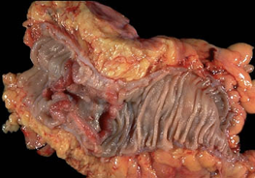
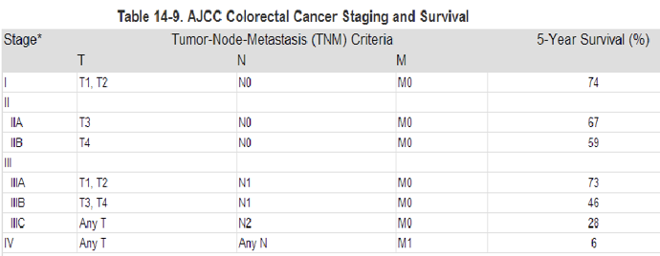
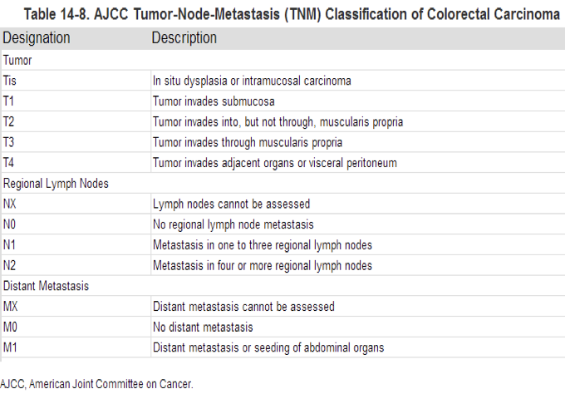
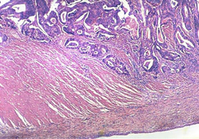
Females slides
This specimen from the left colon shows an annular, encircling, and constricting cancer. The margins of the cancer are heaped-up and firm, and the mid-region is ulcerated.
Left-sided colon cancers come to attention by producing occult bleeding and changes in bowel habits (i.e., constipation and cramping in the left lower quadrant).
Assuming this patient did not have lymph node metastasis, what stage is this carcinoma?
The TNM stage for the current case would be T3N0MX.
T3—extends through the muscularis propria
N0—no lymph node involvement
MX—extent of metastatic involvement unknown
TNM classification based on:
T—extent of invasion
N—number of lymph nodes involved
M—extent of metastatic involvement
The deeper tumor extends into the muscularis propria, and as lymph nodes become involved, the prognosis worsens.
What is the mode of spread of this cancer?
Colonic carcinomas spread by local extension to adjacent structures. The favored sites of metastases are regional lymph nodes, liver, lungs, and bones.

Slide 15
Other questions
 | Peptic ulcers |  |  | A or B
1 | H. pylori |  |  | A
2 | Phospholipid |  |  | B
3 | Drugs (NSAIDs) |  |  | A
4 | Mucus |  |  | B
5 | bicarbonate |  |  | B
6 | Blood flow |  |  | B
7 | Acid |  |  | A
8 | pepsin |  |  | A
9 | Bile salts |  |  | A
10 | cell renewal |  |  | B
11 | Prostaglandins |  |  | B
A- Aggressive Factors
B- Defensive Factors
 | Diarrhea |  |  | A or B
1 | Irritable bowel syndrome |  |  | B
2 | Giardia lamblia |  |  | B
3 | Viral gastroenteritis |  |  | A
4 | Inflammatory bowel disease |  |  | B
5 | Food poisoning |  |  | A
6 | Antibiotic-Associated Diarrhea |  |  | A
7 | Malabsorption |  |  | B
A- Acute diarrhea
B- Chronic diarrhea
 | Diarrhea |  |  | A,B,C or D
1 | Fasting improve the condition |  |  | B
2 | inflammatory bowel diseases |  |  | C
3 | High stool output |  |  | A
4 | Presence of WBC in stool |  |  | C
5 | Irritable bowel syndrome |  |  | D
6 | bacterial toxin |  |  | A
7 | Malabsorption |  |  | B
8 | High fecal osmotic gap |  |  | B
A- Secretory diarrhea
B- Osmotic diarrhea
C- Exudative (inflammatory) diarrhea
D- Motility-related diarrhea

Slide 16
Other questions
 | Malignant small intestine neoplasms |  |  | A or B
1 | Colon only |  |  | B
2 | Diffuse involvement of mucosa |  |  | B
3 | Superficial ulcers |  |  | B
4 | Skip areas of normal mucosa |  |  | A
5 | Any part of the GIT |  |  | A
6 | Mucosal inflammation only |  |  | B
7 | Fistula formation |  |  | A
8 | Transmural inflammation |  |  | A
9 | Granuloma |  |  | A
10 | Deep ulcers (fissure) |  |  | A
11 | Dysplasia is common |  |  | B
12 | Carcinoma is more common |  |  | B
A- crohn’s disease
B- Ulcerative colitis
 | Malignant small intestine neoplasms |  |  | A or B
1 | Crypt abscess |  |  | C
2 | Smooth muscle in lamina propria |  |  | B
3 | Star-shaped crypts |  |  | A
4 | Peutz-Jeghers disease |  |  | B
5 | Turcot syndrome |  |  | D
6 | Dysplasia |  |  | D
7 | Juvenile polyp |  |  | B
8 | Mucocutaneous pigmentation |  |  | B
9 | Neoplastic polyp |  |  | D
10 | Deep ulcers (fissure) |  |  | D
11 | K RAS mutation |  |  | D
12 | Developmental malformation |  |  | B
13 | Retention cysts |  |  | B
A- Hyperplastic polyps
B- Hamartomatous polyps
C-Inflammatory polyps
D- Adenomatous polyps

