Slide 1
Cancer of the liver
and pancreas
Describe hepatocellular and cholangiocarcinoma.
Understand the frequency of metastatic disease to the liver.
Recognize the rarity of primary liver neoplasms in children.
Recognize all aspects of pancreatic carcinoma.
Editing File

Slide 2
Hepatocellular Carcinomas
Introduction
Metastatic tumors are more common in liver then primary carcinomas.
Primary carcinomas commonly arise from:
Hepatocytes → hepatocellular carcinoma.
Bile duct → Cholangiocarcinomas.
Other rare forms: hepatoblastomas and angiosarcomas.
Epidemiology
Male predominance.
Chronic HBV infection:
> 85% of the cases, vertical transmission from mother to infant (carrier stage), increase risk of HCC 200 folds.
Cirrhosis:
85% to 90% of cases of HCC. In the Western¹ world where HBV is not prevalent, in the setting of other chronic liver diseases.
Pathogenesis (hepatocarcinogenesis)
Chronic Viral infection
Cirrhosis
Chronic Alcoholism
Worldwide
HBV
HCV²
Important but not requisite
In the US
Food contaminants
Metabolic syndrome
Other conditions
High exposure to aflatoxins:
- Highly carcinogenic toxins.
- From: Aspergillus flavus
- Found in: moldy grains and peanuts³.
Obesity
Diabetes mellitus
Nonalcoholic fatty liver disease (NAFLD)
Tyrosinemia⁴
Hereditary hemochromatosis⁵
Aflatoxins combined with HBV infection increases the risk for HCC dramatically.
1- Due to alcoholism.
2- More severe if co-infection with HBV.
3-If a hepatitis patient eats it, the risk increases.
4- Hereditary tyrosinemia type I is an autosomal recessive error of tyrosine catabolism caused by a deficiency of the enzyme fumarylacetoacetase an enzyme expressed primarily in the liver and kidneys this lead to accumulation of Fumarylacetoacetate a pathogenic and mutagenic metabolite that reduces intracellular levels of glutathione.
5- Hemochromatosis is caused by mutation in HME gene that lowers hepcidin levels or diminish its functions causing excessive absorption of iron.

Slide 3
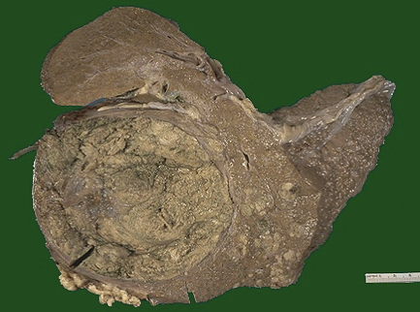
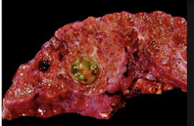
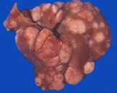
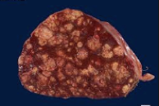
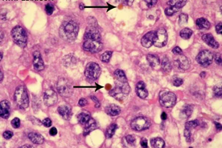
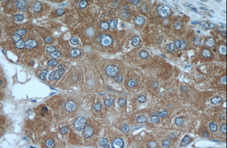
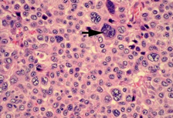
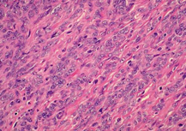
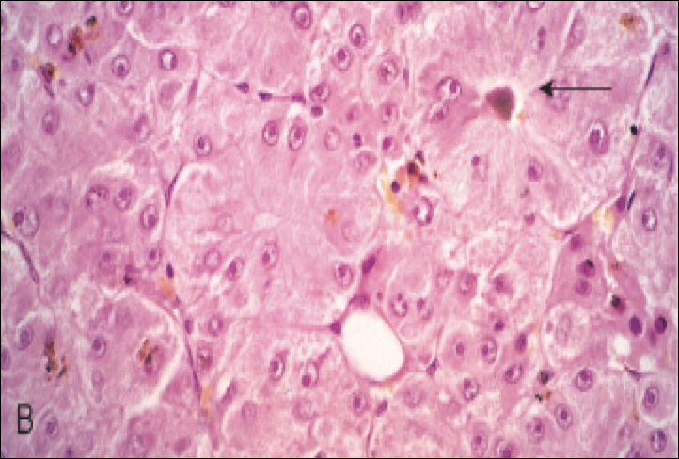
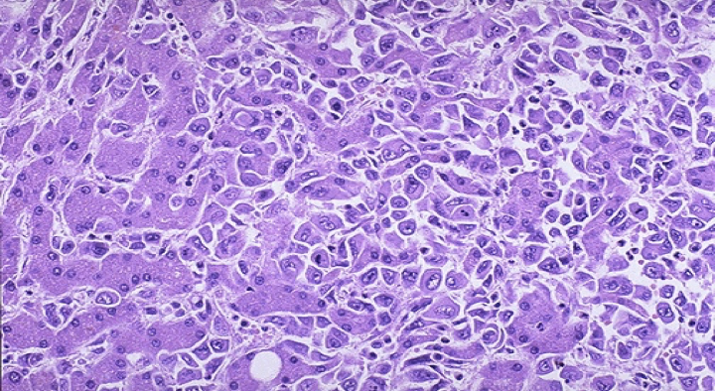
Hepatocellular Carcinomas
Morphology
Gross
Large and bulky.
Greenish cast contains bile.
Small satellite nodules.
Appears: (A) Unifocal, (B) multifocal or (C) diffusely infiltrative.
Theses patterns may cause: liver enlargement or invasion of vascular channels.
A
B
C
Microscopic
well-differentiated & moderately differentiated | Poorly differentiated
Cells recognizable as hepatocytic in origin. Presence of bile pigment. May be +ve for alpha-fetus¹. | Pleomorphic. Numerous anaplastic giant cells. Small & completely undifferentiated.
Bile pigment
alpha-fetoprotein
Metastases
Extensive intrahepatic metastases.
Invasion of the portal vein and circulation → inferior vena cava → right side of the heart.
Lymph node:
Perihilar.
Peripancreatic.
Para aortic above and below diaphragm.
HCC: hepatic pseudo acinar structures formation (arrow)
1- Naturally synthesized in embryo’s liver, but abnormal to find in adult.
Righ: well differentiated malignant HCC cells.
Left: normal hepatocytes.

Slide 4
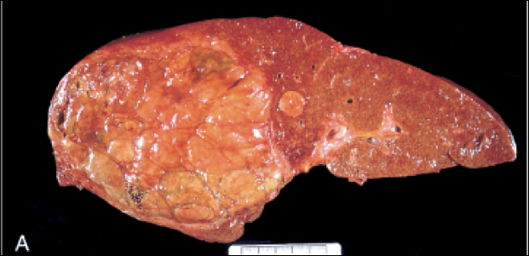
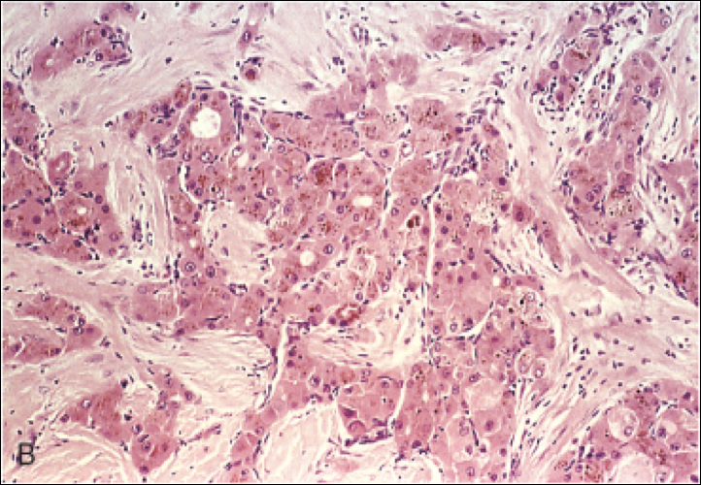
Fibrolamellar Carcinoma
Introduction
A distinctive variant of hepatocellular carcinoma.
In young male & female adults (20-40 years).
No association with HBV or cirrhosis.
Better prognosis.
Morphology
Gross:
Single and large.
Hard “scirrhous”.
Fibrous bands coursing through.
Microscopic:
Well-differentiated polygonal cells in nests or cords.
Separated by parallel lamellae of dense collagen bundles.
Clinical features
Palpable enlarged liver.
Uncommon: Fever and jaundice.
Laboratory findings
Elevated levels of serum α-fetoprotein in 50% to 75% of patients with HCC.
Death usually occurs from
Ill-defined upper
abdominal pain
Malaise
Fatigue
Feeling of
abdominal fullness
Weight loss
1
Cachexia
3
Liver failure with hepatic coma¹.
2
Gastrointestinal bleeding or esophageal variceal bleeding.
4
Rupture of the tumor with fatal hemorrhage.
1- As a complication of hepatic encephalopathy (brain damage due to buildup of of toxins in the blood which resulted from inadequate removal of toxins by liver damage).

Slide 5
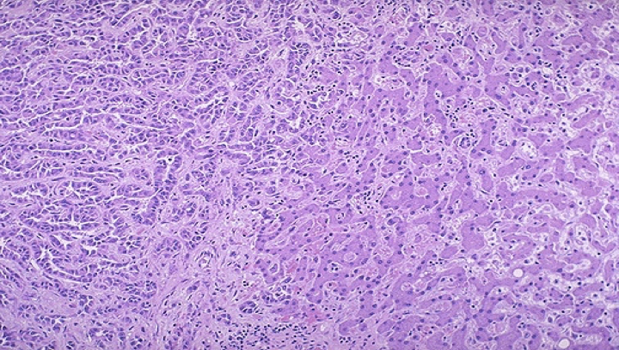
Cholangiocarcinoma
Introduction
It is a malignancy of the biliary tree, arising from bile ducts within and
outside of the liver.
Second most common primary malignant tumor of the liver.
Occurs in non cirrhotic livers.
Risk factors
Primary sclerosing cholangitis.
Congenital fibropolycystic diseases of the biliary system:
Caroli disease
Choledochal cysts
Previous exposure to Thorotrast (formerly used in the radiography of the biliary tract).
In the orient due to chronic infection of the biliary tract by the liver
fluke¹ Opisthorchis sinensis.
Morphology
Clinical features
Macroscopic | Intrahepatic cholangiocarcinoma. A treelike tumours mass within the liver or a massive tumor nodule. Lymphatic and vascular invasion are common.
Microscopic | Well to moderately differentiated. Growing as glandular/tubular structures: Lined by malignant epithelial cells. Surrounded by desmoplasia of the stroma. Mucin producing adenocarcinomas. Rarely bile stained, because differentiated bile duct epithelium does not synthesize bile. Mixed elements of both hepatocellular carcinoma and cholangiocarcinoma are present.
Detected late in its course as a result of obstruction to bile flow or a symptomatic liver mass.
Hematogenous Metastases: Lung, bones (mainly vertebrae), adrenals, brain.
Or Regional lymph node.
Aggressive surgery is the only choice for long-term survival due to poor prognosis.
Alpha-fetoprotein
Is not elevated.
1-Parasitic trematodes

Slide 6
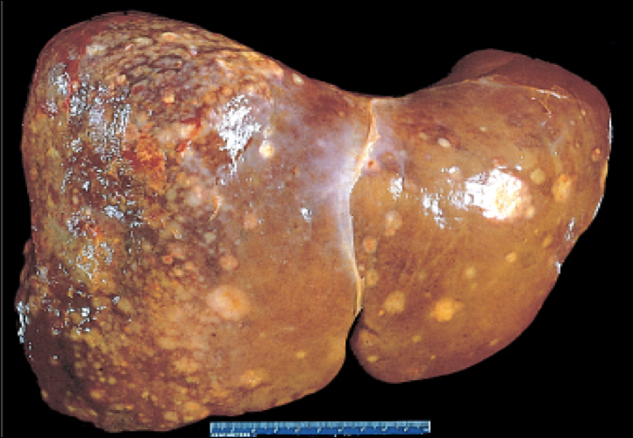
Metastatic tumors
More common than primary neoplasia.
Any cancer in any site may spread to the liver (including leukemias and lymphomas), but the most common types are: breast, lung and colon.
Morphology
Multiple nodular metastases that may replace 80% of hepatic parenchyma causing hepatomegaly (The liver weight increases).
Mass lesions variable in size, larger ones demonstrate central necrosis.
Angiosarcoma
Cirrhosis is present in 20% to 40% of cases.
Risk factor: vinyl chloride¹ and thorotrast² exposure.
Morphology
Pleomorphic endothelial cells with large hyperchromatic nuclei.
Giant cells in frequent mitosis and irregular anastomosing vascular channels.
Spindle shaped cells.
Hepatocellular Adenoma
Benign neoplasms developing from hepatocytes.
Risk Factors | Clinical Features | Microscopy
Sex hormone exposure (ex: oral contraceptives, anabolic steroids) | Detected as: hepatic mass on abdominal imaging or when they cause symptoms. Symptoms: Pain Rupture causing life threatening intra abdominal bleeding. | Normal hepatocytes and absence of portal tracts.
1- Substance used in plastic factories.
2- Radiocontrast agent ( no longer used).

Slide 7
Pancreatic Carcinoma
Introduction
It is carcinoma of the exocrine pancreas arises from ductal epithelial cells.
60% arise in the head of the gland.
15% in the body.
5% in the tail.
20% diffusely involves the entire gland.
Diagnosed at an advanced stage, accounting for the high mortality rate².
Epidemiology
It occurs in the 6th to 8th decade.
Blacks > whites.
Males > females.
Diabetics > non diabetics.
Risk Factors
Smoking doubles the risk.
Long standing chronic pancreatitis and diabetes mellitus.
Germ line mutations of the familial breast/ovarian cancer gene BRCA2 seen in 10% of cases arising in individuals of Ashkenazi origin¹,
Pathogenesis
Pancreatic cancer arises as a consequence of inherited and acquired mutations in cancer associated genes.
Four genes are most commonly affected by somatic mutations:
KRAS, CDKN2A/p16, SMAD4, and TP53
Robbins:
Progression model for the development of pancreatic cancer. It is postulated that telomere shortening and mutations of the KRAS oncogene occur at early stages, inactivation of the p16 tumor suppressor gene occurs at intermediate stages, and inactivation of the TP53, SMAD4, and BRCA2 tumor suppressor genes occurs at late stages. Note that while there is a general temporal sequence of changes, the accumulation of multiple mutations is more important than their occurrence in a specific order. PanIN, Pancreatic intraepithelial neoplasm. The numbers following the labels on the top refer to stages in the development of PanINs.
1- Because of familial marriage.
2- Tumor marker CK19.9

Slide 8
Pancreatic Carcinoma
Morphology
Macroscopic
Majority are ductal carcinoma.
Hard.
Stallete.
Gray-white.
Poorly defined masses.
Microscopic
Highly invasive.
Elicits an intense non-neoplastic host reaction
called a "desmoplastic response".
Metastasis
Lymph nodes
Distant
Peripancreatic.
Gastric.
Mesenteric.
Omental.
Portahepatic.
Lungs.
Bones.
Less common variants of pancreatic cancer include:
Acinar cell carcinomas.
Adenosquamous carcinomas.
Undifferentiated carcinomas with osteoclast-like giant cells.
Clinical Features
Jaundice.
Weight loss.
Pain.
Massive metastasis to the liver.
Migratory thrombophlebitis.

Slide 9
Summary
Hepatocellular carcinoma
Pathogenesis
Metastases
Clinical feautures
HBV
Viral infection
Intrahepatic
Ill-defined upper
abdominal pain
HCV
Cirrhosis
Lymph node
Less common
Weight loss
Chronic alcoholism
Vascular Invasion
Malaise
Metabolic syndrome
Portal vein
Fatigue
Aflatoxins
Food contaminants
IVC
Fullness
Other conditions
Right side of heart
Elevated
α-fetoprotein
Tyrosinemia
Hemochromatosis
Morphology
Prognosis
Microscopic
HCC
Well-differentiated
Recognizable as hepatocytic
bile pigment.
Poorly differentiated
Pleomorphic.
anaplastic giant cells.
Small completely undifferentiated.
Fibrolamellar Carcinoma
Well-differentiated
Polygonal.
Nests or cords.
parallel lamellae of dense collagen bundles.
Gross
HCC
Large.
Bulky.
Greenish cast.
Small satellite noduLes
Microscopic
HCC
Death usually occurs from:
.Cachexia.
Bleeding.
Liver failure.
Rupture.
Fibrolamellar Carcinoma
Better prognosis .
It may be:
1) Unifocal
2) Multifocal
3) Diffusely infiltrative
Fibrolamellar Carcinoma
Single.
Large.
Hard “scirrhous”.
Fibrous bands

Slide 10
Summary
Cholangiocarcinoma
Location | It is a malignancy of the biliary tree, arising from bile ducts within and outside of the liver.
Risk Factors | Primary sclerosing cholangitis Congenital fibropolycystic diseases of the biliary system Chronic infection of biliary tract by the liver fluke Opisthorchis sinensis.
Clinical Features | Alpha-fetoprotein is not elevated.
Metastatic Tumors | More common than primary Neoplasia most common sites are Breast, lung and colon.
Angiosarcoma | Pleomorphic endothelial cells. Risk Factor: Vinyl chloride and thorotrast exposure. .
Hepatocellular adenoma | Benign neoplasms developing from hepatocytes. Risk Factor: Sex hormone exposure.
Pancreatic carcinoma
Location | affects exocrine part and arises from ductal epithelial cells, (Head most commonly)
Risk Factors | 1.Smoking 2.Diabetes 3.Mutation in BRCA2
Pathogenesis | inherited and acquired mutations in cancer associated genes. KRAS CDKN2A/P16 SMAD4 TP53
Clinical Features | 1.Metastases to the liver 2.Jaundice 3. Migratory thrombophlebitis

Slide 11
Quiz
Q1: Which of the following carcinomas is positive for alpha-fetoprotein?
Cholangiocarcinoma
Hepatocellular carcinoma
Pancreatic carcinoma
Angiosarcoma
Q2: Which of the following risk factors is associated with Hepatocellular Adenoma?
Thorotrast exposure
BRCA2 gene mutation
Sex hormone exposure
Diabetes
Q3: One of the most common sites of metastatic tumor:
Colon​​
Brain
Pancreas
Bone
Q4: Fibrous Bands and dense collagenous bundles is present in:
Cholangiocarcinoma
Pancreatic carcinoma
Esophageal carcinoma
Fibrolamellar carcinoma
Q5: Which of the following is not from the morphology of angiosarcomas?
Pleomorphic endothelial cells
Dense collagen bundles
Spindle shaped cells
Giant cells
Q6: Which of the following carcinomas has a scirrhous gross morphology?
Intrahepatic cholangiocarcinoma
Pancreatic carcinoma
Hepatoblastoma
Fibrolamellar carcinoma
Q7: What is a characteristic feature of pancreatic carcinomas?
Elevated levels of alpha-fetoprotein
Desmoplastic response
Tree-like tumor mass
Dense collagen bundles
Q8: What carcinoma has the highest mortality rate?
Fibrolamellar carcinoma
Cholangiocarcinoma
Pancreatic carcinoma
Esophageal carcinoma
Q9: Which of the following genes is not from the four commonly mutated genes in pancreatic carcinomas?
P21
TP53
SMAD4
KRAS
Q1: B
Q2: C
Q3: A
Q4: D
Q5: B
Q6: D
Q7: B
Q8: C
Q9: A

