Slide 1
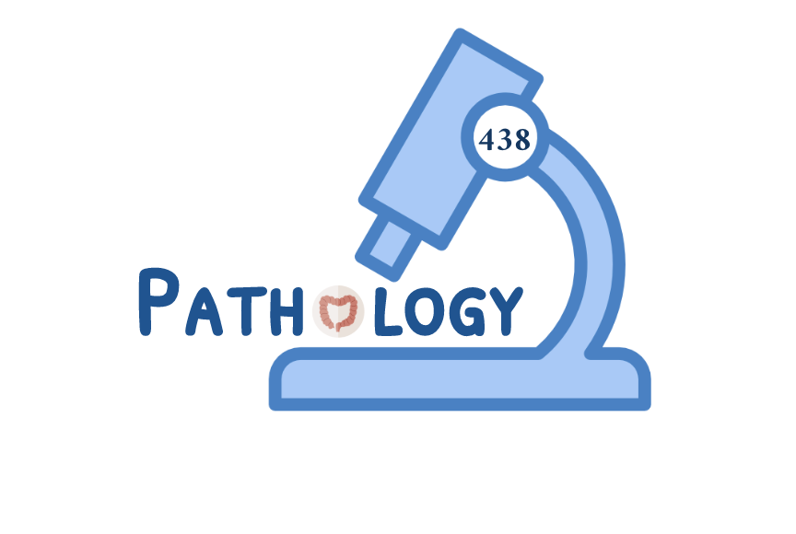
Gallstones and Cholecystitis
 Recognize the predisposing factors of gallstones and cholecystitis.
 Describe the different types of cholecystitis.
 Understand the pathogenesis of acute and chronic cholecystitis.
Editing File

Slide 2
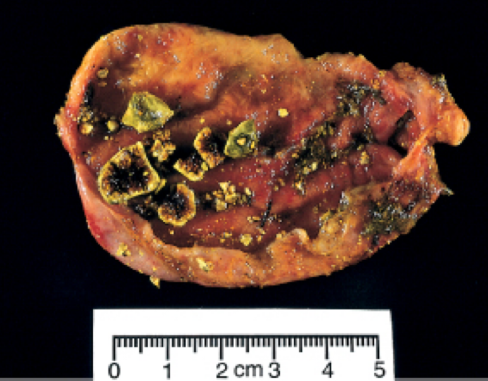
Cholelithiasis (Gallstones)
More than 80% are silent and free of biliary pain or stone complications.
Types
Cholesterol Stones
80% of cases of cholesterol stones. (most common)
Stones contains more than 50% of crystalline cholesterol monohydrate.
Risk factors
Advancing age. Obesity and insulin resistance. Hypocholesterolemic agents. Rapid weight loss. Gallbladder stasis e.g spinal cord injury. Hereditary: Inborn disorders of bile salt metabolism(synthesis and secretion). Dyslipidemia syndrome. | Female Gender: Estrogens increase hepatic cholesterol uptake and synthesis. Oral contraceptive. Pregnancy Demography: Northern Europe, North and South America, Native Americans, Mexican Americans.
Pathogenesis
Cholesterol is soluble in bile by aggregation with water soluble bile salts and water-insoluble lecithins, both of which act as detergents.
When cholesterol concentrations exceed the solubilizing capacity of bile (supersaturation), cholesterol can no longer remain dispersed and nucleates into solid cholesterol monohydrate crystals.
Cholesterol gallstone formation involves three simultaneous defects:
1
Supersaturation of bile with cholesterol
2
Gallbladder
hypomotility
3
Mucus hypersecretion
in the gallbladder
The result of hepatocellular hypersecretion of cholesterol
It promotes nucleation typically
around a calcium salt crystal nidus.
This traps the crystals, permitting
their aggregation into stones.
Morphology
Arise exclusively in the gallbladder.
Composed of cholesterol ranging from 100% pure (which is rare) down to around 50%
Pale yellow, round to ovoid to faceted, and have a finely granular, hard external surface.
Stones composed largely of cholesterol are radiolucent; only 10% to 20% of cholesterol stones are radiopaque.
Cholesterolosis: Yellow flecks.

Slide 3
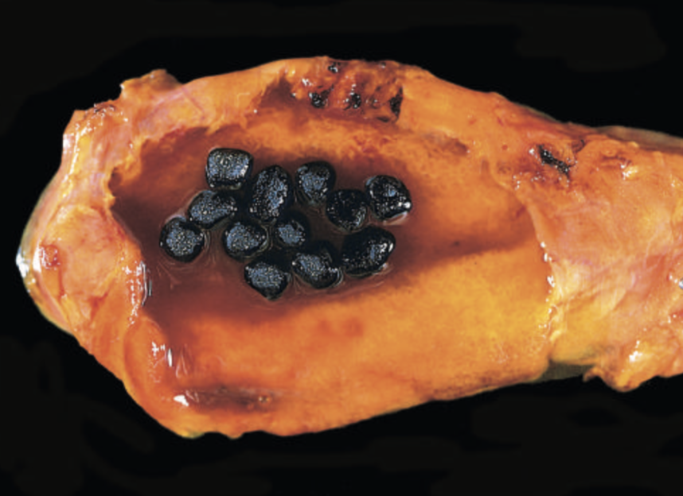
Cholelithiasis (Gallstones)
Pigment Stones
Composed predominantly of bilirubin calcium salts.
Risk factors
Demography: Asian more than western, rural more than urban. Gastrointestinal disorders: ileal disease e.g: crohn disease, ileal resection or bypass, cystic fibrosis with pancreatic insufficiency. | Chronic hemolysis promote formation of unconjugated bilirubin in the biliary tree. Sickle cell anemia. Hereditary spherocytosis. Biliary infection: Escherichia coli Ascaris lumbricoides liver fluke Opisthorchis sinensis
Pathogenesis
Based on the presence of unconjugated bilirubin (poorly water soluble) and precipitation of calcium bilirubin salts in the biliary tract.
Morphology
Black::
Found in sterile bladder.
50% to 75% of black stones are radiopaque, Because of
calcium carbonates and phosphates.
Brown:
Found in infected intrahepatic or extrahepatic bile ducts.
Greasy.
Both are soft and usually multiple.
Cholesterolosis: In cholesterol and pigment stones.
Cholesterol hypersecretion by the liver promotes excessive accumulation of cholesterol esters within the lamina propria of the gallbladder.
The mucosal surface is studded with minute yellow flecks, producing the "strawberry gallbladder”

Slide 4
Cholelithiasis (Gallstones)
Clinical features of gallstones
70% to 80% asymptomatic.
Symptoms:
Spasmodic or "colicky" right upper quadrant pain, which tends to be excruciating.
Due to obstruction of bile ducts by passing stones.
Complications of gallstones
Empyema
Perforation
Fistula
Inflammation of the biliary tree (cholangitis)
Pancreatitis
Obstructive cholestasis:
The very small stones, or "gravel”, are the more dangerous and enter the cystic or common ducts to produce obstruction.
Occasionally, a large stone may erode directly into an adjacent loop of small bowel, generating intestinal obstruction (gallstone ileus).
Gallbladder carcinoma:
The most important risk factor is gallstones (cholelithiasis), which are present in 95% of cases.

Slide 5
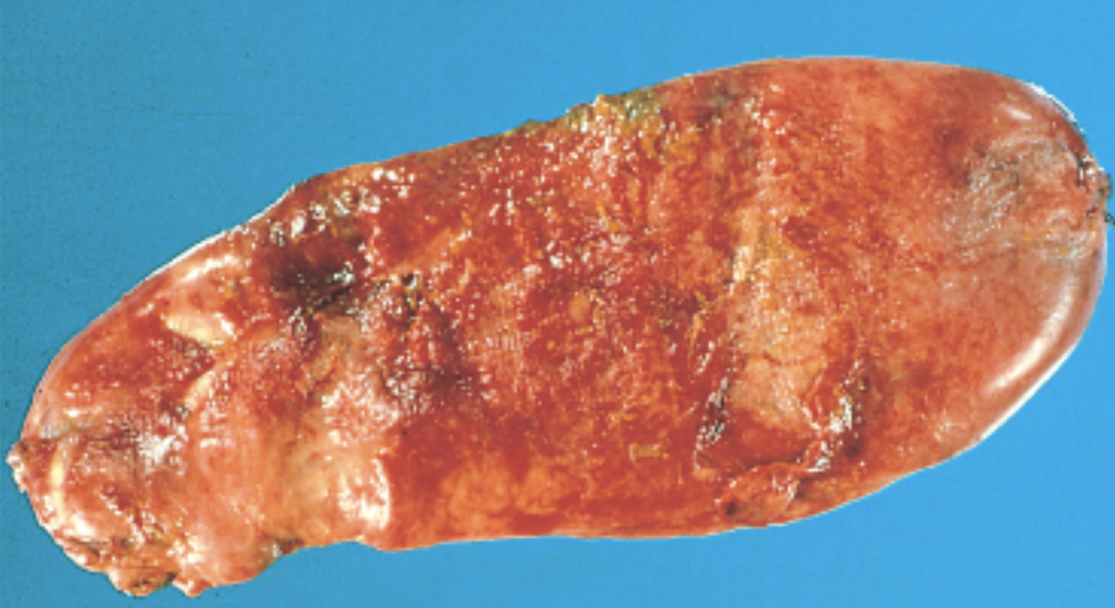
Acute Cholecystitis
Inflammation of the gallbladder may be acute, chronic, or acute superimposed on chronic. It almost always occurs in association with gallstones.
Type | Acute calculous Cholecystitis | Acute acalculous Cholecystitis
Definition | Acute inflammation of the gallbladder caused by obstruction of the neck or cystic duct. | Acute inflammation of the gallbladder occurs in the absence of gallstones.
Pathogenesis | Chemical irritation and inflammation of the obstructed gallbladder in the absence of bacterial infection or may develop later. | Generally in severely ill patient: The postoperative state after major, non-biliary surgery. Severe trauma (motor vehicle accidents, war injuries). Severe burns. Multisystem organ failure. Sepsis. Prolonged intravenous hyperalimentation. The postpartum state.
Morphology | 1- Gallbladder is usually enlarged and tense, and bright red to green-black. 2- The serosal covering is frequently layered by fibrin and, in severe cases → exudate. 2- Cloudy or turbid bile that may contain fibrin, frank pus, and hemorrhage. 3- When the contained exudate is virtually pure pus, the condition is referred to as empyema of the gallbladder. 4- In mild cases → the gallbladder wall is thickened, edematous, and hyperemic. 5- In more severe cases → it is transformed into a green-black necrotic organ, termed gangrenous cholecystitis, with small to large perforations.
Clinical features | Progressive right upper quadrant or epigastric pain, frequently associated with mild fever, anorexia, tachycardia, sweating, and nausea and vomiting. The upper abdomen is tender. Most patients are free of jaundice
 | Remarkable sudden severe upper abdominal pain radiating to right shoulder. This constitute an acute surgical emergency May present with mild symptoms that resolve without medical intervention. | More insidious, since symptoms are obscured by the underlying conditions precipitating the attacks. A higher proportion of patients have no symptoms referable to the gallbladder. The incidence of gangrene and perforation is much higher than in calculous cholecystitis.

Slide 6
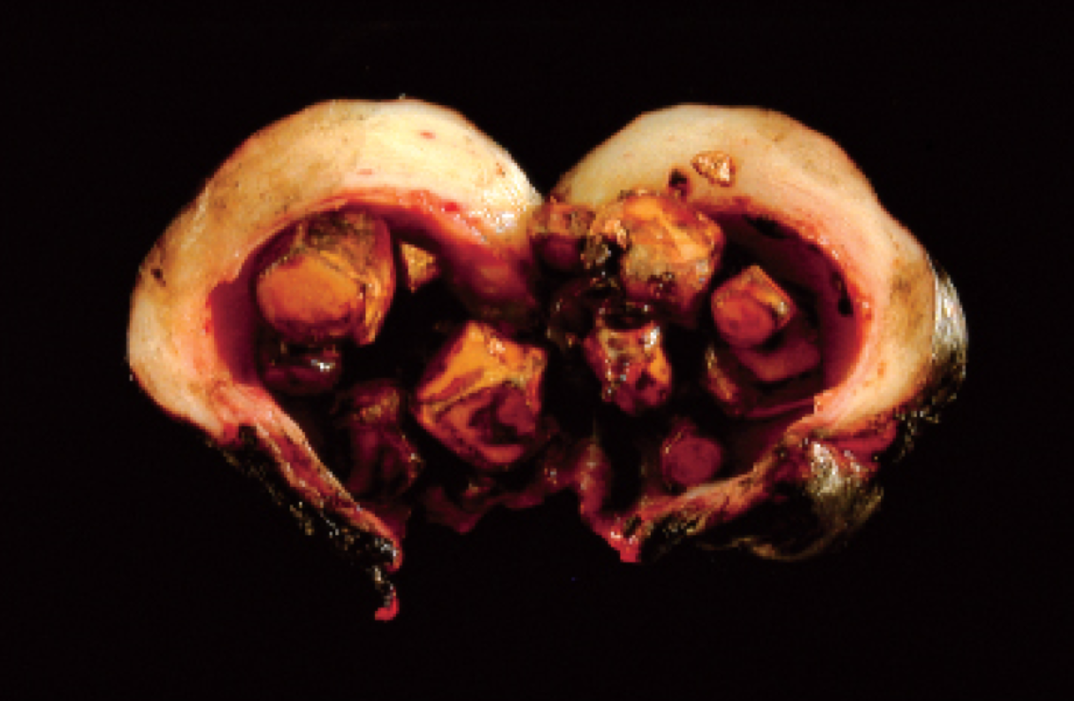
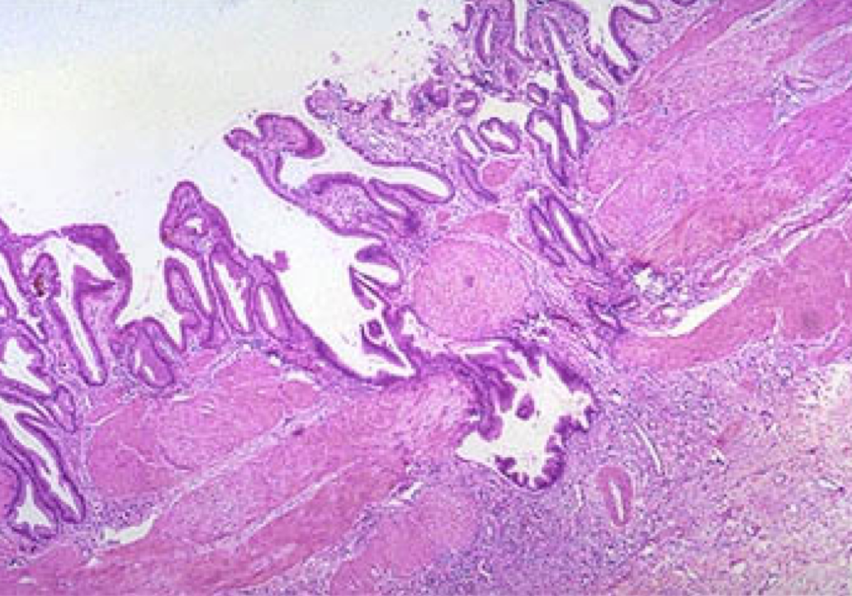
Chronic Cholecystitis
Chronic cholecystitis may be a sequel to repeated bouts of mild to severe acute cholecystitis, but in many instances, it develops in the apparent absence of antecedent attacks.
It is associated with cholelithiasis in over 90% of cases.
Clinical features
The symptoms are similar to the acute form and range from biliary colic to indolent right upper quadrant pain and epigastric distress.
Patients often have intolerance to fatty food, belching and postprandial epigastric distress, sometimes include nausea and vomiting.
Morphology
Macroscopic:
Gall bladder may be contracted (fibrosis) or normal in size,
or enlarged (from obstruction).
The wall is variably thickened. Stones are frequent.
Microscopic:
Variable degree of inflammation.
Rokitansky-Aschoff sinuses (arrow): Outpouchings of the mucosal
epithelium through the wall.
Extensive dystrophic calcification within the gallbladder wall may yield a porcelain gallbladder. (increased incidence of associated cancer).
Xanthogranulomatous cholecystitis: gallbladder is shrunken, nodular, fibrosed and chronically inflamed with abundant lipid filled macrophages..
Hydrops of the gallbladder an atrophic, chronically obstructed gallbladder may contain only clear secretions.
Complications of Cholecystitis
Bacterial superinfection with cholangitis or sepsis.
GB perforation & local abscess formation.
GB rupture with diffuse peritonitis.
Biliary enteric (cholecystoenteric) fistula with drainage of bile into adjacent organs, and potentially gallstone induced intestinal obstruction (ileus).
Aggravation of pre-existing medical illness, with cardiac, pulmonary, renal, or liver decompensation.

Slide 7
Summary
 | Cholesterol stones | Pigment stones
Risk factors | Age, Female,Obesity, Rapid weight reduction, Gallbladder stasis. | Chronic hemolytic syndromes, Biliary infection, Gastrointestinal disorders.
Pathogenesis | - Supersaturation of bile with cholesterol. - Gallbladder hypomotility. - Mucus hypersecretion in the gallbladder. | Based on: 1. The presence of unconjugated bilirubin. 2. Precipitation of calcium bilirubin salts such as infection of the biliary tract.
Morphology | Radiolucent | 50% to 75% of black stones are Radiopaque.
Cholesterolosis | Excessive accumulation of cholesterol esters within the lamina propria of the gallbladder “strawberry gallbladder”.
Clinical features | Mostly asymptomatic. Symptoms: Colicky right upper quadrant pain due to obstruction of bile ducts by passing stones.
Complications | Empyema - Perforation - Fistula -Inflammation of the biliary tree (cholangitis) - Pancreatitis - gallstone ileus.
Acute Cholecystitis | Chronic Cholecystitis
Acute calculous cholecystitis An acute inflammation of the gallbladder. Acute acalculous cholecystitis Occurs in the absence of gallstones. | Repeated bouts of mild to severe acute cholecystitis.
Morphology GB is usually enlarged and tense, and bright red to green-black. Cloudy or turbid bile that may contain fibrin and frank pus. GB wall is thickened, edematous, and hyperemic. | Morphology Fibrosis. Thickened wall. Stones are frequent.
Clinical features Right upper quadrant or epigastric pain. radiating to right shoulder. Mild fever, anorexia, tachycardia, sweating, and nausea and vomiting. | Clinical features Right upper quadrant pain and epigastric distress.
Complications Bacterial superinfection with cholangitis or sepsis. GB perforation & local abscess formation GB rupture with diffuse peritonitis Biliary enteric (cholecystenteric) fistula with drainage of bile into adjacent organs. Aggravation of pre-existing medical illness.

Slide 8
Quiz
Q1: 45-year-old, mildly obese woman presents with a 1-week history of upper abdominal pain, fever, shaking chills, and occasional vomiting. Physical examination shows severe right upper quadrant tenderness. Laboratory studies include serum bilirubin of 1.0 mg/dL, AST of 25 U/L, ALT of 35 U/L, alkaline phosphatase of 220 U/L (high), WBC of 14,000/µL, and amylase of 95 U/L (normal). An ultrasound examination of the abdomen reveals a normal appearing liver and bile duct and
thickening of the wall of the gallbladder. Which of the following is the most likely diagnosis?
Acute cholecystitis
Acute pancreatitis
Adenocarcinoma of the gallbladder
Primary biliary cirrhosis
Q2: One of the following is not a risk factor of cholesterol stone?
Dyslipidemia syndromes
Pregnancy
Smoking
Inborn disorders of bile acids
Q3: Female patient who known have sickle cell anemia come to the hospital with right upper pain and a black color stones was found. Which of the following is right?
The stones found in sterile gallbladder
The stones found in infected intrahepatic or extrahepatic bile ducts.
The stones are radiopaque.
A&C
Q4: Patient presents to the hospital with a long history of intolerance to fatty food, saying they get a sense of fullness specially after they eat butter. Histological findings include Rokitansky-Aschoff sinuses. What is most likely the diagnosis?
Acute cholecystitis
Acute pancreatitis
Adenocarcinoma of the gallbladder
Chronic cholecystitis
Q5: A strawberry gallbladder appearance is a feature of?
Acute calculous cholecystitis
Acute acalculous cholecystitis
Chronic Cholecystitis
Cholesterolosis
Q6: A woman presented to the hospital with cholesterol stones, which of the following could be the precipitating factor?
Chronic hemolytic syndromes
Biliary infection
Oral contraceptives
Ileal disease
Q7: Cholesterol gallstone formation involves which of the following?
Mucus hypersecretion in the gallbladder.
Unsaturation of bile with cholesterol.
Gallbladder hypermotility.
Presence of unconjugated bilirubin
1)A 2)C 3)D 4)D 5)D 6)C 7)A

Slide 9
TEAM LEADERS:
Khalid Alkhani & Lama Alzamil
SUBLEADERS:
Alwaleed Alsaleh & Alhanouf Alhaluli
THIS AMAZING WORK WAS DONE BY:
Noura Alturki
Nojoud Alali
Joud Abu dahesh
Taiba Alzaid
THANK YOU

