Slide 1
L1&2: Gastroesophageal Reflux Disease & Peptic Ulcer
Case scenario
objectives
Describe the definition, pathogenesis, clinical features, pathology (gross and microscopic features) and complications of reflux esophagitis.
Describe the definition, main cause, pathology (gross and microscopic features) and complications (dysplasia and adenocarcinoma) of Barrett esophagus.
Define ulcer and erosion.
Describe the pathogenesis, pathology and clinical features of acute gastric ulcers.
Describe the pathogenesis (H pylori, NSAID, Z-E syndrome), clinical features, pathology (gross and microscopic features) and complications (bleeding, perforation, obstruction) of chronic peptic ulcers.
Editing File

Slide 2
Lecture Content
Physiological reflux
Esophagitis
GERD
(pathological)
Acute gastritis
Severe stress response
Hyperacidity
Acute
Ulcers
Chronic
Gastric
Duodenal
NSAIDs
Bile Reflux
H. pylori Infection
Hyperacidity

Slide 3
Esophagitis
Reflux esophagitis
Symptoms or mucosal damage produced by the abnormal reflux of gastric content into the esophagus, often chronic and relapsing.
Esophagitis is rarely caused by anything other than reflux.
May see complications of GERD in patients who lack typical symptoms.
Some other causes include:
Infective
Fungal infection (common): candida albicans.
Viral infection: Herpes simplex and cytomegalovirus in AIDS patients.
Bacterial infection is very rare.
Physical Agent
Irradiation
Ingestion of caustic agent
Gastroesophageal reflux
Gastroesophageal reflux disease (GERD)
A normal physiological phenomena experienced intermittently by most people:
After a meal (postprandial)
Short lived
Asymptomatic
No nocturnal symptoms
The amount of gastric juice that refluxes into the the esophagus exceeds the normal limit, causing:
Symptoms
with or without esophageal mucosal injury
Nocturnal symptoms
Epidemiology of GERD
44% of americans have heartburns at least once a month (physiological type).
14% have weekly symptoms (GERD).
7% have daily symptoms (GERD).
80% of pregnant women have GERD.
Hiatal hernia in present in 70% of people with GERD.
Symptoms
Typical:
Heartburning; retrosternal burning.
Regurgitation; (feeling of acidity in throat) effortless return of gastric content into pharynx, without nausea, retching, or abdominal contractions.
Atypical (usually in older age group):
Coughing: At night or during sleep
Chest pain: similar to Angina
Wheezing: Fluid return to pharynx → larynx → irritation → bronchospasm

Slide 4
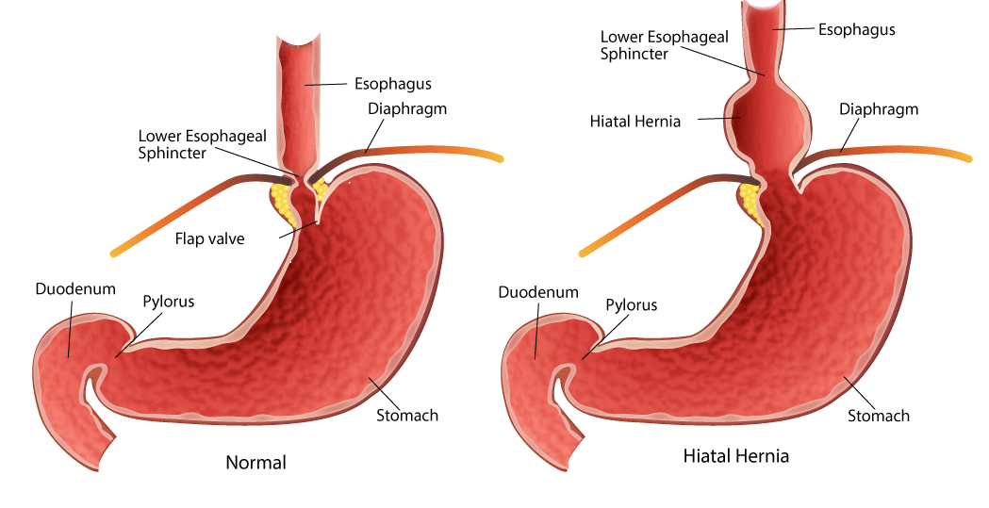
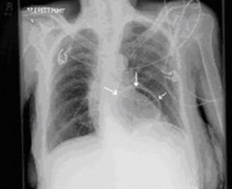
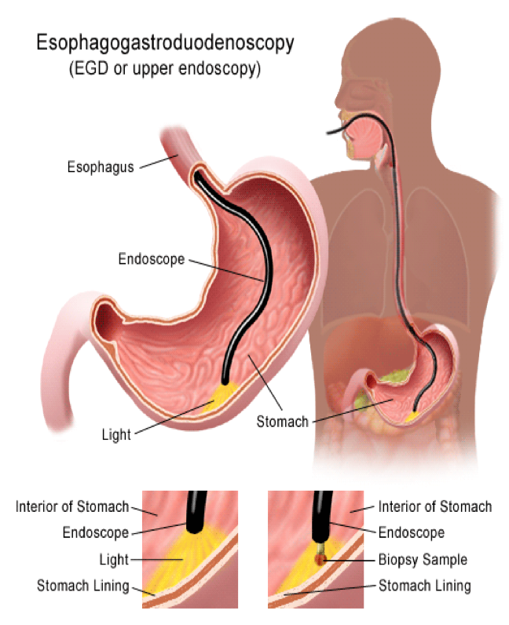
GERD
Pathophysiology
Abnormal Lower esophageal sphincter (LES)
Increased abdominal pressure
The LES prevents the gastric juice from reaching the esophagus, which is sensitive to its acidity.
Functional; frequent transient LES relaxation
Mechanical; hypotensive LES
Food; coffee, alcohol, smoking
Medication; calcium channel blocker, CNS depressants.
Location: hiatal hernia (X-ray show behind heart)
Increased pressure in the stomach compared to that of the esophagus allows for gastric content to reflux into the esophagus.
Obesity
Pregnancy
Increased gastric volume after heavy meal.
Risk Factors
Smoking, Alcohol.
Caffeine, fatty foods, chocolate.
Pregnancy, obesity.
Hiatal hernia: Herniation of a portion
of the stomach into the lower thorax.
Types of hiatal hernia: Sliding (more common in GERD) and rolling.
Diagnosis
If typical symptoms are present, without atypical symptoms, diagnosis is made clinically without further evaluation.
Endoscopy (with biopsy if needed) is done rarely:
Patients with alarm symptoms; dysphagia, which indicated there
is complications.
Patients who fail medication trial.
Those who require long-term treatment.
24-hour pH monitoring:
For establishing and excluding GERD, for patients who do not
have mucosal change.

Slide 5
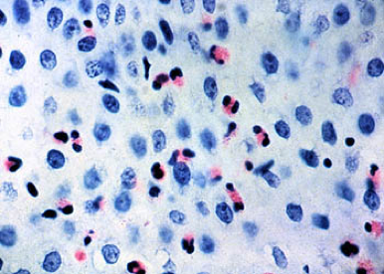
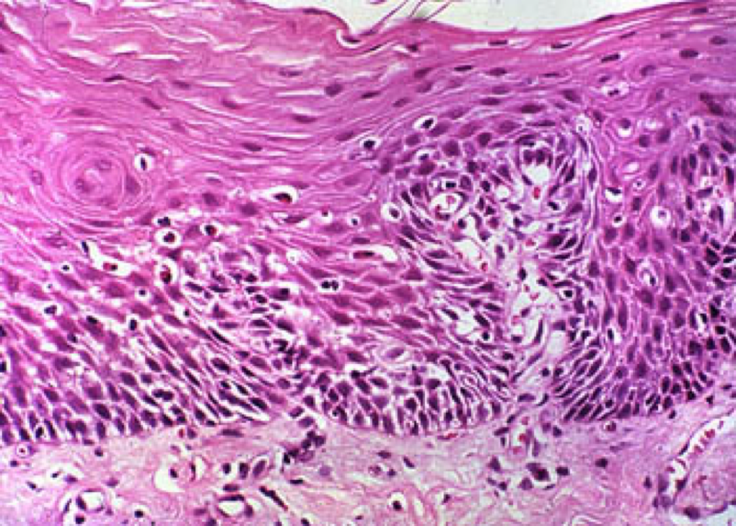
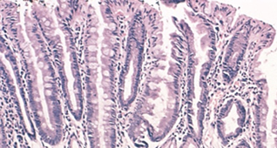
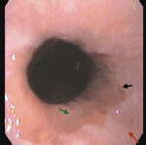
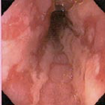
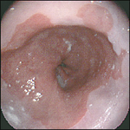
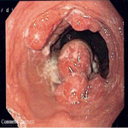
GERD
Complications
1- Hematemesis: the vomiting of blood.
2- Melena: black tarry stools.
3- Erosive esophagitis
Responsible for 40-60% of GERD symptoms.
Severity of symptoms might not match severity of esophagitis.
Morphology:
Basal zone hyperplasia.
Elongation of lamina propria.
Eosinophils and neutrophils.
Red mucosa with erosions and ulceration.
4- Esophageal stricture
Narrowing of esophagus Due to healing erosive esophagitis.
May need dilation.
5- Barrett’s esophagus
Intestinal metaplasia of the esophagus. The stratified squamous
epithelium of the esophagus becomes columnar with goblet cells,
in the lower esophagus.
Patients may be asymptomatic.
The incidence of Barrett esophagus is rising.
Occur in 10% of individuals with symptomatic GERD.
Most common in white males and typically presents between 40 and 60 years.
Can only be identified through endoscopy and biopsy, due to GERD symptoms.
Pathophysiology:
Reflux acid damages the lining of the esophagus causing chronic esophagitis
Healing in a metaplastic process results in columnar cells replacing squamous cells
Could progress to dysplasia and adenocarcinoma
Normal
Short segments
Endoscopic image of barrett’s esophagus: an area of red mucosa
Long segments, tongue like processes + dysplasia
Long segments, Irregular and rough processes
Mass → adenocarcinoma

Slide 6
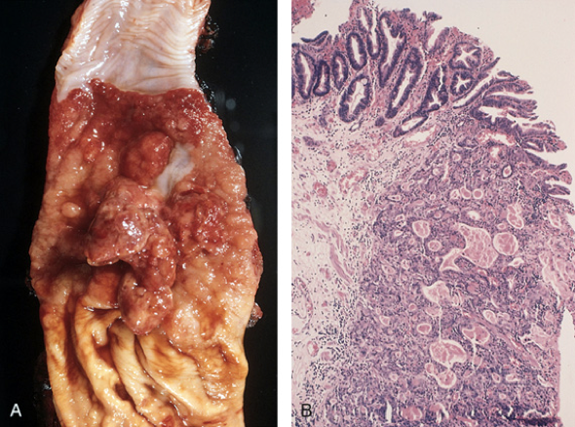
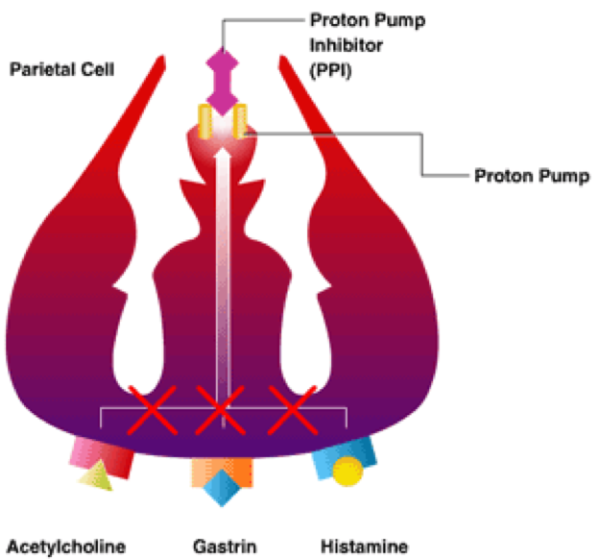
GERD
Complications of Barrett’s esophagus:
Dysplasia
The presence of dysplasia, a preinvasive change, is associated with prolonged symptoms, longer segment length, increased patient age, and Caucasian race.
Low-grade dysplasia: Cytological changes e.g. nuclear stratification, hyperchromasia and increased nuclear to cytoplasmic ratio.
High-grade dysplasia: Architectural irregularities, including gland within gland, or cribriform pattern in addition to cytological changes.
Adenocarcinoma
Risk factors other than Barrett’s esophagus: tobacco and radiation.
The risk is reduced by diets rich in fresh fruits and vegetables.
Occurs in the distal third of the esophagus and may invade
the adjacent gastric cardia.
Well to poorly differentiated adenocarcinoma.
Present with pain or difficulty in swallowing, progressive weight loss, hematemesis, chest pain, or vomiting.
Prognosis depends on the stage.
Dysplasia
Adenocarcinoma
Adenocarcinoma
6- Squamous carcinoma
Most common in middle and lower esophagus.
Common in men who are heavy smokers of alcohol drinkers.
Maybe preceded by epithelial dysplasia.
The most common malignant tumors of the esophagus are squamous carcinoma and adenocarcinoma. Both have poor prognosis.
Not related to GERD
Treatment
H2 receptor blockers
Proton pump inhibitor
May require antireflux surgery

Slide 7
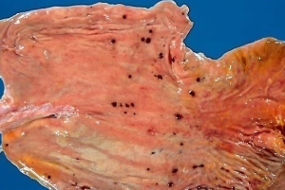
Ulcers
Erosion: is a breach in the epithelium of the mucosa only.
Ulcer: is a breach in the mucosa of the alimentary tract
extending through muscularis mucosa into submucosa or deeper.
Types:
Peptic ulcer: chronic.
Stress ulcers: acute gastric (peptic) ulcers.
Pathophysiology: imbalance between aggressive factors & defensive factors:
Aggressive Factors | Defensive Factors
H. pylori | Mucus
Drugs (NSAIDs) | bicarbonate
Acid | Blood flow & Cell renewal
pepsin | Prostaglandins
Bile salts | Phospholipid
Acute peptic ulcers (stress ulcers)
Pathophysiology:
Part of an acute gastritis:
Acute response to an irritant 'chemical' injury by drugs:
NSAIDs
Alcohol
Complication of a severe stress response:
Severe burns (Curling's ulcer)
Major trauma (Cushing ulcer)
Cerebrovascular accidents (Cushing ulcer)
A result of extreme hyperacidity:
Zollinger-Ellison syndrome
1
Location | Morphology | Prognosis | Clinical findings:
Anywhere in the stomach | They range in depth from very superficial lesions (erosion) to deeper lesions that involve the entire mucosal thickness (true ulceration) | The gastric mucosa can recover completely if the person does not die from the primary disease | Hematemesis Melena Iron deficiency due to chronic bleeding.
A condition in which a gastrin-secreting tumour or hyperplasia of the islet cells in the pancreas causes overproduction of gastric acid, resulting in recurrent peptic ulcers.

Slide 8
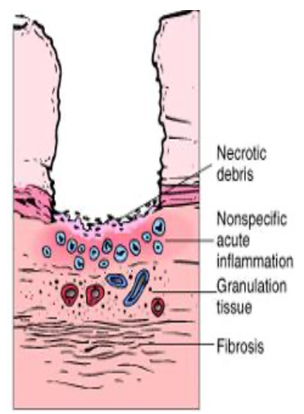
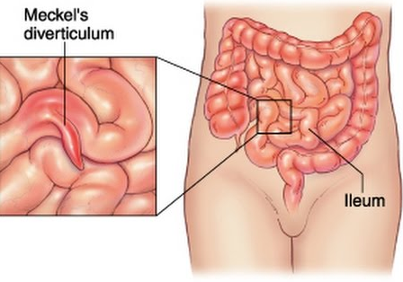
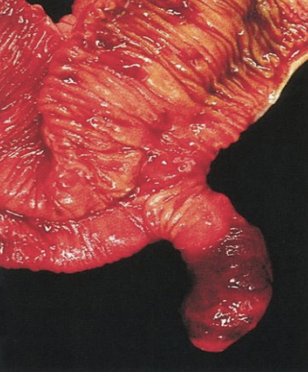
Ulcers
Peptic Ulcer Disease (Chronic peptic ulcer)
Peptic ulcers are chronic, recurring lesions that occur most often in middle-aged to older adults without obvious precipitating conditions, other than chronic gastritis.
Locations
May occur anywhere often solitary in GI tract exposed to acidic gastric juices.
98% located in first portion of duodenum or stomach (Ratio =4:1)
Gastric peptic ulcers are predominantly located near the interface of the body and antrum at lesser curvature.
Duodenal ulcers usually occur within a few centimeters of the pyloric valve at the anterior duodenal wall.
Esophagus, as a result of GERD or acid secretion by ectopic gastric mucosa.
Gastric mucosa within a Meckel diverticulum can result in peptic ulceration of adjacent mucosa.
Most common congenital abnormality of the small intestine caused by an incomplete obliteration of the vitelline duct, Simply its normal tissue at abnormal location, so if Gastric tissue in the small intestine it will cause peptic ulceration of of adjacent mucosa. (More info)
In Zollinger-Ellison syndrome: multiple peptic ulcerations in the stomach, duodenum, and even the jejunum.
Mucosal defences against acid attack consist of:
1) Mucus-bicarbonate barrier |  | 2) Surface epithelium
Disrupted by | Duodeno-gastric reflux ( bile ) | NSAIDs (blocking the synthesis of the prostaglandins)
 |  | H. pylori infection¹ (cytotoxins and ammonia)
Note:
Helicobacter Pylori does not colonise normal duodenal epithelium. If it undergoes Gastric metaplasia in response to excess acid damage it will paves the way for colonisation by Helicobacter.

Slide 9
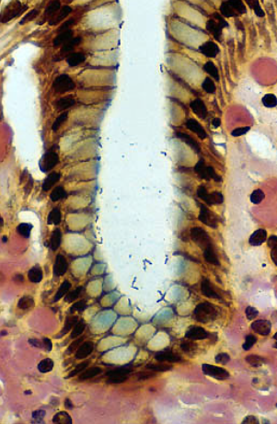
Ulcers
Peptic Ulcer Disease (Chronic peptic ulcer) Cont.
 | Duodenal Ulcer | Gastric Ulcer
Most important factor | Increased Acid production Hyperacidity | Breakdown of mucosal defence Nsaids & Duodeno-gastric reflux (bile)
H pylori infection of the pyloric antrum | Almost all patients | Approximately 75% of patients
H. pylori infected individuals secrete 2-6 times as much acid as non-infected controls (hyperacidity).
Only 20% of H. pylori–infected individuals develop peptic ulcer.
Pathogenesis:
H.Pylori
Form toxic compounds
(NH4Cl & monochloramine)
Intense inflammatory response
Gram-negative spiral bacillus Gastric-biopsy showing H.pylori adhering to gastric epithelium and underlying inflammation
Thrombotic occlusion of surface capillaries due to
Bacterial platelet-activating factor
Chronically inflamed mucosa
IL-1, IL-6, IL-8 and TNF
Susceptible to acid-peptic injury & peptic ulceration
Important in the pathogenesis of Adenocarcinoma & MALToma
H. pylori Virulence factors:
VacA (direct cell injury).
CagA promotes inflammation & tissue damage.
Flagella (motility).
Bacterial Adhesions.
Urease that breaks down urea to make ammonia.
Lipopolysaccharides, recruit inflammatory cells to the mucosa.
Other causes:
NSAID and aspirin.
High-dose corticosteroids, which suppress prostaglandin synthesis.
Cigarette smoking: impairs mucosal blood flow and healing.
Chronic renal failure, and hyperparathyroidism associated with hypercalcemia, stimulates gastrin production and therefore increases acid secretion.
Psychological stress (can increase gastric acid secretion).

Slide 10
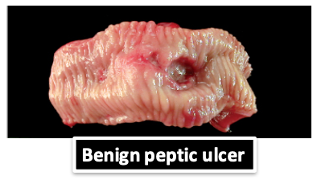
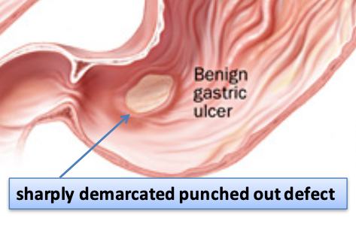
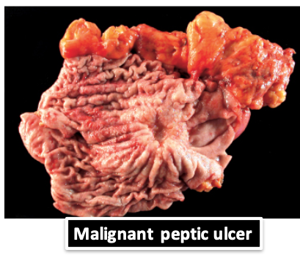
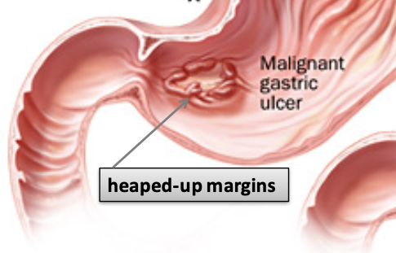
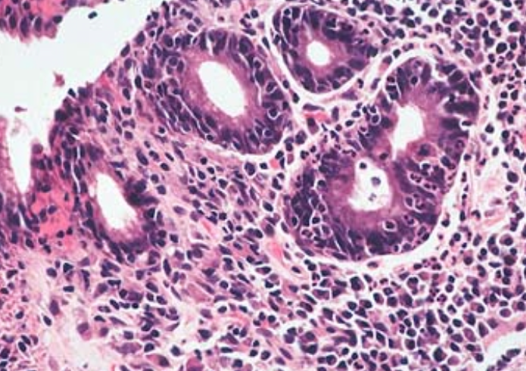
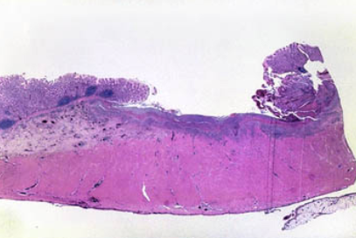
Ulcers
Peptic Ulcer Disease (Chronic peptic ulcer) Con..
Morphology
Gross:
Usually <20 mm in diameter but they may > 100 mm in diameter.
The classic peptic ulcer is a round to oval, sharply punched-out defect, with straight walls, surrounded by hyperemia.
In contrast, heaped-up margins are more characteristic of cancers.
Most gastric ulcers are benign. Small percentage may be malignant, (reason for biopsy)
Duodenal ulcers are never malignant (reason for not taking a biopsy)
Microscopy:
Base consists of necrotic tissue and polymorph exudate overlying inflamed granulation tissue which merges with mature fibrous (scar) tissue.
The presence of neutrophils within the gastric glands signifies active inflammation and, most of the time, the presence of H pylori.
Clinical features
Epigastric pain, the most common symptom:
Gnawing or burning sensation
Duodenal Ulcer | Gastric Ulcer
Food relieves pain | Food aggravates pain
Epigastric pain 2-3 hours after meal | Epigastric pain shortly after meal
Vomiting not common | Vomiting Is common
Patient awakens with pain at night. | Rarely occurs at night
Complications of Chronic Peptic Ulcers:
Iron deficiency anemia and Hemorrhage (frank hemorrhage).
Penetration The ulcer penetrates the full thickness of the stomach or duodenal wall, progressing into adherent underlying tissue, e.g. the pancreas or liver.
Perforation leading to peritonitis, Fibrous stricture causing pyloric stenosis, Malignant change (uncommon).
Therapy
H. pylori eradication: Antibiotics.
Acid suppression: Proton pump inhibitors and H2 blockers.

Slide 11
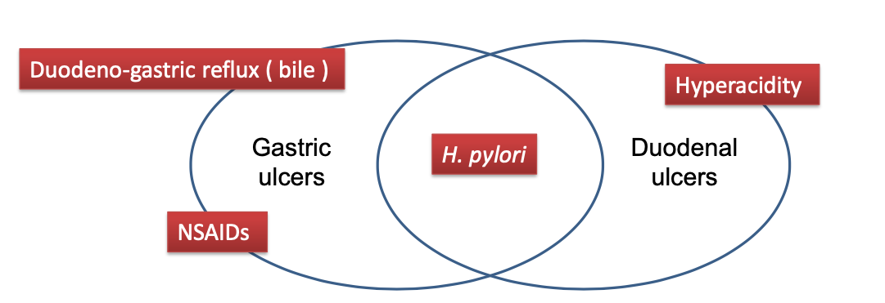
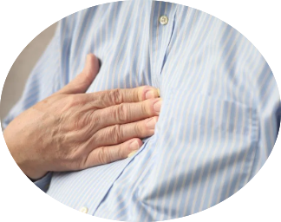
Summary (Ulcers)
Pathophysiology and etiology of acute and chronic peptic ulcer
Pathophysiology and etiology of acute and chronic peptic ulcer
imbalance
Aggressive Factors | Defensive Factors
H. pylori | Mucus
Drugs (NSAIDs) | bicarbonate
Acid | Blood flow & Cell renewal
pepsin | Prostaglandins
Bile salts | Phospholipid
Acute Ulcers Etiology
Acute gastritis
Severe stress response
Extreme hyperacidity
Chronic Ulcers
H. pylori Infection
Gastric
Duodenal
H. pylori Infection
NSAIDs
Hyperacidity
Bile Reflux
Worsen by food
Relieved by food
Malignant associated
Not Malignant associated
Clinical features of Acute and chronic Peptic Ulcer
Epigastric pain
Nausea & vomiting
Loss of appetite

Slide 12
Quiz
Q1: A 45-year-old man presents with long-standing heartburn and dyspepsia. An X-ray film of the chest shows a retrocardiac, gas-filled structure. This patient most likely has which of the following conditions?
Esophageal varices
Esophageal webs
Hiatal hernia
Mallory-Weiss syndrome
Q2: A 57-year-old woman has had burning epigastric pain after meals for more than 1 year. Upper gastrointestinal endoscopy shows an erythematous patch in the lower esophageal mucosa. A biopsy specimen shows basal zone squamous epithelial hyperplasia, elongation of lamina propria papillae, and scattered intraepithelial neutrophils with some eosinophils. Which of the following is the most likely diagnosis?
Barrett’s esophagus
Esophageal varices
Iron deficiency
Reflux esophagitis
Q3: Which of the following is a typical symptom of GERD
​​coughing
wheezing
Retrosternal burning sensation
Nocturnal angina
Q4: A 50-year-old obese man (BMI = 32 kg/m2) comes to the physician complaining of indigestion after meals, bloating, and heartburn. Vital signs are normal. A CT scan of the abdomen reveals a hiatal hernia of the esophagus. Endoscopic biopsy shows thickening of the basal layer of the squamous epithelium, upward extension of the papillae of the lamina propria, and an increased number of neutrophils and lymphocytes. Which of the following is the most likely diagnosis?
Esophageal varices
Schatzki mucosal ring
Squamous cell carcinoma
Reflux esophagitis
Q5: A 68-year-old man from Birmingham, England, has had “heartburn” and substernal pain after meals for 25 years. For the past year, he has had increased pain with difficulty swallowing both liquids and solids. On physical examination, there are no remarkable findings. Upper gastrointestinal endoscopy shows an ulcerated lower esophageal mass that nearly occludes the lumen of the esophagus. A biopsy specimen of this mass is most likely to show which of the following neoplasms?
Squamous cell carcinoma
Barrett’s esophagus
adenocarcinoma
leiomyosarcoma
1- C
2- D
3- C
4- D
5- C

Slide 13
Quiz
Q1: Which of the following is a defensive factor for peptic ulcer?
Prostaglandins
pepsin
Bile salts
Acidity
Q2: In Acute peptic ulcer can be caused by Extreme hyperacidity, which of the following can cause that?
Major trauma
Severe burns
Zollinger-Ellison syndrome
CVA
Q3: which of the following is the most common site of Chronic peptic Ulcers?
Soft palate
Stomach
Esophagus
​​Duodenum
Q4: Which of the following can most likely disrupt the Mucus-bicarbonate barrier ?
Duodeno-gastric reflux
NSAIDs
H. pylori infection
Ammonia
Q5: Normally H.pylori can not colonize the small intestine, But what can make the duodenum suitable to be colonized by H.pylori?
Gastric metaplasia
Decrease mucus secretion
Decreased Motility of small intestine
Hyperplasia
Q6: which of the following is a character of almost all duodenal ulcer patients?
Blood group A
H pylori infected
Fever
Female
Q7: which of the following tumor can arise from a peptic ulcer?
Adenocarcinoma
MALToma
Meningioma
A&B
Q8: which of the following is a Virulence factors for H.pylori?
Serine proteases
Alpha-toxin
M protein
CagA
Q9: which of the following is a gross characteristic of benign peptic ulcer
Heaped-up margins
Sharply punched-out defect
Poorly demarcated
Multiple Ulcers
1- A
2- C
3- D
4- A
5- A
6- B
7- D
8- D
9- B

Slide 14
TEAM LEADERS:
Khalid Alkhani & Lama Alzamil
SUBLEADERS:
Alwaleed Alsaleh & Alhanouf Alhaluli
THIS AMAZING WORK WAS DONE BY:
Omar Aldosari
THANK YOU

