Slide 1
Acute and Chronic Pancreatitis
objectives
Describe the definition, epidemiology, pathogenesis, morphology, and clinical findings of acute and chronic pancreatitis.
Editing File

Slide 2
Acute Pancreatitis
Pancreatitis
Is a group of disorders characterized by inflammation of the pancreas, divided into acute and chronic forms.
Range in severity from a mild, self-limited disease to a life-threatening acute inflammatory process.
Acute pancreatitis
Reversible pancreatic parenchymal injury associated with inflammation.
Glands can return to normal if underlying cause of the pancreatitis is removed.
Epidemiology
1) The annual incidence in Western countries is 10 to 20 cases per 100,000 people.
3) Gallstones are present in 35% to 60% of cases of acute pancreatitis.
2) 80% of cases in Western countries are associated with one of two conditions: 1. biliary tract disease
2. Alcoholism.
4) The male-to-female ratio is
1 : 3 in the group with biliary tract disease
6 : 1 in those with alcoholism.
Etiologic Factors
10% to 20% of cases of acute pancreatitis are idiopathic pancreatitis
Metabolic
Genetic
Mechanical
Vascular
1. Alcoholism
2. Hyperlipoproteinemia
3. Hypercalcemia
4. Drugs (e.g. azathioprine).
Mutations in the cationic trypsinogen (PRSS1) and trypsin inhibitor (SPINK1) genes causing Dysregulation of trypsinogen inactivation.
In these conditions recurrent severe acute pancreatitis often beginning in childhood.
1. Gallstones
2. Trauma (seat belt trauma, posterior penetration of duodenal ulcer)
4. Iatrogenic injury:
I. Operative injury
II. Endoscopic procedures with dye injection
1. Shock
2. Atheroembolism
3. Vasculitis
Infectious
1. Mumps
2. Coxsackievirus
3. Mycoplasma
pneumoniae

Slide 3
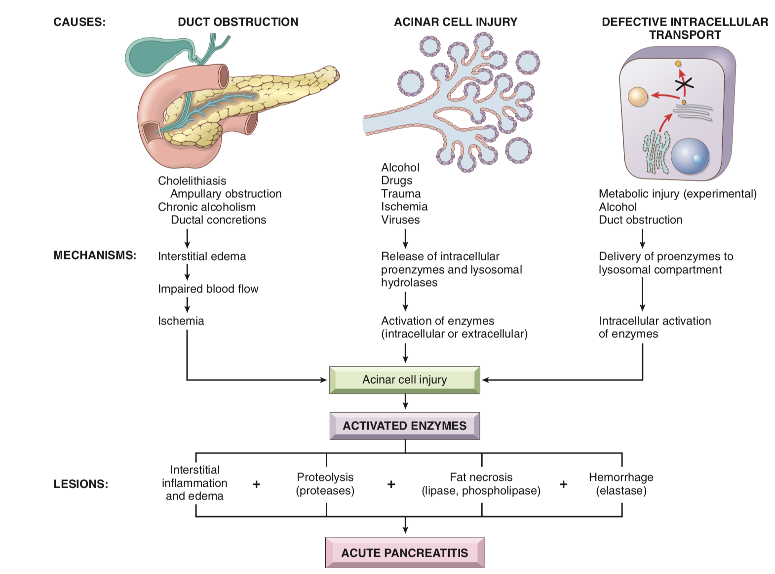
Acute Pancreatitis
Pathogenesis
Autodigestion of the pancreatic substance by inappropriately activated pancreatic enzymes.
Mechanisms protect the pancreas from enzymatic self digestion:
Actions of activated pancreatic enzymes (trypsinogen activation):
Proteases damage acinar cell structure.
Lipases and phospholipases produce enzymatic fat necrosis.
Elastases damage vessel walls and induce hemorrhage
Activated enzymes also circulate in the blood.
1
Most digestive enzymes are synthesized as inactive proenzymes (zymogens), which are packaged within secretory granules.
2
Most proenzymes are activated by trypsin, which itself is activated by duodenal enteropeptidase (enterokinase) in the small bowel.
Acinar and ductal cells secrete trypsin inhibitors, including serine protease
inhibitor Kazal type l (SPINK1) which further limit intrapancreatic trypsin activity.
3
Alcoholism causes release of a very thick secretion → obstruction

Slide 4
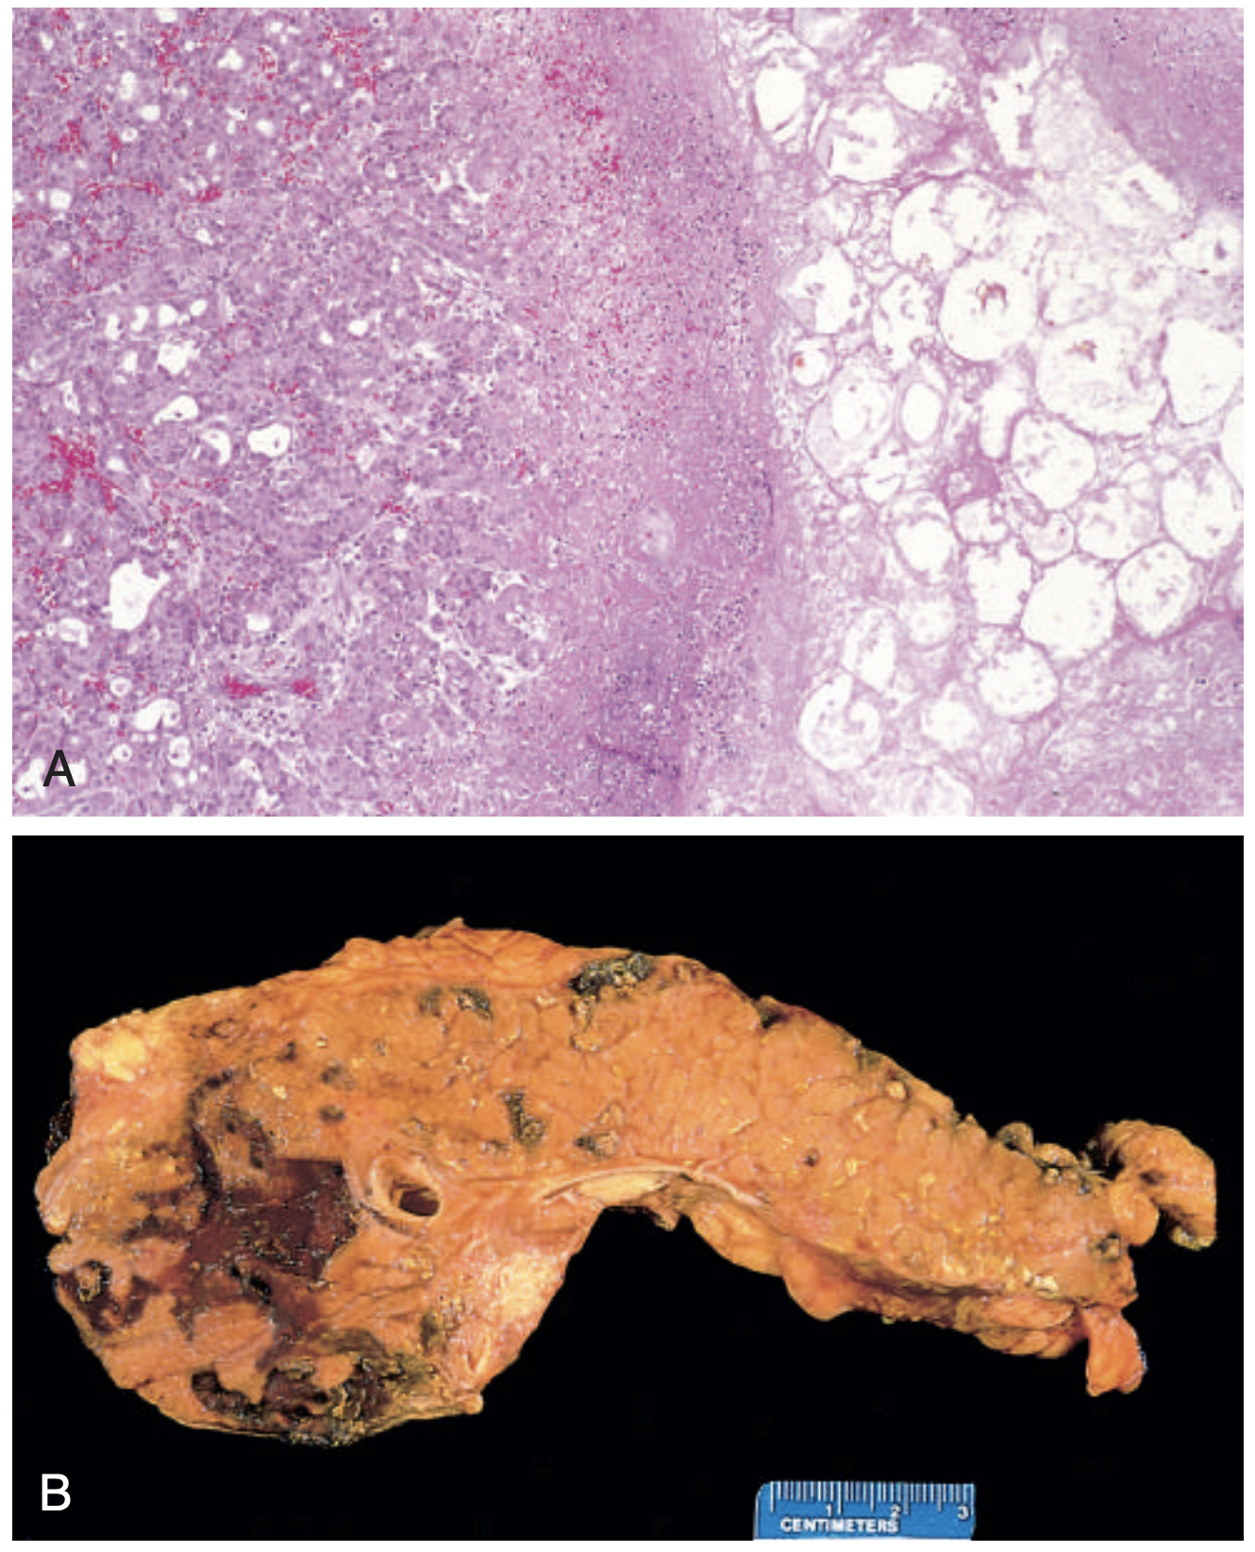
Acute Pancreatitis
Morphology
The morphology of acute pancreatitis ranges from inflammation and edema to severe extensive necrosis and hemorrhage.
Pic A:
Pic B: Fat necrosis results from enzymatic destruction of fat cells. The released fatty acids combine with calcium to form insoluble salts (saponification) that precipitate in situ (appear as foci of yellow-white, chalky material)
01
02
03
04
Acute inflammatory reaction with edema caused by microvascular leakage
Fat necrosis by lipolytic enzymes
Proteolytic destruction of pancreatic parenchyma
Destruction of blood
vessels with subsequent interstitial hemorrhage
Fat necrosis in the peripancreatic fat
Hemorrhage in the head of the pancreas
Clinical Features
Full-blown acute pancreatitis is a medical emergency.
Fever, nausea, and vomiting.
Abdominal pain the cardinal manifestation. varies from mild to severe.
Severe, boring (knife-like) midepigastric pain with radiation into the back.
Hypovolemic shock Due to peripancreatic collection of fluid.
Hypoxemia circulating phospholipase destroys surfactant.
Hemorrhage
Disseminated intravascular coagulation Due to activation of prothrombin by trypsin.
Tetany muscle spasm
Calcium binds to fatty acids, which decreases ionized calcium → hypocalcemia. The worse the inflammation, the lower the calcium level. If persistent, it is a poor prognostic sign.

Slide 5
Acute Pancreatitis
Laboratory findings
Amylase: Not specific for pancreatitis
Initial increase occurs at 2 to 12 hours; peaks over 12 to 30 hours
Returns to normal in 2 to 4 days, Present in urine for 1 to 14 days.
Serum lipase: More specific for pancreatitis
Initial increase occurs in 3 to 6 hours; peaks in 12 to 30 hours; returns to normal over 7 to 14 days, It is not excreted in urine.
Serum immunoreactive trypsin Increases 5 to 10 times normal
Remains increased for 4 to 5 days.
Management and Prognosis
MARS
The key to the management is resting the pancreas by total restriction of food and fluids and by supportive therapy (intravenous fluids and nasogastric suction).
Most patients recover fully
About 5% die from:
1. Shock (during the first week of illness).
2. Acute respiratory distress syndrome
3. Acute renal failure
Complications
In surviving patients:
Sterile pancreatic abscess
Pancreatic pseudocyst Cyst lacks epithelial cells and lined by fibrous tissue.
Chronic pancreatitis due to Repeated episodes of pancreatitis.
Hereditary pancreatitis have a 40% lifetime risk of developing pancreatic cancer (adenocarcinoma).

Slide 6
Chronic Pancreatitis
Prolonged inflammation of the pancreas with irreversible destruction of exocrine parenchyma, and fibrosis.
In the late stages, the destruction of endocrine parenchyma occur.
Epidemiology
The prevalence ranges between 0.04% and 5%.
Most affected patients are middle-aged males.
Causes
Repeated bouts of acute pancreatitis, Long-standing obstruction of the pancreatic duct by calculi or neoplasms.
Chronic alcohol abuse (the most common cause)
Hereditary pancreatitis: Germline mutations in genes such as CFTR (the gene encoding the transporter that is defective in cystic fibrosis), particularly when combined with environmental stressors (up to 25% of chronic pancreatitis has a genetic basis)
Autoimmune injury to the gland (IgG-related disease)
Pathogenesis
Most often follows repeated episodes of acute pancreatitis.
Chronic pancreatic injury leads to local production of inflammatory mediators that promote fibrosis and acinar cell loss.
e.g. transforming growth factor β (TGF-β) and platelet derived growth factor (PDGF).
Induce the activation and proliferation of periacinar myofibroblasts (pancreatic stellate cells), resulting in the deposition of collagen and fibrosis.
Morphology
characterized by:
Grossly:
Microscopically:
1. Parenchymal fibrosis
2. Reduced number and size of acini with relative sparing of the islets of Langerhans
3. Variable dilation of the pancreatic ducts.
Gland is:
Hard.
Dilated ducts.
Visible calcification.
Pic A: Fibrosis and atrophy has left only residual islets and ducts, with chronic inflammatory cells and acinar loss.
Pic B: Dilated ducts with inspissated eosinophilic ductal concretions in alcoholic chronic pancreatitis.

Slide 7
Chronic Pancreatitis
Clinical Features
Silent or repeated attacks of abdominal pain, or persistent abdominal and back pain.
Attacks may be precipitated by:
Alcohol abuse.
Overeating (which increases demand on the pancreas).
The use of opiates and other drugs.
May be entirely silent until:
Pancreatic insufficiency.
Diabetes mellitus develop.
due to destruction of the exocrine and endocrine pancreas.
Diagnosis
Requires a high degree of suspicion.
Gallstone-induced obstruction may be evident as jaundice or elevations in serum levels of alkaline phosphatase.
Serum amylase is variable and less reliable than in acute disease.
Lipase in chronic pancreatitis is not clinically useful.
Serum immunoreactive trypsin: Decease concentration.
Calcifications within the pancreas by CT and ultrasonography.
Prognosis
01
- Not an immediately life-threatening condition.
- The long-term outlook for individuals with chronic pancreatitis is poor, with a 20- to 25-year mortality rate of 50%.
02
Pancreatic exocrine insufficiency, chronic malabsorption, and diabetes mellitus can all lead to significant morbidity and contribute to mortality.
03
- In other patients severe chronic pain is a dominant problem.
- Pancreatic pseudocysts: in about 10% of patient.
04
Patients with hereditary pancreatitis, have a 40% lifetime risk of developing pancreatic cancer

Slide 8
Summary
Pancreatitis
Chronic | Acute
Irreversible injury of the pancreas leading to fibrosis, loss of pancreatic parenchyma, loss of exocrine and endocrine function, and high risk of developing pseudocysts. | Reversible pancreatic parenchymal injury associated with inflammation.
Idiopathic or caused by: Repeated bouts of acute pancreatitis Chronic alcohol abuse Germline mutations in genes such as CFTR Malnutrition (most common cause in developing countries) Autoimmune disorder Long-standing obstruction of the pancreatic duct by calculi or neoplasms. | Caused by: Excessive alcohol intake Pancreatic duct obstruction (e.g., gallstones) Genetic factors (e.g., PRSS1, SPINK1). Traumatic injuries Medications Infections (e.g., mumps). Metabolic disorders leading to hypercalcemia. Ischemia All of these causes promote the inappropriate activation of digestive enzymes within the substance of the pancreas
Clinical features intermittent or persistent abdominal pain, intestinal malabsorption and diabetes. | Clinical features acute abdominal pain, systemic inflammatory response syndrome, and elevated serum lipase and amylase levels
Pathogenesis Repeated episodes of acinar cell injury leads to the production of TGF-β and PDGF, resulting in proliferation of myofibroblasts, secretion of collagen and irreversible loss of acinar cell mass, fibrosis, and pancreatic insufficiency. | Pathogenesis Acinar injury results in release of proteolytic enzymes, leading to activation of the clotting cascade, acute inflammation, vascular injury, and edema. - In most patients, complete resolution of the acute injury occurs with restoration of acinar cell mass.

Slide 9
Quiz
Q1: In acute pancreatitis, inflammation of the pancreas occurs when:
Repeated alcohol intake forms protein plugs in ducts
Pancreatic enzymes are inappropriately activated and start digesting the pancreatic substance
Gallstones cause local production of inflammatory mediators that promote fibrosis and acinar cell loss
Massive amounts of fluid accumulate in the peritoneal cavity
Q2: Which of the following is the most common laboratory finding in acute pancreatitis?
Elevated alkaline phosphate serum levels
Normal serum amylase levels with rising serum lipase level
Elevated serum amylase with normal serum lipase level
elevated serum amylase levels followed by rising serum lipase level
Q3: Mutations in which of the following genes is associated with acute pancreatitis?
​​PRSS1, SPINK1
p53
CFTR
NF2
Q4: Which of the following is NOT seen in acute pancreatitis?
Fat necrosis
Destruction of blood vessels leading to interstitial hemorrhage
Eosinophils
Edema
Q5: Which of the following would be seen in chronic pancreatitis?
Interstitial hemorrhage
Dilated ducts
Neutrophils
Fat necrosis
Q6: what is the most common known cause of chronic pancreatitis
Alcoholism
Gallstones
Autoimmune disorders
Cystic fibrosis
Q7: Which of the following is NOT a complication of chronic pancreatitis?
Malabsorption
Type 1 diabetes mellitus
Acute ischemia
Pancreatic pseudocysts
Q8: Serum amylase levels are increased and reliable to diagnose chronic pancreatitis
True
False
Q9: A 60-year-old alcoholic man presents with a 6-month history of recurrent epigastric pain, progressive weight loss, and foul- smelling diarrhea. The abdominal pain is now almost constant and intractable. An X-ray film of the abdomen reveals multiple areas of calcification in the mid-abdomen. Which of the following is the most likely diagnosis?
Carcinoid syndrome
Chronic pancreatitis
Crohn disease
Insulinoma
1-B
2- D
3- A
4- C
5- B
6- A
7- C
8- B
9- B

Slide 10
TEAM LEADERS:
Khalid Alkhani & Lama Alzamil
SUBLEADERS:
Alwaleed Alsaleh & Alhanouf Alhaluli
“THIS AMAZING WORK WAS DONE BY”¹:
Nouf ALshammari
Deana Awartani
1- May Babaeer, Pharma team, 2019
THANK YOU

