Slide 1
Mechanisms Of Malabsorption and Diarrhea
Case scenario
objectives
Understand that the malabsorption is caused by either abnormal digestion or small intestinal mucosal disease.
Know that malabsorption can affect many organ systems
(alimentary tract, hematopoietic system, musculoskeletal system, endocrine system, epidermis, nervous system).
Know the pathogenesis, clinical features, pathology (gross and microscopic features) and complications (T-cell lymphoma and GI tract carcinoma) of celiac disease.
Know the cause and types of Lactose intolerance.
Define diarrhea.
Understand the four categories of diarrheal diseases, and list the major causes in each category.
List the causes of chronic diarrhea.
Editing File

Slide 2
Malabsorption Syndrome
Malabsorption syndrome
It is the inability of intestine to absorb nutrients adequately into the bloodstream. Such impairment can be of single or multiple nutrients depending on the abnormality. (Single: Lactose intolerance, Multiple: Celiac disease)
Pathophysiology Of Malabsorption Syndrome:
The malabsorption syndrome is caused either by inadequate digestion or small intestine abnormalities.
1
Inadequate digestion
Stomach
Postgastrectomy¹: less stomach tissue (surface area) to digest food.
Zollinger Ellison syndrome.
Pancreas
Deficiency of pancreatic lipase.
Chronic pancreatitis.
Cystic fibrosis: pancreatic juices become thick and enzymes can’t reach the intestine.
Pancreatic resection.
Bile
Obstructive jaundice: obstruction of the bile duct
Terminal ileal resection²
2
Small intestine abnormalities
Mucosa
Celiac disease
Tropical Sprue injury to enterocytes and villi by microbial insult. After visiting a tropical area
Whipple’s disease gram positive infection
Giardiasis protozoan infection
Inadequate small intestine
Intestinal resection
Crohn's disease. Autoimmune transmural inflammatory disease
Lymphatic obstruction
Intestinal lymphangiectasia
Malignant Lymphoma
1- surgical removal of a part or the whole of the stomach.
2- site of reabsorption of bile

Slide 3
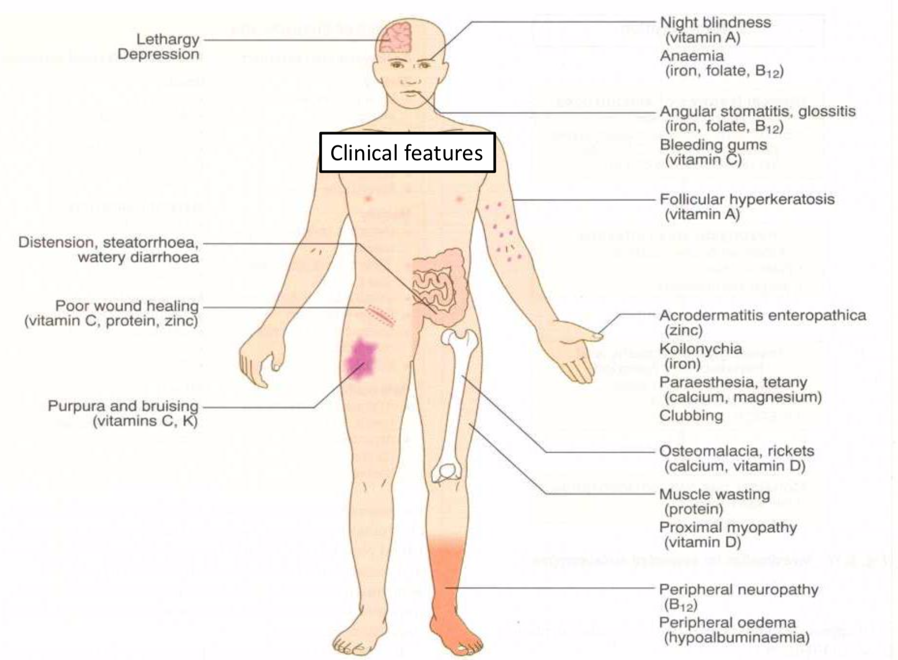
Malabsorption Syndrome
Clinical features of malabsorption syndrome:
Steatorrhea: increased fecal excretion of fat; soft, yellowish, greasy stools Which causes systemic effects of deficiency of vitamins (Fat soluble), minerals, protein and carbohydrates.
Growth retardation, failure to thrive¹ in children.
Weight loss and anorexia despite increased oral intake of nutrients.
Abdominal distension and borborygmi (increased bowel sounds)
Clinical features that depend on the deficient nutrients:
Deficiency of Protein
Deficiency of B12, folic acid and iron
Muscle wasting
Edema² and Swelling
Anemia
(fatigue & weakness)
1
2
Deficiency of Vitamin D, Calcium
Deficiency of Vitamin K, Other Coagulation Factors
Muscle cramp
Osteomalacia & Osteoporosis
Bleeding tendencies
3
4
Diagnosis of Malabsorption Syndrome
There is no specific test for malabsorption. Investigation is guided by symptoms and signs .
Fecal fat study to diagnose steatorrhoea
Blood tests
Stool studies
Endoscopy : Biopsy of small bowel
(1)- Grow
(2)-due to hypoalbuminemia

Slide 4
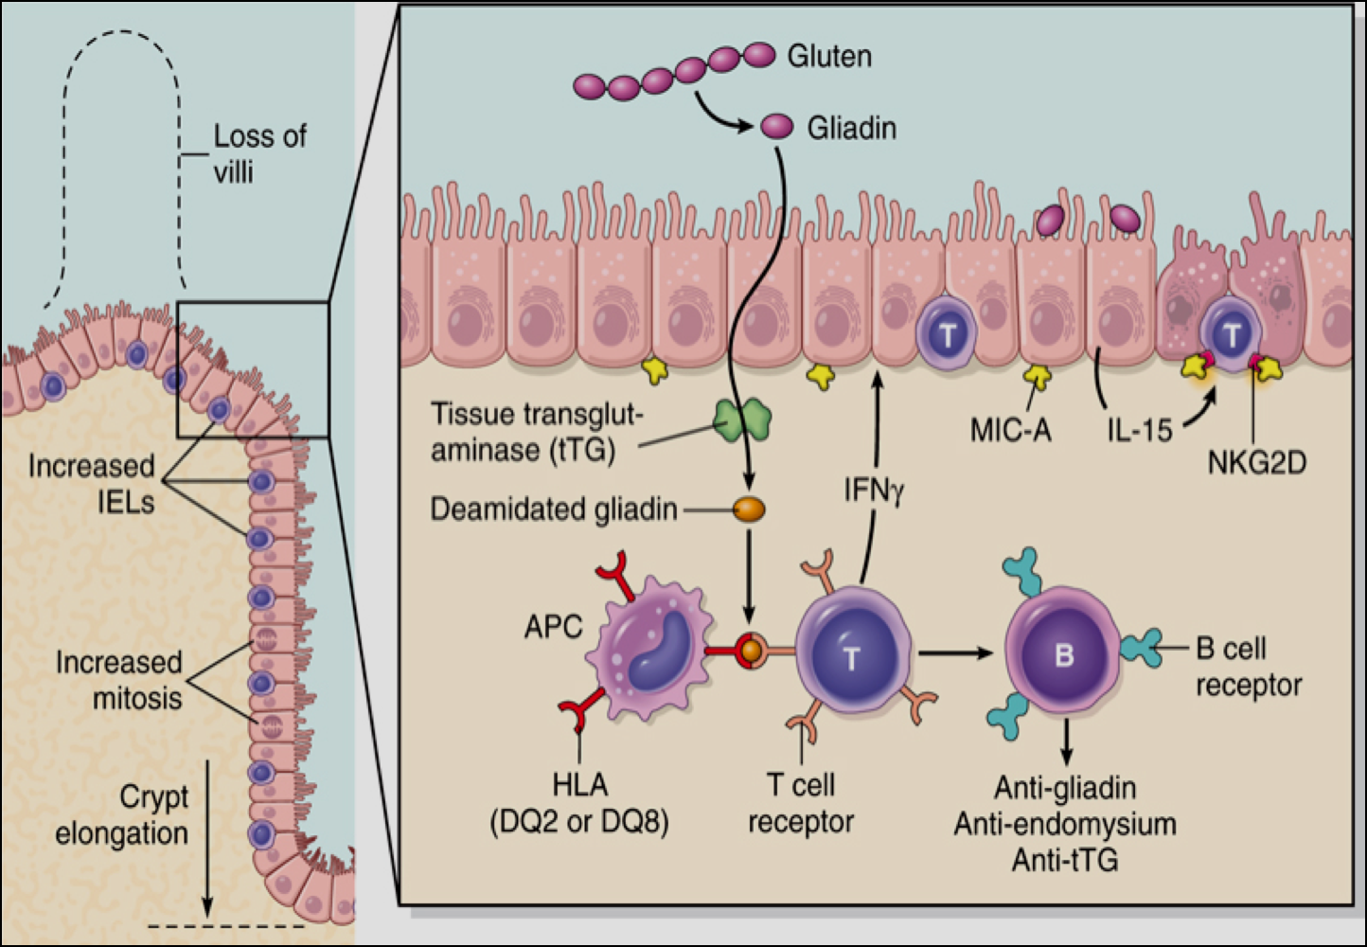
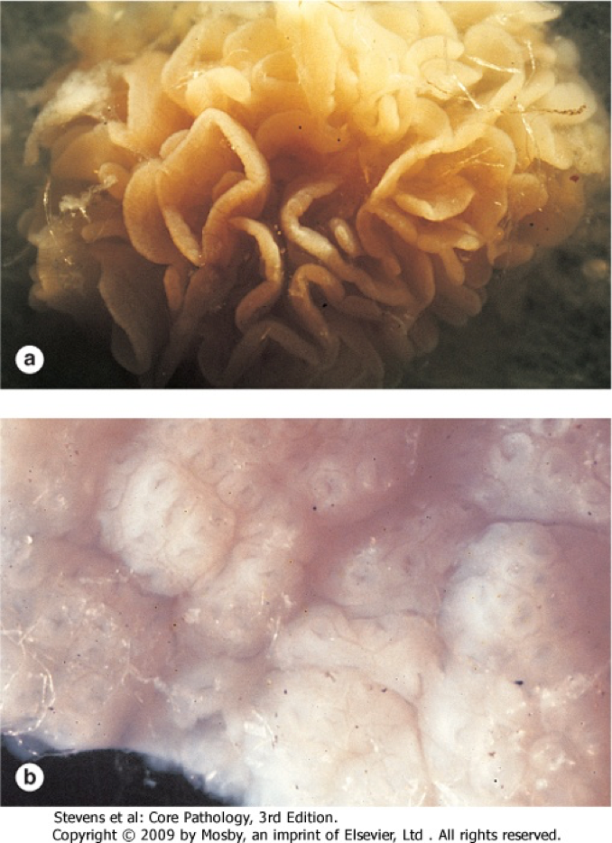
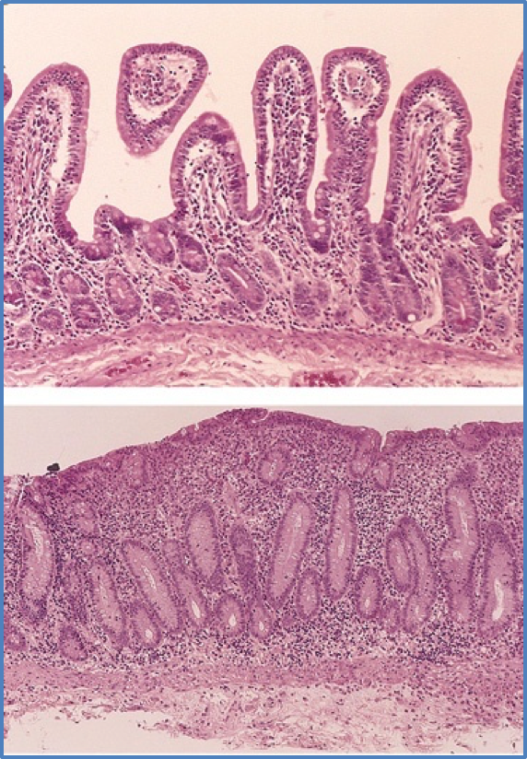
Celiac disease
An immune reaction to gliadin¹ fraction of the wheat protein gluten
Usually diagnosed in childhood – mid adult.
Patients have raised antibodies to gluten autoantibodies (Anti-tissue Transglutaminase Antibody)
Highly specific association with class II HLA (DQ2 or DQ8) and, to a lesser extent, DQ8 (haplotype DR-4).
Clinical features
GI symptoms appear at age 9-24 months.
Symptoms begin at various times after the introduction of foods that contain gluten.
Age of onset and the type of presentation
Infants and toddlers : GI symptoms and failure to thrive.
Childhood : minor GI symptoms, inadequate rate of weight gain.
Young adults : anemia is the most common form of presentation.
Adults and elderly : GI symptoms are more prevalent.
Histological appearance
Mucosa is flattened with marked villous atrophy.
Intraepithelial lymphocytosis.
Crypt elongation(hyperplasia).
Mainly in duodenum, Tropical sprue affects most of small intestine
Diagnosis
Clinical documentations of malabsorption.
Stool : increased fat
Small intestine biopsy demonstrate villous atrophy.
Serology is +ve for IgA to tissue transglutaminase or IgG to deamidated gliadin or anti-endomysial antibodies
Improvement of symptom and mucosal histology on gluten withdrawal from diet (wheat, barley, rye, flour)². (Reversible)
Complications
Osteopenia
Osteoporosis
Infertility in women, short stature, delayed puberty, anemia,
Malignancies,( intestinal T-cell lymphoma )
10 to 15% risk of developing GI lymphoma.
When Gliadin is deamidated it’s able to interact with HLA complexes on antigen-presenting cells and then be presented by these cells to CD4+ T cells. These T cells in lamina propria produce cytokines that contribute to the tissue damage and it’s a characteristic mucosal histopathology. An antibody response follows.
Endoscopy
normal
Celiac disease
Microscopy
Partial villous atrophy
Total villous atrophy
1- A 33-amino acid peptide, resistant to degradation by gastric, pancreatic, and small intestinal proteases.
2- wheat, barley, flour Other grains, such as rice and corn flour, do not have such an effect.

Slide 5
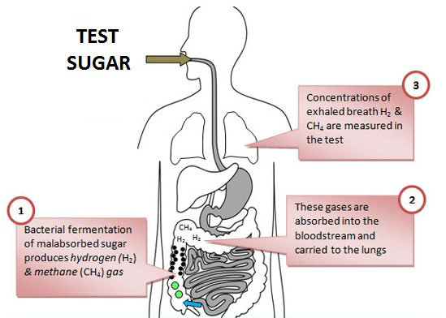
Lactose intolerance
Low or absent activity of the enzyme lactase .
Pathophysiology :
Lactose
Lactase
glucose
+
galactose
At the brush border of enterocytes
Causes
Inherited lactase deficiency
Acquired lactase deficiency
Congenital lactase deficiency :
Extremely rare
Childhood-onset and adult-onset lactase deficiency :
common
Genetically programmed progressive loss of the activity of the small intestinal enzyme lactase.
Transient
Secondary lactase deficiency due to intestinal mucosal injury by an infectious, allergic, or inflammatory process
Gastroenteritis: Infectious diarrhea, particularly viral gastroenteritis in younger children, may damage the intestinal mucosa enough to reduce the quantity of the lactase enzyme. (acquired lactase deficiency)
Clinical features of Lactose intolerance: 1 hour to a few after milk ingestion
Bloating
Abdominal discomfort
Flatulence (Accumilation of gas)
Specific to Lactose intolerance only, so you will not see anemia and hyperplasia in contrast to Celiac disease which is malabsorption of all nutrients.
Diagnosis:
Empirical treatment with a lactose-free diet (3 weeks), which results in resolution of symptoms
Hydrogen breath test
Administer oral dose of lactose.
Since H₂ in the GI can only be produced by bacteria fermenting lactose in the colon.
Unabsorbed lactose that reached the colon will result in increase H₂ production, which is exhaled.
A 3-week trial of a diet that is free of milk and milk products is a satisfactory trial to diagnose lactose intolerance

Slide 6
Diarrhea
Fecal osmolality
Normal fecal fluid values: Osmolality: ~290 mOsm/kg equal to the serum osmolality. Na⁺: ~30 mmol/L K⁺: ~75 mmol/L
Under normal circumstances, the major osmoles are Na⁺, K⁺ Cl–, and HCO3–
Stool (fecal) osmotic gap Female’s slides
Stool osmotic gap = Stool osmolality - 2 x (stool Na + stool K)
A calculation to distinguish among different causes of diarrhea.
A normal gap is between 50 and 100 mosm/kg
A low stool osmotic gap <50 mosm/kg → secretory diarrhea.
That secreted sodium and potassium ions make up a greater percentage of the stool osmolality in secretory diarrhea
A high gap >125 mosm/kg → osmotic diarrhea.
Molecules such as unabsorbed carbohydrates are more significant contributors to stool osmolality.
Diarrhea
3 or more loose or liquid stools per day.
Abnormally high fluid content of stool 200-300 gm/day (more than 250g of stool per day)
The loss of fluids through diarrhea can cause dehydration and electrolyte imbalances. ¹
Easy to treat but if untreated, may lead to death especially in children. More than 70% of almost 11 million child deaths every year are attributable to 6 causes: Diarrhea, Malaria, Neonatal infection, Pneumonia, Preterm delivery, Lack of oxygen at birth.
Classification (based on duration)
Fecal Osmotic Gap
290 mosm/kg H₂O - 2([Na+] + [K+])
1
Acute
2 weeks
2
Persistent or subacute
2-4 weeks
3
Chronic
4 weeks
1-Treatment is mainly IV fluid replacement.

Slide 7
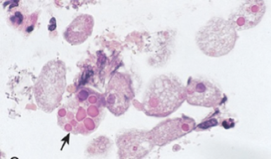
Types of Diarrhea
Type | Secretory | Osmotic
Definition | An increase in the active secretion of water and electrolytes. Enterotoxins stimulate Cl-channels regulated by cAMP and cGMP loss of isotonic fluid. | Excess amount of poorly absorbed substances that exert osmotic effect, so water is drawn into the bowels causing diarrhea, loss of hypotonic fluid. Doesn’t cause inflammation in bowel mucosa.
Stool output | High output | Output is usually not massive
Fasting effect | Lack of response | Improves the condition
Stool osmotic gap | Stool osmotic gap is normal or low < 100 mOsm/kg. | Stool osmotic gap is high, > 125 mOsm/kg (loss of hypotonic fluid)
Causes | The most common cause is a bacterial toxin (E. coli, cholera) that stimulates the secretion of anions. Other causes: Neuroendocrine tumours: Zolinger-elison tumor carcinoid tumor, gastrinomas. Enteropathogenic virus e.g. rotavirus and norwalk virus. Rectal villous adenoma.The villous surface of this tumor secretes water and ions . Chronic laxative use causing Melanosis coli (dark pigment is deposited in the lamina propria of the colon). | Malabsorption in which the nutrients are left in the lumen to pull in water e.g. lactose intolerance, chronic pancreatitis, celiac diseases stool is high in fats. Osmotic laxatives e.g. Lactulose (non-absorbable sugar) Poorly absorbed hexitols, sorbitol, mannitol, xylitol. (Non absorbable sugars). Additive food e.g.in gum. (sugar-less sweater). Disaccharidase deficiency. Ingestion of poorly absorbed solutes.
Screening test | Stool osmotic gap <50 mOsm/kg Fecal smear for leukocytes: negative | Stool osmotic gap > 125 mOsm/kg Fecal smear for leukocytes: negative
Type | Exudative | Motility related
Definition | Results from the outpouring of blood protein, or mucus from an inflamed or ulcerated mucosa. | Caused by hypermotility: the rapid movement of food through the intestines.
Stool output | Bacterial dysentery: diarrhea with blood and pus in stool | -
Fasting effect | Persists on fasting not related to food | -
Causes | Inflammatory bowel diseases. Invasive infections e.g. E. coli, Clostridium difficile and Shigella. Some bacterial infections cause damage by invasion of the mucosa → bacterial dysentery Entamoeba histolytica is a parasite that infect the small intestine causing (amoebiasis), and liver amebic abscess. Colon cancer The main organisms of bacterial dysentery are: Campylobacter invades mucosa in the jejunum, ileum and colon, causing ulceration and acute inflammation. Salmonella typhi, S. paratyphi A, B, and C Shigella are mainly seen in young children. Enteroinvasive and enterohemorrhagic E. coli | Irritable bowel syndrome (IBS): a motor disorder that causes abdominal pain and altered bowel habits (diarrhea and constipation) with diarrhea predominating. Increased serotonin: carcinoid syndrome Serotonin increases bowel motility but no inflammation in bowel mucosa. Diabetic diarrhea Hyperthyroid diarrhea
Screening test | Fecal smear for leukocytes: positive Stool culture for O&P (ova and parasites) | Increased 5-HIAA (5-hydroxyindoleacetic acid)
Female’s slides

Slide 8
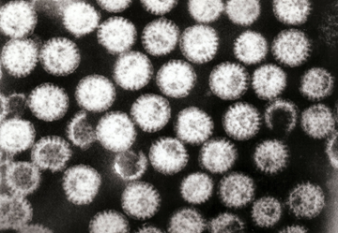
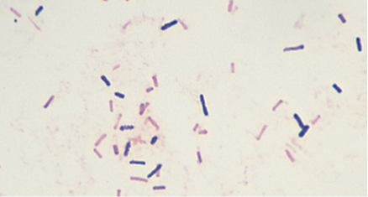
Acute Diarrhea
Causes
Infections: Approximately 80% of acute diarrheas (viruses, bacteria, helminths, and protozoa).
Viral gastroenteritis, viral infection of the stomach and the small intestine is the most common cause of acute diarrhea worldwide.
Rotavirus cause of:
Most common cause of Severe childhood diarrhea and diarrhea related deaths worldwide.
40% of hospitalizations from diarrhea in children under 5.
50% of acute diarrhea in infants.
Preformed toxin, enterotoxin, cytoxin or invasive.
Food poisoning. (Preformed enterotoxin, usually caused by staph.)
Drugs: antibiotic, NSAID, antiacid, bronchodilators, antiarrhythmics.
Others: occlusive colitis, ischemia, toxin (insecticides).
Clinical manifestation
Person become dehydrated with electrolyte disturbance and low bicarbonate in blood.
Mild self limited, need rehydration.
Antibiotic associated diarrhea
Diarrhea occurs in 20% of patients receiving broad-spectrum antibiotics; about 20% of these diarrheas are due to Clostridium difficile (it will replace normal flora after treatment and causes
necrosis and ulcerations)
Leading to pseudomembranous colitis: swelling or inflammation of
the colon due to an overgrowth of Clostridium difficile.
Evaluatory test
Rotavirus
Clostridium species
Gram-positive rods
Pseudomembranous colitis
Necrosis and exudate making a membrane with hemorrhagic area, compare to normal pale tissue.
Fecal leukocytes
Non present | Present
Non-Inflammatory diarrhea Suggests a small bowel source or colon but without mucosal injury. | Inflammatory diarrhea Suggests colonic mucosa damage caused by invasion: Shigellosis, Salmonellosis, Campylobacter or Yersinia infection, amebiasis). Toxin (C difficile, E coli). Inflammatory bowel diseases.

Slide 9
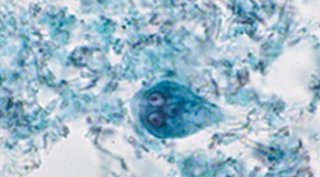
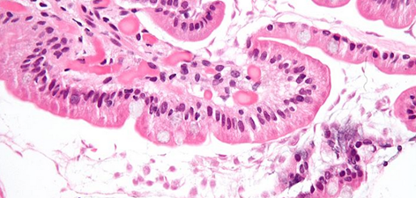
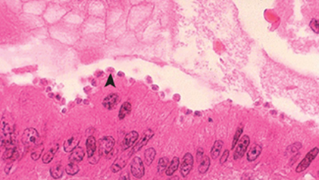
Chronic Diarrhea
Aetiology most of the causes are noninfectious
Infection e.g. Giardia lamblia (Giardiasis) unicellular parasite found
in the lumen of duodenum causing mechanical barrier not allowing the food
to be absorbed. AIDS often have chronic infections of their intestines that cause diarrhea. E.g Cryptosporidiosis
Post-infectious Following acute viral, bacterial or parasitic
infections
Malabsorption
Inflammatory bowel disease (IBD)
Endocrine diseases e.g. carcinoid, gastrinoma
Colon cancer
Irritable bowel syndrome
Parasitic and protozoal infections affect over half of the world’s
population on a chronic or recurrent basis.
Complications
Giardia lamblia
Cryptosporidiosis in AIDS
Low Sodium bicarbonate in blood→ Metabolic acidosis
Fluid loss → Dehydration
Electrolytes loss → Electrolytes imbalance
If persistent will→ malnutrition
Evaluatory test
Female’s slides
Stool analysis ova, parasites
+ve | -ve
Infection | Stool fat test (normal <20%)
 | -ve |  |  | +ve
 | Secretory, Non infectious and Inflammatory diarrhea
If malabsorption is +ve do:
Quantitative stool for fat:
Best screening test
72-hour collection of stool
Positive test >7g of fat/24 hours.
Serum Anti-tissue transglutaminase antibodies.
Anti-endomysial IgA antibodies.
Antigliadin antibodies to check for celiac disease.
Duodenal biopsy.
Malabsorption
Signs of dehydration
Early signs
Mature signs
Fatigue
Anxiety
Irritability
Depression
Cravings
Cramps
Headaches
Heartburn
Joint pain
Back pain
Migraines
Fibromyalgia
Constipation
Colitis

Slide 10
Summary
malabsorption
Definition | It is inability of intestine to absorb nutrients adequatly into the bloodstream. Highly specific association with class II HLA DQ2 (haplotypes DR-17 or DR5/7) and to a lesser extent, DQ8 (haplotype DR-4).
causes | a) Inadequate digestion: Stomach: postgastrectomy 2) pancrase : Cystic fibrosis, Chronic pancreatitis 3) bile: Obstructive jaundice , Terminal ileal resection b) Small intestine abnormalities: 1) Mucosa : Celiac disease,Giardiasis 2)Inadequate small intestine : Intestinal resection ,Crohn's disease. 3)Lymphatic obstruction: Intestinal lymphangiectasia ,Malignant Lymphoma
Diagnosis | Fecal fat study to diagnose steatorrhoea Blood tests Stool studies Endoscopy : Biopsy of small bowel
Celiac disease
Definition | An immune reaction to gliadin fraction of the wheat protein gluten
Typical presentation | GI symptoms that characteristically appear at age 9-24 months.
Histology | Mucosa is flattened with marked villous atrophy.
Diagnosis | Steatorrhoea Histology Improvement of symptom and histology on gluten withdrawal from diet.
Complications | Osteopenia 2) Osteoporosis 3) Infertility in women Short stature 4) delayed puberty 5) anemia 6) Malignancies( intestinal T-cell lymphoma )
Lactose intolerance
Definition | Low or absent activity of the enzyme lactase
causes | Acquired lactase deficiency : Transient => infectious, allergic, or inflammatory process Inherited lactase deficiency: Childhood-onset and adult-onset lactase deficiency Congenital lactase deficiency
Clinical features | Bloating abdominal 2) discomfort 3) flatulence After 1 hour of consuming lactose
Diagnosis | 1)Hydrogen breath test 2) lactose-free diet which results in resolution of symptoms

Slide 11
Summary
Classifications (Duration):
Acute → 2 weeks
Persistant → 2-4 weeks
Chronic → 4 weeks in duration
 | Secretory | Osmotic | Exudative | Motility-related
Osmotic gap | Normal <100 mosm/kg | High >125
Fasting effect | No response | Fasting helps | Persists on fasting
Stool | High stool output | Not massive | Blood and pus in stool
Causes | Increased secretion due to: - Bacterial toxin (E. coli, cholera) - Zolinger elison tumors | Poorly absorbed substance that exert osmotic effect. 1- Malabsorption 2- laxatives | Outpouring of blood or mucus from inflamed or ulcerated mucosa. 1- inflammatory bowel disease 2- invasive infection 3- colon cancer | Rapid movement of food through intestine - IBS -Diabetic diarrhea - Hyperthyroid diarrhea
Aetiology
Acute | Chronic
- Infections: viral gastroenteritis (rotavirus) - Food poisoning - Drugs - Antibiotic-Associated Diarrhea: Clostridium difficile | - Infection: Giardia lamblia, AIDS -> cause other infections that cause diarrhea (Aids have low immunity) - Post-infectious why? Malabsorption lactose intolerance - Malabsorption - IBD - Endocrine disease - Colon cancer - IBS

Slide 12
Quiz
Q1: Which one of the following organisms may cause secretory diarrhea ?
Cholera
gonorrhea
s.aureus
l.monocytogenes
Q2: Which of the following is NOT a chronic malabsorptive disorder?
celiac disease
pancreatic insufficiency
Crohn disease
GERD
Q3: A 1-year-old girl is brought to the emergency room by her parents who report that she had a fever and diarrhea for 3 days. The child’s temperature is 38°C (101°F). The CBC shows a
normal WBC count and increased hematocrit. Which of the
following microorganisms is the most likely cause of diarrhea
in this young child?
​​Cytomegalovirus
Rotavirus
Salmonella typhi
Shigella dysenteriae
Yersinia jejuni
Q4: A 30-year-old woman presents with 2 days of abdominal cramping and diarrhea. Her temperature is 38°C (101°F), respirations are 32/minute, and blood pressure is 100/65 mm Hg. Stool culture shows a toxigenic E.coli infection. Which of the following best explains the pathogenicity of this organism in this patient?
Destruction of Peyer patches.
Invasion of the mucosa of the colon.
Invasion of the mucosa of the ileum.
Stimulation of acute inflammation in the superficial bowel mucosa.
Stimulation of fluid transport into the lumen of the intestine.
Q5: All of the following are causes of acute diarrhea except:
Viral gastroenteritis
Food poisoning
Inflammatory bowel disease
Antibiotic Associated Diarrhea
1-A,2-D,3-B,4-E,5-C

Slide 13
Quiz
Q1: Malabsorption Diagnosis is difficult due to which of the following?
Different presentation from patient to another
Difficult and invasive tests.
Low sensitivity of the tests.
Uncooperative patients.
Q2: Which of the following is diagnostic for celiac disease?
Increased fat in stool.
Detection of antibodies against gliadin.
Small intestine biopsy with villous atrophy.
Improvement with gluten free diet.
Q3: lactose intolerance may cause which type of diarrhea ?
​​osmotic
secretory
inflammatory
motility related diarrhea
Q4: malabsorption diarrhea is classified as?
Chronic invasive
Acute invasive
Chronic osmotic
Acute osmotic
Q5: Which of the following complications are associated with celiac disease but not other malabsorption
diseases?
Osteoporosis
Short stature
Anemia
Malignancies
Q6: A 4-year-old girl is brought to the physician because her parents noticed that she has been having pale, fatty, foul-smelling stools. The patient is at the 50th percentile for height and 10th percentile for weight. Her symptoms respond dramatically to a gluten-free diet. Which of the following is the most likely diagnosis?
Celiac sprue
Cystic ﬁbrosis of the pancreas
Ménétrier disease
Tropical sprue
Q7: which of the following is not a step of Celiac pathogenesis?
Gluten is digested into amino acids and peptides including including “Gliadin” which will get deamidated by “tTG”
it will interact with HLA-DQ2/HLA-DQ8 of the antigen presenting cells which will present it to CD4 leading to cytokines release
B-Cell activation leading to generation of antibodies against tTG , Gliadin and CD8 will enterocytes who expresses surface MIC-A
all of the above are true
1-A 2-D 3-A 4-C 5-D 6-A 7-D

Slide 14
TEAM LEADERS:
Khalid Alkhani & Lama Alzamil
SUBLEADERS:
Alwaleed Alsaleh & Alhanouf Alhaluli
THIS AMAZING WORK WAS DONE BY:
THIS AMAZING WORK WAS DONE BY:
Alhanouf Alhaluli
Nouf Alburaikan
Sedra Elsirawani
Taiba Alzaid
Omar Alotaibi
Ahmed Alajlan
Alwaleed alarabi
THANK YOU

