Slide 1
Inflammatory Bowel Disease
Case scenario
Define inflammatory bowel disease (IBD)
Know the two forms of idiopathic IBD
Compare and contrast Crohn’s disease and Ulcerative Colitis with respect to:
Clinical features and extraintestinal manifestations
Pathogenesis
Pathology (gross and microscopic features)
Complications (especially adenocarcinoma preceded by dysplasia)
Editing File

Slide 2
Inflammatory Bowel Diseases
Chronic (remission and relapse) condition resulting from complex interactions between intestinal microbiota and host immunity in genetically predisposed individuals resulting an inappropriate mucosal immune activation.
Types based on the distribution of affected sites and the morphologic expression:
Crohn's disease (CD) and Ulcerative colitis (UC) which is more common.
Although their causes are still not clear, the two diseases probably have an immunologic hypersensitivity basis.
Epidemiology (Female’s slides)
The geographic distribution of IBD is variable
It is most prevalent in North America, northern Europe, and Australia.
Crohn’s disease (CD) and ulcerative colitis (UC) are more common in females and in young adults.
IBD incidence worldwide is rising and becoming more common in regions in which the prevalence was historically low.
The hygiene hypothesis suggests that changes in incidence are related to improved food storage conditions and decreased food contamination
Improved hygiene has resulted in inadequate development of regulatory processes that limit mucosal immune responses early in life. (children don’t get exposed to enough microbes, so they don’t have immunity against them)
As a result, exposure of susceptible individuals to normally innocuous microbes later in life triggers inappropriate immune responses due to loss of intestinal epithelial barrier function.
Ulcerative colitis | Crohn’s disease
More common in whites than blacks Occurs between 14 and 38 years of age Lower incidence in smokers and other nicotine users Lower incidence if previous appendectomy <20 years. The Concordance rate¹ of monozygotic twins is only 16%. | More common in whites than blacks, in Jews than non-Jews. More common in children than adults. Smoking is a risk factor Majority >75% of cases occur between 11 and 35 years of age The concordance rate for monozygotic twins is approximately 50%.
The presence of the same trait in both members of a pair of twins.

Slide 3
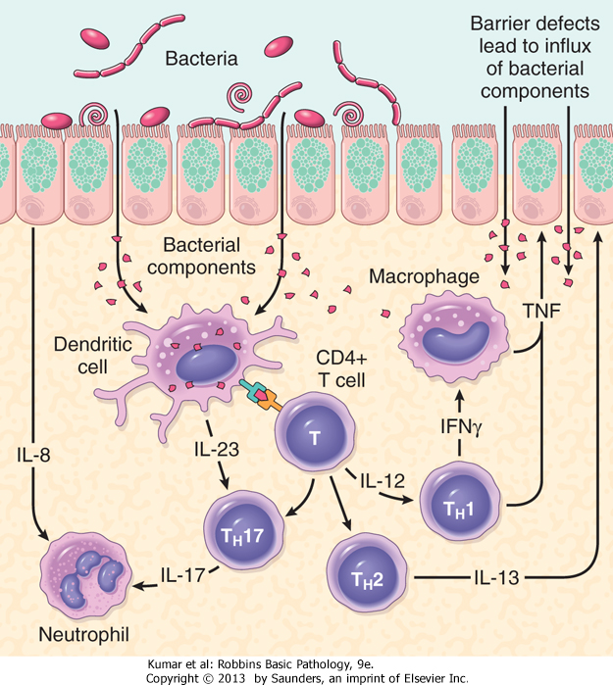
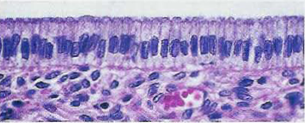
Inflammatory Bowel Diseases
Pathophysiology idiopathic
Defects in host interactions with intestinal microbes.
Intestinal epithelial dysfunction.
Aberrant mucosal immune responses.
Altered composition of the gut microbiome.
Result: activates innate and adaptive immune responses. In a genetically susceptible host, the subsequent release of TNF and other immune signals directs epithelia to increase tight junction permeability, which further increases the flux of luminal material resulting in IBD.
Pathophysiology (based on theories)
Genetics: mutation in NOD2¹ that normally encodes
a protein that binds to intracellular bacterial peptidoglycan ( susceptibility gene in Crohn disease) → abnormal recognition & response to intracellular pathogens
Abnormal intestinal epithelial tight junction barrier function
Less effective at recognizing and combating luminal microbes
Transepithelial flux of luminal bacterial components activates immune responses
Mucosal immune responses → inflammation
Immunosuppression is the mainstay of IBD therapy.
NOD2 mutations are not sufficient for the development of Crohn's disease because it is seen in 15% of patients but are also seen in a smaller percentage of the general population.
Clinical manifestations
The manifestations of IBD depend on the area​ of the intestinal tract involved.
Colon
Bloody diarrhea.
Tenesmus
(Painful defecation)
Small intestine
Abdominal pain
Intestinal obstruction
Steatorrhea
Extraintestinal
Arthritis
Eye manifestation
Skin manifestation
liver
(Nucleotide-binding oligomerization domain)

Slide 4
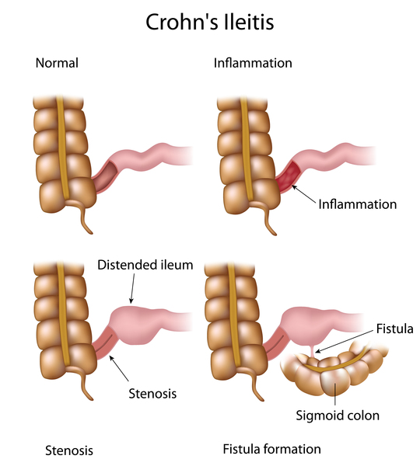
Crohn's disease
Chronic inflammatory disorder that most commonly affects the ileum and colon but has the potential to involve any part of the gastrointestinal tract from the mouth to the anus.
Sites of Involvement
Any part of the GIT from the mouth to the anus.
Ileum (30%) colon (20%), most commonly terminal ileum
Commonly (75%) have perianal lesions such as abscesses, fistulas ,
and skin tags.
Clinical findings (Female’s slides)
Recurrent right lower quadrant colicky pain (obstruction) with diarrhea and weight loss.
Bleeding occurs with colon or anal involvement → fistulas, abscesses.
Aphthous ulcers in mouth.
Extragastrointestinal: erythema nodosum¹, sacroiliitis² (HLA-B27 association), pyoderma gangrenosum³, iritis (CD > UC), primary sclerosing cholangitis⁴ (UC > CD).
Clinical features
Any age but has its highest incidence in young adults
Extremely variable clinical feature.
Acute phase: fever, diarrhea, and right lower quadrant pain may mimic acute appendicitis.
Chronic disease: remissions and relapses over a long period of time.
Thickening of the intestine may produce an ill-defined mass in the abdomen.
Inflammation of the fat cells under the skin, resulting in tender red nodules.
Inflammation of joint between sacrum and ilium.
Is a condition that causes tissue to become necrotic, causing deep ulcers usually occur on the legs.
Fibrosis around bile ducts leading to obstructive jaundice.

Slide 5
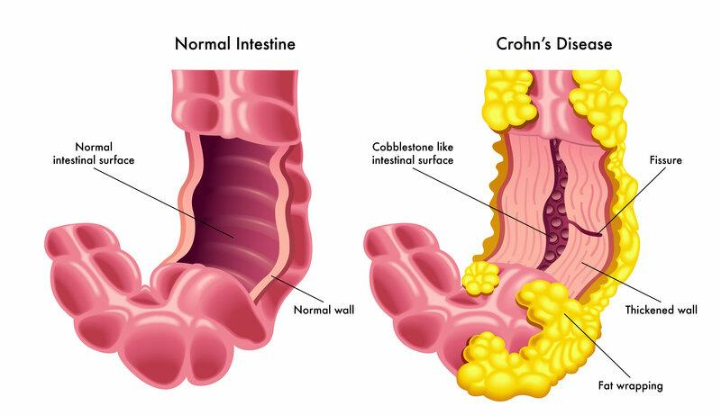
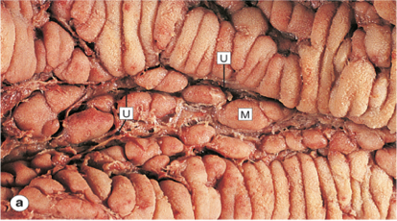
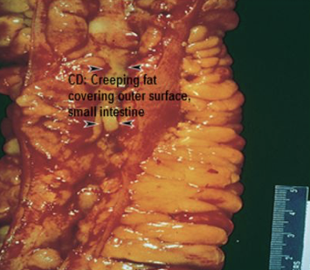
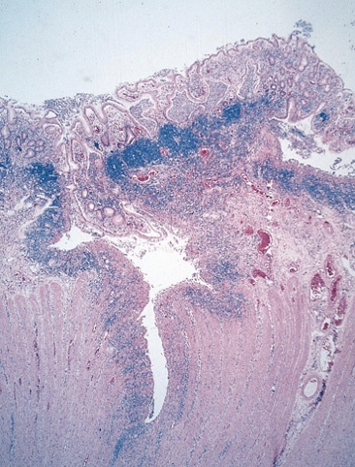
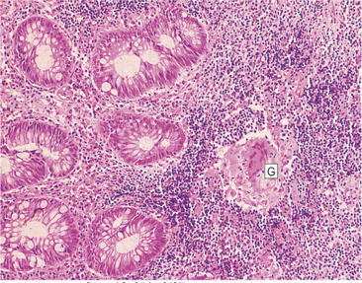
Crohn's disease
Gross appearance
Segmental, with skip areas of normal intestine between areas of involved bowel.
Marked fibrosis causing luminal narrowing with intestinal obstruction.
Fissures: deep and narrow ulcers that look like stabs with a knife that penetrate deeply into the wall of the affected intestine.
Fistulas: communications with other viscera.
Skip lesions
Mucosa | Fat
Cobblestone effect: longitudinal serpiginous ulcers separated by irregular islands of edematous mucosa. | Creeping fat: In involved ileal segments, the mesenteric fat creeps from the mesentery to surround the bowel wall.
Anal abscess
Microscopic appearance
Distortion of mucosal crypt architecture with mucosal inflammation.
Transmural (involves all the layers from mucosa to serosa) inflammation.
Epithelioid noncaseating granulomas [60%]
Fissure ulcers and fistulas can be seen microscopically.
Complications
Intestinal obstruction due to fibrosis
Fistula formation
Between the ileum and the colon → malabsorption
Enterovesical fistulas → urinary infection and passage of gas and feces with urine
Enterovaginal fistulas → fecal vaginal discharge
Peritonitis
Extraintestinal manifestations: arthritis and uveitis.
Slight increased risk of development of carcinoma of the colon - much less than in ulcerative colitis.

Slide 6
Ulcerative Colitis
Chronic relapsing ulcero inflammatory disease of undetermined etiology.
Most common inflammatory bowel disease.
Incidence
20 - 30 year age group but may occur at any age.
Etiology
The cause is unknown
Antibodies that cross-react with intestinal epithelial cells and certain serotypes of Escherichia coli have been demonstrated in the serum of some patients with ulcerative colitis. most commonly terminal ileum.
Smoking reduces the risk of ulcerative colitis.
Site of involvement
UC is a disease of the rectum (in almost all cases), and the colon.
The disease extends proximally from the rectum in a continuous manner without skip areas.
The ileum is not involved as a rule.
Clinical findings
Toxic megacolon¹: up to 10% of patients, mortality rate 50%.
Extra-gastrointestinal more seen in UC than in CD:
Primary sclerosing cholangitis (pericholangitis) (UC > CD): fibrosis around bile ducts leading to obstructive jaundice.
Skin lesions: erythema nodosum and pyoderma gangrenosum.
Iritis or uveitis (CD > UC).
HLA-B27 positive arthritis.
p-ANCA antibodies > 45% of cases.
Acute
Fever, tenesmus, weight loss, leukocytosis, lower abdominal pain, bloody diarrhea and mucus in the stool.
Chronic
Remissions and exacerbations.
Dilation of the colon, with functional obstruction → decreased motility.

Slide 7
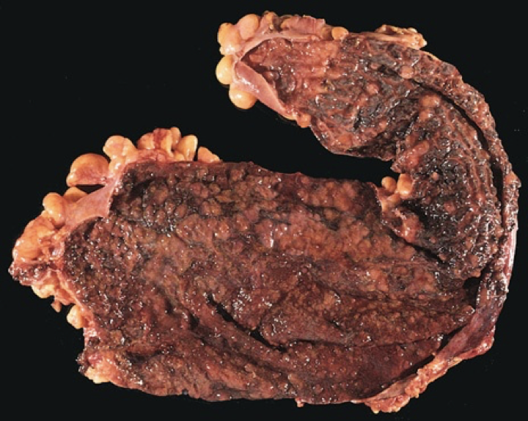
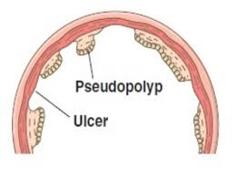
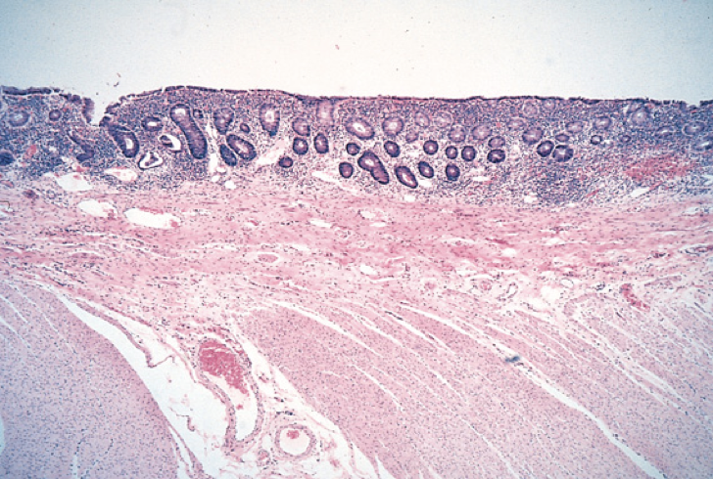
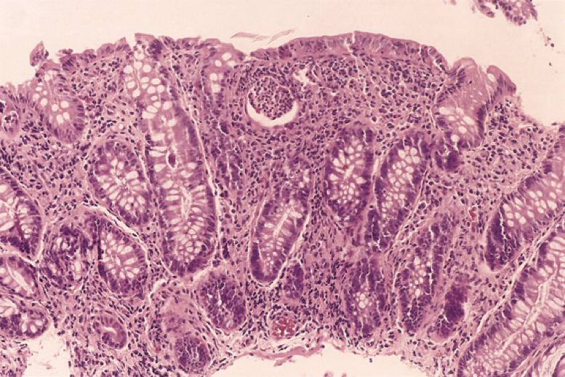
Ulcerative Colitis
Gross appearance
Involves mainly the mucosa:
Diffuse hyperemia.
Superficial ulcerations in the acute phase.
The regenerated or non ulcerated mucosa may appear polypoid (inflammatory pseudopolyps) in contrast with the atrophic areas or ulcers.
Microscopic appearance
The inflammation is usually restricted to the mucosa.
In the active phase → neutrophils (Cryptitis, crypt abscess).
In the chronic phase → crypt atrophy and distortion (dysplasia).
Active inflammation correlates well with the severity of Symptoms.
Inflammation
Complications
Acute phase:
Severe bleeding
Toxic megacolon (dilation of the colon, with functional obstruction.)
Obstruction here is due to dilation while in crohn’s is due to fibrosis.
Chronic ulcerative colitis:
Increase risk of developing colon carcinoma
The presence of high-grade dysplasia in a mucosal biopsy imposes a high risk of cancer and is an indication for colectomy.

Slide 8
Summary
Crohn's disease | Ulcerative Colitis
Any part of the GIT | Colon only
Skip areas of normal mucosa | Diffuse involvement of mucosa
Deep ulcers (fissure) | Superficial ulcers
Transmural inflammation | Mucosal inflammation only
Fistula formation | -
Creeping mesenteric fat | -
Fibrous thickening of wall | -
Granulomas | -
Dysplasia is Rare | Dysplasia is Common
Carcinoma is rare | Carcinoma is more common (10%)
Cobblestone appearances | Pseudopolyps appearances
Thickened wall Narrow lumen | Thin wall Dilated lumen
Marked Lymphoid reaction | Moderate Lymphoid reaction
Complications: Short gut syndrome Fistula formation Bowel perforation Stricture formation | Complications: Haemorrhage Electrolyte loss Toxic megacolon Systemic effects

Slide 9
Quiz
Q1: A complication of ulcerative colitis?
Enterovesical fistulas.
Intestinal obstruction due to thickened wall and narrow lumen
Entervaginal fistula
Pyoderma gangrenosum
Q2: One of the manifestation of IBD involving colon is:
Intestinal obstruction
Steatorrhea
Tenesmus
Uveitis
Q3: A patient diagnosed with ulcerative colitis is at increased risk of
developing which of the following complications?
​​Adenocarcinoma
Fistula
Granulomatous lymphadenitis
Transmural inflammation
Q4: A 24-year-old man is brought to the emergency room with
symptoms of acute intestinal obstruction. His temperature is
38°C. Physical examination reveals a mass in the right lower abdominal quadrant. At laparoscopy, there are
numerous small bowel strictures and a fistula extending into a
loop of small bowel. Which of the following is the most likely
diagnosis?
Adenocarcinoma
Crohn disease
Pseudomembranous colitis
Ulcerative colitis
Q5: A 25-year-old woman is brought to the emergency room with symptoms of acute intestinal obstruction. The patient has an
8-month history of blood-tinged diarrhea and cramping abdominal pain. There is abdominal tenderness to palpation. A CT scan of the abdomen shows massive distention of the transverse colon. Which of the following is the most likely
diagnosis?
Adenocarcinoma
Crohn disease
Pseudomembranous colitis
Ulcerative colitis
Q6: On histological examination of the bowel, granulomas are highly suggestive of?
A) Crohn’s disease
B) Ulcerative colitis
C) Both
D) Neither
Q7: Enterovesical fistula result in?
malabsorption
A fecal vaginal discharge
passage of gas and feces with urine
Obstruction
Q8: Crohn's disease:
Always affects the colon
May lead to intestinal obstruction
Is best treated surgically
Requires a gluten free diet
Q9: Toxic megacolon is a complication of:
Chronic ulcerative colitis
Chronic crohn’s disease
Acute phase of ulcerative colitis
Acute phase of crohn’s disease
1-D
2-C
3-A
4-B
5-D
6-A
7-C
8-B
9-C

Slide 10
TEAM LEADERS:
Khalid Alkhani & Lama Alzamil
SUBLEADERS:
Alwaleed Alsaleh & Alhanouf Alhaluli
THIS AMAZING WORK WAS DONE BY:
THIS AMAZING WORK WAS DONE
Renad Alkanaan
Taef Alotaibi
Sarah Alfarraj
Taiba Alzaid
THANK YOU

