Slide 1
Colonic Polyps And Tumors
Case scenario
objectives
Colon cancer and its epidemiology.
Compare the pathology and clinical features of right-sided colonic adenocarcinoma and left-sided colorectal adenocarcinoma.
Describe the relationship between prognosis and the various stages of cancer of the colon and rectum as noted in the TNM classification and staging system.
Describe the relationship between CEA and recurrence following resection of the primary tumor.
Mention the significant of carcinoid tumor and its features.
Know the classification of intestinal tumors.
Know the definition of a polyp.
Compare adenomatous/neoplastic polyps and non neoplastic polyps with respect to pathology.
Know the three subtypes of adenomatous polyps.
Describe the adenomatous polyp-cancer sequence and the features associated with risk of malignancy.
Describe the classification of the hereditary syndromes involving the GI tract and the syndromes associated with an increased risk of cancer.
Editing File

Slide 2
Tumors of intestine
Non-neoplastic
90%
Polyps
Neoplastic 10%
Hyperplastic
Hamartomatous
Inflammatory
lymphoid
Adenomas
Large intestine
Tumors
Small intestine
Adenocarcinoma
Carcinoid
adenocarcinoma
Lymphoma
leimyosarcoma

Slide 3
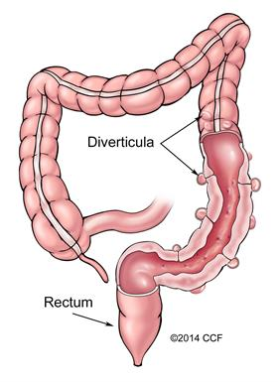
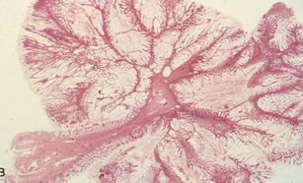
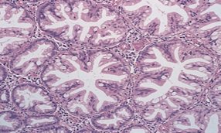
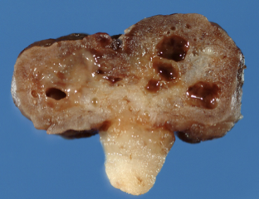
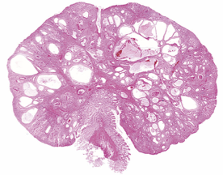
Benign tumors of intestine
Polyps
Abnormal growth of tissue, protruding from a mucous membrane, usually benign but some can develop into cancer.
Pedunculated polyp: attached to the surface by a stalk.
Sessile polyp: attached directly without a stalk.
Diverticula: Small bulging of the colonic mucosa and submucosa through weaknesses of muscle layers in the colon wall.
Non-neoplastic polyps (90%)
1- Hyperplastic polyps
Asymptomatic.
More than 50% are located in the rectosigmoid.
Most common type in adults.
A: Sawtooth surface.
B: Star shaped crypts.
Composed of well-formed glands and crypts lined by differentiated goblet or absorptive cells.
No malignant potential or polyposis syndromes.
2- Hamartomatous polyps¹
Juvenile Polyps (retention polyp):
Developmental malformations affecting the glands
and lamina propria
Commonly occur in children under 5 years old in the rectum.
In adult called retention polyp
No malignant potential.
A
B
Smooth eroded surface with numerous mucus retention cysts, typical of sporadic juvenile polyps.
Female’s slides
Juvenile polyposis
Hereditary |  | Non-hereditary
Autosomal dominant | Cowden syndrome | Cronkhite-Canada syndrome
TGF-β signaling pathway abnormalities. Juvenile polyps; risk of gastric, small intestinal, colonic, and pancreatic adenocarcinoma. | Abnormality in PTEN Hamartomatous polyps, lipomas, ganglioneuromas, inflammatory polyps; increased risk for colon cancer and cancer of thyroid and breast. | Polyps plus ectodermal abnormalities (Nail atrophy, hair loss, abnormal skin pigmentation) cachexia, and anemia.
1- Tumor of tissue embryologically related to its origin (as opposed to teratoma).

Slide 4
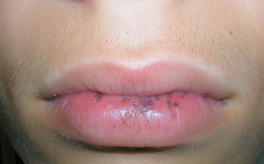
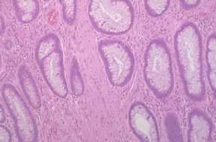
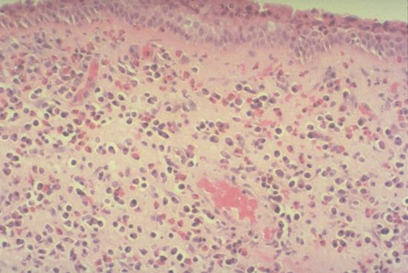
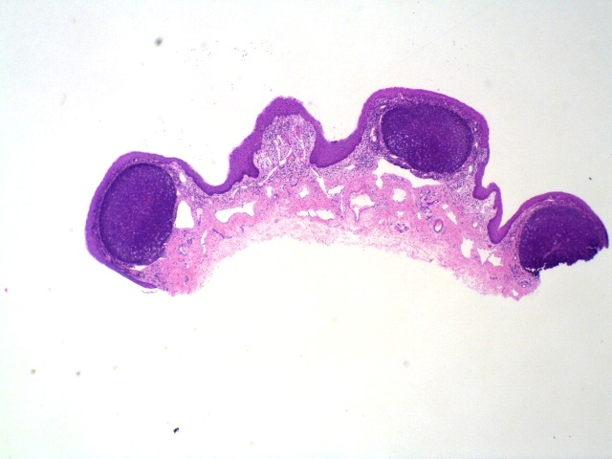
Polyps Cont.
B. Peutz-Jehgers syndrome:
Rare, autosomal dominant.
Hamartomatous polyps.
Mucosal & cutaneous pigmentation around the lips, oral mucosa, face and genitalia.
Present with red blood in stool.
Polyps tend to be large and pedunculated.
Increased risk of developing carcinoma of the pancreas, breast, lung, ovary and uterus.
Present at 10-15 years of age.
Mutated gene: LKB1/STK11 which encodes a tumor suppressive protein kinase that regulates cellular metabolism.
3. Inflammatory Polyps
Longstanding IBD, especially in chronic ulcerative colitis.
Represent an exuberant reparative response to longstanding
mucosal injury called pseudopolyps.
4. Lymphoid Polyps
Reactive peyer's patch
Mucosa is normal

Slide 5
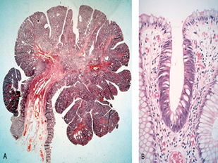
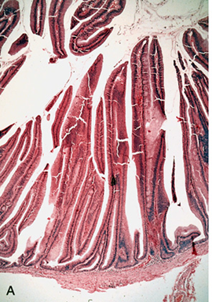
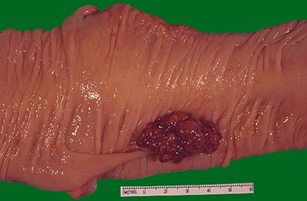
Neoplastic Polyps
Adenomatous Polyp (adenoma)
Occur mainly in large bowel.
Sporadic and familial.
Vary from small pedunculated to large sessile.
Epithelium proliferation and dysplasia.
Divided into:
1. Tubular adenoma (less than 25% villous structures)
Most common.
75 % occur in the distal colon and rectum.
Sigmoid colon most common site.
2. Villous adenoma (villous structures more than 50%)
The least common.
Largest and most likely to become malignant.
Age: 60 to 65 years, 75% located in rectosigmoid area.
Symptoms:
Rectal bleeding or anemia.
Large ones may secrete mucoid material rich in protein and K⁺
Therefor causes hypoalbuminemia & hypokalemia.
3. Tubulovillous adenoma (Villous architecture between 25 and 50%)
20%–30% of polyps
Intermediate in size, degree of dysplasia and malignant potential between tubular and villous adenomas.
Relationship of Neoplastic Polyps to Carcinoma
The probability of carcinoma occurring in a neoplastic polyp is related to:
The size of polyp.
The relative proportion of its villous features.
The presence of significant cytologic atypia (dysplasia) in the neoplastic cells.
Multiple polyps.

Slide 6
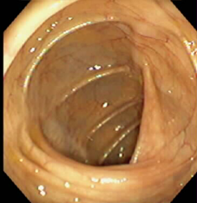
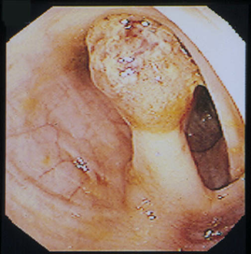
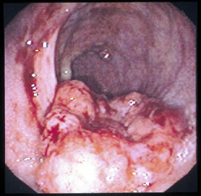
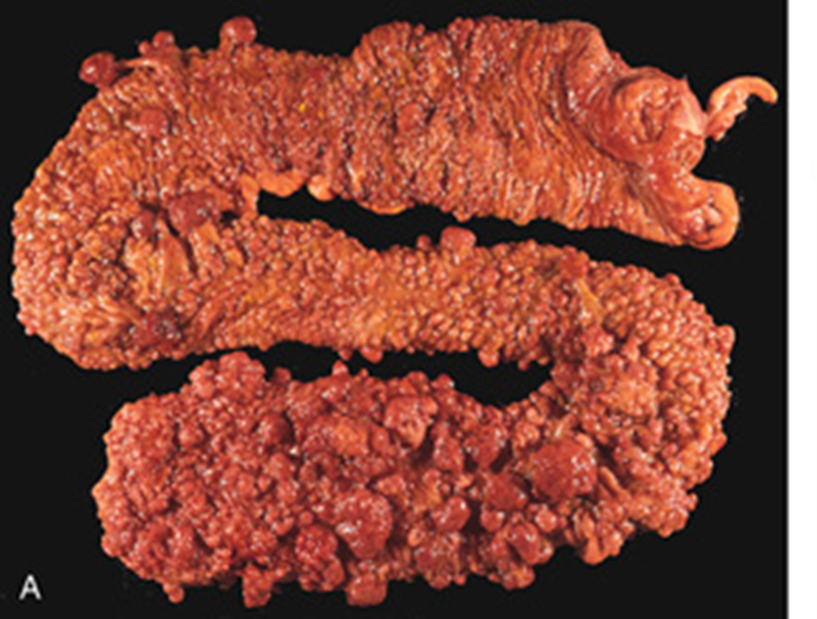
Neoplastic polyps and Carcinoma
Adenoma to Carcinoma pathway
Adenoma to carcinoma sequence is documented by several genetic alterations.
Normal epithelium
APC loss
Hyperprol-iferation
Early Adenoma
K-ras mutations
Intermediate Adenoma
Chromosome 18 loss
Late Adenoma
P53 loss
Cancer
Normal
Adenoma
Cancer
APC loss: hyperproliferation of normal epithelium
K-ras mutation: change of early
Familial Polyposis syndromes
Patients have genetic tendencies to develop neoplastic polyps.
Familial polyposis coli (FPC):
Genetic defect of Adenomatous polyposis coli (APC).
APC gene is a tumor suppressor gene located on the long arm of
chromosome 5 (5q21).
Innumerable neoplastic polyps in the colon (500 to 2500)
Polyps are also found elsewhere in alimentary tract
The risk of colorectal cancer is 100% by midlife.
Gardener’s syndrome:
Polyposis coli; Present at 10-15 years of age.
Multiple Osteomas
Epidermal cysts
Fibromatosis
Turcot syndrome:
Polyposis coli; Present at 10-15 years of age.
Glioma (look for brain symptoms)
Fibromatosis
CNS tumors; medulloblastoma.
FPC

Slide 7
Malignant tumors of intestine
Introduction
Tumors of the small and large intestines:
Carcinoma.
Carcinoid tumor.
Lymphoma.
The small intestine is an uncommon site for benign and malignant tumors.
Adenocarcinoma
Adenocarcinoma of the colon is the most common GI malignancy
Epidemiology
Major cause of morbidity and mortality worldwide.
Constitutes 98% of all cancers in the large intestine.
Incidence peaks at 60 to 70 years of age.
Aspirin or other NSAIDs have a protective effect.
Predisposing factors
IBD, adenomas, polyposis syndrome.
Diet appears to play an important role in the risk for colon cancer:
Low fibre diet.
High fat content.
Alcohol
Reduced intake of vit A, C & E (antioxidants)
Why does less fibers and more fat intake predispose?
Large stool bulks usually wipe off toxic oxidative byproducts produced by normal flora.
Smaller stool bulks allows the toxic byproducts to stay on the mucosa for longer time.
Since reduced fiber intake causes a decrease in stool size, the byproducts increased time on the mucosa will lead to oxidative damage.
High fat intake increases production of bile acids and cholesterol.
Which can be converted by normal flora to carcinogens.

Slide 8
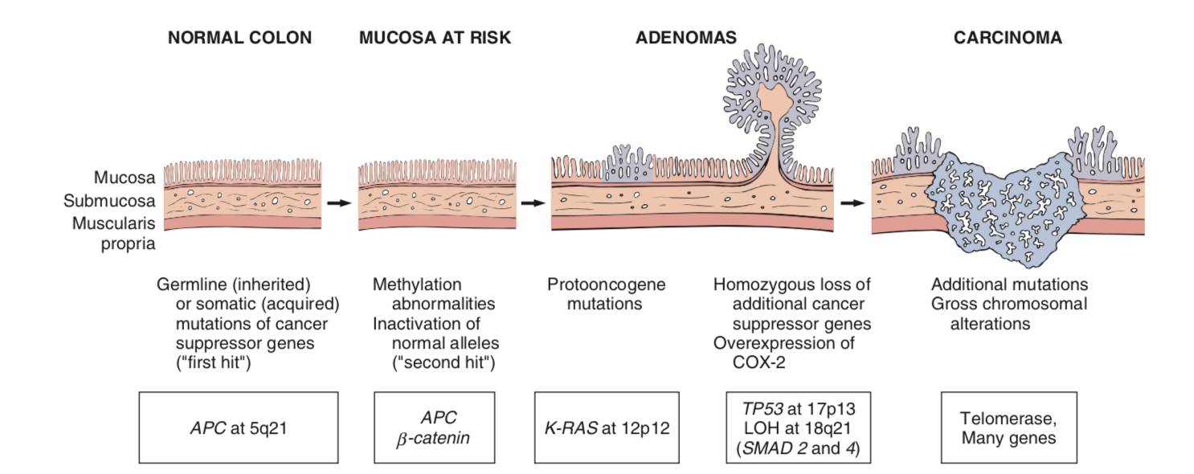
Malignant tumors of intestine
Adenocarcinoma of Large Intestine
Carcinogenesis
Two pathogenetically distinct pathways for the development of colon cancer, both seem to result from accumulation of multiple mutations:
1- The APC/B-catenin pathway (85%):
Chromosomal instability that results
in stepwise accumulation of mutations
in a series of oncogenes and tumor
suppressor genes.
Hereditary mutation of the APC gene is the cause of familial adenomatous polyposis (FAP), where affected individuals carry an almost 100% risk of developing colon cancer by age 40 years.
2- The DNA mismatch repair genes pathway:
Referred to as MSI high, or MSI-H tumors.
10% to 15% of sporadic cases.
There is accumulation of mutations
Five DNA mismatch repair genes (MSH2, MSH6,
MLH1, PMS1, & PMS2)
Give rise to the hereditary non polyposis colon carcinoma (HNPCC) syndrome:
This result in microsatellite instability and permit accumulation of mutations in numerous genes.
If these mutations affect genes involved in cell survival and proliferation, cancer may develop.
It progress from normal to sessile serrated adenomas to adenocarcinoma.
May produce abundant mucin that accumulates within the intestinal wall, and these carry a poor prognosis.
Adenocarcinoma sequence
Females slides

Slide 9
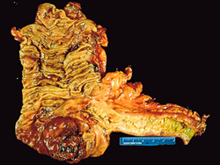
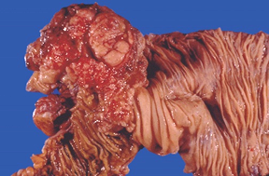
Malignant tumors of intestine
Colorectal Carcinoma
Gross pathology
70% are in the rectum, rectosigmoid and sigmoid colon.
Left-sided carcinomas tend to be
Annular, encircling lesions
Early symptoms of obstruction. (bleeding in stool)
Right-sided carcinomas
Grow as polypoid,fungating masses
Obstruction is uncommon.
Chronic bleeding leads to Anemia, and hard to detect
Microscopy
A,B: Adenocarcinoma: consist of infiltrating glands lined by atypical cells.
C: Mucinous adenocarcinoma secret abundant mucin
that may dissect through cleavage planes in the wall.
Right sided
Left sided
A
B
C
Signs and symptoms
Rectal bleeding (PR): If located closer to the anus.
Change in bowel habit, feeling of incomplete defecation.
Bowel obstruction: A tumor that is large enough to fill the entire lumen of the bowel.
Right-sided lesions are more likely to bleed while left-sided tumors are usually detected later and could present with bowel obstruction.
Tumor markers & prognosis
A substance found in the blood, urine or body tissues that can be elevated in cancer, among other tissue types.
Tumor markers that are useful to asses recurrence:
Carcinoembryonic antigen (CEA): may also be raised in some non-neoplastic conditions like ulcerative colitis, pancreatitis, cirrhosis, COPD, Crohn’s disease as well as in smokers.
Carbohydrate antigen (CA19-9): raised in patients with colon cancer and pancreatic cancer, esophageal cancer and hepatocellular carcinoma, elevated levels may also occur in pancreatitis and cirrhosis.
Tissue inhibitor of metalloproteinases 1 (TIMP1): early as well as late stage diseases.
The most important prognostic factors: depth of invasion, the presence or absence of lymph node metastases and distant metastasis.
Tumor Node Metastasis (TNM) and Duke classification used for Staging of Colon Cancers.

Slide 10
Malignant Small intestinal Neoplasms
Malignant Small intestinal Neoplasms
Carcinoid (most common)
Adenocarcinomas
Lymphomas
Leiomyosarcomas. (least common)
Carcinoid Tumors
Neoplasms arising from endocrine cells found in the GI mucosa.
The peak incidence: sixth decade, but they may appear at any age.
They compose less than 2% of colorectal malignancies
Almost half of small intestinal malignant tumors: 60 to 80% appendix and terminal ileum
10 to 20% rectum.
Behavior: aggressive behavior correlates with: (Females slides)
Site of origin:
Appendiceal and rectal carcinoids rarely metastasize, even though they may show extensive local spread.
90% of ileal, gastric, and colonic carcinoids that have penetrated halfway through the muscle wall have spread to lymph nodes and distant sites at the time of diagnosis, especially those larger than
2 cm in diameter.
Depth of local penetration
Size of the tumor
Morphology
A: A solid, yellow-tan appearance.
B: The cells are monotonously similar, having a scant, pink
granular cytoplasm and a round to oval stippled nucleus.
C: Ultrastructural features: neurosecretory electron dense
bodies in the cytoplasm.
Clinical features
Asymptomatic
May cause obstruction, intussusception¹ or bleeding.
May elaborate hormones: Zollinger-Ellison, Cushing’s carcinoid or
other syndromes.
1- Segment of small bowel will be drawn into next segment of the bowl

Slide 11
Malignant Small intestinal Neoplasms
Carcinoid Syndrome (Caused by Carcinoid tumor)
1% of carcinoid tumor & in 20% of those of widespread metastasis.
The principal chemical mediator is serotonin and other bioactive compounds (e.g., histamine, bradykinin).
The syndrome is classically associated with ileal carcinoids with hepatic metastases.
Clinical findings
Paroxysmal flushing due to vasodilation¹ and serotonin.
Episodes of asthma-like wheezing due to bronchospasm.
Attacks of watery diarrhea & abdominal pain.
Facial telangiectasia
Tricuspid regurgitation and pulmonary stenosis due to increases collagen production in the valves caused by serotonin → Right-sided heart failure.
Serotonin and diarrhea (Females slides)
Diarrhea in carcinoid patients has two components
Secretory component: due to increased serotonergic stimulation of submucosal secretomotor neurons.
Motor component: faster small bowel and colon motility as a exaggerated response to ingestion of food
Lymphoma
Most often low-grade lymphomas arising in mucosal-associated lymphoid tissue (MALT) lymphoma
high-grade non-Hodgkin's lymphomas of B cell type, May occur in any part of the intestine;
The ileocecal region is a favored site for Burkitt's lymphoma.
1- May be triggered by emotion, alcohol, other food.

Slide 12
Summary
Benign tumors of the intestine
Polyps | Non-neoplastic polyps (90): no dysplasia Hyperplastic polyps: sawtooth surface, star-shaped crypts. Hamartomatous polyps (A: Juvenile & B: Peutz-Jeghers polyps): A: occur in children under 5 y.o in the rectum. B: rare, autosomal dominant, increased risk of developing carcinoma. Inflammatory polyps: pseudopolyps caused by IBD or chronic UC. Lymphoid polyps Neoplastic Polyps (10%): there is dysplasia Adenoma: occurs mainly in large bowel, sporadic and familial, epithelium proliferation and Dysplasia, divided into: 1. Tubular adenoma. 2. Villous adenoma. 3. Tubulovillous adenoma. Syndormes related to polyps: 1. Familial polyposis coli (FPC) Genetic defect of Adenomatous polyposis coli (APC). APC gene located on the long arm of chromosome 5 (5q21). APC gene is a tumor suppressor gene. 2. Gardener’s syndrome: Polyposis coli, Multiple Osteomas, Epidermal cysts and Fibromatosis 3. Turcot syndrome: Polyposis coli, Glioma and Fibromatosis
Malignant tumors of intestine
Adeno- carcinoma | The most common malignancy of the GI tract. Mostly rectum or sigmoid colon Predisposing factors IBD, adenomas, polyposis syndrome. Diet appears to play an important role in the risk for colon cancer: Low fibre diet, High fat content, Alcohol, Reduced intake of vit A, C & E: Carcinogenesis: two pathogenetically distinct pathways for the development of colon cancer: The APC/B-catenin pathway ( 85 % ): Hereditary mutation of the APC gene is the cause of familial adenomatous polyposis (FAP) which lead to colon cancer. The DNA mismatch repair genes pathway: Five DNA mismatch repair genes (MSH2, MSH6, MLH1, PMS1, AND PMS2), give rise to the hereditary non polyposis colon carcinoma (HNPCC) syndrome.
Colorectal Carcinoma | Left-sided carcinomas early symptoms of obstruction and frank bleeding Right-sided carcinomas Iron deficiency anemia. Tumor marker for assessment of recurrence: CEA carcinoembryonic antigen
Carcinoid tumors | Neoplasms arising from endocrine cells found along the length of GIT mucosa. Morphology: Ultrastructural features: neurosecretory electron dense bodies in the cytoplasm. Clinical features: Asymptomatic, may cause obstruction, intussusception or bleeding, and may elaborate hormones: Zollinger-Ellison, Cushing’s carcinoid or other syndromes. Carcinoid syndrome: Paroxysmal flushing, episodes of asthma-like wheezing, right-sided heart failure, attacks of watery diarrhea, abdominal pain, The principal chemical mediator is serotonin. The syndrome is classically associated with ileal carcinoids with hepatic metastases.
Lymphoma | Most often low-grade lymphomas arising in mucosal-associated lymphoid tissue (MALT) lymphoma or high-grade non-Hodgkin's lymphomas of B cell type. May occur in any part of the intestine; The ileocecal region is a favored site for Burkitt's lymphoma.

Slide 13
Quiz
Q1: Juvenile polyps occur in children in which of the following structures?
Stomach
Sigmoid colon
Rectum
Ascending colon
Q2: Which of the following is true about Peutz-Jehgers syndrome:
Autosomal recessive
Increase risk of developing Glioblastoma
Common
Autosomal dominant
Q3: The most prominent feature of adenomas:
Granuloma​​
Occur mainly in small bowel
Only familial cases
Dysplasia
Q4: Which of the following gene loss can lead to cancer?
MSH8
Chromosome 10
p53
MLH9
Q5: Right-sided Colorectal carcinoma usually present with:
Iron deficiency anemia
obstruction
Annular cricling lesions
Frank bleeding
Q6: Common presentation between Gardener’s syndrome and Turcot syndrome:
Epidermal cysts
Multiple osteomas
Polyposis coli
Gliomas
Q7: The most common malignancy of the GI tract:
Colorectal
Adenocarcinoma
Lymphoma
Carcinoid
Q8: Carcinoid syndrome related to which of the following:
Ach
Norepinephrine
Histamine
Serotonin
Q9: Defect in which of the following genes can lead to Familial polyposis coli (FPC)?
P53 located on the short arm of chromosome 5 (5p21)
P53 located on the long arm of chromosome 5 (5q21)
APC gene located on the long arm of chromosome 5 (5q21)
APC gene located on the short arm of chromosome 5 (5p21)
1.C 2.D 3.D 4.C 5.A 6.C 7.B 8.D 9.D

Slide 14
TEAM LEADERS:
Khalid Alkhani & Lama Alzamil
SUBLEADERS:
Alwaleed Alsaleh & Alhanouf Alhaluli
THIS AMAZING WORK WAS DONE BY:
THIS AMAZING WORK WAS DONE
Alwaleed Alsaleh
Mohannad makkawi
THANK YOU

