Slide 1
Drugs and biological and immune therapy
in inflammatory bowel disease (IBD)
Objectives:
By the end of the lecture , you should know:
Define inflammatory bowel disease
Differentiate between ulcerative colitis and Crohn’ disease.
Define the stepwise treatment of IBD
Discuss the pharmacokinetics, pharmacodynamics, uses and adverse effects of 5-amino salicylic acid compounds (5-ASA), glucocorticoids, immunomodulators and biological therapy (TNF-α inhibitors)
Compare between drugs used for induction of remission and those used for maintenance of remission
Color index:
Editing File
Black : Main content
Red : Important
Blue: Males’ slides only
Purple: Females’ slides only
Grey: Extra info or explanation
Green : Dr. notes

Slide 2
Inflammatory Bowel Disease IBD
A group of inflammatory conditions of the small intestine and colon.
The major types of IBD are Crohn's disease and ulcerative colitis (UC)
Causes
Unknown
Autoimmune
Genetically
inherited
The Major Types of IBD
 | Crohn’s disease | Ulcerative Colitis
Definition | Chronic transmural inflammation of gastrointestinal tract | Chronic mucosal inflammation of the colon
Location | affect any part of the GIT, From mouth to anus | Restricted to colon & rectum
Distribution | Patchy areas of inflammation | Continuous area of inflammation
Depth of inflammation | May be transmural, deep into tissues | Shallow, mucosal
Complications | Strictures, Obstruction, Abscess, Fistula | Toxic megacolon, Colon cancer
Presentation
Bleeding | Occasional | Very common
Obstruction | Common | Uncommon
Fistulae |  | None
Weight loss |  | Uncommon
Perianal disease |  | Rare
Females only

Slide 3
Symptoms of IBD
Complications
Abdominal pain
Anemia
Vomiting
2
1
Megacolon (mainly for UC)
Weight loss
Diarrhea
Colon cancer (mainly for UC)
Rectal bleeding
Abdominal obstruction(Crohn’s disease)
Treatment
Treatment objectives¹
Stepwise² therapy
Achievement of remission (Induction)
Prevention of disease flares (maintenance)
Normalize bowel function
Maintain nutritional status
Improve quality of life
5-aminosalicylic acid compounds (5-ASA) or aminosalicylates
Glucocorticoids
Immunomodulators
Biological therapy (TNF-α inhibitors)
Surgery in severe condition
Aminosalicylates (5-ASA)
Classes | Azo Compound | Mesalamines (More common)
Drugs | Sulfasalazine Olsalazine Balsalazide | Asacol Pentasa Canasa Rowasa
 | The major differences are in mechanism and site of delivery
MOA | Have TOPICAL³ anti-inflammatory action due to: inhibition of prostaglandins⁴ and leukotrienes. decrease neutrophil chemotaxis Antioxidant activity (scavenging free radical production)
P.K | 5-ASA itself is absorbed from the proximal small intestine⁵ Different formulations (Azo component & Mesalamines) are used to overcome rapid absorption of 5-ASA from the proximal small intestine All aminosalicylates are used for induction (treatment) and maintenance (prophylaxis) of remission
Uses | Induction and maintenance of remission in mild to moderate IBD (First line of treatment) Rheumatoid arthritis (Sulfasalazine only) Rectal formulations are used in distal ulcerative colitis, ulcerative proctitis and proctosigmoiditis
1: no actual cure, aim is to reduce or get rid of the inflammation = reduce disease manifestations.
2: “do not go for option 2 unless you try option 1 and it does not work”.
3: the drug has to come in contact with the affected tissue to produce its effect (which means that there is no need for the drug to be absorbed in case of IBD=less systemic side effects)
4: all prostaglandins will be inhibited, including I&E that are physiologically beneficial for the stomach (by protecting against acidity).
5: not effective in UC unless given in a different formulation that will prevent its absorption in the SI.

Slide 4
Aminosalicylates (5-ASA)
Azo Compound
These compounds contain (5-ASA) that is connected by azo bond (N=N) into :
1- sulfapyridine moiety (Sulfasalazine)
Sulfasalazine: 5-ASA + sulphapyridine
2- another molecule of 5-ASA (Olsalazine)
Olsalazine: 5-ASA + 5-ASA
3- inert compound (Balsalazide)
Balsalazide: 5-ASA + inert carrier¹
Azo structure reduces absorption of 5-ASA in small intestine
In the terminal ileum and colon, azo bond is cleaved by azoreductase enzyme produced by bacterial flora releasing 5-ASA in the terminal ileum and colon².
Drug | Sulfasalazine (Azulfidine)
P.K | Pro-drug A combination of 5-ASA+sulfapyridine Given orally (enteric coated tablets) Little amount is absorbed (10%³) In the terminal ileum and colon, sulfasalazine is broken by azoreductase Into: 5-ASA (not absorbed, active moiety, acting locally) Sulphapyridine (absorbed, causes most of side effects)
ADRs | Due to Sulfapyridine: Folic acid deficiency ( should be provided) Impairment of male fertility (oligospermia)(Temporary) Megaloblastic anemia⁴
4. Crystalluria⁵
5. Bone marrow depression
Due to 5-ASA:
Interstitial nephritis (rare)
B) Mesalamine Compound
(Temporary)
Formulations that have been designed to deliver 5-ASA in terminal small bowel & large colon.
Features of Mesalamine compounds are:
Well tolerated
Sulfate free
Less ADRs than sulfasalazine
Useful in patient sensitive to sulfa drugs
1
Oral⁶ Formulations
2
Rectal Formulations
● Releases 5-ASA in the distal small bowel secondary to pH changes.
● Release starts at the pylorus and continues throughout the small bowel and colon.
release 5-ASA in the distal colon.
Pentasa: micro granules that release 5-ASA throughout the small intestine.(sustain released ⁷)
Canasa (suppositories)
Asacol: 5-ASA coated in pH-sensitive resin that dissolve at pH 7. (delayed release tablet⁸)
Rowasa (enema)
1: Inert carrier has no pharmacological importance, only helps ASA reach the colon. 2: The desired site of action
3: this 10% is powerful enough to produce systemic side effects
4: Due to folic acid antagonism. 5: Advice patient to stay hydrated to avoid crystalluria.
6: ASA release should be controlled to avoid absorption in the SI, which is established by the following:
7: “Sustained release capsules”: the capsules contain different colored granules, each color is meant to disintegrate at a specific part of the GIT (helpful in case of Crohn’s disease where the stomach is affected).
8: “delayed release tablet”: the tablet only disintegrate when exposed to a specific pH (basic pH of the distal SI in this case)

Slide 5
Glucocorticoids¹
Drugs
Route | Orally | Parenteral (I.V , I.M) | Rectal
M.O.A | Inhibits phospholipase A2 Inhibits gene transcription of NO synthase cyclooxygenase-2 (COX-2) Inhibit production of inflammatory cytokines
P.K | Higher rate of absorption |  | Less absorption rate than oral. As enema or suppository, give topical effect
Uses | Indicated for ACUTE flares of disease (moderate to severe active IBD). Are NOT useful in maintaining remission Oral glucocorticoids: are commonly used in active condition. Rectal glucocorticoids: are preferred in IBD involving rectum or sigmoid colon. Other uses: Asthma Rheumatoid arthritis immunosuppressive drug for organ transplants Antiemetic during cancer chemotherapy
ADRs | More adverse effects compared to rectal |  | Minimal side effects and maximum tissue effects
Prednisone
Prednisolone
Hydrocortisone
Methylprednisolone
Hydrocortisone
Drug | Budesonide
M.O.A | A potent synthetic prednisolone analog
P.K | Given orally (controlled release tablets) so release drug in ileum and colon Low oral bioavailability² Subject to extensive first pass metabolism
Uses | Used in treatment of active mild to moderate crohn’s disease involving Ileum and Proximal colon
1: systemic release = more side effects than ASAs
2: lower bioavailability = less release into the systemic circulation (considered an advantage since the site of action is GIT) = topical action in contact with the inflamed tissues .

Slide 6
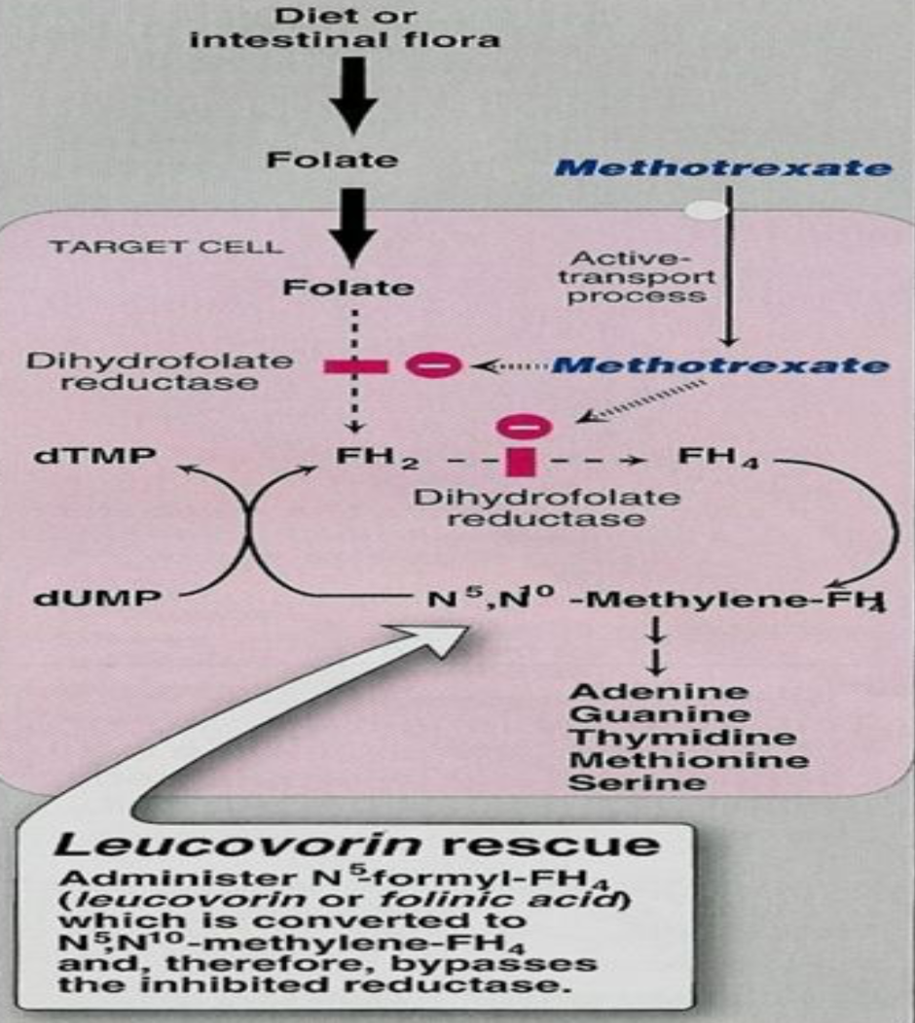
Immunomodulators
Drug | Methotrexate | Purine analogs: Azathioprine | 6-mercaptopurine
M.O.A | a folic acid antagonist Inhibits dihydrofolate reductase required for folic acid activation (tetrahydrofolate) Impairs DNA synthesis | Azathioprine is pro-drug of 6-mercaptopurine Inhibit purine synthesis and inhibits synthesis of DNA, RNA, and proteins. It may decrease proliferation of immune cells, which lowers autoimmune activity.
P.K | Orally, I.M | -
Uses | Induce and maintain remission in IBD in active moderate to severe conditions or steroid dependent or steroid resistant patients.
 | Inflammatory bowel disease Rheumatoid arthritis Cancer | -
ADRs | Megaloblastic anemia ¹ Bone marrow depression ¹ Teratogenic | Bone marrow depression: leucopenia, thrombocytopenia. Hepatic dysfunction CBC & liver function tests are required in all patients Gastrointestinal toxicity.
Monoclonal antibodies used in IBD (TNF-α inhibitors)²
MOA | Act by binding to TNF-a thus preventing its binding to cell surface receptors. Increase apoptosis of T-lymphocytes and monocytes.
Drug | Adalimumab (Humira) | Certolizumab ( Cimzia )
Over- view | Fully humanized³ IgG antibody to TNF-α (TNF-α inhibitor) It binds to TNF-a, preventing it from activating TNF receptors Has an advantage in that it is given by subcutaneous injection | Fab fragment of a humanized antibody directed against TNF-α Certolizumab is attached to polyethylene glycol to increase its half-life in circulation. Given subcutaneously
Uses | moderate to severe Crohn’s disease rheumatoid arthritis psoriasis | Crohn's disease Rheumatoid arthritis
1: both due to folic acid antagonism
2: the suffix (mab) means that the drug is composed of antibodies (protein) so it cannot be given orally because it is going to be degraded before reaching the side of action.
3: less risk of early sensitivity seen in infliximab.

Slide 7
Monoclonal antibodies used in IBD (TNF-α inhibitors) cont...
Drug | Infliximab
Over- view | a chimeric mouse¹-human monoclonal antibody, 25% murine – 75% human. Inhibits soluble or membrane –bound TNF-α located on activated T lymphocytes. Given intravenously as infusion (5-10 mg/kg). has long half life (8-10 days) 2 weeks² to give clinical response.
Uses | In moderate to severe³ active Crohn’s disease and ulcerative colitis. Patients NOT responding to immunomodulators or glucocorticoids. Treatment of rheumatoid arthritis. Psoriasis.
ADRs | Acute or early infusion ADRs(Allergic reactions or anaphylaxis in 10% of patients) Type 1 allergic reaction Delayed type hypersensitivity reaction (serum sickness- reaction, in 5% of patients). Pre-treatment⁴ with diphenhydramine, acetaminophen, corticosteroids is recommended Loss of response to infliximab over time due to the development of antibodies to infliximab. ↑risk of opportunistic infection⁵ (Latent TB, sepsis, hepatitis B, fungal infection). Severe hepatic failure. Rare risk of lymphoma⁶.
Summary from Doctor slides
Treatment of IBD
Inductive Therapy
Maintenance Therapy
A) For Ulcerative colitis:
- Aminosalicylates
-Corticosteroids
-Immunomodulators
-Infliximab
B) For Crohn's disease:
-Aminosalicylates
-Corticosteroids
-Antibiotics
-Biologics
-Aminosalicylates
-Immunomodulators:
Azathioprine &
6-Mercaptopurine &
Methotrexate
-Infliximab
NO corticosteroids
1: leads to allergic manifestations (early)
2: because some T-cells have been already activated, and patient should be aware of the delayed response.
3: not given to mild due to its side effects. 4: to avoid allergic reactions.
5: patients should be tested for those infections before starting the treatment.
6: due to the lower immunity produced by the drug.

Slide 8
Quiz
MCQ
1- A patient suffering from prostate cancer and he is also having IBD which one of the following is drug of choice ?
A- Methotrexate B- Infliximab C- Azathioprine
2- Which of the following drugs is fully humanized IgG antibody to TNF-α?
A- Infliximab B- Adalimumab C- Certolizumab
3- Patient on treatment of IBD comes with oligospermia and Crystalluria, which drug he used?
A- Sulfasalazine B- Canasa C- Methotrexate
4- Which of the following side effects is a result of treatment rheumatoid arthritis using infliximab?
A- Glaucoma B- Vomiting C- Activation of latent tuberculosis
5- A patient came to the ER due to abdominal pain and rectal bleeding, examination and investigations revealed that he has active crohn's disease. Which drug can be use?
A- Budesonide B- Sulfasalazine C- Azathioprine
SAQ
-A 35 years old patient Recently diagnosed with IBD and was prescribed a treatment, After weeks he started developing hepatic dysfunction.
Q1-What drug caused this adverse reaction?
Q2-What is the mechanism of action of that drug?
-A 84 years old male was diagnosed with IBD, after some investigations the doctor found that his proximal colon and ileum were affected.
Q3-What drug is the best to be used in this case?
-43 years old man visited the physician complaining of abdominal discomfort, rectal bleeding and diarrhea for the past month. Endoscopy of the colon showed patchy inflamed areas along the colon.
Q4-What drug do you recommend for him first?
Q5-Mention three side effect.
MCQ
SAQ
Q1 | A
Q2 | B
Q3 | A
Q4 | C
Q5 | A
Q1 | Azathioprine
Q2 | Inhibit purine synthesis and the synthesis of DNA, RNA, and proteins
Q3 | Sulfasalazine or Budesonide
Q4 | Sulfasalazine
Q5 | Bone marrow depression-Megaloblastic anemia-Folic acid deficiency
Answers:

Slide 9
Share with us your ideas !
Good Luck ,
Future Doctors!
Team Leaders:
May Babaeer Zyad Aldosari
This Amazing Work is By:
May Babaeer Raghad AlKhashan
Noura AlMazrou Shahad AlSahil

