Slide 1
ate my life
Treatment of Dysentery and Amoebiasis
Objectives:
By the end of the lecture , you should know:
To understand different causes of dysentery
To describe different classes of drugs used in treatment of both bacillary dysentery and amebic dysentery
To be able to describe actions, side effects of drugs for treating bacillary dysentery
To understand the pharmacokinetics, actions, clinical applications and side effects of antiamebic drugs
to be able to differentiate between types of antiamebic drugs; luminal amebicides, and tissue amebicide
Color index:
Editing File
Black : Main content
Red : Important
Blue: Males’ slides only
Purple: Females’ slides only
Grey: Extra info or explanation
Green : Dr. notes

Slide 2
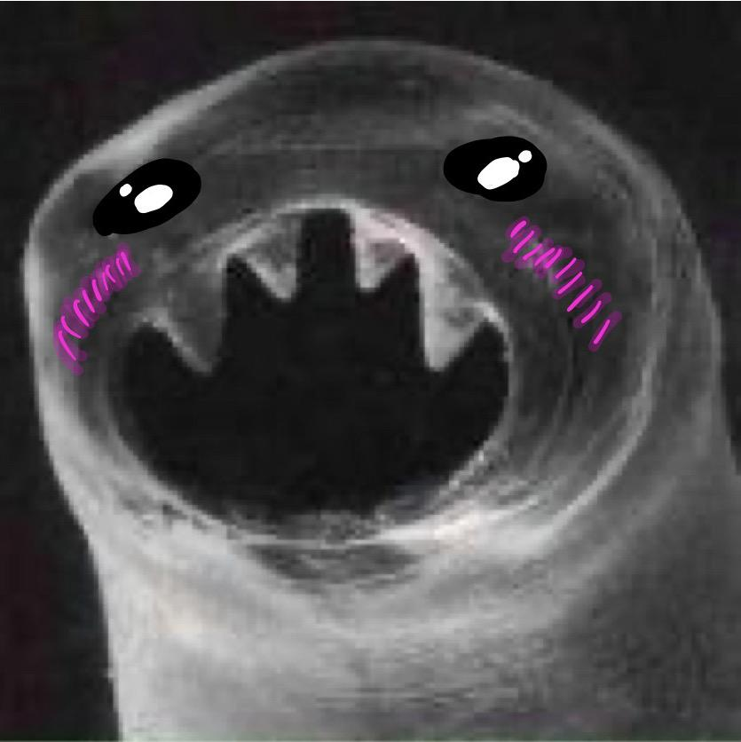
This is a story all about how my life got turned upside down
Dysentery
is an inflammatory disorder of the intestine, especially of the colon, that results in severe diarrhea containing mucus and/or blood in the feces with fever and abdominal pain caused by any kind of infection.
Causes of Dysentery:
The most common:
02
Bacterial infection
Bacillary dysentery (bacterial infection mainly by shigella)
Viral infection
03
01
Parasitic infection
Amebic dysentery (Protozoal infection Mainly by Entamoeba Histolytica)
01
Treatment:
Maintain fluid intake using oral rehydration therapy or intravenous fluid therapy¹.
Antidiarrheal drugs²
Antimicrobial agents should not be given until stool analysis is done to specify the etiological agent³
Antidiarrheal Drugs
Drug | Loperamide Common | Diphenoxylate + Atropine⁴
MOA | opioid-receptor agonist⁵
P.K | μ-opioid receptors in the myenteric plexus of the large intestine. Do not cross BBB⁶ Minimal liability for addiction | Can cross BBB Has high liability for addiction Side effects are mainly due to atropine.
C.I | Treatment should be avoided in: presence of high fever if the stool is bloody. C. difficile infections They are contraindicated because they delay fecal excretion that can prolong fever, as it increases the risk of toxin retention⁷and precipitation of toxic megacolon.
Amebiasis
Is a protozoal infection of the intestinal tract that occurs due to ingestion of foods or water contaminated with cysts of Entameba Histolytica
1: oral if patient is not vomiting, IV if patient cannot handle oral. 2:work by reducing GI motility, but has no antimicrobial effect.
3: so you could treat either with antiviral, antibacterial or antiparasitic.
4:Atropine is added to diphenoxylate to increase the side effects (purposally), to avoid patients getting addicted to it.
5: morphine derivatives, morphine itself is not used due to high liability for addiction.(synergist)
6: advantage over morphine and diphenoxylate.
7: the decrease in GI motility will not allow for the was out of the causative organism, preventing the body from getting rid of it.

Slide 3
Entamoeba histolytica exists in two form:
- Can survive outside the human body.
- When ingested, liberate trophozoites in the lumen of the intestine.
- Multiply and feed on intestinal bacterial flora.
- They may invade and ulcerate wall of large intestine or may migrate to liver or other tissues.
- In rectum, trophozoites transform to cysts and are excreted in feces.
Cysts (infective stage)
Trophozoites (non-infective; invasive stage)
Life cycle of Amebiasis:
Cysts ingestion in contaminated food or water
Liberation of trophozoites in the colon¹.
Invasion² of intestinal wall and multiplication of trophozoites within colon wall
Systemic invasion to other organs (liver, lungs, brain)
Cyst formation in rectum and excretion in feces.
Clinical Presentation:
1
The patients show varying degree of illness from no symptoms to mild diarrhea to severe dysentery
2
Asymptomatic (Lumenal) amebiasis = Carriers (passing cysts in stool)
3
Mild to moderate
intestinal disease (colitis)
4
Severe intestinal infection (amoebic dysentery)
5
Ameboma (localized granulomatous lesion of colon)
6
Hepatic abscess, and other extra-intestinal disease
Antiamebic drugs:
Types | Tissue or systemic amebicides³ | Luminal amebicides⁴
Site of Action | Act on amoeba in tissues E.g. the intestinal wall and/or other extra-intestinal tissues as liver, brain, and lung. | Acts on the parasites in the lumen of the bowel
Uses | Used for treatment of systemic form of the disease (invasive amebiasis) e.g. intestinal wall infection or liver abscesses. | Used for treatment of asymptomatic amebiasis (carriers). Used to eradicate cysts of E.histolytica after treatment of invasive disease.
Drugs | Metronidazole/ tinidazole Emetine / dehydroemetine Chloroquine (liver only) | Diloxanide furoate Iodoquinol Antibiotic: Paromomycin Tetracycline
1: before invasion, the amoeba is only found in the colon, therefore at this stage (asymptomatic patients) Luminal amebicides are enough to treat.
2: once invasion occur, luminal amebicides are no longer enough alone, systemic amebicides should be used to eradicate the infection.
3: They are highly absorbable, allowing them to reach to systemic circulation and eradicate the organism from the systemic tissues. BUT they are not enough to eradicate the cysts from the intestines, thus, luminal amebicides SHOULD be administered after the systemic amebicides.
4: they are poorly absorbed, allowing them to act on the site of infection (the intestines).

Slide 4
Tissue or Systemic Amebicides
Drug | Metronidazole
M.O.A | It is a Tissue amoebicide that acts on trophozoites by: Inhibiting DNA replication Does not eradicate cysts from intestine due to good oral absorption.
P.K | Given orally or IV Absorption is rapid and complete Wide distribution to all tissues and body fluids (CSF, saliva, milk). Short Plasma half life is (8 h). Metabolized in liver (by CYP-450) by mixed function oxidase followed by glucuronidation (consider drug interactions). Clearance is decreased in liver impairment. Excreted in urine.
Uses | Drug of choice for treating invasive amebic infections (intestinal & extraintestinal amebiasis) Should be followed by luminal amebicides Giardiasis Trichomoniasis Anaerobic bacterial infections Peptic ulcer (Helicobacter pylori)¹. Pseudomembranous colitis (Clostridium difficile)².
ADRs
C.I | CNS diseases.(If I.V) Alcohol intake Pregnancy and breastfeeding women
Drug Inter- action | Enzyme inhibitors E.g. cimetidine, ketoconazole → increase duration of action of Metronidazole Enzyme inducers E.g phenytoin, phenobarbitone⁴ → decreased duration of action of Metronidazole Metronidazole inhibits CYP-450 (2C9 & 3A4) so: increases anticoagulant effect of warfarin
Alcohol inter- action | ● Combining metronidazole and alcohol causes nausea, vomiting, abdominal distress, flushing, headache, tachycardia,hyperventilation.
GIT:
Dry mouth, metallic taste.
Nausea, vomiting, diarrhea.
Oral Thrush (Moniliasis, yeast infection).
CNS: Neurotoxic effects
Insomnia, dizziness
Peripheral neuropathy, paresthesia.
Encephalopathy, convulsion (IV infusion, rare).
Other ADRs:
Dysuria, dark urine, neutropenia.
Disulfiram-like effect if taken with alcohol³.
Severe renal disease
Severe hepatic disease
Increases lithium toxicity
Ethanol
Alcohol
dehydrogenase
Acetaldehyde
Aldehyde
dehydrogenase
Acetate
1: as part of the triple therapy (PPI + Clarithromycin + metronidazole
2: Vancomycin can also be used.
3: not only alcohol, other substances such as some antivirals could also cause disulfiram-like effect if given with metronidazole.
4: & rifampicin.

Slide 5
Tissue or Systemic Amebicides cont...
Drug | Tinidazole
M.O.A | Has similar activity to metronidazole but better potency
P.K | Advantages of tinidazole : has longer duration of action (12-14h) a simpler dosing regimen¹ a better toxicity profile than metronidazole²
Drug
M.O.A | Both are effective against tissue trophozoites of E. histolytica causing irreversible block of protein synthesis.
P.K | Emetine is an alkaloid derived from ipeca³ while dehydroemetine is a synthetic analog. Have erratic oral absorption (not given orally). Given preferably subcutaneously but could be given IM, Never given as I.V⁴ Has long plasma half life about 5 days Should not be used for more than 10 days (usually 3-5 days) Metabolized & excreted slowly via kidney so they have a cumulative effect⁵. Because of major toxicity concerns they have been almost completely replaced by metronidazole⁶.
Uses | Amoebic liver abscess Intestinal wall infections Severe forms of amebiasis acute amoebic dysentery, dehydroemetine is preferable due to less toxicity (3-5 days)
ADRs | Dehydroemetine is less toxic than Emetine (safer) Serious toxicity: cardiotoxicity (Hypotension, cardiac arrhythmias, heart failure) GIT: nausea, vomiting, diarrhea
C.I | Patients with cardiac or renal disease Young children Pregnancy
Emetine
Dehydroemetine
Drug | Chloroquine
M.O.A | Anti-malarial drug.
Uses | Used in combination⁷ with metronidazole or dehydroemetine for amebic liver diseases.
ADRS | Pruritus is common Blurring of vision⁸ Hemolysis in G6PD deficient patients⁹ Nausea, vomiting, abdominal pain, anorexia
1: means less frequency of administration. 2: has the same side effects but to a lesser extent.
3: عرق الذهب
4: Due to high CVS toxicity.
5: May cause the patient to reach to level of toxicity . 6: usually only used in countries where metronidazole & tinidazole are unavailable.
7: or alone 8: (ALERT: CNS flashbacks) due to retinal deposition (retinopathy).
9: oxidizing drugs should be avoided in patients with G6PD deficiencies (which include: Sulfa drugs, trimethoprim and chloroquine).
.

Slide 6
B) Luminal Amebicides
Drug | Diloxanide furoate
M.O.A | M.O.A is unknown Direct¹ amoebicidal action against luminal forms (Cyst) Not effective against trophozoites in intestinal wall or extra-intestinal tissues.
P.K | Ester of diloxanide +Furoic acid Given orally It split in the intestine liberating diloxanide The little unabsorbed diloxanide is the amoebicidal agent The absorbed portion is excreted in urine
Uses | Drug of choice for asymptomatic intestinal infection(cyst passers) To eradicate cysts of E.histolytica after treatment of invasive disease with systemic amebicides
ADRs | Flatulence Nausea, vomiting, abdominal cramps.
C.I | Pregnancy Children (less than 2 years).
Drug | Iodoquinol
M.O.A | M.O.A is unknown Effective against the luminal forms of amebiasis
P.K | Is given orally Poorly absorbed, excreted in feces.
Uses | Luminal amoebicide for asymptomatic amebiasis
ADRs | GIT: Nausea,vomiting, diarrhea. Peripheral neuropathy including optic neuritis² Enlargement of the thyroid gland² Iodine sensitivity³ interference with thyroid function tests increase protein-bound serum iodine, decrease in measured (I¹³¹ uptake).
C.I | should be used with caution in patients with optic neuropathy, or thyroid disease discontinued if it produces persistent diarrhea or signs of iodine toxicity (dermatitis, urticaria, pruritus,fever)
1: should come in contact with the infected tissue to be effective (which is the lumen of intestines).
2: Even though it is poorly absorbed, the small traces of iodine that is absorbed is enough to cause all of these ADRs.
3: drug should be DISCONTINUED if patient shows any sign of iodine toxicity such as urticaria or eczema.

Slide 7
B) Luminal Amebicides cont...
Drug | Paromomycin sulphate
M.O.A | Aminoglycoside¹ antibiotic Direct amebicidal action: causes leakage by its action on cell membrane of parasite Indirect effect: killing of bacterial flora² essential for proliferation of pathogenic amoebae
P.K | Effective only against luminal forms of ameba Given orally Not significantly absorbed from GIT Small amount³ absorbed is excreted unchanged in urine (may accumulate with renal insufficiency)
Uses | Use in chronic amebiasis to eliminate cysts (in cysts passers)
ADRs | Gastrointestinal distress and diarrhea
C.I | Severe renal disease Patients with GIT ulceration
Summary For Treatment of Amebiasis
Asymptomatic dysentery (cyst carriers)
Amebic colitis
and dysentery. ameboma, and extra-intestinal disease
Hepatic abscess
Luminal amebicides
- Diloxanide
Or
-iodoquinol
Or
-Paromomycin
-Metronidazole
Or
-Tinidazole
followed by
luminal amebicides
-Metronidazole
Or
-Tinidazole
Or
-Chloroquine
Or
-Dehydroemetine
1: In general, aminoglycosides are usually only given parenterally due to their poor oral absorption, but because paromomycin sulphate is used to treat a parasite in the intestines, it is given orally so it could come in contact with the lumen (the poor oral absorption is used as an advantage).
2: That the amoeba normally feeds on.
3: sometimes enough to cause aminoglycosides usual ADR (phototoxicity and nephrotoxicity)

Slide 8
Bacillary dysentery treated by:
Beta-lactams
Macrolides
-Ampicillin, Amoxicillin
-3rd gen¹ cephalosporins (Cefixime, ceftriaxone)
Azithromycin
Fluoroquinolones
Cotrimoxazole
Such as :
Ciprofloxacin, ofloxacin
Trimethoprim-sulfamethoxazole² (TMP-SMX)
commonly used in traveler’s diarrhea.
Resistance to ampicillin, amoxicillin and sulfonamides has been reported worldwide, and these agents are not recommended as empirical therapy
Antimicrobial therapy is typically administered for 5 days.
Drug | Ciprofloxacin
M.O.A | Active against a variety of gram-positive and gram-negative bacteria Block bacterial DNA synthesis³ and growth (DNA gyrase and topoisomerase)
Uses | Fluoroquinolones are first-line treatment for shigellosis Bacterial diarrhea caused by shigella, salmonella and E coli Drug of choice for bacillary dysentery Urinary tract infections Respiratory tract infections Soft tissues, bones, and joint infections
ADRs | Arthropathy (damage of growing cartilage) Phototoxicity Liver toxicity GIT disorder (nausea, vomiting, diarrhea) CNS disorders (headache, dizziness) CVS disorders (prolong QT interval) Most Serious
C.I | Children, pregnancy, nursing mother. Epilepsy Should not be combined with antacids, divalent cations Arrhythmias
Drug | Cephalosporins ( Cefixime , Ceftriaxone )
M.O.A | Act by inhibiting cell wall synthesis interfering with synthesis of peptidoglycan (major structural component of bacterial cell wall)
P.K | Oral cefixime or parenteral ceftriaxone are safe and effective
Uses | 3rd generation cephalosporins are Second line therapy In case of children or patient allergic to sulfonamides, cephalosporins or azithromycin may be used. Drug of choice in case of pregnancy or children (cotrimoxazole and ampicillin are also safe, used depending on sensitivity)
1: more effective against gram negatives
2: used together to provide synergic effect (each one of them alone is bacteriostatic, together they are bactericidal).
3: = bactericidal

Slide 9
Quiz
MCQ
Q1- A 24-year-old sexually active woman presents with vaginal itching and a greenish, frothy vaginal discharge. Her boyfriend is asymptomatic. She is prescribed with metronidazole for Trichomonas infection. Which of the following is involved in metronidazole’s action?
(A) Blocking folic acid synthesis (B) Inhibition of DNA synthesis
(C) Inhibition of PBPs (D) Inhibition of ribosomes
Q2-A 25-year-old sexually active woman presents to her primary care physician with vaginal itching and a greenish, frothy vaginal discharge. Her boyfriend is asymptomatic. She is prescribed metronidazole for Trichomonas vaginalis. Which of the following should be told to avoid while taking metronidazole?
(A) Alcohol (B) Aspirin
(C) Caffeine (D) Grapefruit juice
Q3- A 20- year- old patient presents to the clinic with acute severe dysentery diarrhea , the doctor said it was caused by amoeba. what Antiamebic drug should be given?
(A)Chloroquine (B)Diloxanide furoate
(C)Dehydroemetine (D)Tetracycline
Q4-Which of the following drugs interferes with thyroid function tests?
(A )Diloxanide furoate (B) Iodoquinol
(C) Metronidazole (D) Diloxanide furoate
Q5- A patient came with dysentery diarrhea and fever after investigation an organism gram -ve, non-lactose fermenter was found. A diagnosis of shigellosis was made. What is the most suitable drug?
(A)TMP-SMX (B)Azithromycin
(C)Diloxanide furoate (D)Ciprofloxacin
SAQ
A patient was given a antiamebic drug later he experienced metallic taste.
Q1- Mention the drug and its MOA :
Q2- Enumerate 3 ADRs :
Q3- mention 3 C.Is:
A 36 year-old patient with bacterial diarrhea and fever caused by salmonella.he was given an antibiotic, later presents with prolonged interval Q-T.
Q1- Mention the drug and its M.O.A:
Q2- mention other drug that can be used :
MCQ
SAQ
Q1 | B
Q2 | A
Q3 | C
Q4 | B
Q5 | D
Q1 | Metronidazole ,Tissue amoebicide that acts on trophozoites by:Inhibiting DNA replication
Q2 | Dry mouth, peripheral neuropathy, dysuria
Q3 | Severe renal disease, Severe hepatic disease, pregnancy
Q4 | Ciprofloxacin, Block bacterial DNA synthesis and growth (DNA gyrase and topoisomerase)
Q5 | Ceftriaxone
Answers:

Slide 10
Share with us your ideas !
Good Luck ,
Future Doctors!
Team Leaders:
May Babaeer Zyad Aldosari
This Amazing Work Was Done By:
May Babaeer Raghad AlKhashan
Told you I’ll drop a reference

