Slide 1
Hepatotoxic Drugs
Objectives:
By the end of the lecture , you should know:
Define the role of liver in drug detoxification
Discuss the types (patterns) of hepatotoxicity
Classify hepatotoxins
Explain how a drug can inflict hepatotoxicity
State the pathological consequences of hepatic injury
Contrast the various clinical presentation of hepatotoxicity
Enlist the possible treatment
The Drugs mentioned in the lecture are VERY important, know them and to which category they belong.
Color index:
Editing File
Black : Main content
Red : Important
Blue: Males’ slides only
Purple: Females’ slides only
Grey: Extra info or explanation
Green : Dr. notes

Slide 2
Liver Functions:
Liver has multiple functions (>5000) ➔ can be categorized into:
Utilization of glucose, lipids & proteins + bile for digesting fats
Glucose (as glycogen), fat soluble vitamins (A,D,E,K)
& minerals
Of endogenous (steroid hormones, cholesterol, FA & proteins) & exogenous (drugs, toxins, herbs) chemicals
Regulation, synthesis, secretion
Storage
Purification, transformation & clearance
In case of the drugs:
Human body identifies almost all drugs as foreign substances i.e. Xenobiotic
Has to get rid of them
thus , liver considered as Metabolic clearance housing
Metabolism of Drugs in the Liver
Liver subjects drugs to chemical transformation (metabolism) to become inactive and easily excreted
Since most drugs are lipophilic they’re changed into hydrophilic water soluble to be suitable for elimination through the bile or urine.
Such metabolic transformation usually occur in 2 phases:
Phase 1 Reaction
VS
Phase 2 Reaction
Oxidation, Reduction, Hydrolysis, Hydration Catalyzed by CYT P-450
Conjugation with a moiety
(acetate, a.a., glutathione, Glucuronic a., sulfate )
Yields intermediates→ polar, transient, usually highly reactive→ far more toxic than parent substrates→ may result in liver injury [ Drug-Induced Liver Injury (DILI) ]
Yields products of increased solubility:
• If of high molecular weight → excreted in bile.
• If of low molecular weight→ to blood→ excreted in urine.

Slide 3
Hepatotoxic Drugs
Hepatotoxic drugs: are drugs that induced liver injury.
Hepatotoxicity is the leading cause of ADRs.
Injury / damage of the liver ( Inflammation→Apoptosis→Necrosis) is Caused by: exposure to a drug→ Inflict varying impairment in liver functions → Manifests clinically a long range → hepatitis → failure
Why the Liver is the major site of ADRs?
It is the first organ to come in contact with the drug after absorption from the GIT
2. Being the metabolic clearing house of the body →it expresses the highest levels of drug metabolizing enzymes that converts some drugs (Protoxins) into intermediate (Toxins) before being conjugated for elimination.
[ Drug(Pro-toxin) → Toxin→ Injury ]
Example:
Paracetamol→ CYT P450 → NABQI → centrilobular liver injury
(NAPBQI): N-acetyl-p-benzoquinone imine.
Can any drug cause liver-related ADRs?
Not all drugs do so
Drugs that can cause ADRs in the liver (hepatotoxicity) are called Hepatotoxin
Toxicity potential of the drug:
Chemical composition of the drug itself
Nature of its reactive metabolite
Conjugation reactions linked to it & their availability
Mitochondrial effects of the drug
Drug formulation (Long-acting drugs)
Types of drug-induced hepatotoxic
1
Intrinsic hepatotoxin
2
Idiosyncratic hepatotoxin
Causes Direct hepatotoxicity.
Inflicted by:
Super-therapeutic (increased) dose
Cumulative dose ¹
belong to type A ADRS :
predictable /direct.
Dose-dependent hepatotoxicity
Causes Indirect hepatotoxicity
Inflicted by: Normal dose.
Belong to type B ADRS:
bizarre / unpredictable / idiosyncratic .
Dose-Independent hepatotoxicity.
Total dose that results from repeated exposure to a drug e.g prolonged use of oral contraceptives can lead to hepatotoxicity

Slide 4
Drugs that causes Intrinsic hepatotoxin
Increased Dose | Cumulative Dose | Both
Acetaminophen Salicylates Statins | Amiodarone Oral contraceptive | Methotrexate Alcohol
Drugs that causes Idiosyncratic hepatotoxin
Divided into:
Hypersensitivity or Immunologic reactions:
A drug or its metabolite binds to hepatic membranes or proteins which act as hapten¹ to induce a variety of immune reactions.
Metabolic-idiosyncratic reactions:
The metabolite of the offending drug interferes with hepatic metabolism as that of bilirubin or protein synthesis...etc
Immunologic-idiosyncratic Hepatotoxicity |  | Metabolic-idiosyncratic Hepatotoxicity
Inflammatory cholestasis | Viral hepatitis-like pattern | Interfere with bilirubin metabolism | Interfere with protein synthesis
Erythromycin Chlorpropamide Chlorpromazine | Isoniazid Phenytoin Methyldopa | Erythromycin Rifampicin | Corticosteroid Tetracycline
“Note that not all drugs fall neatly into one of these categories, and overlapping mechanisms
may occur with some drugs”
How can a drug induces hepatotoxicity?
Drug or its reactive metabolites can form covalent bonds with target molecules or alter the target molecule by non-covalent interactions or both.
1- Weaker
2- Lipid peroxidation → generation of cytotoxic oxygen radicals.
3- Impairment of mitochondrial Respiration.
4- Depletion of GSH → reactions leads to oxidative stress.
5- Modification of sulfhydryl groups → impair Ca2+ homeostasis.
6- Protein synthesis inhibition.
1- Stronger
2- It is adduct formation between the metabolite of the drug and cellular macromolecules
3- If covalent binding to protein leads to immunogenic reaction.
4- If binding to DNA become carcinogenesis.
Non-covalent interaction
Covalent interaction
1.a small molecule which, when combined with a larger carrier such as a protein, can elicit the production of antibodies which bind specifically to it .

Slide 5
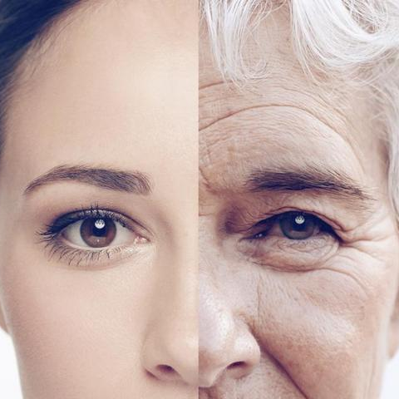
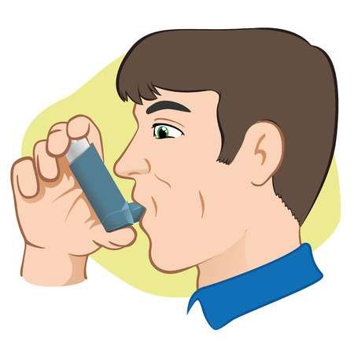
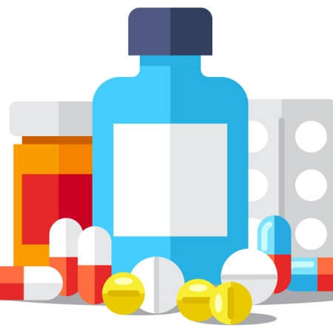
Do hepatotoxins cause liver disease in all people?
Most hepatotoxins cause liver disease only in certain persons depending on:
Environmental host Factors
Age
Disease
Race
Sex
Nutritional status
Concomitant
habits
Drugs
Host genetic makeup
1
2
3
Metabolizing enzymes
Detoxifying
system
Drug transport
Drug-Induced Hepatic Injury (DIHI)
Is DIHI common?
Incidence of DIHI:
Drugs produce about 10% of all cases of hepatitis in young adults.
40% of cases in patients older than 50 years.
Are certain persons or population more susceptible ?
Upon exposure to hepatotoxins people are categorized as:
Tolerators
No Injuries
Adaptors
Mild transient injury but adapt
Susceptibles
Develop overt symptoms depending on existing predisposing factors
In Threat
DILI accelerates beyond initial targets due to loss of synthetic
& clearance function of hepatocyte with recruitment of inflammatory cells provoke apoptotic & necrotic signals
[ 1. Toxicity potential of the drug 2. Environmental host factors 3. Host genetic makeup ]
Those factors determine the patient’s response to hepatotoxins
What are the presenting manifestations?
1
Individual drugs tend to have characteristic signature composed of:
2
3
A particular latency period
A clinical
pattern
A particular pathological
finding

Slide 6
Latency Period
Short (hrs\days)
Intermediate (1-8ws)
Long (1-12ms)
Direct dose dependent hepatotoxicity: Latency period is short as it occurs
after a threshold of toxicity
is reached.
E.g acetaminophen
( toxic dose)
Direct cumulative or In Indirect Immunoallergic Idiosyncratic Hepatotoxicity: Latency period is intermediate, but may continue to evoke even after drug withdrawal.
E.g -amiodarone(cumulative)
-phenytoin, isoniazid (idiosyncratic)
In indirect metabolic idiosyncratic hepatotoxicity: latency period is usually long, unpredictable and most problematic
E.g tetracycline, oral contraceptives
Clinical Pattern
The clinical presentation could be of variable intensity, ranging from asymptomatic slightly increased liver enzymes to fulminant hepatic failure.
A) Some drugs just induce Asymptomatic increase in the enzymes (Aminotransferase)
Phenytoin
Statins
Sulfonamides
Sulfonylureas
B) Other drugs induce symptomatic manifestations
Some Patterns of symptomatic drug-induced liver disease:
Hepatic Injury | Hepatocellular | Cholestatic | Mixed
How They Develop | If injury targets hepatocytes → apoptosis or necrosis → HEPATITIS (cytotoxic) develops → rapid onset of malaise, severe anorexia and jaundice + ↑ in alanine aminotransferases (ALT) | If injury targets biliary system (canalicular or ductal) → CHOLESTASIS develop → jaundice +\- severe pruritus predominate → ↑ in alkaline phosphatase (ALP ) +\- hyperbilirubinemia. | if injury targets both hepatocytes & biliary system→ MIXED TYPE.
Symptoms | Flu-like, malaise, m. aches weakness, loss of appetite, GIT symptoms, diarrhea, jaundice, urine discolored. | Yellowish discoloration of skin, dark urine, rash, pruritus, stool may be light | Symptoms of both types of injury (Hepatocellular and Cholestatic) are present with elevation of both enzymes
ALT | ≥ 3 fold rise | Normal or slight | ≥ 3 fold rise
ALP | Normal | ≥ 2 fold rise | ≥ 2 fold rise
E.g | Acetaminophen NSAIDs Isoniazid Amiodarone | Chlorpropamide Erythromycin Rifamycin Oral contraceptives | Phenytoin Carbamazepine Sulfonamides ACE Inhibitors

Slide 7
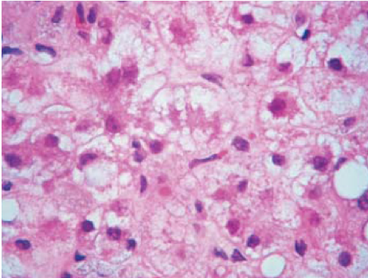
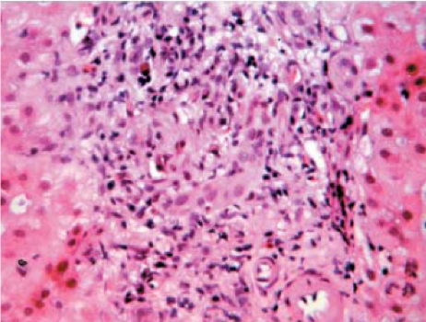
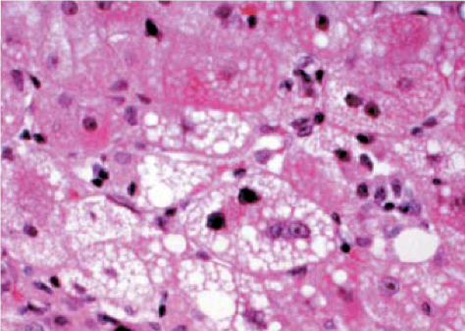
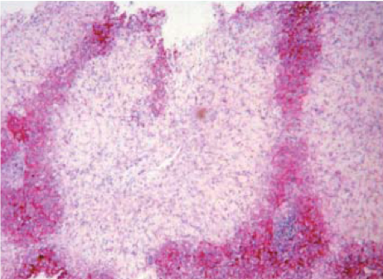
Histopathological Patterns
No universal histopathological pattern of DIHI exist; the commonest are:
Hepatocellular necrosis b. Cholestasis c. Steatosis
More than one type of injury may occur in the same patient
Any one agent may produce different types of injury in different patient
Ballooning & degeneration of hepatocyte
Cholestatic injury with damaged bile duct
Fatty accumulation
Centrilobular & Midzonal necrosis
Lines of Treatment
Immediate withdrawal | Of any suspected drug
No specific treatment | Symptomatic: Corticosteroids for severe allergic reaction is observed Cholestyramine for Pruritus to enhance bile acid secretion ursodeoxycholic acid (Ursodiol) for Cholestatic liver injury Coagulopathy or encephalopathy develop (treat accordingly) | Supportive: High carbohydrate Moderate protein diet Adequate in calories
Specific antidotes | N-acetylcysteine for acetaminophen toxicity L-carnitine for valproate toxicity
Emergency liver transplantation | For any drug induced fulminant hepatic failure

Slide 8
Cases from Dr Slides
A long standing rheumatoid arthritic patient developed tuberculosis 2 month ago. Today she was received in E.R complaining of yellowish discoloration of skin, severe anorexia, vomiting and flu like manifestations since two days. She is very weak and looks toxic. Her drug history reveals that she has been 4 month ago on cyclosporine to control the arthritis exacerbations. A month ago, she was put on isoniazid when she developed T.B. and multivitamins because she is weak. Currently she is given domperidone for the emesis. Lab results reveals severe elevation in ALT but no elevation in ALP.
Q1) Which of the following drugs is the most likely cause of her symptoms?
Cyclosporine b) Multivitamins c) isoniazid d) Domperidone
Q2) Which type of hepatotoxin is it considered?
Q3) What is the likely hepatotoxic pattern inflicted by the drug?
Q4) Which drug can be used for the treatment of her condition?
Q1) C Q2)Immunoallergic Idiosyncratic ( Viral Hepatitis-like pattern) Q3) Hepatocellular Q4) Corticosteroids
A hypercholesterolemic patient was received in E.R complaining of yellowish discoloration of skin, change in color of urine & stools, and severe itching
He has been receiving statins for the long time for the hypercholesterolemia. Three month ago he was diagnosed as being diabetic and hypertensive and since then he is receiving chlorpropamide for the diabetes and nadolol for the hypertension. The last couple of days he had a flue; for which he was given acetaminophen for muscle aches and nasal drops for his nasal stuffiness. Lab investigations shows severe elevation in ALP and no significant elevation in ALT.
Q1) Which of the following drugs is the most likely cause of her symptoms?
Nadolol b) Chlorpropamide c) Acetaminophen d) Statins
Q2) Which type of hepatotoxin is it considered?
Q3) What is the likely hepatotoxic pattern inflicted by the drug?
Q4) Which drug can be used for the treatment of her condition?
Q1) B Q2)Immunoallergic Idiosyncratic (Inflammatory cholestasis) Q3)Cholestasis Q4) Ursodiol \ Cholestyramine

Slide 9
Quiz
MCQ
1- Hepatitis is an injury in:
A- Biliary system B- Hepatocytes C- A&B
2- Which of the following antitubercular drug interferes with bilirubin metabolism? :
A- Isoniazid B- Rifampicin C- Ethambutol
3- ALT (alanine aminotransferase) and ALP (Alkaline Phosphatase) both will be increased in :
A- Cholestatic B- Hepatocellular C- Mixed type
4- Drugs that cause intrinsic hepatotoxin are?
A- Indirect Hepatotoxic B- Belong to TYPE B ADRs C- Dose dependent
5- If a covalent interaction happened between the metabolite of the drug and the proteins which of the following will happen?
A- Immunogenic reaction B- Carcinogenesis C- Oxidative stress
SAQ
Q1-A 63-year-old man presents to the emergency department with altered mental status after ingesting an entire bottle of acetaminophen. The patient’s heart rate is 120 beats/minute, blood pressure is 100/58 mm Hg, and respiration rate is 28/minute. His aspartate aminotransferase and alanine aminotransferase are 4,128 IU and 3,978 IU, respectively. What is the most appropriate treatment for this patient?
2-3.A patient came to the clinic with a history of pruritus, yellowish discoloration of the skin and dark urine.
Q2-What is the type of hepatic injury in this case?
Q3-What is the best drug to be given in this case?
Q4-A patient took an increased dose of drug A, after one hour he developed anorexia and muscle aches. what is drug A?
Q5- A patient use phenytoin as a treatment for epilepsy, he takes his medication regularly in the therapeutic dose, eventually he develop hepatitis. What is the type of ADRs for in this condition?
MCQ
SAQ
Q1 | B
Q2 | B
Q3 | C
Q4 | C
Q5 | A
Q1 | N-Acetylcysteine
Q2 | Cholestatic hepatic injury
Q3 | Ursodiol\Cholestyramine
Q4 | Acetaminophen (check slide 6 and 4 )
Q5 | Type B: bizarre / unpredictable / idiosyncratic
Answers:

Slide 10
Share with us your ideas !
Good Luck ,
Future Doctors!
Team Leaders:
May Babaeer Zyad Aldosari
This Amazing Work Was Done By:
May Babaeer Nouf AlShammari
Noura AlMazrou Shahad AlSahil

