Slide 1
Cytochrome System and Drug Metabolism
Objectives:
By the end of the lecture , you should know:
Revise the aim & phases of drug metabolism
Define the role of cytochrome system in relation to drug metabolism
Expand on the nature, location, nomenclature, structure, distribution & function of CYT P450
Focus on its regulation; directly & indirectly, its induction & inhibition in relevance to drug interactions
Interpret molecular mechanism of interactions by CYT P450
Classify its different isoforms, their substrates, inducers& inhibitors
Delineate some of its genetic variations.
Color index:
Editing File
Black : Main content
Red : Important
Blue: Males’ slides only
Purple: Females’ slides only
Grey: Extra info or explanation
Green : Dr. notes

Slide 2
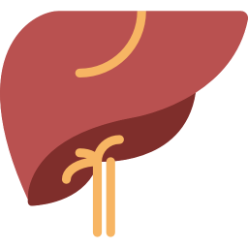
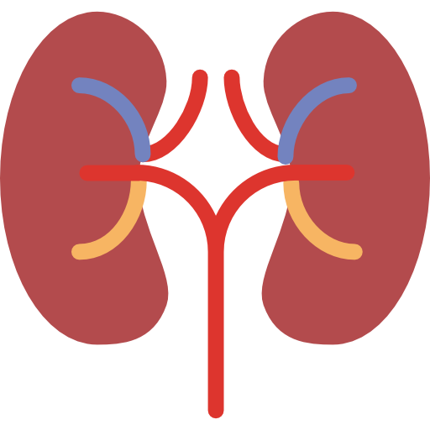
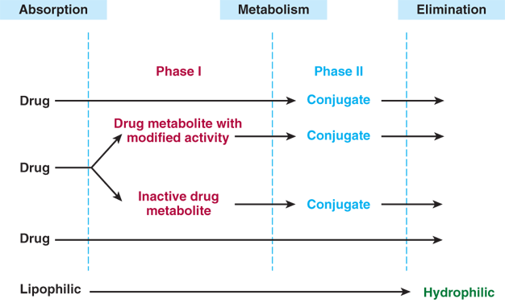
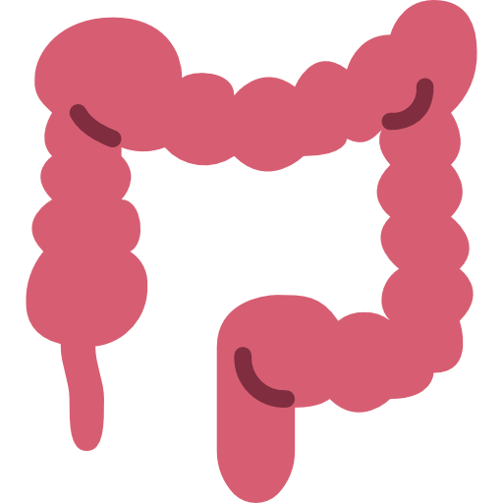
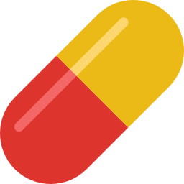
Drug Metabolism
Identified as foreign substances that body must get rid of.
Occurs mainly in the liver “ metabolic clearing house”.
Being mostly lipophilic ➔ The liver subjects them to chemical transformation (Metabolism) to become inactive & easily excreted, by either transforming them into:
Polar product and excreted by Renal elimination
Or Non-Polar product and excreted by Biliary elimination.
Cytochrome P450 “CYT P450”
What does it mean?
“Cytochrome"
= colored cells.
They color the liver cells dark red as they contain iron
"P450“
= absorbs a very characteristic wavelength (450 nm) of UV light when it is exposed to carbon monoxide.
They are located mainly attached to the smooth endoplasmic reticulum
(SER) of hepatocytes, they are isolated in the subcellular fraction termed the microsomes
Liver Microsomal Enzymes\ CYT P450
What are they?
1
4
CYT P450 superfamily is the terminal rate limiting oxidase of this system
Distribution:
Highly concentrated in hepatocytes.
Enterocytes of the small intestine present their principal extra-hepatic source.
Very small quantities in kidneys, lungs, & brain.
2
Its enzymes are part of a cascade to transfers electrons from molecular oxygen to oxidize the drugs
5
Responsible for most of the oxidative metabolism of:
Endogenous substances: steroid hormones, prostaglandins, lipids
& fatty acids
Exogenous compounds: diet
(food & beverages), Drugs, environmental xenobiotics.
3
Structure: they are heme-containing isoenzymes attached to
O2, N3, Su, Fe
There are two phases of drug metabolism:
Phase I
Oxidation\Reduction\Hydrolysis
Phase II
Conjugation
Result in:
Inactive product
Active metabolite
Similar to parent
More active than parent
A product with different effect
Toxic metabolite

Slide 3
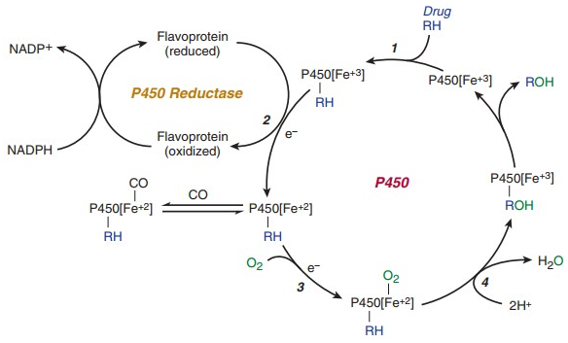
Cycle of CYT P450 in Drug Oxidations
Microsomal drug oxidations require P450, P450
reductase, NADPH, & molecular oxygen
Step 1 oxidized (Fe3+) P450 combines with drug substrate to form a binary complex
Step 2 NADPH donates an electron to the flavoprotein P450 reductase, which in turn reduces the (oxidized P450 drug complex)
Step 3 A second electron is introduced from NADPH via the same P450 reductase, which serves to reduce molecular oxygen & to form (an activated oxygen – P450-substrate complex)
Step 4 This complex in turn transfers activated oxygen to the drug substrate to form the oxidized product
Regulation of CYPs
Activation or Inactivation can be processed by any food, intrinsic products or extrinsic xenobiotics as drugs (usually the lipophilic) that have to be metabolized
Activation or Inactivation of the CYT P450 can be achieved either:
Directly
VS
Indirectly
The drug activates/inhibits the CYT p450 system directly
By expression or repression of its relevant genes by activation or inhibition of the responsible transcription factors
Drug A = Substrate
Drug B = Affected
Enzyme = CYT P450
induces/inhibits
Drug A
Enzyme
induces/inhibits
Transcription factor
Metabolizes
Drug A
Regulates
Decreases/increases effect of
Enzyme
Drug B
Decreases/increases effect of
Metabolizes
Drug B
Drug A acts directly on CYT P450 by either induces or inhibits it, this eventually affect the metabolization of Drug B and alter its efficacy
Drug A acts on the genes that regulate CYT P450 by activates or inhibits their transcription, this eventually affect the metabolization of Drug B and alter its efficacy
When drugs play a role in regulation of the CYT P450 they are termed
Enzyme Inducers
Enzyme Inhibitors
If they activate the enzyme
If they inactivate the enzyme
This causes drug-drug interactions (pharmacokinetics)

Slide 4
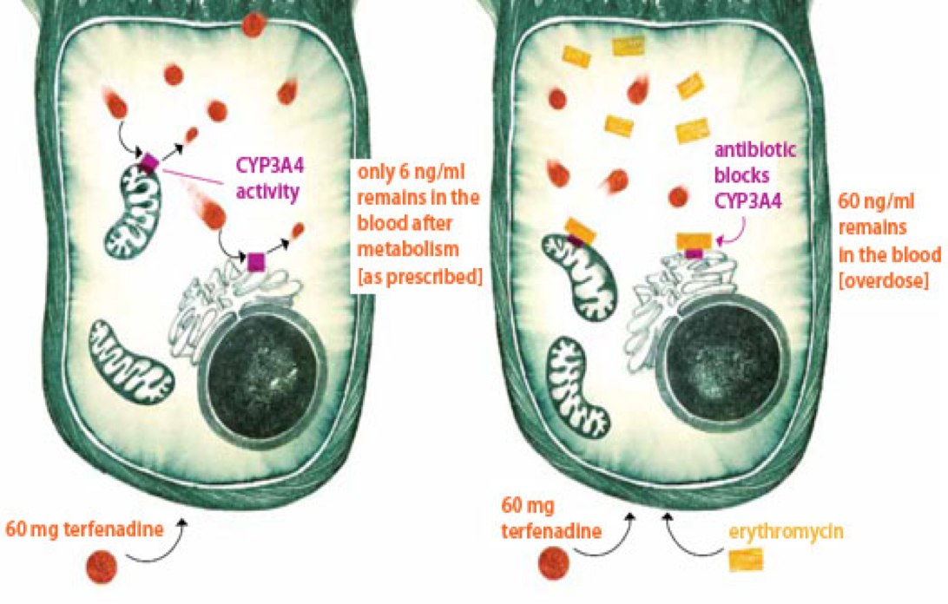
Examples for Regulation of CYPs
A) Direct Regulation:
Normally: Terfenadine ( Anti-histaminic drug ) after its metabolization, 6 ng\ml remains to reach the blood and produce the desired effect.
In case of co-administration with Erythromycin: Erythromycin is an enzyme inhibitor, decreases the metabolization of Terfenadine to 60 ng\ml causing toxicity
B) Indirect Regulation
“ Molecular Basis of drug-drug interaction”:
PXR: Pregnane X receptor
RXR: Retinoid X receptor
Drug A
PXR
RXR
CYP3A
CYP3A
enzyme
Examples of drugs metabolized by CYP 3A
Liver, intestine
Ethinylestradiol Efavirenz Warfarin
Erythromycin Cyclosporine Tamoxifen
Atorvastatin Carbamazepine Doxorubicin
Indinavir
Drug B
HO
Drug B
oxidation
The orphan nuclear receptor PXR is a Transcription factor that regulates the expression of the CYP P450 genes.
If Drug A is INDUCER: it binds & activates PXR, which translocates in nucleus → dimerize with RXR → the hetero-diamer PXR / RXR will induce the expression of
CYT P450 isoenzymes to increase metabolism of Drug B.
If Drug A is an INHIBITOR: its binding will prevent the activation of PXR → repression of CYT P450 isoenzymes to decrease metabolism of Drug B
Outcome Of Drug-drug Interactions Mediated By CYT P450
Enzyme Inducers
↑metabolism of the inducer (it self) and the co-administered drugs →↓ their pharmacological action
= Tolerance or complete nullification \ ↓Efficacy
Enzyme Inhibitors
↓ or retard metabolism & excretion of the inhibitor and the
co-administered drugs →↑or prolong their pharmacological action
= ↑ toxicity

Slide 5
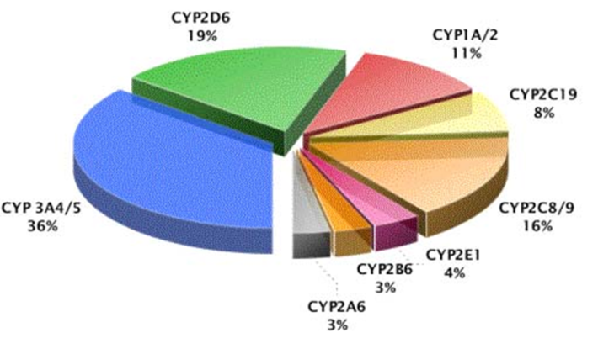
Classification of CYT P450
It has been classified into:
Families designated by numbers & Sub families designated by letters
Distribution of different CYP isoforms in the liver:
• CYP3A4/5 : 36% • CYP2D6: 19% • CYP2C9: 16%
• CYP1A/2 : 11% • CYP2C19: 8%
Genetic Variation
Genetic polymorphisms in CYT P450 isoenzymes have been observed & are reasons behind the altered response to drug therapy
CYT P450 3A4
Substrates | Inducers | Inhibitors
Ca⁺² channel blocker Amlodipine Verapamil Benzodiazepines Midazolam Clonazepam HMG-CoA- reductase inhibitors ( statins ) Atorvastatin Immunosuppressants Cyclosporine Azole Antifungals Fluconazole Antibiotics Erythromycin Clarithromycin Cancer Chemotherapy Cyclophosphamide Tamoxifen Non-Sedating Antihistamines Astemizole | Rifampicin\Rifampin Phenytoin Carbamazepine Barbiturates Dexamethasone Progestins Rifabutin | Grapefruits Nefazodone H2 Blocker Cimetidine Immunosuppressant Cyclosporine Azole Antifungals Fluconazole Ketoconazole Itraconazole Antibiotics Erythromycin Clarithromycin Troleandomycin Chloramphenicol Protease Inhibitors Ritonavir
Most calcium channel blockers
Most benzodiazepines
Most HIV protease inhibitors
Most HMG-CoA- reductase inhibitors (statins)
Cyclosporine
Most non-sedating antihistamines
Cisapride

Slide 6
CYT P450 2D6
Substrates | Inducers | Inhibitors
Codeine Many B-blockers Propranolol Metoprolol Timolol Bupranolol Many tricyclic antidepressants | Rifampicin | Fluoxetine Haloperidol Paroxetine Quinidine
Genetic Variation
This isoenzyme has the most frequent polymorphisms in all CYT P450 and when polymorphism occurs → ↓ metabolizing capacity of CYP2D6 i.e those who exhibit the polymorphism become poor metabolizers: 1-Metabolism of some drugs neuroleptics, tricyclic antidepressants, antianginals agent (perhexiline), antiarrhythmics (propafenone & metoprolol) are suppressed , so side effects & toxicity develop. i.e.: Neuropathy after therapeutic doses of perhexiline Bradycardias & arrhythmias on therapeutic dose of propafenone or metoprolol 2-The pro-drugs cannot be converted to their therapeutically active metabolite e.g. poor analgesia with codeine & tramadol because they are not transformed into active forms. It is Absent in 7% of Caucasians, 1-2% non-Caucasians. Hyperactive in up to 30% of East Africans.
CYT P450 1A2
Substrates | Inducer | Inhibitors
Theophylline Imipramine Propranolol Clozapine | smoking tobacco | Many fluoroquinolone antibiotics Fluvoxamine Cimetidine

Slide 7
CYT P450 2C9
Substrates | Inducers | Inhibitors
Most NSAIDs (including COX-2) Celecoxib Diclofenac Ibuprofen Tolbutamide S-warfarin (the active form) Phenytoin | Rifampicin Barbiturates | Fluconazole
Genetic Variation
Warfarin, phenytoin, & tolbutamide are examples of drugs with narrow therapeutic index that are metabolized by CYP2C9 Clearance of these drugs is impaired in genetic variation of the enzyme Absent in 1% Caucasians and African-Americans
CYT P450 2C19
Substrates | Inducers | Inhibitors
Diazepam Omeprazol Phenytoin | Rifampicin Barbiturates | Omeprazole Isoniazid Ketoconazole
Genetic Variation
Polymorphism in CYP2C19 shows increased & prolonged action of its substrates as omeprazole. This has been an advantage as in those variants there is↑ cure rates in peptic ulcer patient with Helicobacter pylori ( beneficial effect) . Absent in 20-30% of Asians, 3-5% Caucasians.
Case from Dr. Slides
A 50 years old, patient was treated for the last 3 years by the hypocholestrolemic agent; atorvastatin. Yesterday he began to complain of severe muscle pains, weakness & reddish discoloration of urine.
He receives daily multivitamins & his lab results last week, proved that he has become diabetic, for which he was prescribed metformin. He was also started on a course of fluconazole for a concomitant fungal infection.
From drug history, the diagnosis of his current state was likely rhabdo-myositis (severe musculoskeletal toxicity) & was verified by the lab finding of severe elevation in
creatinine phosphokinase.
Which one of the following drug-drug interaction on CYT 3A4 is the likely cause
of his current state?
A) Metformin + Atorvastatin B) Atorvastatin + Fluconazole
C) Metformin + Fluconazole C) Fluconazole+ Multivitamins
Correct answer: B

Slide 8
Quiz
MCQ
1- Which of the following is a CYP2C19 inhibitor?
(A)Omeprazole (B)Itraconazole (C)Grapefruit (D)Erythromycin
2- Which of the following is a CYP450 inducer?
(A)Ritonavir (B)Paroxetine (C)Rifampin (D)Cimetidine
3- CYP2D6 catalyzes the metabolism of:
(A)Haloperidol (B)Quinidine (C)Fluoxetine (D)Amoxapine
4- Which of the following is induced by smoking tobacco?
(A)CYP2C9 (B)CYP2C19 (C)CYP1A2 (D)CYP2D6
5- Which of the following is characteristic of enzyme inducers?
(A)Increase metabolism and prolong the duration of action
(B)Decrease metabolism and prolong the duration of action
(C)Increase Efficacy
(D)Decrease Efficacy
6- A 34-year-old female insists on drinking a cup of grapefruit juice every morning for “body cleansing.” Grapefruit juice is known to interfere with the cytochrome P450 system, disrupting levels of certain drugs. The cytochrome P450 system includes dozens of enzymes. Which is the most abundant CYP enzyme in human livers?
(A) CYP1A2 (B) CYP2A6 (C) CYP2D6 (D)CYP3A4
Answers:
MCQ
Q1 | A | Q2 | C | Q3 | D | Q4 | C | Q5 | D | Q6 | D

Slide 9
Share with us your ideas !
Good Luck ,
Future Doctors!
Team Leaders:
May Babaeer Zyad Aldosari
This Amazing Work Was Done By:
Reema Alserhani Raghad AlKhashan

