Slide 1
Anticoagulant Drugs
Objectives:
By the end of the lecture , you should know:
Introduction about coagulation cascade
Classification of drugs acting as anticoagulants
Elaborate on their mechanism of action, correlating that with methods of monitoring.
Contrast the limitations & benefits of injectable anticoagulants in clinical settings.
Emphasis on the limitations of VKAs & on variables altering or modifying their response.
Apply such variability in a clinical scenario
Color index:
Editing File
Black : Main content
Red : Important
Blue: Males’ slides only
Purple: Females’ slides only
Grey: Extra info or explanation
Green : Dr. notes

Slide 2
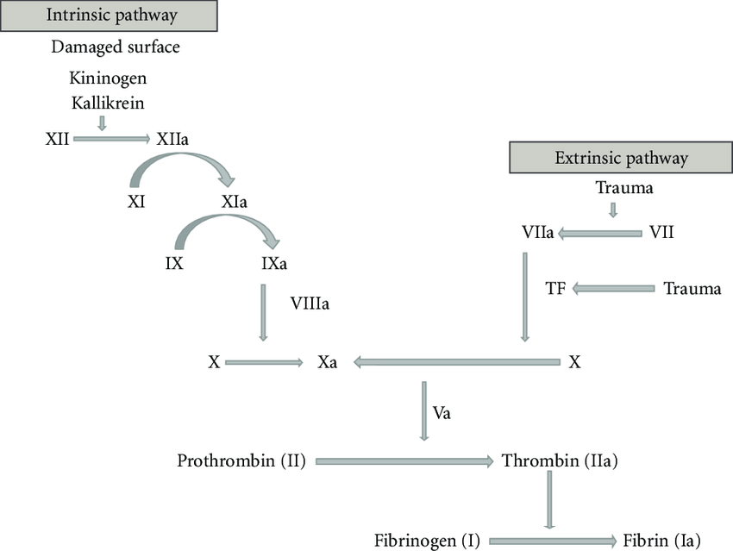
Coagulation Pathways
Drugs Anti Coagulation
Anticoagulants: prevent thrombus formation and extension by inhibiting clotting factors e.g heparin, low molecular weight heparin, coumarins/Warfarin
Antiplatelet Drugs: reduce risk of clot formation by inhibiting platelet functions e.g aspirin and ticlopidine
Fibrinolytic agents: dissolve thrombi already formed e.g. streptokinase
1.
Two Major pathways: 1. Intrinsic pathway
2. Extrinsic pathway
2.
Intrinsic pathway: All clotting factors are within the blood (tissue factor=thromboplastin)
Extrinsic pathway: Initiating factor is outside the blood.
3.
4.
Both converge to common pathway
5.
13 soluble factors are involved in clotting which normally circulate in an inactive state and must be activated to form a fibrin clot.
6.
Endogenous Inhibitors of Coagulation:
1
Antithrombin III: It’s a plasma protein that acts by inhibiting the activated thrombin (factor IIa) and factor Xa. it is the site of action of heparin.
Antithrombin III: Antithrombin III, is a plasma protein that inhibits activated thrombin (factor IIa) and Xa, it is the site of action of heparin.
It inactivates thrombin and other coagulation factors (IXa, Xa, XIa and XIIa) by forming complex with these factors. Heparin like molecules enhances these interactions.
2
Prostacyclin (prostaglandin I2): It is synthesized by endothelial cells and inhibits platelet aggregation.
3
Protein C and protein S
Prostacyclin (prostaglandin I2): It is synthesized by endothelial cells and inhibits platelet aggregation. ¹
Protein C and protein S: these are vitamin K dependent proteins that slow the coagulation cascade by inactivating factor Va and VIIIa.
They have an antiplatelet effect (not an anticoagulant).

Slide 3
1
Parenteral
Oral
Act as thrombin inhibitors either in: A direct way² or an indirect way³
Anticoagulants
Act as Vitamin K antagonist (e.g. Warfarin)
Parenteral Anticoagulants |  |  |  | Oral
Unfractionated heparin | Low Mol. Weight Heparin | Direct Thrombin Inhibitors | Factor Xa inhibitors | Vit. K antagonists
3000-30000 | <800 |  | Pentasaccharide | Coumarins; Warfarin > 40 potency than Dirumarol
 | >Xa | IIa | Xa
 | Enoxaparin Dalteparin | Bivalirudin R Lepirudin IR Argatroban R Dabigatran R(Oral) | Fondaparinux IR Rivaroxaban R (Oral)
Anticoagulant Indications
1
Myocardial infarction (MI)
2
Deep venous thrombosis (DVT)
3
Peripheral arterial emboli, pulmonary embolism (PE) and many other conditions
4
Blood transfusions and dialysis procedures
Parenteral Anticoagulants
Indirect Thrombin Inhibitors
Drug
Heparin (Unfractionated heparin “UFH”)
Unfractionated heparin “UFH”
Origin
Normally occurs as macromolecule in mast cells with histamine (its physiological role is unknown)
Commercial preparations are extracted from beef lung or pig intestine
(can cause hypersensitivity reaction)
Drug | Heparin (Unfractionated heparin “UFH”)
Origin | Normally occurs as macromolecule in mast cells with histamine (its physiological role is unknown) Commercial preparations are extracted from beef lung or pig intestine (can cause hypersensitivity reaction)
Function | Heparin stops the expansion of a thrombus and prevents the formation of new thrombi but it does not dissolve an existing thrombus
P.K | Heparin is an injectable rapidly acting anticoagulant ⁴ Active in vitro and in vivo Low–molecular–weight forms (LMWHs), 1/3 the size of UFH are used as well and have many advantages over UFH Heparin is not absorbed from the GIT It should be administered by IV or SC injection. Not injected IM as it causes haematomas at injection site Once in the bloodstream, UFH binds to plasma proteins, endothelial cells and macrophages ⁵ Heparin does not cross the placenta; therefore it is the drug of choice as anticoagulant during pregnancy Close monitoring of the activated partial thromboplastin time (aPTT) is necessary in patients receiving UFH
Function
Heparin stops the expansion of a thrombus and prevents the formation of new thrombi but it does not dissolve an existing thrombus
P.K
Heparin is an injectable rapidly acting anticoagulant
Active in vitro and in vivo
Low–molecular–weight forms (LMWHs), 1/3 the size of UFH are used as well and have many advantages over UFH
Heparin is not absorbed from the GIT
It should be administered by IV or SC injection. Not injected IM as it causes haematomas at injection site
Once in the bloodstream, UFH binds to plasma proteins, endothelial cells and macrophages
Heparin does not cross the placenta; therefore it is the drug of choice as anticoagulant during pregnancy
Close monitoring of the activated partial thromboplastin time (aPTT) is necessary in patients receiving UFH
Heparin and Heparin-like drugs.
Directly acts on thrombin molecule and deactivate it.
Acts on Antithrombin which will in turn act on factor 2 and 10.
Used in emergencies and followed by oral anticoagulants.
Thus it has an unpredictable adverse effects when taken at a high dose.

Slide 4
Indirect Thrombin Inhibitors CONT...
Drug | Heparin (Unfractionated heparin “UFH”)
MOA | It acts indirectly by increasing the activity of the endogenous anticoagulant “antithrombin III” (1000 folds) which inhibits activated clotting factors mainly thrombin (factor IIa), other serine proteases (clotting factors) e.g VIIa, IXa and particularly Xa, The anti-coagulant effect of heparin is mediated via anti-thrombin III In the absence of heparin this inactivation is slow, when Heparin binds to antithrombin III (heparin acting is a co-factor), it causes conformational changes that accelerates its rate of action 1000 fold Heparin binds to both antithrombin III and thrombin to form a ternary complex Heparin dissociates leaving the thrombin bound to its inhibitor Once dissociated, Heparin is free to bind to another antithrombin molecule and subsequently inhibits more thrombin
Uses | Due to its rapid onset of action, it is used to initiate immediate anticoagulation in thromboembolic disease (PE, DVT, MI) mainly as induction for oral vitamin K antagonists (VKAs) Prevention of postoperative DVT (in patient undergoing hip replacement) Prevention of coagulation during renal dialysis or cardiac surgery
Dis- advantage | No predictable anticoagulant effects; inter-patient & intra-patient variability in response to a given dosage → in hospital setting, repeated monitoring Low bioavailability → binds to plasma proteins, endothelium & macrophages Re-thrombosis → activates platelets as it does not neutralize fibrin-bound II a Heparin discontinuation → No packed platelets → More thrombosis No warfarin→ precipitate venous gangrene, give → Direct thrombin inhibitor The inconvenience of administration by injection The need for regular monitoring (aPTT) UFH carries a risk of heparin-induced thrombocytopenia, a fall in the platelet count and increased risk of thrombosis due to binding to platelets Generally, if the number of platelets is too low, excessive bleeding can occur If the number of platelets is too high, blood clots can form thrombosis However, There are disorders that reduce the number of platelets, such as heparin-induced thrombocytopenia (HIT) that typically cause thrombosis, or clots, instead of bleeding. It happen in 4% pts. on heparin, latency 5-10 days. after 1st exposure or 2-3 days. after re-exposures →Venous → Arterial thrombosis
ADRs | The major adverse effect of heparin is bleeding Allergic reactions (chills, fever, urticaria) as heparin is of animal origin and should be used cautiously in patients with allergy Long-term heparin therapy is associated with osteoporosis ¹ Heparin-induced thrombocytopenia (HIT)
C.I | Bleeding disorders, hemophilia Patients with hypersensitivity to the drug Recent surgery of the brain, eye or spinal cord, threatened abortion
Reverse Heparin Action | Discontinuation of the drug Heparin is strongly acidic and is neutralized by i.v. protamine sulfate (a strongly basic protein) ² It combines with heparin to form a stable complex devoid of anticoagulant activity
M.O.A
Indirect Thrombin Inhibitor
It acts indirectly by increasing the activity of the endogenous anticoagulant “antithrombin III” (1000 folds) which inhibits activated clotting factors mainly thrombin (factor IIa) and particularly Xa
When Heparin binds to antithrombin III, it causes conformational changes that accelerates its rate of action 1000 fold
Heparin binds to both antithrombin III and thrombin to form a ternary complex
Heparin dissociates leaving the thrombin bound to its inhibitor
Once dissociated, Heparin is free to bind to another antithrombin molecule and subsequently inhibits more thrombin
The anti-coagulant effect of heparin is mediated via anti-thrombin III.
Anti-thrombin III inactivate thrombin (essential for clot formation) and other serine proteases (clotting factors) e.g VIIa, IXa and particularly Xa.
In the absence of heparin this inactivation is slow, heparin acting is a co-factor accelerate the reaction by 1000-fold.
Uses
Due to its rapid onset of action, it is used to initiate immediate anticoagulation in thromboembolic disease (PE, DVT, MI) mainly as induction for oral vitamin K antagonists (VKAs)
Prevention of postoperative DVT (in patient undergoing hip replacement)
Prevention of coagulation during renal dialysis or cardiac surgery
Dis- advantages
The inconvenience of administration by injection
The need for regular monitoring (aPTT)
UFH carries a risk of heparin-induced thrombocytopenia, a fall in the platelet count and increased risk of thrombosis due to binding to platelets
No predictable anticoagulant effects; inter-patient & intra-patient variability in response to a given dosage → in hospital setting, repeated monitoring
Low bioavailability → binds to plasma proteins, endothelium & macrophages
Re-thrombosis → activates platelets as it does not neutralize fibrin-bound II a
Heparin-
Induced
Thrombo cytopenia
(HIT)
Generally, if the number of platelets is too low, excessive bleeding can occur
If the number of platelets is too high, blood clots can form thrombosis
However, There are disorders that reduce the number of platelets, such as heparin-induced thrombocytopenia (HIT) that typically cause thrombosis, or clots, instead of bleeding
Heparin Induced Thrombocytopenia (HIT); in 4% pts. on heparin, latency 5-10 dys. after 1st exposure or 2-3 dys. after re-exposures →Venous → Arterial thrombosis
Heparin discontinuation → No packed platelets → More thrombosis
No warfarin→ precipitate venous gangrene
Give → Direct thrombin inhibitor
ADRs
The major adverse effect of heparin is bleeding
Allergic reactions (chills, fever, urticaria) as heparin is of animal origin and should be used cautiously in patients with allergy
Long-term heparin therapy is associated with osteoporosis
Heparin-induced thrombocytopenia (HIT)
Contra-
indications
Bleeding disorders, hemophilia
Patients with hypersensitivity to the drug
Recent surgery of the brain, eye or spinal cord, threatened abortion
Reversal
Of
Heparin
Action
Discontinuation of the drug
Heparin is strongly acidic and is neutralized by i.v. protamine sulfate (a strongly basic protein)
It combines with heparin to form a stable complex devoid of anticoagulant activity
Heparin causes increased bone resorption by stimulating osteoclasts and suppressing osteoblast function, leading to decreased bone mass. Other proposed mechanisms include depletion of mast cells in bone marrow and enhancement of parathyroid hormone (PTH) function, an important regulator of calcium in the body. The actions of PTH increase the release of calcium and phosphorus from bone into the blood to elevate serum levels; PTH is usually released in response to low serum calcium levels.
What’s the treatment of bleeding caused by UFH?

Slide 5
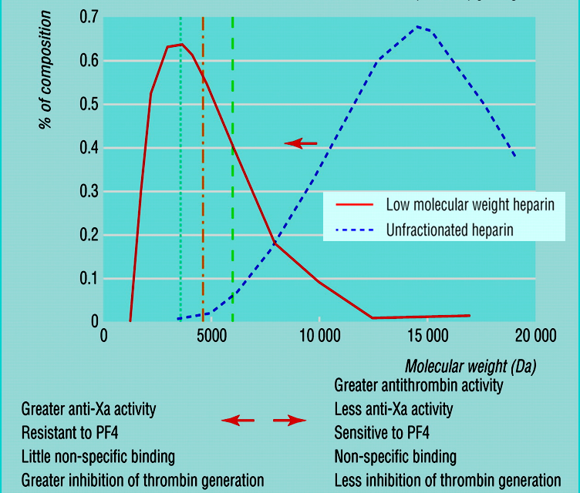
Low-Molecular-Weight Heparins (LMWHs)
Drug
Heparin fragments
(enoxaparin, dalteparin)
Synthetic pentasaccharide
(fondaparinux)
Indirect Thrombin Inhibitors CONT...
M.O.A
LMWHs increase the action of antithrombin III on factor Xa but not its action on thrombin, because the moleacules are too small to bind to both enzyme and inhibitor.
Low-Molecular-Weight Heparins (LMWHs)
LMWHs are derived from the chemical or enzymatic degradation of UFH into fragments approximately one-third the size of heparin.
Uses
The theoretical pharmacologic advantages of LMWH over UFH arise from the preferential binding ratio to factor Xa over thrombin. LMWH (Enoxaparin , Dalteparin) have:
less plasma protein binding,
less platelet activation and lower risk of re- thrombosis and thrombocytopenia.,
Good bioavaialibility
More predictable response
Used increasingly in place of unfractionated heparin.
Drug | Heparin fragments (enoxaparin, dalteparin) | Synthetic pentasaccharide (fondaparinux)
MOA | LMWHs increase the action of antithrombin III on factor Xa (ONLY) but not its action on thrombin, because the molecules are too small to bind to both enzyme and inhibitor.
Uses | Used increasingly in place of unfractionated heparin.
Advantage | ↑ Predictability of anticoagulant response i.e. little inter-patient and intra- patient variability in response to a given dosage. without the need for laboratory monitoring (suitable for outpatient therapy) Good bioavailability; as it hardly binds to plasma proteins, endothelium & macrophages. ↓Incidence of thrombocytopenia; as it seldom sensitive to PF4. ↓Incidence of bleeding tendency; ↓ effect anti thrombin III & ↓ platelet interactions. ↓Binding to platelets and osteoblasts Less platelet activation and lower risk of re-thrombosis and thrombocytopenia; Fondaparinux is less likely than UFH or LMWH to trigger HIT Much better tolerability; given subcutaneously ↓ frequency of administration due to longer duration of action ↓ need for regular monitoring Outside hospital settings
Advantages
LMWHs are derived from the chemical or enzymatic degradation of UFH into fragments approximately one-third the size of heparin.
Have equal efficacy, without frequent laboratory monitoring (suitable for outpatient therapy)
Have a more predictable anticoagulant response
better bioavailability, longer half life
Binding to platelets and osteoblasts is reduced with LMWH compared with UFH
Less platelet activation and lower risk of re-thrombosis and thrombocytopenia
↑ Predictability of anticoagulant response i.e. little inter-patient and intra- patient variability in response to a given dosage. without the need for laboratory monitoring
↑ Bioavailability; as it hardly binds to plasma proteins, endothelium & macrophages.
↓Incidence of thrombocytopenia; as it seldom sensitive to PF4.
↓Incidence of bleeding tendency; ↓ effect AT III & ↓ platelet interactions.
Much better tolerability;
given sub. cut.
↓ frequency of administration due to longer duration of action
↓ need for regular monitoring
Outside hospital settings
Synthetic Heparin Derivatives (fondaparinux)
M.O.A
a synthetic compound that inhibits factor Xa by antithrombin but does not inhibit thrombin
Advantages
can be given once a day at a fixed dose without coagulation monitoring
Less likely than UFH or LMWHs to trigger HIT
Heparin (UFH)
LMWH
IV ½ life
2 hours
Bioavailability after SC injection
20%
Anticoagulant response
Variable
Major adverse effect
Frequent bleeding, HIT, osteoporosis
Specific Antagonist
Protamine sulfate
Setting for Therapy
Hospital
Laboratory Monitoring
Needed aPTT
Differences between UFH and LMWH Heparins
IV ½ life
4 hours
Bioavailability after SC injection
90%
Anticoagulant response
Predictable
Major adverse effect
Less frequent bleeding
Specific Antagonist
Incomplete
Cannot be completely antagonized
Setting for Therapy
Hospital and outpatient clinic
Laboratory Monitoring
Not needed
This is important!
This is important! In case you were asked
about the differences between LMWH and UFH

Slide 6
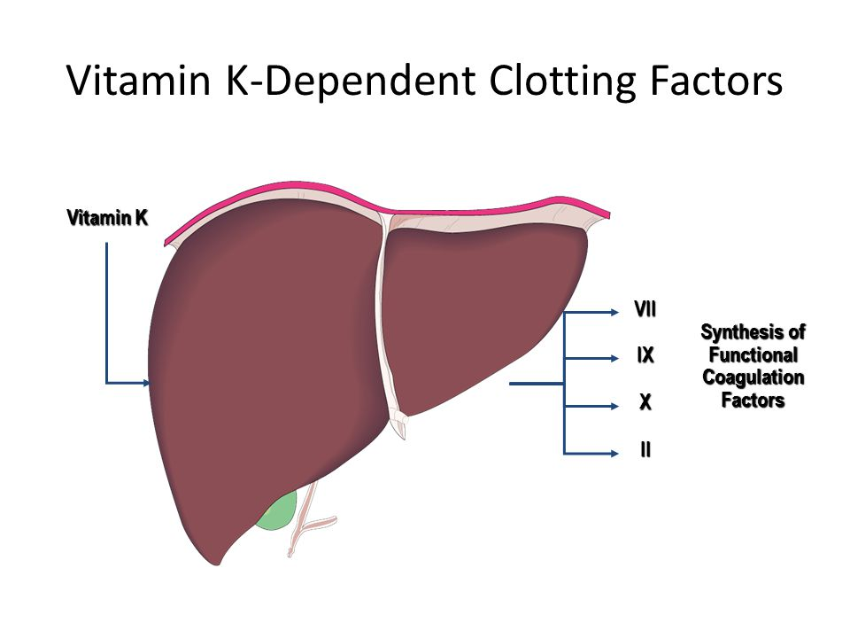
2) Direct Thrombin Inhibitors
Drug
Hirudin
First to be developed, was isolated from the saliva of the leech
Lepirudin
polypeptide that binds directly to the active site of thrombin
(Females’ slides)
Drug | Hirudin | Lepirudin
Info | First to be developed, was isolated from the saliva of the leech | polypeptide that binds directly to the active site of thrombin
MOA | Exert their effect by direct binding to thrombin. This direct effect is rapid & potent.
Advantage | Are not associated with thrombocytopenia. Recombinant hirudin “Lepirudin” is used as IV anticoagulant in patients with HIT (Heparin-induced thrombocytopenia)
M.O.A
Exert their effect by direct binding to thrombin.
Advantages
This direct effect is rapid & potent.
NOT associated with thrombocytopenia.
Recombinant hirudin “Lepirudin” is used as IV anticoagulant in patients with HIT (Heparin-induced thrombocytopenia)
Lepirudin, like heparin, it must be administered parenterally and is monitored by the aPTT.
Oral Anticoagulants “Vitamin K Antagonists”
Required for synthesis (Vitamin K and Vit K-dependent clotting factors)
Source of vitamin:
Green vegetable synthesized by normal flora
Required for synthesis:
-Factors II, VII, IX, X
- Protein C and S (endogenous anticoagulants)
Causes of deficiency:
-Malnutrition
-Malabsorption
-Antibiotic therapy
Vitamin K
(fat soluble vitamins)
M.O.A of Warfarin
Inactive clotting factors (II, VII, IX, X)
Active clotting factors
Vit K
Epoxide form
Protein C and S
Warfarin
Epoxide reductase
Precursors of factors II, VII, IX & X require carboxylation of their glutamic acid residues to allow them to bind to phospholipid surfaces, this is provided by Vit. K as it changes from its oxidized to its reduced form.
Instantaneously , the reduced Vit K has to recycle back to oxidized form by Vit K epoxide reductase.
This enzyme is blocked by Vitamin K Antagonists → losing the coagulation factors the ability to function.

Slide 7
Drug | Coumarin (Warfarin)
MOA | Inhibits synthesis of Vitamin K-dependent coagulation factors II, VII, IX, & X as well as anticoagulant proteins C & S 3-4 days until effect is seen, Why? Does not have an effect on already-synthesized coagulation factors; therefore, the therapeutic effects are not seen until these factors are depleted
P.K | Act only in vivo Bioavailability 100% 98% bound to plasma proteins (albumin)¹ Monitoring anticoagulant effect of warfarin by measuring PT, which is expressed as an International Normalized Ratio (INR) Their effect takes several days (3-4) to develop because of the time taken for degradation for circulating functional coagulate factors. Therefore the onset of action starts when these factors have been eliminated Warfarin has a slow offset of action due to the time required for synthesis of new functional coagulation factors
Dis- advantage | Variable, unpredictable effect necessitating regular INR monitoring and dose adjustment Narrow therapeutic window,so any change in that level can be hazardous leading to increased risk of severe bleeding Slow onset and offset of action, so not in given in emergency conditions Numerous food- & drug-drug interactions and Polymorphism in CYT P450 isoforms that metabolizes warfarin adds to its unpredictable response →  liability to toxicities or under use.
Drug inter- actions | Increase Warfarin activity Inhibition of Vit. K synthesis by intestinal flora; oral antibiotics Inhibition of Vit K absorption; liquid paraffin Decrease in drug metabolism by microsomal enzyme inhibitors; chloramphenicol, & cimetidine Displacement of the drug from protein binding sites; phenylbutazone & salicylates Co-administration of drugs that increase bleeding tendency by; Inhibiting platelet function; NSAIDs Inhibiting coagulation factors; heparin Decrease Warfarin activity Inhibition of drug absorption from GIT; cholystyramine, colestipol Increase in synthesis of clotting factors; Vit K, oral contraceptives Increase in drug metabolism by microsomal enzyme inducers; Carbamazepine; barbiturates, rifampicin
C.I | pregnancy as it can cross the placental barrier and cause abortion, hemorrhagic disorder in the fetus and birth defects → give heparin or LMWH instead
Reverse Warfarin Action | If the patient develops bleeding due to Warfarin: Stop the drug IV injection of vitamin K Fresh frozen blood ²
Drug
Coumarin (Warfarin)
Same in both slides
M.O.A
It inhibits the synthesis of biologically active forms of vitamin K-dependent clotting factors II, VII, IX and X as well as anticoagulant proteins C & S. (picture in next slide)
3-4 days until effect is seen.
Does not have any effect on already-synthesized coagulation factors; therefore, the therapeutic effects are not seen until these factors are depleted.
Inhibits synthesis of Vitamin K-dependent coagulation factors II, VII, IX, & X as well as anticoagulant proteins C & S
Does not have an effect on already-synthesized coagulation factors; therefore, the therapeutic effects are not seen until these factors are depleted
3-4 days until effect is seen
P.K
Act only in vivo
Bioavailability 100%
98% bound to plasma proteins (albumin)
Monitoring anticoagulant effect of warfarin by measuring PT, which is expressed as an International Normalized Ratio (INR)
Their effect takes several days (3-4) to develop because of the time taken for degradation for circulating functional coagulate factors
Therefore the onset of action starts when these factors have been eliminated
Warfarin has a slow offset of action due to the time required for synthesis of new functional coagulation factors
Limitations
Wide variation in drug response
Has narrow therapeutic window, So any change in that level can be hazardous.
Slow onset of action, so not in given in emergency conditions
Polymorphisms in CYT P450 isoforms that metabolizes warfarin  adds to its non predictable response  →liability to toxicities or under use.
Numerous food- & drug-drug interactions →  liability to toxicities or under use.
Contraindicated in pregnancy  → give heparin or LMWH instead
Dis- advantages
Variable, unpredictable effect necessitating regular INR monitoring and dose adjustment
Narrow therapeutic window leading to increased risk of severe bleeding
Slow onset and offset of action.
Numerous interactions with foods containing vitamin K and drugs.
Drug interactions with oral anti
coagulants
Increase Activity of Warfarin
oral antibiotics: Inhibition of Vit. K synthesis by intestinal flora
liquid paraffin: Inhibition of Vit K absorption
chloramphenicol & cimetidine: Decrease in drug metabolism by microsomal enzyme inhibitors
phenylbutazone & salicylates: Displacement of the drug from protein binding sites
NSAIDs¹: Co-administration of drugs that increase bleeding tendency by; inhibiting platelet functio
Heparin; inhibiting coagulation factors.
Decrease Activity of Warfarin:
Carbamazepine; barbiturates, rifampicin: Increase in drug metabolism by microsomal enzyme inducers
cholystyramine, colestipol: Inhibition of drug absorption from GIT
Vitamin K, oral contraceptives : Increase in synthesis of clotting factors
1. Vitamin K deficiency;
a- Inadequate diet; malnutrition, dieting, decreased GI absorption….
2. Impaired synthesis of clotting factors;
a. In hepatocellular disorders; ( hepatitis;infective or chronic alcoholism ... etc.)
3. Increased catabolism of clotting factors;
In hypermetabolic states; as in fever, thyrotoxicosis
1. Decreased plasma protein binding;
elimination of free drug & shortening of its t1/2. as pts with nephrotic syndrome (proteinuria)
2. Decreased catabolism of clotting factors; Hypothyroidism
3. Hereditary resistance to oral anticoagulants
Contra indications
pregnancy as it can cross the placental barrier and cause abortion, hemorrhagic disorder in the fetus and birth defects (Teratogenicity).
Reversal of action (antidote)
If the patient develops Bleeding due to Warfarin:
Stop the drug
IV injection of vitamin K
Fresh frozen blood
1- because they are
Increased risk for drug-drug interactions.
Because it contain activated clotting factors.

Slide 8
Factors that Alter the response to
VIT K Antagonists
(Males’ slides)
1. Vitamin K deficiency;
a- Inadequate diet; malnutrition, dieting, decreased GI absorption….
2. Impaired synthesis of clotting factors;
a. In hepatocellular disorders; ( hepatitis;infective or chronic alcoholism ... etc.)
3. Increased catabolism of clotting factors;
In hypermetabolic states; as in fever, thyrotoxicosis
1. Decreased plasma protein binding;
elimination of free drug & shortening of its t1/2. as pts with nephrotic syndrome (proteinuria)
2. Decreased catabolism of clotting factors; Hypothyroidism
3. Hereditary resistance to oral anticoagulants
Factors increase the response
An old, peptic ulcer patient, sustained on cimetidine, has been bed ridden since a month following a major orthopedic surgery for pelvic fracture. The last week he began to complain of pain, tenderness, warmth & swelling of his left leg. He was diagnosed as deep vein thrombosis. His treating physician put him first on heparin that was replaced after three days by VKAs. Today he began to show bleeding of gums.
Vitamin K deficiency
Impaired synthesis of clotting factors
Increased catabolism of clotting factors
Case 1
Inadequate diet: -Malnutrition
-Dieting
-Decreased GI absorption
Hepatocellular disorders:
-Hepatitis; infective or chronic alcoholism
In hypermetabolic states; as in fever, thyrotoxicosis
Factors decrease the response
Decreased plasma protein binding
Decreased catabolism of clotting factors
Genetic
↑elimination of free drug & shortening of its t1/2
E.g patient with nephrotic syndrome (proteinuria)
Hypothyroidism
Hereditary resistance to oral anticoagulants
A young rheumatic artheritic patient has underwent valve replacement and is sustained on warfarin therapy for the last three years. When she married, last summer, she did not want to get pregnant, so she has taken since then, oral contraceptive pills. Her regular lab monitoring today showed a decrease in INR this time.
What is the expected explanation of her lab result?
Warfarin isn't working.
What will the treating physician consider doing?
Giving heparin on top
Adjusting warfarin dose
Stopping the OC
Stopping warfarin
Answer: C
Case 2
Comparison Between Heparin and Warfarin
Drugs | Heparin | Warfarin
Chemical nature | Large polysaccharide, water soluble | Small molecule, lipid soluble derivatives of vit k
MOA | ↑ Activity of Antithrombin III, resulting in the inactivation of factor IIa and Xa. Action in vivo and vitro | ↓Hepatic synthesis of vit k- dependent factors II, VII, IX, X by prevent their carboxylation. Has no effect on factors already present. Action in vivo only
P.K | Given parenterally ( IV,SC) Hepatic and reticuloendothelial elimination Half life = 2 h Does not cross placenta | Given orally 98% protein bound Liver metabolism Half life= 30+ h Cross placenta
Monitoring | Partial thromboplastin time (PTT) | Prothrombin time (PT) ; International Normalized Ratio (INR)
Antagonist (Antidot) | Protamine sulfate ( chemical antagonism, fast onset) | ↑Vit k cofactor synthesis (slow onset) Fresh frozen plasma ( fast onset )
Uses | Rapid anticoagulation ( intensive ) for: Thromboses, emboli, unstable angina disseminated intravascular coagulation (DIC), open heart surgery ...etc | Long term anticoagulation ( controlled ) for: Thromboses, emboli, post MI, heart valve damage , atrial arrhythmias ...etc
Toxicity | Bleeding Osteoporosis HIT Hypersensitivity | Bleeding Skin necrosis ( if low protein C) Drug interactions Teratogenic ( bone dysmorphogenesis )

Slide 9
Quiz
MCQ
1- Which must heparin bind to in order to exert its anticoagulant effect?
A- Thrombin B- Antithrombin III C- von Willebrand factor
2- Which is most appropriate for reversing the anticoagulant effect of heparin?
A- Aminocaproic acid B- Protamine sulfate C- Vitamin K₁
3- What factor is inhibited by Fondaparinux in conjunction with antithrombin? ?
A- Factor Xa B- Factor IIa C- Factor VI
4- What of the following drugs increases warfarin activity?
A- Barbiturate. B- Oral contraceptive C- NSAIDs
5- What test is used to monitor the effect of warfarin?
A- Prothrombin time (PT)/International normalized ratio (INR) (PT/INR) Test
B- Polymerase Chain Reaction (PCR) C- Bleeding timed (BT)Test
SAQ
1-2.A 35-years-old pregnant woman in her first trimester was on a 16 hour long flight and subsequently developed deep vein thrombosis.
Q1-Which drug would be best used in her case?
Q2-What is the M.O.A of that drug?
Q3-A male patient brought to the ER with signs of allergic reaction, when taking history his relative mentioned that he recently started taking heparin, What is the best treatment in this case?
Q4-A 80-year-old male is taking warfarin indefinitely for the prevention of deep venous thrombosis. He is a compliant patient with a stable INR and has no issues with bleeding or bruising. He is diagnosed with a urinary tract infection and is prescribed an oral antibiotic. What effect will this have on his warfarin therapy?
Q5-Mention 2 drugs that decrease activity of Warfarin.
MCQ
SAQ
Q1 | B
Q2 | B
Q3 | A
Q4 | C
Q5 | A
Q1 | Heparin
Q2 | Indirect Thrombin Inhibitor by increasing the activity of “antithrombin III”which inhibits mainly thrombin and Xa.
Q3 | IV protamine sulfate
Q4 | Increase activity of Warfarin by inhibiting synthesis of vitamin K
Q5 | Rifampicin - oral contraceptive ( any drug from slide 7)
Answers:

Slide 10
Share with us your ideas !
Good Luck ,
Future Doctors!
Team Leaders:
May Babaeer Zyad Aldosari
This Amazing Work Was Done By:
Deana Awartani Nouf AlShammari
Noura AlMazrou Shahad AlSahil

