Slide 1
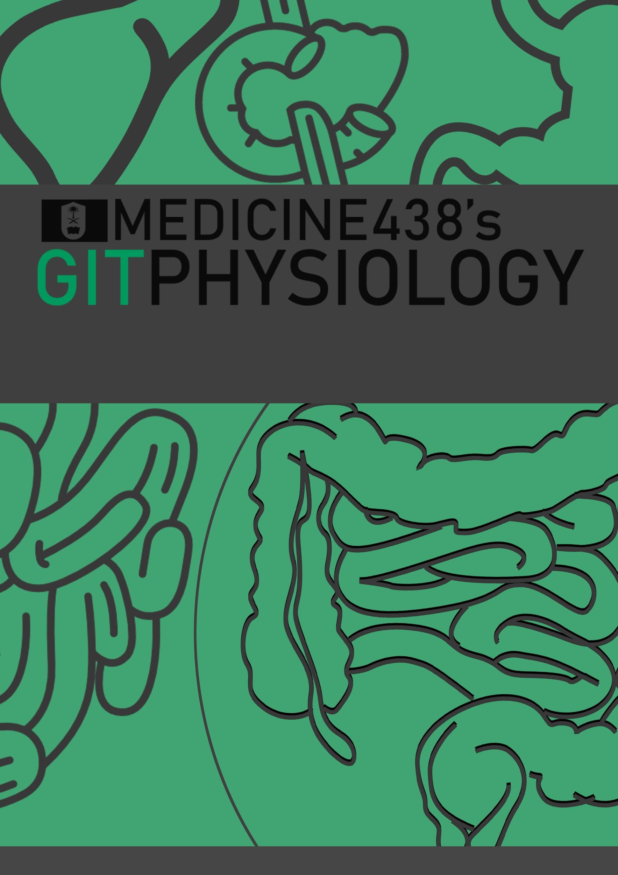
LECTURE II: Esophageal Motility and Pathophysiology of Reflux Disease
EDITING FILE
IMPORTANT
MALE SLIDES
EXTRA
FEMALE SLIDES
LECTURER’S NOTES

Slide 2
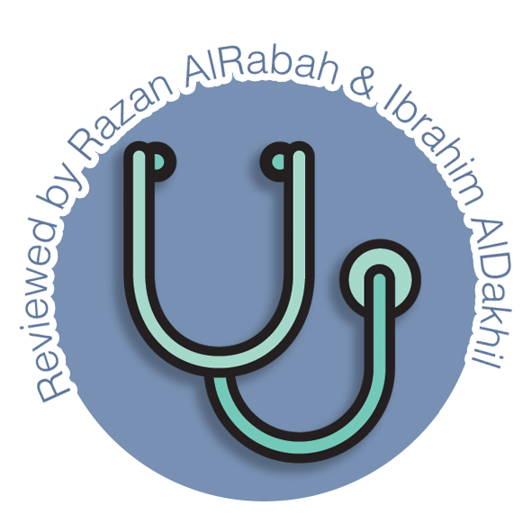
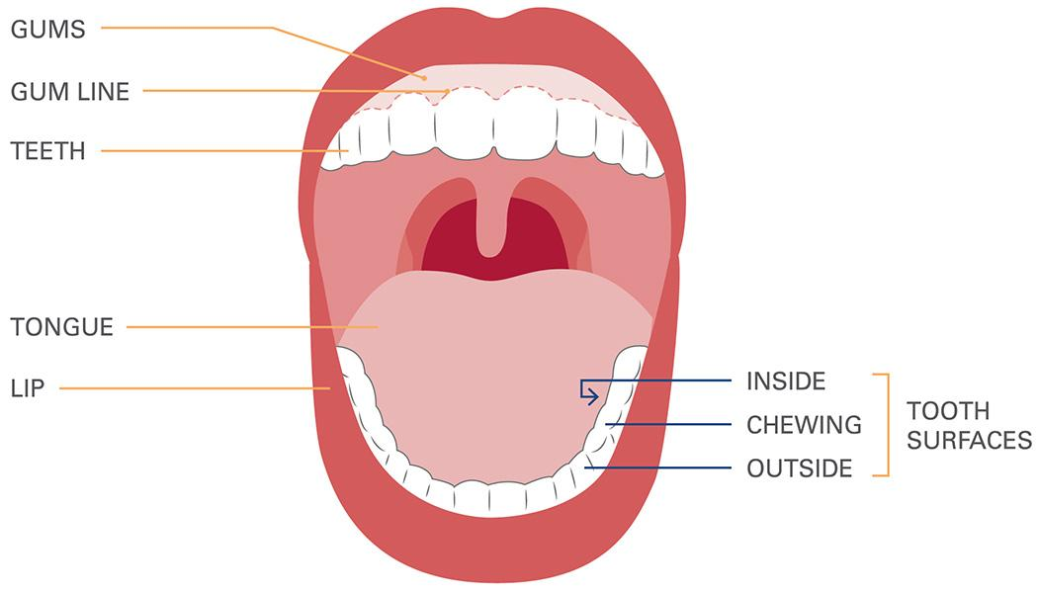
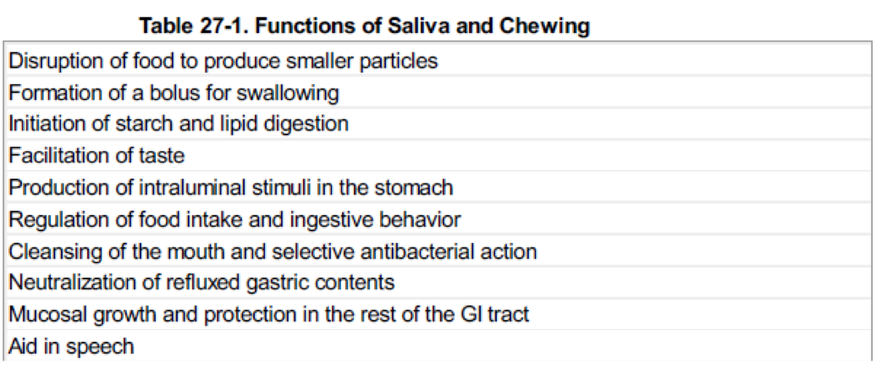
1
ESOPHAGEAL MOTILITY AND PATHOPHYSIOLOGY OF REFLUX DISEASE
Lecture Two
OBJECTIVES
❖ Mastication and chewing reflex.
❖ Swallowing process and its stages.
❖ Nervous initiation of pharyngeal stage of swallowing and its effect on respiration.
❖ Salivary glands and Contents, Function , Secretion of saliva and control of secretion.
❖ Types of esophageal peristalsis.
❖ Esophageal sphincter.
❖ Function of lower esophageal sphincter.
❖Prevention of esophageal reflux by valve like mechanism.
What is the Early Response of the GIT to a Meal? It can be divided into three phases:
Cephalic phase
1
Occurs before ingesting food.
Thinking or anticipating food, smelling or seeing food.
Aim to prepare the GIT for the meal.
Stimuli cause an increase in parasympathetic neural outflow to gut leading to enhanced GI secretions (salivary, gastric, pancreatic.. Etc).
Oral phase
2
Occurs when ingested food is in the mouth.. (Extra stimulus which is food touching the receptor)
Same features as cephalic phase but here there is contact between food and GI surface.
Adding more stimuli from mouth → taste.
The response is similar to the cephalic phase → an increase in parasympathetic neural outflow to gut leading to enhanced GI secretions (salivary,gastric, pancreatic.. Etc).
Esophageal phase
3
When food is transferred from mouth to esophagus.
Where Does Food Digestion Start From? At the mouth (oral cavity)
What is meant by digestion? Breaking down food
What are the types of digestion? Chemical - mechanical
What is the role of the mouth in digestion? Digestion begins in the mouth when food mixes with saliva. Saliva contains an enzyme (amylase) that begins the breakdown of carbohydrates.
Figure 2-1
Mastication (Chewing):
Teeth perform cutting and grinding action.
Chewing is largely a reflex (5th CN).
Functions:
1. To lubricate the bolus with salivary secretion.
2. To breakdown the bolus to small particles.
3. To begin digestion of carbohydrate (by amylase).
Figure 2-2

Slide 3
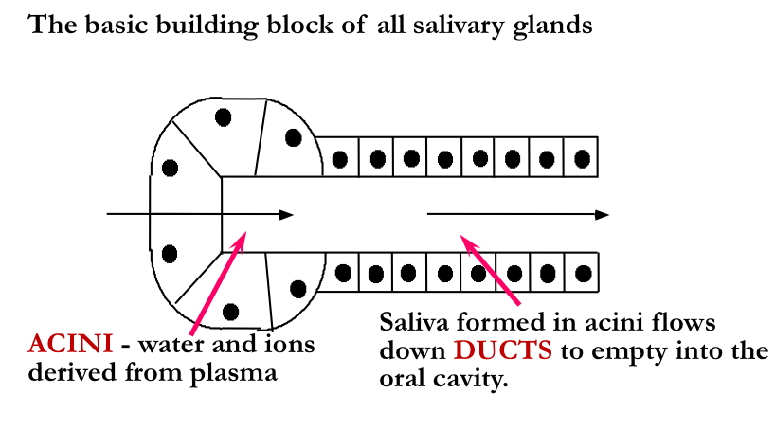
2
ESOPHAGEAL MOTILITY AND PATHOPHYSIOLOGY OF REFLUX DISEASE
Lecture Two
Mastication (Chewing)
Teeth organization:
Chewing muscles are innervated by cranial nerve V (trigeminal nerve):
Masseter
Temporalis
Pterygoid (lateral & medial)
1
2
Anterior teeth (incisors) for cutting.
Posterior teeth (molars) for grinding.
Taste centers in the brainstem and hypothalamus responsible for rhythmical chewing movements.
Much of the chewing process is caused by chewing reflex & stretch reflex.
Chewing (Stretch) Reflex
Reflex
inhibition
to muscles
of
mastication
Jaw
drops> The drop initiates a stretch reflex
in jaw
muscles
Rebound
contraction
Jaw raises (closure of the teeth)
Bolus is compressed again against the linings of the mouth
Jaw muscles are once again inhibited > jaw drops
Rebound contraction
(This process is repeated again and again)
Food in
mouth
Salivary Glands:
Are exocrine glands.
The secretory unit is made up of acini and ducts.
Salivary Secretions: We secrete ≈ 800 – 1500 ml of saliva per day (average 1L).
pH of saliva = 6-7
Based on type of secretion they are classified into
Figure 2-3
Serous
Mucinous
Mixed
Clear, salty, watery containing ptyalin (α-amylase).
e.g. Parotid gland
Thick slimy secretion of mucus (mucin).
e.g. buccal glands
A mixture of both
e.g. Submandibular & sublingual

Slide 4
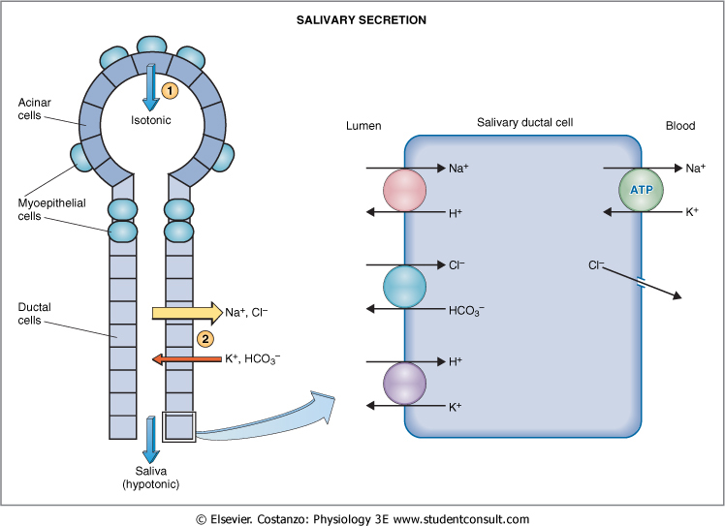
33
ESOPHAGEAL MOTILITY AND PATHOPHYSIOLOGY OF REFLUX DISEASE
Lecture Two
functions of saliva
Digestion
Lubrication
Cleansing
Protection
Proteolytic enzymes.
Antibodies.
Mechanism of Salivary Secretion
First Stage: Acini
Isotonic
concentration of major ions similar to that in plasma
Two stages process
Second Stage: Ducts
Figure 2-4
hypotonic
Initial saliva is produced by acinar cells & subsequently modified by ductal epithelial cells.
The fluid secreted from the acini is overall isotonic with the extracellular fluid.
As the primary secretion (from the acini) flows through the ducts, two major active transport processes take place that markedly modify the ionic composition of the fluid in the saliva.
Na⁺ ions are actively reabsorbed from all the salivary ducts and K⁺ ions are actively secreted in exchange for the sodium.
Cl⁻ ions are passively reabsorbed.
HCO₃⁻ ions are secreted by the ductal epithelium into the lumen.
Composition of saliva
Mucus that serves as a lubricant.
Amylase: initiates the digestion of starch.
Lingual lipase: begins digestion of fat.
Electrolytes (Na⁺,Cl⁻, K⁺, HCO₃⁻): moisten food.
Sodium and chloride ions are usually at a lower concentration than the plasma (hypotonic).
Potassium, calcium and iodide ions are usually at a higher concentration than plasma (hypertonic)
Proteins & Enzymes.
What happens to the composition of saliva in cases of increased flow of secretion?
When the production of saliva is stimulated, flow exceeds the ductal cells maximum rate of modification and so the acinar secretion is modified less (Less hypotonic than resting saliva).
Slow
Fast
Figure 2-5

Slide 5
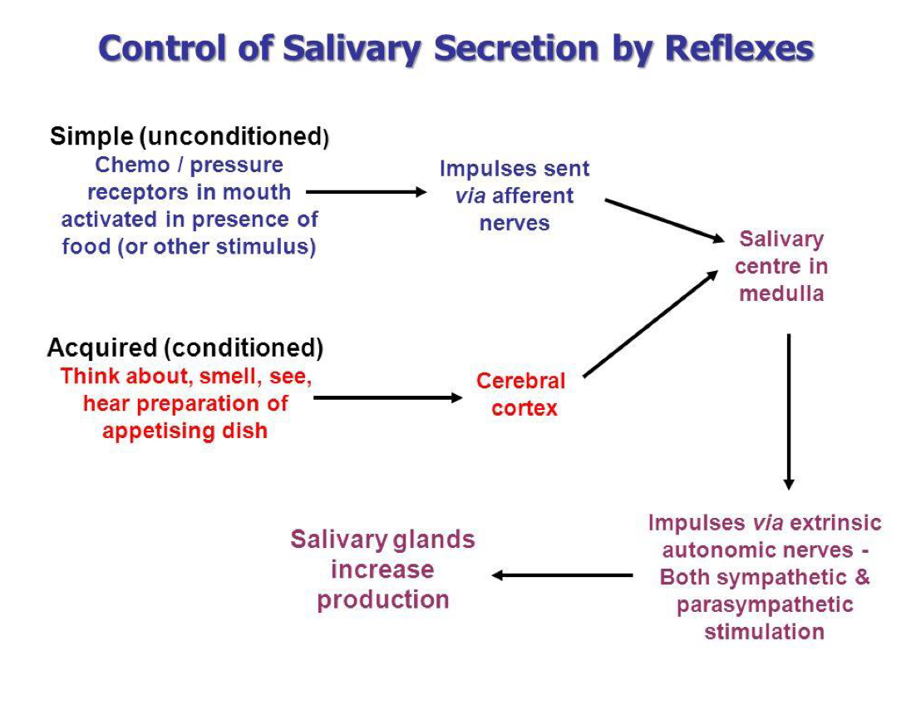
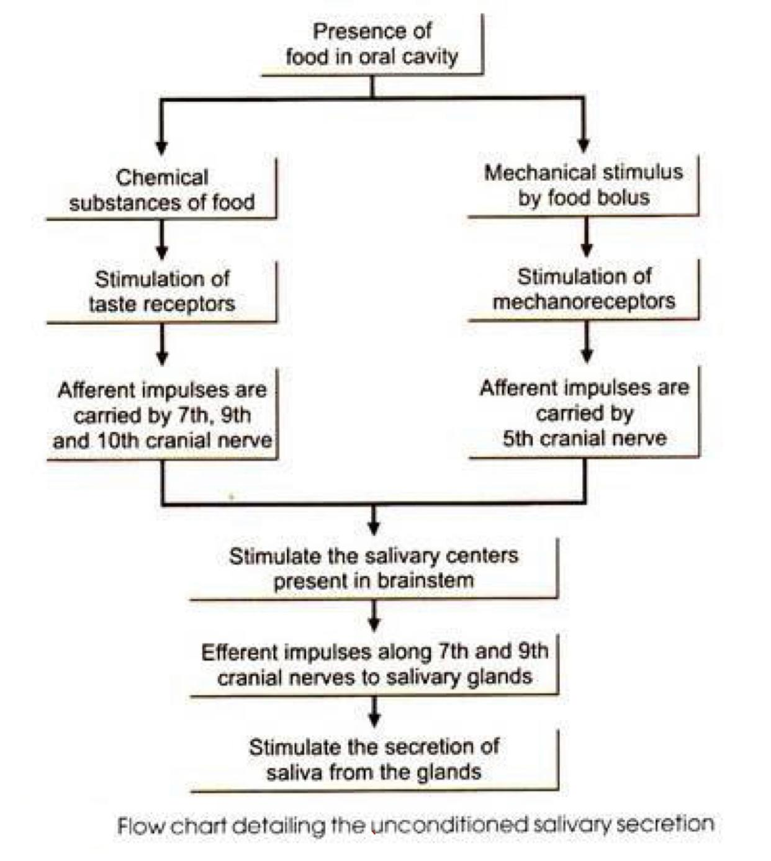
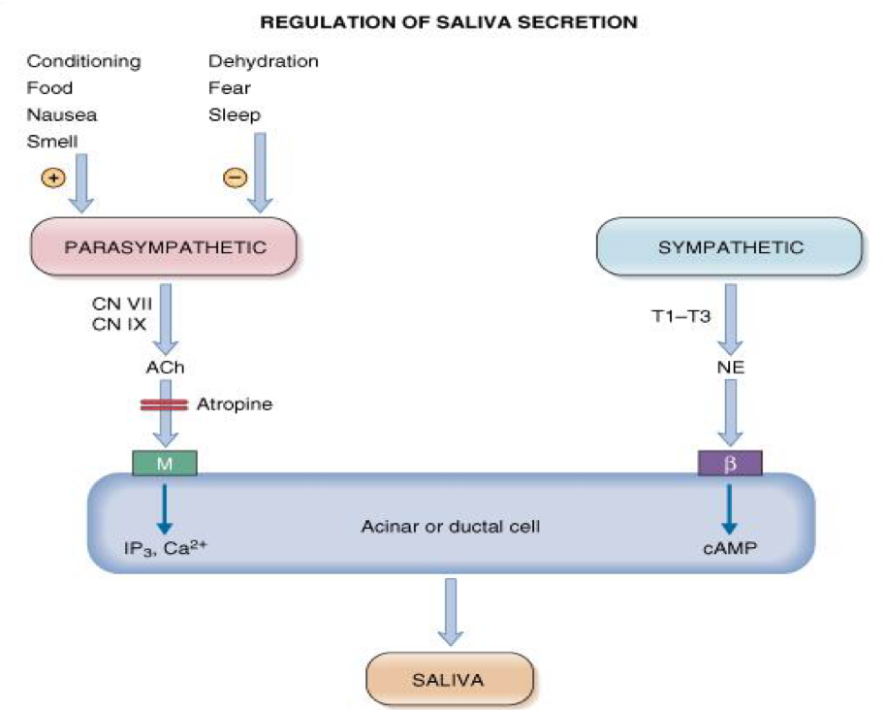
4
ESOPHAGEAL MOTILITY AND PATHOPHYSIOLOGY OF REFLUX DISEASE
Lecture Two
Regulation of Salivary Secretion:
Exclusively neural
Increased secretion of salivary glands in response to a meal is a reflex, two types of salivary reflexes;
1
Unconditioned (born with it).
2
Conditioned reflex (learnt by experience).
Salivation may occur in response to reflexes originating in the stomach and upper small intestine. E.g. Nauseous, presence of irritating food
Figure 2-6
Figure 2-7
Nerve supply of salivary glands
Sympathetic nerves | Parasympathetic nerves
Originate in the superior cervical ganglion and reach the 3 pairs of salivary glands through blood vessels | Originate in the superior & inferior salivary nuclei in brain stem.
Functions:- Act on mucous cells and produce small amount of viscous secretion. Cause vasoconstriction. | Fibers from the superior salivary nucleus leave in VII cranial nerve supply both submandibular and sublingual glands. Fibers from the inferior salivary nucleus leave the medulla in IX cranial nerve supply the parotid gland.
Stimulation of both sympathetic and parasympathetic nerves stimulates salivary secretion.
Figure 2-8

Slide 6
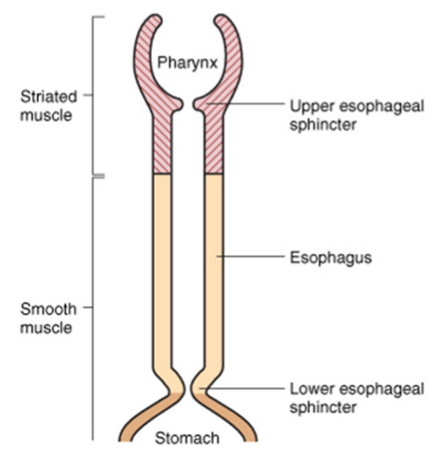
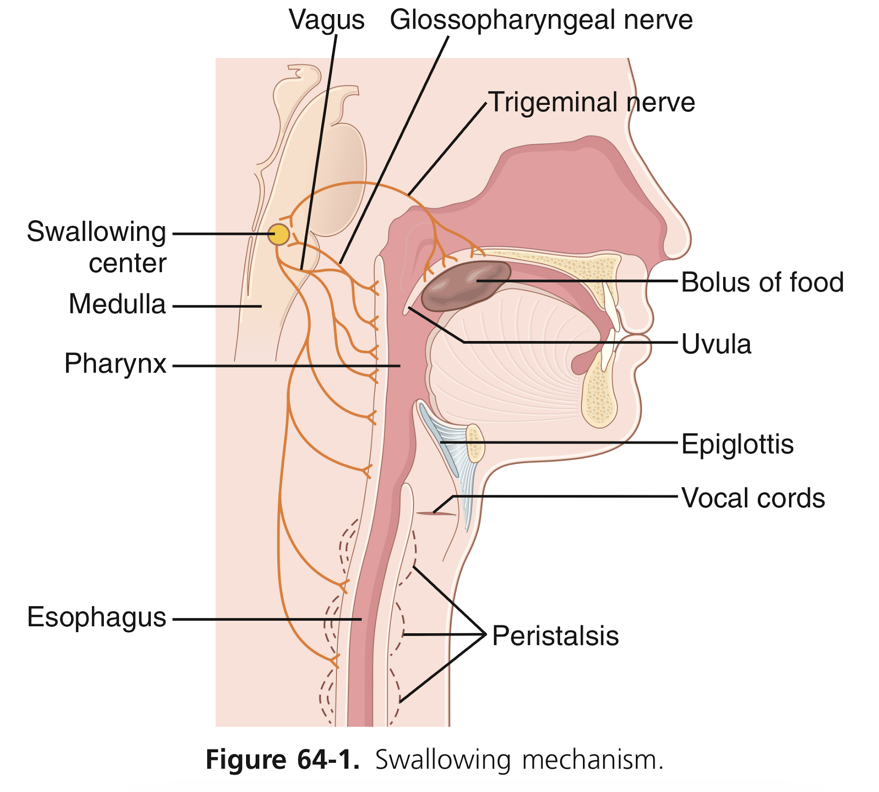
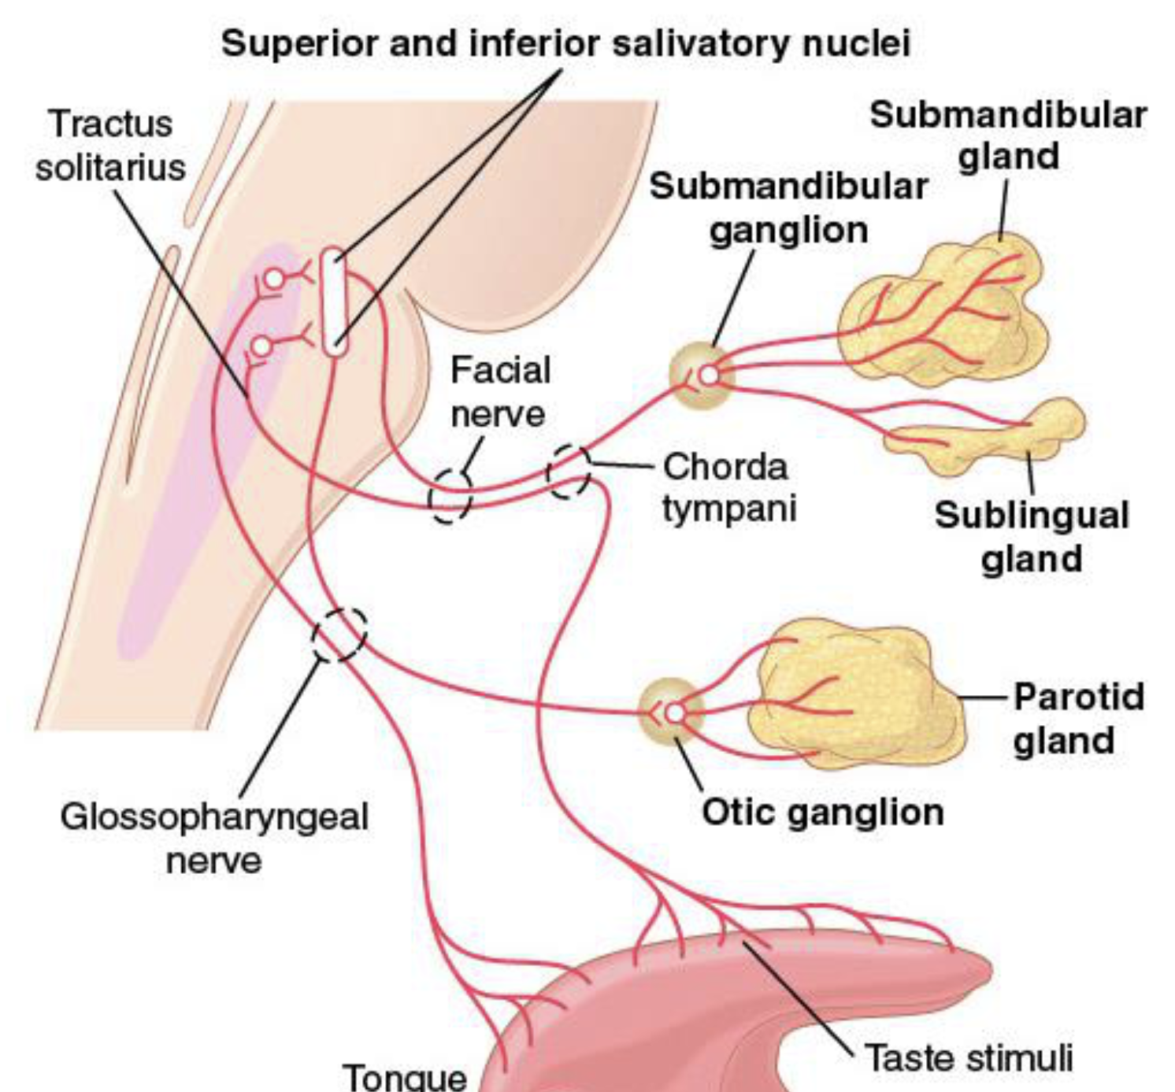
5
ESOPHAGEAL MOTILITY AND PATHOPHYSIOLOGY OF REFLUX DISEASE
Lecture Two
The Esophageal Phase:
Esophagus:
Collapsible muscular tube that conveys food from pharynx to stomach (10 inches long).
Food passes through quickly because of peristalsis.
Figure 2-9
Swallowing (Deglutition)
Propels food from mouth to stomach.
Complicated process since pharynx is a shared space between respiration & swallowing.
Swallowing is initiated voluntarily in the mouth, but thereafter is under involuntary or reflex control. The reflex portion is controlled by the swallowing center in the medulla.
Food should move without compromising respiration.
Figure 2-10
Stages of Swallowing:
Voluntary Stage of Swallowing
1
Moves bolus of food from mouth → pharynx
Changes: food is squeezed posteriorly into the pharynx by the tongue
Figure 2-11
Pharyngeal Stage of Swallowing (Involuntary)
2
Moves bolus of food from pharynx → esophagus.
Food stimulates touch receptors in pharynx → impulses (Afferent fibers via CN V & IX) → to swallowing center in the brain stem → Motor efferent via CN V, IX, X, & XII → initiate a series of autonomic pharyngeal muscle contractions as follows: (continued on the next page)

Slide 7
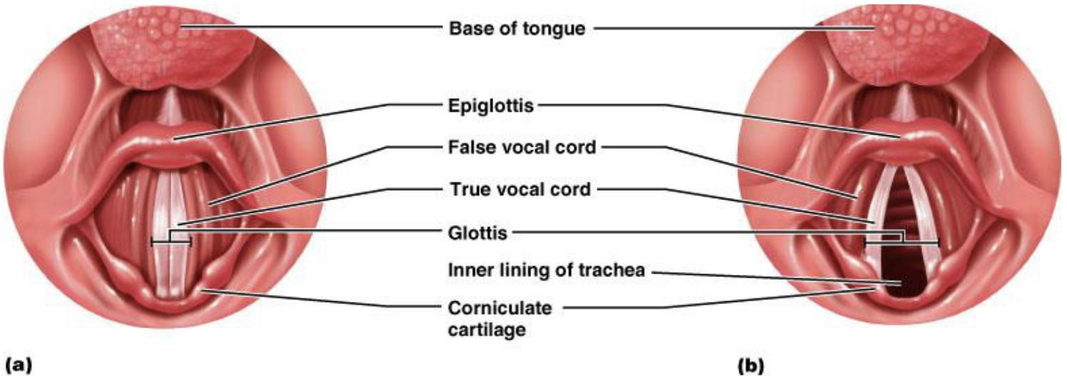
6
ESOPHAGEAL MOTILITY AND PATHOPHYSIOLOGY OF REFLUX DISEASE
Lecture Two
Pharyngeal stage of Swallowing (Involuntary)
2
1
2
3
Palatopharyngeal folds (on each side of the pharynx) → pulled medially to approximate each other.
→ form a sagittal slit
→ food pass through it to the posterior pharynx.
larynx → pulled upward and anteriorly (by the neck muscles).
Vocal cords → close
Epiglottis → bent over the airway as larynx is lifted.
All these effects prevent food from going into the nose and trachea.
Destruction of the vocal cords or the muscle that approximate them can cause strangulation.
Soft palate & uvula → pulled upward to close off the nasopharynx
Figure 2-12
4
5
Esophagus → opens due to the upward movement of the larynx.
Upper esophageal sphincter → relaxes
Respiration → inhibited (the swallowing center inhibits the respiratory center in the medulla during the swallowing cycle)
The entire muscular wall of the pharynx → contracts (superior, middle, then inferior parts) propelling the food by a wave of peristalsis.
Summary of Pharyngeal Stage of Swallowing:
The pharyngeal stage of swallowing is a reflex act initiated by:
The voluntary movement of food into the back of the mouth which stimulates involuntary pharyngeal sensory receptors to elicit the swallowing reflex.
The trachea is closed.
The esophagus is opened.
A fast peristaltic wave initiated by the nervous system of the pharynx forces the bolus of food into the upper esophagus (time of process is < 2 seconds).

Slide 8
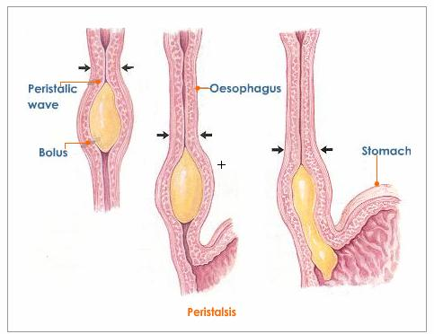
7
ESOPHAGEAL MOTILITY AND PATHOPHYSIOLOGY OF REFLUX DISEASE
Lecture Two
Sensory impulses
(From the mouth)
Are received by the nucleus tractus solitarius via the medulla oblongata through the 5th & 9th cranial nerves.
Most sensitive areas for its initiating
Are located in a ring around the pharyngeal opening including the tonsillar pillars.
Pharyngeal stage
Swallowing
(deglutition) centers
The reticular substance of medulla
Lower portion of pons
Motor impulses to pharynx and upper esophagus
Are transmitted by
The 5th, 9th, 10th, and 12th cranial nerves
Few of the superior cervical nerves.
Esophageal Stage
3
Move food rapidly from pharynx → stomach.
It’s controlled partly by the swallowing reflex and partly by the enteric nervous system (ENS). (Myenteric plexus & vagus)
In case of vagotomy¹ → enteric nervous system takes over.
When bolus of food passes through the upper esophageal sphincter, the swallowing reflex closes the sphincter so food cannot reflux into the pharynx.
Musculature:
The pharyngeal wall & upper 1/3 of esophagus: striated muscles, innervated by 10th & 9th cranial nerves.
Lower two thirds of the esophagus: smooth muscle, controlled by the vagus through connections with the esophageal myenteric nervous system.
Primary Peristalsis²
Secondary Peristalsis²
Continuation of the peristaltic wave that started in the pharynx (to push bolus down)
It passes from the pharynx to the stomach in 8-10 sec
It occurs if the primary peristaltic wave fails to move the food to the stomach
Starts at the point of esophageal distention by retained food → will continue until all the food is emptied into the stomach.
Receptive Relaxation³
A wave of relaxation (of LES & stomach) that travels along the myenteric plexus ahead of peristaltic wave.
→ Allows LES & stomach to prepare to receive the food bolus.
Figure 2-13
FOOTNOTES
A surgical operation in which one or more branches of the vagus nerve are cut, typically to reduce the rate of gastric secretion.
Nerve pathway of peristalsis: Esophageal distension by bolus → Stimulates mechanoreceptors located on the sensory neurons that lie beneath the epithelium → Sensory neurons send afferent fibers through the vagus nerve to NTS → NTS sends axons to dorsal vagal nucleus (remember this is the autonomic nucleus of the vagus nerve that sends efferents to the GIT) → Axons of dorsal vagus nucleus (vagus efferent fibers) stimulates excitatory motor neurons and inhibitory motor neurons of myenteric plexus → Excitatory motor neurons cause contraction above distension through ACh, inhibitory motor neurons cause relaxation of the segment below the bolus through NO.

Slide 9
8
ESOPHAGEAL MOTILITY AND PATHOPHYSIOLOGY OF REFLUX DISEASE
Lecture Two
Esophageal Stage of Swallowing
The Upper Esophageal Sphincter (UES)
The Lower Esophageal (Gastroesophageal) Sphincter
Formed of skeletal muscle but is not under voluntary control
located at the lower end of pharynx
guards the entrance into the esophagus.
• It prevents :
esophageal air insufflation¹ during negative intrathoracic pressure events(eg: inspiration.)
esophagopharyngeal/laryngeal reflux during esophageal peristalsis.
• It relaxes during swallowing for about 1 sec → allowing the bolus to be forced through the relaxed UES.
Formed by circular muscles
Extends 3cm above its junction with stomach
Normally remains tonically constricted → Helps to prevent reflux of gastric juice.
Valvelike mechanism of short portion of esophagus that extend slightly into the stomach also helps in preventing reflux.
Relaxes ahead of esophageal peristaltic wave
“receptive relaxation” → emptying of the propelled food into the stomach.
Failure of the sphincter to relax will result in achalasia.
Causes of Competence and the antireflux functions of the LES
Control of LES Function
● Additional Prevention of Esophageal Reflux by Valve-like Closure of the Distal End of the Esophagus.
A protective mechanism
prevents reflux of gastric secretions into the lower portion of the esophagus.
a short portion of the esophagus extends slightly into the stomach & caves the esophagus inward (closure of the lower esophagus) in response to increased intra-abdominal pressure.
→ Prevents the high pressure in the stomach from forcing its contents into the esophagus.
● During swallowing, efferent inhibitory impulses from vagus nerve cause the sphincter to relax.
Transmitters:
Nitric oxide (NO) or
Vasoactive intestinal peptide (VIP).
● The gastrin hormone, released from the stomach by food, contracts LES.
● Secretin and cholecystokinin (CCK), are released from the upper small intestine, relax the LES.
● Resting pressure (15-30 mmHg).
● Contraction of the circular musculature of the sphincter is regulated by:
Nerves
Hormones
Neurotransmitter.
● The diaphragm wraps around the esophagus at the level of lower esophageal sphincter (LES).
→ contraction of the diaphragm helps to increase the pressure at the LES during inspiration.
● Between swallows, tonic vagal cholinergic impulses maintain contraction to keep the sphincter closed.
FOOTNOTES
Esophageal insufflation: When inspiration occurs, the lung inflates as air flows into the lung and the intrathoracic pressure becomes negative, this creates a pressure gradient for air to flow into the respiratory tract, but this can affect the esophagus due to the pharynx serving a respiratory function. When air puffs touch the nasopharynx neuronal signals causes the UES to close, preventing the esophagus and stomach from being filled with air.

Slide 10
9
ESOPHAGEAL MOTILITY AND PATHOPHYSIOLOGY OF REFLUX DISEASE
Lecture Two
Achalasia:
A condition due to high resting pressure at the LES that fails to relax during swallowing. As a result, food transmission from the esophagus into the stomach is prevented.
Causes: pathology of or absence of the myenteric plexus containing VIP & NO in the lower third of esophagus.
The musculature of the lower esophagus instead remains contracted and the myenteric plexus has lost the ability to transmit a signal to cause relaxation of the LES.
As achalasia gets worse, the esophagus gradually enlarged as food collects within it.
Food becomes putridly infected during the long periods of esophageal stasis causing ulceration of the esophageal mucosa, severe substernal pain or even rupture & death.
Figure 2-14
Gastroesophageal Reflux Disease (GERD)
“Incompetence of the LES”
Incompetence of the lower esophageal sphincter allows reflux of gastric contents into the esophagus.
It may result from a generalized loss of intrinsic sphincter tone or from recurrent inappropriate transient relaxations triggered by gastric distention.
Contributing factors are:
weight gain
fatty foods
caffeinated or carbonated beverages
alcohol
tobacco smoking
drugs (as anticholinergics, antihistamines, calcium channel blockers, progesterone and nitrates).

Slide 11
10
Lecture Two
ESOPHAGEAL MOTILITY AND PATHOPHYSIOLOGY OF REFLUX DISEASE
FURTHER READINGS
Nerve pathways of peristalsis: Note how the sensory neurons lie beneath the epithelium in Figure 2-14, those sensory neurons contain mechanoreceptors, chemoreceptors, both of which can initiate peristalsis. That’s why the presence of acids in the esophagus might initiate peristalsis! But mostly mechanoreceptors sense distension and initiate peristalsis. Peristalsis is aided by gravity but not dependent on it, since you can swallow food upside-down.
Figure 2-15
Figure 2-16
Nerve pathway of peristalsis: Esophageal distension by bolus → Stimulates mechanoreceptors located on the sensory neurons that lie beneath the epithelium → Sensory neurons send afferent fibers through the vagus nerve to NTS → NTS sends axons to dorsal vagal nucleus (remember this is the autonomic nucleus of the vagus nerve that sends efferents to the GIT) → Axons of dorsal vagus nucleus (vagus efferent fibers) stimulates excitatory motor neurons and inhibitory motor neurons of myenteric plexus → Excitatory motor neurons cause contraction above distension by bolus through ACh, inhibitory motor neurons cause relaxation of the segment below the bolus through NO → Bolus moves in caudad direction.

Slide 12
Which of the following physiological process assists in clearing a large food bolus from the esophagus?
Migrating myoelectric complex
Receptive relaxation
Reverse peristalsis
Secondary peristalsis
The process of mastication is initiated by:
Stretch reflex
Jaw drop
Food bolus inhibiting jaw muscles
Jaw muscles contraction
Which ONE of the following is most correct about sympathetic stimulation over salivary glands?
Decreases salivary secretion initially
Increase watery secretion of saliva
Decreases salivary secretion when vasoconstriction superimposes
Increases salivary secretion
At low flow rate, saliva in the mouth is?
Isotonic, acidic and low in K⁺
Hypotonic, acidic and low in K⁺
Hypertonic, alkaline and rich in Na⁺
Hypotonic, slightly acidic and rich in K⁺
Which of the following is a mechanism which keeps the valve (of the Gastroesophageal Sphincter) closed.
Valve-like Closure mechanism
Diaphragm helping mechanism
Hormonal and neural mechanism
all of the above
SHORT ANSWER QUESTIONS
Q1: How does the swallowing reflex function?
Q2: What is achalasia?
Q3: List 3 ions in saliva, and their concentration compared to plasma.
The swallowing reflex center is located in the medulla oblongata. Generator neurons are situated within a primary sensory relay, that is, the nucleus tractus solitarii. which is transmitted by the 5th, 9th, 10th, and 12th cranial nerves and few of the superior cervical nerves.
A condition due to high resting pressure at the LES that fails to relax during swallowing. As a result, food transmission from the esophagus into the stomach is prevented.
Na (Low), K (High) and Cl (Low).
ANSWER KEY: D, A, C, D, D

Slide 13
Noura Alturki, Taibah alzaid
FEMALE PHYSIOLOGY CO-LEADERS
Maha Alnahdi, Taif Alshammari
MALE PHYSIOLOGY CO-LEADERS
Nayef Alsaber, Hameed M. Humaid
REFERENCES
Guyton and Hall Textbook of Medical Physiology
Ganong’s Review of Medical Physiology

