Slide 1
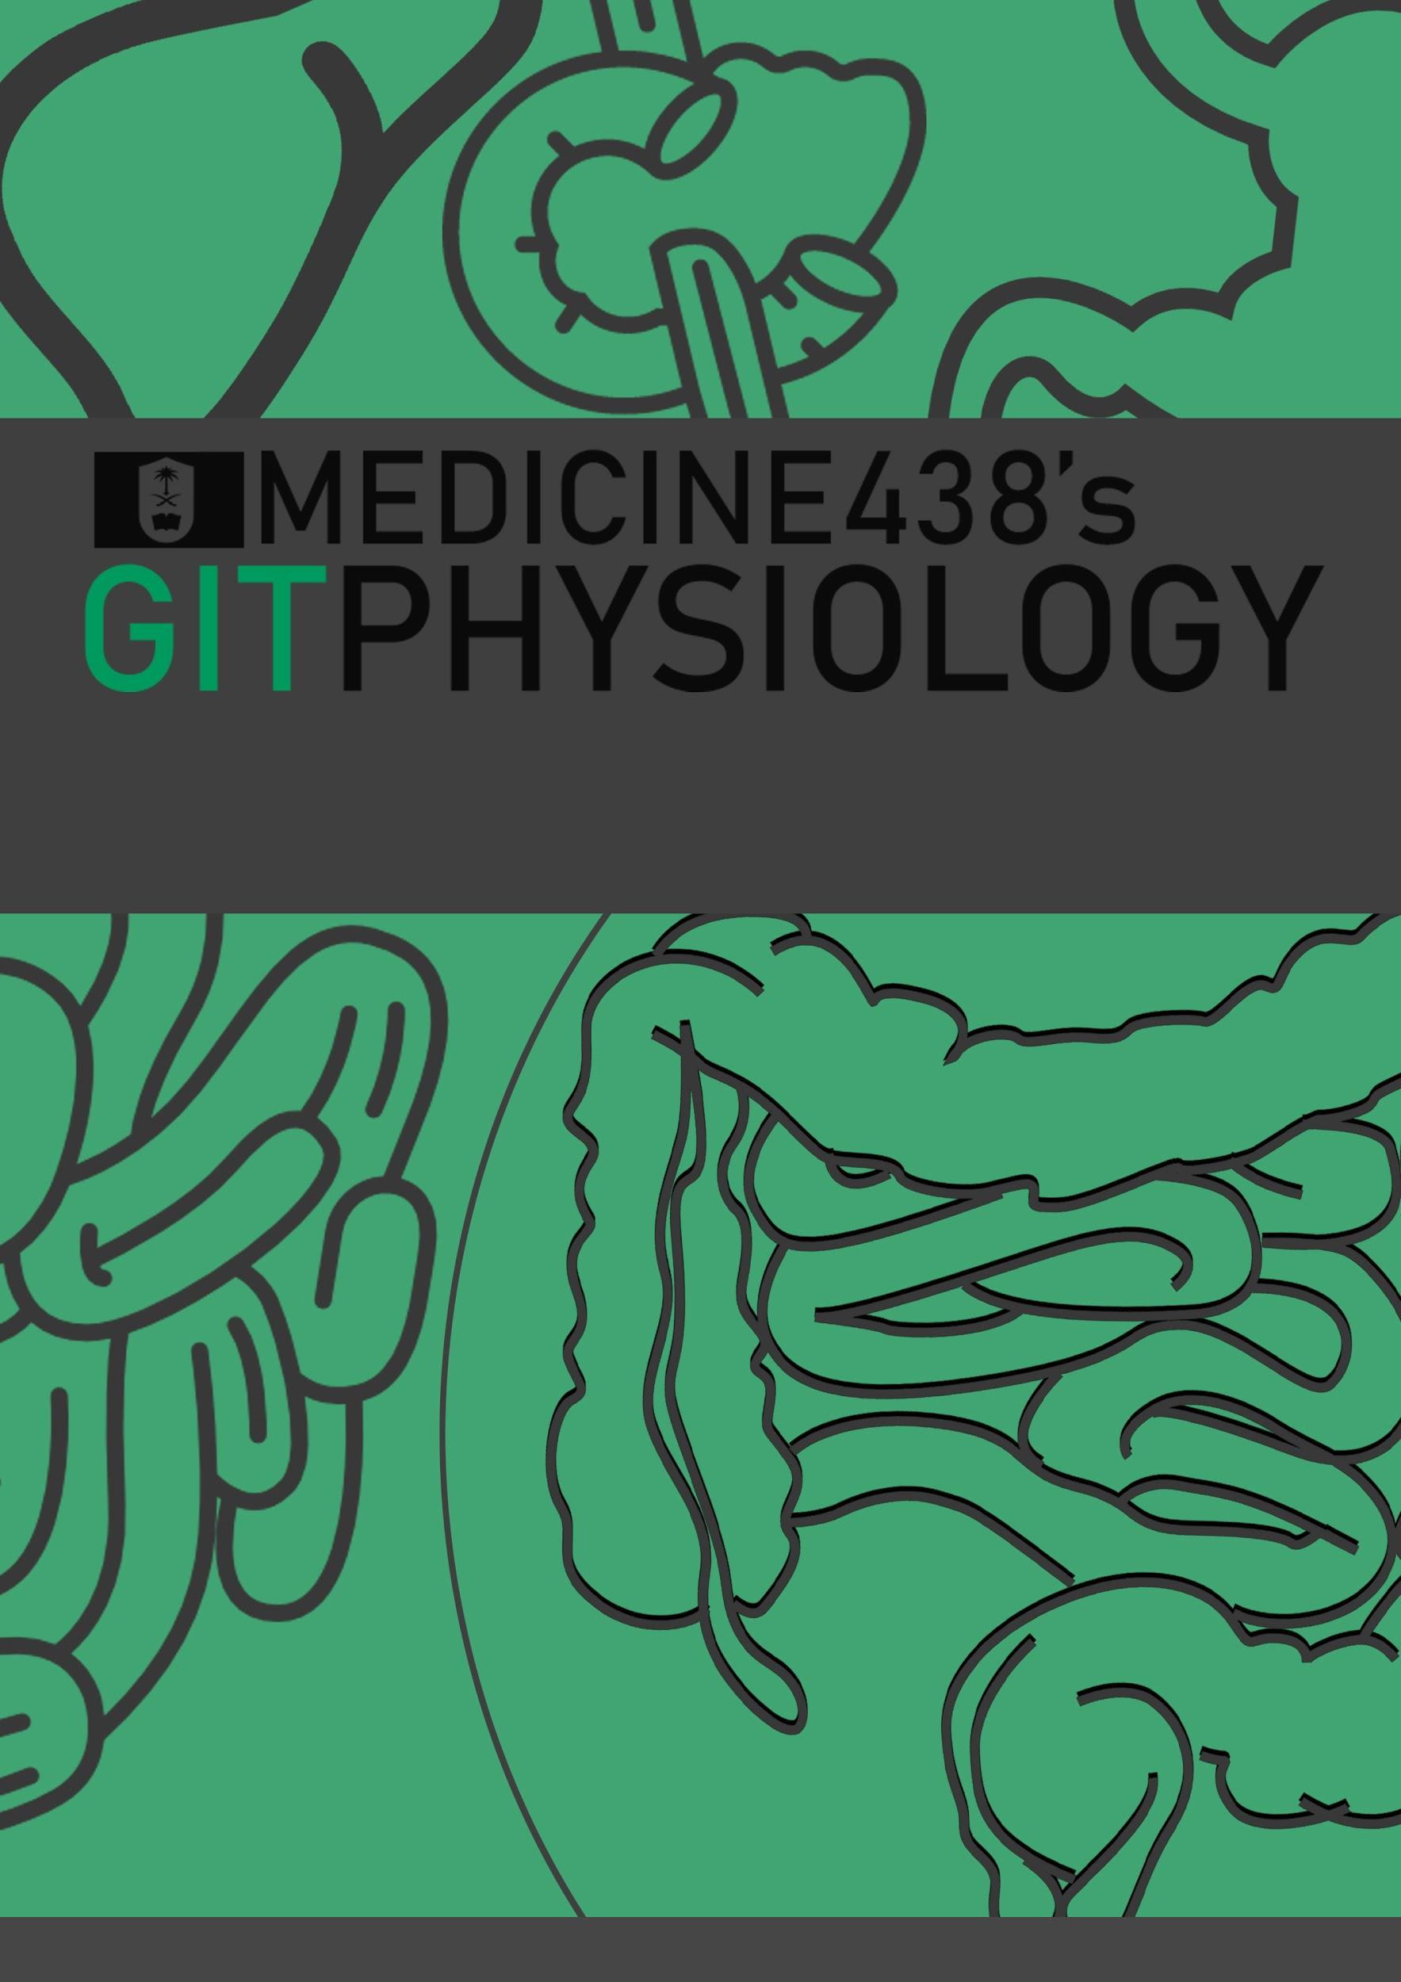
LECTURE III: Physiology of the Stomach and Regulation of Gastric Secretions
EDITING FILE
IMPORTANT
MALE SLIDES
EXTRA
FEMALE SLIDES
LECTURER’S NOTES

Slide 2
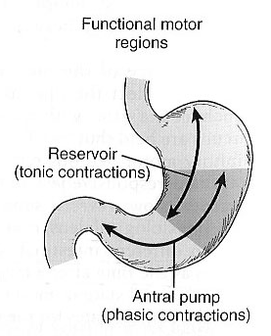
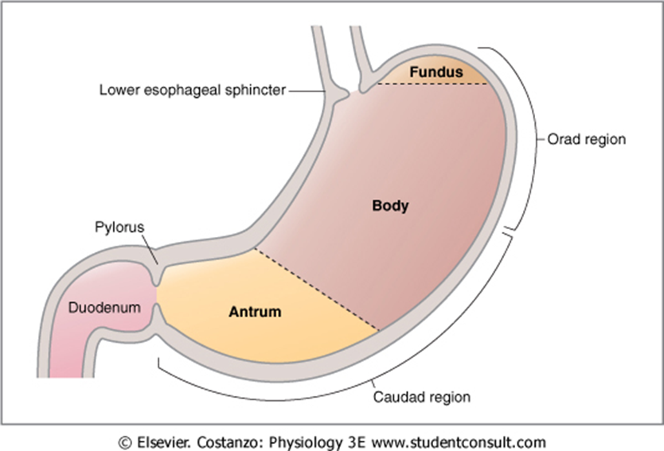
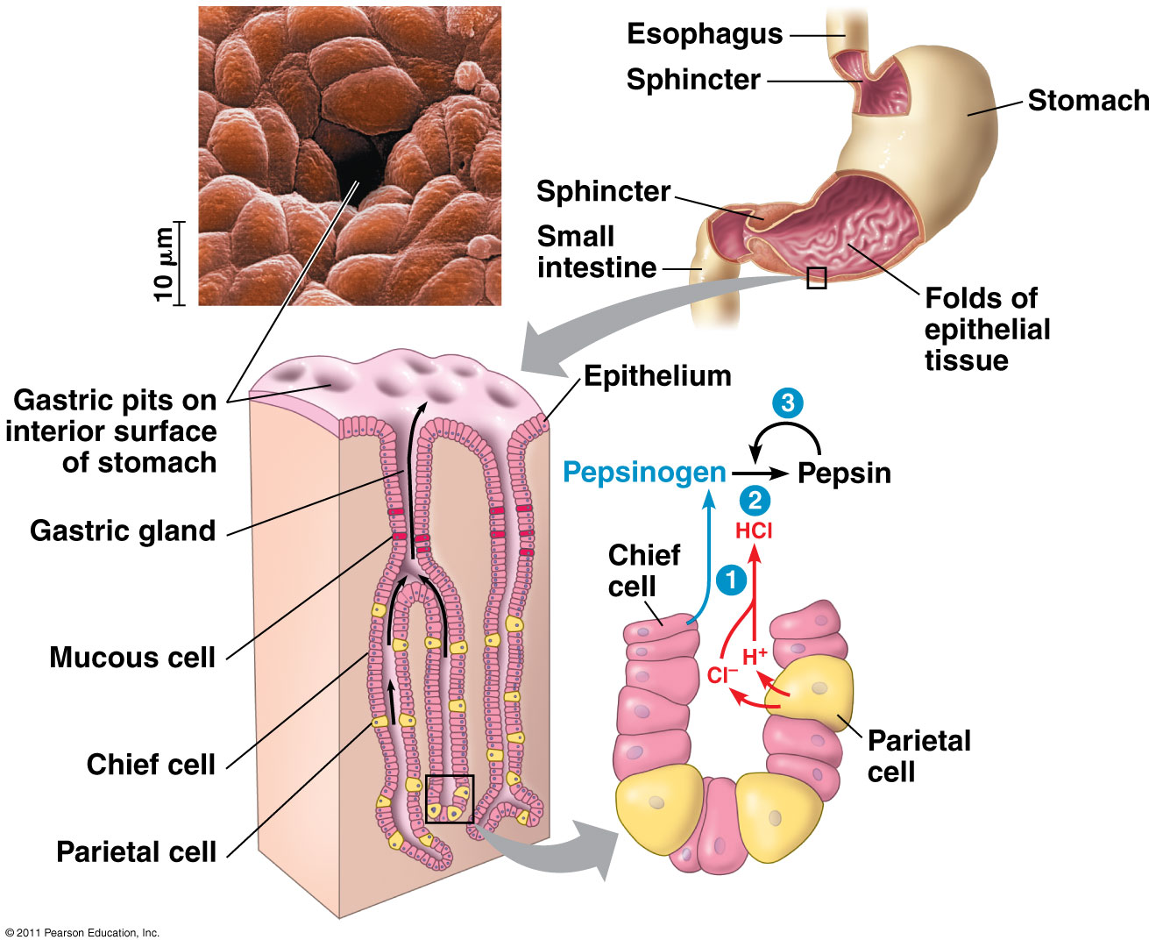
1
PHYSIOLOGY OF THE STOMACH AND REGULATION OF GASTRIC SECRETIONS
Lecture Three
OBJECTIVES
•Functions of stomach.
•Gastric secretion.
•Mechanism of HCl formation.
•Gastric digestive enzymes.
•Neural & hormonal control of gastric secretion.
•Phases of gastric secretion.
•Motor functions of the stomach.
•Stomach Emptying.
Functional Anatomy of the Stomach:
Orad (Reservoir)
fundus and upper two thirds of the body
physiologically
orad
Caudad (Antral Pump)
lower third of the body plus antrum
stomach
Caudad
fundus
Figure 3-1
anatomical
body
antrum
Figure 3-2
Gastric mucosa is formed of columnar epithelium that is folded into “pits”.
The pits are the opening of gastric glands.
There are several types of gastric glands in the stomach and are distributed differentially in the stomach.
Figure 3-3

Slide 3
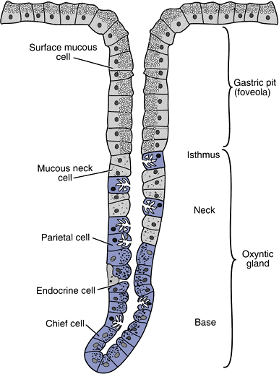
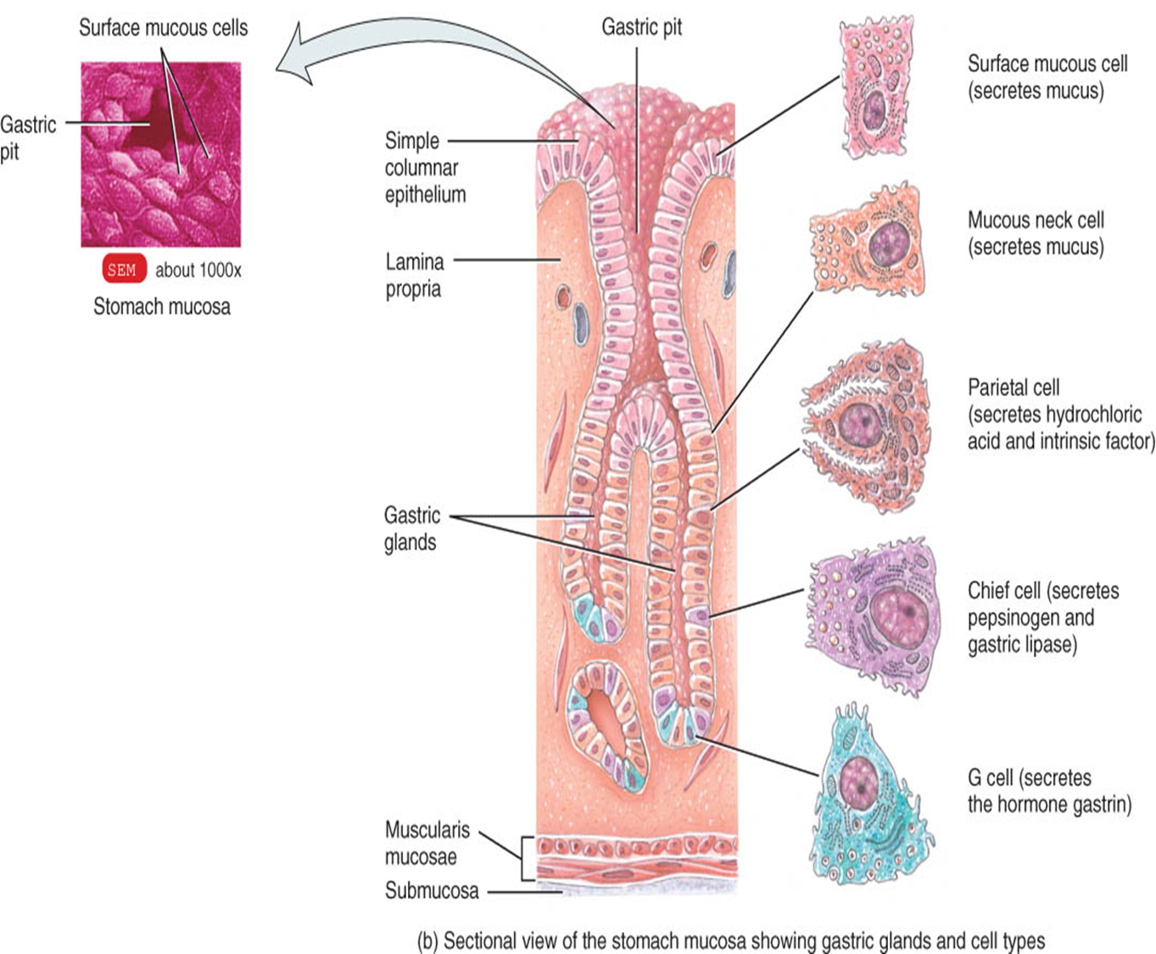
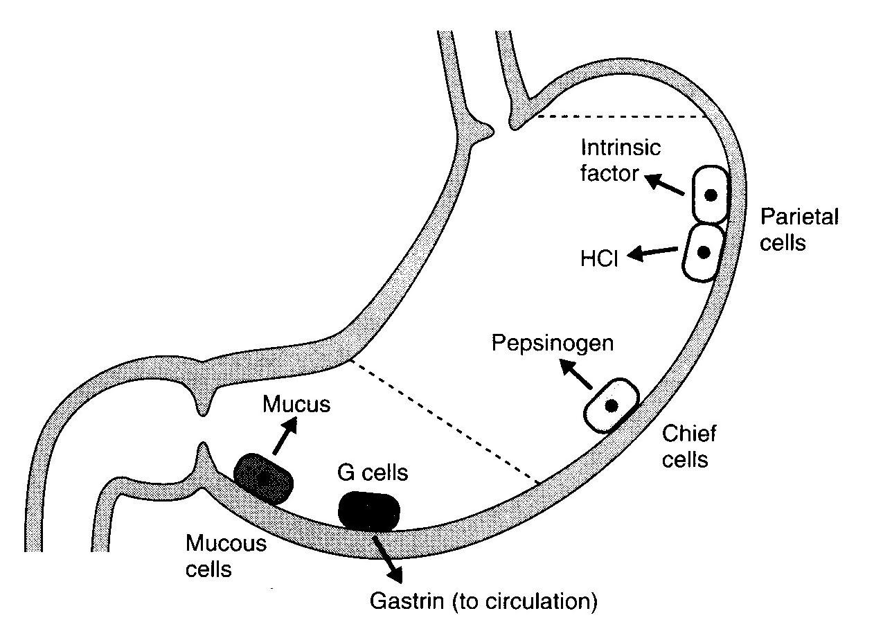
2
PHYSIOLOGY OF THE STOMACH AND REGULATION OF GASTRIC SECRETIONS
Lecture Three
Types of Gastric Glands:
 | Mucus secreting glands (cardiac glands) | oxyntic(parietal)glands (most abundant glands) | Pyloric glands
Types of cells | - | Mucus neck cells Peptic (Chief) cells Parietal cells (Oxyntic cells) | Many G cells
secrete | Mucus HCO3 | HCl Pepsinogen IF Mucus | Gastrin Mucus
Found in | Cardia | Body & fundus (above the notch) Proximal 80% of stomach | Antrum (below the notch) Distal 20% of stomach
Structure of a Gastric Oxyntic Gland:
HCl is secreted across the parietal cell microvillar membrane and flows out of the intracellular canaliculi into the oxyntic gland lumen.
The surface mucous cells line the entire surface of the gastric mucosa and the openings of the cardiac, pyloric, and oxyntic glands.
These cells secrete mucus and HCO₃⁻ to protect the gastric surface from the acidic environment of the stomach.
The distinguishing characteristic of a surface mucous cell is the presence of numerous mucus granules at its apex.
Figure 3-4
Types of Cells Present in Gastric Glands:
Cell type | Secretion | location
Oxyntic (parietal) cell | HCl & IF (intrinsic factor) | Body most distinctive cells in stomach
Peptic (chief )cell | Pepsinogen | Body
Mucus (neck) cells | Mucus, HCO₃⁻ | antrum
Enterochromaffin -like cells | Histamine | -
G cells | Gastrin (increases HCl secretion from Parietal cells) | antrum
D Cells (decreases HCl secretion) | Somatostatin | antrum
Figure 3-5
Figure 3-6

Slide 4
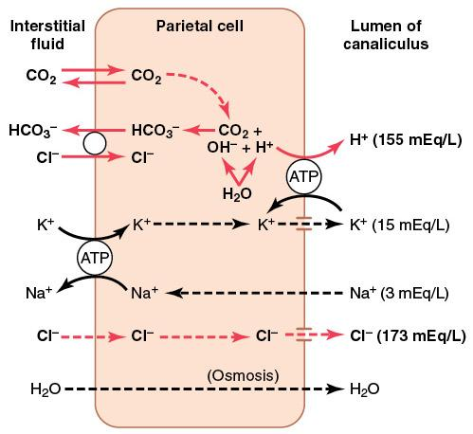
3
PHYSIOLOGY OF THE STOMACH AND REGULATION OF GASTRIC SECRETIONS
Lecture Three
Gastric juice is composed of:
HCL.
Pepsinogen.
Electrolytes.
Intrinsic factor.
Mucus (mucus gel layer).
Mechanism of HCl Secretion by Parietal Cells:
Cl⁻ is actively transported from the cytoplasm of the parietal cell into the lumen of the canaliculus¹.
Na⁺ are actively transported out of the canaliculus into the cytoplasm of the parietal cell.
Water becomes (because it is a weak acid) dissociated into H⁺ and OH⁻ in the cell cytoplasm. The H⁺are then actively secreted into the canaliculus in exchange for K⁺.
CO₂, either formed during metabolism in the cell or entering the cell from the blood, combines under the influence of carbonic anhydrase with the OH⁻ to form HCO₃⁻.
HCO₃⁻ then diffuse out of the cell cytoplasm into the extracellular fluid in exchange for Cl⁻ that enter the cell.
Mechanism of HCl production:
Depends on H/K ATPase. (H/K ATPase pump depends on [K]out)
Inhibited by: omeprazole
[HCl] drives water into gastric content to maintain osmolality
During gastric acid secretion: amount of HCO₃⁻ in blood = amount of HCl being secreted
Alkaline tide¹.
Figure 3-7
Control of HCL secretion :
direct
Ach act on parietal cells → increases HCL secretion
Neural
Act on G cells by releasing Gastrin releasing peptide(GRP) → secrete gastrin which act on CCK_{B} receptor⁴ of parietal cells → increases HCL secretion
indirect
HCL secretion control
Act on enterochromaffin like cells (ECL) which secrete histamine → act on H2 receptor of parietal cell → increases HCL secretion.
Hormonal
Gastrin
(Endocrine secretion)³
Paracrine
Histamine activate H2 receptor on parietal cells thus increase HCL secretion.
H2 blockers are used for the treatment of peptic ulcer disease or gastroesophageal reflux disease. (e.g, Cimetidine)
histamine
FOOTNOTES
Footnotes
A canaliculus is an adaptation found on gastric parietal cells. It is a deep infolding, or little channel, which serves to increase the surface area, e.g. for secretion.
Alkaline tide refers to a condition, normally encountered after eating a meal, where during the production of hydrochloric acid by parietal cells in the stomach, the parietal cells secrete bicarbonate ions across their basolateral membranes and into the blood, causing a temporary increase in pH.
Forms of chemical signaling:
Autocrine: act on the cells which produce them, e.g. cytokines.
Paracrine: act on the cells that are in close proximity to the cells that produce them, e.g. histamine.
Endocrine: a cell target a distant cell through the bloodstream
Gastrin can act on CCK receptors because they are members of the same family of peptide hormones known as the gastrin family.

Slide 5
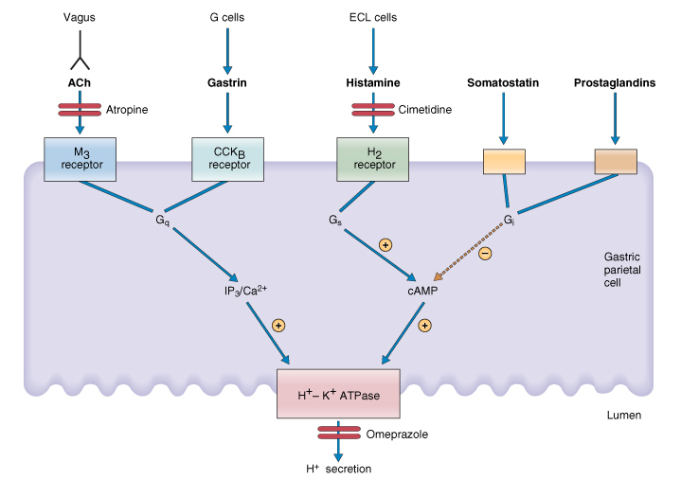
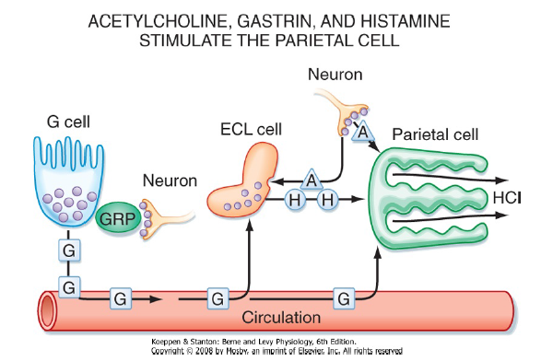
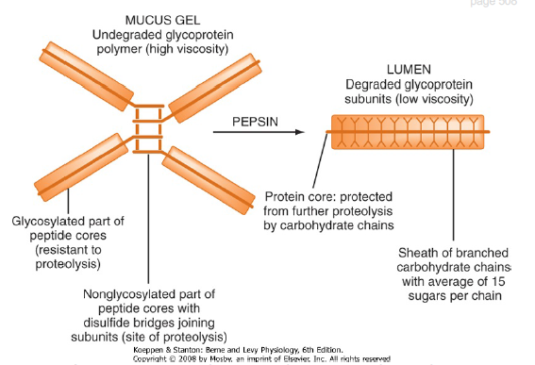
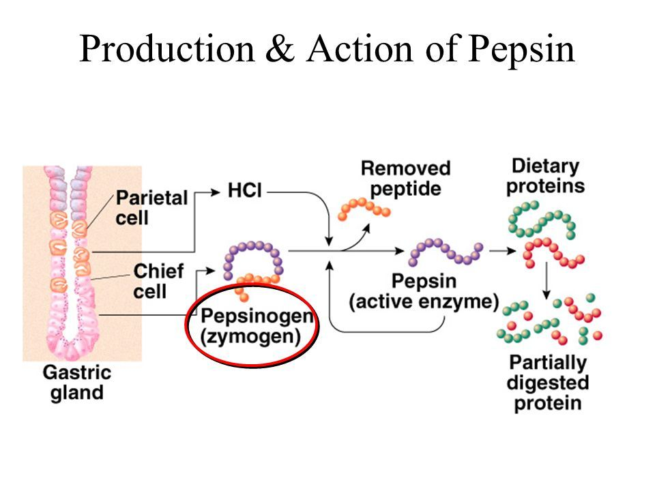
4
PHYSIOLOGY OF THE STOMACH AND REGULATION OF GASTRIC SECRETIONS
Lecture Three
Figure 3-8
Figure 3-9
Other Gastric Secretions-Mucus:
Bicarbonate rich mucus layer protects the stomach mucosa. (Mucus is a protein, so it needs to be produced continuously because it gets degraded by pepsin).
Figure 3-10
Other Gastric Secretions-Pepsin:
Several types of pepsinogen secreted from chief cells. They are activated by HCl into pepsin and once activated, they can activate more pepsinogen. These amino acids or peptides activate G cells to secrete Gastrin thus increasing HCL secretion.
The optimum pH is (1.5-3.5) (1.8-3.5).
Pepsin breaks down proteins into peptones & polypeptides.
pH > 5 inactivates pepsin
Pepsinogen secretion is stimulated by Ach, acid, gastrin, secretin & CCK.
Figure 3-11
Other Gastric Secretions-Intrinsic Factor:
It is a glycoprotein secreted by parietal cells.
It is the only essential function of stomach as it is essential for vitamin B₁₂ absorption.
Atrophy of gastric mucosa leads to pernicious anemia.

Slide 6
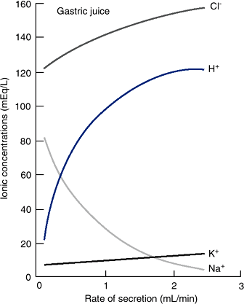
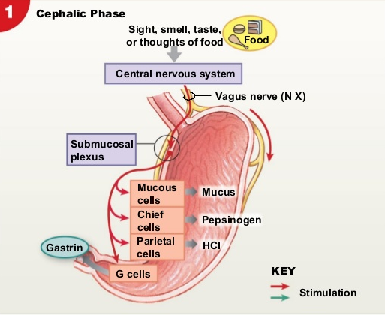
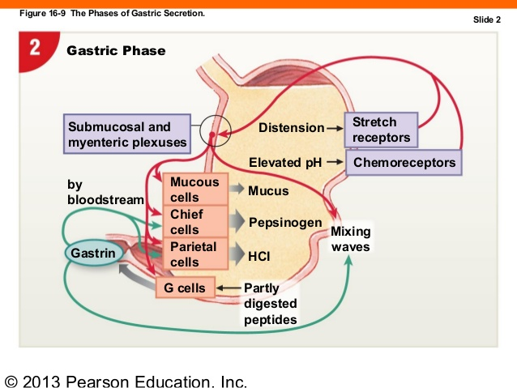
5
PHYSIOLOGY OF THE STOMACH AND REGULATION OF GASTRIC SECRETIONS
Lecture Three
The Rate of Secretion Modify the Composition of Gastric Juice:
At a low secretion rate, gastric juice contains high concentrations of Na⁺ and Cl⁻ and low concentrations of K⁺ and H⁺.
When the rate is increased:
Na⁺ concentration decreases.
H⁺ concentration increases significantly.
Cl⁻ concentration increases.
Gastric juice is derived from the secretions of two major sources:
Parietal cells: its secretion (HCl secretion) contributes mainly to the changes in electrolyte composition with higher secretion rates.
Nonparietal cells: constant secretion, thus having little contribution to the electrolyte changes
Low secretion rate (between meals): high NaCl.
High secretion rate (after a meal): high HCl.
Always isotonic.
Salivary secretion is the opposite (at high secretion rates there is high NaCl concentration)
Figure 3-12
Gastric Secretion Phases :
The stimulation of acid secretion resulting from the ingestion of food can be divided into three phases:-
Cephalic phase
1
30% of HCL is secreted in this phase.
Before food arrives at stomach.
Stimuli (Smelling, taste , Chewing and swallowing).
Mechanism:
CNS send impulses via the vagus nerves,The nerve endings release ACh, which directly stimulates acid secretion from parietal cells.
CNS send impulses via the vagus nerves ,nerves also release gastrin-releasing peptide (GRP), which stimulates G cells to release gastrin, indirectly stimulating parietal cell acid secretion.
Gastric phase
Figure 3-13
2
60% of HCL is secreted in this phase.
when food enters the stomach .
Stimuli (distention , amino acid , small peptides).
Mechanism :
Distention of the stomach stimulates mechanoreceptors, which stimulate the parietal cells directly through short local (enteric) reflexes and by long vago-vagal reflexes.
Digested proteins in the stomach are also potent stimulators of gastric acid secretion, an effect mediated through gastrin release. Several other chemicals, such as alcohol and caffeine, stimulate gastric acid secretion through mechanisms that are not well understood.
Figure 3-14

Slide 7
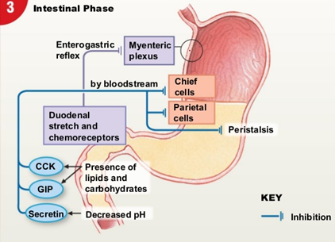
6
PHYSIOLOGY OF THE STOMACH AND REGULATION OF GASTRIC SECRETIONS
Lecture Three
intestinal phase
3
10% of HCL is secreted in this phase.
when chyme enters duodenum.
Stimuli (protein digestion products in the duodenum).
Mechanism :-
protein digestion products in the duodenum stimulate gastric acid secretion through the action of the circulating amino acids on the parietal cells.
Distention of the small intestine, probably via the release of the hormone entero-oxyntin from intestinal endocrine cells, stimulates acid secretion.
Inhibitory hormones (Enterogastrones):
Somatostatin (D-cells) in antrum.
Secretin (S-cells) in duodenum.
Glucose-dependent insulinotropic peptide (GIP) (K-cells) in duodenum.
Figure 3-15
Hormones summary :
Hormone | Site of Secretion | Stimuli for Secretion | Actions
Gastrin | G cells of the: Antrum Duodenum jejunum | Protein Distention of the stomach Vagal stimulation Gastrin releasing peptide (GRP) (Acid inhibits release) | Stimulates: Gastric H⁺ secretion Growth of gastric mucosa
Cholecystokinin (CCK) | I cells of the: Duodenum Jejunum ileum | Protein Fatty acids Acids | Stimulates: Pancreatic enzyme secretion Pancreatic HCO₃⁻ secretion Gallbladder contraction Growth of the exocrine pancreas Relaxation of the sphincter of Oddi Inhibits: Gastric emptying
Secretin | S cells of the: Duodenum jejunum ileum | Acids Fat (in the duodenum) | Stimulates: Pepsin secretion Pancreatic HCO₃⁻ secretion Biliary HCO₃⁻ secretion Growth of the exocrine pancreas Inhibits: Gastric H⁺ secretion
Glucose-Dependent Insulinotropic Peptide (GIP) | K cells of the: Duodenum jejunum | Protein Fatty acids Oral glucose | Stimulates: Insulin secretion from pancreatic β cells Inhibits: Gastric H⁺ secretion
Motilin | M cells of the: duodenum jejunum | Fat Acid Nerve | Stimulates: Gastric motility Intestinal motility

Slide 8
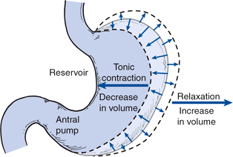
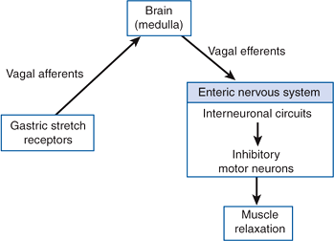
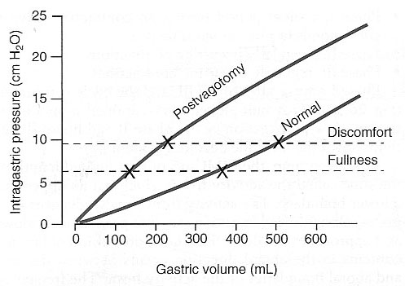
7
PHYSIOLOGY OF THE STOMACH AND REGULATION OF GASTRIC SECRETIONS
Lecture Three
Function Of Stomach Movement:
1
Storage of food:
When the stomach is stretched by food, a vagovagal reflex is initiated from the stomach to the brain stem and back to the muscular wall of the stomach resulting in reduction in muscular wall tone which allows storage. Stomach can store 0.8-1.5 L of food.
Gastric contents may remain unmixed for 1 hour in the corpus (body of stomach).
The pressure in the stomach remains low until the volume reaches ~1.5 L of food. This function is regulated by Relaxation Reflexes:
Triggered by: swallowing reflex.
Relaxation of stomach muscles (inhibition of myenteric neurons) as peristaltic waves move through esophagus and enters stomach.
Receptive Relaxation Reflex
Triggered by: stretch receptors (vago-vagal reflex).
Stomach dilates when filled, accommodating greater and greater quantities of food up to a limit (0.8 to 1.5 L).
Gastric stretch receptors → Vagal afferents → brain stem (medulla oblongata) → Vagal efferents → enteric nervous system → inhibitory motor neurons → Muscle Relaxation
Figure 3-16
Three Kinds of Relaxation Occur in the Gastric Reservoir(orad)
Adaptive relaxation
Adaptive relaxation is lost in patients undergone a vagotomy.
Following a vagotomy, increased tone in the musculature of the reservoir decreases the wall compliance, which in turn affects the responses of gastric stretch receptors to distention of the reservoir.
Figure 3-17
Feedback Relaxation
Pressure–volume curves obtained before and after vagotomy reflect the decrease in compliance of the gastric wall. The loss of adaptive relaxation after a vagotomy is associated with a lowered threshold for sensations of fullness and pain.
Triggered by : The presence of nutrients in the small intestine.
It can involve both local reflex connections:
between receptors in the small intestine and the gastric ENS(Enteric nervous system).
Hormones released from endocrine cells in the small intestinal mucosa and transported by the blood to signal the gastric ENS and stimulate firing in vagal afferent terminals in the stomach.
Figure 3-18
2
Mixing Of Food :
Major mixing activities take place in the antrum (antral pump region, phasic contraction).
The Basic Electrical Rhythm of the Stomach Wall. The digestive gastric juices come in contact with the food lying against the mucosal surface of the stomach.
The presence of food causes weak peristaltic constrictor waves called mixing/constrictor waves once every 15-20 seconds. It’s initiated by the basic electrical rhythm of the slow spontaneous electrical waves of the gut wall.
These waves progress from the body to the antrum and become intense, forcing the chyme to mix and move under high pressure from the antrum toward the pylorus.
Retropulsion results when it move against a tight pylorus.

Slide 9
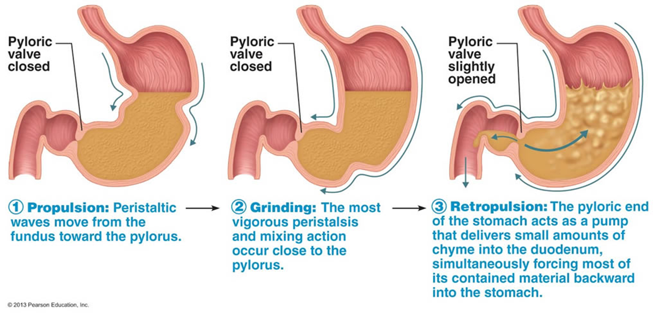
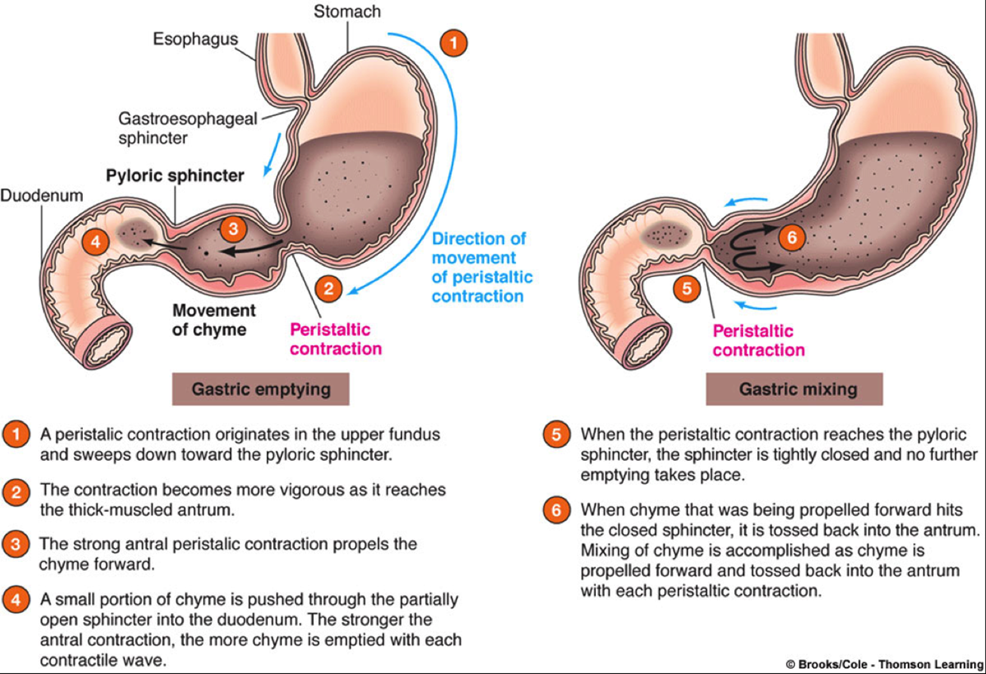
8
PHYSIOLOGY OF THE STOMACH AND REGULATION OF GASTRIC SECRETIONS
Lecture Three
3
Regulate emptying of the chyme from the stomach into the small intestine(duodenum):
Chyme Is a murky semi-fluid or paste composed of food that is thoroughly mixed with gastric secretions .
Movement of chyme into duodenum is achieved by “Pyloric pump”
Each time a peristaltic wave passes from to the antrum to the pylorus, few millimeters of antral content move into the duodenum through the pyloric sphincter.
4
Hunger Contraction:
Rhythmical peristaltic contractions that can become very strong and fuse to form a continuing tetanic contraction lasting sometimes 2-3 minutes .
It’s intense in young healthy people and increase by low blood glucose levels.
Hunger pain can begin after 12-24 hr of last food ingestion.
5
The main functions of the upper part of the stomach (Reservoir part):
To maintain a continuous compression.
To accommodate the received food without significant gastric wall distention or pressure (Storage of food).
6
Absorption of water and a few highly-lipid soluble substances (alcohol and Aspirin):
Stomach is a poor absorptive area of GIT:
It lacks the villous type of absorptive membrane.
It has tight junctions between epithelial cells.
Retropulsion Phenomena:
As the trailing contraction (explained in the next page) approaches the closed pylorus, the gastric contents are forced into an antral compartment of ever-decreasing volume and progressively increasing pressure.
Results in
Jet-like retropulsion through the orifice formed by the trailing contraction(discussed in the next page).
Repetition at 3 cycles/min reduces particle size to the 1-mm to 7-mm range that is necessary before a particle can be emptied into the duodenum.
These intense peristaltic contractions that cause emptying increase the pressure in the stomach to 50-70 cm of H₂O (compared to a pressure of ~10 cm of H₂O during the mixing peristaltic contractions).
Figure 3-19
Figure 3-20

Slide 10
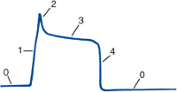
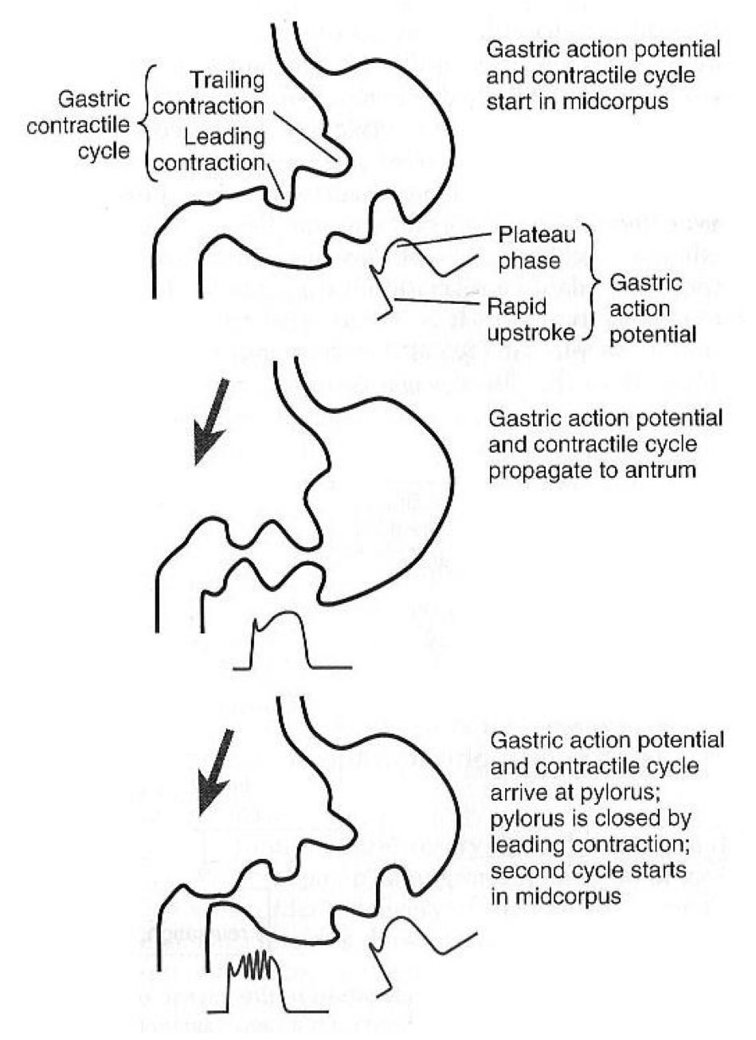
9
PHYSIOLOGY OF THE STOMACH AND REGULATION OF GASTRIC SECRETIONS
Lecture Three
Motor Behavior of the Antral Pump Is Initiated by a Dominant Pacemaker (Motility in the Antrum):
Gastric action potentials determine the duration and strength of the phasic contractions of the antral pump.
They are initiated by a dominant pacemaker (ICC) (interstitial cells of Cajal).
1
The action potentials (AP) propagate rapidly around the gastric circumference and trigger a ring-like contraction
2
The AP and associated ring-like contraction then travel more slowly toward the gastroduodenal junction.
Electrical syncytial properties of the gastric musculature account for propagation of the action potentials from the pacemaker site to the gastroduodenal junction.
The pacemaker region in humans generates AP and associated antral contractions at a frequency of three per minute.
The gastric action potential lasts about 5 seconds, it has:
Rising phase (depolarization)
Plateau phase
Falling phase (repolarization)
Electrical action potentials in gastrointestinal muscles occur in four phases, determined by specific ionic mechanisms:
Phase 1:
Rising phase (upstroke depolarization)
Activation of voltage-gated calcium channels and voltage-gated potassium channels
Phase 3:
Plateau phase; balance of inward calcium current and outward potassium current.
Phase 4:
Falling phase (repolarization); inactivation of voltage-gated calcium channels and activation of calcium-gated potassium channels.
Phase 0:
Resting membrane potential; outward potassium current
Figure 3-21
The Gastric Action Potential Triggers Two Kinds of Contractions:
The gastric action potential is responsible for two components of the propulsive contractile behavior in the antral pump:
Leading contraction
Trailing contraction
It has a relatively constant amplitude.
Associated with the rising phase of the action potential.
Variable amplitude
Associated with the plateau phase.
3
Figure 3-22
The leading contractions have negligible amplitude as they propagate to the pylorus. As the rising phase reaches the terminal antrum and spreads into the pylorus, contraction of the pyloric muscle closes the orifice between the stomach and duodenum.
The trailing contraction follows the leading contraction by a few seconds.
3

Slide 11
10
PHYSIOLOGY OF THE STOMACH AND REGULATION OF GASTRIC SECRETIONS
Lecture Three
Stomach emptying:
Stomach emptying is the result of intense peristaltic antral contractions against resistance to passage of chyme at the pylorus.
The pyloric sphincter is characterized by strong circular muscle (as compared to the antrum) and remains tonically contracted most of the time. However, during pyloric constriction, watery chyme can still pass through the pylorus into the duodenum, but not food particles.
Pyloric constriction is determined by:
Nervous reflex signals
Humoral reflex signals (from the duodenum and stomach).
The rate of stomach emptying is controlled by signals from the stomach and duodenum, with the latter being far stronger and controls emptying of the chyme at a rate that allows the proper digestion and absorption in the small intestines.
Factors that regulate gastric emptying:
Gastric Factors that Promote Stomach Emptying
Powerful Duodenal Factors That
Inhibit Stomach Emptying.
1
Effect of Gastric Food Volume on Rate of Stomach Emptying.
Increased gastric food volume → increased stretch in the stomach wall (which elicits local myenteric reflexes) → increased pyloric pump activity & the tonic contraction of the pyloric sphincter gets inhibited, leading to increased stomach emptying.
2
Effect of the Hormone Gastrin on Stomach Emptying.
Gastrin is released from the antral mucosa in response to the presence of digestive products of meat.
It promotes the secretion of acidic gastric juices (e.g. HCl) by the stomach gastric glands (or oxyntic glands) located on the inside surface of the body and fundus of the stomach; (i.e. proximal 80% of the stomach).
It also enhances the activity of the pyloric pump and motor stomach function (moderate effect) and probably promotes stomach emptying.

Slide 12
11
PHYSIOLOGY OF THE STOMACH AND REGULATION OF GASTRIC SECRETIONS
Lecture Three
Factors that regulate gastric emptying:
Gastric Factors that Promote Stomach Emptying
Powerful Duodenal Factors That Inhibit Stomach Emptying.
1
Inhibitory Effect of Enterogastric Nervous Reflexes from the Duodenum.
When food enters the duodenum, multiple nervous reflexes are initiated from the duodenal wall and pass back to the stomach to regulate stomach emptying depending on the volume of chyme in the duodenum.
These duodenal reflexes are mediated by three routes:
Directly from the duodenum to stomach through the ENS (enteric nervous system) in the gut wall.
Through extrinsic nerves that go to the prevertebral sympathetic ganglia and then back through inhibitory sympathetic nerve fibers to the stomach.
Through the vagus nerves reflex (to a slight extent) → the brain stem → inhibit the normal excitatory signals that are transmitted to the stomach through the vagus nerves.
These reflexes inhibit the pyloric pump and increase the tone of the pyloric sphincter thus decreasing stomach emptying.
The duodenal factors that can initiate the enterogastric inhibitory reflexes include:
Duodenal distention.
Duodenal irritation.
Duodenal acidity.
Osmolality of the chyme in the duodenum.
Protein (and may be fat) content of the chyme in the duodenum.
2
Hormonal Feedback from the Duodenum Inhibits Gastric Emptying , Role of Fats and the Hormone Cholecystokinin
3
Fat entering the duodenum or acidity of chyme or excess quantities of chyme causes (probably a receptor mediated mechanism) the release of:
cholecystokinin (CCK) , acts as an inhibitor to block increased stomach motility caused by gastrin.
other inhibitory hormones such as (secretin and gastric inhibitory peptide (Glucose-dependent insulinotropic peptide GIP) from the epithelium of the duodenum and jejunum.)
Release of CCK, secretin, and GIP: they circulate and inhibit the pyloric pump and increase the tone of the pyloric sphincter thus decreasing stomach emptying.

Slide 13
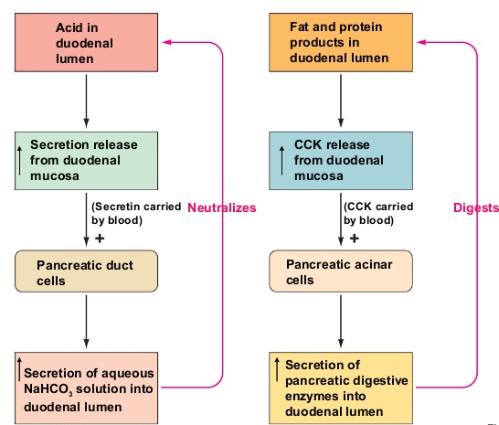
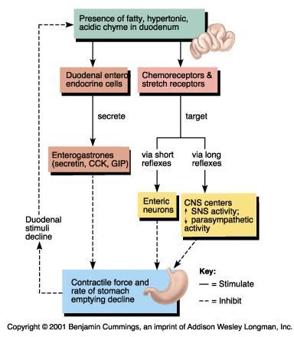
12
PHYSIOLOGY OF THE STOMACH AND REGULATION OF GASTRIC SECRETIONS
Lecture Three
Figure 3-23
3
Figure 3-24

Slide 14
13
PHYSIOLOGY OF THE STOMACH AND REGULATION OF GASTRIC SECRETIONS
Lecture Three
FURTHER READINGS
What trjggers gastric emptying? The difference between mixing and emptying contractions
Action potentials originate in a region in the body of the stomach, the ICC, which spreads downwards towards the duodenum.
The rate of firing of ICC is three per minute in the region of the stomach, it is always constant and is not affected by neural or hormonal control.
Differences in patterns of contractions (mixing or emptying) seen at different times shouldn't be attributed to frequency of slow waves, since it is always constant, the differences then must be determined by differences in the intensity of action potential (generated at the peaks of slow wave potentials) which will generate different types of movements.
The higher the positivity (in millivolts) and the more intense the action potential which will result in a stronger contraction, excitatory signals (hormones, neurotransmitters) cause positive ion influx, and increase the positivity.
Mixing contractions: Usually the movements are of the mixing type, the slow waves of ICC are always generated, however mixing movements only occur if these slow waves were compounded with excitatory signals triggered most commonly by gastric distension due to the presence of food (mechanoreptors that stimulate ENS to release ACh, serotonin or substance P and cause contraction of SMCs).
Emptying contractions: We know that there is a rising wave of a constant amplitude and a plateau phase of a variable amplitude, therefore any change in the action potential’s intensity must be due to signals superimposed on the plateau phase, since the contraction during the rising phase (leading contraction) is always constant, therefore the changes affect the plateau phase and causes the action potential to become more intense. And in turn causes the mixing movement to be a stronger, emptying movement. With the circular muscles of the stomach generating much higher pressure inside the stomach.
These excitatory signals that increase the intensity plateau phase can be neurotransmitters, like ACh, serotonin triggered by gastric distension. Or due to lack of inhibitory control, as we know, CCK and Secretin are released in the presence of nutrients in the duodenum and they can inhibit gastric emptying by decreasing the intensity of the plateau phase, therefore the emptying movement remain as mixing movements. This is why hunger contractions are intense and resemble emptying contractions, the duodenum during emptying contractions exerts way less inhibitory effect (through CCK or ENS) on gastric motility (plateau phase).
In short, there are two types of movement. Mixing, which is triggered by the presence of food and generates enough intensity in the plateau phase to accomodate mixing movements, and emptying movements, which is caused by an increase in the intensity of plateau phase due to lack of inhibitory control (CCK, which can decrease action potential intensity, it binds to nerve endings and causes presynaptic inhibition) or an increase in an excitatory input (vagus nerve due to distension) and prevents the entry of food into a busy small bowel.
3

Slide 15
The gastric motility is stimulated by:
Cholecystokinin
Distention of the stomach
Secretin
Peptide YY
Histamine stimulates acid secretion by binding with which of the following receptors on parietal cells?
CCK-B receptors
H₂ receptors
H₁ receptors
M₃ receptors
Pepsinogen is converted to pepsin by:
Gastrin
HCL
Secretin
Somatostatin
Somatostatin is secreted by:
Delta cells
Enterochromaffin-like cells
Parietal cells
Chief cells
Major stimulus that causes release of secretin is?
Gastrin
Cholecystokinin
Protein digestion products
HCL
6. Deficiency of intrinsic factor is associated with?
Steatorrhea
Pernicious Anemia
Jaundice
Protein energy malnutrition
1. Gastric Factors that Promote Stomach Emptying
Increased gastric food volume
Gastrin promotes the secretion of acidic gastric juices, and enhances the activity of the pyloric pump and motor stomach function
2.
Mucus secreting glands (cardiac glands):
Secretes: Mucus, HCO₃⁻
Oxyntic (parietal) gland:
Type of cells: mucus neck cells, peptic cells, parietal cells
Secretes : HCL, pepsinogen, Intrinsic Factor, mucus
Pyloric glands:
Type of cells: G cells
Secretes: Gastrin & Mucus
SHORT ANSWER QUESTIONS
Q1: Mention factors that promote stomach emptying?
Q2: Mention the gastric glands and their cell types & secretions?
ANSWER KEY: B, B, B, A, D, B

Slide 16
Taif Alshammari
FEMALE PHYSIOLOGY CO-LEADERS
Maha Alnahdi, Taif Alshammari
MALE PHYSIOLOGY CO-LEADERS
Nayef Alsaber, Hameed M. Humaid
REFERENCES
Guyton and Hall Textbook of Medical Physiology
Ganong’s Review of Medical Physiology

