Slide 1
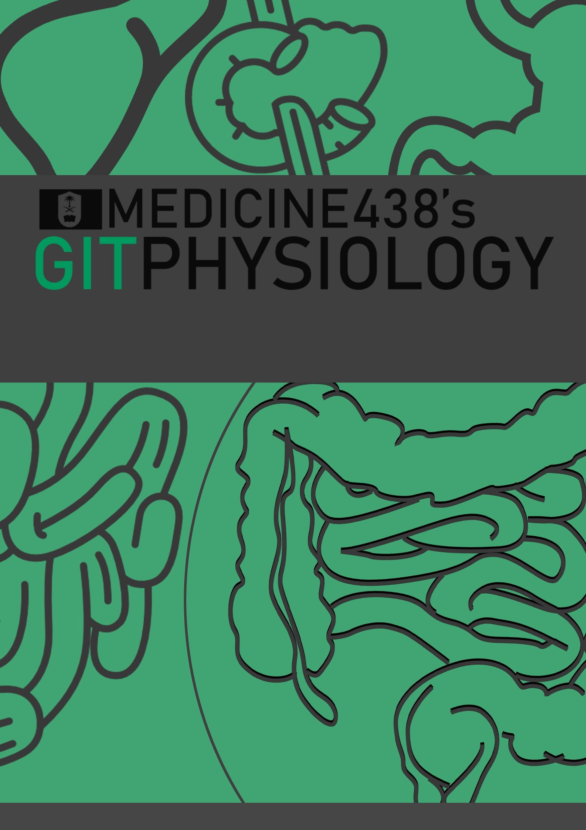
LECTURE IV: Physiology of the Pancreas
EDITING FILE
IMPORTANT
MALE SLIDES
EXTRA
FEMALE SLIDES
LECTURER’S NOTES

Slide 2
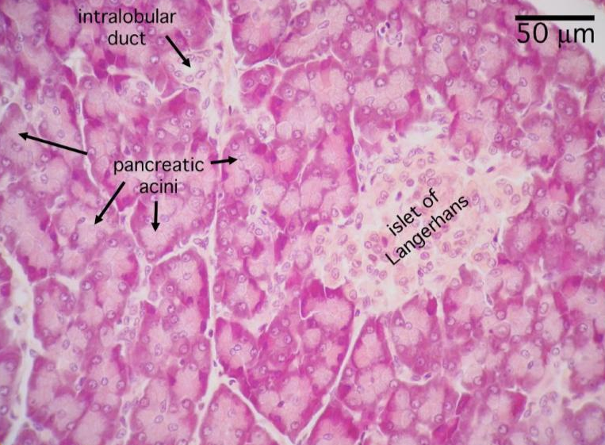
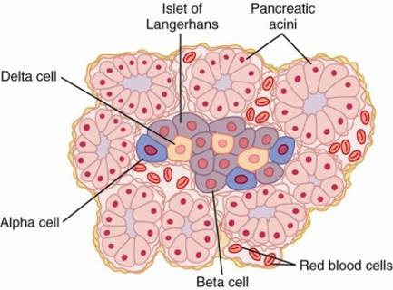
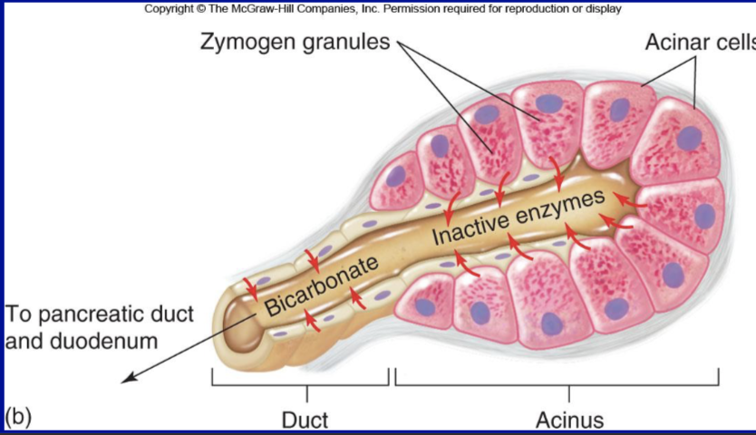
1
PHYSIOLOGY OF THE PANCREAS
Lecture Four
OBJECTIVES
Functional Anatomy
Major components of pancreatic juice and their physiologic roles
Cellular mechanisms of bicarbonate secretion
Cellular mechanisms of enzyme secretion
Activation of pancreatic enzymes
Hormonal & neural regulation of pancreatic secretion
Potentiation of the secretory response
Pancreas
Lying parallel to and beneath the stomach, it is a large compound gland with most of its internal structure similar to that of the salivary glands. It is composed of:
Figure 4-1
Endocrine portion 1-2%
(Made of Islets of Langerhans)
Secrete hormones into the blood
Insulin (beta cells; 60%)
Glucagon (alpha cells; 25%)
Somatostatin (delta cells; 10%).
Exocrine portion 95%
(Acinar gland tissues)
Made of acinar & ductal cells.¹
secretes digestive enzymes, HCO₃⁻ and water into the duodenum .
Figure 4-2
Figure 4-3
The pancreatic digestive enzymes are secreted by pancreatic acini.
Large volumes of sodium bicarbonate solution are secreted by the small ductules and larger ducts leading from the acini.
Pancreatic juice is secreted in response to the presence of chyme in the upper portions of the small intestine.
Insulin and Glucagon are crucial for normal regulation of glucose, lipid, and protein metabolism.
FOOTNOTES
Acinar cells arrange themselves like clusters of grapes, that eventually release their secretions into ducts. Collection of acinar cells is called acinus, acinus and duct constitute one exocrine gland.

Slide 3
2
PHYSIOLOGY OF THE PANCREAS
Lecture Four
Pancreatic Secretion:
Amount ≈ 1.5 L/day in an adult human.
The major functions of pancreatic secretion:
To neutralize the acids in the duodenal chyme to optimum range (pH=7.0-8.0) for activity of pancreatic enzymes.
To prevent damage to duodenal mucosa by acid & pepsin.
To produce enzymes involved in the digestion of dietary carbohydrate, fat, and protein.
1
2
3
Acinar Cell Secretion | Ductal Cell Secretion
Acini provide the primary secretion in a solution with similar composition to plasma. Secrete a protein-rich (digestive enzymes) proenzymes secretion in an isotonic plasma-like fluid. Constitute 25% of total pancreatic secretion. Stimulated by CCK & Ach | Secretes a HCO₃⁻-rich fluid that alkalinizes & hydrates the protein-rich secretion of acinar cells. (to dilute & alkalinize the pancreatic juice) Constitute 75% of pancreatic secretion. Stimulated by Secretin. Effects of Secretin are potentiated by CCK & Ach
Pancreatic Juice: Refers to the final combined product secreted by the exocrine pancreas.
Digestive enzymes
An electrolyte solution rich in HCO3-
Proteolytic:
For protein
Trypsin, Chymotrypsin, Carboxypolypeptidase
Amylolytic:
For lipids:
Pancreatic lipase, Cholesterol Esterase, Phospholipase A2
For carbohydrates:
pancreatic Amylase
Nucleolytic:
For DNA & RNA:
Nucleases, Ribonuclease, Deoxyribonuclease

Slide 4
3
PHYSIOLOGY OF THE PANCREAS
Lecture Four
Flow of Pancreatic Secretion into Duodenum:
01
The combined product of enzymes and NaHCO3 flows through a long pancreatic duct.
Pancreatic duct joins the common bile duct immediately before it empties into the duodenum through the papilla of Vater, surrounded by the sphincter of Oddi.
02
Pancreatic enzymes for digesting proteins are:
Trypsin
(active form of Trypsinogen)
Chymotrypsin
(active form of Chymotrypsinogen)
Carboxypolypeptidase
(active form of Procarboxypolypeptidase)
Trypsin and Chymotrypsin split whole and partially digested proteins into peptides of various sizes but do not cause release of individual amino acids.
Carboxypolypeptidase splits some peptides into individual amino acids, thus completing digestion of some proteins to amino acids.
These enzymes become activated only after they are secreted into the Intestinal Tract.
Trypsinogen is activated by:
Enteropeptidase (enterokinase), an enzyme secreted by the intestinal mucosa when chyme comes in contact with the mucosa.
Trypsinogen can be autocatalytically activated by trypsin formed from previously secreted trypsinogen.
Chymotrypsinogen and Procarboxypolypeptidase:
They are activated by trypsin to form chymotrypsin and carboxypolypeptidase.

Slide 5
4
PHYSIOLOGY OF THE PANCREAS
Lecture Four
Trypsin Inhibitor:
Secretion of trypsin inhibitor prevents digestion of the pancreas itself.
Proteolytic enzymes of the pancreatic juice do not become activated until after they have been secreted into the intestine because the trypsin and the other enzymes would digest the pancreas itself.
The same cells that secrete proteolytic enzymes into the acini of the pancreas secrete another substance called trypsin inhibitor.
Trypsin inhibitor is formed in the cytoplasm of the glandular cells, and it prevents activation of trypsin both inside the secretory cells and in the acini and ducts of the pancreas.
Because trypsin activates the other pancreatic proteolytic enzymes, therefore trypsin inhibitor prevents activation of the other enzymes as well.
Figure 4-4 Activation of digestive enzymes in small intestine
Enzymes For Digesting Carbohydrate:
Pancreatic amylase: it hydrolyzes starches, glycogen, and most other carbohydrates (except cellulose) to form mostly disaccharides and a few tri-saccharides.
Enzymes For Digesting Fat:
Figure 4-5
(1) Pancreatic lipase (2) Cholesterol esterase (3) Phospholipase
Figure 4-6

Slide 6
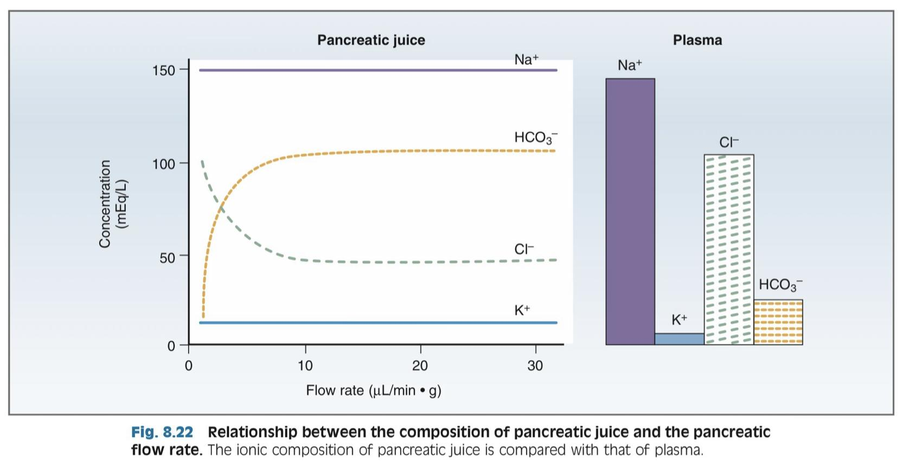
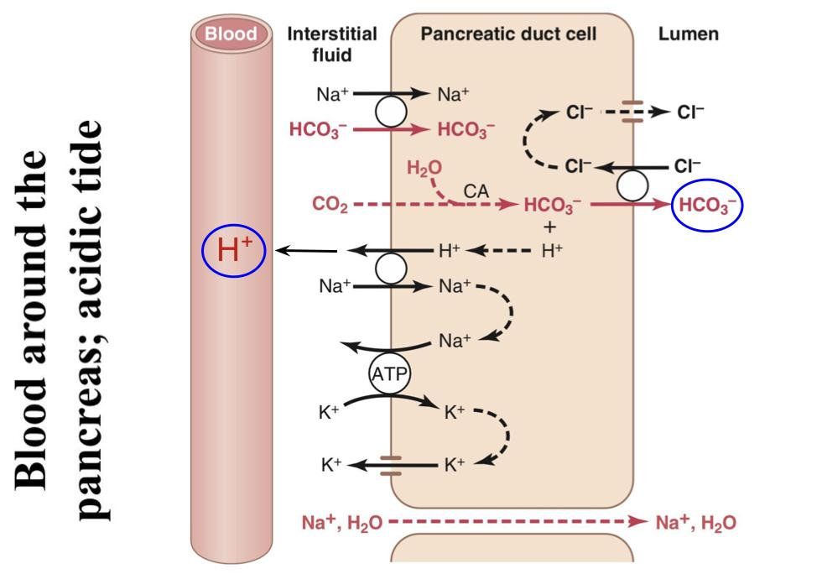
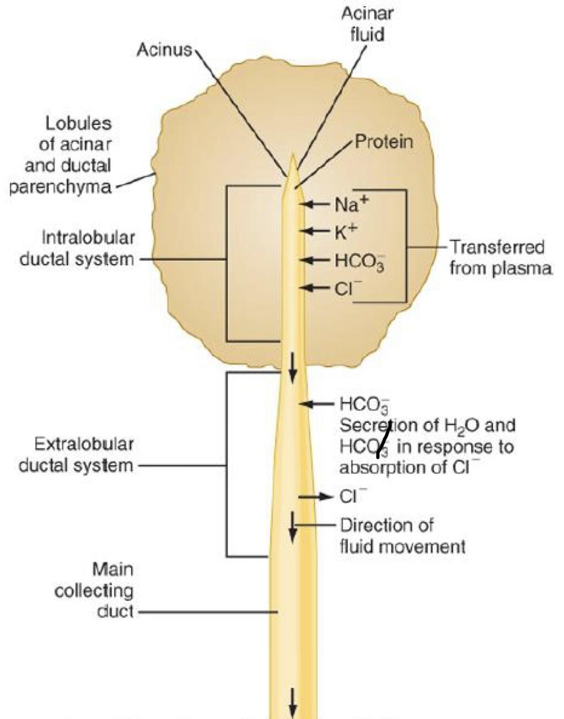
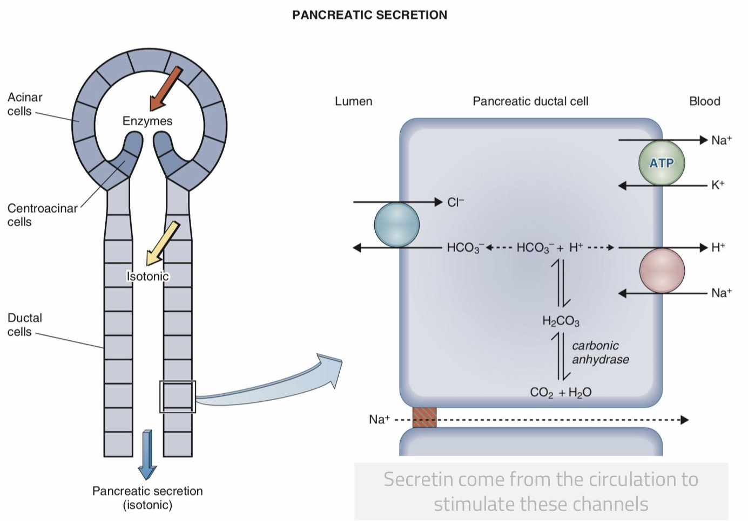
5
PHYSIOLOGY OF THE PANCREAS
Lecture Four
Pancreatic Secretions
The pancreas secrets about 1 L/day of HCO₃⁻ rich fluid from the epithelial cells of the ductules and ducts.
HCO₃⁻ is exchanged for Cl⁻. Secretin increases the rate of this exchanger.
The osmolarity of pancreatic fluid is equal to that of plasma.
HCO₃⁻ concentration increases with increasing secretion rate.
Figure 4-7, Flow Rate & Pancreatic Secretion
Mechanism of HCO₃⁻ Secretion:
01
Basolateral membrane contains Na⁺-K⁺ ATPase and
a Na⁺-H⁺ exchanger. By this step, H⁺ goes to the blood and combines with HCO₃⁻ which results in CO₂ & H₂O formation.
02
CO₂ and H₂O combine in ductal cells to form H₂CO₃.
03
H₂CO₃ dissociates into H⁺ and HCO₃⁻.
04
H⁺ is transported into blood by Na⁺-H⁺ exchanger at basolateral membrane of ductal cells.
05
HCO₃⁻ is secreted into pancreatic juice by Cl⁻-HCO₃⁻
exchanger at apical membrane of ductal cells, followed by osmotic flow of water. ¹
Figure 4-8
Absorption of H⁺ causes acidification of pancreatic venous blood.²
Figure 4-10, Secretion of Isosmotic Sodium Bicarbonate Solution
Figure 4-9
FOOTNOTES
This is a crucial step, and why cystic fibrosis causes pancreatitis. Failure of Cl⁻ secretion by the channel (CFTR) seen in Figure 4-9 results in dysfunctional activity of Cl-HCO₃⁻ exchanger, since there would be no chloride to exchange with bicarbonate. Bicarbonate then will not be secreted into the lumen, consequently, water will not flow into the lumen. Water is essential for the pancreatic secretions to flow out of the pancreatic duct, without water the secretions will be thick and clogged, some proteases can get activated, and we will end up with pancreatitis.
Venous blood coming from pancreas is acidic, whereas venous blood coming from stomach is alkaline, it is sometimes referred to as “alkaline tide”.

Slide 7
6
PHYSIOLOGY OF THE PANCREAS
Lecture Four
Phases Of Pancreatic Secretion
Pancreatic secretion is under neural and hormonal control.
It normally results from the combined effects of the multiple basic stimuli which potentiate each other.
Phase | Cephalic (20%) | Gastric (5-10%) | Intestinal (70-75%)
Stimulus | Smell, taste, chewing and swallowing | Protein, gastric distention | Amino acid and fatty acids in chyme
Mediator | Through Vagus nerve | Through Vagus nerve | Through hormonal stimulation (Secretin, CCK) and enteropancreatic reflexes.³
Pancreatic Secretion is Under Neural and Hormonal Control:
01
02
03
Parasympathetic
Secretin
Cholecystokinin²
Stimulation through Ach on acinar cells, results in increase in enzyme secretion and HCO₃⁻.
Acetylcholine:
Released:
from the para-sympathetic vagus nerve endings & other cholinergic nerves in the enteric nervous system.
Tends to stimulate a HCO₃⁻ rich secretion by activating ductal cells.
27 amino acid polypeptide.
HCO₃⁻ concentration in pancreatic secretion = 145 mmol/L
Release:
From “S” cells in the mucosa of the duodenum & jejunum (present as in an inactive form: prosecretin).¹
Stimulus:
Mainly acid chyme with pH less than 4.5-5.0 in the duodenum.
Stimulates a marked increase in enzyme secretion by stimulating the acinar cells.
A 33-amino acid polypeptide.
Release:
From enteroendocrine “I” cells in the mucosa of the duodenum & upper jejunum.¹
Stimulus:
By proteoses, peptones (products of partial protein digestion) & long-chain fatty acids in the chyme.
Acetylcholine and cholecystokinin stimulate the acinar cells of the pancreas, causing production of large quantities of pancreatic digestive enzymes but relatively small quantities of water and electrolytes to go with the enzymes.
Secretin stimulates secretion of large quantities of H₂O & NaHCO₃ solution by the pancreatic ductal epithelium.
Secretin Causes the pancreas to secrete large quantities of fluid containing a high concentration of HCO₃⁻ (up to 145 mEq/L = ~5X normal) but a low concentration of Cl-.
HCl + NaHCO₃ ➔ NaCl + H2CO₃ (H2CO₃ dissociates into CO2 and H2O).
Cholecystokinin effect is similar to that caused by vagal stimulation but even more pronounced, accounting for 70-80% of the total secretion of the pancreatic digestive enzymes after a meal.³
FOOTNOTES
S cells function as pH sensors, the mechanisms are not clear but it could involve proton-gated ion channels.
Cholecystokinin is released in response to also cells sensing fatty acids and peptides in the lumen (probably ligand-gated ion channels) , these cells secrete CCK- releasing peptide, this peptide then binds on receptors on I cells and this will cause release of CCK. It’s worth noting that the pancreas itself sends a peptide to sense chyme content of the lumen, this peptide is called monitor peptide. Monitor peptide binds to I cells when chyme content supports CCK secretion. See further readings in our last page for illustrations.
Cholecystokinin actually has receptors on vagal afferents near to the site of its secretion in small intestines, CCK binds to those vagal afferents to initiate a vagovagal reflex that causes more pancreatic enzymes to be secreted by action of ACh on acinar cells. This is called an enteropancreatic reflex.

Slide 8
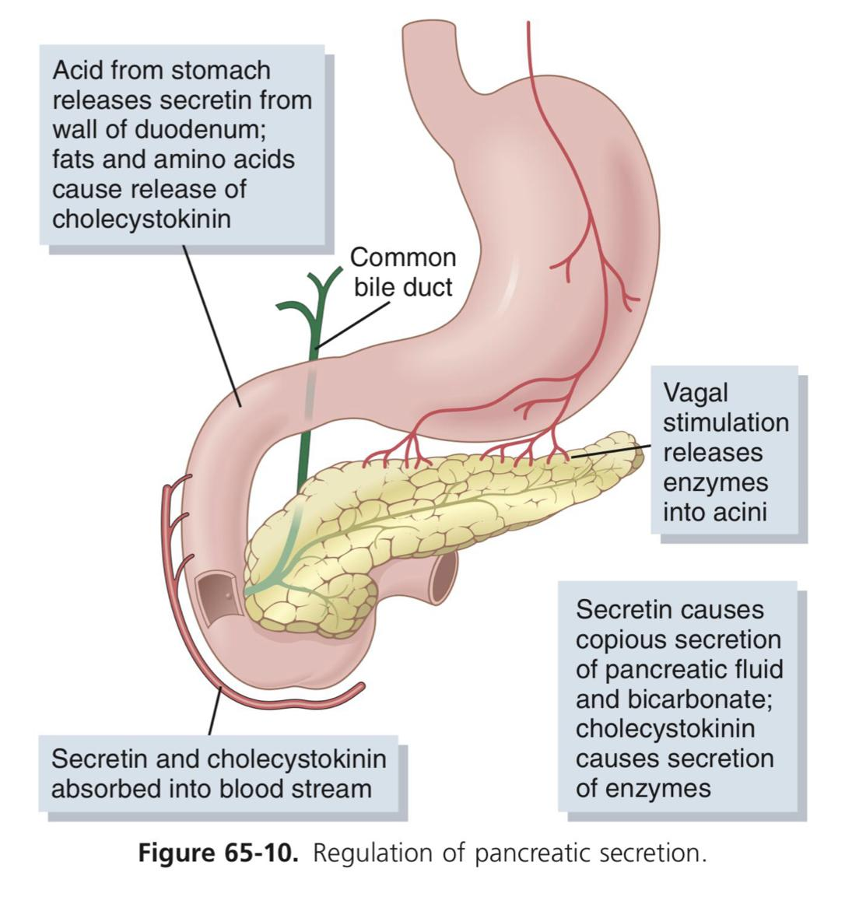
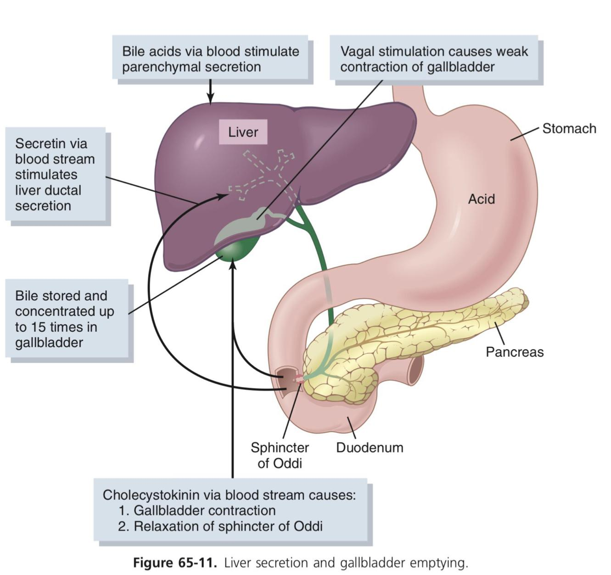
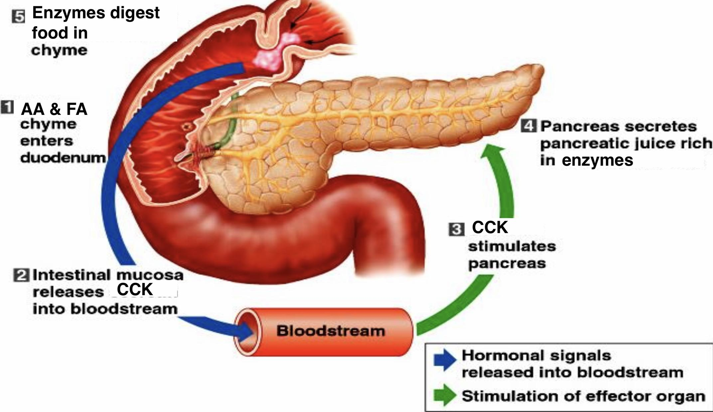
7
PHYSIOLOGY OF THE PANCREAS
Lecture Four
Regulation of pancreatic secretion:
Figure 4-11
Figure 4-12
Functions Of Secretin & Cholecystokinin
Inhibit
intestinal motility and contracts ileocecal sphincter.
6
1
Stimulates
Pancreatic secretion rich in HCO₃⁻ and H₂O from duct cells.
5
Secretin
2
Inhibit
gastric motility, contracts pylorus and slows gastric emptying, relaxes LES.
Augments
stimulation of enzyme secretion
by CCK.
Inhibit
gastric acid secretion and gastrin release, but it stimulates pepsin secretion.
4
3
Stimulates
hepatic bile flow and HCO₃⁻ secretion.
Figure 4-13
Inhibits
stomach contraction moderately and slows its emptying.
6
1
Stimulates
Pancreatic enzyme secretion, accounting for 70-80% of total pancreatic digestive enzymes secretion after meal.
Has: trophic effect on pancreas. In addition, it may be concerned with the mechanism of satiety.
5
CCK
2
Augments
stimulation of H₂O and HCO₃⁻ secretion by secretin.
Contract
Gallbladder, relaxes sphincter of Oddi and causes bile discharge into intestine.
4
3
Stimulates
intestinal motility and relaxes ileocecal sphincter.
Figure 4-14

Slide 9
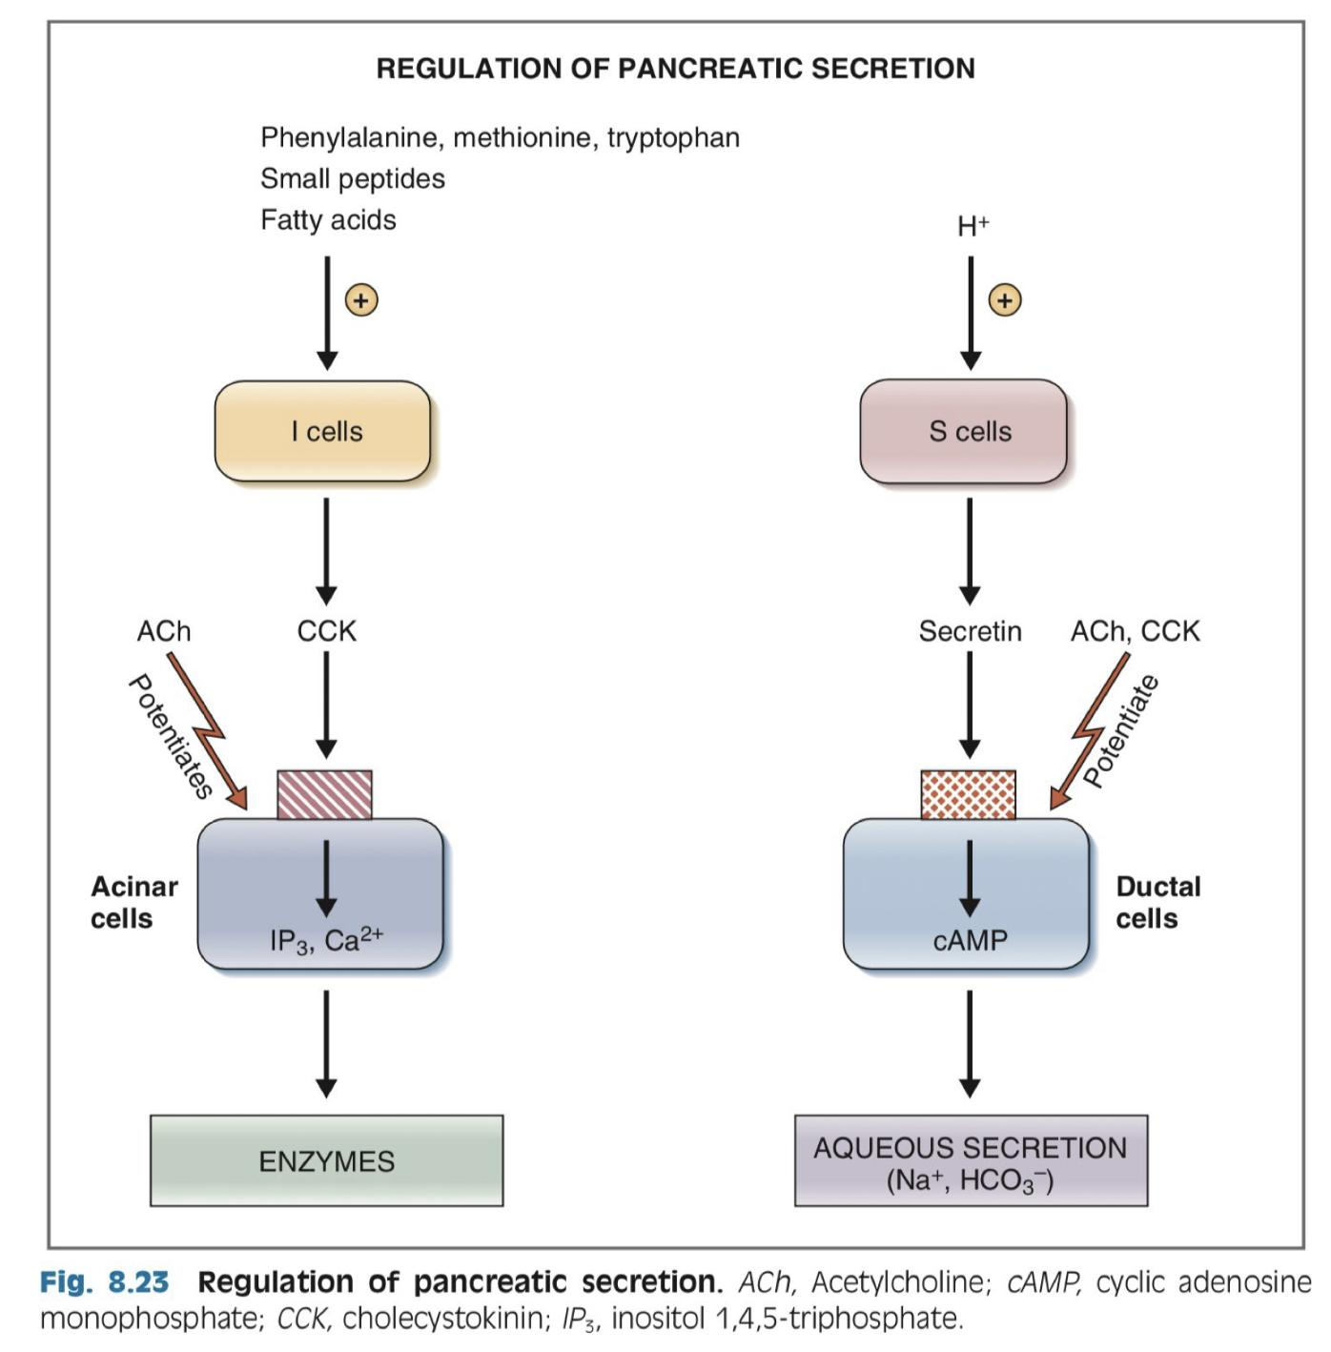
8
PHYSIOLOGY OF THE PANCREAS
Lecture Four
Multiplicative or Potentiation Effects of:
Different Pancreatic Secretion Stimuli
01
Usually, pancreatic secretions are the result of multiple stimuli (Ach, cholecystokinin, and secretin) rather than one stimulus alone.
02
When all these different stimuli of pancreatic secretion occur at once, then the total secretion is far greater than the sum of the secretions caused by each stimulus separately.
03
The stimuli are said to “multiply” or “potentiate” one another.
Figure 4-15

Slide 10
9
PHYSIOLOGY OF THE PANCREAS
Lecture Four
FURTHER READINGS
CCK secretion
Figure 4-16 Note that trypsin is non-selective in its proteolytic activity, if there is abundance of trypsin in small intestines it will actually breakdown the peptides responsible for CCK secretion (CCK-RP or CCK-releasing peptide plus monitor peptide), thereby maintaining a negative feedback mechanism that protects both the pancreas and small intestines from autodigestion.
Monitor peptide is normally present in small intestines, it is secreted by pancreas as a sensor for chyme content, if there is an abundance of trypsin, this peptide will be degraded by trypsin and it will act less on I cells to secrete CCK. Similarly, CCK-RP is secreted in large amounts in response to chyme contents rich in fats and peptides, when trypsin levels increase CCK-RP will be degraded more and will act less on I cells to secrete CCK. Also, negative feedback.

Slide 11
1. Pancreatic secretion is stimulated by?
Cholecystokinin
Secretin
Vagal stimulation
All of the above factors
2. Which of the following is a function of the pancreas?
Increase acidity of chyme
Produce enzymes involved in the digestion
Secretes mucin to protect duodenal lining
Storage of digestive enzymes
3. Chymotrypsinogen is activated by which of the following?
Low PH in duodenum
Trypsin inhibitor
Trypsin
Enterokinase
4. Increased HCO₃⁻ exchange with Cl⁻ occurs by:
Increased secretion of cholecystokinin
Decreased secretion of cholecystokinin
Increased secretion of secretin
Decreased secretion of secretin
5. Pancreatic juice is released in response to:
Presence of chyme in stomach
Presence of chyme in small intestines
Hypoglycemia
Hyperglycemia
SHORT ANSWER QUESTIONS
Q1: Why does the pancreas secretes enzymes in an inactive form?
Q2: Compare between phases of pancreatic secretion.
Because it secretes digestive enzymes that can digest the pancreas itself, so it secretes the enzymes in an inactive form to be activated in the duodenum.
Phase | Cephalic (20%) | Gastric (5-10%) | Intestinal (70-75%)
Stimulus | Smell, taste, chewing and swallowing | Protein, gastric distention | Amino acid and fatty acids in chyme
Mediator | Vagus nerve | Vagus nerve | hormonal stimulation (Secretin, CCK), enteropancreatic reflexes.
ANSWER KEY: D, B, C, C, B

Slide 12
Haifa Alessa, Nouf Alhumaidhi
FEMALE PHYSIOLOGY CO-LEADERS
Maha Alnahdi, Taif Alshammari
MALE PHYSIOLOGY CO-LEADERS
Nayef Alsaber, Hameed M. Humaid
REFERENCES
Guyton and Hall Textbook of Medical Physiology
Ganong’s Review of Medical Physiology

