Slide 1
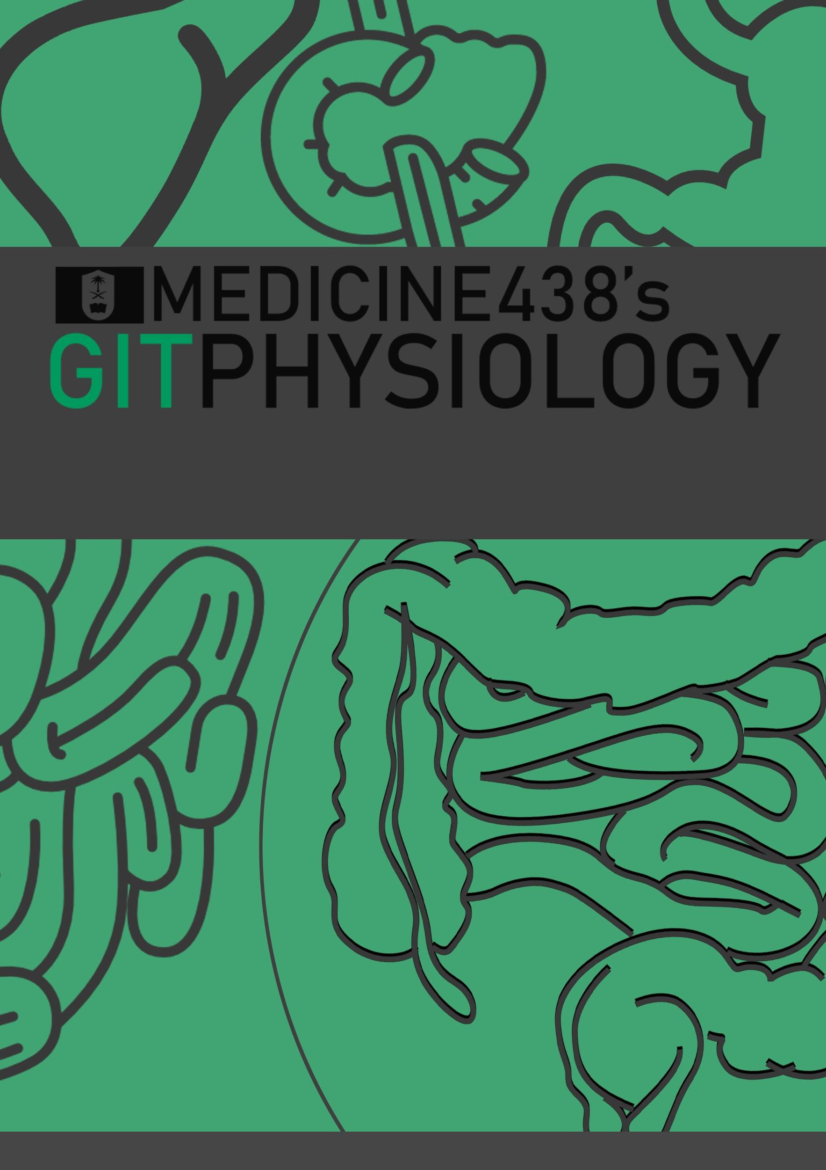
R E V I S I O N F I L E
EDITING FILE
IMPORTANT
MALE SLIDES
EXTRA
FEMALE SLIDES
LECTURER’S NOTES

Slide 2
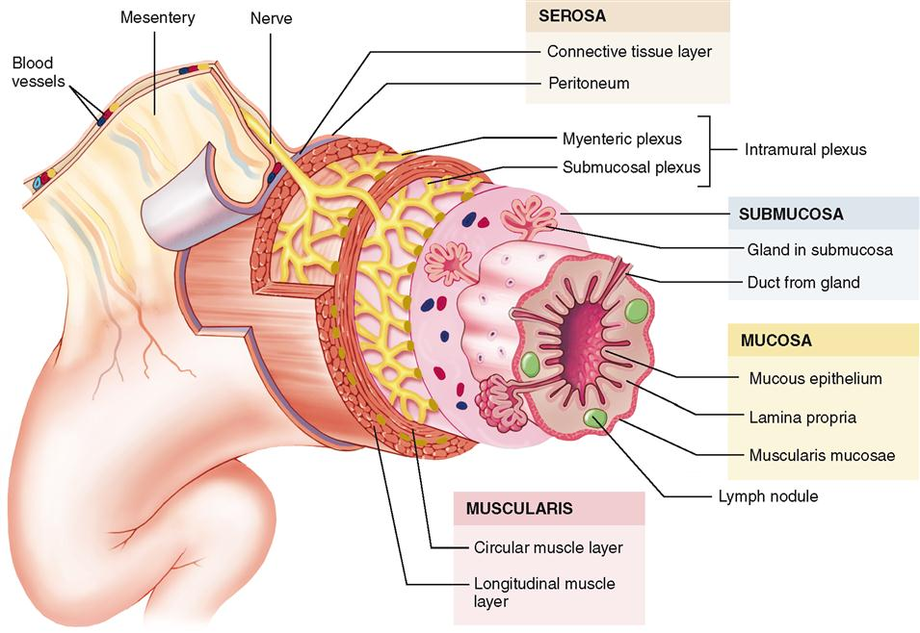
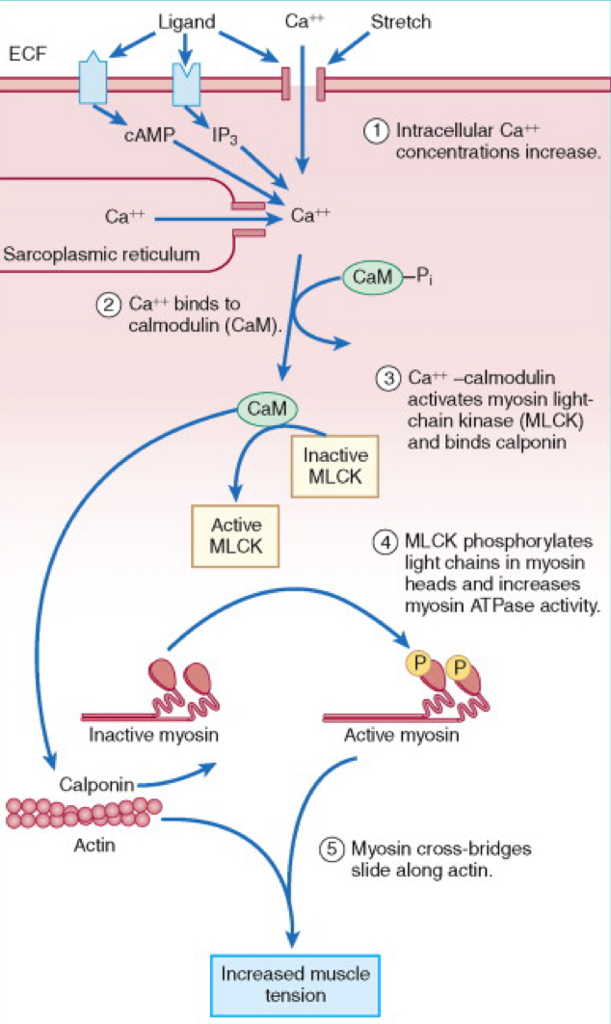
1
GENERAL PRINCIPlES OF GIT PHYSIOLOGY
Lecture One
Lecture I: General Principles of GIT Physiology
Figure 1-1 Functional anatomy of the wall of GIT
The General Characteristics of Smooth Muscle
2 Main muscle layers | 2 Muscle classification | 2 Types of contraction
1. Longitudinal Smooth Muscles
Contraction:
Expands the lumen.
Shortens the segment.
1. Unitary (single-unit)
Contracts
in the absence of neural or hormonal influence.
in response to stretch.
Examples:
Stomach & intestine.
Cells are electrically coupled via gap junctions.
1. Phasic (rhythmical)
Smooth muscle cells contract rhythmically or intermittently.
Periodic contractions followed by relaxation
Example:
Walls of the GI tract.
Gastric antrum
Small intestine
Esophagus.
2. Circular Smooth Muscles
Contraction:
Reduces the diameter of the lumen
Increases the length.
2. Multi-unit
Does not Contract
in the absence of neural or hormonal influence.
in response to stretch.
2. Tonic
Smooth muscle cells continuously active maintaining a “tone”
Continuous partial contraction.
Examples:
sphincters:
Lower esophageal .
Ileocecal .
Internal anal.
Molecular Basis of Smooth Muscle Contraction
↑ Intracellular ca⁺² concentration by:
Entry to cell
Ca⁺² release from sarcoplasmic reticulum
Ca⁺² binds to calmodulin (CaM)
Ca⁺² -calmodulin activates Myosin Light Chain Kinase (MLCK)
MLCK phosphorylates light chains in myosin heads and increases myosin ATPase activity
Active myosin crossbridges slide along actin and create muscle tension.
How Does Smooth Muscle Contraction Stop?
Dephosphorylation by Myosin Phosphatase → Deactivation of phosphorylated myosin heads
Drop in Ca⁺² → Deactivation of MLCK
Figure 1-2

Slide 3
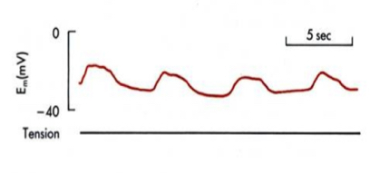
2
GENERAL PRINCIPlES OF GIT PHYSIOLOGY
Lecture One
GI Smooth Muscle: Each muscle layer functions as a syncytium.
Electrical Activity of GI Smooth Muscle
Slow Waves
Definition: Rhythmic oscillating depolarization and repolarization in the resting membrane potential.
Origin: Interstitial cells of Cajal (ICC)
It’s the GI pacemaker.
Abundant in myenteric plexuses (between smooth muscle layers)
form a network with each other
synaptic-like contacts to smooth muscle cells.
Function: Determine the rhythm of GI contraction
Features:
No Ca entry (only Na)
Not action potentials (because it’s below threshold)
No muscle contraction
Intensity: 5-15 mV
Frequency: Ranges in different parts of GI tract
Stomach: 3/min
Duodenum: 12/min
Ileum: 8-9/min
Figure 1-3
Spike Potentials
True Action potentials
Generation:
Automatically when the resting membrane potential becomes more positive <-40 mV (Resting membrane potential : -50 - -60 mV)
At the peaks of slow waves.
Frequency: 1-10 spikes/min
Duration:
Each spike lasts as long as 10-20 ms
10-40 times as long as the action potentials in large nerve fibers
Direct Relation with slow waves:
↑ slow wave potential (above threshold) → ↑ frequency of the spike potentials
Factors depolarize the membrane | Factors hyperpolarize the membrane
1-Muscle stretch. 2- Acetylcholine 3- Specific GI hormones. | Sympathetic stimulation Epinephrine (mainly). Norepinephrine.
With parasympathetic input, the membrane at the plateau of the slow wave depolarizers all the way to threshold; action potentials occur “on top of” the slow wave, and these set off contractions. The contraction / tension follows slightly after the electrical response.
If resting potential is shifted to more negative values (from sympathetic input) spikes and contractions will not occur.

Slide 4
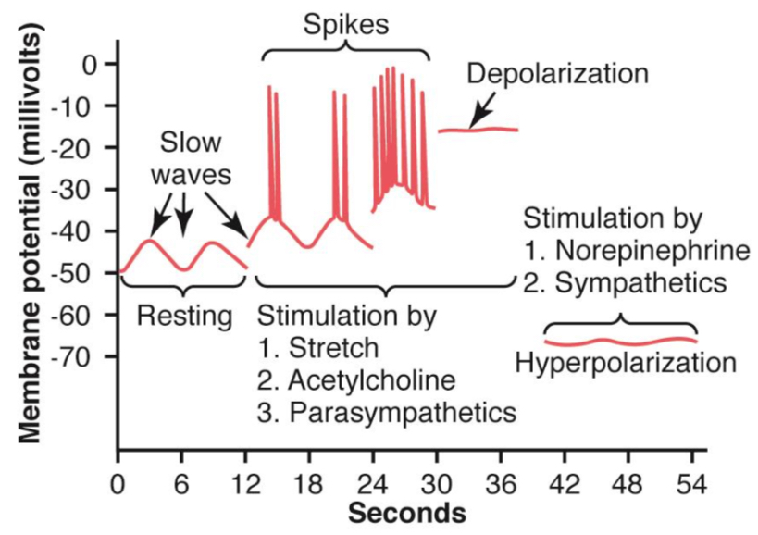
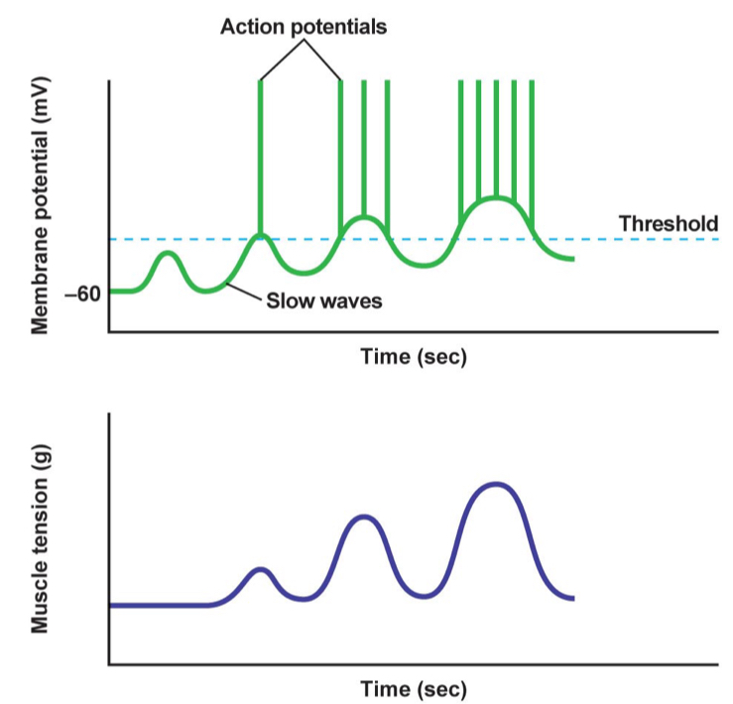
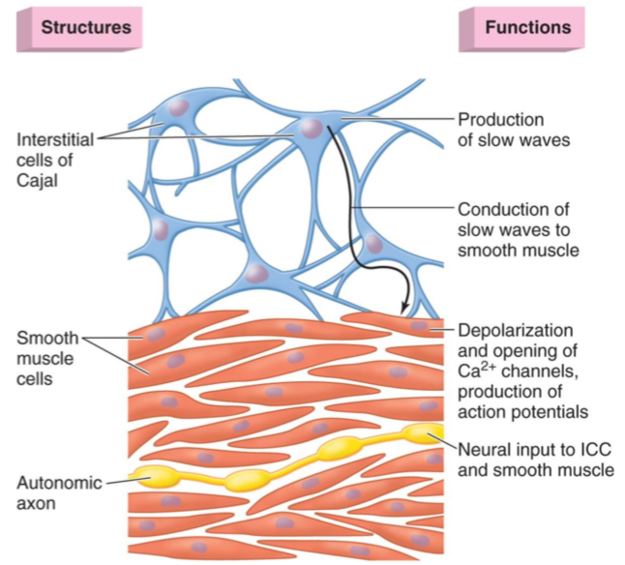
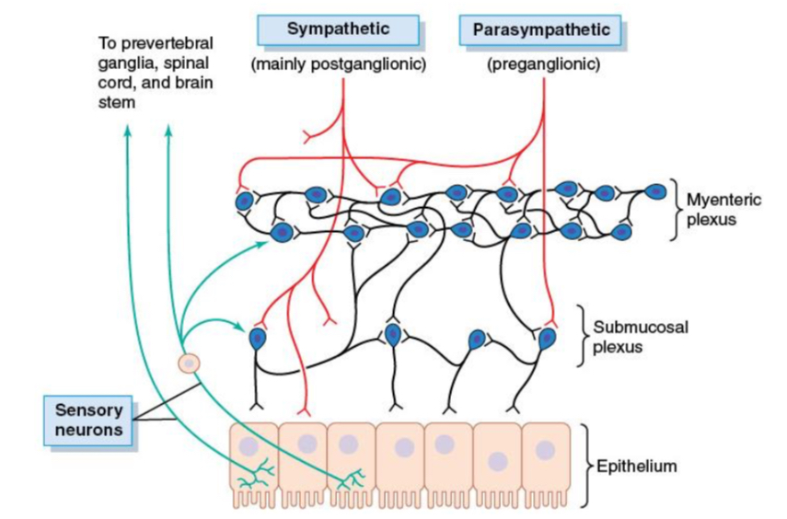
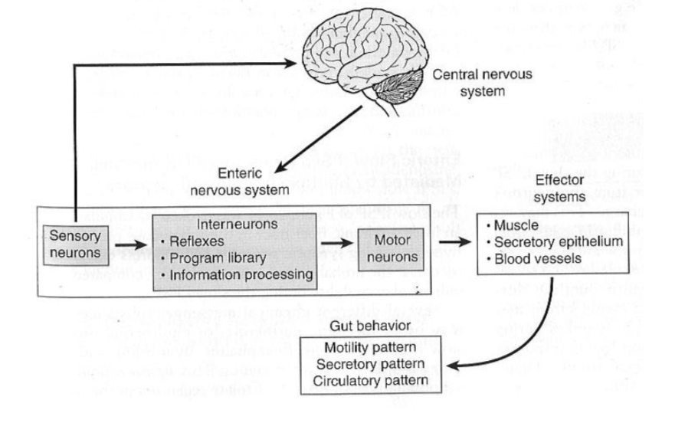
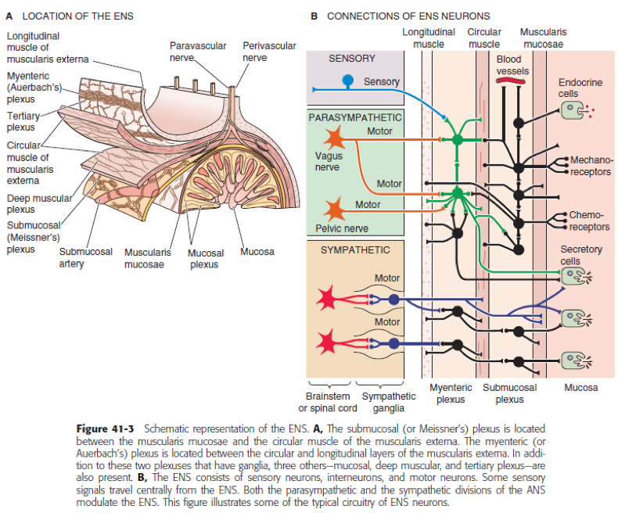
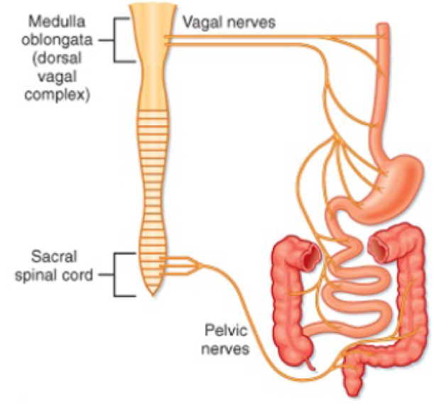
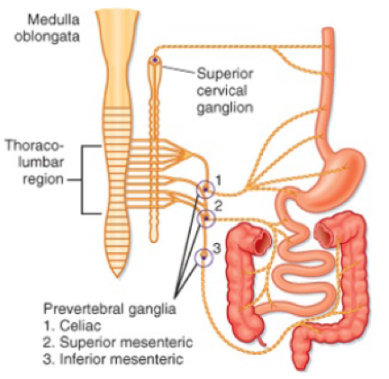
3
GENERAL PRINCIPlES OF GIT PHYSIOLOGY
Lecture One
Figure 1-4
Figure 1-5
Figure 1-6
Control of GI Function
Neural
Hormonal
GI contents
1. Enteric Nervous system:
The nervous system of GI tract.
Its function is largely independent of the extrinsic NS.
2 main plexuses
Myenteric “Auerbach’s” | Submucosal “Meissner's”
between longitudinal & circular muscle layers. | In submucosa
Found throughout the GIT Consists mostly of a linear chain of many interconnecting neurons. Has excitatory & inhibitory motor neurons. | Only in small & large intestine
Controls GI movement “Motility” | Controls secretions & local blood flow.
Figure 1-7
Figure 1-8
2. Sympathetic nervous system:
Origin: T5-L2
Stimulation inhibits activity of the GI.
3. Parasympathetic nervous system:
Vagus nerves (cranial division) & Pelvic nerves (sacral division).
Stimulation causes general increase in activity of the enteric nervous system.
Figure 1-9
Figure 1-10

Slide 5
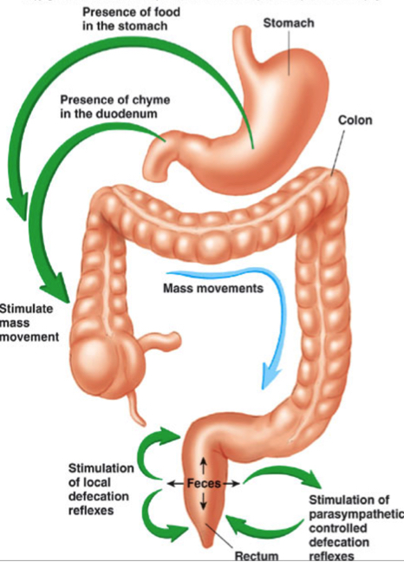
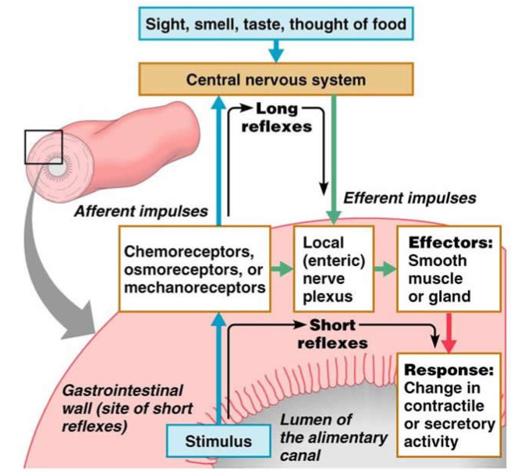
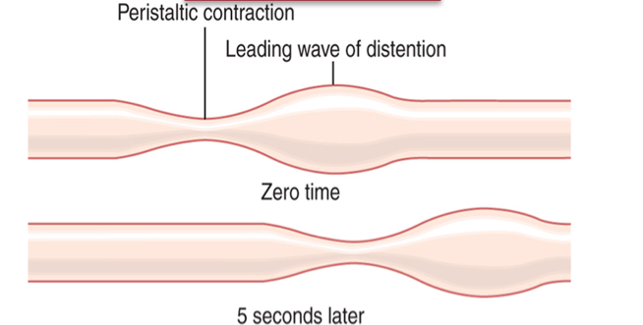
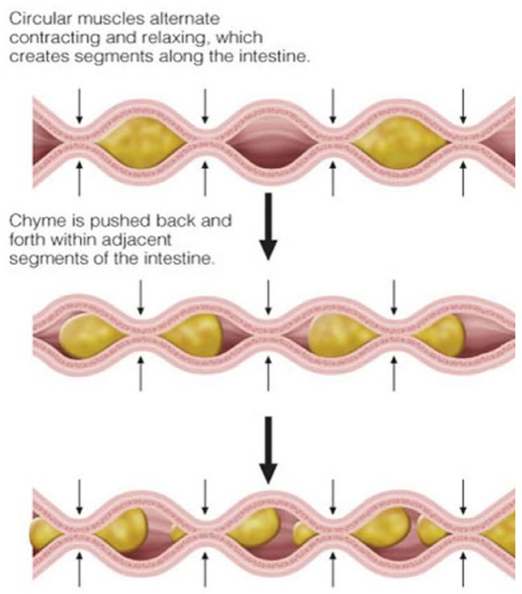
4
GENERAL PRINCIPlES OF GIT PHYSIOLOGY
Lecture One
GI reflexes
Integrated within
ENS
Integrated at
Sympathetic ganglia
Integrated at
spinal cord/brain stem
Local effects
Signals Travel Long distance in GIT
Pain reflexes
GI secretions
Gastrocolic
Peristalsis
Enterogastric
Defecation reflexes
Mixing movement
Colonoileal
Figure 1-11
Figure 1-12
Functional Types of Movement in the GIT
Propulsive (Peristalsis) | Mixing (segmentation)
Progressive wave of contraction & relaxation. To push food forward | Non-propulsive segmental contractions. To break food into smaller pieces
Organizes propulsion of material over variable distances within the GI lumen.
Stimulus: distention. Others: Chemical irritation. Physical irritation.
Blend different juices with the chime.
Bring products of digestion in contact with absorptive surfaces.
Propulsive (upstream) segment
Contraction (circular Muscle)
Relaxation (longitudinal Muscle)
Receiving (downstream) segment
Contraction (longitudinal Muscle)
Relaxation (circular Muscle)
Propulsive segment.
Contraction (circular Muscle)
Receiving segment.
Relaxation (circular Muscle)
Figure 1-13

Slide 6
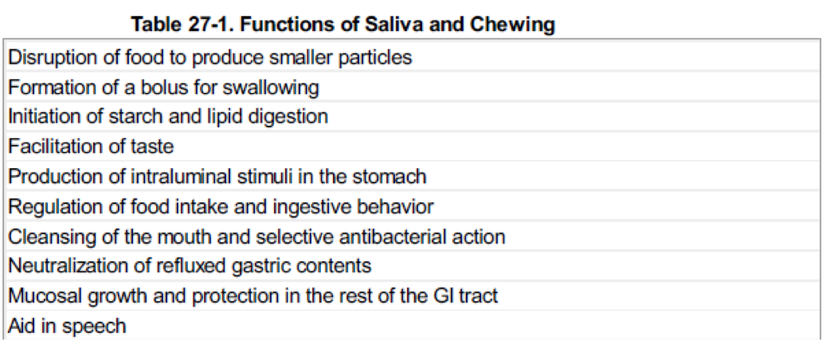
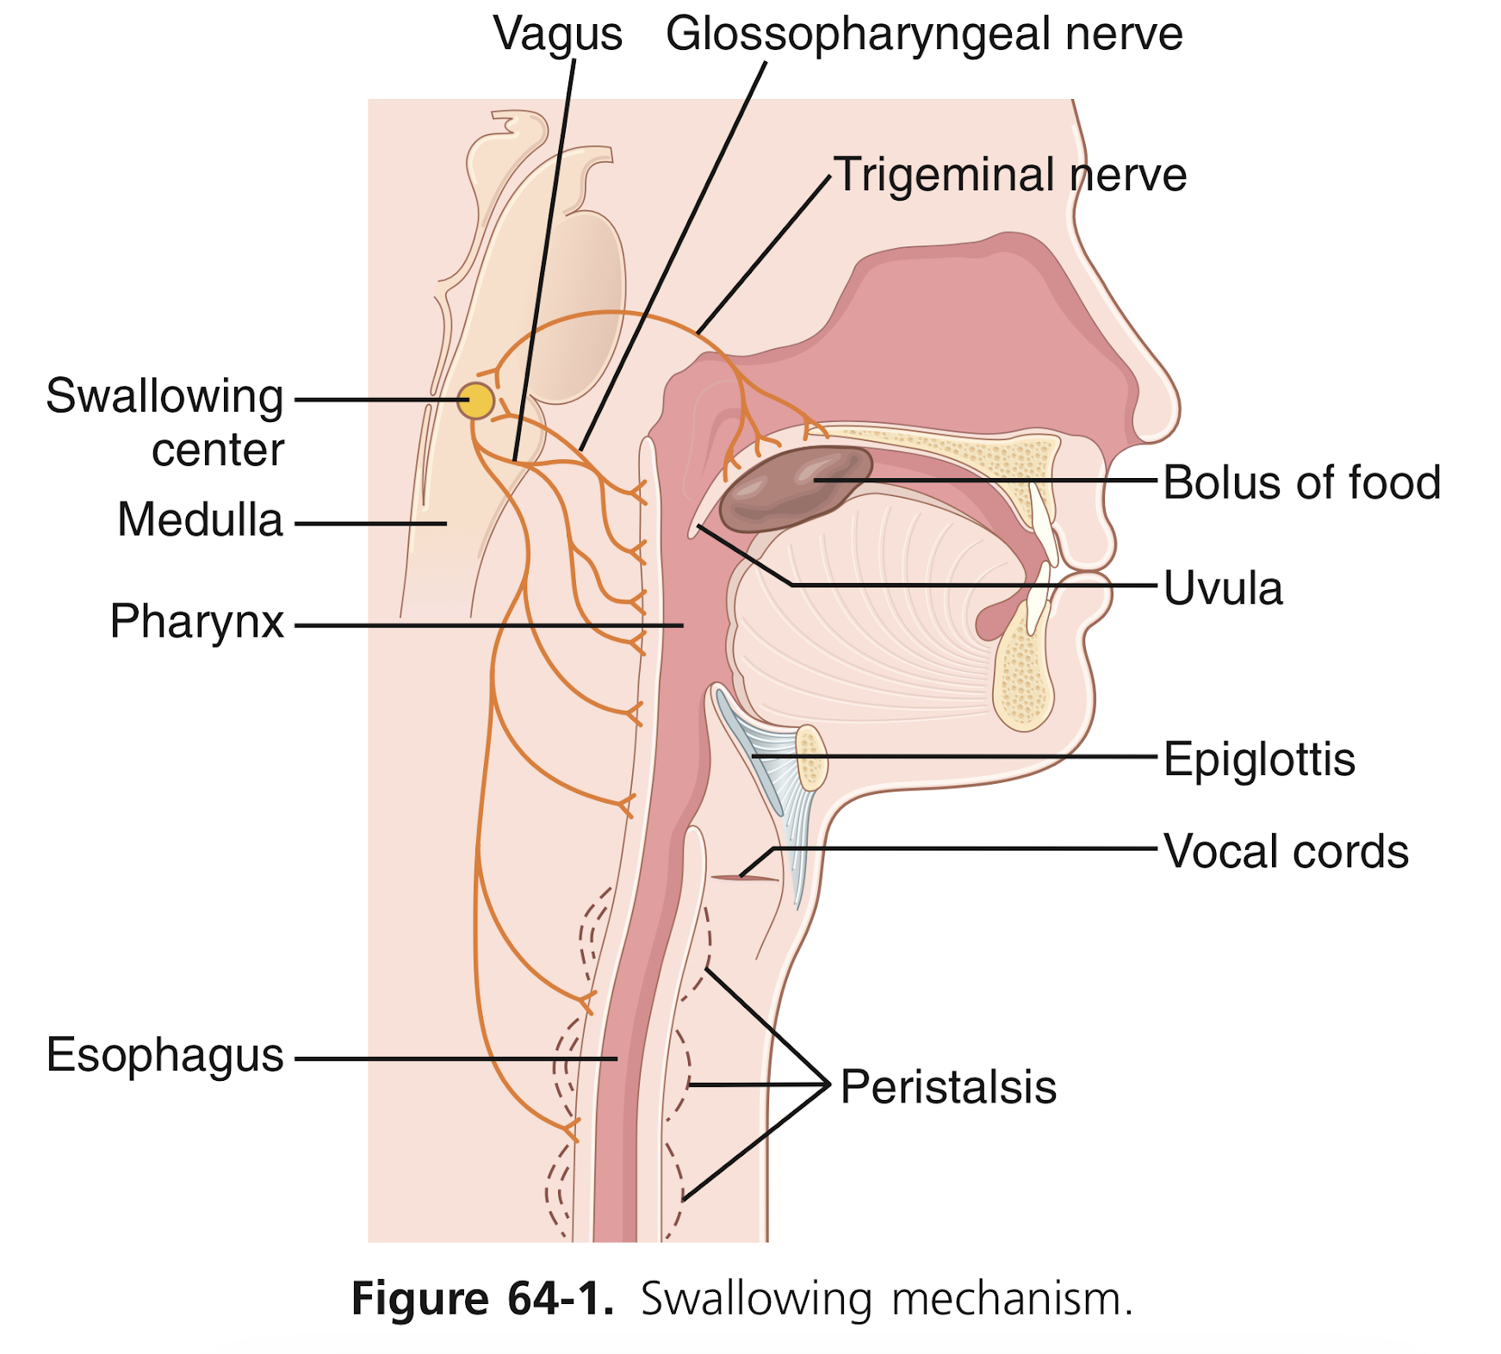
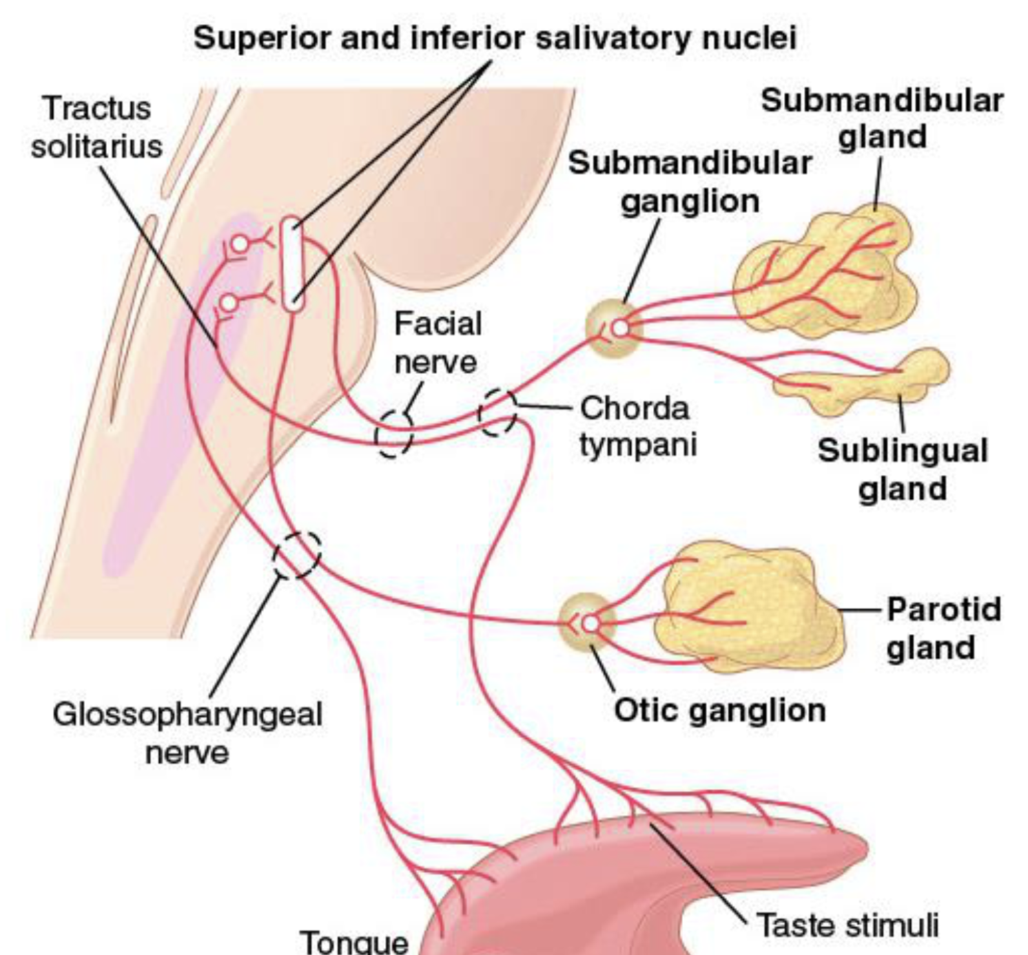
5
ESOPHAGEAL MOTILITY AND PATHOPHYSIOLOGY OF REFLUX DISEASE
Lecture Two
Lecture II: Esophageal Motility and Pathophysiology of Reflux Disease
Mastication (Chewing)
Functions:
1. To lubricate the bolus with salivary secretion.
2. To breakdown the bolus to small particles.
3. To begin digestion of carbohydrate (by amylase).
Chewing (Stretch) Reflex
Figure 2-1
Reflex
inhibition
to muscles
of
mastication
Jaw
drops> The drop initiates a stretch reflex
in jaw
muscles
Rebound
contraction
Jaw raises (closure of the teeth)
Bolus is compressed again against the linings of the mouth
Jaw muscles are once again inhibited > jaw drops
Rebound contraction
(This process is repeated again and again)
Food in
mouth
Swallowing (Deglutition)
Propels food from mouth to stomach.
Complicated process since pharynx is a shared space between respiration & swallowing.
Swallowing is initiated voluntarily in the mouth, but thereafter is under involuntary or reflex control. The reflex portion is controlled by the swallowing center in the medulla.
Food should move without compromising respiration.
Stages of Swallowing:
Figure 2-2
Voluntary Stage of Swallowing
1
Moves bolus of food from mouth → pharynx
Changes: food is squeezed posteriorly into the pharynx by the tongue.
Pharyngeal Stage of Swallowing (Involuntary)
Figure 2-3
2
Moves bolus of food from pharynx → esophagus.
Food stimulates touch receptors in pharynx → impulses (Afferent fibers via CN V & IX) → to swallowing center in the brain stem → Motor efferent via CN V, IX, X, & XII → initiate a series of autonomic pharyngeal muscle contractions as follows: (continued on the next page)

Slide 7
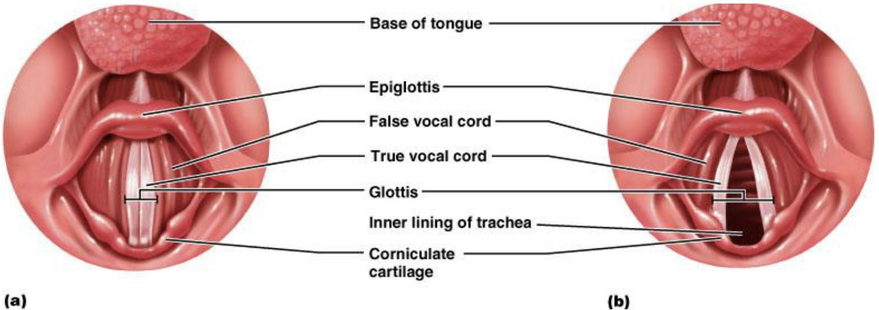
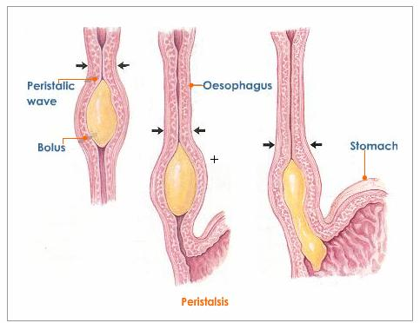
6
ESOPHAGEAL MOTILITY AND PATHOPHYSIOLOGY OF REFLUX DISEASE
Lecture Two
Pharyngeal stage of Swallowing (Involuntary)
2
1
2
3
larynx → pulled upward and anteriorly (by the neck muscles).
Vocal cords → close
Epiglottis → bent over the airway as larynx is lifted.
All these effects prevent food from going into the nose and trachea.
Destruction of the vocal cords or the muscle that approximate them can cause strangulation.
Soft palate & uvula → pulled upward to close off the nasopharynx
Palatopharyngeal folds (on each side of the pharynx) → pulled medially to approximate each other.
→ form a sagittal slit
→ food pass through it to the posterior pharynx.
Figure 2-4
4
5
Esophagus → opens due to the upward movement of the larynx.
Upper esophageal sphincter → relaxes
Respiration → inhibited (the swallowing center inhibits the respiratory center in the medulla during the swallowing cycle)
The entire muscular wall of the pharynx → contracts (superior, middle, then inferior parts) propelling the food by a wave of peristalsis.
Esophageal Stage
3
Move food rapidly from pharynx → stomach.
It’s controlled partly by the swallowing reflex and partly by the enteric nervous system (ENS).
When bolus of food passes through the upper esophageal sphincter, the swallowing reflex closes the sphincter so food cannot reflux into the pharynx.
Primary Peristalsis
Continuation of the peristaltic wave that started in the pharynx (to push bolus down).
Receptive Relaxation
Secondary Peristalsis
Figure 2-5
A wave of relaxation (of LES & stomach) that travels along the myenteric plexus ahead of peristaltic wave.
→ Allows LES & stomach to prepare to receive the food bolus.
It occurs if the primary peristaltic wave fails to move the food to the stomach
Starts at the point of esophageal distention by retained food → will continue until all the food is emptied into the stomach.

Slide 8
7
ESOPHAGEAL MOTILITY AND PATHOPHYSIOLOGY OF REFLUX DISEASE
Lecture Two
Esophageal Stage of Swallowing
The Upper Esophageal Sphincter (UES)
The Lower Esophageal (Gastroesophageal) Sphincter
Formed of skeletal muscle but is not under voluntary control.
Located at the lower end of pharynx.
Guards the entrance into the esophagus.
• It prevents:
esophageal air insufflation during negative intrathoracic pressure events (eg: inspiration.)
esophagopharyngeal/laryngeal reflux during esophageal peristalsis.
• It relaxes during swallowing for about 1 sec → allowing the bolus to be forced through the relaxed UES.
Formed by circular muscles.
Extends 3cm above its junction with stomach.
Normally remains tonically constricted → Helps to prevent reflux of gastric juice.
Relaxes ahead of esophageal peristaltic wave “receptive relaxation” → emptying of the propelled food into the stomach.

Slide 9
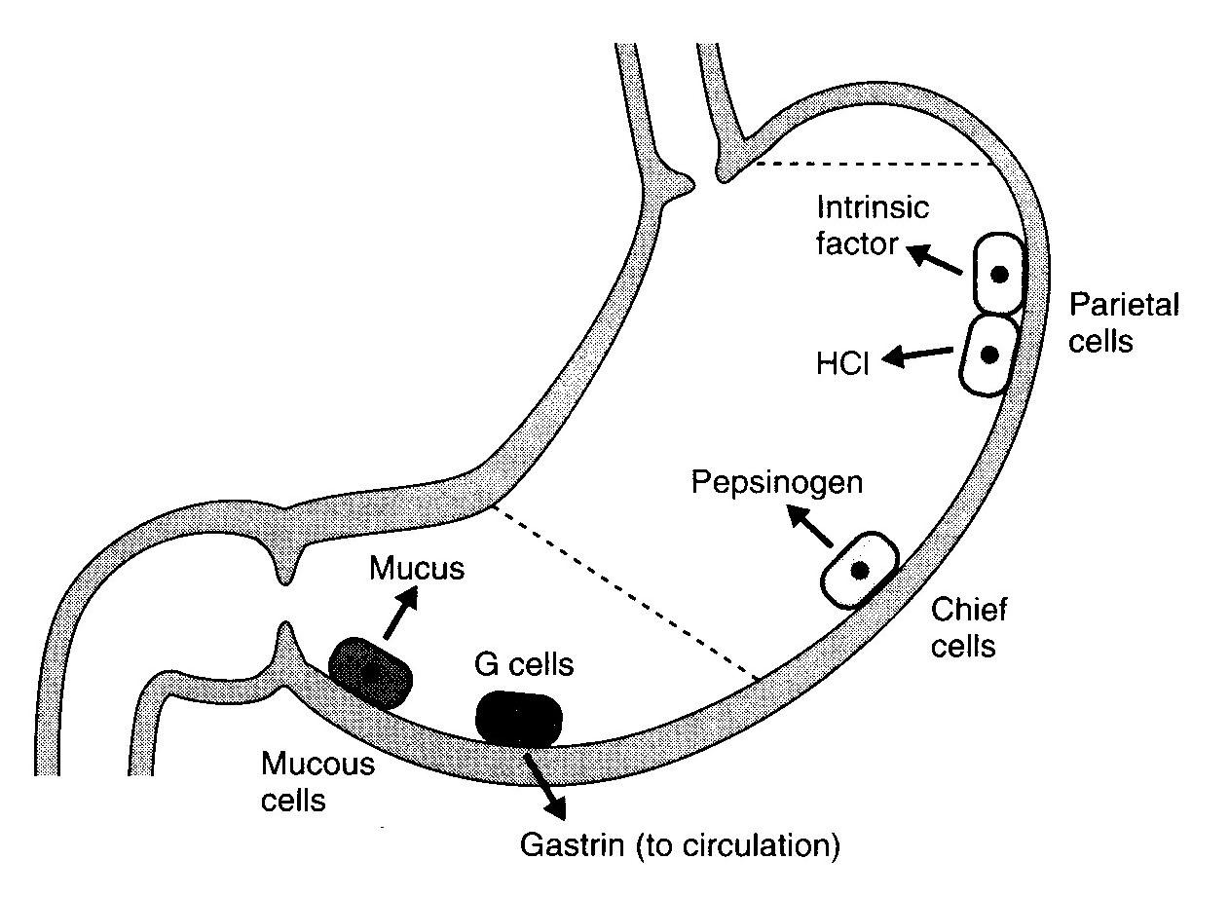
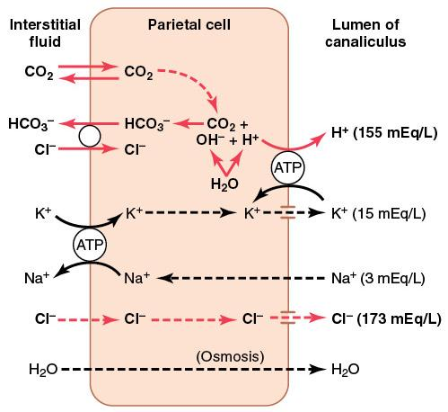
8
PHYSIOLOGY OF THE STOMACH AND REGULATION OF GASTRIC SECRETIONS
Lecture Three
Lecture III: Gastric Motility and Secretion
Functional Anatomy of the Stomach
Types of Gastric Glands
Orad (Reservoir)
fundus and upper two thirds of the body
physiologically
 | Mucus secreting glands | Oxyntic (parietal) glands | Pyloric glands
secrete | Mucus HCO3 | Mucus HCl Pepsinogen IF | Mucus Gastrin
Found in | Cardia | Body & fundus (above the notch) Proximal 80% of stomach | Antrum (below the notch) Distal 20% of stomach
Caudad (Antral Pump)
lower third of the body plus antrum
stomach
fundus
anatomical
body
antrum
Types of Cells Present in Gastric Glands:
Cell type | Secretion | location
Oxyntic (parietal) cell | HCl & IF (intrinsic factor) | Body most distinctive cells in stomach
Peptic (chief )cell | Pepsinogen | Body
Mucus (neck) cells | Mucus, HCO₃⁻ | antrum
Enterochromaffin -like cells | Histamine | -
G cells | Gastrin (increases HCl secretion from Parietal cells) | antrum
Figure 3-1
Gastric juice is composed of:
HCL.
Pepsinogen.
Electrolytes.
Intrinsic factor.
Mucus (mucus gel layer).
Mechanism of HCl Secretion by Parietal Cells:
Cl⁻ is actively transported from the cytoplasm of the parietal cell into the lumen of the canaliculus.
Na⁺ are actively transported out of the canaliculus into the cytoplasm of the parietal cell.
Water becomes (because it is a weak acid) dissociated into H⁺ and OH⁻ in the cell cytoplasm. The H⁺are then actively secreted into the canaliculus in exchange for K⁺.
CO₂, either formed during metabolism in the cell or entering the cell from the blood, combines under the influence of carbonic anhydrase with the OH⁻ to form HCO₃⁻.
HCO₃⁻ then diffuse out of the cell cytoplasm into the extracellular fluid in exchange for Cl⁻ that enter the cell.
Figure 3-2

Slide 10
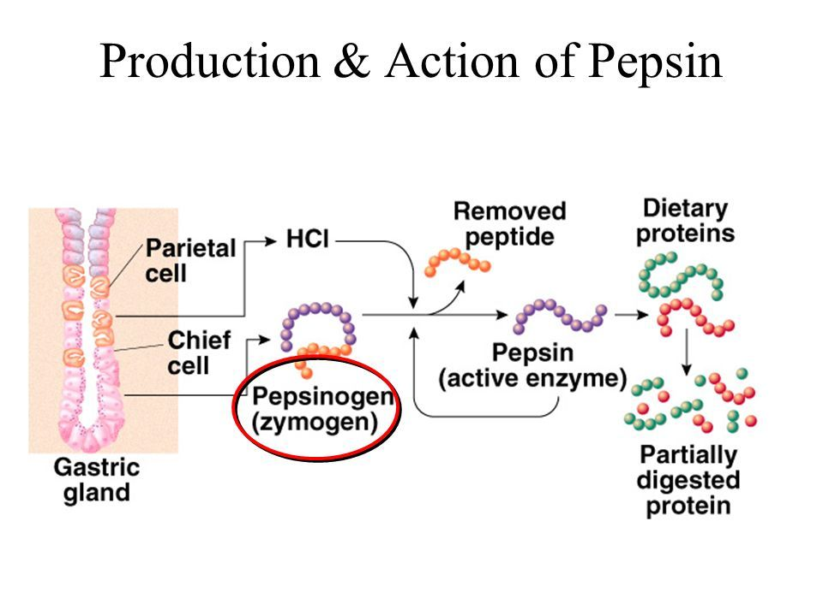
9
PHYSIOLOGY OF THE STOMACH AND REGULATION OF GASTRIC SECRETIONS
Lecture Three
Control of HCL secretion
direct
Ach act on parietal cells → increases HCL secretion
Neural
Act on G cells by releasing Gastrin releasing peptide(GRP) → secrete gastrin which act on CCK_{B} receptor of parietal cells → increases HCL secretion
indirect
HCL secretion control
Act on enterochromaffin like cells (ECL) which secrete histamine → act on H2 receptor of parietal cell → increases HCL secretion.
Hormonal
Gastrin
(Endocrine secretion)
Paracrine
Histamine activate H2 receptor on parietal cells thus increase HCL secretion.
H2 blockers are used for the treatment of peptic ulcer disease or gastroesophageal reflux disease. (e.g, Cimetidine)
histamine
Other Gastric Secretions-Pepsin:
Other Gastric Secretions-Mucus:
Several types of pepsinogen secreted from chief cells. They are activated by HCl into pepsin and once activated, they can activate more pepsinogen. These amino acids or peptides activate G cells to secrete Gastrin thus increasing HCL secretion.
The optimum pH is (1.5-3.5) (1.8-3.5) , pH > 5 inactivates pepsin.
it breaks down proteins into peptones & polypeptides.
Bicarbonate rich mucus layer protects the stomach mucosa. (Mucus is a protein, so it needs to be produced continuously because it gets degraded by pepsin).
Function Of Stomach Movement:
Storage of food
Figure 3-3
1
stomach is stretched by food from the stomach to the brain stem and back to the muscular wall of it resulting in reduction in muscular wall tone which allows storage.
Stomach can store 0.8-1.5 L of food.
a vagovagal reflex is initiated
2
Mixing Of Food
Food presence causes weak peristaltic constrictor waves called mixing/constrictor waves.
It progress from the body antrum and become intense, forcing the chyme to mix and move under high pressure from the antrum the pylorus.
Retropulsion results when it move against a tight pylorus.
3
Regulate emptying of the chyme from the stomach into the small intestine(duodenum):
Rhythmical peristaltic contractions that can become very strong and fuse to form a continuing tetanic contraction lasting sometimes 2-3 minutes .
It’s intense in young healthy people and increase by low blood glucose levels.
Hunger pain can begin after 12-24 hr of last food ingestion.

Slide 11
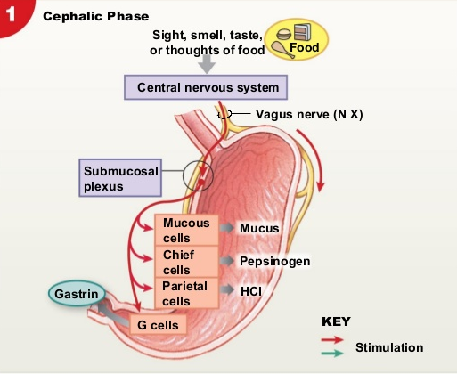
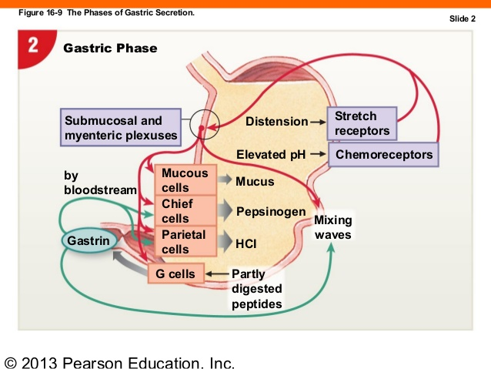
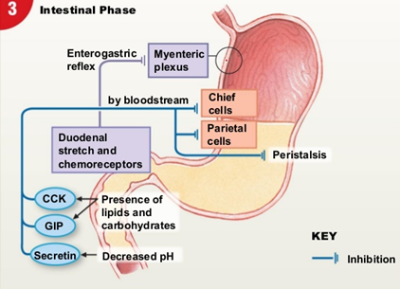
10
PHYSIOLOGY OF THE STOMACH AND REGULATION OF GASTRIC SECRETIONS
Lecture Three
4
Hunger Contraction:
Rhythmical peristaltic contractions that can become very strong and fuse to form a continuing tetanic contraction lasting sometimes 2-3 minutes .
It’s intense in young healthy people and increase by low blood glucose levels.
Hunger pain can begin after 12-24 hr of last food ingestion.
5
The main functions of the upper part of the stomach (Reservoir part):
To maintain a continuous compression.
To accommodate the received food without significant gastric wall distention or pressure (Storage of food).
6
Absorption of water and a few highly-lipid soluble substances (alcohol and Aspirin)
Retropulsion Phenomena
As the trailing contraction approaches the closed pylorus, the gastric contents are forced into an antral compartment of ever-decreasing volume and progressively increasing pressure.
Results in
Jet-like retropulsion through the orifice formed by the trailing contraction reduces particle size to the 1-mm to 7-mm range that is necessary before a particle can be emptied into the duodenum.
Gastric Secretion Phases
phase | Amount of HCL secreted | stimulus | mechanism
Cephalic phase | 30% | Before food arrives at stomach. Stimulated by (Smelling, taste , Chewing and swallowing). | CNS send impulses via vagus nerves (The nerve endings release ACh) which directly stimulates acid secretion from parietal cells. CNS send impulses via vagus nerves ,nerves also release gastrin-releasing peptide (GRP) which stimulates G cells to release gastrin, indirectly stimulating parietal cell acid secretion.
Gastric phase | 60% | when food enters the stomach . Stimulated by (distention , amino acid , small peptides). | Distention of the stomach stimulates mechanoreceptors, which stimulate the parietal cells directly through short local (enteric) reflexes and by long vago-vagal reflexes. Digested proteins in the stomach are also potent stimulators of gastric acid secretion, an effect mediated through gastrin release.
intestinal phase | 10% | when chyme enters duodenum. Stimulated by (protein digestion products in the duodenum). | Inhibitory hormones (Enterogastrones): Somatostatin (D-cells) in antrum. Secretin (S-cells) in duodenum. Glucose-dependent insulinotropic peptide (GIP) (K-cells) in duodenum.
Figure 3-4
Figure 3-5
Figure 3-6

Slide 12
11
PHYSIOLOGY OF THE STOMACH AND REGULATION OF GASTRIC SECRETIONS
Lecture Three
Stomach emptying:
Stomach emptying is the result of intense peristaltic antral contractions against resistance to passage of chyme at the pylorus.
The pyloric sphincter is characterized by strong circular muscle (as compared to the antrum) and remains tonically contracted most of the time. However, during pyloric constriction, watery chyme can still pass through the pylorus into the duodenum, but not food particles.
Pyloric constriction is determined by:
Nervous reflex signals
Humoral reflex signals (from the duodenum and stomach).
The rate of stomach emptying is controlled by signals from the stomach and duodenum, with the latter being far stronger and controls emptying of the chyme at a rate that allows the proper digestion and absorption in the small intestines.
Factors that regulate gastric emptying:
Gastric Factors that Promote Stomach Emptying
Powerful Duodenal Factors That
Inhibit Stomach Emptying.
1
Effect of Gastric Food Volume on Rate of Stomach Emptying.
Increased gastric food volume → increased stretch in the stomach wall (which elicits local myenteric reflexes) → increased pyloric pump activity & the tonic contraction of the pyloric sphincter gets inhibited, leading to increased stomach emptying.
2
Effect of the Hormone Gastrin on Stomach Emptying.
Gastrin is released from the antral mucosa in response to the presence of digestive products of meat.
It promotes the secretion of acidic gastric juices (e.g. HCl) by the stomach gastric glands (or oxyntic glands) located on the inside surface of the body and fundus of the stomach; (i.e. proximal 80% of the stomach).
It also enhances the activity of the pyloric pump and motor stomach function (moderate effect) and probably promotes stomach emptying.

Slide 13
12
PHYSIOLOGY OF THE STOMACH AND REGULATION OF GASTRIC SECRETIONS
Lecture Three
Factors that regulate gastric emptying:
Gastric Factors that Promote Stomach Emptying
Powerful Duodenal Factors That Inhibit Stomach Emptying.
1
Inhibitory Effect of Enterogastric Nervous Reflexes from the Duodenum.
When food enters the duodenum, multiple nervous reflexes are initiated from the duodenal wall and pass back to the stomach to regulate stomach emptying depending on the volume of chyme in the duodenum.
These duodenal reflexes are mediated by three routes:
Directly from the duodenum to stomach through the ENS (enteric nervous system) in the gut wall.
Through extrinsic nerves that go to the prevertebral sympathetic ganglia and then back through inhibitory sympathetic nerve fibers to the stomach.
Through the vagus nerves reflex (to a slight extent) → the brain stem → inhibit the normal excitatory signals that are transmitted to the stomach through the vagus nerves.
These reflexes inhibit the pyloric pump and increase the tone of the pyloric sphincter thus decreasing stomach emptying.
The duodenal factors that can initiate the enterogastric inhibitory reflexes include:
Duodenal distention.
Duodenal irritation.
Duodenal acidity.
Osmolality of the chyme in the duodenum.
Protein (and may be fat) content of the chyme in the duodenum.
2
Hormonal Feedback from the Duodenum Inhibits Gastric Emptying , Role of Fats and the Hormone Cholecystokinin
3
Fat entering the duodenum or acidity of chyme or excess quantities of chyme causes (probably a receptor mediated mechanism) the release of:
cholecystokinin (CCK) , acts as an inhibitor to block increased stomach motility caused by gastrin.
other inhibitory hormones such as (secretin and gastric inhibitory peptide (Glucose-dependent insulinotropic peptide GIP) from the epithelium of the duodenum and jejunum.)
Release of CCK, secretin, and GIP: they circulate and inhibit the pyloric pump and increase the tone of the pyloric sphincter thus decreasing stomach emptying.

Slide 14
13
PHYSIOLOGY OF THE STOMACH AND REGULATION OF GASTRIC SECRETIONS
Lecture Three
Hormones Summary
Hormone | Site of Secretion | Stimuli for Secretion | Actions
Gastrin | G cells of the: Antrum Duodenum jejunum | Protein Distention of the stomach Vagal stimulation Gastrin releasing peptide (GRP) (Acid inhibits release) | Stimulates: Gastric H⁺ secretion Growth of gastric mucosa
Cholecystokinin (CCK) | I cells of the: Duodenum Jejunum ileum | Protein Fatty acids Acids | Stimulates: Pancreatic enzyme secretion Pancreatic HCO₃⁻ secretion Gallbladder contraction Growth of the exocrine pancreas Relaxation of the sphincter of Oddi Inhibits: Gastric emptying
Secretin | S cells of the: Duodenum jejunum ileum | Acids Fat (in the duodenum) | Stimulates: Pepsin secretion Pancreatic HCO₃⁻ secretion Biliary HCO₃⁻ secretion Growth of the exocrine pancreas Inhibits: Gastric H⁺ secretion
Glucose-Dependent Insulinotropic Peptide (GIP) | K cells of the: Duodenum jejunum | Protein Fatty acids Oral glucose | Stimulates: Insulin secretion from pancreatic β cells Inhibits: Gastric H⁺ secretion
Motilin | M cells of the: duodenum jejunum | Fat Acid Nerve | Stimulates: Gastric motility Intestinal motility

Slide 15
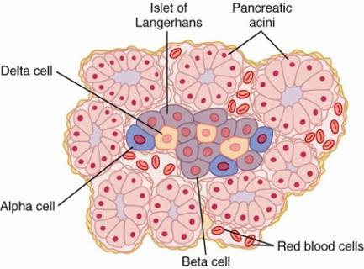
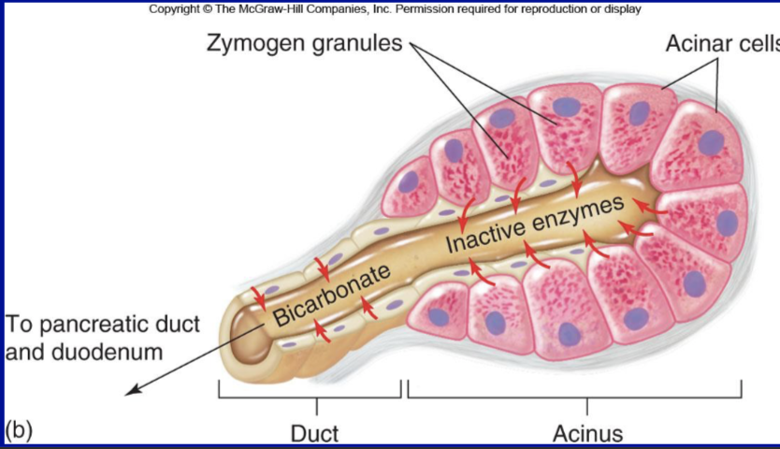
14
PHYSIOLOGY OF THE PANCREAS
Lecture Four
LECTURE IV: Physiology of the Pancreas
Pancreas
Lying parallel to and beneath the stomach, it is a large compound gland with most of its internal structure similar to that of the salivary glands. It is composed of:
Endocrine portion 1-2%
(Made of Islets of Langerhans)
Secrete hormones into the blood.
Exocrine portion 95%
(Acinar gland tissues)
Made of acinar & ductal cells.
secretes digestive enzymes, HCO₃⁻ and water into the duodenum .
Figure 4-1
Figure 4-2
The pancreatic digestive enzymes are secreted by pancreatic acini.
Large volumes of sodium bicarbonate solution are secreted by the small ductules and larger ducts leading from the acini.
Pancreatic juice is secreted in response to the presence of chyme in the upper portions of the small intestine.
Insulin and Glucagon are crucial for normal regulation of glucose, lipid, and protein metabolism.
Pancreatic Secretion
Amount ≈ 1.5 L/day in an adult human.
The major functions of pancreatic secretion:
To neutralize the acids in the duodenal chyme to optimum range (pH=7.0-8.0) for activity of pancreatic enzymes.
To prevent damage to duodenal mucosa by acid & pepsin.
To produce enzymes involved in the digestion of dietary carbohydrate, fat, and protein.
Pancreatic Juice: Refers to the final combined product secreted by the exocrine pancreas.
Digestive enzymes
An electrolyte solution rich in HCO3-
Proteolytic:
For protein: Trypsin, Chymotrypsin, Carboxypolypeptidase
Amylolytic:
For lipids: Pancreatic lipase, Cholesterol Esterase, Phospholipase A2
For carbohydrates: Pancreatic Amylase
Nucleolytic:
For DNA & RNA.

Slide 16
15
PHYSIOLOGY OF THE PANCREAS
Lecture Four
Pancreatic Enzymes for Digesting Proteins Are:
Trypsin
(active form of Trypsinogen)
Chymotrypsin
(active form of Chymotrypsinogen)
Carboxypolypeptidase
(active form of Procarboxypolypeptidase)
These enzymes become activated only after they are secreted into the Intestinal Tract.
Trypsinogen is activated by:
Enteropeptidase (enterokinase), an enzyme secreted by the intestinal mucosa when chyme comes in contact with the mucosa.
Trypsinogen can be autocatalytically activated by trypsin formed from previously secreted trypsinogen.
Chymotrypsinogen and Procarboxypolypeptidase:
They are activated by trypsin to form chymotrypsin and carboxypolypeptidase.
Trypsin Inhibitor
Secretion of trypsin inhibitor prevents digestion of the pancreas itself.
Proteolytic enzymes of the pancreatic juice do not become activated until after they have been secreted into the intestine because the trypsin and the other enzymes would digest the pancreas itself.
The same cells that secrete proteolytic enzymes into the acini of the pancreas secrete another substance called trypsin inhibitor.
Trypsin inhibitor is formed in the cytoplasm of the glandular cells, and it prevents activation of trypsin both inside the secretory cells and in the acini and ducts of the pancreas.
Because trypsin activates the other pancreatic proteolytic enzymes, therefore trypsin inhibitor prevents activation of the other enzymes as well.
Figure 4-3 Activation of digestive enzymes in small intestine
Enzymes For Digesting Carbohydrate:
Enzymes For Digesting Fat:
Pancreatic amylase: it hydrolyzes starches, glycogen, and most other carbohydrates (except cellulose) to form mostly disaccharides and a few tri-saccharides.
(1) Pancreatic lipase (2) Cholesterol esterase (3) Phospholipase
Figure 4-4
Figure 4-5

Slide 17
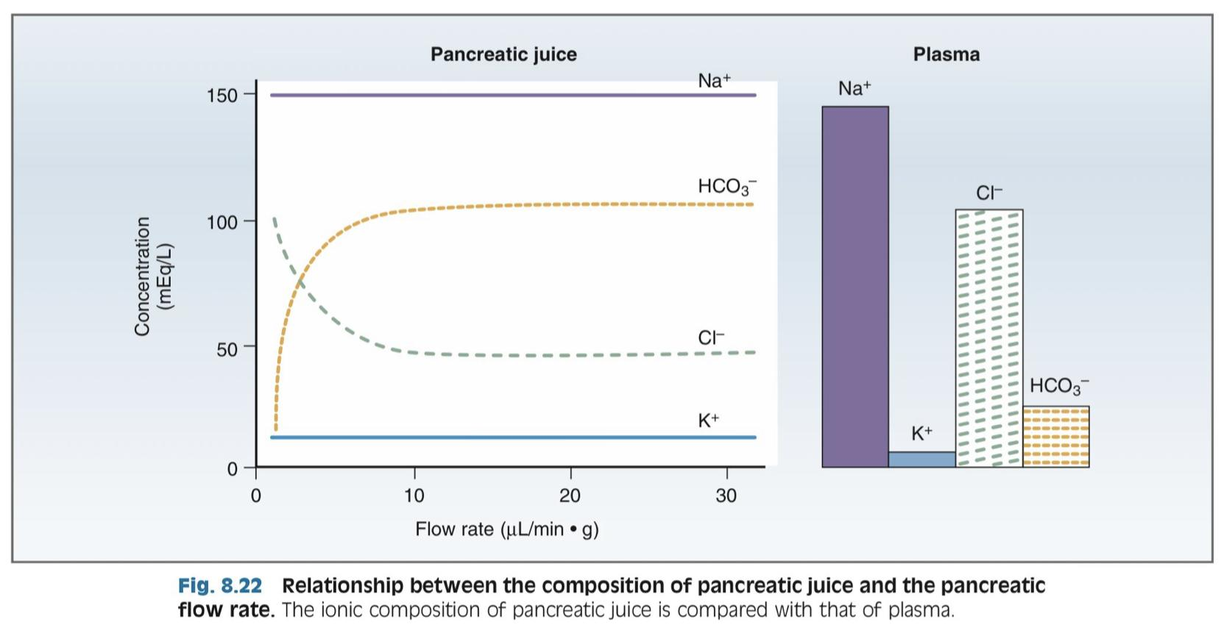
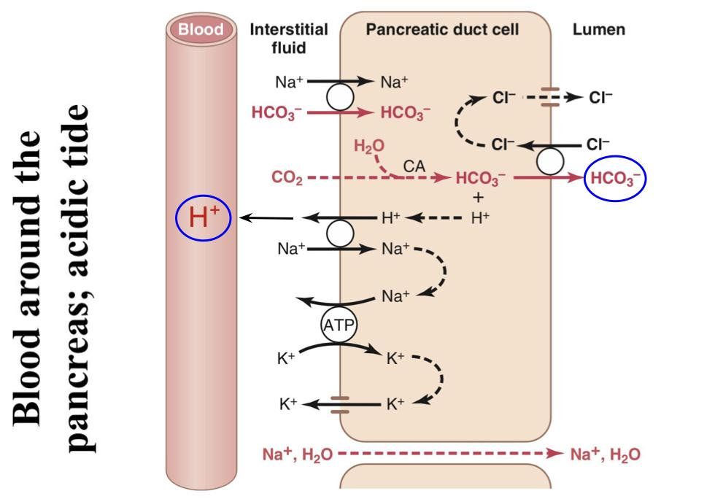
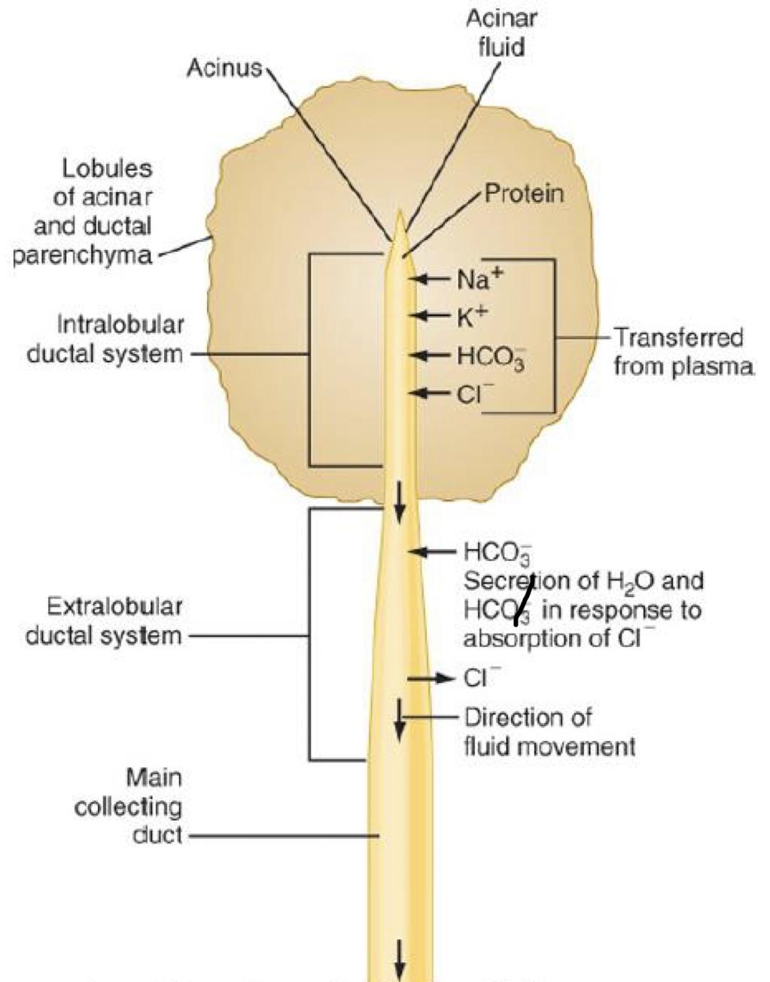
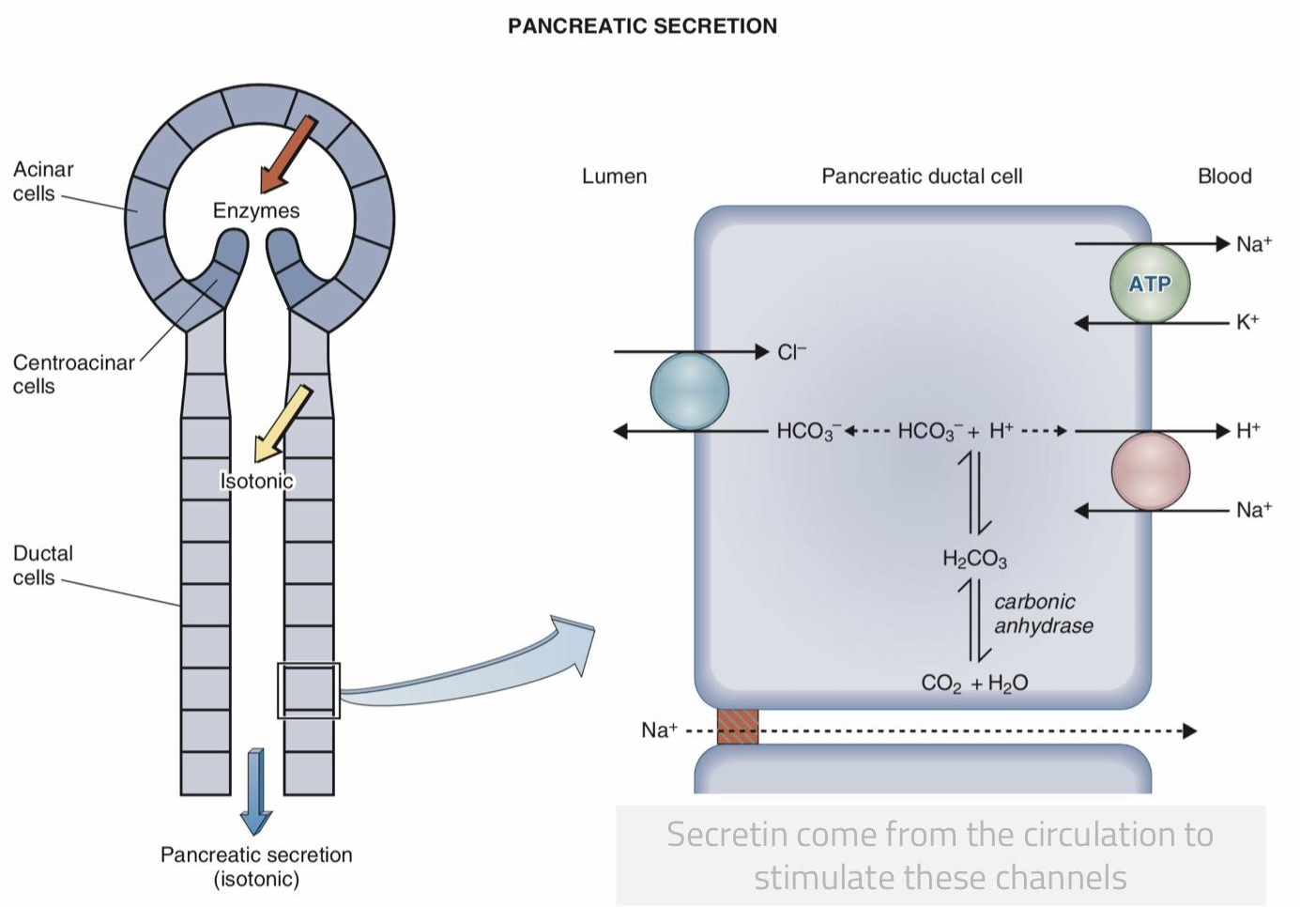
16
PHYSIOLOGY OF THE PANCREAS
Lecture Four
Pancreatic Secretions
The pancreas secrets about 1 L/day of HCO₃⁻ rich fluid from the epithelial cells of the ductules and ducts.
HCO₃⁻ is exchanged for Cl⁻. Secretin increases the rate of this exchanger.
Figure 4-6, Flow Rate & Pancreatic Secretion
Mechanism of HCO₃⁻ Secretion
01
Basolateral membrane contains Na⁺-K⁺ ATPase and
a Na⁺-H⁺ exchanger. By this step, H⁺ goes to the blood and combines with HCO₃⁻ which results in CO₂ & H₂O formation.
02
CO₂ and H₂O combine in ductal cells to form H₂CO₃.
03
H₂CO₃ dissociates into H⁺ and HCO₃⁻.
04
H⁺ is transported into blood by Na⁺-H⁺ exchanger at basolateral membrane of ductal cells.
05
HCO₃⁻ is secreted into pancreatic juice by Cl⁻-HCO₃⁻
exchanger at apical membrane of ductal cells, followed by osmotic flow of water.
Figure 4-7
Absorption of H⁺ causes acidification of pancreatic venous blood.
Figure 4-8
Figure 4-9, Secretion of Isosmotic Sodium Bicarbonate Solution
Phases of Pancreatic Secretion
Pancreatic secretion is under neural and hormonal control.
It normally results from the combined effects of the multiple basic stimuli which potentiate each other.
Phase | Cephalic (20%) | Gastric (5-10%) | Intestinal (70-75%)
Stimulus | Smell, taste, chewing and swallowing | Protein, gastric distention | Amino acid and fatty acids in chyme
Mediator | Through Vagus nerve | Through Vagus nerve | Through hormonal stimulation (Secretin, CCK) and enteropancreatic reflexes.

Slide 18
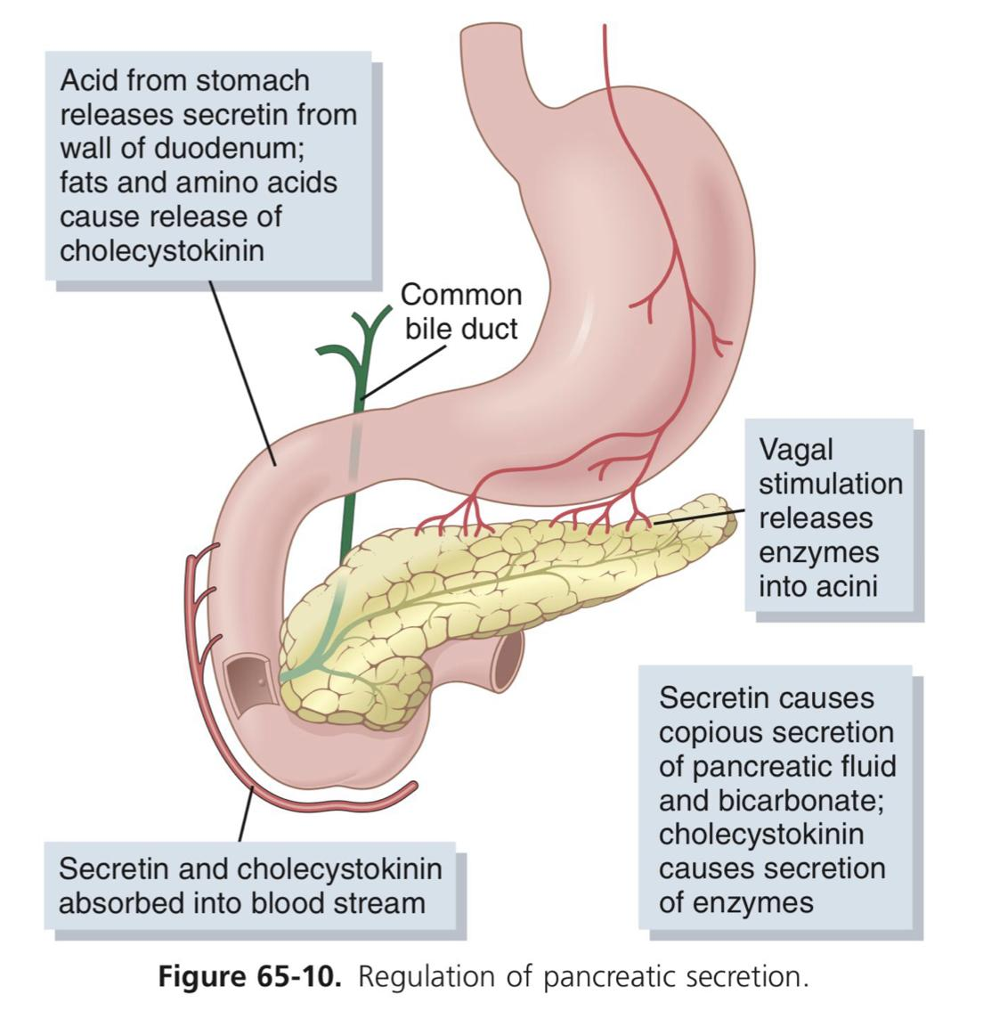
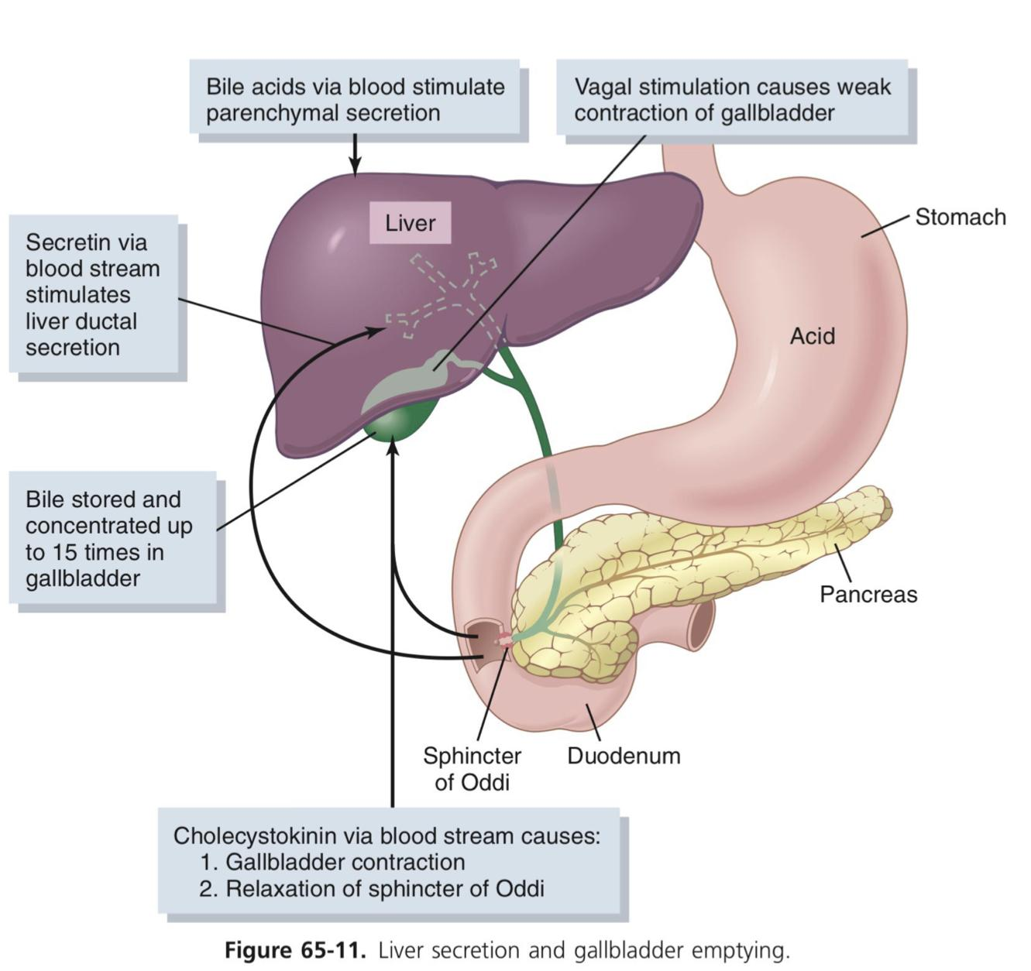
6
17
PHYSIOLOGY OF THE PANCREAS
Lecture Four
Pancreatic Secretion Is Under Neural and Hormonal Control:
01
02
03
Parasympathetic
Secretin
Cholecystokinin
Stimulation through Ach on acinar cells, results in increase in enzyme secretion and HCO₃⁻.
Acetylcholine:
Released:
from the para-sympathetic vagus nerve endings & other cholinergic nerves in the enteric nervous system.
Tends to stimulate a HCO₃⁻ rich secretion by activating ductal cells.
Release:
From “S” cells in the mucosa of the duodenum & jejunum (present as in an inactive form: prosecretin).
Stimulus:
Mainly acid chyme with pH less than 4.5-5.0 in the duodenum.
Stimulates a marked increase in enzyme secretion by stimulating the acinar cells.
Release:
From enteroendocrine “I” cells in the mucosa of the duodenum & upper jejunum.
Stimulus:
By proteoses, peptones (products of partial protein digestion) & long-chain fatty acids in the chyme.
Acetylcholine and cholecystokinin stimulate the acinar cells of the pancreas, causing production of large quantities of pancreatic digestive enzymes but relatively small quantities of water and electrolytes to go with the enzymes.
Secretin stimulates secretion of large quantities of H₂O & NaHCO₃ solution by the pancreatic ductal epithelium.
Secretin Causes the pancreas to secrete large quantities of fluid containing a high concentration of HCO₃⁻ (up to 145 mEq/L = ~5X normal) but a low concentration of Cl-.
HCl + NaHCO₃ ➔ NaCl + H2CO₃ (H2CO₃ dissociates into CO2 and H2O).
Cholecystokinin effect is similar to that caused by vagal stimulation but even more pronounced, accounting for 70-80% of the total secretion of the pancreatic digestive enzymes after a meal.
Regulation of Pancreatic Secretion
Figure 4-10
Figure 4-11

Slide 19
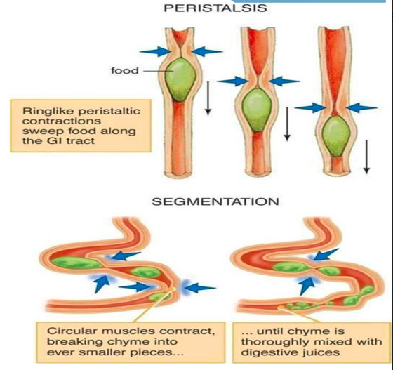
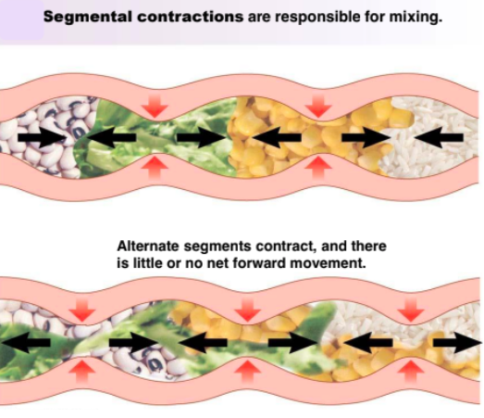
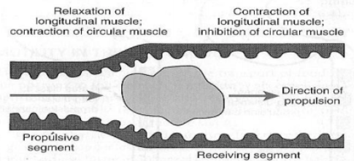
18
PHYSIOLOGY OF THE SMALL INTESTINE: MOTILITY AND SECRETION
Lecture Five
Lecture V: PHYSIOLOGY OF THE SMALL INTESTINE: MOTILITY AND SECRETION
Motility in the Small Intestine
The movements of the small intestine can be divided into five main types of movement:
Segmenting / Mixing contractions
Propulsive / Peristalsis contractions
Stimulus distention.
activated by enteric nervous system (ENS).
It's a localized contraction of circular smooth muscles that constricts (divide) the intestine into spaced segments, last for fraction of min.
chain of sausages appearance (As one of segmentation contractions relaxes, a new often begins at points between the previous ones).
blocked by the drug atropine.
Mixing V.S Peristalsis
Stimulus distention.
A contraction ring appears, moves forward
occur in any part of the small intestine, at velocity of 0.5 to 2.0 cm/sec, it's faster in proximal intestine slower in the terminal intestine.
3 - 5 hours are required for passage of chyme from the pylorus to the ileocecal valve.
Myenteric plexus is important for these movements
blocked by atropine.
Its divide into:
Receiving segment that contract longitudinal and relax circular muscles.
Propulsive segment that contract circular and relax longitudinal Muscles.
Figure 5-1
Figure 5-2
The significance of segmentation contraction:
Blend different juices with the chyme.
Bring products in contact with absorptive surfaces.
Figure 5-3
The significance of peristaltic contractions:
Organize propulsion of material over variable distances within the intestinal lumen.
Migrating motor complex (MMC)
Antiperistalsis
Peristaltic rush
They’re bursts of depolarization accompanied by peristaltic contraction that begins in empty stomach during interdigestive period (after absorption occurs)
Travels along whole length of small intestine to reach ileocaecal valve after 1.5-2 h. Where it disappears then a new wave starts.
Its activity terminates as soon as food is ingested.
Its function is to propel/sweep any remnants in stomach & small intestine into colon during the interdigestive period( in between meals).
Regulated by autonomic nerves and by release of hormone motilin.
A wave of contraction in the alimentary canal that passes in an oral direction(i.e. upward or backwards) and propel the chyme in the opposite direction.
Occurs between:-
Stomach and duodenum to allow more time for neutralization of chyme.
Ileum and caecum to allow more time for absorption.
Mostly physiological
Powerful rapid peristalsis due to intense irritation of intestinal mucosa (eg: infectious diarrhea).
Initiated mainly by extrinsic nervous reflexes to brain stem and back to gut.
Sweeps the contents of intestine into the colon and thereby relieving the small intestine of irritative chyme or excessive distension.
Pathological
Movement of Villi
The villous movement consists of fast shortening and slow lengthening as well as side to side movements.
Villous contractions are initiated by local nervous reflexes in response to chyme in small intestine.
They are stimulated by villikinin hormone released by intestinal mucosa when it comes in contact with digestive products.
They facilitate absorption and lymph flow from central lacteals into lymphatic system.

Slide 20
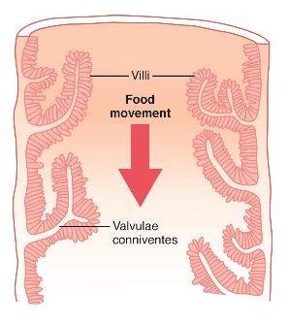
19
PHYSIOLOGY OF THE SMALL INTESTINE: MOTILITY AND SECRETION
Lecture Five
Control of Intestinal Motility
NEURONAL
Vagal(parasympathetic):
excitation increases intestinal and villous movements.
Sympathetic:
excitation decreases intestinal and villous movements.
Gastroileal reflex:
Initiated by gastric distension mediated by vagus nerve.
Impulses are conducted through myenteric plexus to initiate a fast peristaltic wave passing to the ileum.
The ileocaecal valve relaxes allowing chyme to pass into cecum.
HORMONAL
Gastrin, CCK, insulin and serotonin stimulate intestinal motility.
Gastrin and CCK relax ileocaecal sphincter.
Secretin and glucagon inhibits intestinal motility and contract ileocaecal sphincter.
Motilin secreted from duodenum stimulates intestinal motility and regulate MMC.
*Remember that Villikinin stimulates movement of the villi.
Source of Small Intestinal Secretions
Brunner’s Glands
Crypts of Lieberkühn
Located in the wall of the first few centimeters of the duodenum.
Secrete large amounts of alkaline mucus to protect the mucosa, which contains a large amount of bicarbonate ions.
stimulated by:
secretin, tactile (chyme contacts brushborder) and vagal stimulation.
inhibited by:
sympathetic stimulation.
Located in small pits which lie between intestinal villi
Secrete Intestinal juices.
The enterocytes of the mucosa contain the following digestive enzymes:
Aminopeptidases, Oligopeptidases, Intracellular di / tri peptidases for splitting small peptides into amino acids.
sucrase, maltase, lactase, a-dextrinase for splitting disaccharides into monosaccharides.
At a volume of 1800 ml/day (Composition: 0.6 % organic (enzymes & mucus), 1 % inorganic (electrolytes) substance and a
stimulated by :
Distension, tactile and irritating stimuli.
Hormones as gastrin, secretin, CCK.
Inhibited by: sympathetic stimulation.
Absorptive Surface
The absorptive surface of the small intestinal mucosa shows many folds called valvulae conniventes, well developed in the duodenum and jejunum. They increase the surface area of the absorptive mucosa X 3-fold.
The presence of villi on the mucosal surface enhances X 10-fold.
The epithelial cell on each villus is characterized by a brush border, (Provides the surface area equivalent to a tennis court) consisting of as many as 1000 microvilli (X 20- fold).
All these increase the intestinal surface 600x
Figure 5-4

Slide 21
20
PHYSIOLOGY OF THE SMALL INTESTINE: MOTILITY AND SECRETION
Lecture Five
Digestion and absorption of :
Carbohydrates
Protein
Fats
Digestion of Carbohydrate
In the Small Intestine:
The enterocytes lining the villi contain 4 enzymes (lactase, sucrase, maltase, and a-dextrinase, which are capable of splitting the disaccharides lactose, sucrose, and maltose plus other small glucose polymers, into their constituent monosaccharides.
These enzymes are located in the enterocytes covering the intestinal microvilli brush border, so disaccharides are digested as they come in contact with these enterocytes.
Absorption of Carbohydrate
All the carbohydrates in the food are absorbed in the form of monosaccharides only a small fraction are absorbed as disaccharides.
Glucose and galactose absorption occurs in a co-transport mode with active transport of Na+ (2ry active transport) (fastest).
Fructose is independent on Na+ but it transports in luminal membrane via facilitated diffusion.
Figure 5-5
Digestion and absorption of :
Carbohydrates
Protein
Fats
Digestion of Proteins:
Digestion of protein in the intestines:
A small percentage of proteins are digested to amino acids(AA) by the pancreatic juices.
Most remain as dipeptides and tripeptides to be digested by Peptidases (di/tri peptidases) in the Enterocytes mainly in the duodenum and jejunum(intracellularly).
Most protein digestion occurs in the duodenum and jejunum by aminopeptidases, oligopeptidases and Di/tri peptidases.
Absorption of Proteins:
Proteins are absorbed in the form of dipeptides, tripeptides, and a few free amino acids.
D- AA are transported by passive diffusion.
L- AA are transported by 2ry active transport.
Di and tripeptides cross the brush border by active transport protein carrier. Then they're hydrolyzed by brush border and cytoplasmic oligopeptidases.
AA leaves the cell at the basolateral membrane by facilitated transport.
Figure 5-6

Slide 22
21
PHYSIOLOGY OF THE SMALL INTESTINE: MOTILITY AND SECRETION
Lecture Five
Digestion and absorption of :
Carbohydrates
protein
fats
Digestion of Fat:
Bile salts and lecithin in the bile help fat digestion by make the fat globules readily fragmentable with the water in the small intestine (emulsification of fat)--> Bile salts break the fat globules into very small sizes, so that the water-soluble digestive enzymes can act on the globule surfaces.
Absorption of Fat:
Bile salts have the ability to form micelles.
Bile salt & lecithin are amphipathic molecules, each composed of a sterol nucleus (fat-soluble) and a polar group(water-soluble).
The polar parts are (-ve) charged, they allow the entire micelle globule to dissolve in the water of the digestive fluids.
Micelles are small spherical, cylindrical globules 3 to 6 nm in diameter composed of 20 to 40 molecules of bile salts, Which carry Fatty acids(FA) & monoglycerides(MG) to the luminal borders of the intestinal epithelial cells.
Long chain Fatty acids (FA) & monoglycerides (MG), cholesterol and fat soluble vitamins are incorporated into the interior of the micelle.
Figure 5-7
Water and Electrolytes Secretion & Absorption
The permeability of the tight junctions varies with the type of epithelium.
Leaky epithelia are in the small intestine and gallbladder.
A tight epithelium is in the colon.
Figure 5-8
Water and Na+ absorption | Cl⁻ absorption
Electrolytes and H2O cross intestinal epithelial cells by either transcellular or paracellular route. Na+ moves into the intestinal cells by the following mechanisms: Passive diffusion. Na+ - glucose or Na+ - amino acid co-transport. Na+ - Cl- exchange. Na+ - H+ exchange¹. The next step is osmosis of water into the paracellular spaces.. Aldosterone Enhances Na+ Absorption. This effect is important in the colon because it allows virtually no loss of NaCl and water. | Cl⁻ absorption accompanies Na+ absorption by the following mechanisms: Passive diffusion Na+ - Cl⁻ cotransport Cl⁻ - HCO- exchange
 | Ca++ absorption
 | Low plasma Ca++ → Elevated Parathyroid hormone activates Vitamin D:- 25-hydroxy-vitamin D3 → 1,25-dihydroxy-vitamin D3 Which stimulates synthesis of Calcium binding protein and Calcium- ATPase in enterocytes
absorption and secretion of K+ | Secretion of HCO₃ in the ileum
• K+ is absorbed in the small intestine by passive diffusion. • K+ secretion in the colon is stimulated by aldosterone. • Excessive loss of K+ in diarrheal fluids causes hypokalemia. | The epithelial cells on the surfaces of the villi in the ileum and large intestine have a special capability of secreting bicarbonate ions in exchange for absorption of Cl-. So it provides alkaline bicarbonate ions that neutralize acid products formed by bacteria in the large intestine.

Slide 23
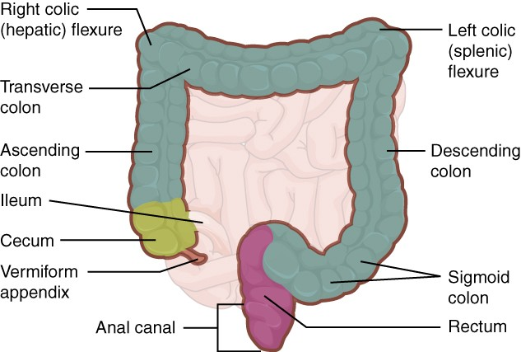
22
PHYSIOLOGY OF THE COLON
Lecture Six
Lecture VI: PHYSIOLOGY OF THE COLON
Parts Of The Colon
It consists of the ascending, transverse, descending & sigmoid colon, rectum and anal canal.
The transit of radiolabeled chyme through the large intestine occurs in 36-48 hrs.
Mucous Membrane Of The Colon
Figure 6-1
Lacks villi and has many crypts of Lieberkühn.
The crypts consist of simple short glands lined by mucous-secreting goblet cells (provides an adherent medium for holding fecal matter together).
The epithelial cells contain almost no digestive enzymes.
FUNCTIONS OF THE COLON
1
Absorb
Vitamins produced by bacteria (NOT dietary vitamins)
2
Reabsorb
Water and compact material into feces
3
Store
Fecal matter prior to defecation
Ascending Colon
Transverse Colon
Specialized for processing chyme delivered from the terminal ileum.
The primary site for the removal of water and electrolytes and the storage of feces.
Function
The physiology of different
Colon regions
Rectosigmoid Region
Descending Colon
It maintains fecal continence together with anal canal & pelvic floor musculature.
A conduit between the transverse and sigmoid colon.
Has the neural program for power propulsion (mass movement), involved in defecation reflex.

Slide 24
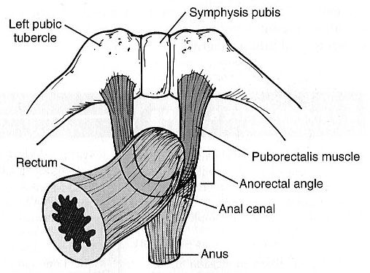
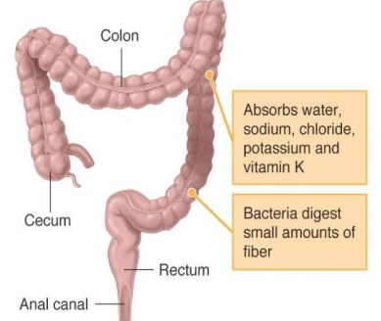
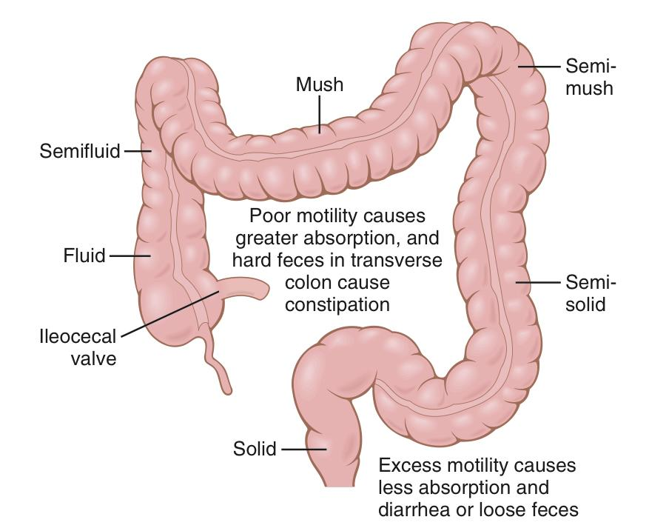
23
PHYSIOLOGY OF THE COLON
Lecture Six
How the Rectosigmoid Region, Anal Canal & Pelvic Floor Musculature Maintains Fecal Continence?
The sigmoid and rectum are reservoirs with a capacity of up to 500 mL.
Fibers of puborectalis pass around the anorectum and join behind it to form a U-shaped sling (physiological valve).
The puborectalis muscle and external anal sphincter comprise a functional unit that maintain continence.
Figure 6-2
Effect Of Parasympathetic Stimulation On Secretion
Stimulation of the pelvic nerves (nerves of defecation reflex) cause:
Increase in peristaltic motility of the colon.
Marked increase in mucus secretion.
During extreme parasympathetic stimulation, so much mucus can be secreted into the large intestine that the person has a bowel movement of ropy mucus as often as every 30 minutes; this mucus often contains little or no fecal material.
Absorption In The Large Intestine
Little absorption occurs in the large intestine.
Most of absorption occurs in the proximal half of the colon (absorptive colon). Whereas the distal colon function for storage (storage colon).
The large intestine can absorb a maximum of 5 - 8 liters of fluid and electrolytes each day.
Water
About 0.5- 1.5L/day is absorbed.
Sodium and Chloride
Cl⁻ is absorbed in exchange for HCO₃⁻ which is secreted.
Figure 6-3
vitamins
Vitamins as vit. K, biotin, B5 , folic acid and some amino acids and short chain fatty acids resulting from bacterial fermentation of CHO are absorbed.
others
Reabsorption of organic wastes (urobilinogens & Stercobilinogen) and toxins.
Reabsorption of bile salts.
Figure 6-4
Gut Flora (Gastrointestinal Microbiota)
it’s a complex community of microorganisms that live in GIT. It’s established at 1-2 years after birth. They live in symbiosis with human & their effects are beneficial to the body.

Slide 25
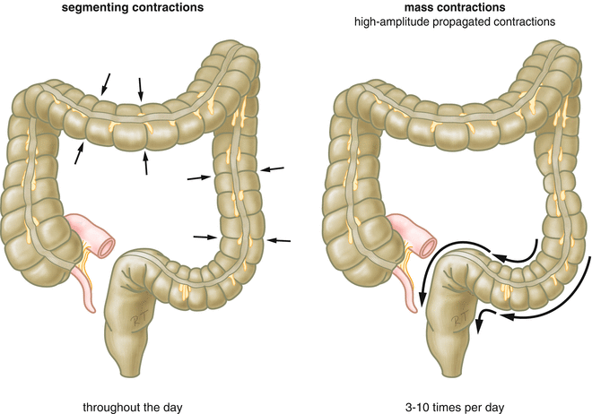
24
PHYSIOLOGY OF THE COLON
Lecture Six
Function Of Bacterial Flora
1
Synthesis of vitamin K & some B group vitamins: folic acid, biotin, thiamine, B12.
The bacteria-formed vitamin K is important since the amount in our daily ingest food isn’t sufficient to maintain adequate blood coagulation.
2
Deconjugation and decarboxylation of bile salts.
3
Breakdown of bile pigments to produce stercobilinogen.
4
Decarboxylation of amino acids to produce amine & histamine.
The amines are excreted in feces and responsible for its smell.
5
Breakdown of urea by bacterial urease to ammonia.
Most ammonia is absorbed and converted back into urea by the liver.
6
Fermentation of undigested oligosaccharides producing gases.
Motility In The Colon
Antiperistalsis
Starts at the junction of ascending and transverse colon & traveling towards the cecum.
Mixes contents
Absorbs water
Mixing Movement (Haustrations)
The motor events in proximal colon (cecum & ascending colon).
Ring-like contractions (2.5 cm) of circular muscles divide the colon into pockets (haustra).
(The longitudinal muscle also contracts at the same time)
The contracted & relaxed segments remain in their respective state for longer periods.
Uniform repetition of haustra occurs along the colon.
Net forward propulsion happens when sequential migration of haustra occurs along the length of bowel.
Propulsive (Mass) Movement
The motor events in distal colon (transverse & descending colon).
Starts in the middle of transverse colon, 15 mins after breakfast.
Constrictive ring occurs at a distended point, then 20 cm of the colon distal to constriction, contracts as a unit forcing the fecal mass down the colon.
Preceded by relaxation of circular muscle & downstream disappearance of haustral contractions.
Completed in 30 sec. Another mass movement occurs 2-3 mins later.
Mass movement persists for 10-30 mins. (They then cease but return perhaps a half day later).
The desire of defecation is felt when a mass of feces is forced into rectum.
Figure 6-5

Slide 26
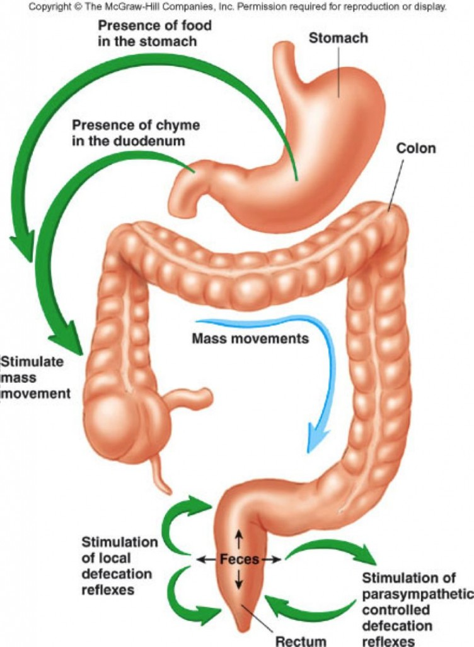
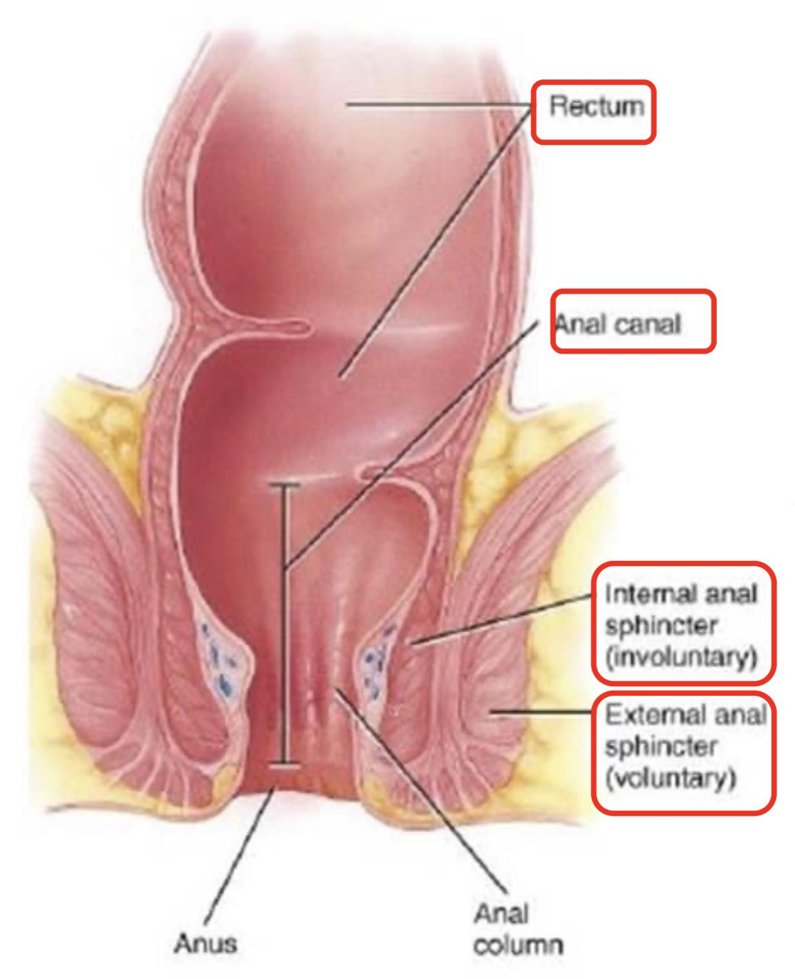
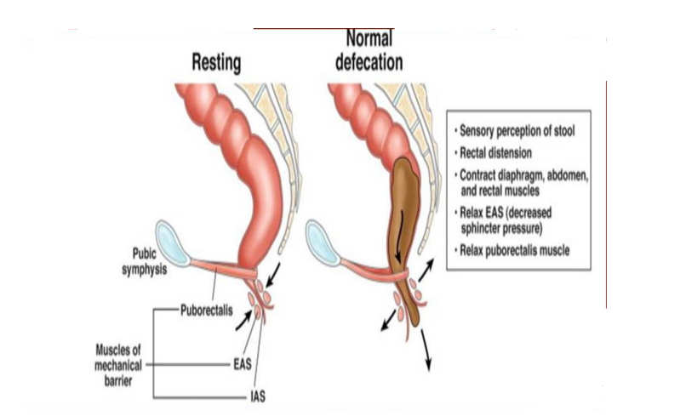
25
PHYSIOLOGY OF THE COLON
Lecture Six
Initiation of Mass Movement
Gastrocolic & duodenocolic reflexes after meals, They result from distension of the stomach & duodenum.
Irritation of the colon. e.g. Castor oil.
Threatening agents. e.g. Parasites & enterotoxins can initiate mass movement.
Control Of Colonic Motility
Figure 6-6
Stimulatory Enteric Motor Neurons Release: | Inhibitory Enteric Motor Neurons Release:
Acetylcholine | vasoactive intestinal peptide (VIP)
Substance P | Nitric oxide (NO)
The extrinsic autonomic nerves to the colon modulate the control of colonic motility by enteric nervous system
The Rectum & Anal Canal
The rectum is the last portion of GIT that terminates at the anal canal.
Contains mechanoreceptors that detect distinction.
Skin of anal canal is innervated by somatosensory nerves that transmit pain, temperature & touch signals to CNS.
Contraction of anal sphincters (external & internal) and puborectalis muscle blocks the passage of feces and maintain continence with small volumes in the rectum.
when puborectalis is contracted, it pulls the junction of the rectum and the anal canal forwards, creating an angle in the bowel called the anorectal angle. This angle prevents the movement of stool stored in the rectum moving into the anal canal.
Conversely, relaxation of the puborectalis reduces the pull on the junction of the rectum and the anal canal, causing the anorectal angle to straighten out. A squatting posture is also known to straighten the anorectal angle, meaning that less effort is required to defecate when in this position.
Figure 6-7
Fecal Incontinence
Figure 6-8
Altered rectal or anal sensation
Infants (physiological)
Diarrheal conditions
Fecal incontinence
Spinal reflex of defecation operates without interference from higher centers
CAUSES ARE:
Spinal cord lesion
Diminished rectal capacity
Weakness of anal sphincters (internal and external)
Weakness of puborectalis

Slide 27
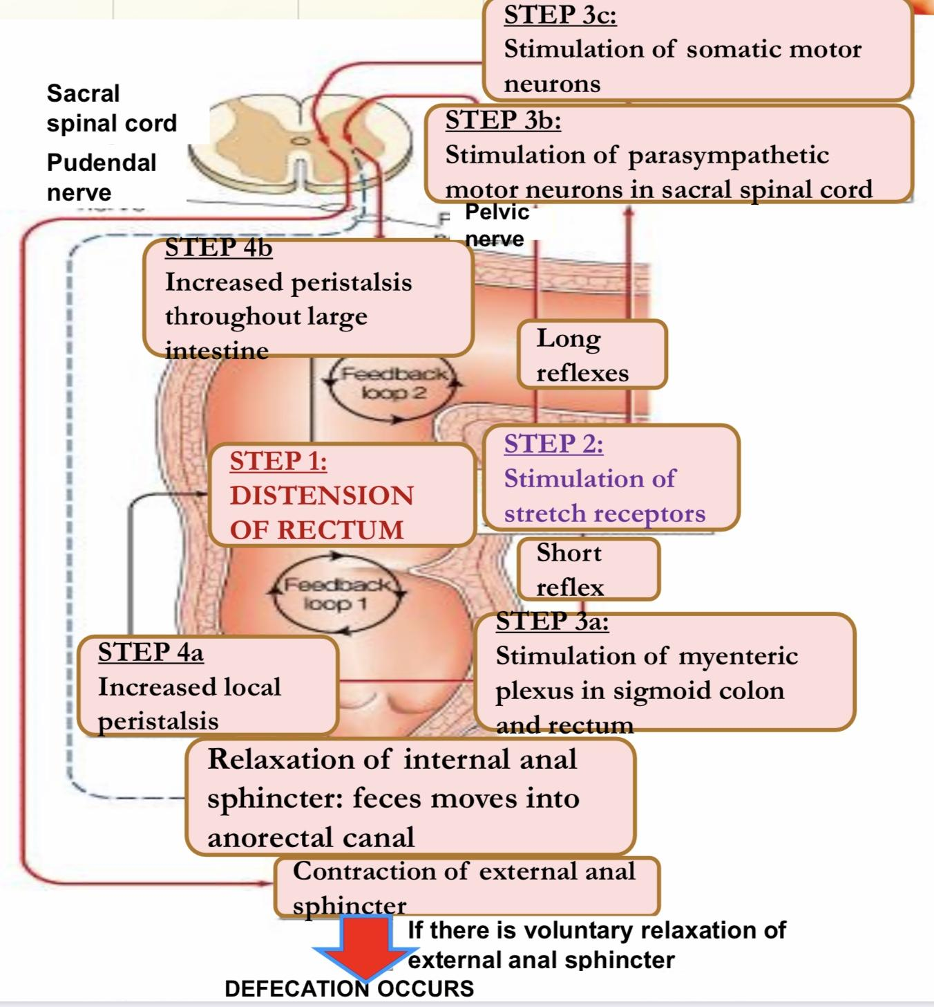
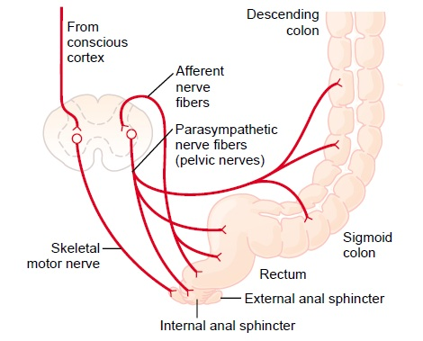
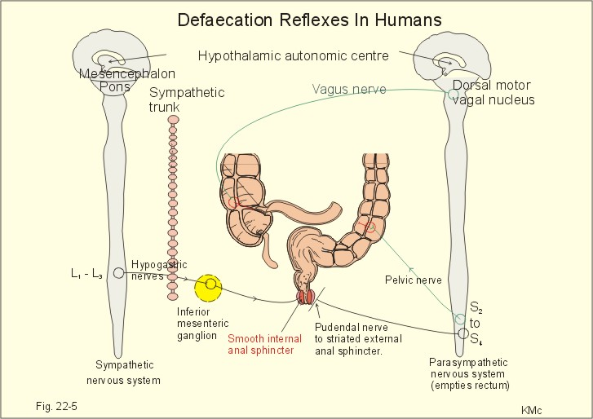
26
PHYSIOLOGY OF THE COLON
Lecture Six
Defecation
Most of the time the rectum is empty.
Both internal & external anal sphincters are
maintained in a state of tonic contraction.
Defecation is a spinal reflex, influenced by higher centers.
Gastrocolic & duodenocolic reflexes initiate a mass movement in the colon that pushes feces into the rectum.
Rectal distension sends signals to cerebral cortex producing the desire to defecate.
Defecation reflex:
Distention of rectum.
Stimulation of stretch receptors in rectum.
Short (local) reflex:
Stimulation of myenteric plexus in sigmoid colon and rectum. (But the intrinsic myenteric defecation reflex functioning by itself normally is relatively weak. To be effective in causing defecation, it usually must be fortified by parasympathetic defecation reflex)
Long reflex:
Stimulation of parasympathetic motor neurons in sacral spinal cord (it will increase peristalsis throughout large intestine).
Stimulation of somatic motor neurons.
4. Results in:
Increases local peristalsis
Relaxation of internal anal sphincter
Contraction of external anal sphincter
Figure 6-9
Different Situation For Defecation
Suitable Situation | Not Suitable Condition
Allowed defecation reflex. Stretch of rectal wall is sent to SC by pelvic nerve. | Inhibited defecation reflex from cerebral cortex
Efferent pelvic impulses cause reflex contraction of rectum & relaxation of internal anal sphincter. | Maintain voluntary tonic contraction of external anal sphincter.
Followed by reduction in tonic impulses to external anal sphincter, so it relaxes voluntary. | Return of tonic contraction of internal anal sphincter.
Feces leave rectum assisted by voluntary straining & contraction of pelvic floor muscles. | Accomodation of rectum to distinction. People who too often inhibit their natural reflexes are likely to become severely constipated.
Figure 6-10
Figure 6-11

Slide 28
27
PHYSIOLOGY OF THE COLON & COAGULATION MECHANISMS
Lecture Six and Seven
Summary Of Defecation Reflexes
Parasympathetic Defecation Reflex (Parasympathetic Pelvic Nerves)
Stimulus | Feces enter the rectum - distention of rectal wall
Receptors | Stretch receptors in the rectal wall
Afferents | Sensory fibers terminating in S2-S4 cord level
Center | S2- S4 spinal cord segments
Efferents | Pelvic Parasympathetic Nerves
Effectors | Smooth muscle cells of Descending, Sigmoid colon & Rectum
Response | Peristaltic waves forcing feces towards rectum - Relaxation of internal anal sphincter
Intrinsic Defecation Reflex (Myenteric Plexus)
Stimulus | Feces enter the rectum - distention of rectal wall
Receptors | Stretch receptors in the rectal wall
Afferents | Sensory fibers terminating in Myenteric Plexus
Center | Myenteric Plexus
Efferents | Motor signals to smooth muscles
Effectors | Smooth muscle cells of Descending, Sigmoid colon & Rectum
Response | Peristaltic waves forcing feces towards rectum - Relaxation of internal anal sphincter
Lecture VII: Coagulation Mechanisms
Hemostasis is defined as spontaneous arrest or stoppage of blood loss.
Coagulation: Formation of fibrin meshwork or threads to form a clot.
Blood clot: is composed of a meshwork of fibrin fibers running in all directions and entrapping blood cells, platelets, plasma.
Clot formation: A series of biochemical reactions leading to the formation of a blood clot within few seconds after injury.
Figure 7-1
Mechanism of Hemostasis:
1. Vessel wall (vasoconstriction)
2. Platelets (production and activation of platelets followed by platelet plug formation)
3. Blood coagulation: clot formation and retraction (intrinsic & extrinsic pathways)
4. Fibrinolysis: Formed blood clot can either become fibrous or dissolved.
Fibrinolysis (dissolving): Breakdown of fibrin by naturally occurring enzyme plasmin therefore prevent intravascular blocking.
There is a balance between clotting and fibrinolysis
Excess clotting → blocking of blood vessels.
Excess fibrinolysis → tendency for bleeding.
Prothrombin (II) | Thrombin | Fibrinogen (I)
Is a plasma protein, α2-globulin. Present in normal plasma in a concentration of 15 mg/dl. It is unstable protein that can be split easily into thrombin. Synthesized by the liver. | Is a protein enzyme with weak proteolytic capabilities It acts on fibrinogen to form one molecule of fibrin monomer. Fibrin monomers polymerize with one another to form fibrin fibers. Thrombin is essential in platelet morphological changes to form a primary plug. Thrombin stimulates platelets to release ADP & thromboxane A2; both stimulate further platelets aggregation. It activates Factor XIII and Factor V. | is a high-molecular weight plasma protein Little or no fibrinogen leaks from blood vessels.²

Slide 29
28
COAGULATION MECHANISMS
Lecture Seven
Prothrombin (inactive thrombin) is activated by a long intrinsic or short extrinsic pathways.
This reaction leads to the activation of thrombin enzyme from inactive form prothrombin.
Thrombin will change fibrinogen (plasma protein) into fibrin (insoluble protein)
Intrinsic Pathway
Figure 7-2
The trigger is the activation of factor XII by contact with foreign surface, injured blood vessel, and glass. (all clotting factors present in the blood)
Activated Factor XII will activate Factor XI
Activated Factor Xl will activate Factor IX
Activated Factor IX + Factor VIII + platelet phospholipid factor (PF3) + Ca⁺⁺ activate Factor X
Extrinsic Pathway
Figure 7-2 Classical model of coagulation.
The trigger is release of tissue thromboplastin from damaged tissues and it is composed of phospholipids from the membranes of the tissue plus a lipoprotein complex that functions mainly as a proteolytic enzyme.
Tissue thromboplastin activates Factor VII
Tissue thromboplastin + Factor VII + Ca⁺⁺ activate Factor X
Common Pathway
Following the above steps, the pathway is common for both intrinsic and extrinsic pathways.
Activated Factor X + Factor V +PF3 + Ca⁺⁺ activate prothrombin activator; a proteolytic enzyme which activates prothrombin.
Activated prothrombin activates thrombin.
Thrombin acts on fibrinogen forming insoluble fibrin monomers.
Factor XIII + Ca⁺⁺ causes additional strength of fibrin meshwork → strong fibrin (strong clot)
Figure 7-3 Cell-based model of coagulation
Plasmin is present in the blood in an inactive form “plasminogen.”
It is activated by tissue plasminogen activators (t-PA) in blood.
Uses: Tissue Plasminogen Activator (t-PA) used to activate plasminogen to dissolve coronary clots. (an example for this is streptokinase)
Digests intravascular and extravascular deposit of fibrin → fibrin degradation products (FDP)
Unwanted effect of plasmin is the digestion of clotting factors.
Plasmin is controlled by:
Tissue Plasminogen Activator Inhibitor (t-PAI)
Antiplasmin from the liver

Slide 30
29
COAGULATION MECHANISMS
Lecture Seven
I | Fibrinogen
II | Prothrombin
III | Tissue factor (Thromboplastin)
IV | Calcium
V | Labile factor
VI | No longer used (previously thought to be present, was mistaken for factor Va)
VII | Stable factor
VIII | Antihemophilic factor, antihemophilic factor A
IX | Antihemophilic factor B, christmas factor
X | Stuart-Prower factor, Stuart factor
XI | Plasma Thromboplastin Antecedent (PTA), antihemophilic factor C
XII | Hageman factor, glass factor
XIII | Fibrin stabilizing factor
Pre-K | Fletcher factor, prekallikrein
HMWK | High molecular weight kallikrein, Fitzgerald factor
Conditions That Cause Excessive Bleeding
Vitamin K Deficiency
Thrombocytopenia
Hemophilia
Required for synthesis of prothrombin, factor VII factor IX, and factor X.
Deficiency is rare, but maybe seen in: Hepatitis, cirrhosis, acute yellow atrophy and gastrointestinal disease.
Very low number of platelets in blood (<50,000/μl)
Thrombocytopenia purpura: hemorrhages throughout all the body tissues.
Idiopathic Thrombocytopenia: unknown cause.
Bleeding tendency.
X-linked recessive disease.
Affects males.
85% due to factor VIII deficiency (hemophilia A).
15% due to factor IX deficiency (hemophilia B).
Pseudothrombocytopenia
Partial clotting of specimen
EDTA-platelet clumping
Platelet satellitism around WBCs
Cold agglutinins
Giant platelets
Prevention of Blood Clotting and Anticoagulants
Endothelial Surface Factors
Smoothness of the endothelial cell surface (ECS)
Glycocalyx layer
Thrombomodulin protein
Fibrin Fibers
Adsorbs 90% of thrombin to remove it from circulation.
Antithrombin III
Combines the remaining thrombin and removes it from circulation.
Heparin
Combines with antithrombin III and quickly removes thrombin from blood.
Sources: Mast cells and basophils which are abundant in liver and lungs.

Slide 31
30
PHYSIOLOGY OF BILE SALTS AND ENTEROHEPATIC CIRCULATION
Lecture Eight
Lecture VIII: BILE SALTS & ENTEROHEPATIC CIRCULATION
Functions of The Liver
The largest internal organ in the body, constituting about 2.5% of an adult’s body weight.
Receives 25% of the cardiac output via the hepatic portal vein and hepatic artery.
Synthesizes many of the circulating plasma proteins.
Performs important endocrine functions. (IGF-1, thrombopoietin and angiotensinogen secretion).
Serves as an excretory organ for bile pigments, cholesterol, and drugs.
The main digestive function of the liver is the secretion of bile (normally 600-1000 ml/day).
Figure 8-1 Bile Canaliculi & Ducts.
FUNCTIONS OF BILE
Fat Digestion And Absorption
Emulsifying the large fat particles of the food into minute particles.
They aid in absorption of the digested fat end products through the intestinal mucosal membrane, via micelles formation.
Excretion Of Waste Products From The Blood
These include especially bilirubin, an end product of hemoglobin destruction.
Stages of Bile Secretion
First Stage(Hepatic Bile):
secreted by the hepatocytes into bile canaliculi that originate between the hepatic cells, and by this way bile can be emptied into the duodenum.
Hepatic bile: Isotonic secretion, with high Na⁺, Cl⁻ and HCO₃⁻ and low K⁺ and Ca⁺⁺.
There is an Active reabsorption of Glucose and A.A. to prevent bacterial growth.
Second Stage(Gallbladder Bile):
Bile can be diverted for minutes up to several hours through the cystic duct into the gallbladder (second portion of liver secretion, added to the initial bile).
Gallbladder bile: high bile acid anion and Ca⁺⁺; but low Na⁺, Cl⁻, HCO₃⁻ and H₂O.

Slide 32
31
PHYSIOLOGY OF BILE SALTS AND ENTEROHEPATIC CIRCULATION
Lecture Eight
COMPONENT OF BILE
Cholesterol
4%
(From Hepatocytes)
Bile pigments
0.3% as bilirubin
(From Hepatocytes)
Ions and Water
(Aqueous alkaline solution)
Mainly HCO₃⁻ & H₂O
(From bile ducts epithelial cells), contribute to the volume of hepatic bile
Phospholipids (Lecithin),
Phosphatidylcholine
20% as lecithin
(From Hepatocytes)
Proteins
5%
(From Hepatocytes)
Bile acids (Bile salts)
65% of weight of bile
(From Hepatocytes)
Concentrating Bile in the Gallbladder
Gallbladder concentrates the bile during every 12 hours of bile secretion (usually about 450 mL).
Concentration is due to active transport of sodium, followed by secondary absorption of chloride ions, water, and most other diffusible constituents.
Bile is normally concentrated in this way about 5-fold, but it can be concentrated up to a maximum of 20-fold.
Figure 8-2 The Tight junction resist the passage of Bile Acid Anion .
Regulation of Bile Secretion
The major determinant of bile acid synthesis is its concentration in hepatic portal blood (feedback control).
Hormonal: CCK, Secretin & estrogen stimulate bile secretion.
Neural:
Parasympathetic (vagal) stimulation results in contraction of the gallbladder and relaxation of the sphincter of Oddi, as well as increased bile formation.
stimulation of the sympathetic nervous system results in reduced bile secretion and relaxation of the gallbladder.
Figure 8-3, Neurohumoral control of gallbladder contraction and biliary secretion

Slide 33
32
PHYSIOLOGY OF BILE SALTS AND ENTEROHEPATIC CIRCULATION
Lecture Eight
Bile Acids & Bile Salts
Bile acids are steroid acids, synthesized in the liver from cholesterol. During the conversion, hydroxyl groups (by 7α- hydroxylase) and a carboxyl group are added to the steroid nucleus.
Bile acids are classified as primary or secondary.
Primary: Cholic, Chenodeoxycholic acids.
Secondary: Deoxycholic, Lithocholic acids.
Bile acids are secreted as conjugates of taurine or glycine and it is converted into secondary bile acids by Dehydroxylation and Deconjugation processes done by intestinal bacteria.
At a neutral pH, the bile acids are mostly ionized (zwitterion form)¹, more water soluble and are present almost entirely as salts of various cations (mostly Na+) e.g., sodium glycocholate and are called bile salts.
Function of Bile Acid
DIGESTION OF FATS
ABSORPTION OF FATS
ABSORPTION OF FAT-SOLUBLE VITAMINS (A, K, E, D)
STIMULATING BILE SECRETION AND FLOW A process known as “choleretic flow”
INCREASE SOLUBILITY OF CHOLESTEROL IN BILE
Role of Bile Salts To Accelerate Fat Digestion & Formation of Micelles
Bile acids are amphipathic molecules that have the ability to form micelles(each bile salt molecule is composed of a sterol nucleus that is fat-soluble and a polar group that is water-soluble).
The polar groups are (-) charged, they allow the entire micelle globule to dissolve in the water of the digestive fluids and to remain in stable solution.
The micelles act as a transport medium to carry the monoglycerides and free fatty acids to the brush borders of the intestinal epithelial cells.
Figure 8-4
Enterohepatic Circulation (Portal Circulating) of Bile Salts
The enterohepatic circulation of bile salts is the recycling of bile salts between the small intestine and the liver, (3-5) times a day; in a heavy eater, it may circulate (14-16) times a day.
The total amount of bile acids in the body, primary or secondary, conjugated or free, at any time is defined as the total bile acid pool. In healthy people, the bile acid pool ranges from 2-4 g.
If enterohepatic circulation is interrupted (e.g. due to obstruction or surgical removal
or inflammation of the terminal ileum), bile flow is markedly reduced.
Figure 8-5

Slide 34
33
PHYSIOLOGY OF BILE SALTS AND ENTEROHEPATIC CIRCULATION
Lecture Eight
Absorption of Bile Acids in Intestinal Lumen
Bile salts or bile acids in the intestine lumen are absorbed via four pathways into portal circulation (enterohepatic circulation):
An active carrier-mediated process (Apical Na+ dependent Bile salt transporter (ASBT) (Conjugated bile acids, 2ry active transported. Powered by Na gradient across the brush border membrane).
Simple diffusion (Unconjugated bile acids, less polar).
Deconjugation and/or transforming of bile salts to bile acids (by bacteria).
Transforming the primary bile acids to secondary bile acids (by bacteria).
Figure 8-6
Absorption of Bile Acid or Bile Salt Back Into Hepatocytes
Bile salts or bile acids in the portal circulation are absorbed via four pathways into hepatocytes:
An active carrier-mediated process: Conjugated bile acids-Na co-transport (Bile salt-Na+ coupled (Ntcp).
Na-independent pathway (Bile acid-Na+independent (OATP).
Bile acid-HCO3 or Bile acid-OH exchange.
Passive diffusion (very little).
Figure 8-7

Slide 35
34
BILIRUBIN METABOLISM
Lecture Nine
Lecture IX: Bilirubin Metabolism
Definition of Bilirubin
Greenish yellow pigment excreted in bile, urine & feces, the major pigment present in bile is the orange compound bilirubin.
It is water insoluble breakdown product of heme catabolism in senescent (aging) erythrocytes. Mononuclear phagocyte system (MPS)
Bilirubin is highly soluble in all cell membranes (hydrophobic) and very toxic, therefore, its excretion in the bile is one of the very important functions of liver.
Serum bilirubin level is an important clinical marker of hepatobiliary excretory function.
Unconjugated bilirubin
Conjugated bilirubin
Insoluble in water.
Tightly complex to albumin.
Toxic substance.
Water soluble
Loosely bound to albumin
Filtered through renal glomeruli and excreted in urine
Non-toxic
Present in low concentration in the blood
1
Formation of Bilirubin
Life span of RBCs is 60-120 days.
Senescent RBCs are phagocytosed intravascularly or extravascularly by reticuloendothelial system (RES) (Mononuclear Phagocytes System) specially in the spleen,
The hemoglobin is first split into globin & heme , and converts it into Biliverdin.
Globin: AA formed from breakdown of globin are stored in the body
Heme: heme ring is opened to give:
Free ion : Transported in blood by transferrin & stored in the body as a reservoir for erythropoiesis.
Bile pigment (biliverdin): reduced by biliverdin reductase to free bilirubin which is gradually released into the plasma.
Plasma
Amino acid in AA pool
Iron pool
Bind with albumin
goes to Liver for conjugation process
Globin
Spleen
Heme
Iron
RBC
Hemoglobin
Bilirubin

Slide 36
35
BILIRUBIN METABOLISM
Lecture Nine
2
Transport of Bilirubin in Plasma
Free bilirubin is hydrophobic it immediately combines with plasma proteins (mainly albumin ) forming a water soluble compound ( hemobilirubin, unconjugated, indirect bilirubin) which is rapidly transported to hepatocytes for further metabolism.
Even when bound to albumin it’s called free bilirubin.
Significance of bilirubin binding to albumin:
increase solubility of whole molecule.
Prevent unconjugated bilirubin freely come
into other tissue, cause damage.
Albumin + bilirubin
bilirubin-albumin complex (Unconjugated, indirect bilirubin hemobilirubin)
Figure 9-1
Hepatic Phases
3
On coming in contact with the hepatocyte surface, unconjugated bilirubin is preferentially metabolized which involved 3 steps:
Hepatic uptake
Conjugation
Secretion in bile
Hepatic Uptake
2. Bilirubin Conjugation
Bilirubin (lipid soluble) is absorbed through the hepatic cell membrane, mediated by a carrier protein
In the smooth ER of hepatocytes, about 80% of bilirubin conjugates with uridine diphospho-glucuronic acid (UDPGA).
Each bilirubin molecule reacts with 2 UDPGA molecules catalyzed by the enzyme glucuronyl transferase to form bilirubin diglucuronide (cholebilirubin, direct, conjugated bilirubin) which is more water soluble than free bilirubin.
10 conjugate with sulphate or other substances.
3. Secretion in Bile
Cholebilirubin is actively secreted into the bile canaliculi through an active carrier-mediated process
its energy-dependent, rate limiting step is susceptible to impairment in liver disease.
In normal adults this results in a daily load of 250-300 mg of bilirubin.
Unconjugated bilirubin is normally not excreted.

Slide 37
36
BILIRUBIN METABOLISM
Lecture Nine
Fate of Conjugated Bilirubin
Majority of conjugated bilirubin passes via the bile ducts to the intestine then colon where it is transformed by bacteria, which will deconjugate it back to bilirubin & convert it to the highly soluble colorless compound called Urobilinogen.
Small amount 20% is deconjugated and converted to Urobilinogen in the small intestine & absorbed into the portal blood to the liver where it is extracted by the liver cells & conjugate again & excreted in the bile (enterohepatic circulation of bile pigments).
Small portion of conjugated bilirubin returns to plasma either directly into the liver sinusoids or indirectly by absorption into the blood from the bile ducts or lymphatics. This represents 10% only this causes a small portion of the conjugated bilirubin in the ECF it bound less tightly to albumin & is excreted in the urine.
Fate of Urobilinogen
Most of urobilinogen (70%) is converted into stercobilinogen in the large intestine, oxidized & excreted in the feces as stercobilin that causes dark brown color of the feces.
Some of urobilinogen (20%) is reabsorbed through the intestinal mucosa into the portal vein & re-excreted by the hepatic cells in the bile (enterohepatic circulation).
Small amount 5% of urobilinogen escapes to the general circulation & excreted by the kidneys in urine where it is oxidized to urobilin when the urine is exposed to air.
Figure 9-3 Urobilinogen fate
Figure 9-2

Slide 38
37
BILIRUBIN METABOLISM
Lecture Nine
Types of Bilirubin in Serum
Direct bilirubin: is conjugated (water soluble) bilirubin, it reacts rapidly with reagent (direct reacting).
Indirect bilirubin: is unconjugated (water insoluble) bilirubin because it is less soluble, it reacts more slowly with reagent (reaction carried out in methanol).
In this case both conjugated and unconjugated bilirubin are measured given total bilirubin.
Unconjugated is calculated by subtracting direct from total.
Total bilirubin = D + ID
Total bilirubin (1-1.5 mg/dL) – conjugated = unconjugated.
Knowing the level of each type of bilirubin is of diagnostic importance.
Major Differences Between Unconjugated and Conjugated Bilirubin
Feature | Unconjugated bilirubin (Hemobilirubin) | Conjugated bilirubin (Cholebilirubin)
Normal serum level | The chief form of bilirubin in the blood | Present in low conc. in the blood
Water solubility | Absent | Present
Affinity to lipids | Present | Absent
Binding | Bind to albumin | Bind to glucuronic acid
Reaction to reagents | Indirect (Total minus direct) | Direct
Renal excretion | Absent | Present
Affinity to brain tissue | Present (kernicterus), toxic | Absent, less toxic
Jaundice(Hyperbilirubinemia, Icterus)
It is the yellow coloration of the skin, sclera, mucous membranes and deep tissues.
The usual cause is large quantities of bilirubin in the ECF, either free or conjugated bilirubin.
The normal plasma concentration of total bilirubin is 0.3-1.2 mg/dl of blood .
Subclinical jaundice occur when the Bilirubin level is from 1 to 2 mg/dl .
The skin usually begins to appear jaundiced when the concentration of total bilirubin in the plasma is greater than 2 -2.5 mg/dl.

Slide 39
38
BILIRUBIN METABOLISM
Lecture Nine
Classification Of Jaundice
Pre-hepatic (hemolytic) jaundice
Hepatic (hepatocellular) jaundice
Post-hepatic (obstructive) jaundice
Figure 9-4
Prehepatic: Hemolytic Jaundice
The excretory function of the liver is not impaired. It results from excess production of bilirubin (beyond the livers ability to conjugate it) following hemolysis Excess RBC lysis is commonly the result of: Autoimmune disease Hemolytic disease of the newborn Rh- or ABO- incompatibility Structurally abnormal RBCs (Sickle cell disease) Breakdown of extravasated blood Therefore the plasma concentrations of free bilirubin (hemobilirubin) rises to levels much above normal but it is not filtered through the kidney, because they are unconjugated bilirubin. The urine is free from bilirubin The stools appear darker than the normal color due to excessive stercobilin formation
Figure 9-5
Hepatic: Hepatocellular Jaundice
Hyperbilirubinemia may be due to: Impaired uptake of bilirubin into hepatic cells. Disturbed intracellular protein binding or conjugation. Disturbed active secretion of bilirubin into bile canaliculi. If there is a defect in the active transporter to the bile canaliculi, then the conjugated B. will leak outside (and here it will look like Obstructive jaundice )
Causes
Damage of liver cells e.g., viral hepatitis, drugs, chemical, alcohol, or toxins. Autoimmune hepatitis. Hepatocytes will not be able to take up free bilirubin Genetic errors in bilirubin metabolism. (eg, enzyme) Genetic errors in specific proteins. The diseased liver cells are unable to take all the unconjugated hemobilirubin, increasing its concentration in the blood. There is intrahepatic biliary duct obstruction that leads to regurgitation of conjugated bilirubin to blood. Both types of bilirubin (conjugated & unconjugated) are present in blood in high concentration.
FOOTNOTES

Slide 40
39
BILIRUBIN METABOLISM
Lecture Nine
Clinical features
Stools appear pale grayish in color due to deficiency of stercobilin. Urine appears dark brown due to filtration of excess conjugated bilirubin through the kidney. In this case, hyperbilirubinemia is usually accompanied by other abnormalities in biochemical markers of liver function {Alanine amine transferase (ALT) & Aspartate amine transferase (AST)
Figure 9-6
Posthepatic: Obstructive Jaundice
Causes
Intrahepatic bile duct obstruction such as in the liver canaliculi e.g Drugs Primary biliary cirrhosis Cholangitis. Hepatitis Extrahepatic bile duct obstruction e.g Gallstones. Carcinoma of the head of the pancreas Cholangiocarcinoma
The rate of bilirubin formation is normal, bilirubin enters the liver cells and become conjugated in the usual way. The conjugated bilirubin formed cannot pass into small intestine and it returns back into blood. In this type of jaundice, conjugated bilirubin is filtered through the kidney and appears in urine giving it dark brown color. Urine is free from urobilinogen. Stools are clay color due to absence of stercobilin.
Figure 9-7
 | Prehepatic hemolytic | Hepatic Hepatocellular | Posthepatic Obstructive
Unconjugated | Increased | Increased | Normal
Conjugated | Normal | Increased | Increased
Bilirubin | Indirect | Both | Direct
AST & ALT | Normal | Increased | Normal
ALP & yGT (y glutamyl transpeptidase) | Normal | Normal | Increased
Urine bilirubin | Absent | Present (dark brown) | Present (dark brown)
Urine urobilinogen | Present | Present | Absent
Stercobilin | Darker | Pale grayish | Absent (Clay colored)
FOOTNOTES

Slide 41
40
RETICULOENDOTHELIAL SYSTEM AND SPLEEN FUNCTIONS
Lecture Ten
Lecture X: Reticuloendothelial System and Spleen Functions
Innate Immunity
(non specific)
Examples:
Complement
Barriers
Phagocytes (neutrophils, monocytes, natural killer cells)
Humoral
Antibody mediated
(B lymphocytes)
Note: Macrophages are key components of the innate immunity & activate adaptive immunity by transforming into Antigen Presenting Cells.
Acquired Immunity
(specific, adaptive)
Cell mediated
(T lymphocytes)
RETICULOENDOTHELIAL SYSTEM (RES)
Reticuloendothelial system is an older term for the mononuclear phagocyte system. The term is not specific, Why? Because Most endothelial cells are not macrophages (not phagocytic).
It is a network of connective tissue fibers inhabited (occupied) by phagocytic cells such as macrophages ready to attack and ingest microbes.
Monocytes transform themselves into macrophages (in tissues) & this system of phagocytes is called as Monocyte- Macrophage Cell System.
Cellular Component Of RES
01
Monocytes In blood
02
Macrophage
Located in all tissues such as skin (histiocytes), liver (kupffer), spleen, bone marrow, lymph nodes, lung.
Endothelial cells:
specialized in bone marrow, spleen and lymph nodes.
03
General Functions of RES
Phagocytosis
Immune function
Breakdown of aging RBC
Storage and circulation of iron
Bacterial, dead cells,
foreign particles (direct).
Processing antigen and antibodies production (indirect).
Monocytes/Macrophages
Liver
Kupffer cells
Life span: 10-20 hours in blood and months or years in tissues.
Two types: mobile and fixed.
Often remain fixed to their organs (tissue-resident). They filter and destroy objects which are foreign to the body, such as bacteria, viruses.
Some macrophages are mobile, and they can group together to become one big multinucleated giant cells in order to ingest larger foreign particles. This is sometimes seen in chronic inflammatory diseases like TB.
Brain
Microglia
Lymph nodes, bone marrow, spleen
Reticular
Subcutaneous tissues, skin, mucosa
Tissue histiocytes
(fixed macrophages).
Figure 10-1
Lungs
Alveolar cells

Slide 42
41
RETICULOENDOTHELIAL SYSTEM AND SPLEEN FUNCTIONS
Lecture Ten
Phagocytosis
Indirect Immune
Function of RES
Phagocytosis
A part of the natural or innate immune process.
Ingest foreign body, process it and
present it to lymphocytes.
Macrophages
Powerful phagocytic cells:
Ingest up to 100 bacteria.
Ingest larger particles such as old RBC.
Get rid of waste products.
Lymphoid Organs
Spleen
Figure 10-2
1 Thymus
high rate of growth and activity until puberty, then begins to shrink; site of T-cell maturation.
2 Lymph nodes
small, encapsulated, bean-shaped organs stationed along lymphatic channels and large blood vessels of the thoracic and abdominal cavities.
3 Spleen
structurally similar to lymph node, it filters circulating blood to remove worn out RBCs and pathogens.
Is soft purple gray in color located in the left upper quadrant of the abdomen.
It is a highly vascular lymphoid organ.
It plays an important roles in RBC integrity and has immune function.
It holds a reserve of blood in case of hemorrhagic shock.
It is one of the centers of activity of the RES and its absence leads to a predisposition toward certain infections.
Despite its importance, there are no tests specific to splenic function.
1
2
3
Structural Function of Spleen
Functions of Spleen
White pulp (immunologic functions): Thick sleeves of lymphoid tissue, that provides the immune function of the spleen.
Red pulp (Hematological/filtering function): Surrounds white pulp, composed of Venous sinuses filled with whole blood and Splenic cords of reticular connective tissue rich in macrophages.
01
Haematopoiesis (Hemopoiesis): fetal life.
Spleen is a main site for destruction of RBCs specially old and abnormal e.g. spherocytosis.
Blood is filtered through the spleen.
Reservoir of thrombocytes (platelets) and immature erythrocytes.
Recycles iron in red pulp.
02
03
04
05

Slide 43
42
RETICULOENDOTHELIAL SYSTEM AND SPLEEN FUNCTIONS
Lecture Ten
Immune Functions of Spleen
Reservoir of lymphocytes in white pulp.
Site for Phagocytosis of bacteria and worn-out blood cells (Slow blood flow in the red pulp cords allows foreign particles to be phagocytosed)
Site of B cell maturation into plasma cells, which synthesize antibodies in its white pulp and initiates humoral response.
Destruction and processing of antigens.
Removes antibody-coated bacteria along with antibody-coated blood cells.
Because the organ is directly connected to blood circulation, it responds faster than other lymph nodes to blood-borne antigens.
It contains (in its blood reserve) half of the body monocytes within the red pulp, upon moving to injured tissue (such as the heart), turn into dendritic cells and macrophages that promote tissue healing.
Splenectomy Indications
Hypersplenism: enlargement of the spleen (splenomegaly) with defects in the blood cells count.
Primary spleen cancers.
Haemolytic anaemias: Sickle cell anaemia,
Thalassemia,hereditary spherocytosis (HS) and elliptocytosis.
Idiopathic thrombocytopenic purpura (ITP).
Trauma (very common)
Hodgkin's disease.
Autoimmune hemolytic disorders.
Risks & Complications of Splenectomy
Inflammation of the pancreas and collapse of the lungs.
Excessive post-operative bleeding (surgical).
Post-operative thrombocytosis and thus thrombosis.
Patient prone to malaria.
Overwhelming bacterial infection / post splenectomy sepsis.

Slide 44
43
PLATELETS STRUCTURE AND FUNCTION
Lecture Eleven
Lecture XI: Platelets Structure and Function
Anuclear and discoid cell spherical when activated.
Platelet count = 150 x103-300x103/ml.
Size: 1.5–3.0 µm.
Life span: 7–10 days.
Platelet Ultrastructure
Showing presence of two types of Granules:
1- Alpha Granules, contains:
von Willebrand Factor (vWF)
Fibrinogen
Chemokines (PF4,etc.)
Thrombospondin
P-selectin
2- Dense Granules (delta), contains:
ADP/ATP
Calcium
Serotonin
3- Mitochondria
4- Open canalicular system
5- Microtubules
Platelet Receptors
Glycoprotein Ia and VI receptors for collagen.
Glycoprotein Ib, IX and V receptors for Von willebrand factor.
Glycoprotein IIb and IIIa receptors for Von willebrand factor and Fibrinogen.
TPα receptor for Thromboxane A2.
P2Y₁₂ receptor for ADP.
Figure 11-1
Figure 11-2 Showing the functions of different receptors
Platelet Plug Formation (Activation)
Adhesion
2. Shape change
(Activation)
3. Aggregation
4. Release reaction
5. Clot retraction

Slide 45
44
PLATELETS STRUCTURE AND FUNCTION
Lecture Eleven
Platelet Haemostatic Plug Formation
Platelets activated by adhesion.
Extend projections to make contact with each other.
Release:
Thromboxane A2, serotonin & ADP >>> activating other platelets.
Serotonin & thromboxane A2 are vasoconstrictors
decreasing blood flow through the injured vessel.
ADP causes stickiness and enhances aggregation.
Figure 11-3
Platelet Aggregation
Fibrinogen is needed to join platelets to each other via platelet fibrinogen receptors.
Figure 11-4
Normal endothelium secrete:
Prostacyclin.
ADP Phosphatase.
NO.
TO PREVENT PLATELETS AGGREGATION
Release Reaction of the Platelets and Clot Retraction
Activated Platelets Secrete:
1. ADP
2. 5HT (vasoconstriction)
3. Platelet phospholipid (PF3) (clot formation)
4. Thromboxane A2 (TXA2)
is a prostaglandin formed from arachidonic acid, function:
- Vasoconstriction. - Platelet aggregation.
(TXA2 inhibited by aspirin)
Clot Retraction: Myosin and actin filaments in platelets are stimulated to contract during aggregation further reinforcing the plug and help release of granule contents.

Slide 46
45
PLATELETS STRUCTURE AND FUNCTION
Lecture Eleven
Platelet Function: Maintenance of Vascular Integrity
1- Initial arrest of bleeding by platelet plug formation
2- Stabilization of hemostatic plug by contributing to fibrin formation
An adequate number and function of platelets is essential
to participate optimally in hemostasis.
Summary of Platelet Activation
Platelets are activated when brought into contact with collagen exposed when the endothelial blood vessel lining is damaged.
Activated platelets release a number of different coagulation and platelet activating factors.
Transport of negatively charged phospholipids to the platelet surface; provide a catalytic surface for coagulation cascade to occur.
Platelets adhesion receptors (integrins): Platelets adhere to each other via adhesion receptors forming a hemostatic plug with fibrin.
Myosin and actin filaments in platelets are stimulated to contract during aggregation further reinforcing the plug and help release of granule contents.
GPIIb/IIIa: the most common platelet adhesion receptor for fibrinogen and von Willebrand factor (vWF).
Platelet Disorders
1. Deficiency in number (thrombocytopenia)
2. Deficiency in function (thrombasthenia)
THROMBOCYTOPENIA
Decreased production (leukemia, various anemias, infections and medications)
Increased destruction (Autoimmune diseases, Idiopathic (immune) thrombocytopenic purpura, medications, pregnancy and infections)
Pseudothrombocytopenia (Partial clotting of specimen, EDTA-platelet clumping, giant platelets, satellitism around WBCs, cold agglutinins)
Abnormal distribution (splenomegaly with sequestration in the spleen)

Slide 47
46
PLATELETS STRUCTURE AND FUNCTION
Lecture Eleven
CONGENITAL PLATELET DISORDERS
1- Disorders of Adhesion:
2- Disorder of Aggregation:
Bernard-Soulier
Glanzmann thrombasthenia
Figure 11-5
In Bernard-Soulier Syndrome, there is deficiency of vW factor receptors causing defects in adhesion.
Figure 11-6
In Glanzmann Thrombasthenia, there is deficiency of fibrinogen receptors causing defects in aggregation.
3- Disorders of Granules:
4- Disorders of Production:
Grey Platelet Syndrome. Storage Pool deficiency. Hermansky-Pudlak syndrome . Chediak-Higashi syndrome.
Congenital amegakaryocytic thrombocytopenia. MYH9 related disorders. Thrombocytopenia with absent radii (TAR). Paris-Trousseau/Jacobsen.
Laboratory Testing for Platelet Functions
Platelet Aggregation in
Platelet Rich Plasma (PRP)
Peripheral smear and platelet count (& shape)
Electron-microscopy
Bleeding time (Duke method)
Platelet Aggregation (platelet aggregometry)
Platelet Function Analyzer (PFA-100)
Flow-cytometry
Granule release products
It provides information on time course of platelets activation.
Agonists:
ADP
Adrenaline
Collagen
Arachidonic acid
Ristocetin
Thrombin
(Reference ranges need to be determined for each agonist)
Case Study
Investigation:
CBC: RBC, WBC, Platelets. (All normal)
Platelet morphology: normal.
Aggregometry: Absent platelet aggregation in response to ADP, collagen, thrombin, and epinephrine.
A 7 years old girl complaining of severe bruising since birth and if she had injury she would bleed for days.
She had epistaxis which lasted for days.
Her mother said “she just bruise more easily than her older sister”.
Diagnosis
Glanzmann's Thrombasthenia
(Defects in aggregation)

Slide 48
Physiology Team Leaders
Special Contribution by: Sarah Alhelal
FEMALE PHYSIOLOGY CO-LEADERS
Maha Alnahdi, Taif Alshammari
MALE PHYSIOLOGY CO-LEADERS
Nayef Alsaber, Hameed M. Humaid
REFERENCES
Guyton and Hall Textbook of Medical Physiology
Ganong’s Review of Medical Physiology

