Slide 1
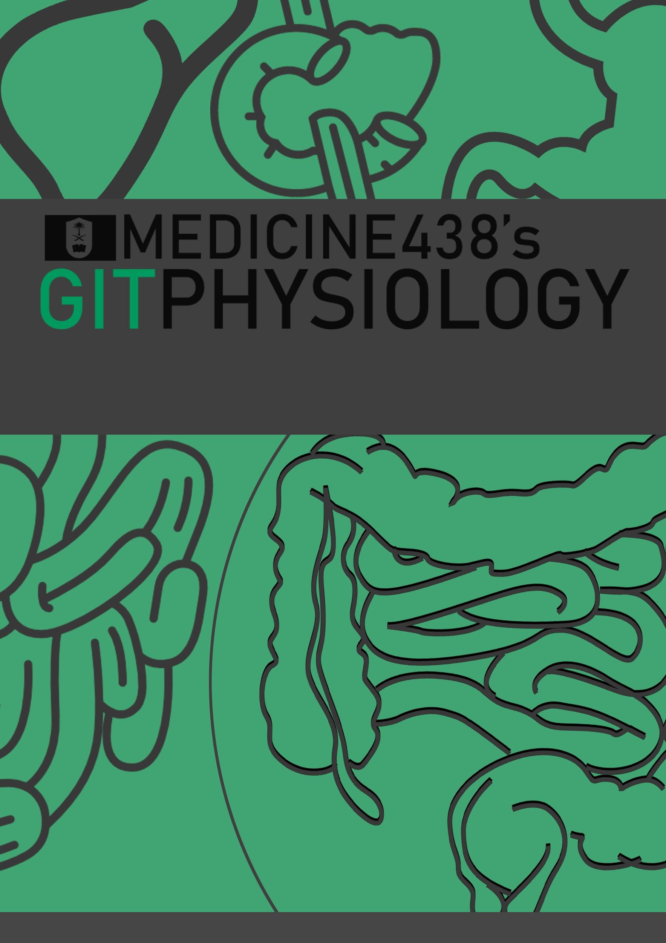
LECTURE XI: Platelets Structure and Functions
EDITING FILE
IMPORTANT
MALE SLIDES
EXTRA
FEMALE SLIDES
LECTURER’S NOTES

Slide 2
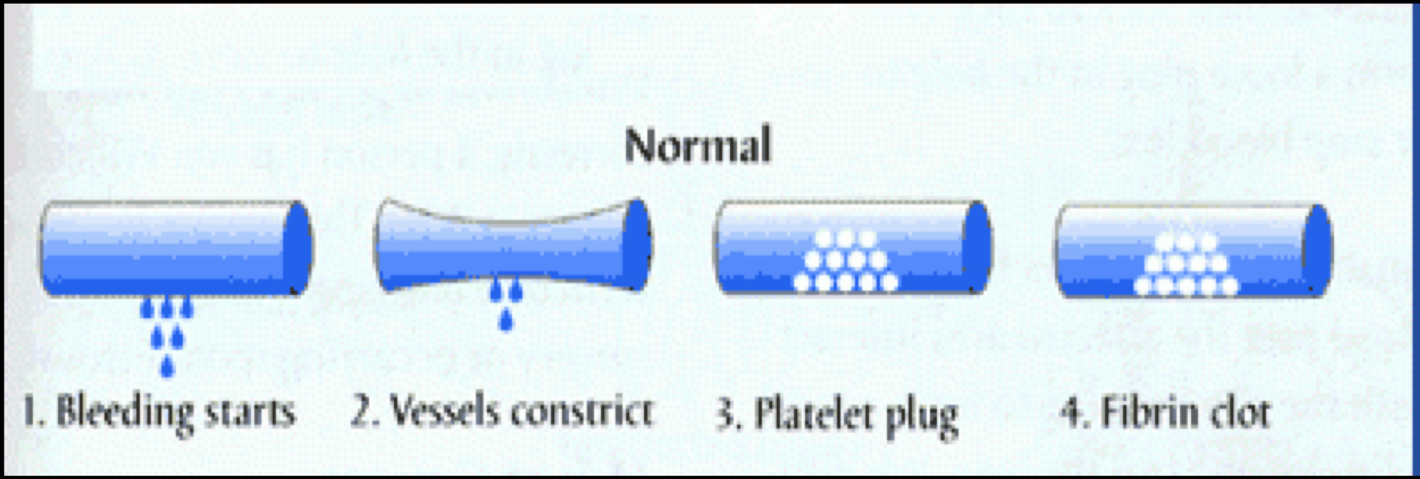
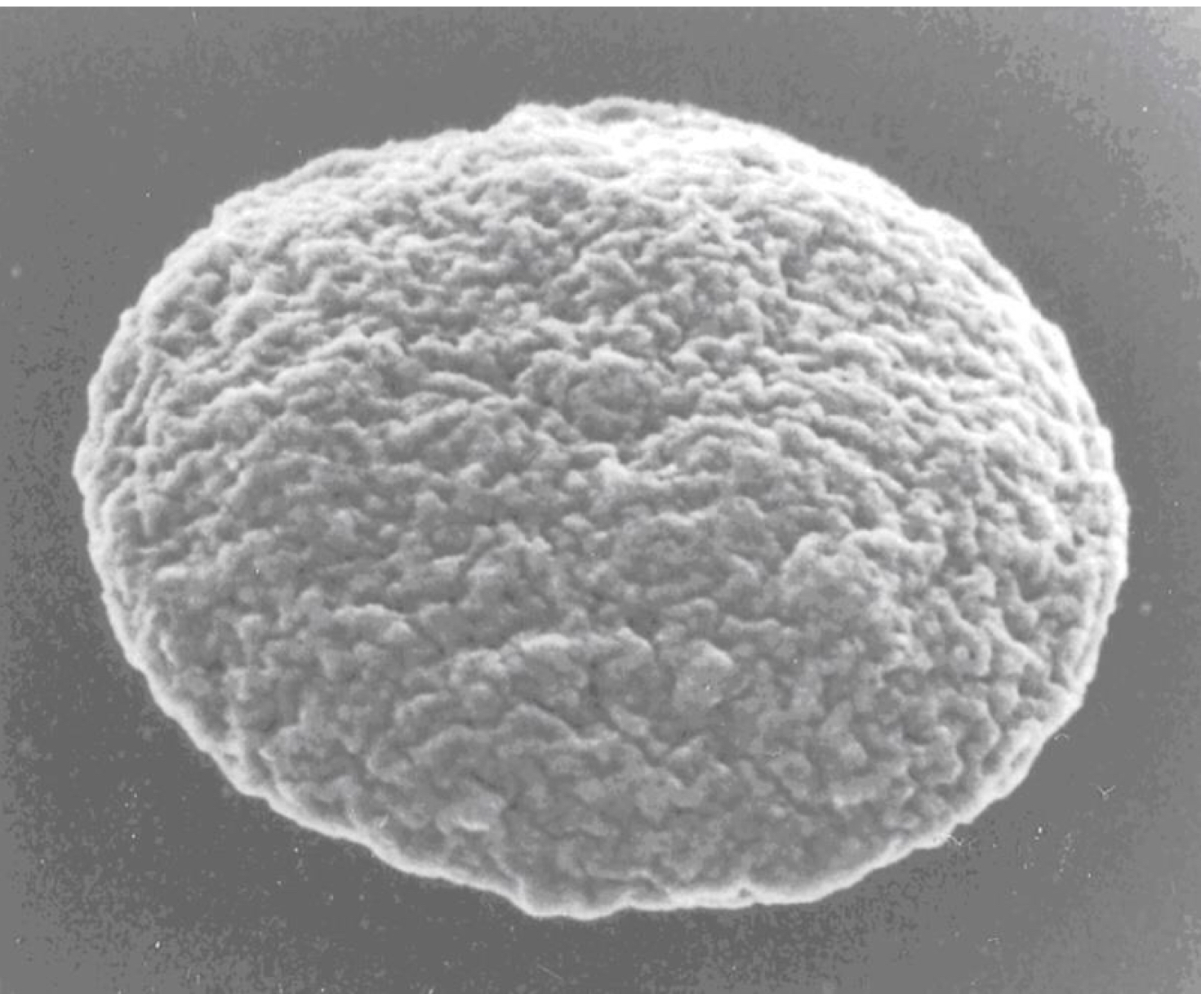
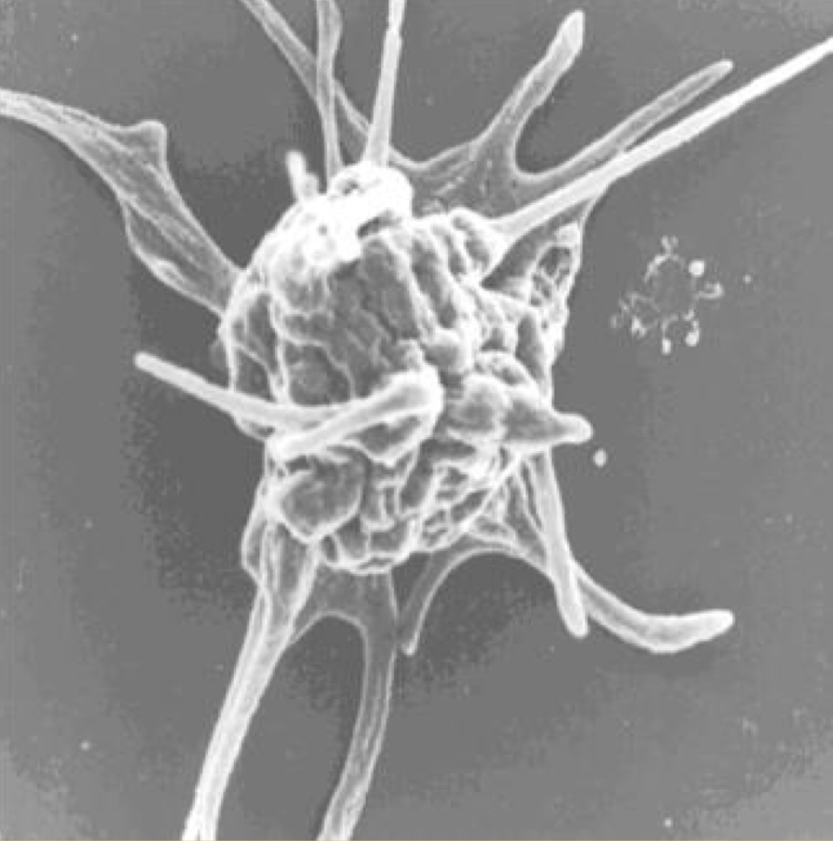
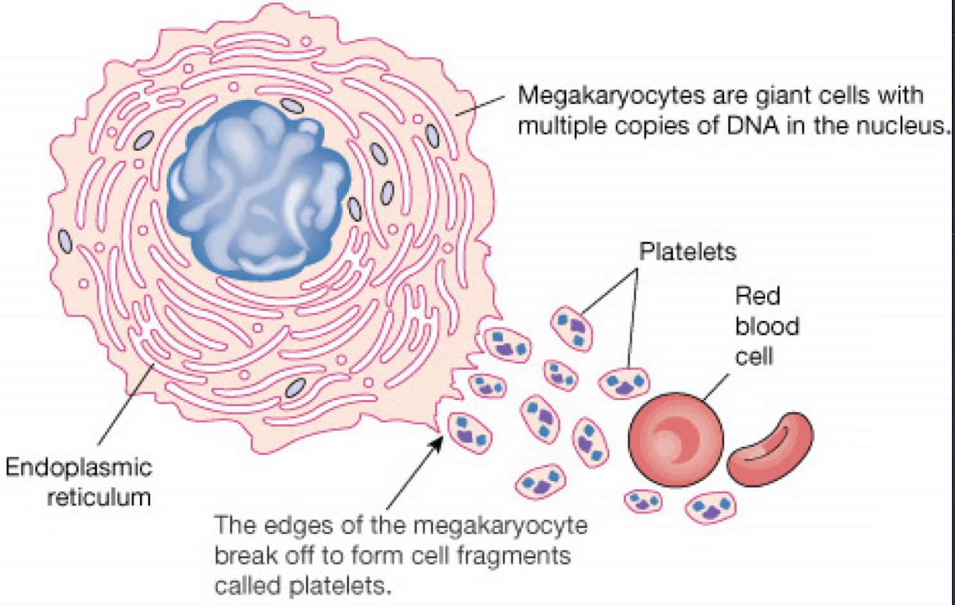
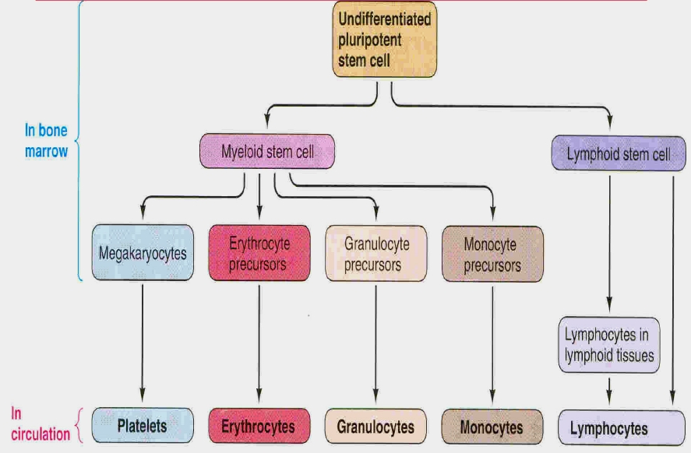
1
PLATELETS STRUCTURE AND FUNCTIONS
Lecture Eleven
OBJECTIVES
Describe formation and development of platelets.
Understand platelet normal ultrastructure.
Understand the functions of different platelets organelles and surface receptors.
Understand the mechanisms of platelet functions.
Relate membrane receptors and granule content to normal function in hemostasis and bleeding (platelet) disorders.
Recall… “HEMOSTASIS”
Vascular phase
Platelet phase
Coagulation phase
Fibrinolysis phase
Figure 11-1
Thrombocytes
Anuclear and discoid cell (oval disc shaped) spherical when activated.
Platelet count = 150,000-300,000/ml.
Size: 1.5–3.0 µm.
Life span: 7–10 days.
Sequestered in the spleen; hypersplenism may lead to low platelet counts.
Location: 80% in the blood, and 20% in the spleen (hypersplenism may lead to low platelet count).
Contractile, adhesive, cell fragments.
Store coagulation factors and enzymes.
Surface binding antigens glycoproteins.
Formation of Platelets
Figure 11-2
Platelets formed by fragmentation of megakaryocytes.
Formed in the bone marrow.
Figure 11-3

Slide 3
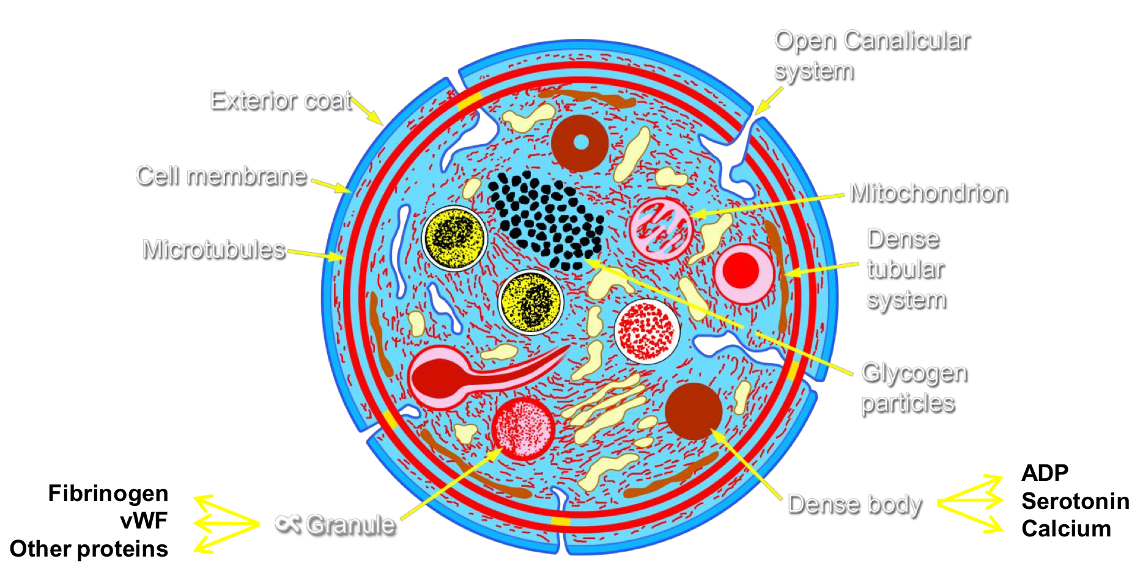
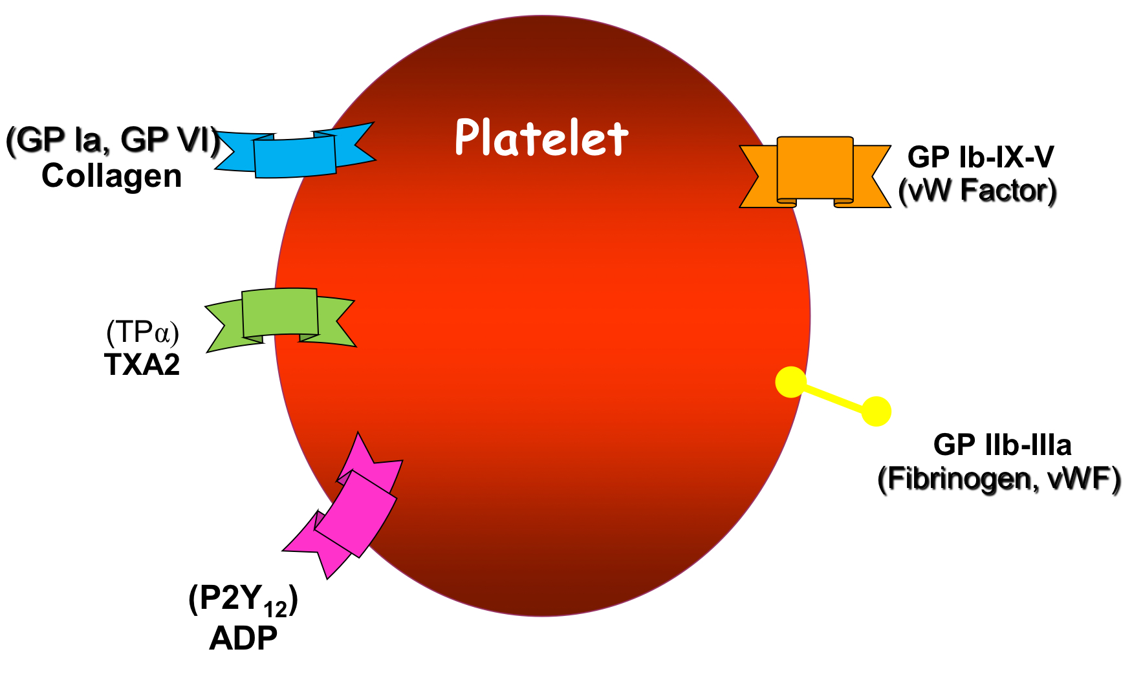
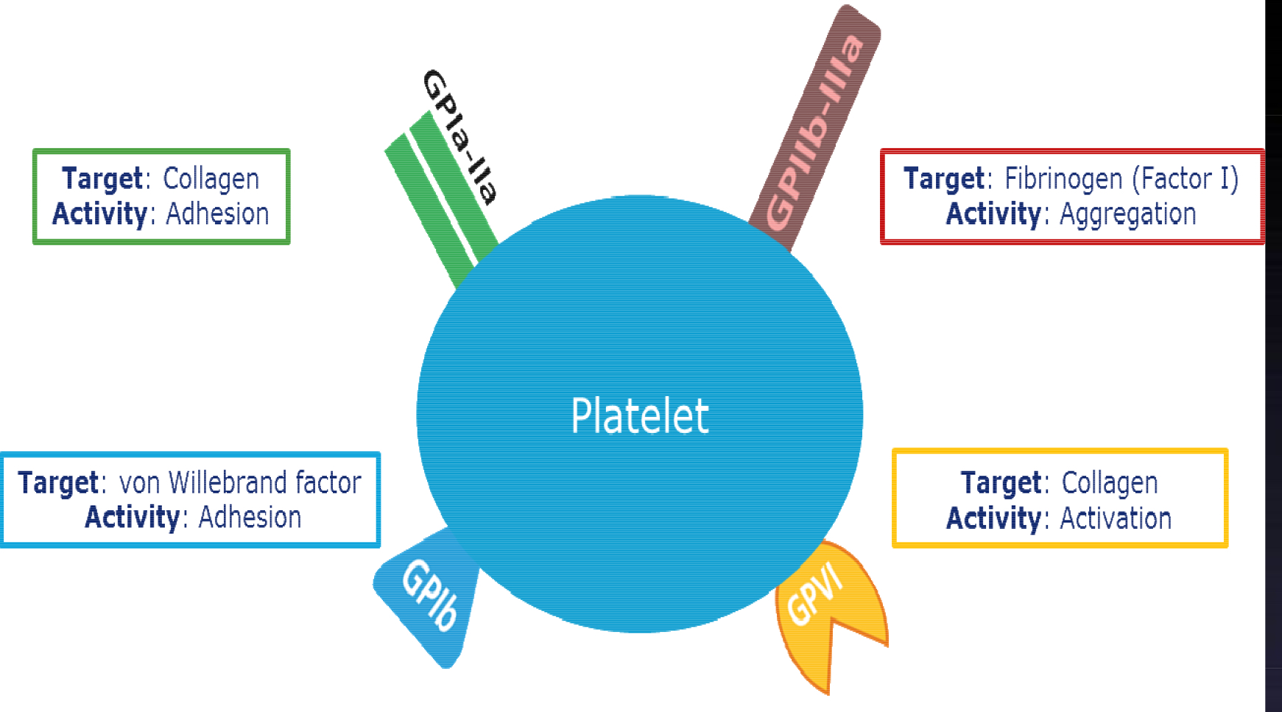
2
PLATELETS STRUCTURE AND FUNCTIONS
Lecture Eleven
Platelet Ultrastructure
Showing presence of:
1-Two types of granules:
A- Alpha Granules, contains:
von Willebrand Factor (vWF)
Fibrinogen
Chemokines (PF4,etc.)
Thrombospondin
P-selectin
Platelet derived growth factor (PDGF)
B- Dense Granules (delta), contains:
ADP/ATP
Calcium
Serotonin
2- Mitochondria
3- Open canalicular system
4- Microtubules
Figure 11-4
Functional Characteristics of Platelets
Motile: Actin and myosin molecules.
Active endoplasmic reticulum, golgi apparatus and mitochondria.
Enzymes system such as for synthesis of prostaglandins.
Granules (alpha and delta).
Platelet Receptors
Glycoprotein Ia and VI receptors for collagen.
Glycoprotein Ib, IX and V receptors for Von willebrand factor.
Glycoprotein IIb and IIIa receptors for Von willebrand factor and Fibrinogen.
TPα receptor for Thromboxane A2.
P2Y₁₂ receptor for ADP.
Figure 11-5
Figure 11-6 Showing the functions of different receptors

Slide 4
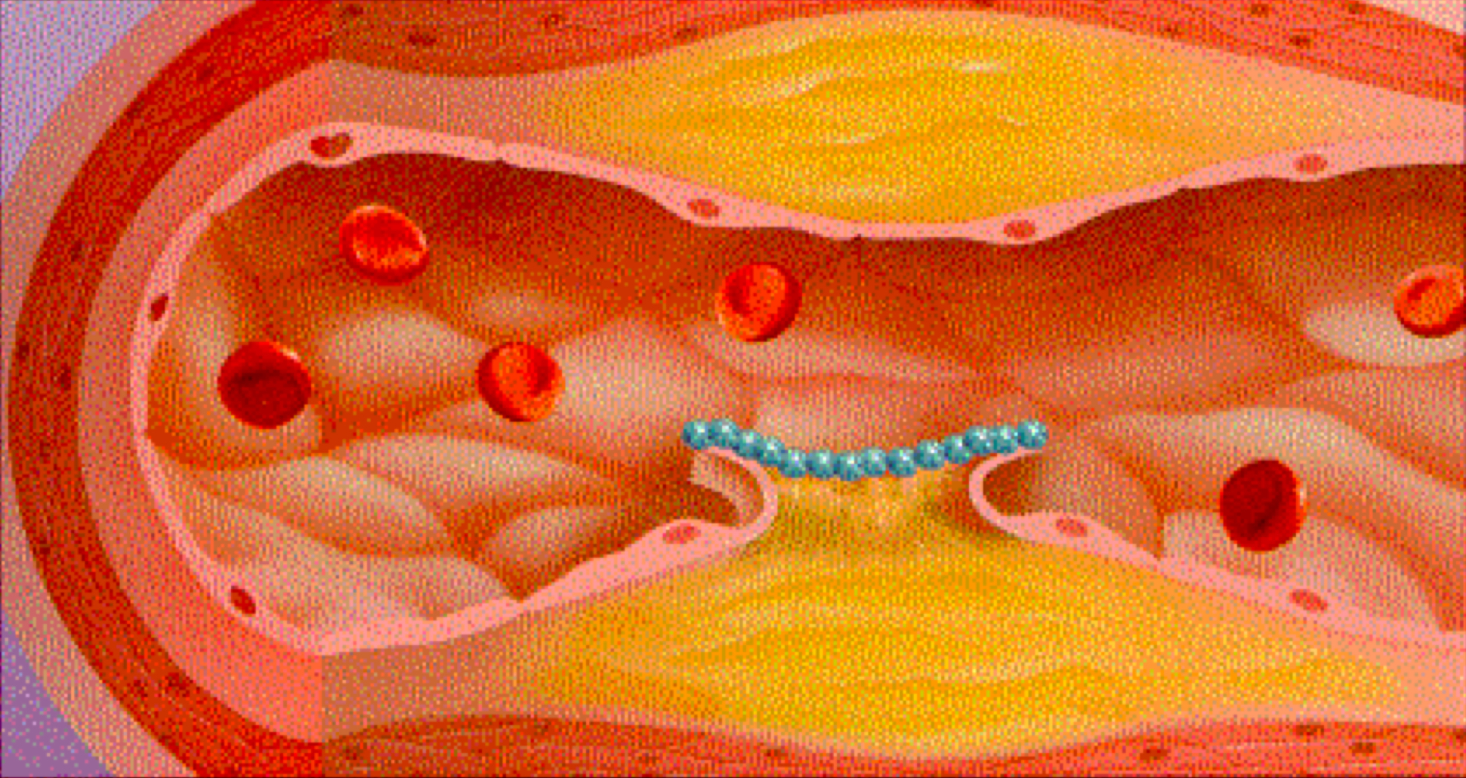
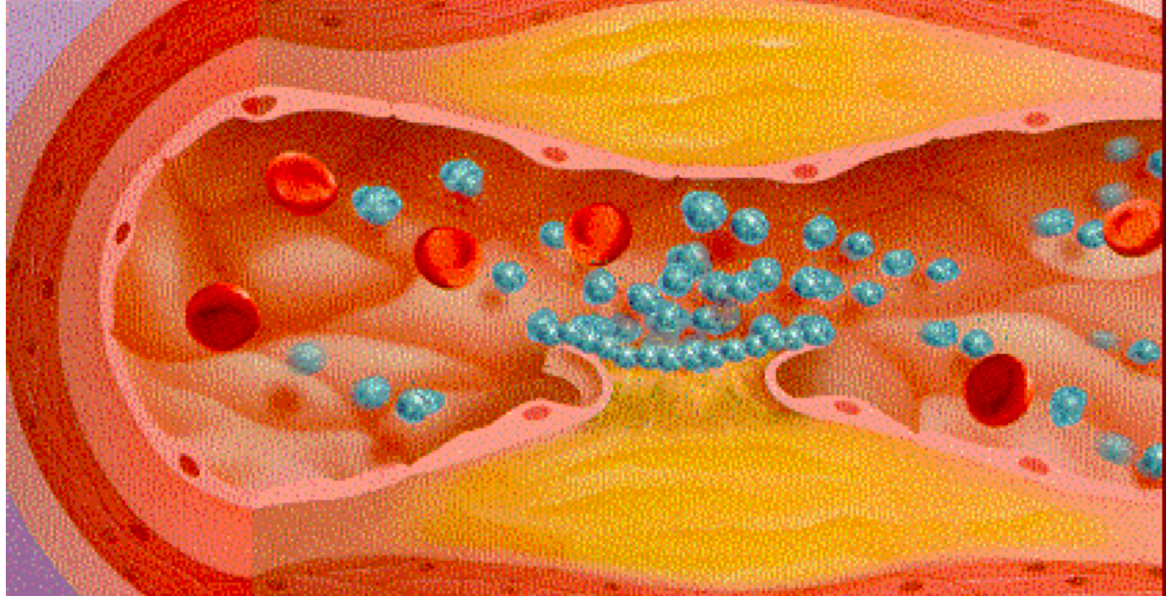
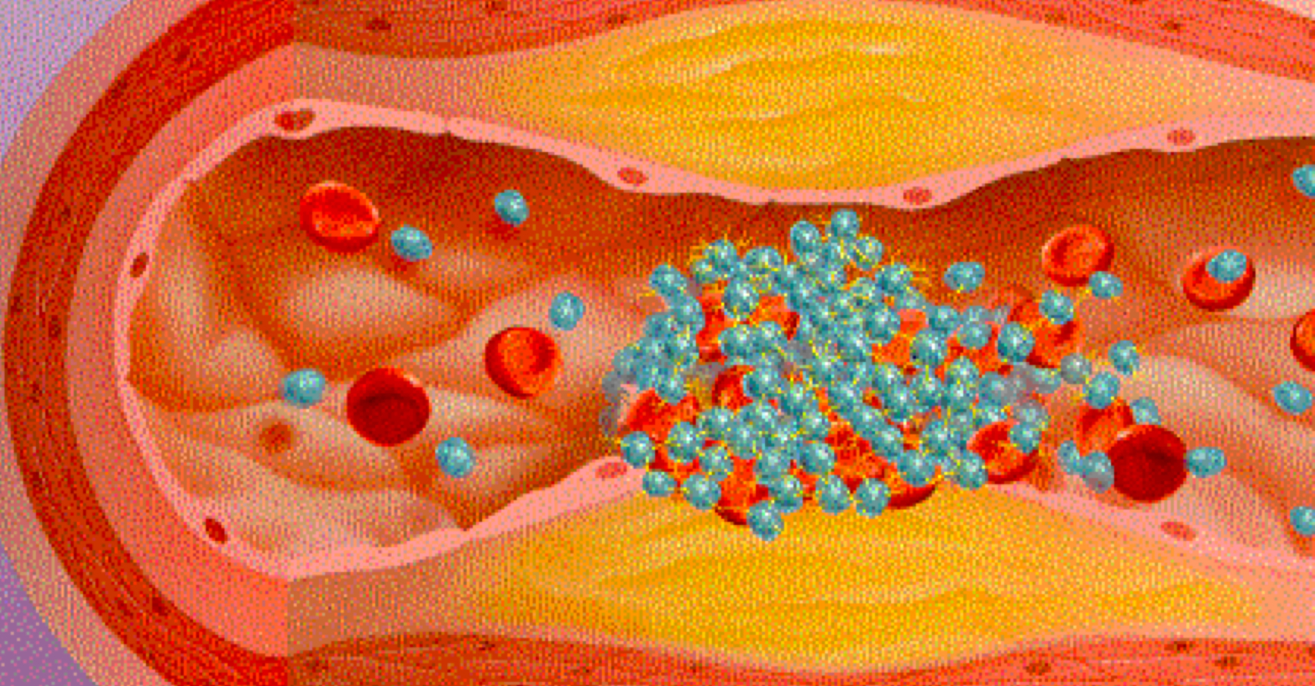
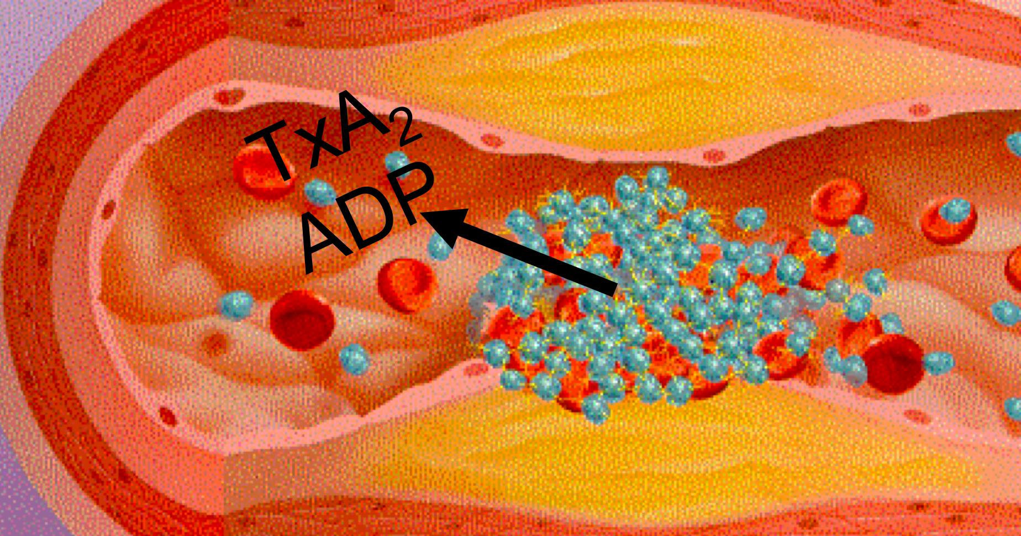
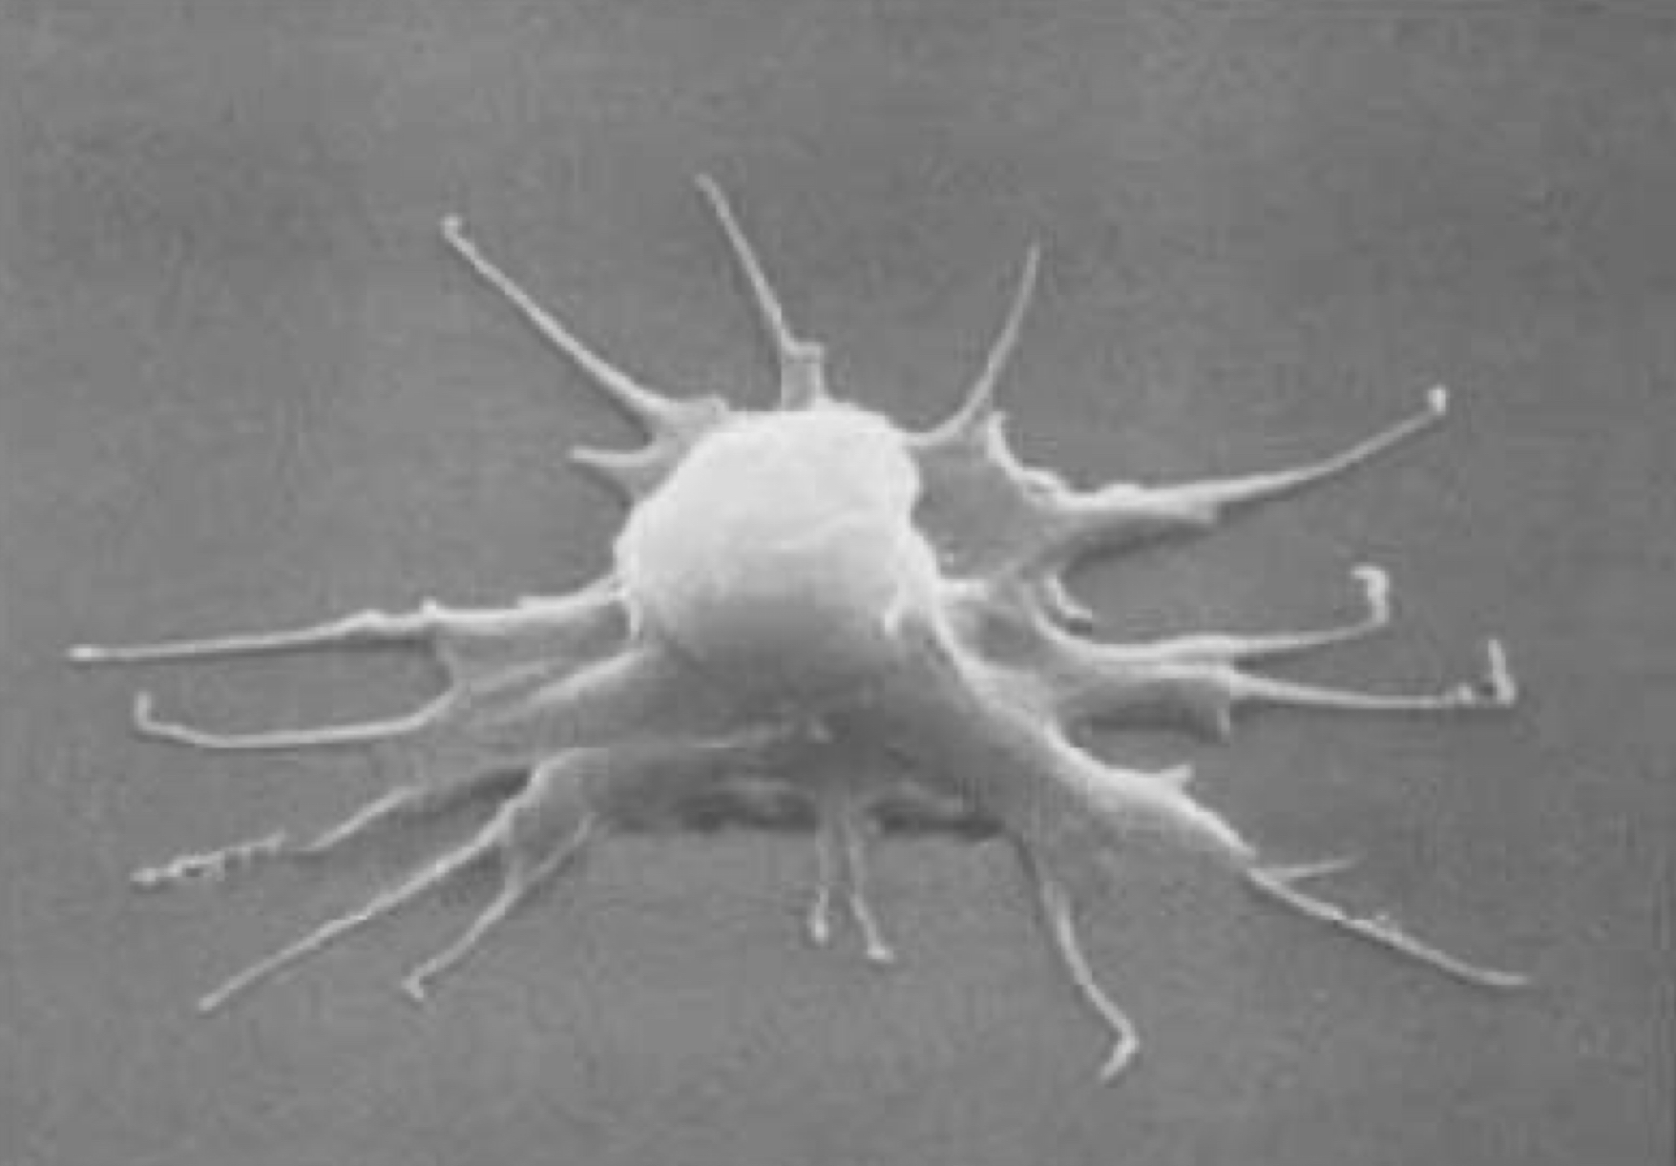
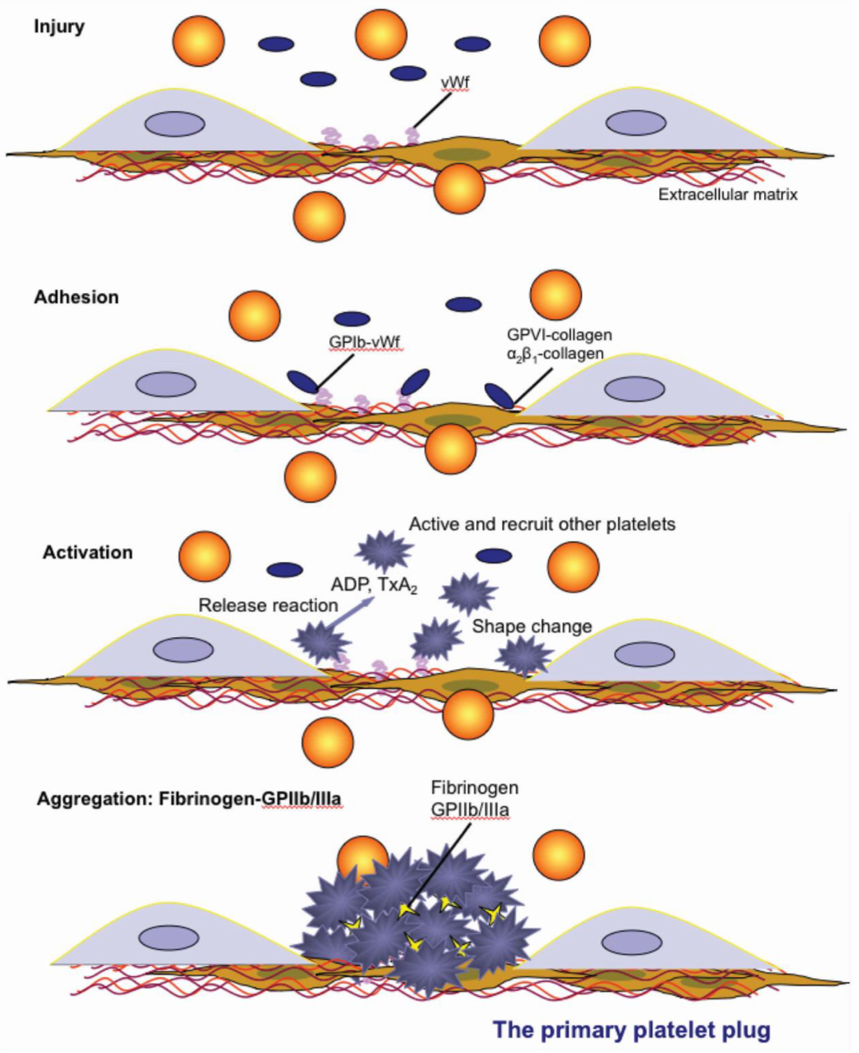
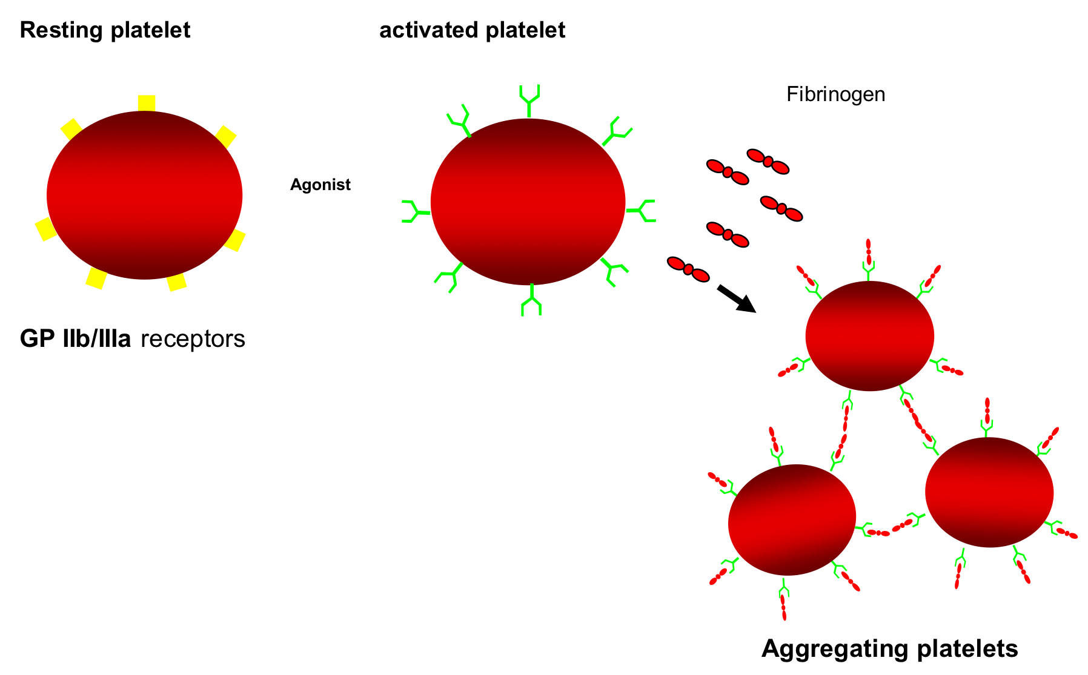
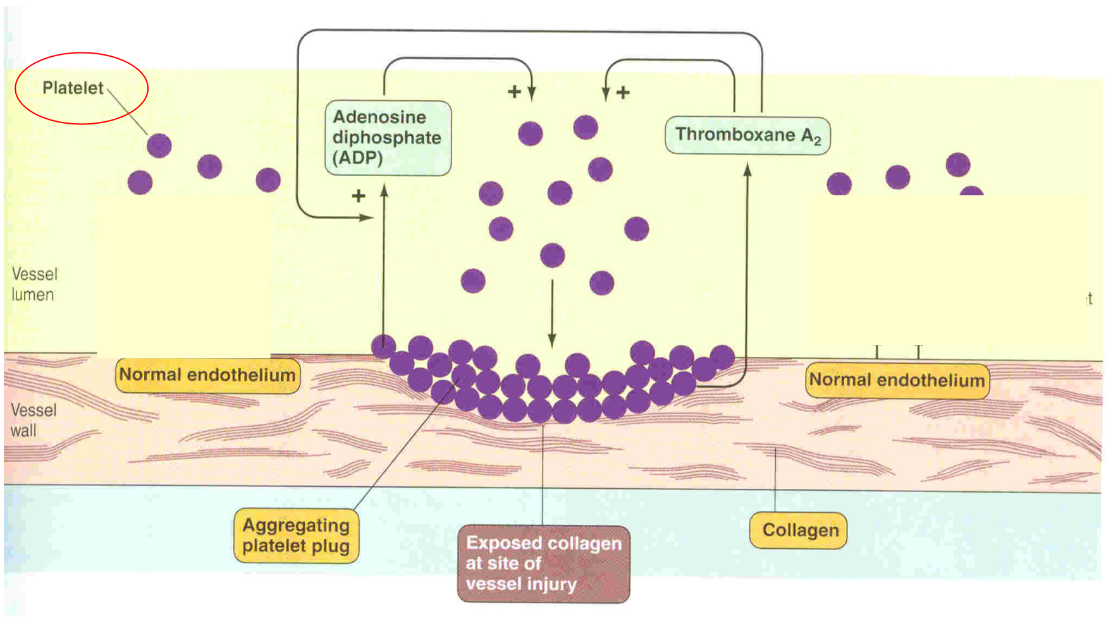
3
PLATELETS STRUCTURE AND FUNCTIONS
Lecture Eleven
Platelet Plug Formation (Activation)
Adhesion
Shape change
(Activation)
Aggregation
Release reaction
Clot retraction
Platelet Haemostatic Plug Formation
Platelets activated by adhesion.
Extend projections to make contact with each other.
Release:
Thromboxane A2, serotonin & ADP >>> activating other platelets.
Serotonin & thromboxane A2 are vasoconstrictors
decreasing blood flow through the injured vessel.
ADP causes stickiness and enhances aggregation.
Figure 11-7
Platelet Aggregation
Fibrinogen is needed to join platelets to each other via platelet fibrinogen receptors.
Figure 11-8
Normal endothelium secrete:
Prostacyclin.
ADP Phosphatase.
NO.
TO PREVENT PLATELETS AGGREGATION
Figure 11-9

Slide 5
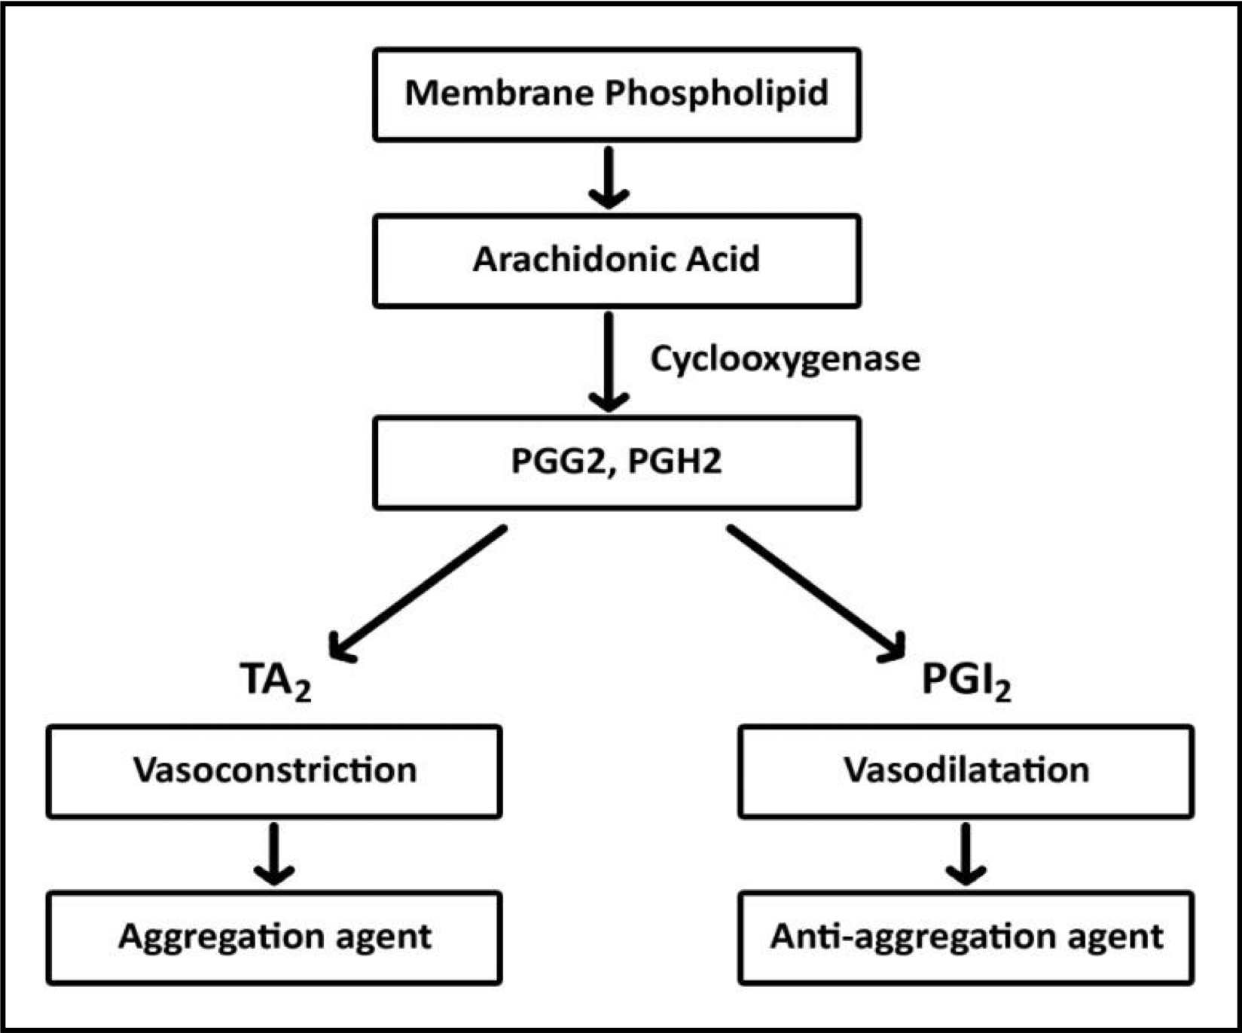
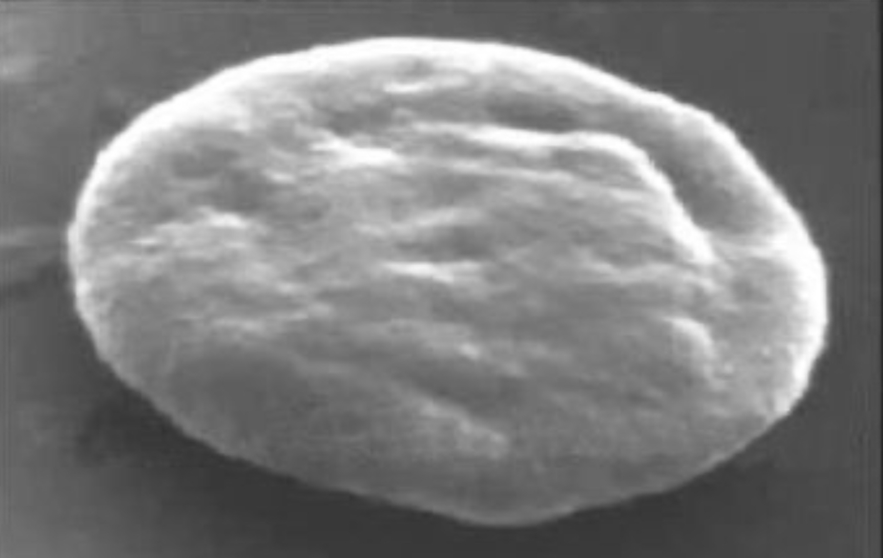
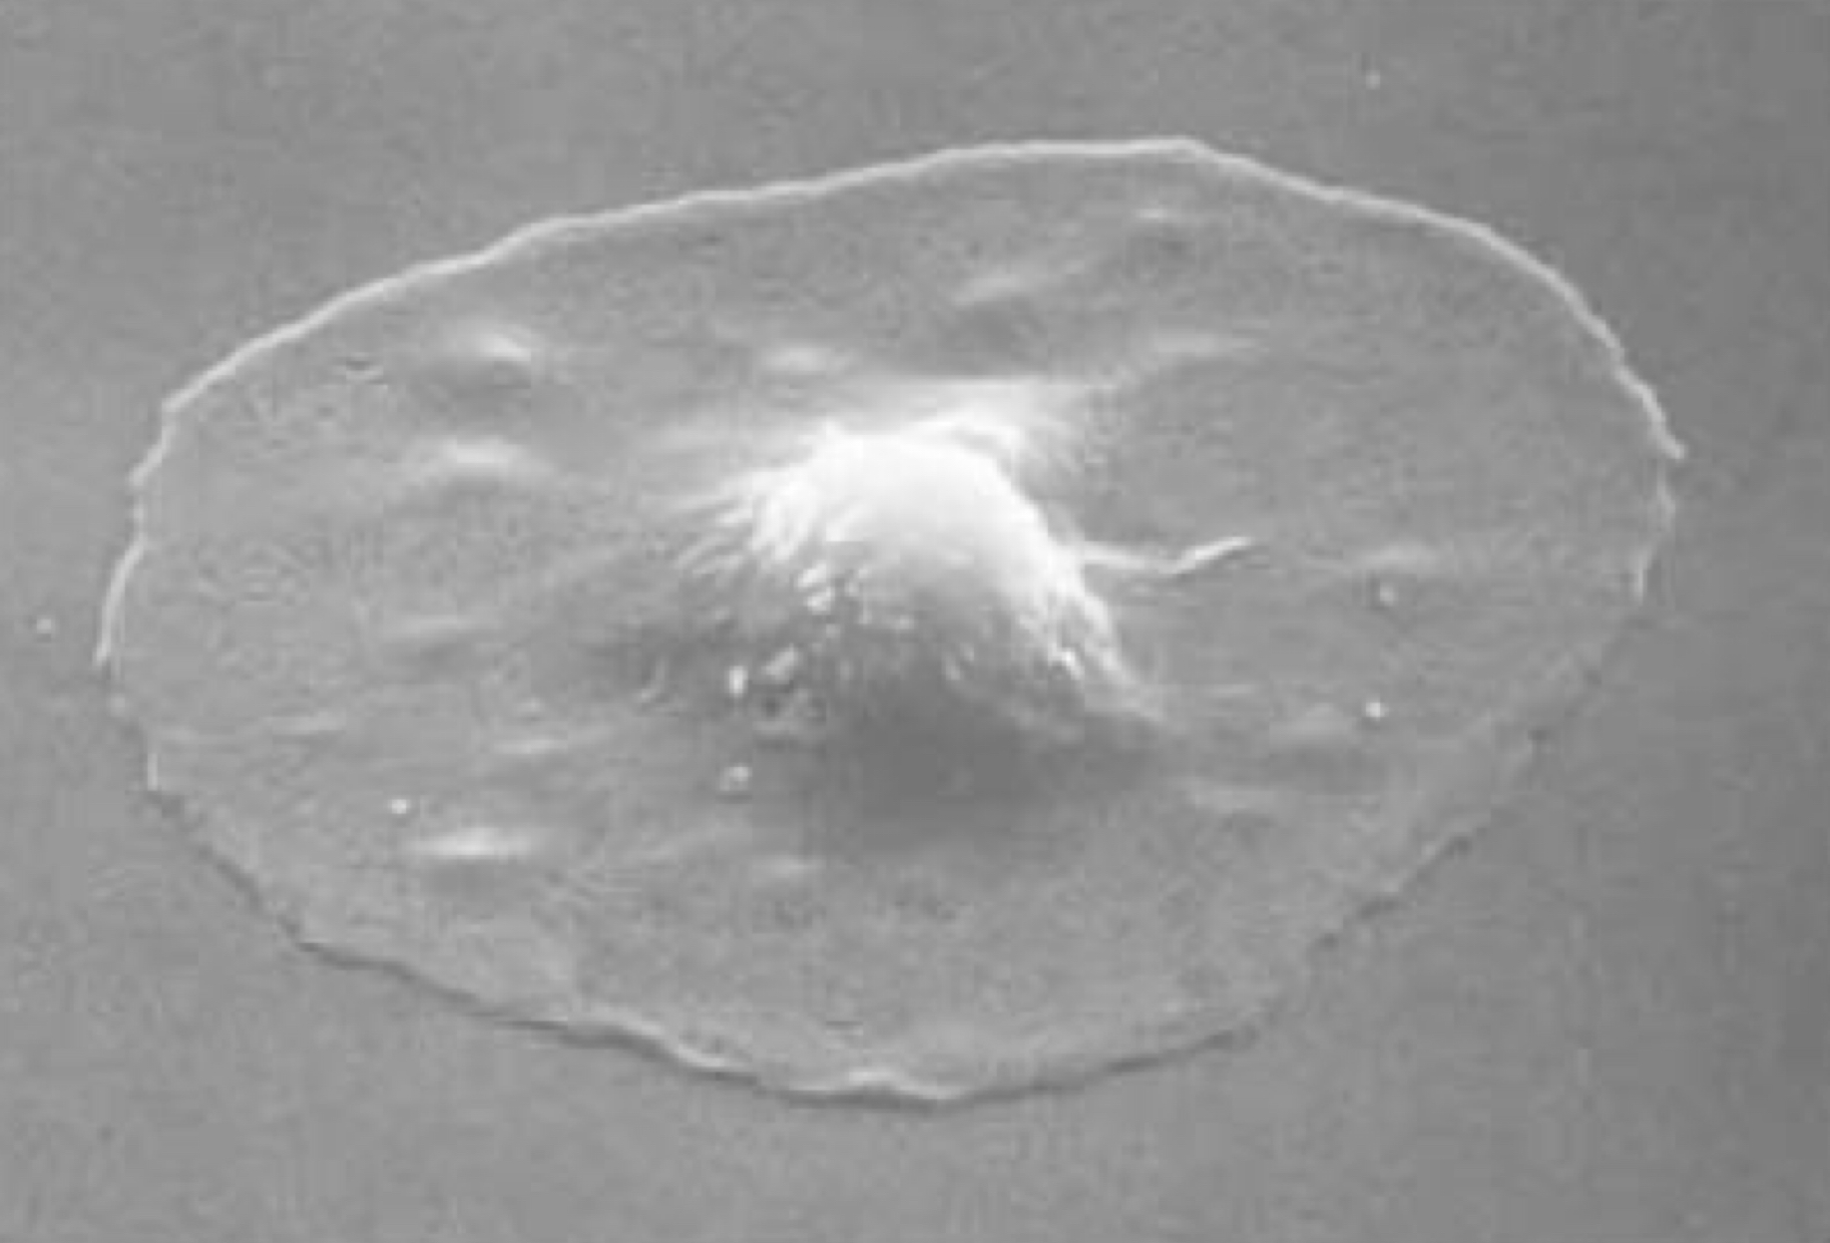
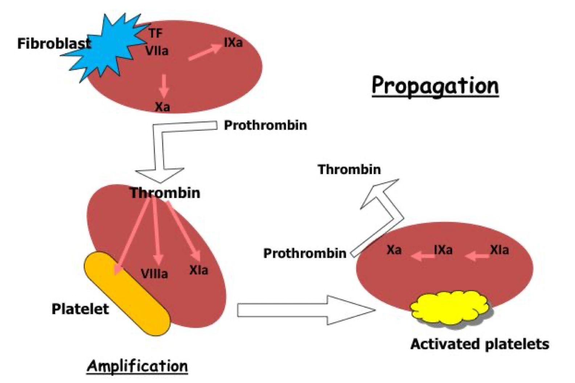
4
PLATELETS STRUCTURE AND FUNCTIONS
Lecture Eleven
Release Reaction of the Platelets
Activated Platelets Secrete:
1. ADP
2. 5HT (vasoconstriction)
3. Platelet phospholipid (PF3) (clot formation)
4. Thromboxane A2 (TXA2)
is a prostaglandin formed from arachidonic acid, function:
- Vasoconstriction. - Platelet aggregation.
(TXA2 inhibited by aspirin)
Figure 11-10
Platelet Retraction
Myosin and actin filaments in platelets are stimulated to contract during aggregation further reinforcing the plug and help release of granule contents.
When clot retracts (contract), it expresses most of the fluid from the clot within 20-60 min called: serum.
Serum cannot clot.
Figure 11-11
Role of Platelet in Blood Coagulation
(The cell based model of blood coagulation)
Role of platelets in clot formation and retraction: They are contractile.
Fate of clot
Lysis or fibrous tissue formation
(Platelet derived growth factor)
Figure 11-12

Slide 6
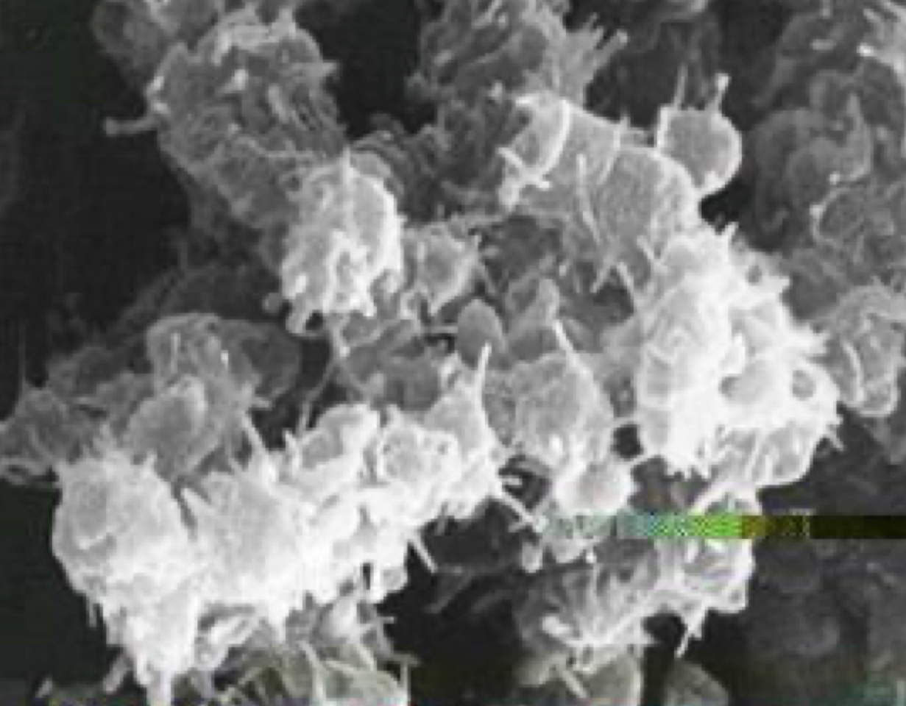
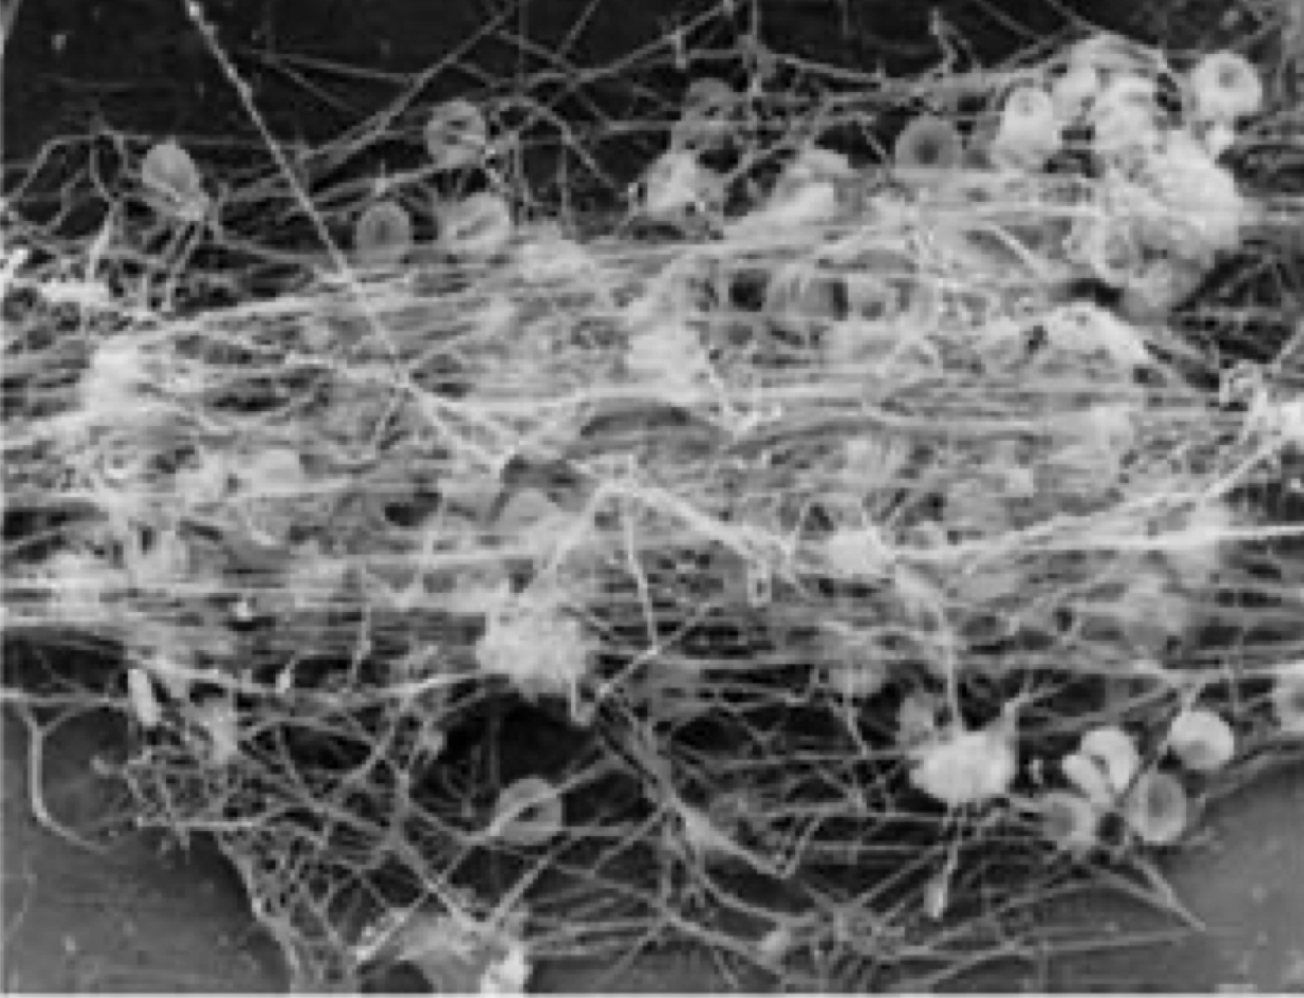
5
PLATELETS STRUCTURE AND FUNCTIONS
Lecture Eleven
Platelet Function: Maintenance of Vascular Integrity
1- Initial arrest of bleeding by platelet plug formation
2- Stabilization of hemostatic plug by contributing to fibrin formation
An adequate number and function of platelets is essential
to participate optimally in hemostasis.
Summary of Platelet Activation:
Platelets are activated when brought into contact with collagen exposed when the endothelial blood vessel lining is damaged.
Activated platelets release a number of different coagulation and platelet activating factors.
Transport of negatively charged phospholipids to the platelet surface; provide a catalytic surface for coagulation cascade to occur.
Platelets adhesion receptors (integrins): Platelets adhere to each other via adhesion receptors forming a hemostatic plug with fibrin.
Myosin and actin filaments in platelets are stimulated to contract during aggregation further reinforcing the plug and help release of granule contents.
GPIIb/IIIa: the most common platelet adhesion receptor for fibrinogen and von Willebrand factor (vWF).

Slide 7
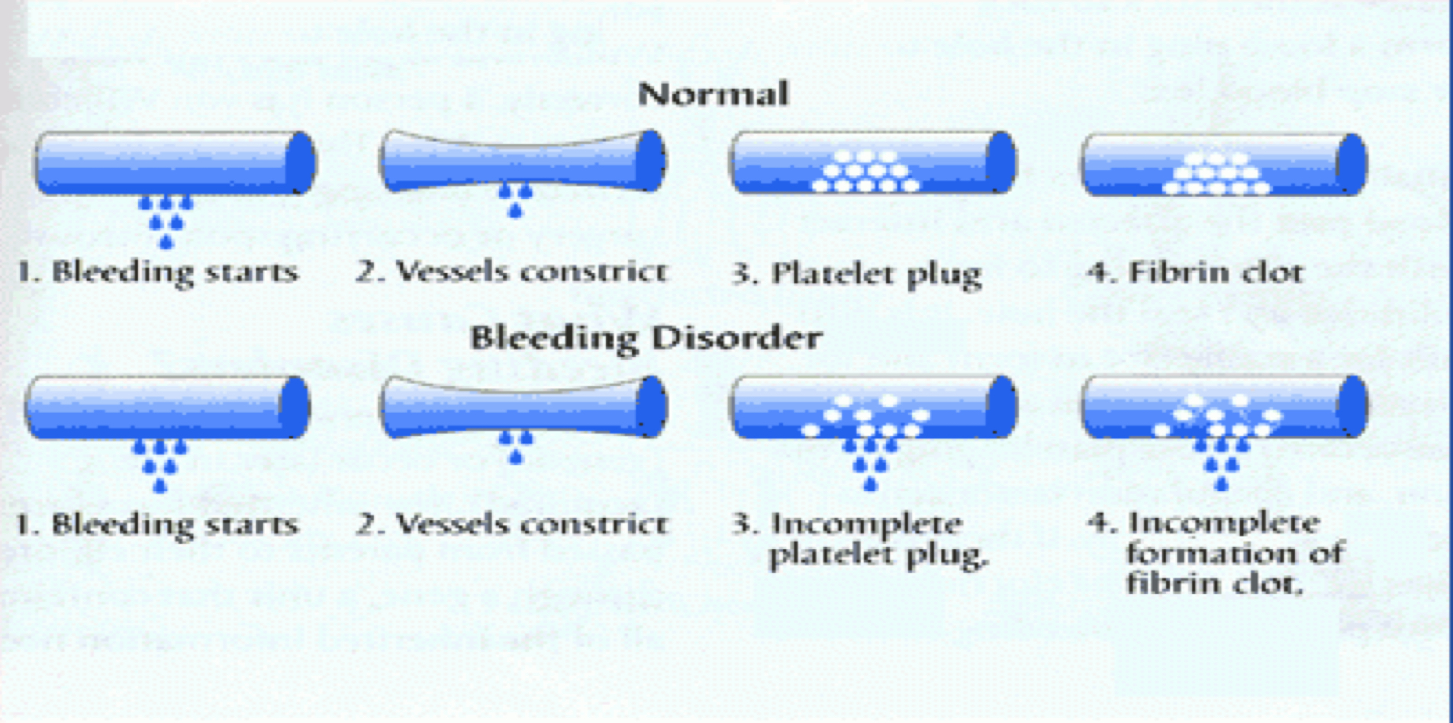
6
PLATELETS STRUCTURE AND FUNCTIONS
Lecture Eleven
Bleeding Disorders
Bleeding can result from:
Deficiency in number (thrombocytopenia).
Count < 50,000 ul may cause spontaneous bleeding.
Less than 10,000 (Fatal).
Defect in function.
Liver diseases & Vitamin-K deficiency.
Figure 11-13
1- Thrombocytopenia
1- Decreased Production
2- Increased destruction
Leukemia or lymphoma Cancer treatments such as radiation or chemotherapy Various anemias (Aplastic anemia) Toxic chemicals Medications: diuretics, chloramphenicol Infections (Viruses): chickenpox, mumps, Epstein-Barr, parvovirus, AIDS HIV, Measles Alcohol in excess Genetic conditions: Wiskott-Aldrich, May-Hegglin.
Autoimmune diseases: Idiopathic (immune) thrombocytopenic purpura Medications: quinine, antibiotics containing sulfa, Dilantin, vancomycin, rifampin, heparin-induced thrombocytopenia. Surgery: man-made heart valves, blood vessel grafts, bypass machines Infection: septicemia, HIV Pregnancy: about 5% of pregnant women develop mild decrease Thrombotic thrombocytopenic purpura
3- Abnormal distribution
4-Pseudothrombocytopenia
Splenomegaly with sequestration in the spleen
Partial clotting of specimen EDTA-platelet clumping Platelet satellitism around WBCs Cold agglutinins Giant platelets
Platelet count decreased
Bleeding time increased
Rx of the underlying cause
platelet concentrates
Fresh whole blood transfusion
Splenectomy
Easy bruisability
Epistaxis
Gum bleeding
Hemorrhage after minor trauma
Petechiae/Ecchymosis
Diagnosis
Clinical Features
Treatment
Physiological Factors Affecting Platelet Count
Increase in injury.
Increase with adrenaline.
Increase with hypoxia.
Age: decrease in newborn.
Menstrual cycle: decrease prior menstruation and increase after it.
Decrease in pregnancy.
Decrease with smoking.
Decrease with nutritional deficiencies. Eg: vitamin B12, folic acid and iron.

Slide 8
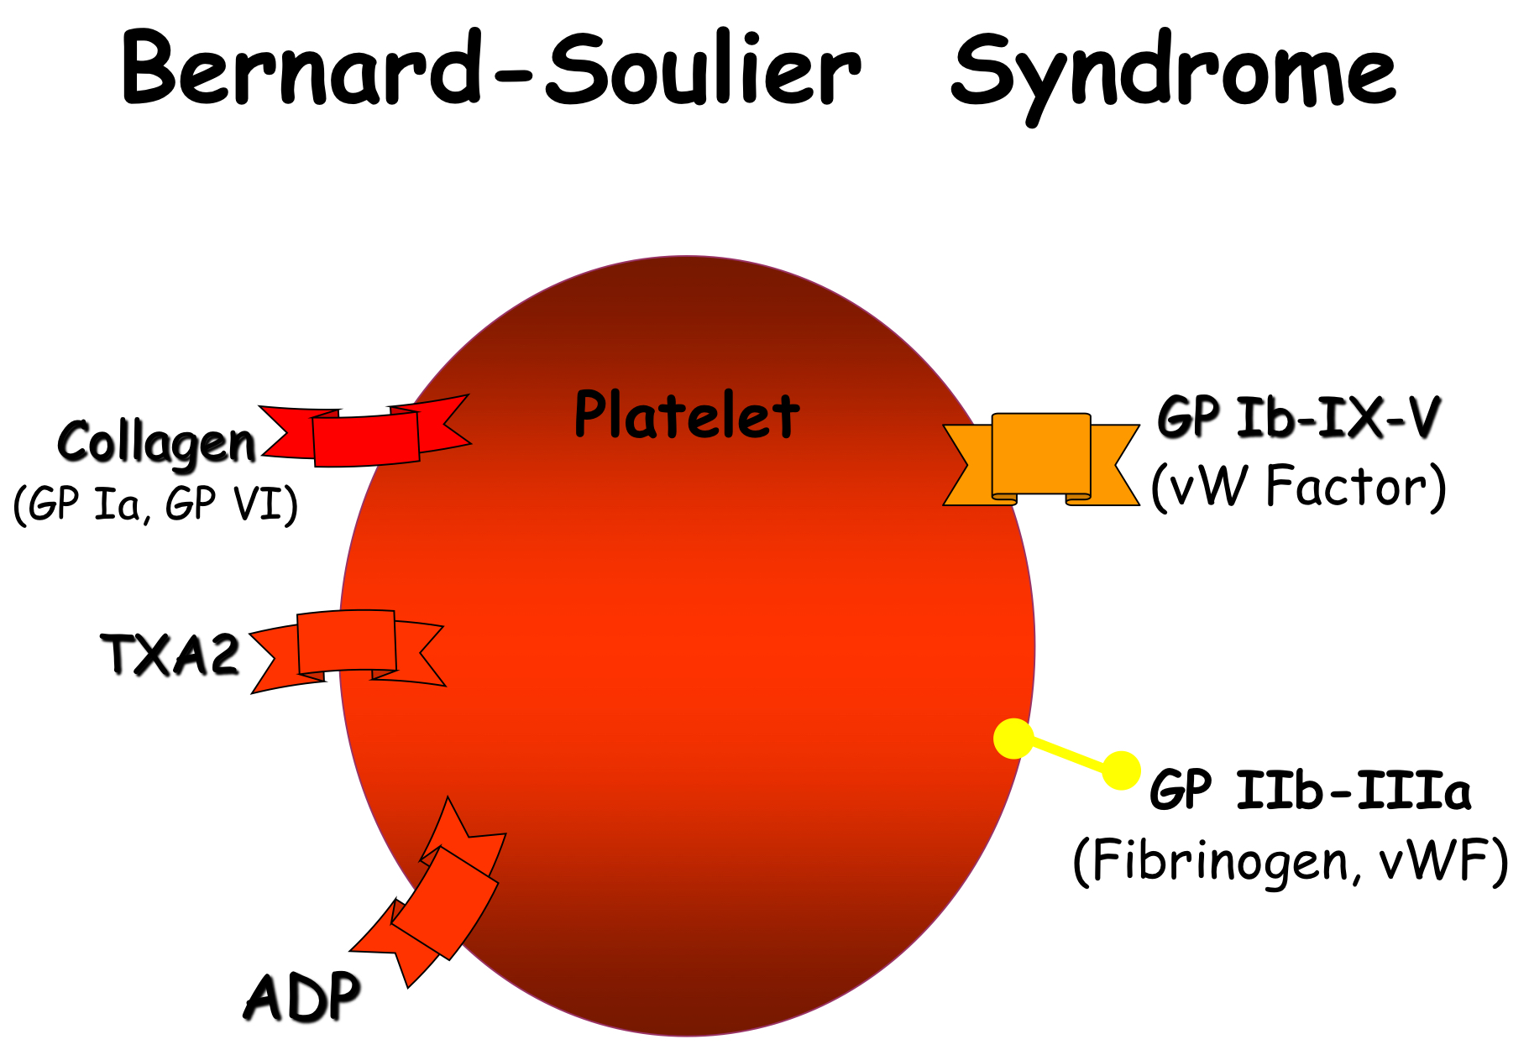
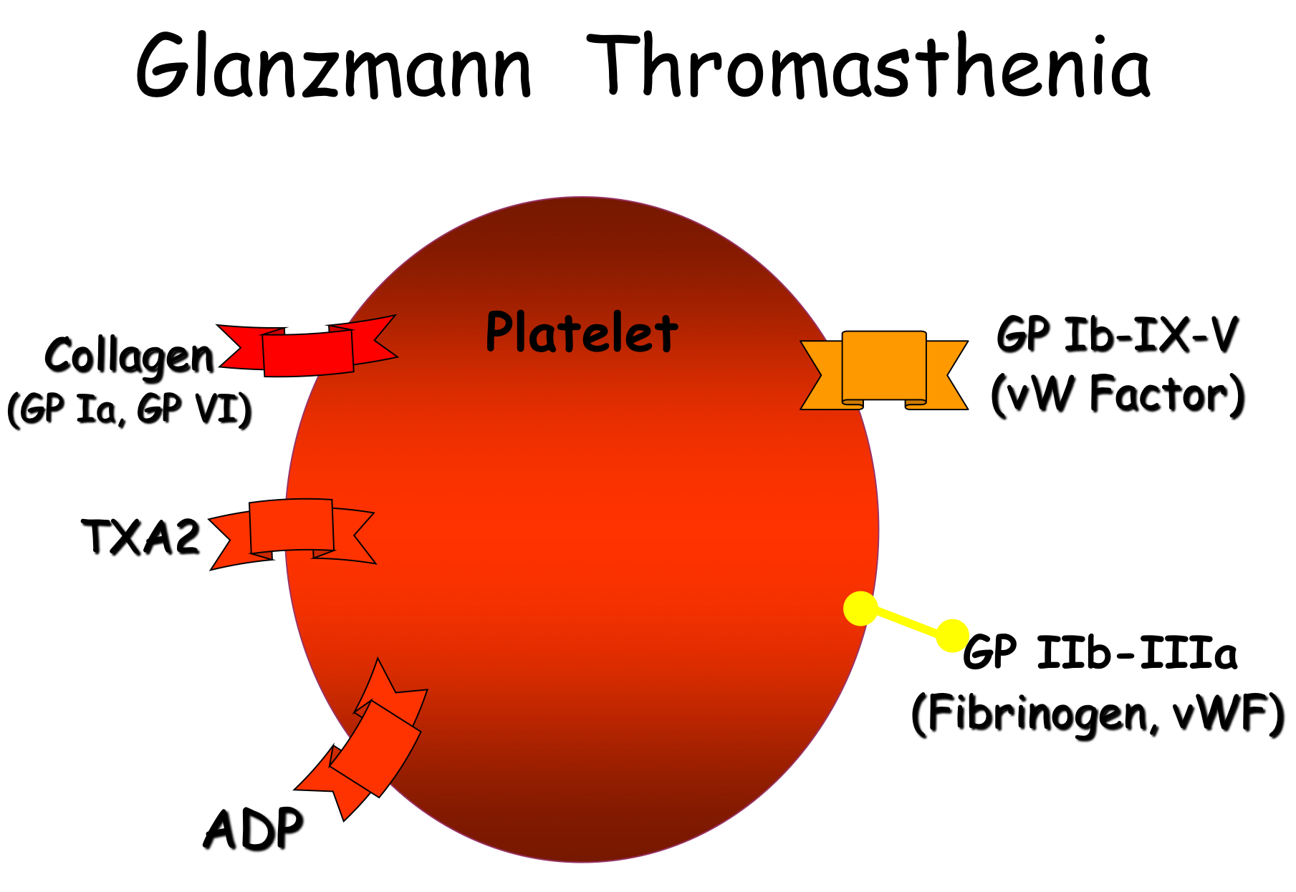
7
PLATELETS STRUCTURE AND FUNCTIONS
Lecture Eleven
2- Congenital Platelet Disorders
Recall… (Platelets activation:
Adhesion
Shape change
Aggregation
Release
Clot Retraction
1- Disorders of Adhesion:
2- Disorder of Aggregation:
Bernard-Soulier
Glanzmann thrombasthenia
Figure 11-14
In Bernard-Soulier Syndrome, there is deficiency of vW factor receptors causing defects in adhesion.
Figure 11-15
In Glanzmann Thrombasthenia, there is deficiency of fibrinogen receptors causing defects in aggregation.
3- Disorders of Granules:
4- Disorders of Production:
Grey Platelet Syndrome. (α granule deficiency) Storage Pool deficiency. Hermansky-Pudlak syndrome . Chediak-Higashi syndrome.
Congenital amegakaryocytic thrombocytopenia. MYH9 related disorders. Thrombocytopenia with absent radii (TAR). Paris-Trousseau/Jacobsen.
5- Disorders of Primary Secretion:
6- Disorders of Cytoskeleton:
Receptor defects (TXA2, collagen ADP, epinephrine)
Wiskott-Aldrich syndrome
3- Liver Diseases & Vitamin-K Deficiency
Hepatitis & Cirrhosis: Decreased formation of clotting factors and Increased clotting time.
Vitamin K dependent factors: Factors II, VII, IX & X.
Vitamin-K is a fat soluble vitamin. It’s required by liver for formation of four clotting factor: II, VII, XI and X.
Sources: Diet, Synthesized in the intestinal tract by bacteria.
Deficiency is caused by Malabsorption syndromes, Biliary obstruction, Broad spectrum antibiotics, Dietary deficiency (in Neonates).
Treat the underlying cause → Vit K injections

Slide 9
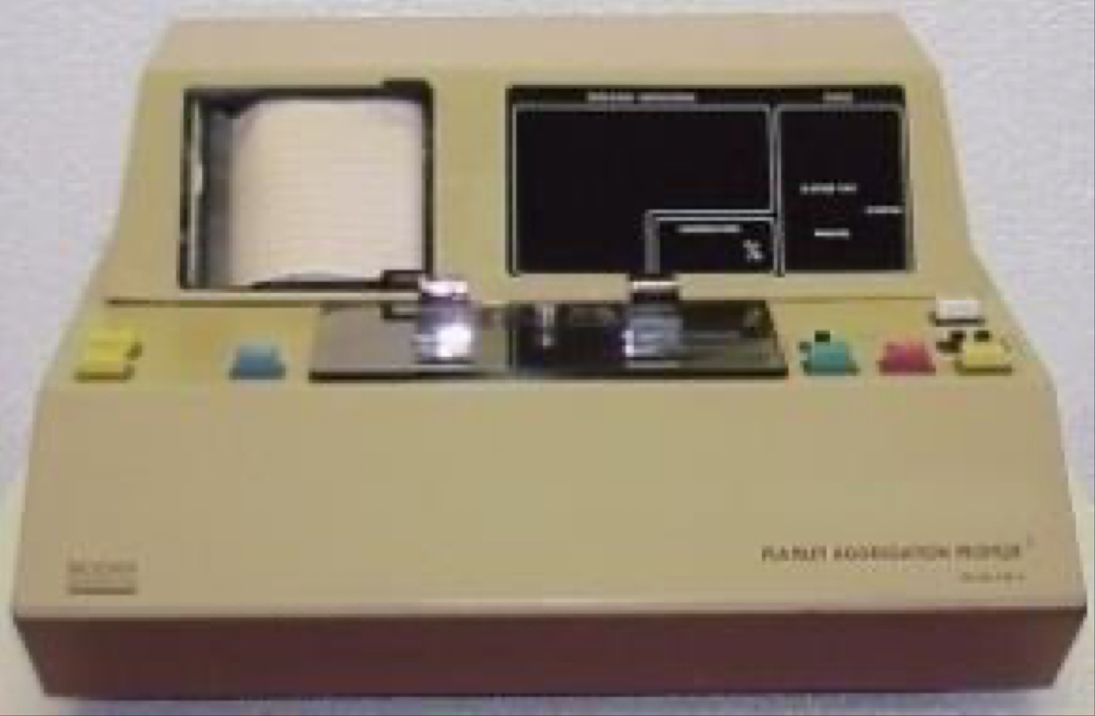
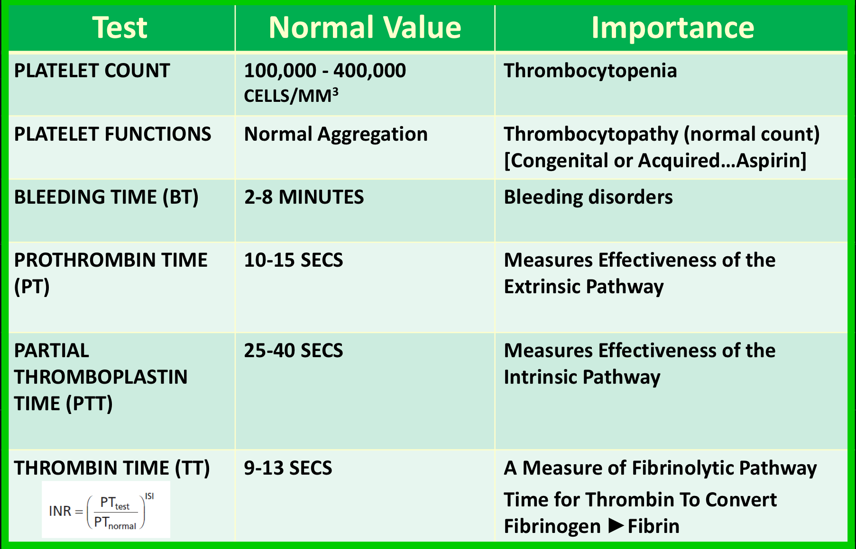
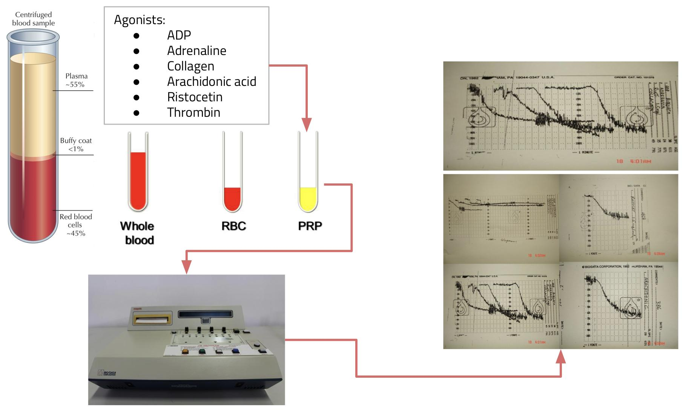
8
PLATELETS STRUCTURE AND FUNCTIONS
Lecture Eleven
Laboratory Testing of Platelet Functions
Peripheral smear and platelet count (& shape)
Electron-microscopy
Bleeding time (Duke method)
Platelet Aggregation
Platelet Function Analyzer (PFA-100)
Flow-cytometry
Granule release products
Figure 11-16 Bleeding time test
Figure 11-17
Platelet Aggregometry
Significance of lab tests
Platelet Aggregation in Platelet Rich Plasma (PRP):
It provides information on time course of platelets activation.
Agonists:
ADP
Adrenaline
Collagen
Arachidonic acid
Ristocetin
Thrombin
Figure 11-18
(Reference ranges need to be determined for each agonist)

Slide 10
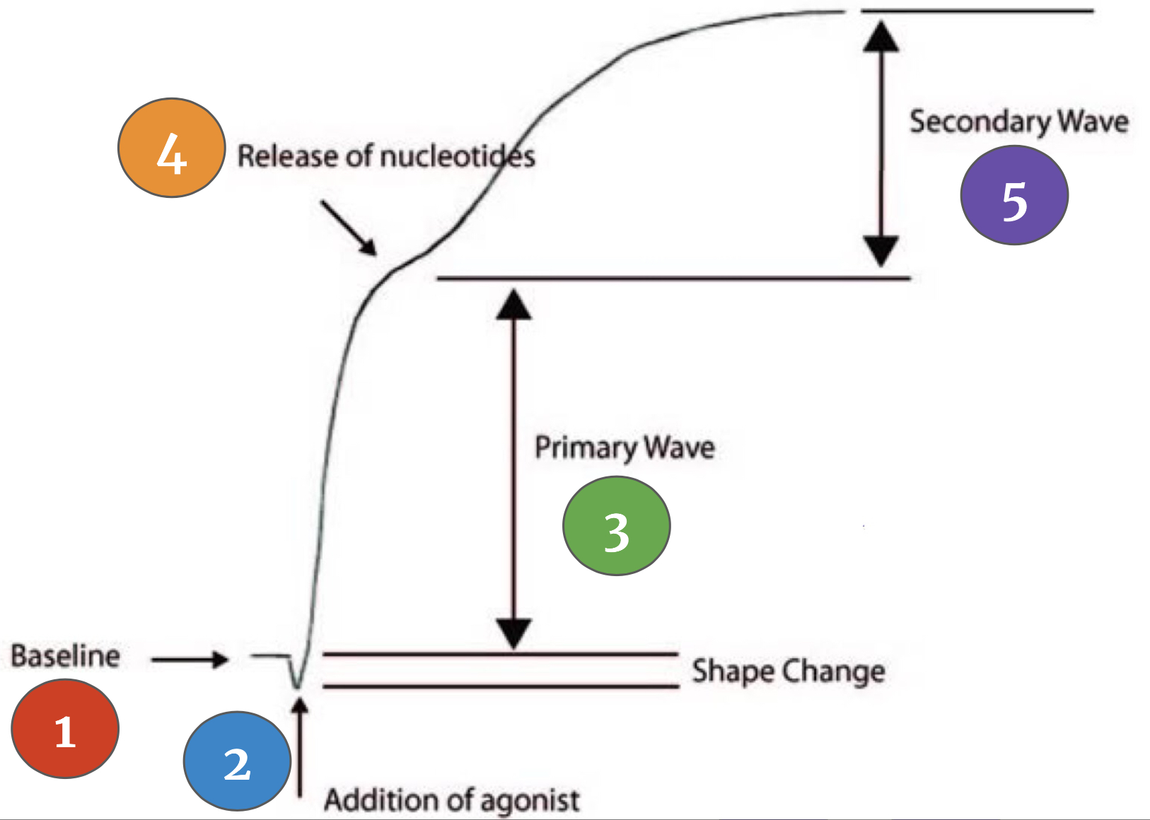
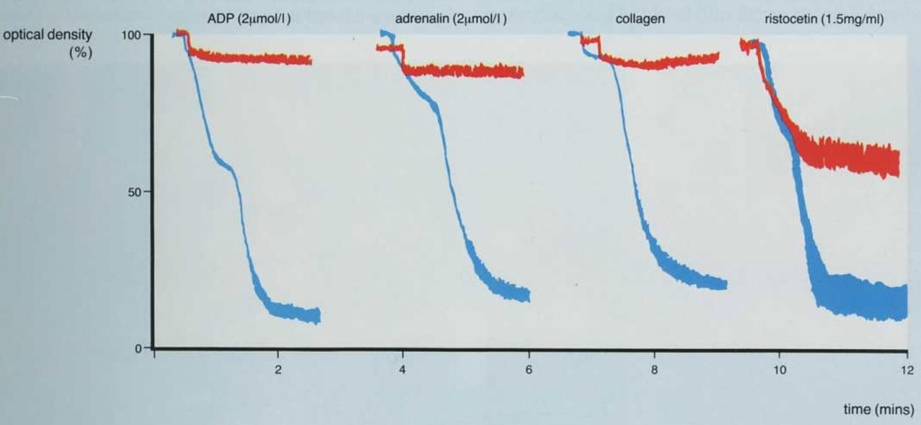
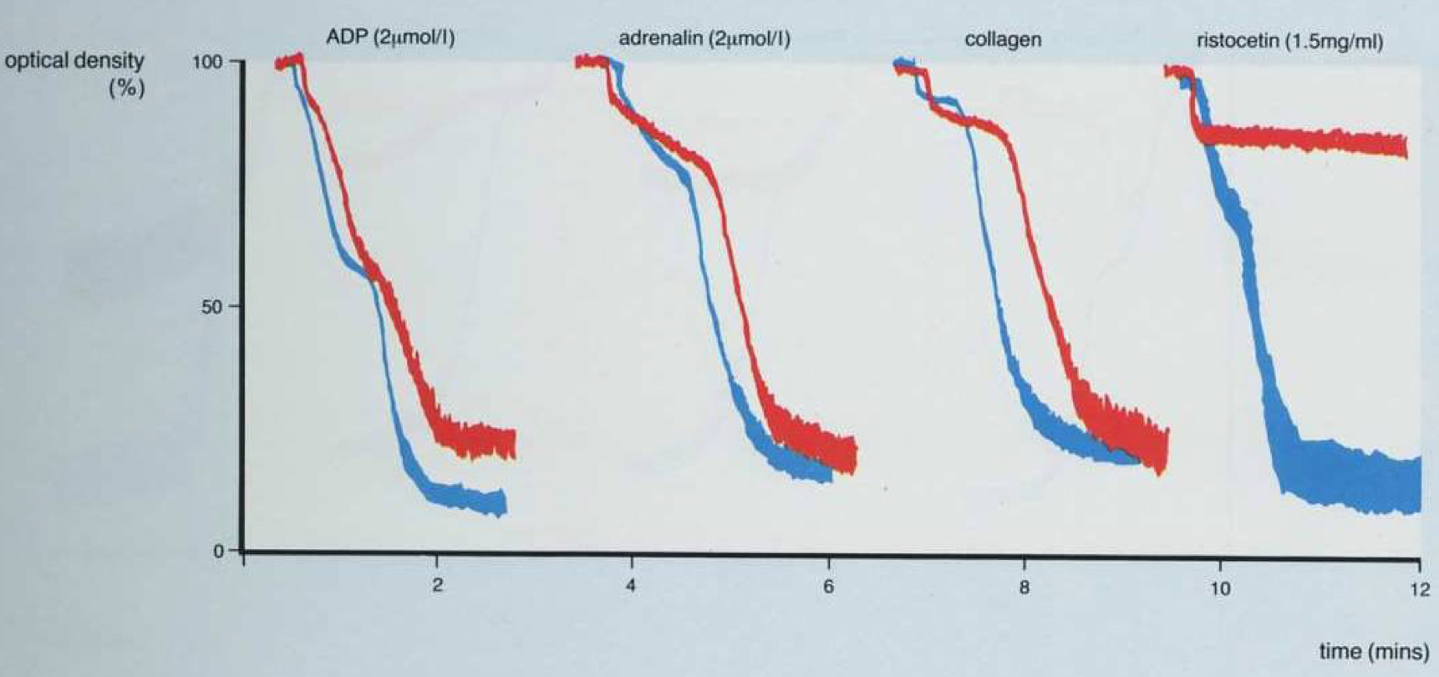
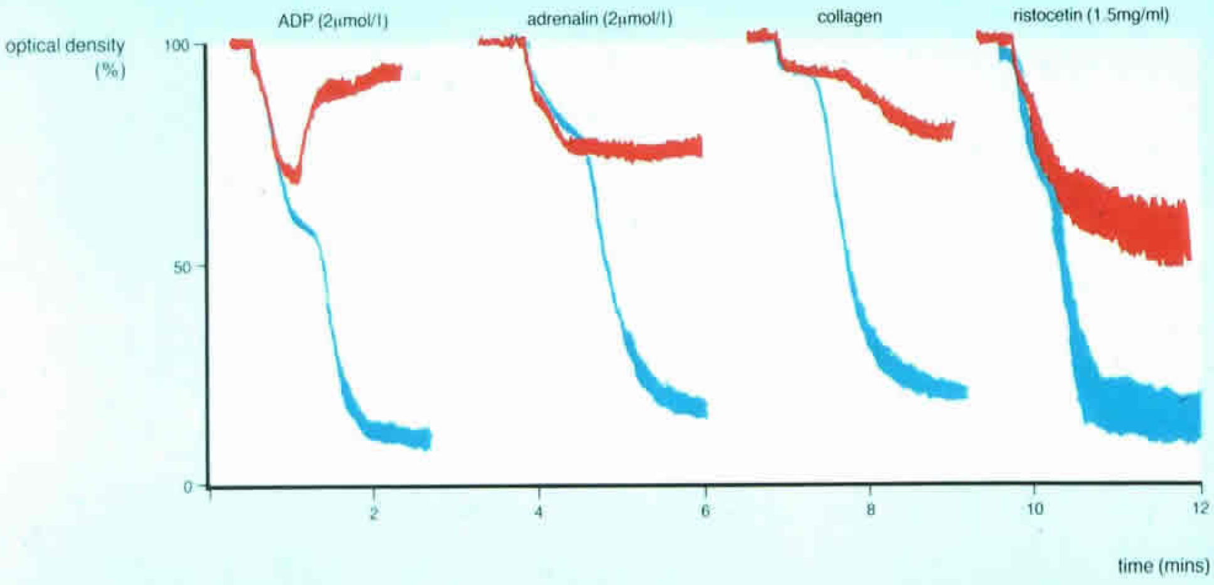
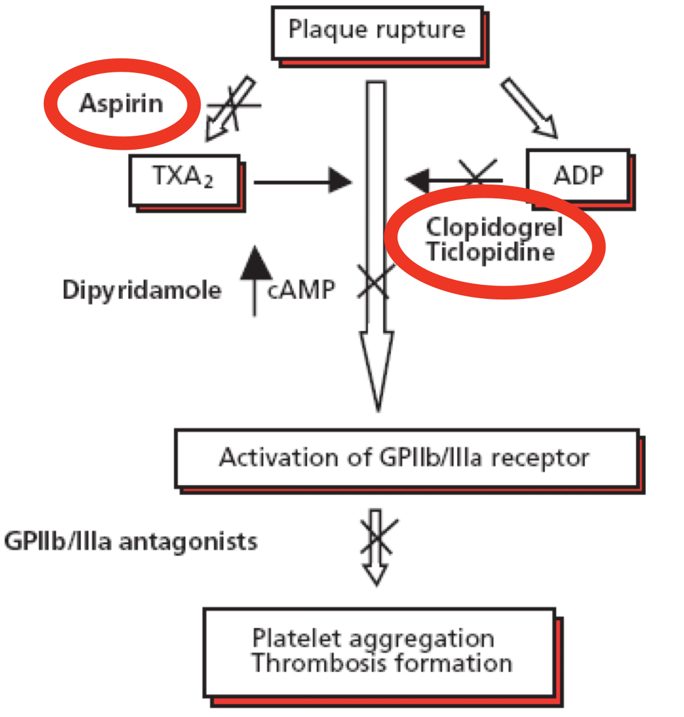
9
PLATELETS STRUCTURE AND FUNCTIONS
Lecture Eleven
Classic Biphasic Aggregation
1- Baseline.
2- Addition of an agonist.
(this results in change in platelet change and hence a drop in the baseline)
3- Primary wave aggregation.
4- Release of nucleotides.
5- Secondary wave aggregation.
(Adrenaline and low dose ADP classically give a biphasic aggregation )
Figure 11-19
Aggregometry Results and Diagnosis
Figure | Characteristic of findings on LTA | Diagnosis
 | Absent or markedly impaired aggregation to all agonists except ristocetin. (Ristocetin-induced agglutination shows only primary wave aggregation, aggregation cannot occur because fibrinogen cannot bind) | Glanzmann’s thrombasthenia Afibrinogenemia
 | Absent or markedly reduced platelet agglutination with Ristocetin. | Bernard soulier syndrome Von willebrand disease
 | Primary aggregation only with ADP, Adrenaline and collagen and only partial agglutination with ristocetin suggesting failure of granule release or a deficiency of platelet granules. | Storage pool Disorder. Platelet release defects.
 | Absent aggregation to Arachidonic acid. Primary wave aggregation only with ADP. Decreased or absent aggregation with collagen. | Aspirin (or defects on COX pathway)
 | Absent aggregation with ADP. | Clopidogrel (ADP inhibitor.
Aspirin inhibits platelet cyclooxygenase by irreversible acetylation, therapy preventing the formation of thromboxane A2, which is powerful stimulant of platelet aggregation.
Clopidogrel, a thienopyridine, acts by inhibiting adenosine receptors, which inhibits the early step of platelet activation.

Slide 11
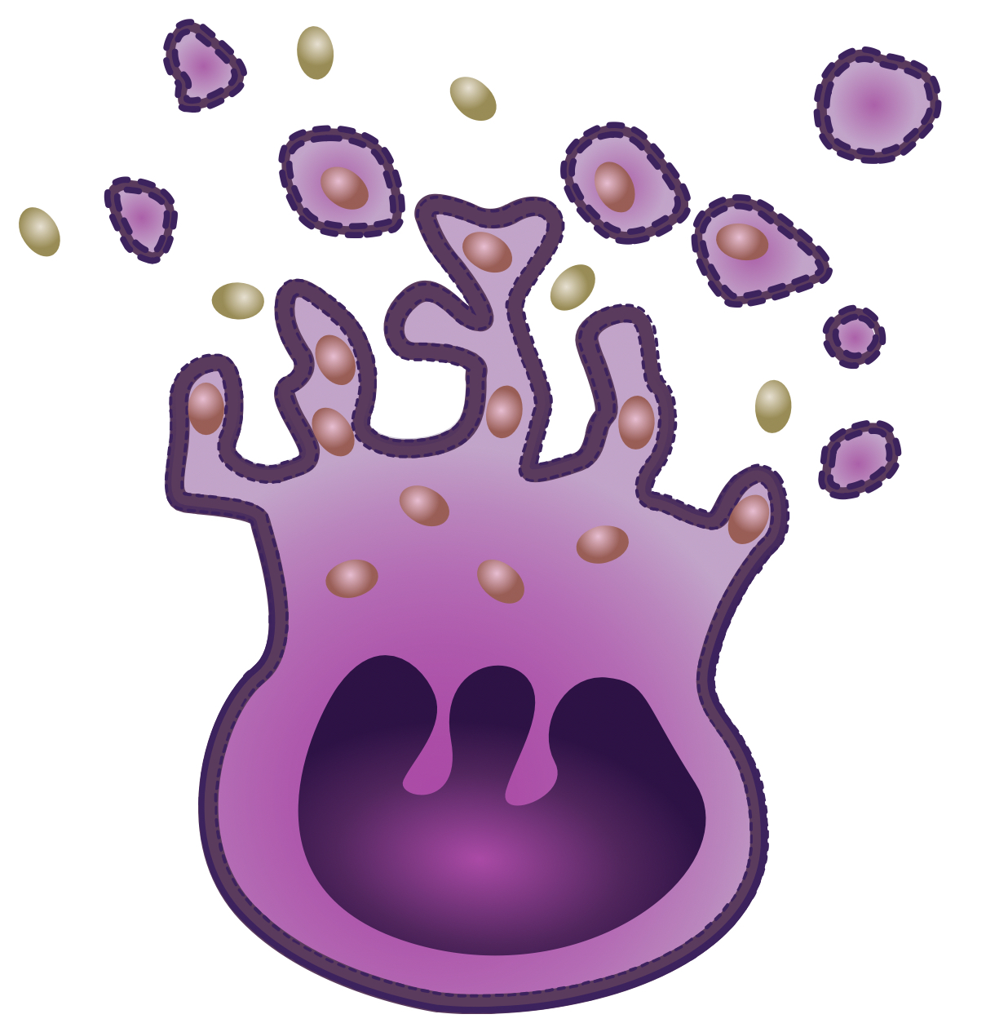
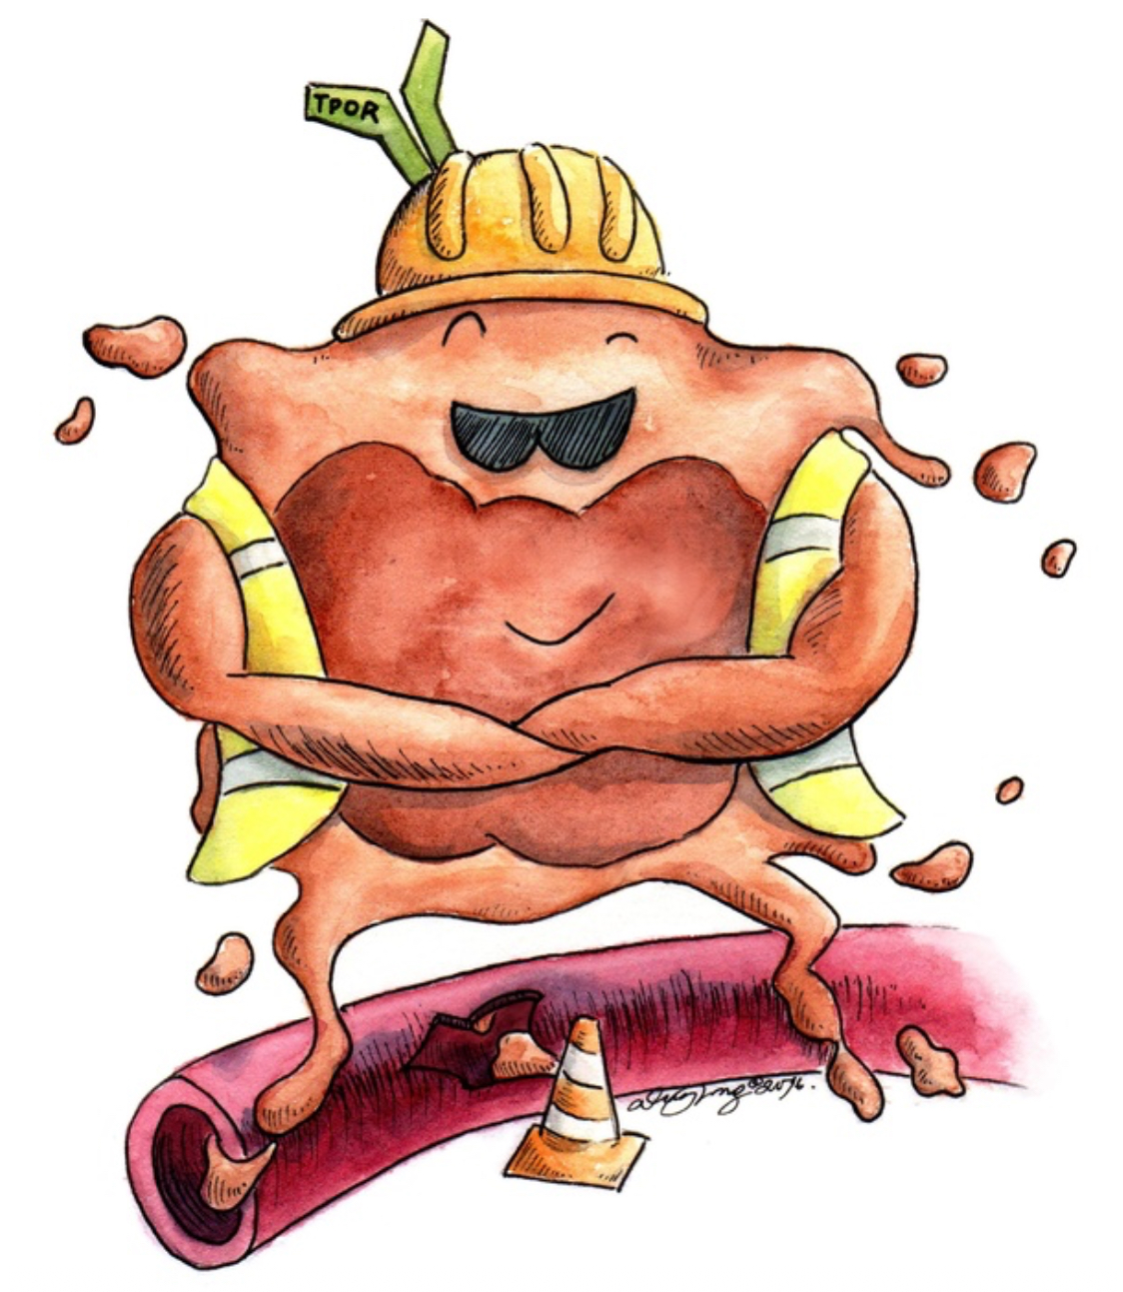
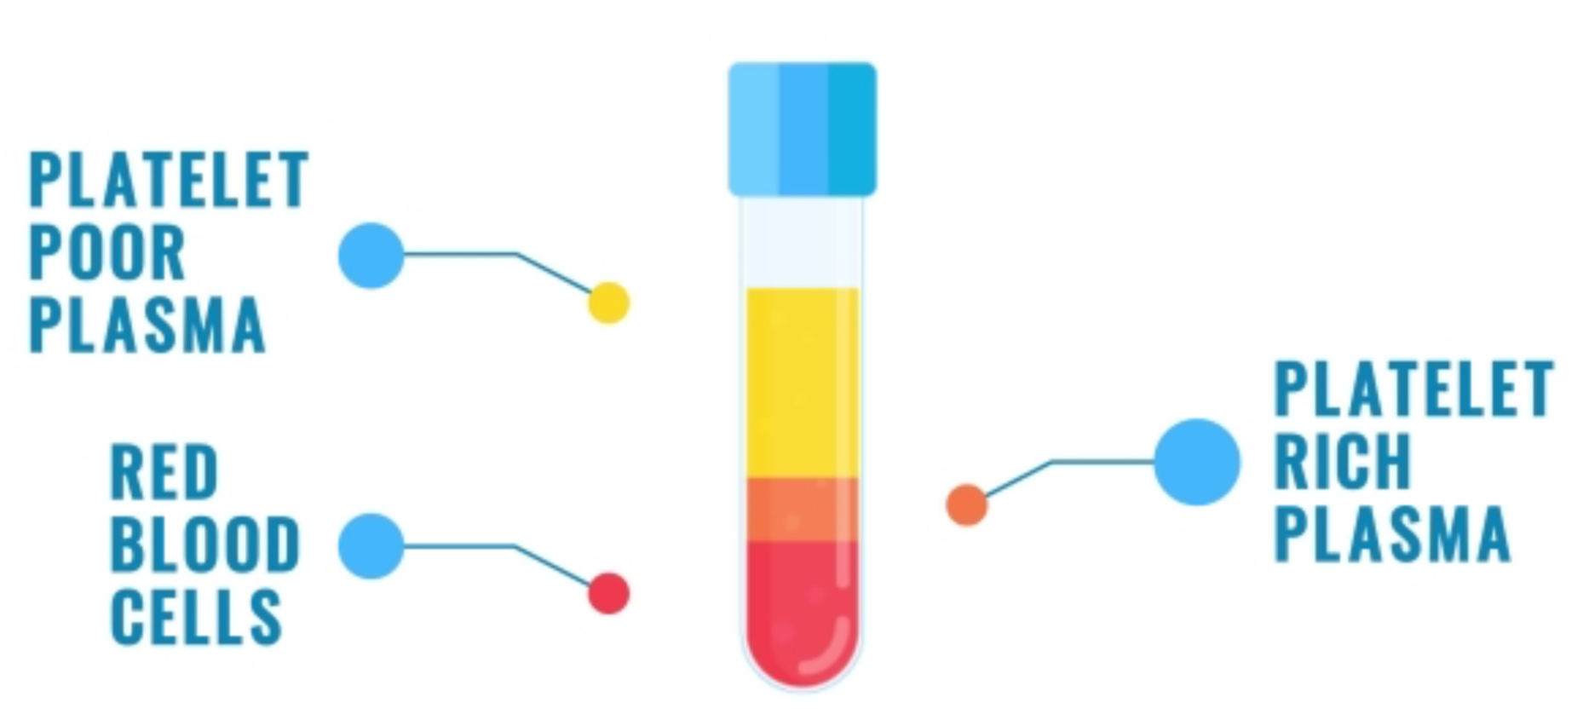
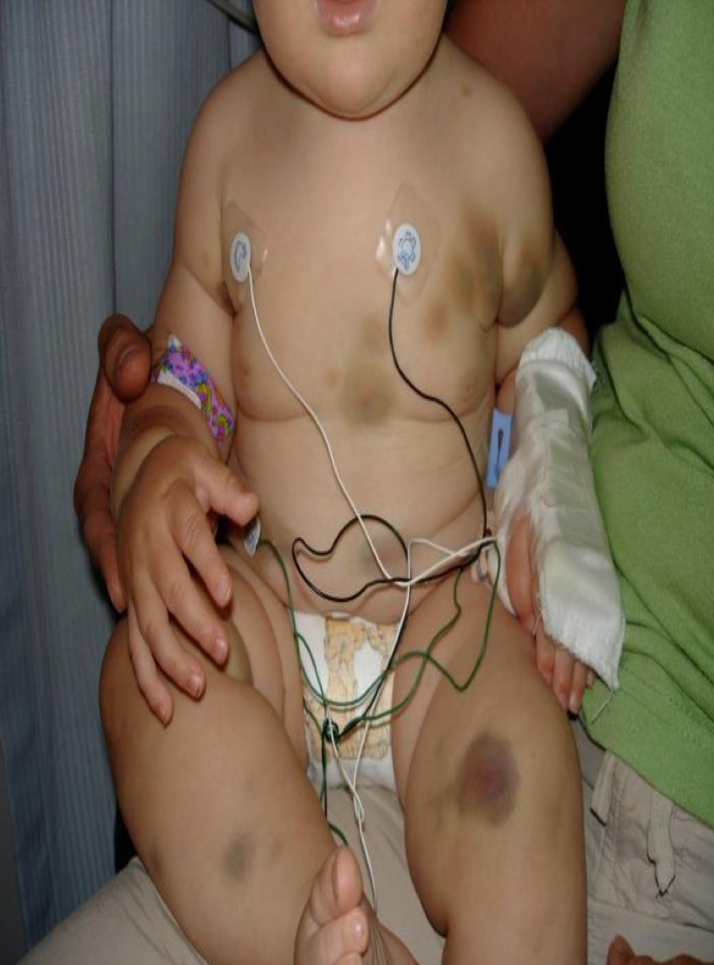
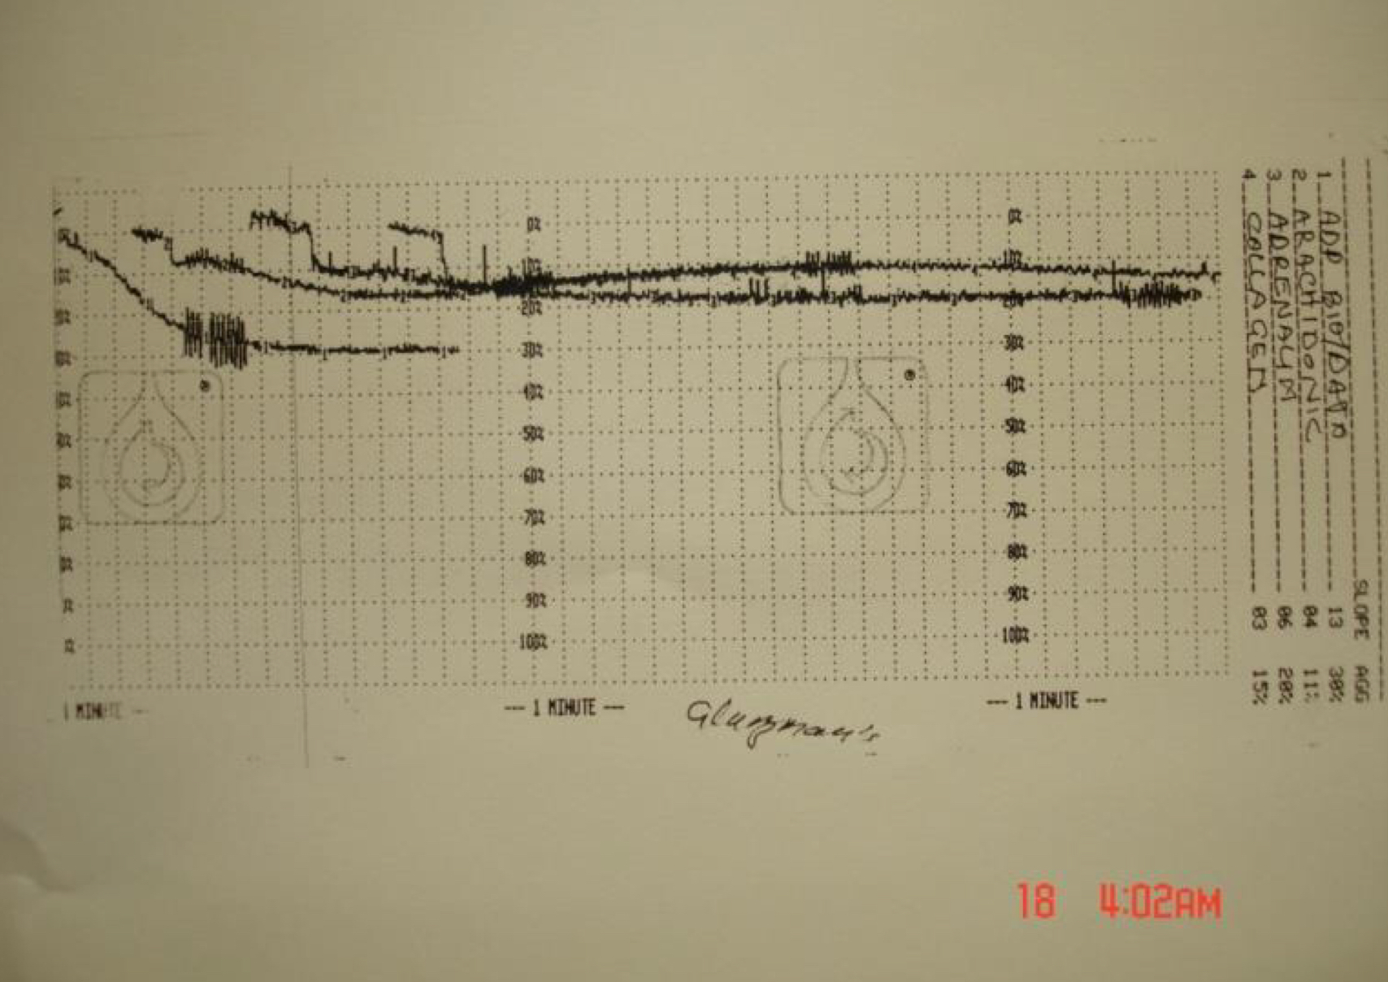
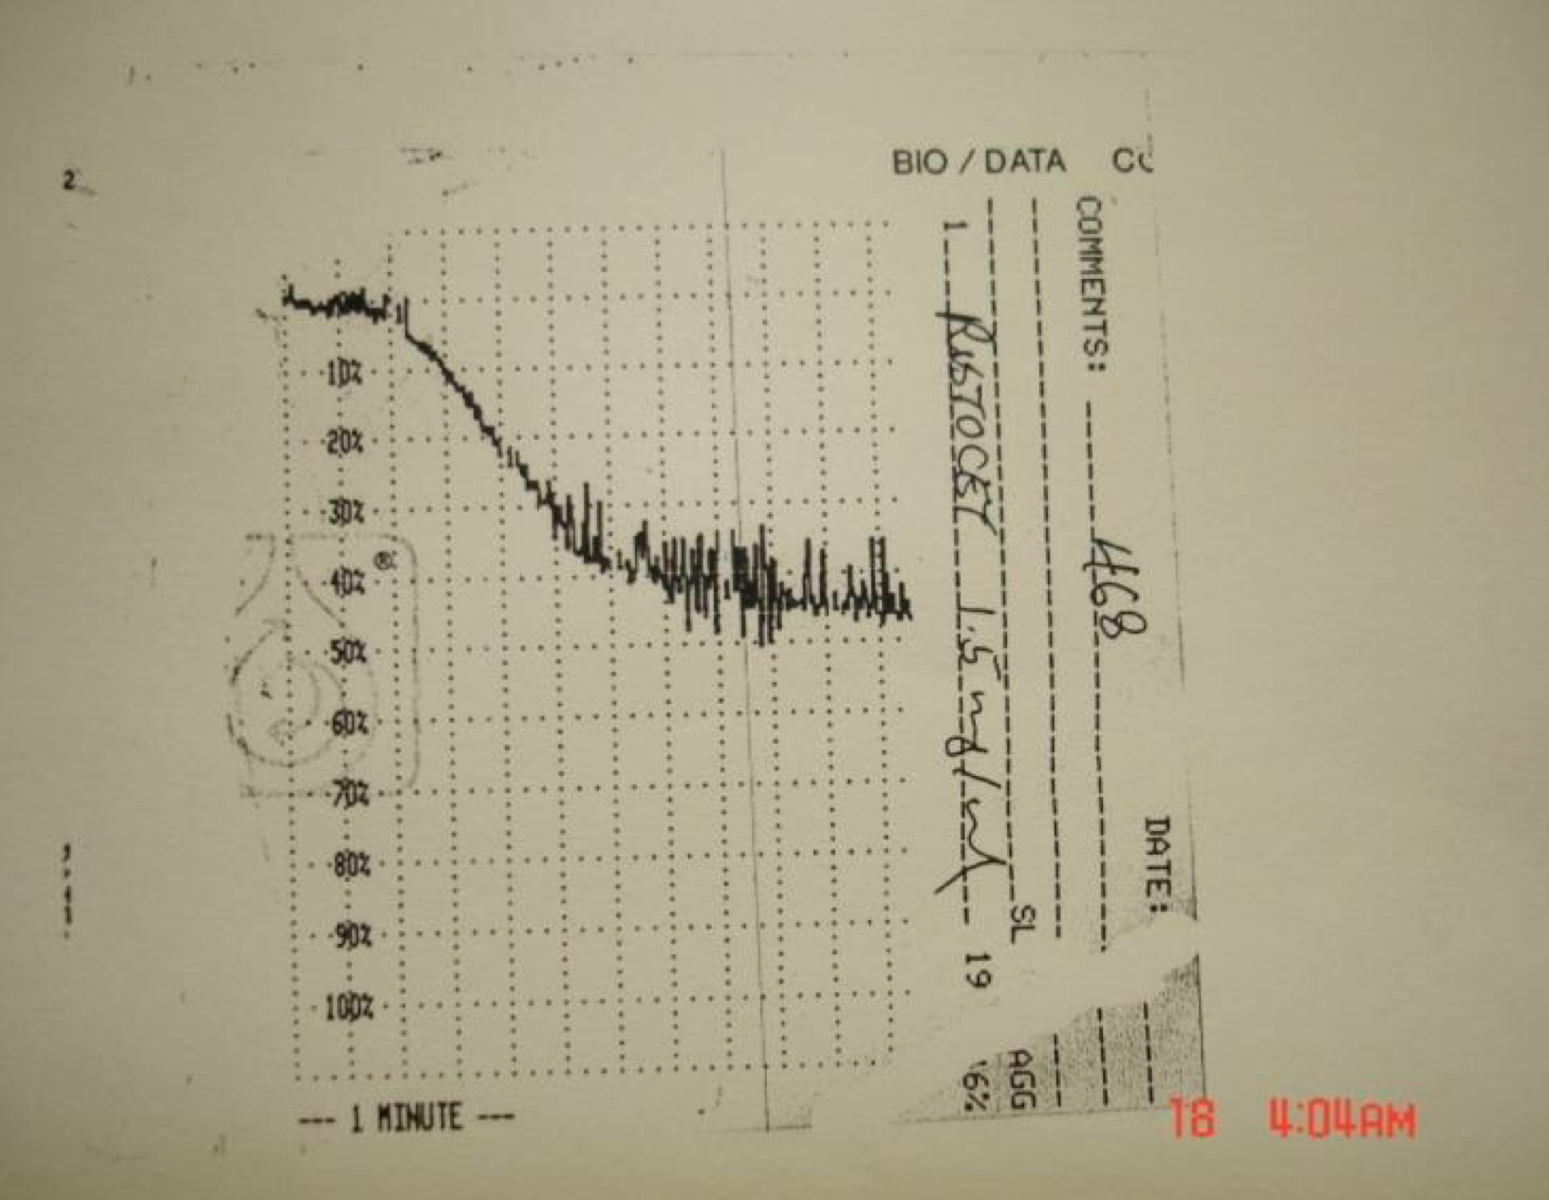
10
PLATELETS STRUCTURE AND FUNCTIONS
Lecture Eleven
Summary
-Platelets are cell fragments derived from megakaryocyte in the bone marrow.
-Platelets play a pivotal role in haemostasis
by arresting bleeding from an injured blood vessels
-Bleeding can result from: Platelet defects acquired or congenital.
-Platelet function tests are used to detect abnormal platelet function.
Case Study:
A 7 years old girl complaining of:
severe bruising since birth and if she had injury she would bleed for days.
She had epistaxis which lasted for days.
Her mother said “she just bruise more easily than her older sister”.
Investigation:
CBC: RBC, WBC, Platelets. (All normal)
Platelet morphology: normal.
Aggregometry: Absent platelet aggregation in response to ADP, collagen, thrombin, and epinephrine.
Figure 11-20
Notice the bruises
Diagnosis
Glanzmann's Thrombasthenia
(Defects in aggregation)
Figure 11-21

Slide 12
Which of the following is stored inside the platelets by the alpha granules?
ADP.
Serotonin.
Fibrinogen.
Calcium.
What is the first event happens during platelet activation?
Shape change.
Adhesion.
Release reaction.
Aggregation.
Which one of the following is essential for platelet aggregation?
von Willebrand Factor.
Fibrinogen.
Collagen.
Haemoglobin.
In Bernard-Soulier Syndrome there is defect in the receptor for which of the following?
von Willebrand Factor.
Fibrinogen.
Collagen.
Thromboxane A2
SHORT ANSWER QUESTIONS
Enumerate (in order) the four events of platelet activation.
ANSWERS
Adhesion.
Shape Change. (if they consider them 5 events)
Agregation.
Release reaction.
Clot retraction
ANSWER KEY: C, B, B, A

Slide 13
ABDULLAH ALASSAF
FEMALE PHYSIOLOGY CO-LEADERS
Maha Alnahdi, Taif Alshammari
MALE PHYSIOLOGY CO-LEADERS
Nayef Alsaber, Hameed M. Humaid
REFERENCES
Guyton and Hall Textbook of Medical Physiology
Ganong’s Review of Medical Physiology

