Slide 1
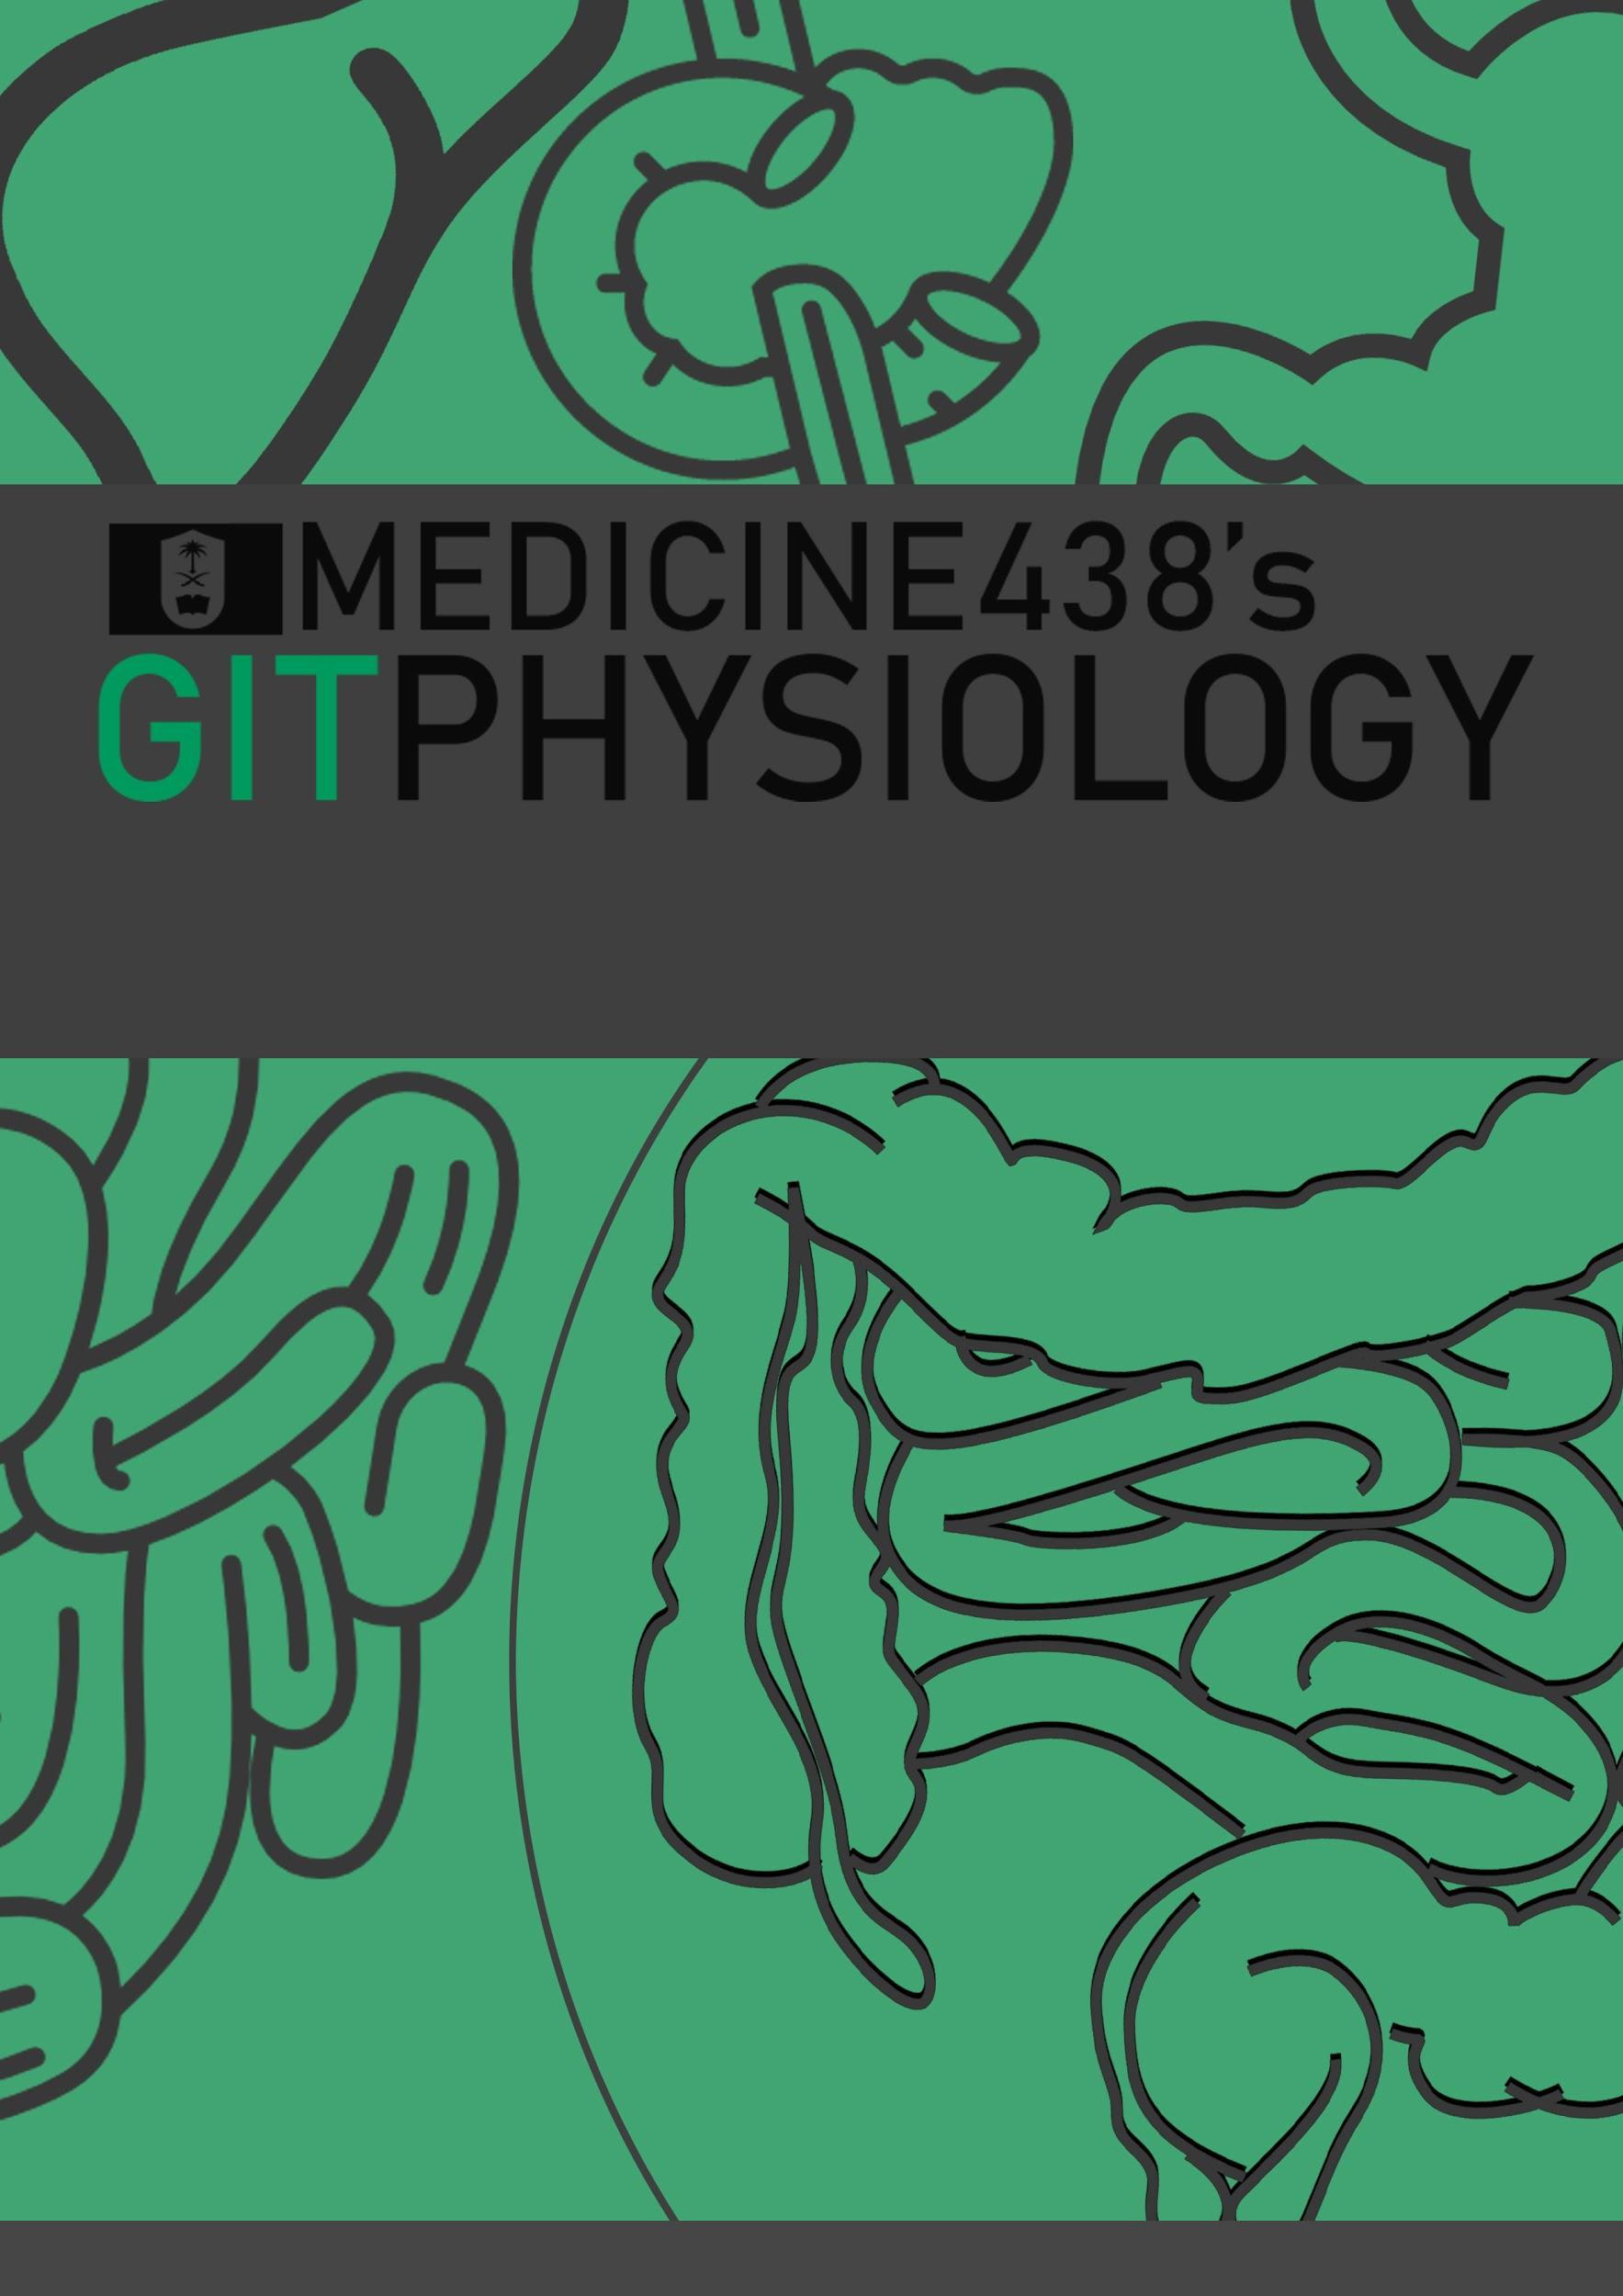
LECTURE VI: Physiology of the Colon
EDITING FILE
IMPORTANT
MALE SLIDES
EXTRA
FEMALE SLIDES
LECTURER’S NOTES

Slide 2
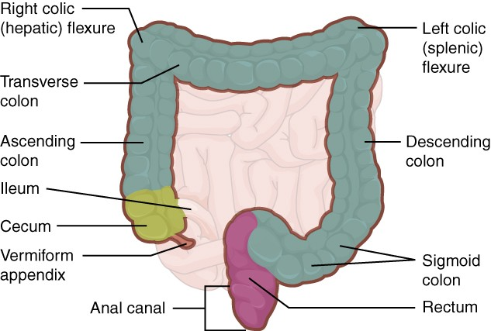
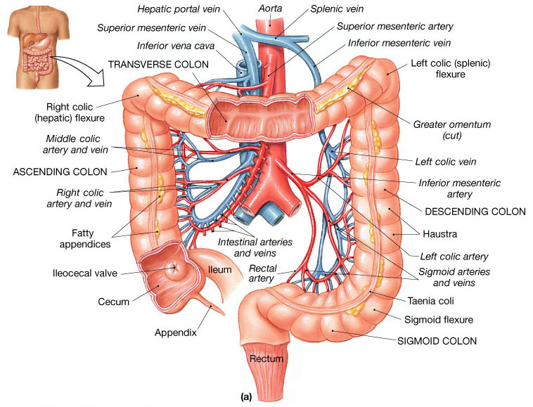
1
PHYSIOLOGY OF THE COLON
Lecture Six
OBJECTIVES
Physiological Functions of Different Colon Regions
Secretion in the Colon
Nutrient Digestion & Absorption in the Colon
Bacterial Action in the Colon
Motility in the Colon
Defecation Reflex
THE LARGE INTESTINE
This is the final digestive structure.
By the time the digested food (chyme) reaches the large intestine, most of the nutrients have been absorbed.
The primary role of the large intestine is to convert chyme into feces for excretion.
Figure 6-1
PARTS OF THE COLON
It consists of the ascending, transverse, descending & sigmoid colon, rectum and anal canal.
The transit of radiolabeled chyme through the large intestine occurs in 36-48 hrs.
The colon has a length of about 1.5 meters (one-fifth of the whole length of GIT).
The large intestine is divided into two parts:
Absorptive part (proximal half of large intestine): cecum, ascending colon, and proximal half of transverse colon.
Storage part (distal half of large intestine): distal half of transverse colon till the anus.
Figure 6-2
MUCOUS MEMBRANE OF THE COLON
Lacks villi and has many crypts of Lieberkühn.
The crypts consist of simple short glands lined by mucous-secreting goblet cells (provides an adherent medium for holding fecal matter together).
The epithelial cells contain almost no digestive enzymes.
The mucosa, like that of the small intestine, has a high capability for active absorption of sodium, Cl and water.
The outer longitudinal muscle layer is modified to form three longitudinal bands called tenia coli visible on the outer surface.
Since the muscle bands are shorter than the length of the colon, the colonic wall is sacculated and forms haustra.
Figure 6-3
Figure 6-4

Slide 3
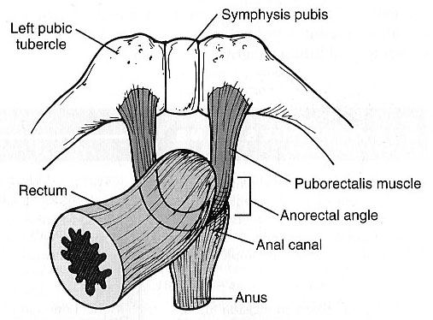
2
PHYSIOLOGY OF THE COLON
Lecture Six
FUNCTIONS OF THE COLON
1
Absorb
Vitamins produced by bacteria (NOT dietary vitamins)
2
Reabsorb
Water and compact material into feces
3
Store
Fecal matter prior to defecation
Ascending Colon
Transverse Colon
Specialized for processing chyme delivered from the terminal ileum.
When rediolabeled chyme is instilled (put gradually) into cecum, half of the instilled volume empties from ascending colon in 87 min.
This period is short in comparison with the transverse colon.
The ascending colon is not the primary site of storage, mixing and removal of water.
The primary site for the removal of water and electrolytes and the storage of feces.
The labeled material is retained for about 24 hrs.
Function
The physiology of different
Colon regions
Rectosigmoid Region
Descending Colon
It maintains fecal continence together with anal canal & pelvic floor musculature. (the ability to voluntarily control urinary and fecal discharge).
A conduit between the transverse and sigmoid colon.
Has the neural program for power propulsion (mass movement), involved in defecation reflex.
Labeled feces begin to accumulate in the sigmoid colon about 24 hours after the label is instilled in the cecum.
How the Rectosigmoid Region, Anal Canal & Pelvic Floor Musculature Maintains Fecal Continence?
The sigmoid and rectum are reservoirs with a capacity of up to 500 mL.
Fibers of puborectalis pass around the anorectum and join behind it to form a U-shaped sling (physiological valve).
The puborectalis muscle and external anal sphincter comprise a functional unit that maintain continence.
Figure 6-5

Slide 4
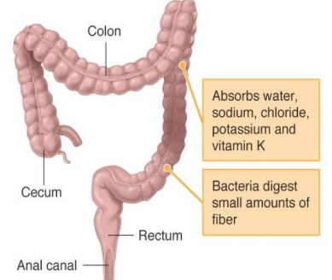
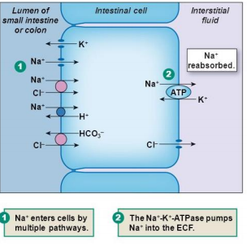
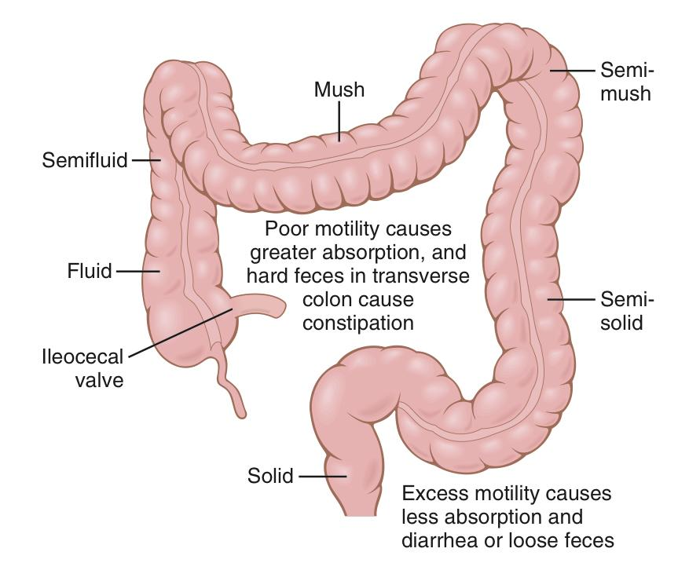
3
PHYSIOLOGY OF THE COLON
Lecture Six
SECRETION IN THE COLON
The secretion is mainly mucus, it has the following functions:
It neutralizes against any acids present.
It protects against irritation.
It helps to lubricate feces.
It provides a binding medium for fecal matter.
EFFECT OF PARASYMPATHETIC STIMULATION ON SECRETION
Stimulation of the pelvic nerves (nerves of defecation reflex) cause:
Increase in peristaltic motility of the colon.
Marked increase in mucus secretion.
During extreme parasympathetic stimulation, so much mucus can be secreted into the large intestine that the person has a bowel movement of ropy mucus as often as every 30 minutes; this mucus often contains little or no fecal material.
SECRETION OF WATER AND ELECTROLYTES
Whenever a segment of large intestine becomes irritated as occurs in bacterial infection, the mucosa secretes large amount of water & electrolytes in addition to the alkaline mucus.
This dilute the irritating factors and causes rapid movement of the feces toward the anus.
ABSORPTION IN THE LARGE INTESTINE
Little absorption occurs in the large intestine.
Most of absorption occurs in the proximal half of the colon (absorptive colon). Whereas the distal colon function for storage (storage colon).
The large intestine can absorb a maximum of 5 - 8 liters of fluid and electrolytes each day.
Water
About 0.5- 1.5L/day is absorbed.
The net water loss is 100-200 ml/day.
Figure 6-6
Sodium
In the presence of Na⁺-K⁺ ATPase at the basolateral membrane, Na+ is actively absorbed and K+ is secreted into the lumen of colon.
Chloride
Cl⁻ is absorbed in exchange for HCO₃⁻ which is secreted.
Vitamins
Vitamins as vit. K, biotin, B5 , folic acid and some amino acids and short chain fatty acids resulting from bacterial fermentation of CHO are absorbed.
It does not absorb vitamin B12.
Figure 6-7
Others
Certain drugs as steroids and aspirin may be absorbed.
Reabsorption of organic wastes (urobilinogens & Stercobilinogen) and toxins.
Reabsorption of bile salts.
Figure 6-8

Slide 5
4
PHYSIOLOGY OF THE COLON
Lecture Six
GUT FLORA (GASTROINTESTINAL MICROBIOTA)
it’s a complex community of microorganisms that live in GIT. It’s established at 1-2 years after birth. They live in symbiosis with human & their effects are beneficial to the body.
FUNCTIONS OF BACTERIAL FLORA
1
Synthesis of vitamin K & some B group vitamins: folic acid, biotin, thiamine, B12.
The bacteria-formed vitamin K is important since the amount in our daily ingest food isn’t sufficient to maintain adequate blood coagulation.
2
Deconjugation and decarboxylation of bile salts.
3
Breakdown of bile pigments to produce stercobilinogen¹.
4
Decarboxylation of amino acids to produce amine & histamine.
The amines are excreted in feces and responsible for its smell.
5
Breakdown of urea by bacterial urease to ammonia.
Most ammonia is absorbed and converted back into urea by the liver².
6
Fermentation of undigested oligosaccharides producing gases.
Colon bacilli are capable of ingesting small amounts of cellulose.
Chronic disruption of normal flora in the colon leads to bruising and excessive bleeding.
FOOTNOTES
Stercobilinogen (fecal urobilinogen) is a chemical created by bacteria in the gut. It is made of broken-down hemoglobin. It is further processed to become the chemical that gives feces its brown color.
Ammonia is normally converted to urea in the liver and cleared out of the body through the urine. In individuals with acute or chronic liver disease, there’s a buildup of ammonia in the blood which play a role in hepatic encephalopathy.

Slide 6
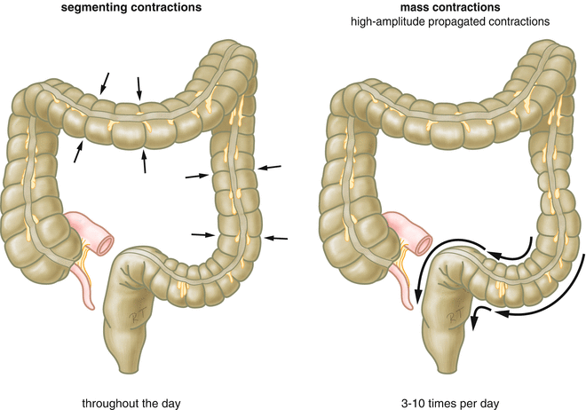
5
PHYSIOLOGY OF THE COLON
Lecture Six
MOTILITY IN THE COLON
Antiperistalsis
Starts at the junction of ascending and transverse colon & traveling towards the cecum.
Mixes contents
Absorbs water
Mixing Movement (Haustrations)
The motor events in proximal colon (cecum & ascending colon).
Ring-like contractions (2.5 cm) of circular muscles divide the colon into pockets (haustra).
(The longitudinal muscle also contracts at the same time)
The contracted & relaxed segments remain in their respective state for longer periods.
Uniform repetition of haustra occurs along the colon.
Net forward propulsion happens when sequential migration of haustra occurs along the length of bowel.
Propulsive (Mass) Movement
The motor events in distal colon (transverse & descending colon).
Starts in the middle of transverse colon, 15 mins after breakfast.
Constrictive ring occurs at a distended point, then 20 cm of the colon distal to constriction, contracts as a unit forcing the fecal mass down the colon.
Preceded by relaxation of circular muscle & downstream disappearance of haustral contractions.
Completed in 30 sec. Another mass movement occurs 2-3 mins later.
Mass movement persists for 10-30 mins. (They then cease but return perhaps a half day later).
The desire of defecation is felt when a mass of feces is forced into rectum.
Figure 6-9

Slide 7
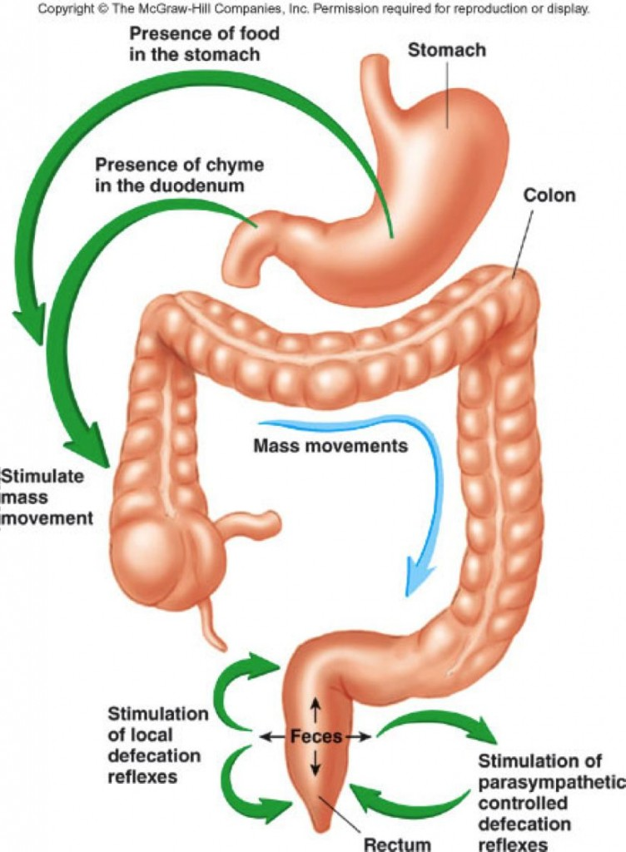
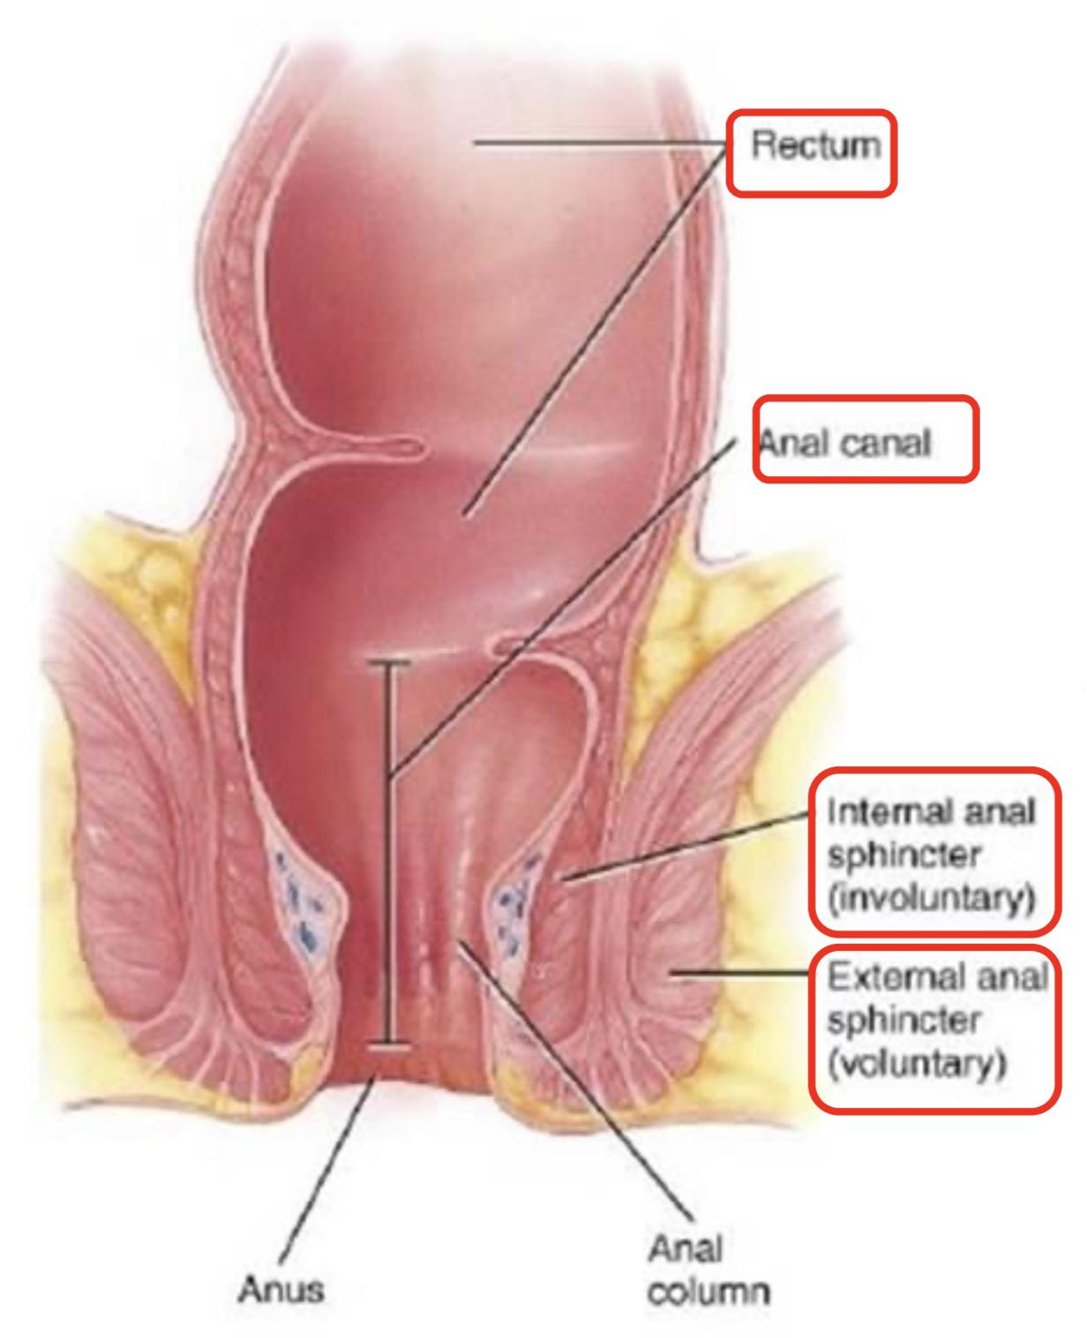
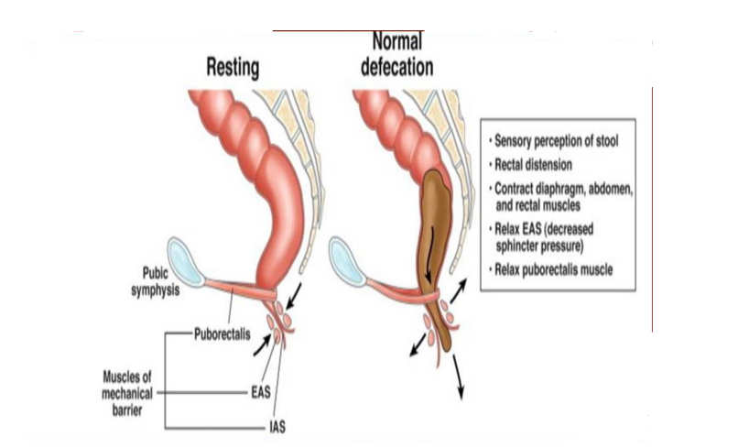
6
PHYSIOLOGY OF THE COLON
Lecture Six
Initiation of Mass Movement
Gastrocolic & duodenocolic reflexes after meals. They result from distension of the stomach & duodenum.
Irritation of the colon¹. e.g. Castor oil.
Threatening agents. e.g. Parasites & enterotoxins can initiate mass movement.
CONTROL OF COLONIC MOTILITY
Figure 6-10
Stimulatory Enteric Motor Neurons Release: | Inhibitory Enteric Motor Neurons Release:
Acetylcholine | vasoactive intestinal peptide (VIP)
Substance P | Nitric oxide (NO)
The extrinsic autonomic nerves to the colon modulate the control of colonic motility by enteric nervous system
Table 6-1
THE RECTUM & ANAL CANAL
The rectum is the last portion of GIT that terminates at the anal canal.
Contains mechanoreceptors that detect distinction.
Skin of anal canal is innervated by somatosensory nerves that transmit pain, temperature & touch signals to CNS.
Contraction of anal sphincters (external² & internal) and puborectalis muscle blocks the passage of feces and maintain continence with small volumes in the rectum.
when puborectalis is contracted, it pulls the junction of the rectum and the anal canal forwards, creating an angle in the bowel called the anorectal angle. This angle prevents the movement of stool stored in the rectum moving into the anal canal.
Conversely, relaxation of the puborectalis reduces the pull on the junction of the rectum and the anal canal, causing the anorectal angle to straighten out. A squatting posture is also known to straighten the anorectal angle, meaning that less effort is required to defecate when in this position.
Figure 6-11
Figure 6-12
FOOTNOTES
For instance, a person who has an ulcerated condition of the colon mucosa (ulcerative colitis) fre­quently has mass movements that persist almost all the time.
The external sphincter is controlled by nerve fibers in the pudendal nerve, which is part of the somatic nervous system and therefore is under voluntary control. Subconsciously, the external sphincter is usually kept continuously constricted unless conscious signals inhibit the constriction.

Slide 8
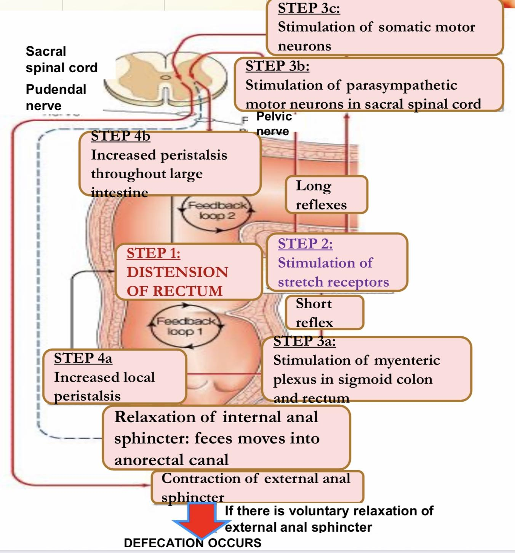
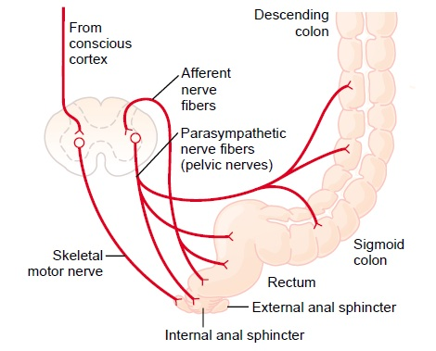
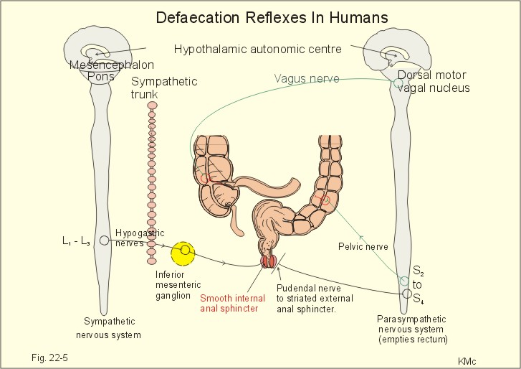
7
PHYSIOLOGY OF THE COLON
Lecture Six
DEFECATION
Most of the time the rectum is empty.
Both internal & external anal sphincters are
maintained in a state of tonic contraction.
Defecation is a spinal reflex, influenced by higher centers.
Gastrocolic & duodenocolic reflexes initiate a mass movement in the colon that pushes feces into the rectum.
Rectal distension sends signals to cerebral cortex producing the desire to defecate.
Defecation reflex:
Distention of rectum.
Stimulation of stretch receptors in rectum.
Short (local) reflex:
Stimulation of myenteric plexus in sigmoid colon and rectum. (But the intrinsic myenteric defecation reflex functioning by itself normally is relatively weak. To be effective in causing defecation, it usually must be fortified by parasympathetic defecation reflex)
Long reflex:
Stimulation of parasympathetic motor neurons in sacral spinal cord (it will increase peristalsis throughout large intestine).
Stimulation of somatic motor neurons.
4. Results in:
Increases local peristalsis
Relaxation of internal anal sphincter
Contraction of external anal sphincter
Figure 6-13
DIFFERENT SITUATIONS FOR DEFECATION
Suitable Situation¹ | Not Suitable Condition²
Allowed defecation reflex. Stretch of rectal wall is sent to SC by pelvic nerve. | Inhibited defecation reflex from cerebral cortex
Efferent pelvic impulses cause reflex contraction of rectum & relaxation of internal anal sphincter. | Maintain voluntary tonic contraction of external anal sphincter.
Followed by reduction in tonic impulses to external anal sphincter, so it relaxes voluntary. | Return of tonic contraction of internal anal sphincter.
Feces leave rectum assisted by voluntary straining & contraction of pelvic floor muscles. | Accomodation of rectum to distinction. People who too often inhibit their natural reflexes are likely to become severely constipated.
Figure 6-14
Figure 6-15
Table 6-2
FOOTNOTES
When it is appropriate, the external anal sphincter is relaxed voluntarily, the smooth muscle of the rectum contracts to create pressure, and feces are forced out through the anal canal. The intra-abdominal pressure created for defecation can be increased by a Valsalva maneuver (closure of glottis, deep inspiration, and abdominal contraction).
Briefly, when a person feels the urge to defecate, the internal anal sphincter is relaxed, the rectum contracts, and the external anal sphincter is either contracted or relaxed depending on the circumstances.

Slide 9
8
PHYSIOLOGY OF THE COLON
Lecture Six
SUMMARY OF DEFECATION REFLEXES
Parasympathetic Defecation Reflex (Parasympathetic Pelvic Nerves)
Stimulus | Feces enter the rectum - distention of rectal wall
Receptors | Stretch receptors in the rectal wall
Afferents | Sensory fibers terminating in S2-S4 cord level
Center | S2- S4 spinal cord segments
Efferents | Pelvic Parasympathetic Nerves
Effectors | Smooth muscle cells of Descending, Sigmoid colon & Rectum
Response | Peristaltic waves forcing feces towards rectum - Relaxation of internal anal sphincter
Intrinsic Defecation Reflex (Myenteric Plexus)
Stimulus | Feces enter the rectum - distention of rectal wall
Receptors | Stretch receptors in the rectal wall
Afferents | Sensory fibers terminating in Myenteric Plexus
Center | Myenteric Plexus
Efferents | Motor signals to smooth muscles
Effectors | Smooth muscle cells of Descending, Sigmoid colon & Rectum
Response | Peristaltic waves forcing feces towards rectum - Relaxation of internal anal sphincter
FECAL INCONTINENCE
Altered rectal or anal sensation
Infants (physiological)
Fecal incontinence
Spinal reflex of defecation operates without interference from higher centers
CAUSES ARE:
Diarrheal conditions
Spinal cord lesion
Weakness of anal sphincters (internal and external)
Weakness of puborectalis
Diminished rectal capacity

Slide 10
Which colon region is specialized for processing chyme delivered from the terminal ileum?
Ascending colon
Transverse colon
Descending colon
Rectosigmoid region
2. Which of the following statements about colonic motility is true?
Mass contractions involve only the rectum
Antiperistaltic contractions occur in the descending colon
Defecation involves both sensory and motor pathways
3. Mass movements are often stimulated after a meal by distention of the stomach (gastrocolic reflex) and distention of the duodenum (duodenocolic reflex). Mass movements often lead to which of the following?
Bowel movements
Gastric movements
Haustrations
Esophageal contractions
Pharyngeal peristalsis
4. The SC of 60 YO is severed at T6 in an automobile accident. She devises a method to distend the rectum to initiate the rectosphincteric reflex. Rectal distention causes which of the following responses in this women?
Contraction of the rectum
Contraction of EAS, contraction of the rectum
Relaxation of IAS, contraction of the rectum
Relaxation of IAS, contraction of EAS
Relaxation of IAS, contraction of EAS, contraction of the rectum
5. After 20 mins of eating a big meal, a 20 YO women feels the urge to defecate, but manages to hold it. Which mechanism occurred in this women?
Contraction of EAS & rectum
Relaxation of IAS, contraction of rectum
Relaxation of IAS
Relaxation of IAS, contraction of EAS & rectum
SHORT ANSWER QUESTIONS
Q1: What are the three functions of the colon?
Q2: What does reabsorption in the large intestine include?
Q3: What are the causes of fecal incontinence?
Absorb vitamins produced by bacteria. Reabsorb water and compact material into feces. Store facial matter prior to defecation.
Water, vitamins, bile salts, and toxins.
Spinal cord injury, altered rectal or anal sensation, weakness of anal sphincters or puborectalis.
ANSWER KEY: A, C, A, C, D

Slide 11
Shahd Alsalamh, Shahad Althaqep
FEMALE PHYSIOLOGY CO-LEADERS
Maha Alnahdi, Taif Alshammari
MALE PHYSIOLOGY CO-LEADERS
Nayef Alsaber, Hameed M. Humaid
REFERENCES
Guyton and Hall Textbook of Medical Physiology
Ganong’s Review of Medical Physiology

