Slide 1
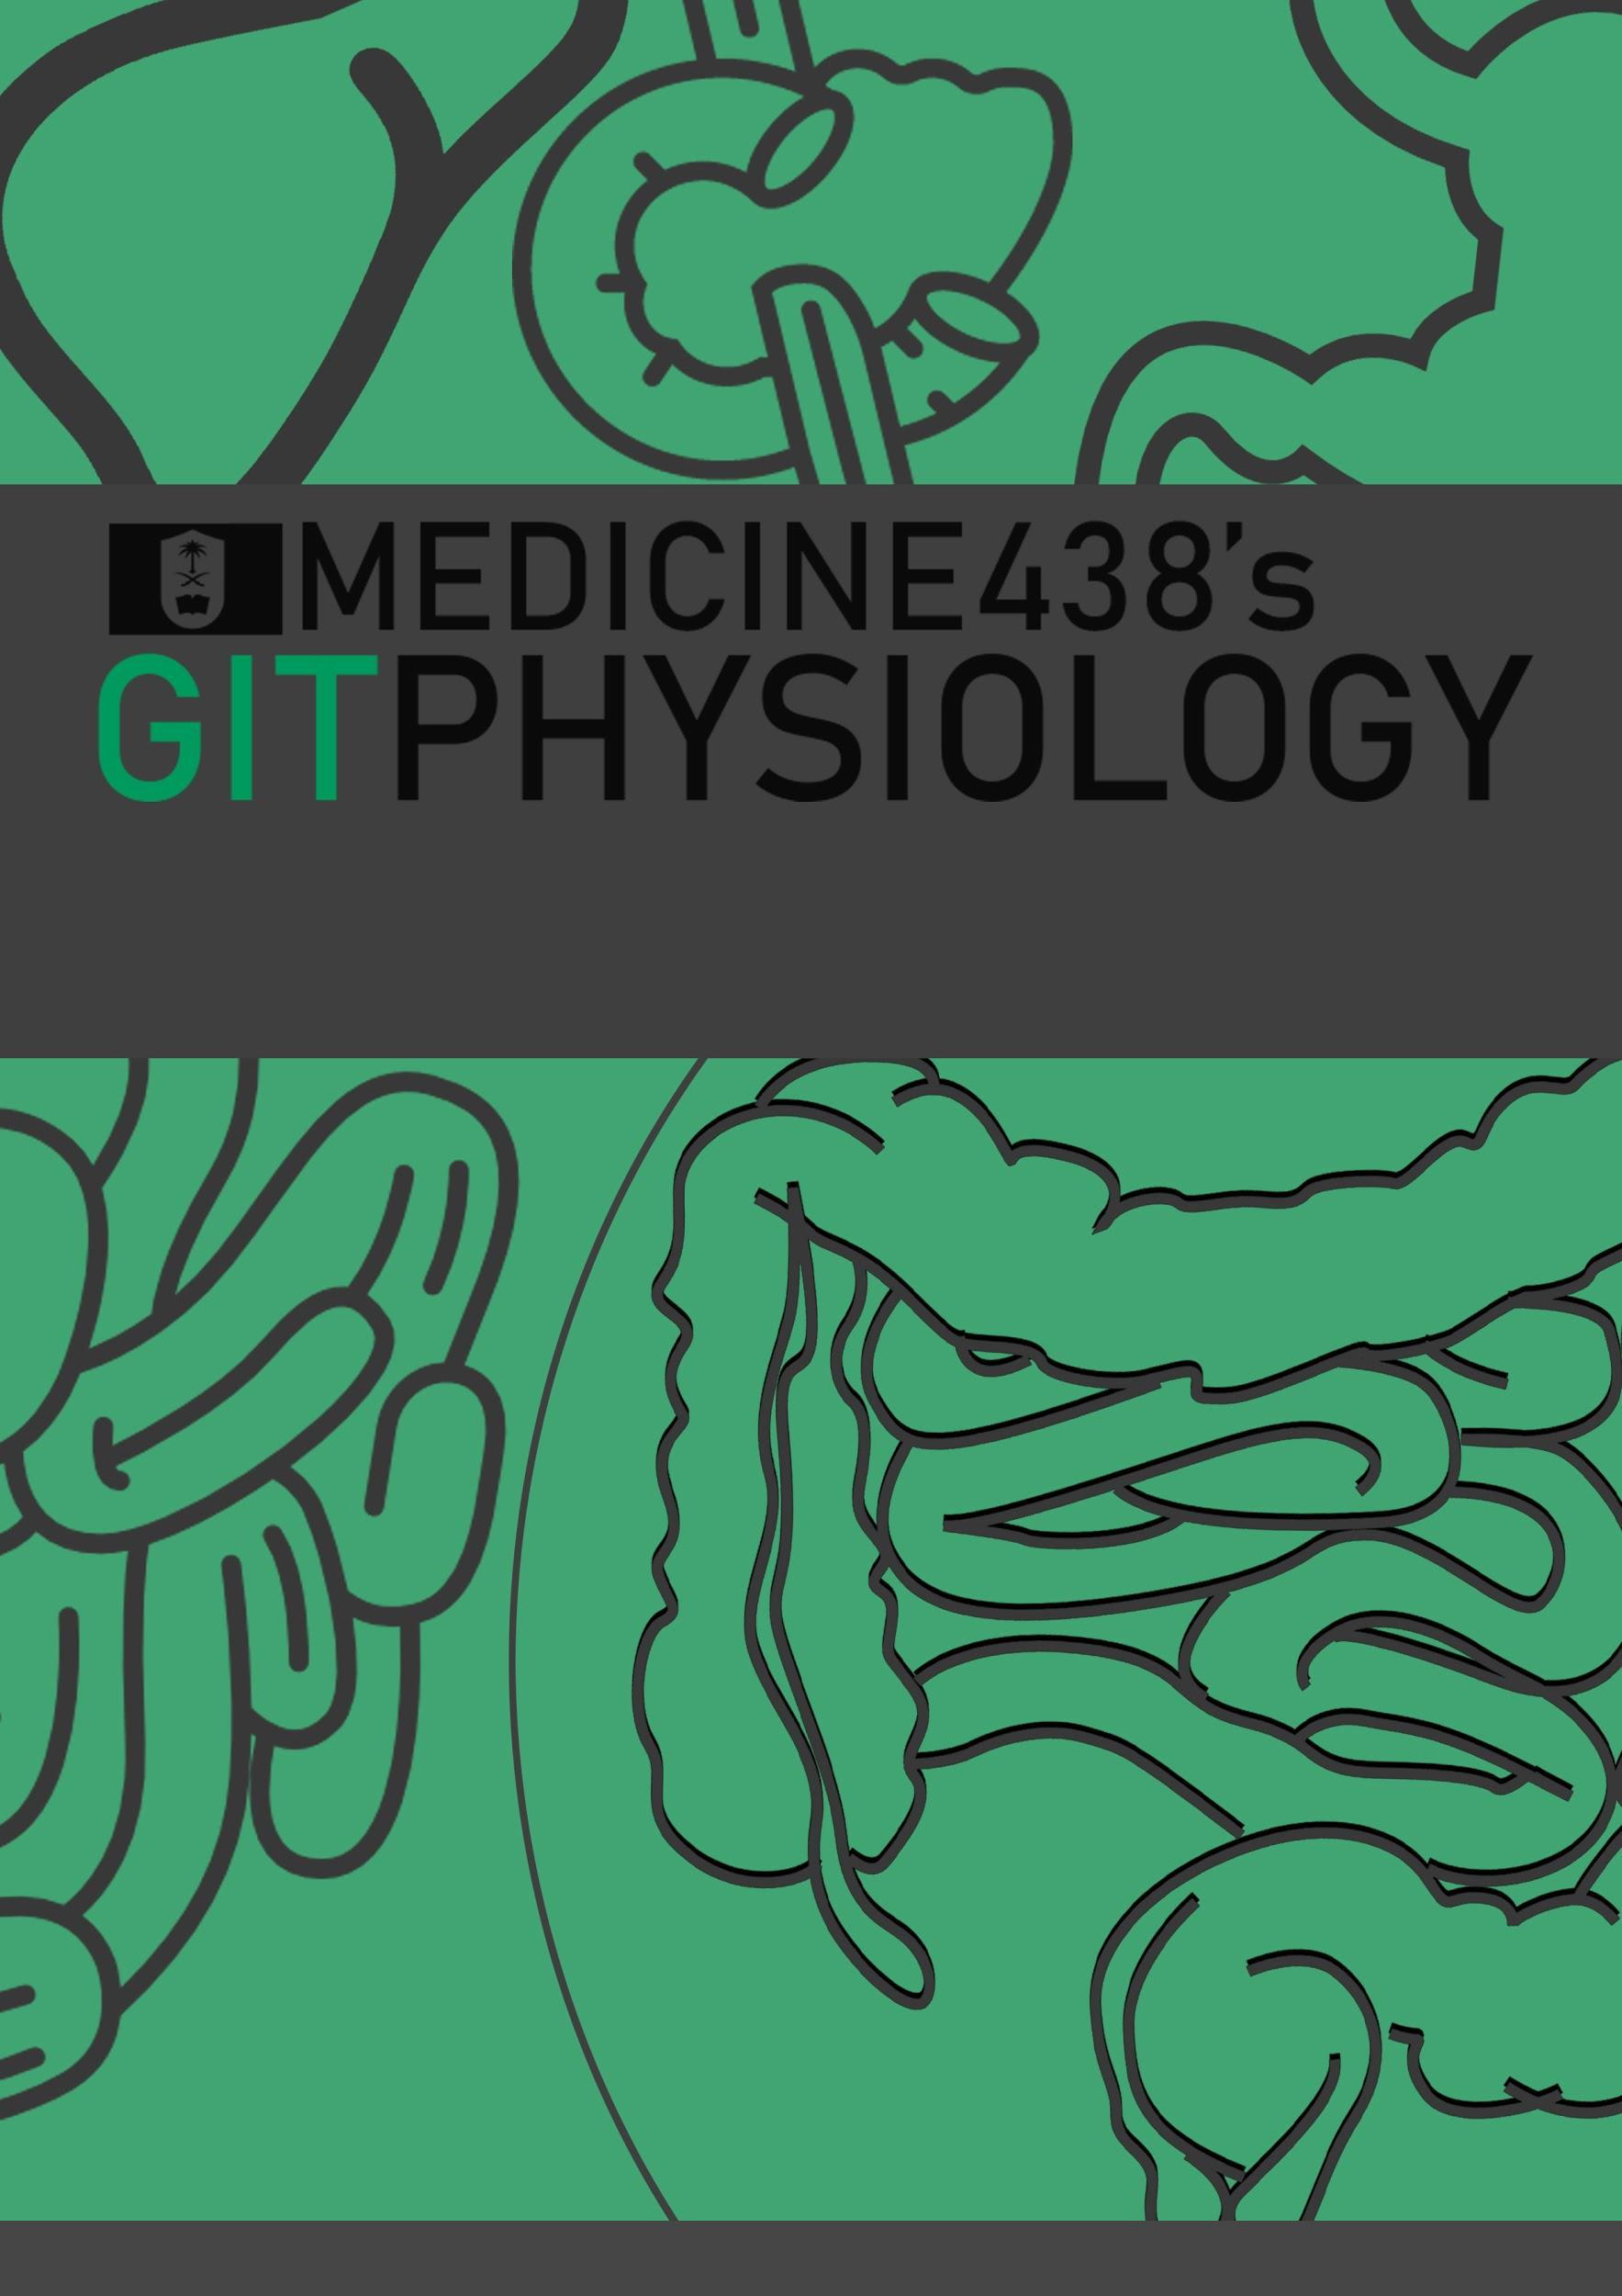
LECTURE VII: Coagulation Mechanisms
EDITING FILE
IMPORTANT
MALE SLIDES
EXTRA
FEMALE SLIDES
LECTURER’S NOTES

Slide 2
1
COAGULATION MECHANISMS
Lecture Seven
OBJECTIVES
Recognize the different clotting factors
Understand the role of calcium ions during clotting cascades.
Describe the cascades of intrinsic and extrinsic pathways for clotting.
Recognize process of fibrinolysis and function of plasmin.
Recognize some conditions causing excessive bleeding.
Understand some important anticoagulants and their mechanism of action.
Introduction
A crucial physiological balance exists between factors promoting coagulation “procoagulants” (eg; platelets, phospholipids, clotting factors) and factors inhibiting coagulation “anticoagulants” (eg; natural inhibitors, antithrombin III, protein C and S, fibrinolysis)(discussed later)
Coagulation depends on balance between these two factors.
Disturbances in this balance leads to thrombosis or bleeding.
Hemostasis
Hemostasis is defined as spontaneous arrest or stoppage of blood loss.
Coagulation: Formation of fibrin meshwork or threads to form a clot.
Blood clot: is composed of a meshwork of fibrin fibers running in all directions and entrapping blood cells, platelets, plasma.¹
Figure 7-1
Figure 7-2
Figure 7-3
Mechanism of Hemostasis:
1. Vessel wall (vasoconstriction)
Causative Factors are three:
Nervous reflexes.
Local myogenic spasm
Local humoral factors (Platelets release Thromboxane A2 which is a vasoconstrictor). It’s inhibited by aspirin, as it is a product of COX enzymes action on arachidonic acid.
Importance: Crushing injuries → intense spasm→ no lethal loss of blood.
2. Platelets (production and activation of platelets followed by platelet plug formation)
Figure 7-2, Figure 7-3
3. Blood coagulation: clot formation and retraction (intrinsic & extrinsic pathways)(discussed later)
4. Fibrinolysis (discussed later)
I | Fibrinogen
II | Prothrombin
III | Tissue factor (Thromboplastin)
IV | Calcium
V | Labile factor, proaccelerin, Ac-globulin (Ac-G)
VI | No longer used (previously thought to be present, was mistaken for factor Va)
VII | Stable factor, serum prothrombin conversion accelerator (SPCA), proconvertin
VIII | Antihemophilic factor, antihemophilic factor A, antihemophilic globulin
IX | Antihemophilic factor B, christmas factor, plasma thromboplastin component (PTC)
X | Stuart-Prower factor, Stuart factor
XI | Plasma Thromboplastin Antecedent (PTA), antihemophilic factor C
XII | Hageman factor, glass factor
XIII | Fibrin stabilizing factor
Pre-K | Fletcher factor, prekallikrein
HMWK | High molecular weight kallikrein, Fitzgerald factor
Vessel wall
Immediately After injury there is localized Vasoconstriction.
Table 7-1
FOOTNOTES
Platelets contain myosin and actin contractile proteins, and aggregated platelets can contract almost like a muscle within the clot to pull the blood vessel ends, and also to squeeze out the trapped plasma into a serum, since it will be lacking its clotting factors.

Slide 3
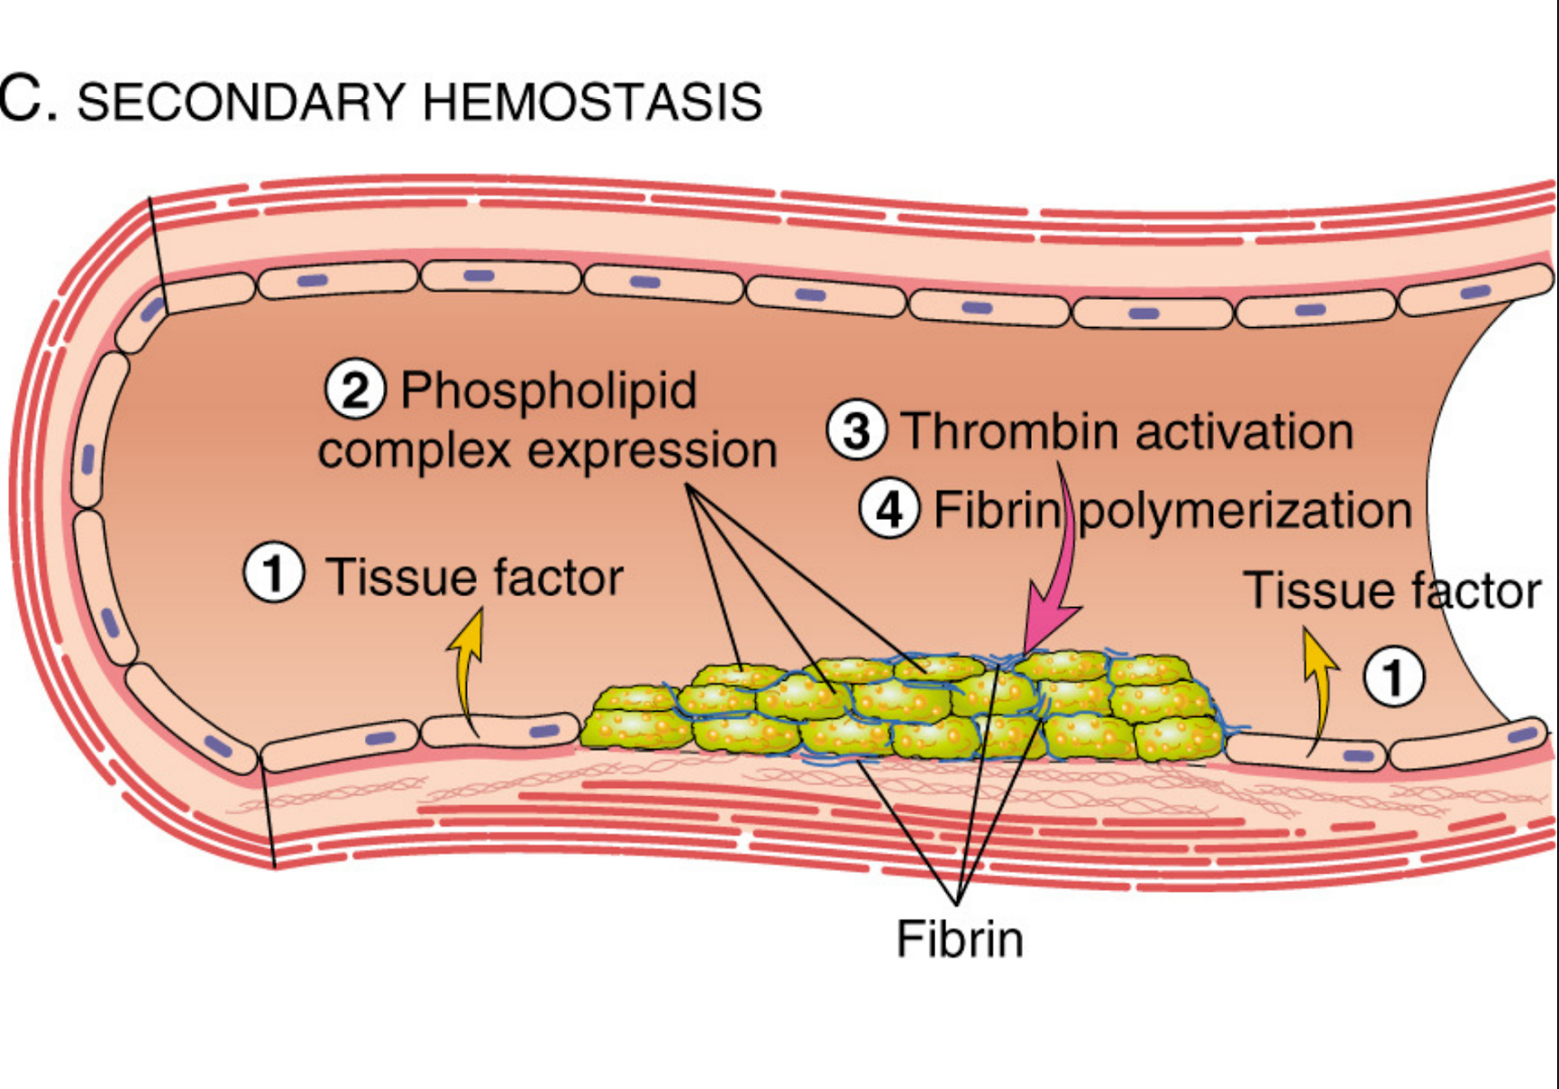
2
COAGULATION MECHANISMS
Lecture Seven
Features of Some Factors
Factors | Prothrombin (II) | Thrombin | Fibrinogen (I) | Fibrin-stabilizing factor (XIII)
Characteristics | Is a plasma protein, α2-globulin and its molecular weight is 68,700 Daltons Present in normal plasma in a concentration of 15 mg/dl. It is unstable protein that can be split easily into thrombin. | Is a protein enzyme with weak proteolytic capabilities It acts on fibrinogen to form one molecule of fibrin monomer. Fibrin monomers polymerize with one another to form fibrin fibers. Thrombin is essential in platelet morphological changes to form a primary plug. Thrombin stimulates platelets to release ADP & thromboxane A2; both stimulate further platelets aggregation.¹ It activates Factor XIII and Factor V. | is a high-molecular weight plasma protein (nearly 340,000 Daltons). Plasma concentration 100-700 mg/dl Little or no fibrinogen leaks from blood vessels.² | is a plasma protein, it is also released from platelets that is entrapped in the clot. It must be activated before it affects the fibrin fibers. Activated Factor XIII operates as an enzyme causing additional strength of fibrin meshwork, promoting cross-linking.
Site of Synthesis | Liver | Activated form of prothrombin | Liver | Liver and megakaryocytes (platelets)
Table 7-2
Blood Coagulation
Clot formation: A series of biochemical reactions leading to the formation of a blood clot within few seconds after injury.
The duration depends on the severity of the injury:
1-2 min→ Minor trauma.
15-20 sec→ Severe trauma.
Prothrombin (inactive thrombin) is activated by a long intrinsic or short extrinsic pathways.
This reaction leads to the activation of thrombin enzyme from inactive form prothrombin.
Thrombin will change fibrinogen (plasma protein) into fibrin (insoluble protein)
Figure 7-4
Figure 7-5
FOOTNOTES
Thromboxane A2 is a prostaglandin that causes vasoconstriction and platelet activation.
This occurs in normal conditions, in inflammatory conditions increased vascular permeability can promote extravasation of fibrinogen and possibly fibrosis.
A biochemical point to remember is that proteins are generally divided into structural and globular proteins, structural proteins are generally insoluble in water and mainly are not involved in metabolic reactions, like fibrin. Whereas globular proteins like enzymes perform a metabolic function and are water-soluble.

Slide 4
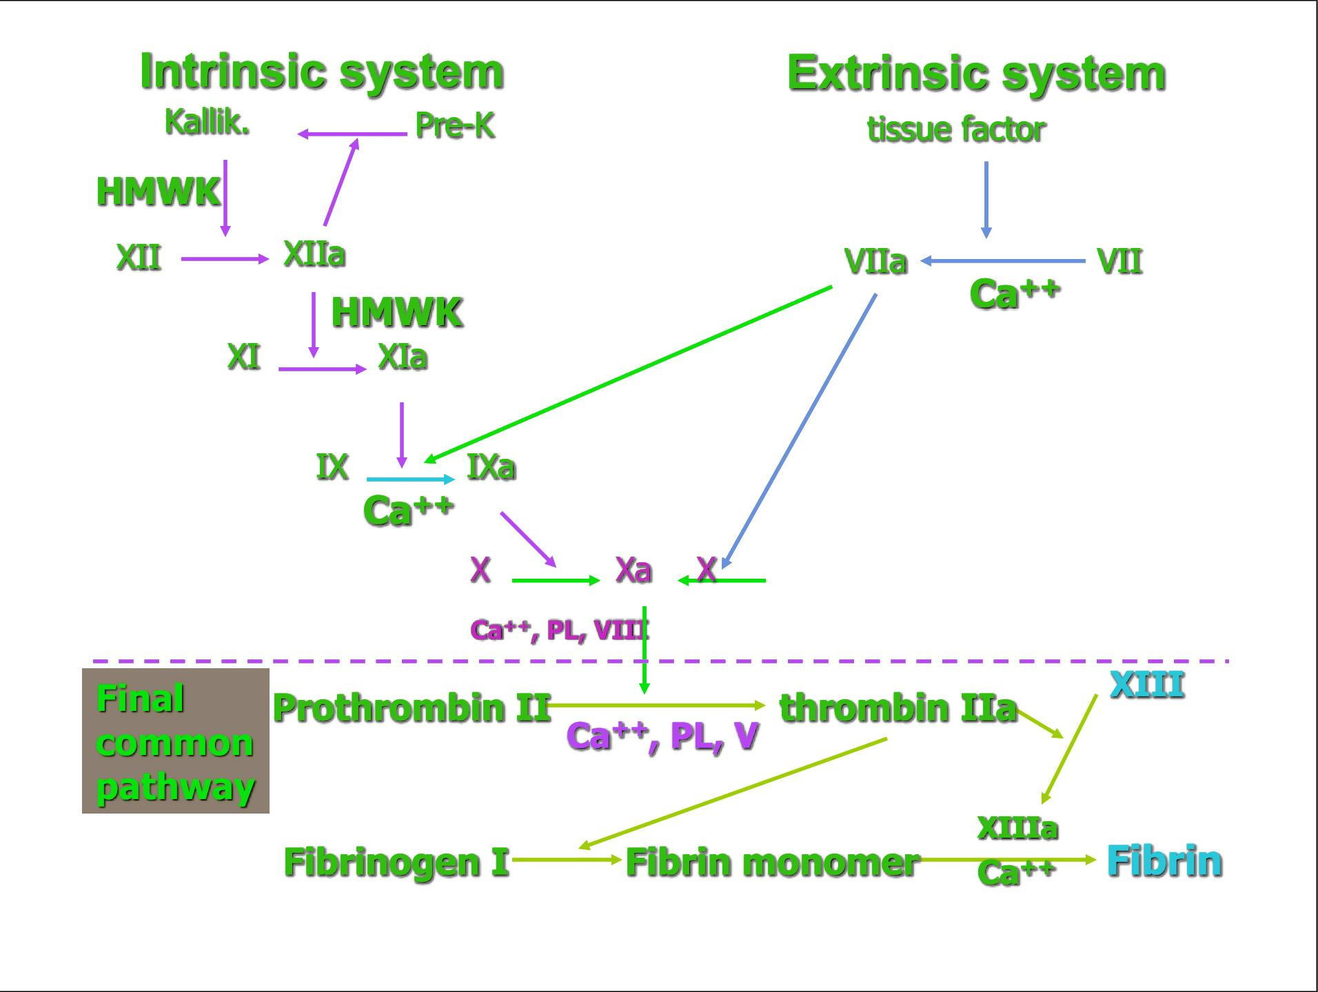
3
COAGULATION MECHANISMS
Lecture Seven
Coagulation Cascade: Classical Model
Figure 7-6 HMWK: High Molecular Weight. Kallikrein, a protease.
Intrinsic Pathway
Extrinsic Pathway
The trigger is the activation of factor XII by contact with foreign surface, injured blood vessel, and glass.¹ (all clotting factors present in the blood)
Activated Factor XII will activate Factor XI
Activated Factor Xl will activate Factor IX
Activated Factor IX + Factor VIII + platelet phospholipid factor (PF3) + Ca⁺⁺ activate Factor X
The trigger is release of tissue thromboplastin from damaged tissues and it is composed of phospholipids from the membranes of the tissue plus a lipoprotein complex that functions mainly as a proteolytic enzyme.
Tissue thromboplastin activates Factor VII
Tissue thromboplastin + Factor VII + Ca⁺⁺ activate Factor X
TF includes phospholipids from the membranes of the tissue plus a lipoprotein complex that functions mainly as a proteolytic enzyme.
Common Pathway
Following the above steps, the pathway is common for both intrinsic and extrinsic pathways.
Activated Factor X + Factor V +PF3 + Ca⁺⁺ activate prothrombin activator; a proteolytic enzyme which activates prothrombin.²
Activated prothrombin activates thrombin.
Thrombin acts on fibrinogen forming insoluble fibrin monomers.
Factor XIII + Ca⁺⁺ causes additional strength of fibrin meshwork → strong fibrin (strong clot)
FOOTNOTES
As in blood clotting within a glass tube.
To be exact, the molecule that causes thrombin activation is Factor Xa, however, once thrombin is activated it activates Factor V, and Factor V accelerates subsequent thrombin activation by combining with Xa. This is an example of positive feedback.

Slide 5
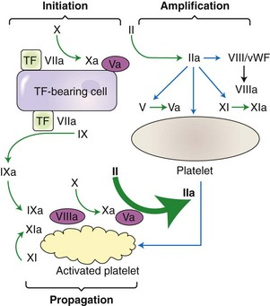
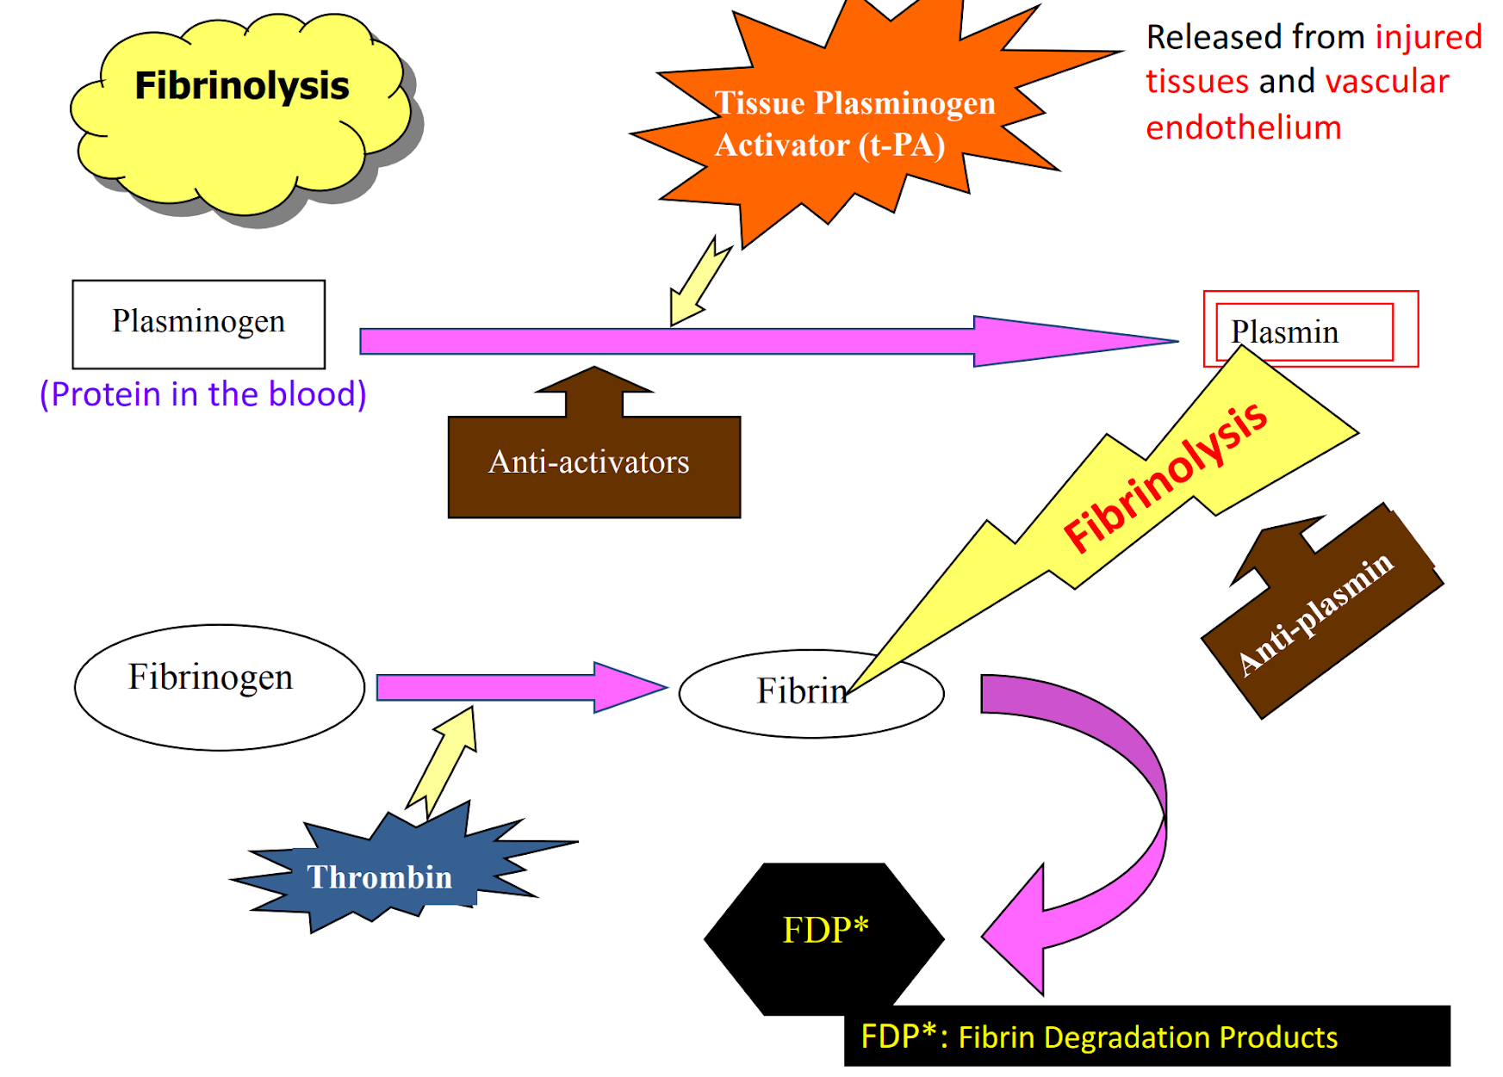
4
COAGULATION MECHANISMS
Lecture Seven
Coagulation Cascade: Cell-Based Model
Figure 7-7 This is an alternative method to describe coagulation but in a precise, cell-based manner. (This is a modified figure, the original slides figure can be seen here)
Damaged tissues express tissue factor on their surfaces, tissue factor acts as a receptor and an activator for factor VII, together they form a complex that activates factor X (much like the extrinsic pathway), and a non-specific activation of small amounts of factor IX. Activated factor X is expressed on the cell surface where it attracts factor V, together they activate small amounts of thrombin, this concludes the initiation phase.
Thrombin then acts on platelets causing their activation, activated platelets release chemotactic factors attracting other coagulation factors that attach to the cell’s surface, like factor VIII and factor XI, these factors were shown to be activated by the released thrombin. Activated factor VIII combines with factor IX from the initiation phase, and they activate larger amount of thrombin, this concludes the amplification phase.
Thrombin activates more platelets, and attracts more coagulation factors and the process of the previous stage is repeated, this is the propagation phase.
Clot Retraction When clot retracts (contracts), it expresses most of the fluid from the clot within 20-60 min called → Serum which cannot clot. Serum is plasma minus clotting factors.
Formed blood clot can either become fibrous or dissolved.
Fibrinolysis (dissolving): Breakdown of fibrin by naturally occurring enzyme plasmin therefore prevent intravascular blocking.
There is a balance between clotting and fibrinolysis
Excess clotting → blocking of blood vessels.
Excess fibrinolysis → tendency for bleeding.
Fibrinolysis
Figure 7-8
Figure 7-9
Figure 7-10
Role of Plasmin
Plasmin is present in the blood in an inactive form “plasminogen.”
It is activated by tissue plasminogen activators (t-PA) in blood.
Uses: Tissue Plasminogen Activator (t-PA) used to activate plasminogen to dissolve coronary clots. (an example for this is streptokinase)
Digests intravascular and extravascular deposit of fibrin → fibrin degradation products (FDP)
Unwanted effect of plasmin is the digestion of clotting factors.¹
Plasmin is controlled by:
Tissue Plasminogen Activator Inhibitor (t-PAI)
Antiplasmin from the liver

Slide 6
5
COAGULATION MECHANISMS
Lecture Seven
Conditions That Cause Excessive Bleeding
Vitamin K Deficiency
Hemophilia
Thrombocytopenia
Required for synthesis of prothrombin, factor VII factor IX, and factor X.
It leads to increased prothrombin Time.
Sources are diet and synthesis by intestinal bacterial flora
Deficiency is rare, but maybe seen in:
Hepatitis, cirrhosis, acute yellow atrophy¹ and GIT disease. Malabsorption syndromes, Biliary obstruction, Broad spectrum antibiotics, Dietary def (Neonates).
Treatment:
Treat the underlying cause
Vitamin K injections
Bleeding tendency.
X-linked recessive disease.
Affects males.
It leads to increased Activated Partial Thromboplastin Time(aPTT).
Types :
Hemophilia A due to deficiency of factor VIII small component(85%) .
Hemophilia B (Christmas disease) due to factor IX deficiency(15%) .
Hemophilia C (Rosenthal syndrome) due to factor XI deficiency and it affects both sexes.
Clinical Features includes : Easy bruising, massive bleeding after trauma or operation, hemorrhages in joints.
Very low number of platelets in blood (<50,000/μl and < 10,000 is fatal )
Etiology:
Decreased production such as Aplastic anemia, Leukemias, Drugs, Infections (HIV,Measles).
Increased destruction such as Immune Thrombocytopenia purpura, Drugs, Infections (HIV)
Thrombocytopenia purpura: hemorrhages throughout all the body tissues.
Idiopathic Thrombocytopenia: unknown cause.
Clinical features include:
Easy bruising, epistaxis, gum bleeding, hemorrhage after minor, trauma, petechiae.
Diagnosis:
PLT count decreased.
Bleeding time increased.
Treatment :
Treatment of the underlying cause.
Platelets concentrates.
Fresh whole blood.
Transfusion.
Spleenectomy.
Pseudothrombocytopenia²
Partial clotting of specimen
EDTA-platelet clumping
Platelet satellitism around WBCs
Cold agglutinins
Giant platelets
Von Willebrand Disease
It is an autosomal dominant disease due to defect in the large component of factor VIII .
It leads to increased :
Activated Partial Thromboplastin Time(aPTT).
Bleeding Time.
Table 7-3
FOOTNOTES
A fatal condition that leads to reduction in the liver’s size, and an overall degeneration of its functions in response to toxic chemicals.
It’s an in-vitro condition when taking blood samples, the platelets clump together and appear as few large platelets thereby mistakenly giving the impression of thrombocytopenia. This is associated with the use of EDTA as an anticoagulant, and the presence of cold agglutinin (autoantibodies) against platelets. As expected, antibodies can bind to WBC, therefore satellitism around WBC is also observed.

Slide 7
6
COAGULATION MECHANISMS
Lecture Seven
Test | Mechanism Tested | Normal Value | Disorder
Prothrombin time (PT) | Extrinsic and common pathway | <12s beyond neonate, 12-18s in-term neonate | Liver disease, defect in vitamin K-dependent factors, disseminated intravascular coagulation (DIC)
Activated partial thromboplastin time (aPTT) | Intrinsic and common pathway | 25-40s beyond neonate, 70s in-term neonate | DIC, von Willebrand disease, hemophilia
Platelet count | Platelet number | 150-450 cells per millimeter cubed | Thrombocytopenia
Bleeding time (BT) | Hemostasis, capillary and platelet function | 3-7 minutes beyond neonate | Thrombocytopenia, on Willebrand disease
Test | Hemophilia A | Hemophilia B | vW disease
Bleeding time (BT) | Normal | Normal | Prolonged
Prothrombin time (PT) | Normal | Normal | Normal
Activated partial thromboplastin time (aPTT) | Prolonged | Prolonged | Prolonged
Factor VIII | Low | Normal | Low or normal
Factor IX | Normal | Low | Normal
vW Factor | Normal | Normal | Low
Table 7-4 Screening tests and their significance.
Table 7-5 Hemostasis in hereditary coagulation disorders
Prevention of Blood Clotting and Anticoagulants
Endothelial Surface Factors
Smoothness of the endothelial cell surface (ECS)
Glycocalyx layer¹
Thrombomodulin protein
Thrombomodulin binds to thrombin Activates Protein C (with Protein S) inactivates factors V & VIII and inactivates an inhibitor of tPA increasing the formation of plasmin.:
Fibrin Fibers
Adsorbs 85-90% of thrombin to remove it from circulation.
Antithrombin III
Combines the remaining thrombin (10-15%) and removes it from circulation.
Warfarin (used in vivo)
Decreases the production of Vit. K dependent clotting factors (II, VII, IX and X) by liver (Monitored by PT time).
Heparin
A negatively charged polysaccharide that combines with antithrombin III and quickly removes thrombin from blood.
Sources: Mast cells and basophils which are abundant in liver and lungs.
Ir increases antithrombin III effectiveness by 100-1000 fold.
Also remove Factors XII, XI, X, and IX (Monitored by PTT time).
Taken parenterally, can not be taken orally, since it is a large molecule and highly charged.
It’s the most widely used anticoagulant clinically, as in stroke.
α₂-macroglobuIin
Synthesized mainly in liver and acts as a binding agent for several coagulation factors.
Inhibits thrombin.
Anticoagulants Used in vitro² No Ca++ → no Clotting (needed in many steps).
Citrate ions → Deionization of Ca++
Oxalate ions → Precipitate the Ca++
Ethylenediaminetetraacetic acid (EDTA) → chelates (binds) calcium ions
Heparin → Binds to AT III
FOOTNOTES
Glycocalyx is a mucopolysaccharide on the surface of endothelial cells that repels clotting factors and platelets, preventing coagulation.
These anticoagulants are useful in determining partial thromboplastin and prothrombin time, this is done in the following manner: after a blood sample is taken, EDTA, citrate or oxalate are added to prevent activation of prothrombin, since they sequester and de-ionize calcium. After that, a huge amount of calcium and tissue factor are added, this will nullify the effect of oxalate or citrate and the time taken for the blood to clot is the prothrombin time. This tests the extrinsic pathway. To test the intrinsic pathway silica or other substance that cause activation factor XII are added, and the time taken for the blood to clot is the activated partial thromboplastin time, this tests the intrinsic pathway.

Slide 8
7
COAGULATION MECHANISMS
Lecture Seven
Figure 7-11 Summary of thrombin’s actions

Slide 9
Which of the following minerals found naturally in the body plays an essential role in the coagulation cascade?
Gold
Aluminium
Magnesium
Calcium
2. An essential vascular protective mechanism that is affected in smokers and hyperlipidemic patients and serves to protect against excessive activation of the coagulation cascade:
Smoothness of endothelial surface layer
Increased activity of plasmin
Deficiency of christmas factor
Vitamin K deficiency
3. A vasoconstricting prostaglandin playing an important role in initiating the hemostatic process:
Prostaglandin E2
Thromboxane A2
ADP
Prothrombin
4. The initiating step of the extrinsic pathway is:
Release of tissue thromboplastin
Conversion of prekallikrein to kallikrein
Activation of Factor VI
Activation of Factor XII
5. The most common cause for hemophilia is an X-linked deficiency in encoding which of the following factors:
Factor IV
Antihemophilic Factor B
Factor VIII
Factor III
SHORT ANSWER QUESTIONS
Name two factors activated by thrombin.
Name three physiological anticoagulants.
ANSWERS
Factor V and XIII
Heparin, protein C, antithrombin III
ANSWER KEY: D, A, B, A, C

Slide 10
Nayef Alsaber, Hameed M. Humaid
FEMALE PHYSIOLOGY CO-LEADERS
Maha Alnahdi, Taif Alshammari
MALE PHYSIOLOGY CO-LEADERS
Nayef Alsaber, Hameed M. Humaid
REFERENCES
Guyton and Hall Textbook of Medical Physiology
Ganong’s Review of Medical Physiology

