Slide 1
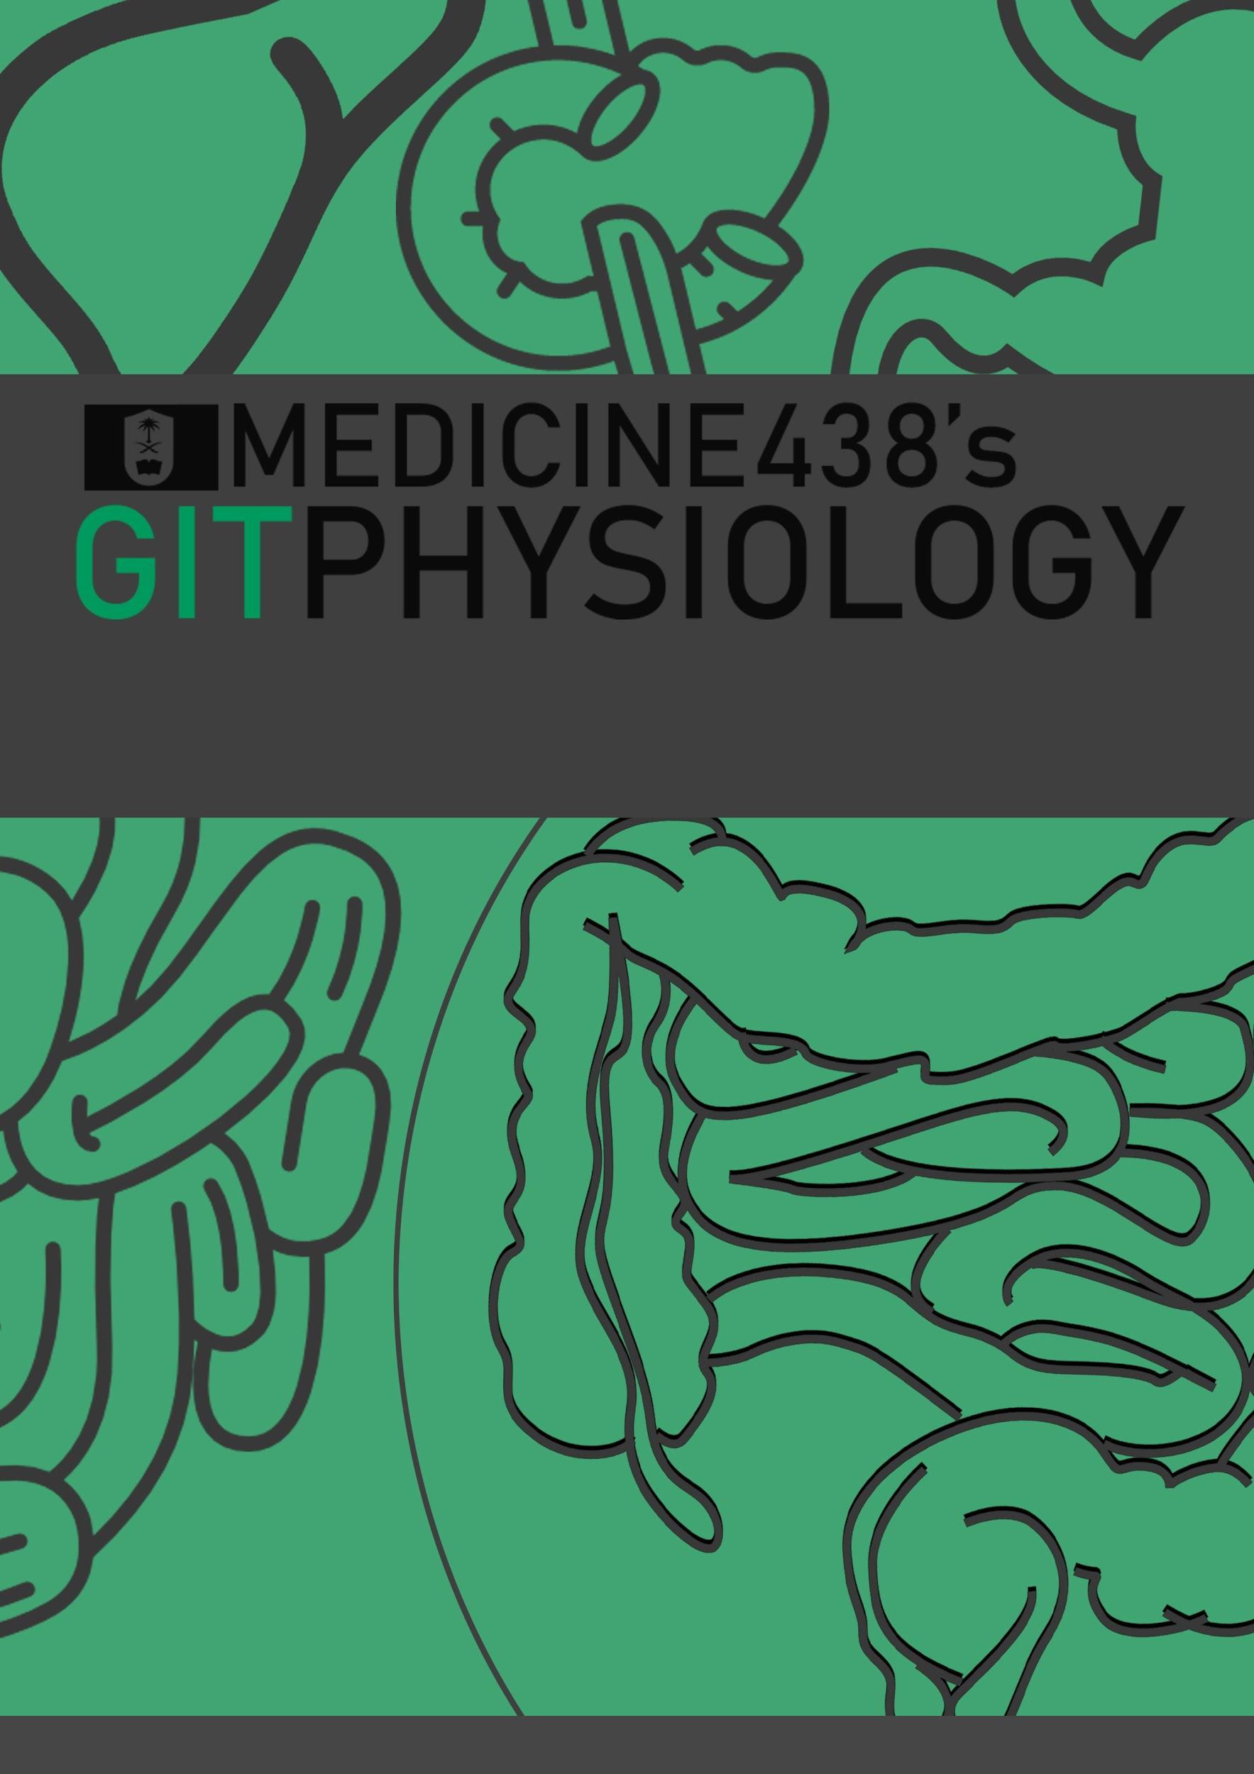
LECTURE VIII: Physiology of Bile Salts and Enterohepatic Circulation
EDITING FILE
IMPORTANT
MALE SLIDES
EXTRA
FEMALE SLIDES
LECTURER’S NOTES

Slide 2
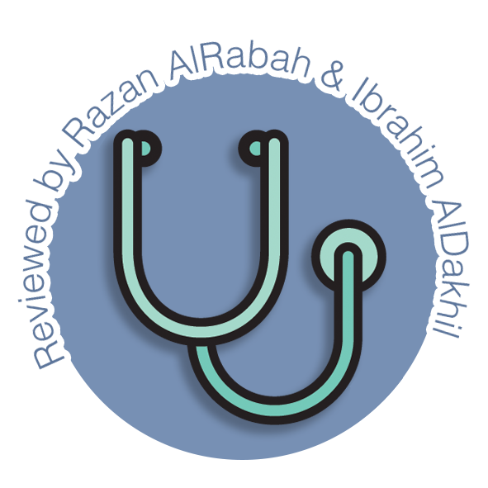
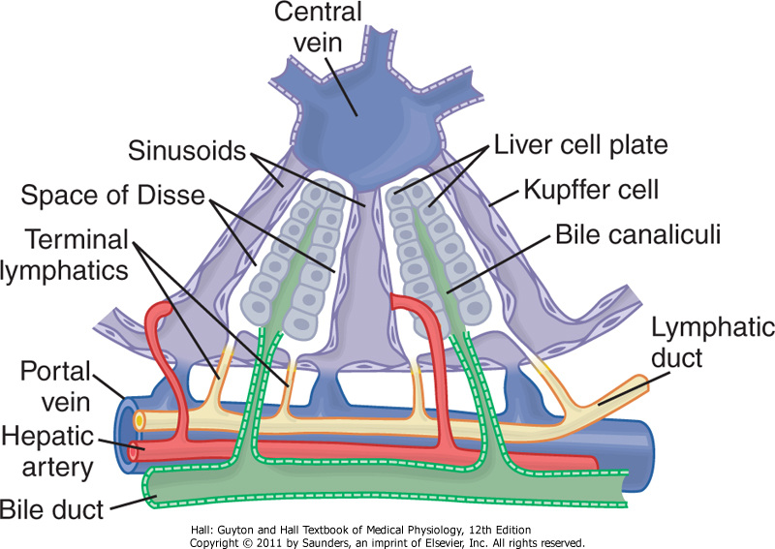
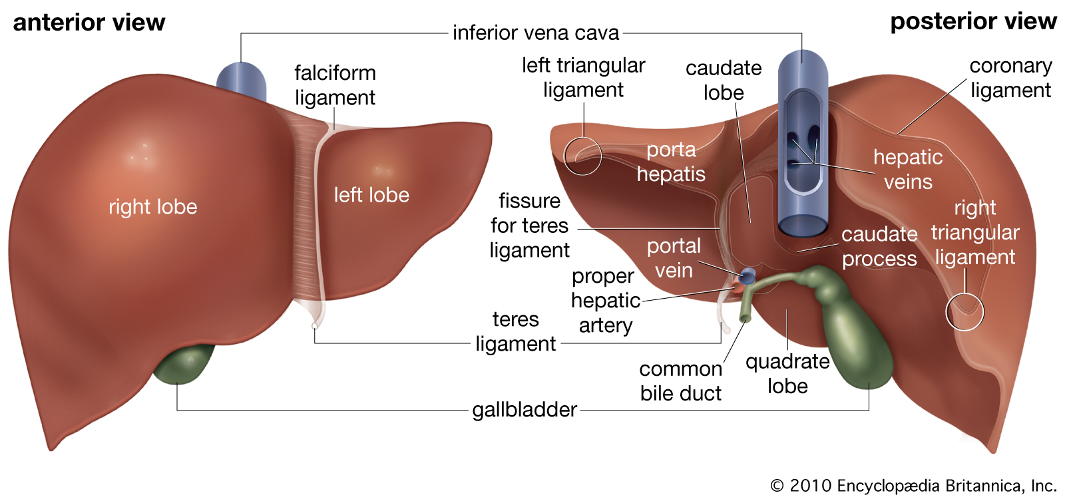
1
PHYSIOLOGY OF BILE SALTS AND ENTEROHEPATIC CIRCULATION
Lecture Eight
OBJECTIVES
Liver Digestive Functions.
Physiologic Anatomy of Biliary Secretion.
The Components of Bile.
What is the bile acid? & What are the types of the bile acid?
Storing and Concentrating Bile in the Gallbladder.
Function of Bile Salts in Fat Digestion and Absorption.
Enterohepatic Circulation of Bile Salts.
The mechanisms of bile reabsorption back into hepatocytes.
THE LIVER
The largest internal organ in the body, constituting about 2.5% of an adult’s body weight.
Receives 25% of the cardiac output via the hepatic portal vein and hepatic artery.
Takes up, stores, and distributes nutrients and vitamins.
Plays an important role in maintaining blood glucose levels.
Regulates the circulating blood lipids by the amount of very low–density lipoproteins (LDL) it secretes.
Synthesizes many of the circulating plasma proteins.
Takes up numerous toxic compounds and drugs from the portal circulation.
Performs important endocrine functions. (IGF-1, thrombopoietin and angiotensinogen secretion)¹
Serves as an excretory organ for bile pigments, cholesterol, and drugs.
PHYSIOLOGY OF BILE SALTS AND ENTEROHEPATIC CIRCULATION
Figure 8-1 Bile Canaliculi & Ducts.
Figure 8-2 The Anatomy of the Liver.
THE MAIN DIGESTIVE FUNCTION OF THE LIVER:
The main digestive function of the liver is the secretion of bile (normally 600-1000 ml/day).
FOOTNOTES
IGF-1 or Insulin-like growth factor-1 is secreted by the liver in response to growth hormone stimulation. It has receptors all over the body and enhances neural, renal even muscular development. Thrombopoietin as the name suggests, stimulates the differentiation of megakaryocytes into platelets.

Slide 3
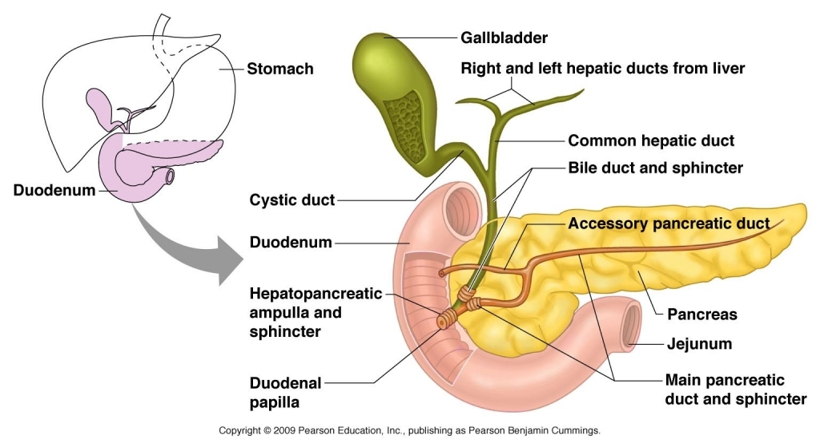
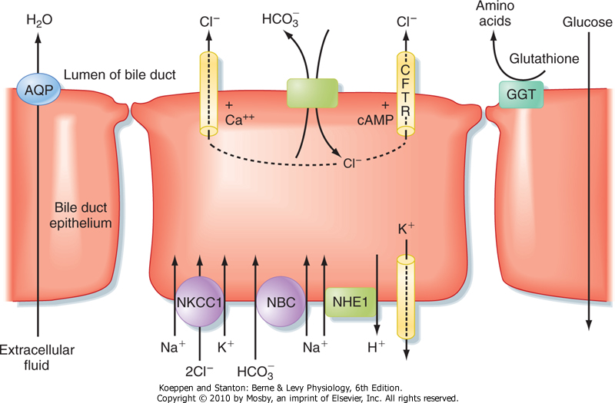
2
PHYSIOLOGY OF BILE SALTS AND ENTEROHEPATIC CIRCULATION
Lecture Eight
FUNCTIONS OF BILE
Fat Digestion And Absorption
Emulsifying the large fat particles of the food into minute particles.
They aid in absorption of the digested fat end products through the intestinal mucosal membrane, via micelles formation.
Excretion Of Waste Products From The Blood
These include especially bilirubin, an end product of hemoglobin destruction.
The common bile duct open into the duodenum in company with the pancreatic duct at the ampulla of vater.
This opening is guarded by the sphincter of Oddi (choledochoduodenal sphincter).
Figure 8-3 The Gallbladder.
Gallbladder Bile Differs From Hepatic Bile
Bile Is Secreted In Two Stages
First Stage:
The initial portion is secreted by the hepatocytes. It is secreted into bile canaliculi that originate between the hepatic cells.
The bile flows in the canaliculi toward the hepatic duct and common bile duct.
From here the bile empties directly into the duodenum.
Hepatic bile: Isotonic secretion, with high Na⁺, Cl⁻ and HCO₃⁻ and low K⁺ and Ca⁺⁺.
Second Stage:
Bile can be diverted for minutes up to several hours through the cystic duct into the gallbladder (second portion of liver secretion, added to the initial bile).
Gallbladder bile: high bile acid anion and Ca⁺⁺; but low Na⁺, Cl⁻, HCO₃⁻ and H₂O.
Figure 8-4 The major transport processes of cholangiocytes that secrete an alkaline-rich fluid, There is an Active reabsorption of Glucose and A.A. to prevent bacterial growth.

Slide 4
3
PHYSIOLOGY OF BILE SALTS AND ENTEROHEPATIC CIRCULATION
Lecture Eight
CHARACTERISTICS OF BILE
Bile: is a viscous golden yellow or greenish fluid.
pH: It’s isotonic with plasma and slightly alkaline (due to NaHCO₃). It participates in neutralization of acid chyme delivered from stomach.
Volume: The liver produces about 5 L/day, but only 600-1000 ml/day are poured into the duodenum.
COMPONENT OF BILE
Cholesterol
4%
(From Hepatocytes)
Bile pigments
0.3% as bilirubin
(From Hepatocytes)
Ions and Water
(Aqueous alkaline solution)
Mainly HCO₃⁻ & H₂O
(From bile ducts epithelial cells), contribute to the volume of hepatic bile
Phospholipids (Lecithin),
Phosphatidylcholine
20% as lecithin
(From Hepatocytes)
Proteins
5%
(From Hepatocytes)
Bile acids (Bile salts)
65% of weight of bile
(From Hepatocytes)
Differences Between Hepatic & Gallbladder Bile
 | Hepatic Bile | Gallbladder Bile
Water | 98% | 89%
Total solids | 2-4% | 11%
Bile salts | 26 | 145
Bilirubin | 0.7 | 5
Cholesterol | 2.6 | 16
Phospholipids | 0.5 | 4
Na+ | 145 | 130
HCO3- | 28 | 10
Ca+2 | 5 | 23
Cl- | 100 | 25
K+ | 5 | 12
pH | 8.3 | 7.5
Table 8-1 The numbers are only for illustration, no need to memorize it according to doctors.

Slide 5
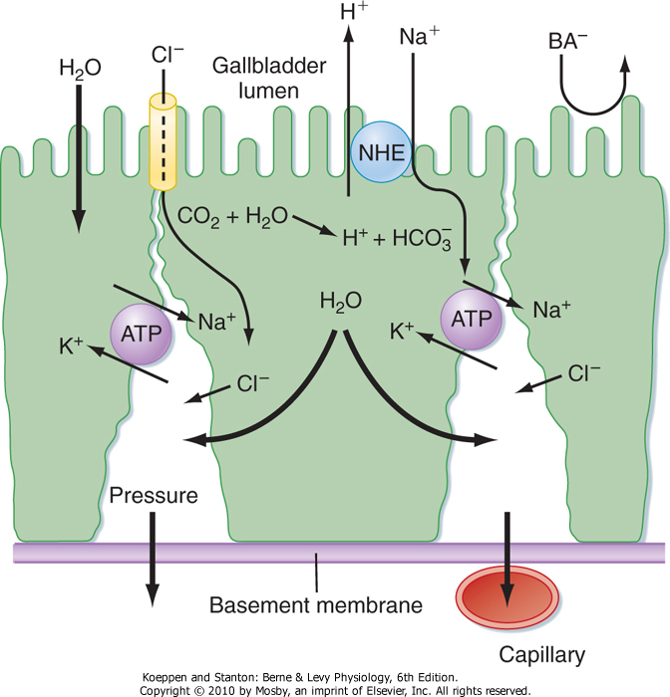
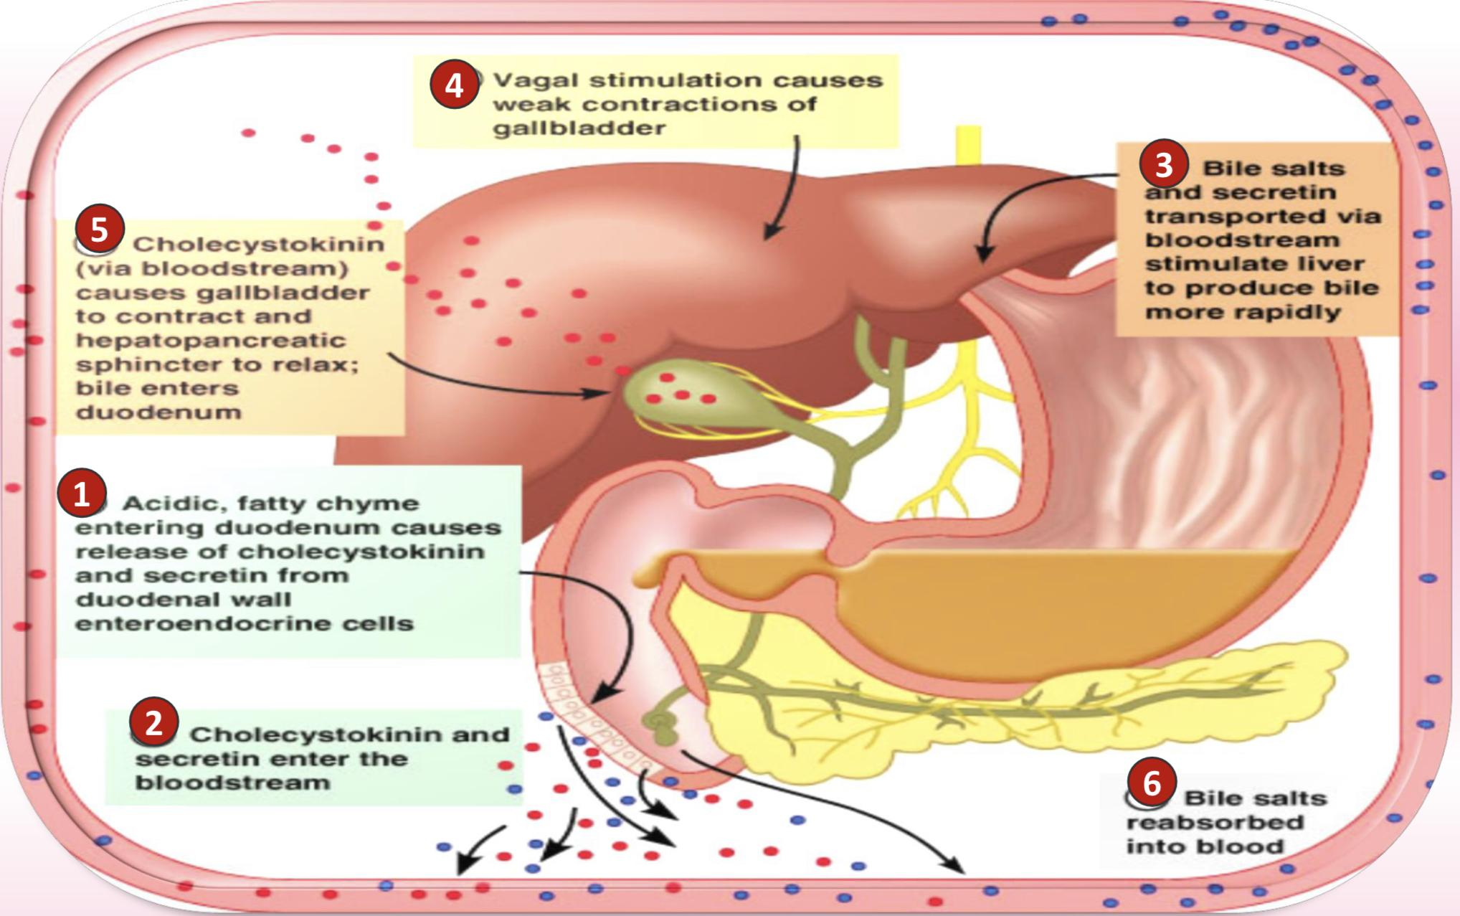
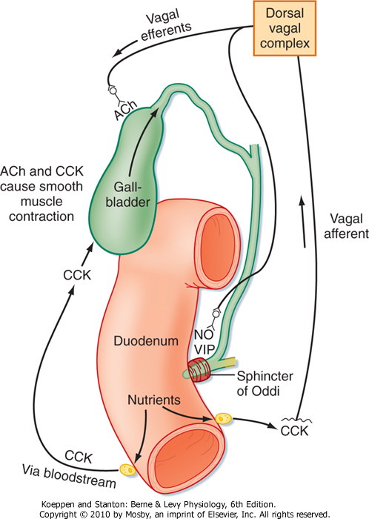
4
PHYSIOLOGY OF BILE SALTS AND ENTEROHEPATIC CIRCULATION
Lecture Eight
STORING & CONCENTRATING BILE IN THE GALLBLADDER
Bile is secreted continually by the liver cells and then normally stored in the gallbladder until needed in the duodenum (gallbladder can hold 30 to 60 mL).
Gallbladder concentrates the bile, which has the bile salts, cholesterol, lecithin, and bilirubin during every 12 hours of bile secretion (usually about 450 mL).
Concentration is due to water, Na, Cl, and most other small electrolytes being continually absorbed through the gallbladder mucosa by active transport of sodium, followed by secondary absorption of chloride ions, water, and most other diffusible constituents.
CFTR: Cystic fibrosis transmembrane conductance regulator (chloride channel).
The tight junctions have low permeability, they resist the passage of Bile Acid anions (BA) out of the lumen.
Bile is normally concentrated in this way about 5-fold, but it can be concentrated up to a maximum of 20-fold.
PHYSIOLOGY OF BILE SALTS AND ENTEROHEPATIC CIRCULATION
Figure 8-5
REGULATION OF BILE SECRETION
Figure 8-6, Regulation of bile secretion in different pathways
Figure 8-7, Neurohumoral control of gallbladder contraction and biliary secretion

Slide 6
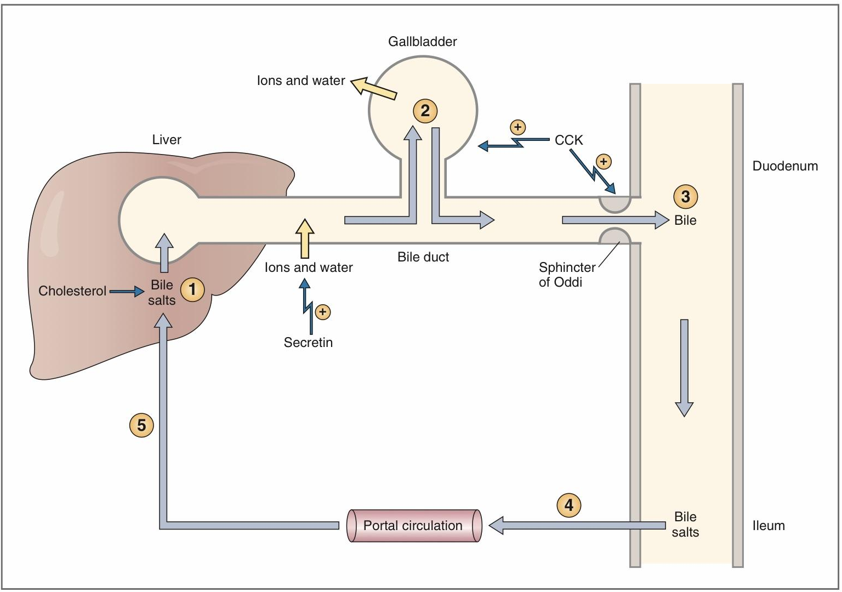
5
PHYSIOLOGY OF BILE SALTS AND ENTEROHEPATIC CIRCULATION
Lecture Eight
REGULATION OF BILE SECRETION
Bile secretion is primarily regulated by a feedback mechanism, with secondary hormonal and neural controls.
The major determinant of bile acid synthesis is its concentration in hepatic portal blood (feedback control).¹
CCK, Secretin & estrogen stimulate bile secretion (hormonal control).
Parasympathetic (vagal) stimulation results in contraction of the gallbladder and relaxation of the sphincter of Oddi, as well as increased bile formation.
Bilateral vagotomy results in reduced bile secretion after a meal, suggesting that the parasympathetic nervous system plays a role in mediating bile secretion.
By contrast, stimulation of the sympathetic nervous system results in reduced bile secretion and relaxation of the gallbladder.
SECRETION AND ENTEROHEPATIC CIRCULATION OF BILE SALTS
It is essential for stimulating & maintaining the secretion of bile by hepatocytes.
The greater the quantity of bile salts in the enterohepatic circulation, the greater the rate of bile secretion.
The hepatocytes of the liver continuously synthesize and secretes bile.
Bile flows out of the liver through the bile ducts and fills the gallbladder, where it is stored.
The gallbladder then concentrates the bile salts by absorption of water and ions.
When chyme reaches the small intestine, CCK is secreted.
CCK has two separate but coordinated actions on the biliary system: (a) It stimulates contraction of the gallbladder and (b) relaxation of the sphincter of Oddi, causing bile release into duodenum.
In the small intestine, the bile salts emulsify and solubilize dietary lipids. When lipid absorption is complete, the bile salts are recirculated to the liver via the enterohepatic circulation.
The steps involved in the enterohepatic circulation include absorption of bile salts from the ileum into the portal circulation, delivery back to the liver, and extraction of bile salts from the portal blood by the hepatocytes.
Figure 8-8
Feedback control of biliary secretions
Abbreviation:
Bile salt export pump (BSEP).
Bile acid-Na⁺independent (OATP).
Bile salt-Na⁺ coupled (Ntcp).
Multiple organic anion transporter (MOAT).
Apical Na⁺ dependent Bile salt transporter (ASBT).
FOOTNOTES
Bile acids absorbed from the intestines enter the portal vein where they reach the basolateral border of hepatocytes, there they activate nuclear receptors on basolateral surface of hepatocytes, this result in the transcription of channels on the apical membrane of hepatocytes (facing bile canaliculi) that secrete bile acids into bile canaliculi. Hence, increased return of bile acids increases secretion of bile acids.

Slide 7
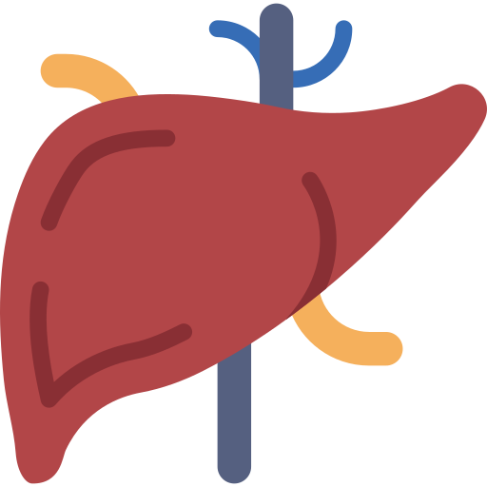
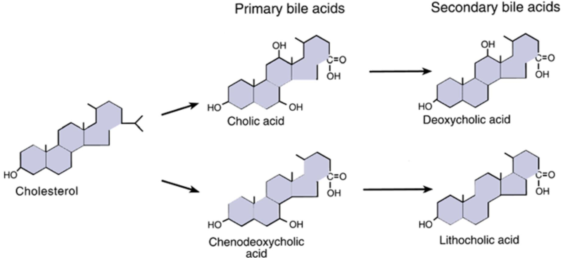
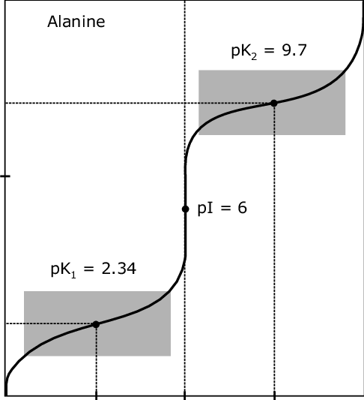
6
PHYSIOLOGY OF BILE SALTS AND ENTEROHEPATIC CIRCULATION
Lecture Eight
BILE ACID AND THE TYPES OF BILE ACIDS
Bile acids are steroid acids, synthesized in the liver from cholesterol. During the conversion, hydroxyl groups (by 7α- hydroxylase) and a carboxyl group are added to the steroid nucleus.
Bile acids are classified as primary or secondary.
Primary: Cholic, Chenodeoxycholic acids.
Secondary: Deoxycholic, Lithocholic acids.
The hepatocytes synthesize the primary bile acids (by C 27-dehydroxylase).
Bile acids are secreted as conjugates of taurine or glycine. When bile enters the intestine, bacteria present in the lumen act on the primary bile acids and convert them to secondary bile acids by dehydroxylation and deconjugation.
Cholic acid is converted to deoxycholic acid and chenodeoxycholic acid to lithocholic acid, which is cytotoxic and can be sulfated by the liver if it presents in high concentration.
Figure 8-9
CHEMICAL PROPERTIES OF BILE ACIDS
At a neutral pH, the bile acids are mostly ionized (zwitterion form)¹, more water soluble and are present almost entirely as salts of various cations (mostly Na+) e.g., sodium glycocholate and are called bile salts.
Conjugated bile acids ionize more readily than the unconjugated bile acids.
The conjugation biochemical reaction decreases the pKa² of the compound and make it more ionized.
Bile salts are much more polar than bile acids and have greater difficulty penetrating cell membranes.
Consequently, the small intestine absorbs bile salts much more poorly than bile acids. This property of bile salts is important because they play an integral role in the intestinal absorption of lipid.
Therefore, it is important that the small intestine absorb bile salts only after all of the lipid has been absorbed.
LINDA S. COSTANZO
Bile is necessary for the digestion and absorption of lipids in the small intestine. Compared with carbohydrates and proteins, lipids pose special problems for digestion and absorption because they are insoluble in water. Bile, a mixture of bile salts, bile pigments, and cholesterol, solves this problem of insolubility. Bile is produced and secreted by the liver, stored in the gallbladder, and ejected into the lumen of the small intestine when the gallbladder is stimulated to contract. In the lumen of the intestine, bile salts emulsify lipids to prepare them for digestion and then solubilize the products of lipid digestion in packets called micelles.
Figure 8-10
FOOTNOTES
Bile salts exist in zwitterion form, meaning they have positively charged ends and negatively charged ends, this maximizes their solubility since the negative end or positive end can bind with the partial positive charge of H⁺ in H₂O.
PKa refers to the minimum pH at which an acid donates a proton, stronger acids have lower pKas, meaning they give protons quite easily and become charged and soluble.

Slide 8
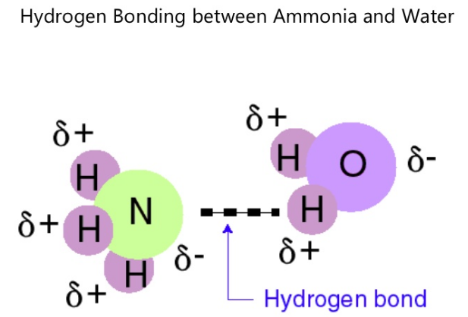
7
PHYSIOLOGY OF BILE SALTS AND ENTEROHEPATIC CIRCULATION
Lecture Eight
FUNCTION OF BILE ACIDS
DIGESTION OF FATS: They have a detergent action (emulsifying) on the fat particles in the food which decreases the surface tension (explained below) of the particles. This increases the surface area for maximal action of digestive enzymes.
ABSORPTION OF FATS: Bile salts combine with fats to form micelles (water soluble compounds) from which fatty acids, monoglycerides, cholesterol, and other lipids from the intestinal tract.
Without the presence of bile salts in intestinal tract up to 40% of lipids are lost into the stools (steatorrhea).
ABSORPTION OF FAT-SOLUBLE VITAMINS (A, K, E, D)
STIMULATING BILE SECRETION AND FLOW A process known as “choleretic flow”
INCREASE SOLUBILITY OF CHOLESTEROL IN BILE
ROLE OF BILE SALTS TO ACCELERATE FAT DIGESTION & FORMATION OF MICELLES
Bile acids are amphipathic that have the ability to form micelles (each bile salt molecule is composed of a sterol nucleus that is fat-soluble and a polar group that is water-soluble).
Micelles are small spherical, cylindrical globules 3 to 6 nm in diameter composed of 20 to 40 molecules of bile salt.
In bile acid micelle, the hydrophobic side of bile acid faces inside & away from water. The hydrophilic surface faces outward towards the water.
The polar groups are (-) charged, they allow the entire micelle globule to dissolve in the water of the digestive fluids and to remain in stable solution.
The micelles act as a transport medium to carry the monoglycerides and free fatty acids to the brush borders of the intestinal epithelial cells.
Bile acid micelles form when the conc. of bile acids exceed a certain limit (critical micelle conc.). Above this conc., any additional bile acid will join the micelle.
Normally bile acid conc. in bile is much greater than critical micelle conc.
WHAT MAKES A COMPOUND POLAR? HOW EMULSIFICATION WORKS (EXTRA)
One of the strongest determinant of polarity is the ability to form hydrogen bonds. This happens in the following manner:
Water consists of H2O, H+ has a partial positive charge whilst a O has a partial negative charge due to higher electronegativity (electrons are more pulled towards oxygen).
The partial positive charge of hydrogen can interact with the partial negative charge of other molecules, such as ammonia as seen in the figure on the right. This is a weak bond between two molecules “intermolecular” hydrogen bond.
In an aqueous solution, lipids tend to be sequestered centrally, and are stabilized this way.
What bile salts do, is that the hydrophobic end of bile salt is bound in the center with the lipids, but the charged end form hydrogen bonds with the watery solution of the environment. This slightly tears the lipids of the center away from one another by the bile salts due to the bile salts being pulled by the binding with the watery solution and increases the surface area of individual lipid particles for the digestive enzymes to act on individual lipid particles, this is basically emulsification.
Surface tension the force that pulls particles inward in a solution, since as we mentioned, bile salts pull lipids slightly away from one another and pulls them toward the watery environment, the surface tension is decreased.
Figure 8-11
Figure 8-12

Slide 9
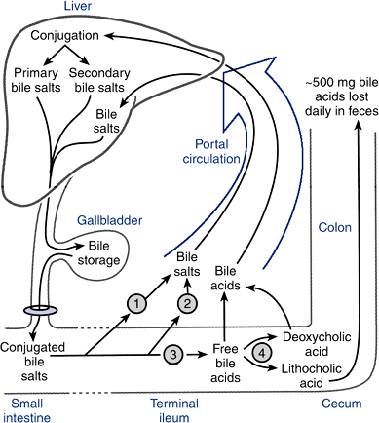
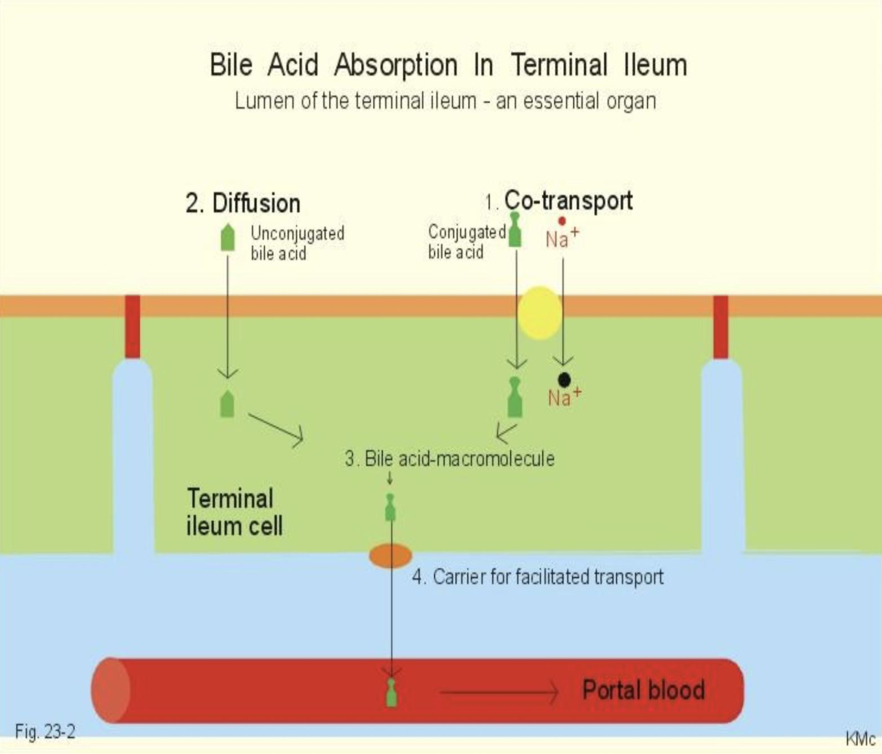
8
PHYSIOLOGY OF BILE SALTS AND ENTEROHEPATIC CIRCULATION
Lecture Eight
ENTEROHEPATIC CIRCULATION (PORTAL CIRCULATING) OF BILE SALTS
The enterohepatic circulation of bile salts is the recycling of bile salts between the small intestine and the liver.
The total amount of bile acids in the body, primary or secondary, conjugated or free, at any time is defined as the total bile acid pool.
In healthy people, the bile acid pool ranges from 2-4 g.
The enterohepatic circulation of bile acids in this pool is physiologically extremely important. By cycling several times during a meal, a relatively small bile acid pool can provide the body with sufficient amounts of bile salts to promote lipid absorption.
In a light eater, the bile acid pool may circulate three to five (3-5) times a day; in a heavy eater, it may circulate 14 to 16 times a day.
If enterohepatic circulation is interrupted (e.g. due to obstruction or surgical removal
or inflammation of the terminal ileum), bile flow is markedly reduced.
About 5-15 g of bile acids are poured into the duodenum day.
On reaching the terminal ileum, about 95% of bile acids are absorbed, and reach the liver through the portal vein.
About 0.3-0.5 g of bile acids are lost in feces daily (15- 35% of total bile acid pool). These are replaced by new synthesis in liver.
5% of bile is lost in feces.
Figure 8-13 Bile salts are recycled.
ABSORPTION OF BILE ACIDS IN INTESTINAL LUMEN
The intestine is normally extremely efficient in absorbing the bile salts by carriers located in the terminal ileum.
Bile salts or bile acids in the intestine lumen are absorbed via four pathways into portal circulation (enterohepatic circulation):
An active carrier-mediated process (Apical Na+ dependent Bile salt transporter (ASBT) (Conjugated bile acids, 2ry active transported. Powered by Na gradient across the brush border membrane).
Simple diffusion (Unconjugated bile acids, less polar).
Deconjugation and/or transforming of bile salts to bile acids (by bacteria).
Transforming the primary bile acids to secondary bile acids (by bacteria).
Figure 8-14

Slide 10
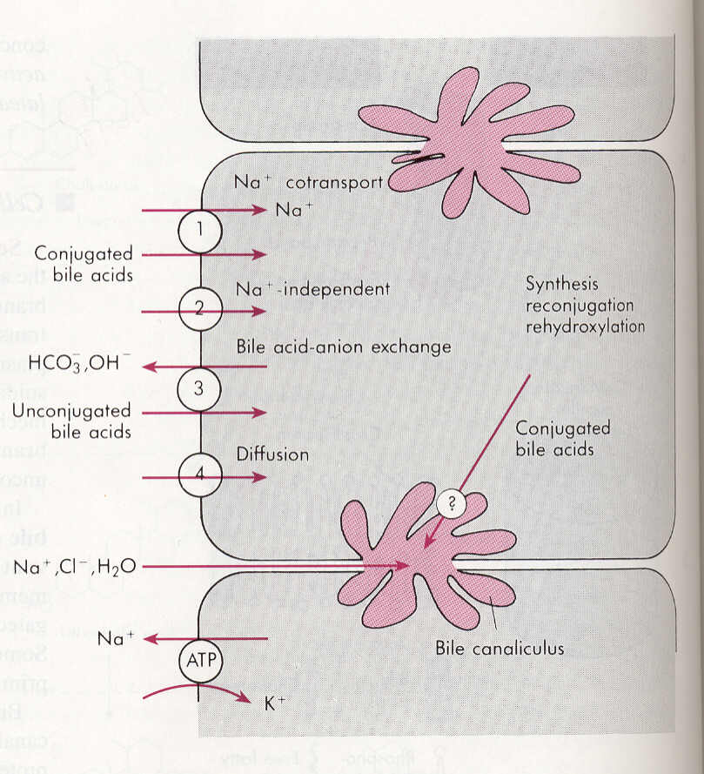
9
PHYSIOLOGY OF BILE SALTS AND ENTEROHEPATIC CIRCULATION
Lecture Eight
PATHOLOGICAL CORRELATION
Inflammation of the ileum can lead to their malabsorption and result in the loss of large quantities of bile salts in the feces e.g., inflammatory bowel diseases (Crohn’s disease and ulcerative colitis).
Depending on the severity of illness, malabsorption of fat may result in steatorrhea (fat in stool) because bile salt pool was depleted following the ileal inflammation or resectioning.
Presence of bile salt in the colonic lumen will activate Cl secretion, Na and water will follow Cl into the intestinal lumen, producing secretory diarrhea.
ABSORPTION OF BILE ACID OR BILE SALT BACK INTO HEPATOCYTES
Hepatocytes extract bile acids, essentially clearing the bile acids from the blood in a single pass through the liver.
In the hepatocytes, most deconjugated bile acids are reconjugated & some secondary bile acids are rehydroxylated.
The reprocessed bile acids, together with newly synthesized bile acids, are secreted into bile.
Bile salts or bile acids in the portal circulation are absorbed via four pathways into hepatocytes:
An active carrier-mediated process: Conjugated bile acids-Na co-transport (Bile salt-Na+ coupled (Ntcp).
Na-independent pathway (Bile acid-Na+independent (OATP).
Bile acid-HCO3 or Bile acid-OH exchange.
Passive diffusion (very little).
Figure 8-15

Slide 11
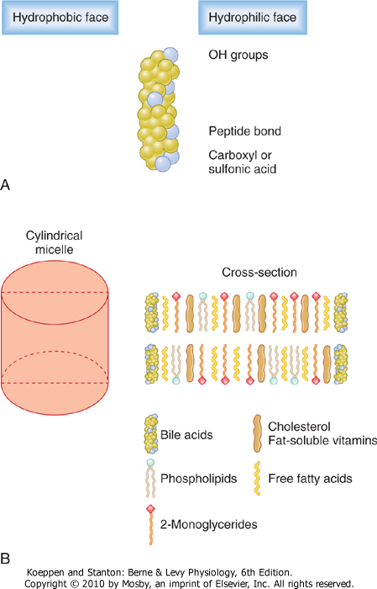
10
PHYSIOLOGY OF BILE SALTS AND ENTEROHEPATIC CIRCULATION
Lecture Eight
SUMMARY
COMPONENT OF BILE
Cholesterol
4%
(From Hepatocytes)
Bile pigments
0.3% as bilirubin
(From Hepatocytes)
Ions and Water
Mainly HCO3- & H2O
(From Bile ducts epithelial cells), contribute to the volume of hepatic bile
Phospholipids (Lecithin),
Phosphatidylcholine
20% as lecithin
(From Hepatocytes)
Proteins
5%
(From Hepatocytes)
Bile acids (Bile salts)
65% of weight of bile
(From Hepatocytes)
Bile salts or bile acids in the intestine lumen are absorbed via four pathways into portal circulation (enterohepatic circulation):
diffusion.
An active carrier-mediated process (Apical Na+ dependent Bile salt transporter (ASBT).
Deconjugation and/or transforming of bile salts to bile acids (by bacteria).
Transforming the primary bile acids to secondary bile acids (by bacteria).
Micelles Formation

Slide 12
The liver regulates the circulating blood lipids by amount of:
VLDL
HDL
Cholesterol
TAG
Hepatic bile isotonic secretion has high.......... and low..........:
Ca, K
Na, Cl
HCO, Na
Cl, Ca
3. Liver bile is:
Isotonic
Isotonic and slightly alkaline
Isotonic and slightly acidic
Alkaline
4. Which one of the following is not a component of bile:
Bile pigments
LDL
Lecithin
Phospholipids
5. Hormonal control of bile secretion by:
CCK
5-HT
Gastrin
Progesterone
6. Removal of the terminal ileum will most likely result in which of the following?
Decreased water content of the feces
Decreased bile acid concentration in the enterohepatic circulation
Increased absorption of fatty acids
Increased iron absorption
7. Which of the following would be expected with contraction of the gallbladder following a meal?
It is inhibited by the presence of amino acids in the duodenum
It is stimulated by atropine
It occurs in response to cholecystokinin
It occurs simultaneously with the contraction of the sphincter of Oddi
8. Which one of the following best describes bile acid function?
They are essentially water insoluble
The majority of bile acids are absorbed by passive diffusion
Glycine conjugates are more soluble than taurine conjugates
The amount lost in the stool each day represents the daily loss of cholesterol
SHORT ANSWER QUESTIONS
Mention two functions of bile?
Fat digestion and absorption by the following:
Emulsifying the large fat particles of the food into minute particles.
They aid in absorption of the digested fat end products through the intestinal mucosal membrane, via micelles formation.
Excretion of waste products from the blood
These include especially bilirubin, an end product of hemoglobin destruction.
ANSWER KEY: A, D, B, B, A, B, C, D

Slide 13
Abdulrahman M. Bedaiwi
FEMALE PHYSIOLOGY CO-LEADERS
Maha Alnahdi, Taif Alshammari
MALE PHYSIOLOGY CO-LEADERS
Nayef Alsaber, Hameed M. Humaid
REFERENCES
Guyton and Hall Textbook of Medical Physiology
Ganong’s Review of Medical Physiology

