Slide 1
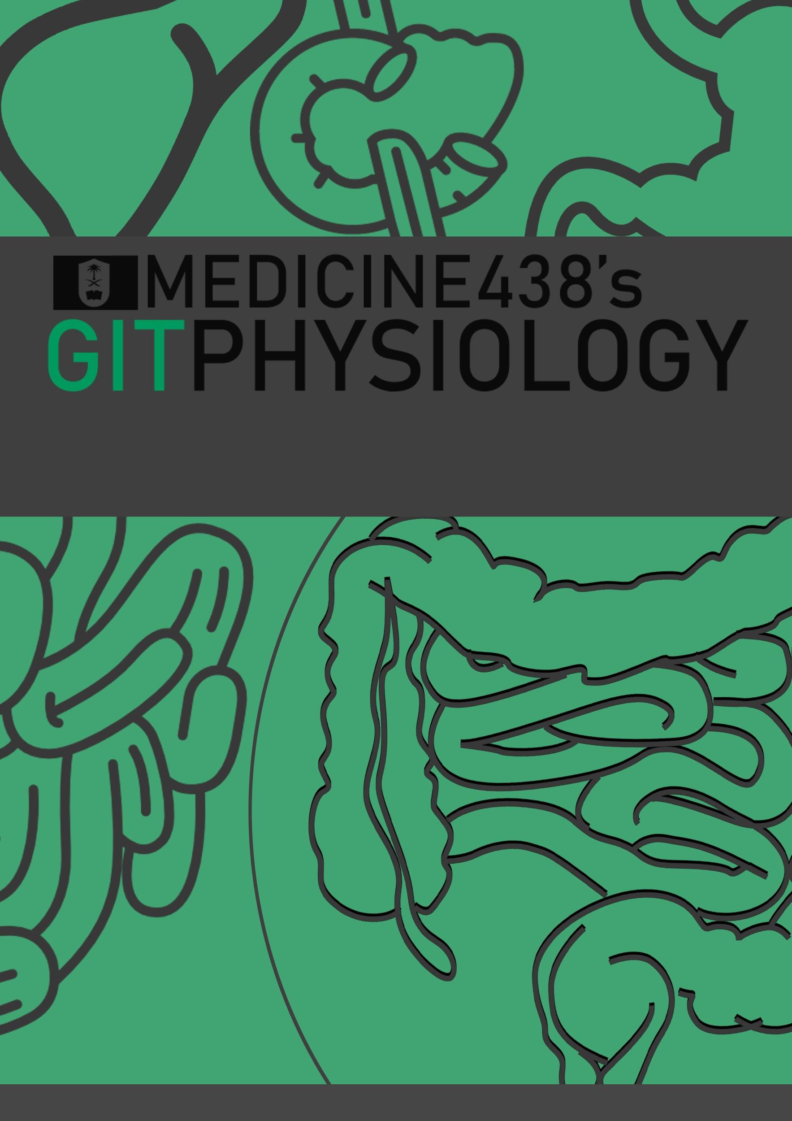
LECTURE IX: Bilirubin Metabolism
EDITING FILE
IMPORTANT
MALE SLIDES
EXTRA
FEMALE SLIDES
LECTURER’S NOTES

Slide 2
1
BILIRUBIN METABOLISM
Lecture Nine
OBJECTIVES
Definition of bilirubin
Bilirubin metabolism, formation, Transport in Plasma, Hepatic Transport, Excretion Through Intestine.
Other substances conjugated by glucuronyl transferase.
Differentiation between conjugated & unconjugated bilirubin.
Definition, classification, Causes, and pathogenesis of jaundice.
The normal plasma concentration of total bilirubin.
Definition of Bilirubin
Greenish yellow pigment excreted in bile, urine & feces, the major pigment present in bile is the orange compound bilirubin.
It is water insoluble breakdown product of heme catabolism in senescent (aging) erythrocytes. Mononuclear phagocyte system (MPS)
Heme is found in hemoglobin, a principal component of RBCs (Heme: iron + organic compound porphyrin).
Heme source in body:
80% from hemoglobin
20% other hemo-protein: cytochrome, catalase, peroxidase , myoglobin.
Bilirubin is highly soluble in all cell membranes (hydrophobic) and very toxic, therefore, its excretion in the bile is one of the very important functions of liver.
Serum bilirubin level is an important clinical marker of hepatobiliary excretory function.
Usually, 90% of total bilirubin is unconjugated and 10% conjugated.
Bilirubin Metabolism
Formation
Transport in plasma
Hepatic Phase
Uptake
Conjugation
Biliary excretion
Excretion through intestine
The 4 steps are finely balanced ,Therefore:
Reduction at any step may cause hyperbilirubinemia.
Enhancement of the rate of production (throughput) requires induction of multiple genes, probably coordinated by nuclear receptors.
Unconjugated bilirubin
Conjugated bilirubin
Insoluble in water.
Tightly complex to albumin.
Toxic substance.
Not filtered through renal glomeruli , not excreted in urine
The chief form of bilirubin In the blood (represents the normal bilirubin in the blood; 0.5 mg/dl of plasma )
Water soluble
Loosely bound to albumin
Filtered through renal glomeruli and excreted in urine
Non-toxic
Present in low concentration in the blood

Slide 3
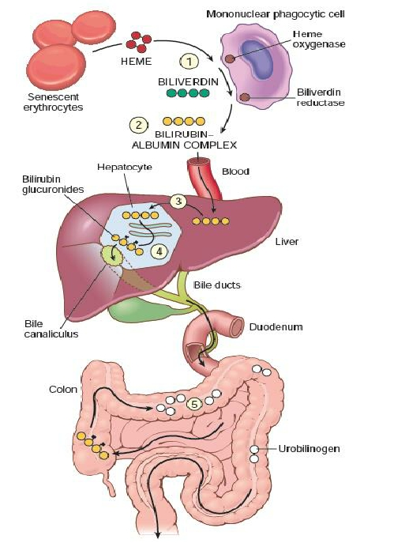
2
BILIRUBIN METABOLISM
Lecture Nine
1
Formation of Bilirubin
Life span of RBCs is 60-120 days.
Senescent RBCs are phagocytosed intravascularly or extravascularly by reticuloendothelial system (RES) (Mononuclear Phagocytes System) specially in the spleen, liver & bone marrow.
The hemoglobin is first split into globin & heme In the presence of NADPH & O₂ the Heme oxygenase, with a concomitant oxidation of ferrous Fe²⁺ iron to ferric Fe⁺³, and converts it into Biliverdin.
Globin: AA formed from breakdown of globin are stored in the body
Heme: heme ring is opened to give:
Free ion : Transported in blood by transferrin & stored in the body as a reservoir for erythropoiesis.
Bile pigment (biliverdin): reduced by biliverdin reductase to free bilirubin which is gradually released into the plasma.
Plasma
Amino acid in AA pool
Iron pool
Bind with albumin
goes to Liver for conjugation process
Spleen
Globin
Heme
Iron
RBC
Hemoglobin
Bilirubin
2
Transport of Bilirubin in Plasma
Free bilirubin is hydrophobic it immediately combines with plasma proteins (mainly albumin & globulin) forming a water soluble compound ( hemobilirubin, unconjugated, indirect bilirubin) which is rapidly transported to hepatocytes for further metabolism.
Even when bound to albumin it’s called free bilirubin.
Significance of bilirubin binding to albumin:
increase solubility of whole molecule.
Prevent unconjugated bilirubin freely come
into other tissue, cause damage.
Certain drugs (sulfonamides, salicylates) compete with bilirubin for albumin binding and displace bilirubin to enter into the brain in neonates and increase the risk of kernicterus (a type of brain damage that can result from high levels of bilirubin in a baby’s blood). It can cause cerebral palsy and hearing loss.
Albumin + bilirubin
bilirubin-albumin complex (Unconjugated, indirect bilirubin hemobilirubin)
Figure 9-1

Slide 4
3
BILIRUBIN METABOLISM
Lecture Nine
Hepatic Phases
3
On coming in contact with the hepatocyte surface, unconjugated bilirubin is preferentially metabolized which involved 3 steps:
Hepatic uptake
Conjugation
Secretion in bile
Hepatic Uptake
2. Bilirubin Conjugation
Bilirubin (lipid soluble) is absorbed through the hepatic cell membrane, mediated by a carrier protein (organic anion transporting protein OATP) but this process is inefficient, so there is always some unconjugated bilirubin in the veins.
Then combined with Y¹ & Z proteins that trap the bilirubin inside the cells.
In the smooth ER of hepatocytes, about 80% of bilirubin conjugates with uridine diphospho-glucuronic acid (UDPGA).
Each bilirubin molecule reacts with 2 UDPGA molecules catalyzed by the enzyme glucuronyl transferase to form bilirubin diglucuronide (cholebilirubin, direct, conjugated bilirubin) which is more water soluble than free bilirubin.
Inherited glucuronyl transferase deficiency causes jaundice.
10/20% conjugate with sulphate or other substances.
3. Secretion in Bile
Cholebilirubin is actively secreted into the bile canaliculi through an active carrier-mediated process giving bile its color, mediated by multiple anion transporter & induced by phenobarbitone.
its energy-dependent, rate limiting step is susceptible to impairment in liver disease.
In normal adults this results in a daily load of 250-300 mg of bilirubin.
Unconjugated bilirubin is normally not excreted.
Fate of Conjugated Bilirubin
Majority of conjugated bilirubin passes via the bile ducts to the intestine then colon where it is transformed by bacteria, which will deconjugate it back to bilirubin & convert it to the highly soluble colorless compound called Urobilinogen.
Small amount 20% is deconjugated and converted to Urobilinogen in the small intestine & absorbed into the portal blood to the liver where it is extracted by the liver cells & conjugate again & excreted in the bile (enterohepatic circulation of bile pigments).
Small portion of conjugated bilirubin returns to plasma either directly into the liver sinusoids or indirectly by absorption into the blood from the bile ducts or lymphatics. This represents 10% only this causes a small portion of the conjugated bilirubin in the ECF it bound less tightly to albumin & is excreted in the urine.
FOOTNOTES
1, Y and Z proteins are cytosolic proteins, Y protein is also called ligandin, it binds bilirubin within the hepatocytes thus preventing its regurgitation into the blood. Genetic mutation in this protein contributes to neonatal jaundice. Z protein is a fatty acid binding protein.

Slide 5
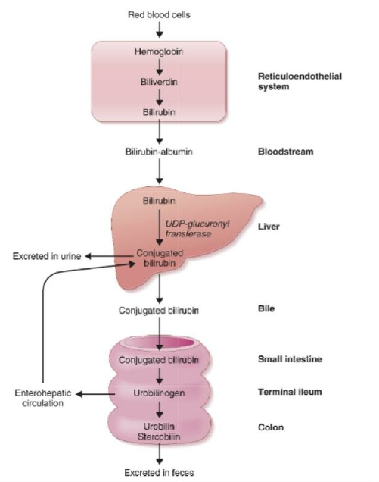
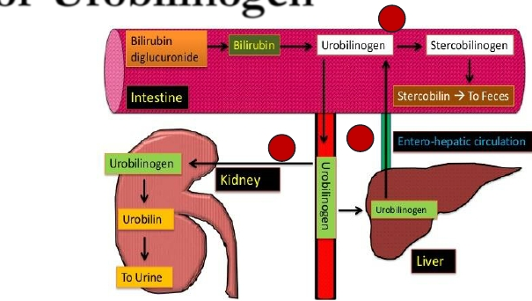
4
BILIRUBIN METABOLISM
Lecture Nine
Fate of Urobilinogen
Most of urobilinogen (70%) is converted into stercobilinogen in the large intestine, oxidized & excreted in the feces as stercobilin that causes dark brown color of the feces.
Some of urobilinogen (20%) is reabsorbed through the intestinal mucosa into the portal vein & re-excreted by the hepatic cells in the bile (enterohepatic circulation).
Small amount 5% of urobilinogen escapes to the general circulation & excreted by the kidneys in urine where it is oxidized to urobilin when the urine is exposed to air.
Other Substances Conjugated By Glucuronyl Transferase
Glucuronyl transferase system in smooth ER catalyzes the formation of glucuronides of a variety of substances in addition to bilirubin.
The list includes steroids & various drugs.
These compounds can compete with bilirubin for the enzyme system when they are present in appreciable amounts e.g phenobarbitone.
Substances That Increase Glucuronyl Transferase Activity
Several substances as barbiturates, antihistamines & anticonvulsants can cause marked proliferation of the smooth ER in hepatic cells, with a concurrent increase in hepatic glucuronyl transferase activity.
Phenobarbital has been used successfully for the treatment of a congenital disease in which there is a relative deficiency of 2 UDP- glucuronyl transferase.
Figure 9-2
Figure 9-3 Urobilinogen fate

Slide 6
5
BILIRUBIN METABOLISM
Lecture Nine
Types of Bilirubin in Serum
Direct bilirubin: is conjugated (water soluble) bilirubin, it reacts rapidly with reagent (direct reacting).
Indirect bilirubin: is unconjugated (water insoluble) bilirubin because it is less soluble, it reacts more slowly with reagent (reaction carried out in methanol).
In this case both conjugated and unconjugated bilirubin are measured given total bilirubin.
Unconjugated is calculated by subtracting direct from total.
Total bilirubin = D + ID
Total bilirubin (1-1.5 mg/dL) – conjugated = unconjugated.
Knowing the level of each type of bilirubin is of diagnostic importance.
Major Differences Between Unconjugated and Conjugated Bilirubin
Feature | Unconjugated bilirubin (Hemobilirubin) | Conjugated bilirubin (Cholebilirubin)
Normal serum level | The chief form of bilirubin in the blood | Present in low conc. in the blood
Water solubility | Absent | Present
Affinity to lipids | Present | Absent
Binding | Bind to albumin | Bind to glucuronic acid
Reaction to reagents | Indirect (Total minus direct) | Direct
Renal excretion | Absent | Present
Affinity to brain tissue | Present (kernicterus), toxic | Absent, less toxic

Slide 7
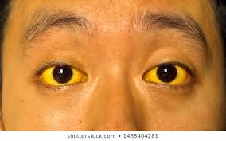
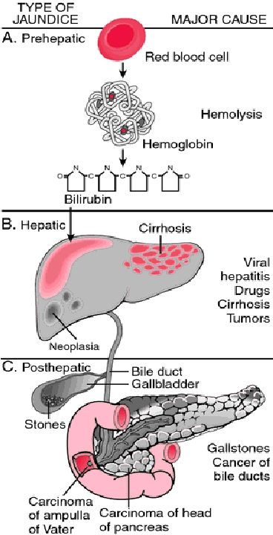
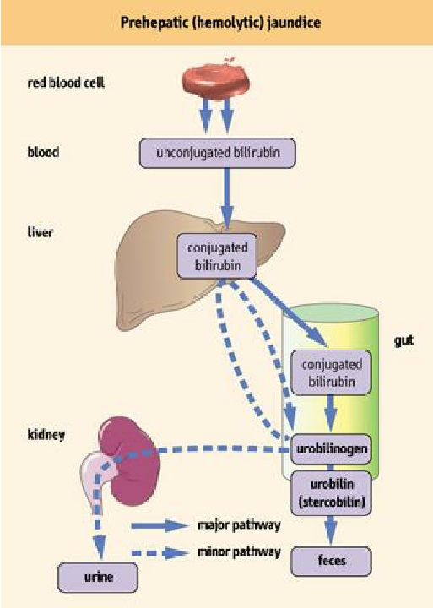
6
BILIRUBIN METABOLISM
Lecture Nine
Jaundice(Hyperbilirubinemia, Icterus)
It is the yellow coloration of the skin, sclera, mucous membranes and deep tissues.
The usual cause is large quantities of bilirubin in the ECF, either free or conjugated bilirubin.
The normal plasma concentration of total bilirubin is 0.3-1.2 mg/dl of blood . However, in certain abnormal conditions this can rise up to 40mq/dL of blood.
Subclinical jaundice (occult jaundice) occur when the Bilirubin level is from 1 to 2 mg/dl .
The skin usually begins to appear jaundiced when the concentration of total bilirubin in the plasma is greater than 2 -2.5 mg/dl.
Classification Of Jaundice
Pre-hepatic (hemolytic) jaundice
Hepatic (hepatocellular) jaundice
Post-hepatic (obstructive) jaundice
Figure 9-4
Prehepatic: Hemolytic Jaundice
The excretory function of the liver is not impaired. It results from excess production of bilirubin (beyond the livers ability to conjugate it) following hemolysis of erythrocytes (RBC). Excess RBC lysis is commonly the result of: Autoimmune disease Hemolytic disease of the newborn Rh- or ABO- incompatibility Structurally abnormal RBCs (Sickle cell disease) Breakdown of extravasated blood Therefore the plasma concentrations of free bilirubin (hemobilirubin) rises to levels much above normal but it is not filtered through the kidney, because they are unconjugated bilirubin¹. The urine is free from bilirubin (acholuric jaundice). The stools appear darker than the normal color due to excessive stercobilin formation
Figure 9-5
FOOTNOTES
Remember that unconjugated bilirubin has strong affinity to albumin and form a tight complex together. The kidney glomeruli is equipped with a basement membrane that prevents passage of albumen, hence there is no bilirubin in urine.

Slide 8
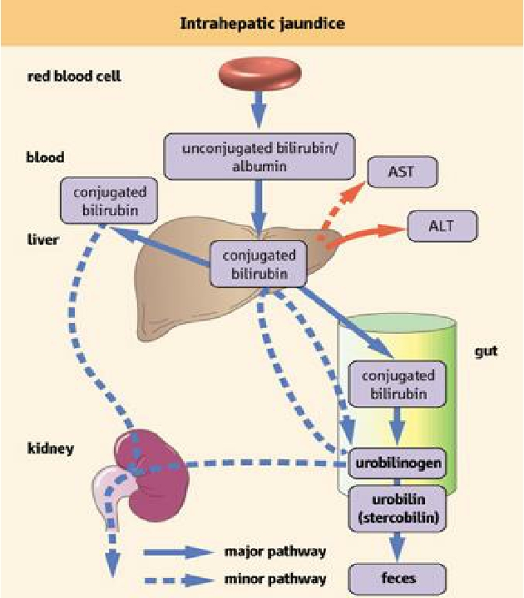
7
BILIRUBIN METABOLISM
Lecture Nine
Classification of Jaundice
Hepatic: Hepatocellular Jaundice
Hyperbilirubinemia may be due to: Impaired uptake of bilirubin into hepatic cells. Disturbed intracellular protein binding or conjugation.¹ Disturbed active secretion of bilirubin into bile canaliculi. If there is a defect in the active transporter to the bile canaliculi, then the conjugated B. will leak outside (and here it will look like Obstuctive jaundice )
Causes
Damage of liver cells e.g., viral hepatitis, drugs, chemical, alcohol, or toxins. Autoimmune hepatitis. Hepatocytes will not be able to take up free bilirubin Genetic errors in bilirubin metabolism. (eg, enzyme) Genetic errors in specific proteins. The diseased liver cells are unable to take all the unconjugated hemobilirubin, increasing its concentration in the blood. There is intrahepatic biliary duct obstruction that leads to regurgitation of conjugated bilirubin to blood. Both types of bilirubin (conjugated & unconjugated) are present in blood in high concentration.
Clinical features
Stools appear pale grayish in color due to deficiency of stercobilin.
Urine appears dark brown due to filtration of excess conjugated bilirubin through the kidney.
In this case, hyperbilirubinemia is usually accompanied by other abnormalities in biochemical markers of liver function {Alanine amine transferase (ALT/ SGPT) & Aspartate amine transferase (AST/SGOT)
By looking at the ratio between different liver enzymes we can distinguish the cause whether it is from biliary (cholestatic) or liver (hepatic).
The main diagnostic tip is:
Biliary obstruction : the ALT goes up and down (pulsatile increase ) and Bilirubin in the blood is high.
Hepatic jaundice : ALT shows persistent increase for along period of time (months).
Figure 9-6
FOOTNOTES
e.g. if there is a defect in Glucuronyl transferase enzyme .

Slide 9
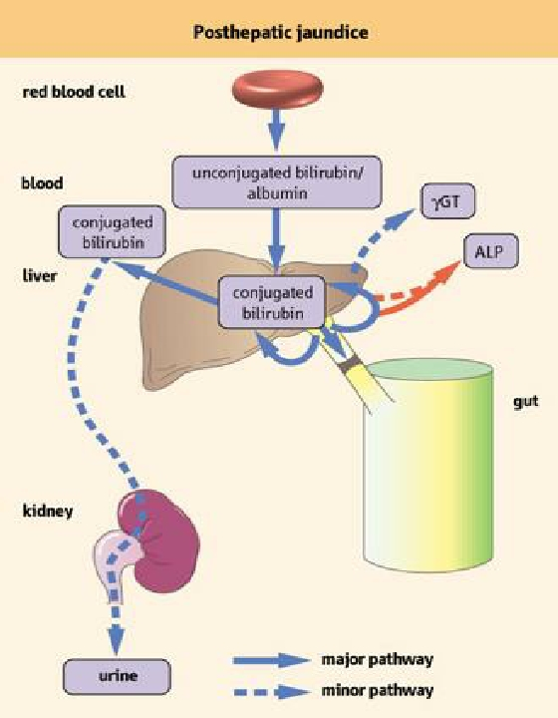
8
BILIRUBIN METABOLISM
Lecture Nine
Classification of Jaundice (continued)
Posthepatic: Obstructive Jaundice
Causes
Intrahepatic bile duct obstruction such as in the liver canaliculi e.g Drugs Primary biliary cirrhosis Cholangitis. Hepatitis Extrahepatic bile duct obstruction e.g Gallstones. Carcinoma of the head of the pancreas (usually accompanied by high ALP levels) Cholangiocarcinoma Edema of pancreatitis Sclerosing cholangitis
The rate of bilirubin formation is normal, bilirubin enters the liver cells and become conjugated in the usual way. The conjugated bilirubin formed cannot pass into small intestine and it returns back into blood. In this type of jaundice, conjugated bilirubin is filtered through the kidney and appears in urine giving it dark brown color. Urine is free from urobilinogen. Stools are clay color due to absence of stercobilin.
Figure 9-7
There is a special endocrine tumor called VIPoma or Verner-Morrison syndrome, this tumor result in excessive secretion of VIP which acts on colonic epithelial cells to increase active secretion of potassium resulting in a secretory diarrhea.
 | Prehepatic hemolytic | Hepatic Hepatocellular | Posthepatic Obstructive
Unconjugated | Increased | Increased | Normal
Conjugated | Normal | Increased | Increased
Bilirubin | Indirect | Both | Direct
AST & ALT | Normal | Increased | Normal
ALP & yGT (y glutamyl transpeptidase) | Normal | Normal | Increased
Urine bilirubin | Absent | Present (dark brown) | Present (dark brown)
Urine urobilinogen | Present | Present | Absent
Stercobilin | Darker | Pale grayish | Absent (Clay colored)

Slide 10
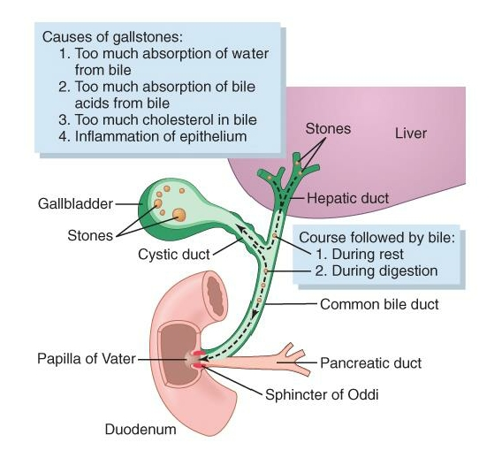
9
BILIRUBIN METABOLISM
Lecture Nine
Liver Secretion Of Cholesterol And Gallstone Formation
(Cholethiasis)
Under abnormal conditions, the cholesterol may precipitate in the gallbladder, resulting in the formation of cholesterol gallstones.
The amount of cholesterol in the bile is determined partly by the quantity of fat that the person eats, because liver cells synthesize cholesterol as one of the products of fat metabolism in the body.
For this reason, people on a high-fat diet over a period of years are prone to the development of gallstones.
Inflammation of the gallbladder epithelium, often resulting from low-grade chronic infection, may also change the absorptive characteristics of the gallbladder mucosa, sometimes allowing excessive absorption of water and bile salts but leaving behind the cholesterol in the bladder, and then progressing to large gallstones.
Figure 9-8
Figure 9-9

Slide 11
Khalid, a 24 year-old engineer, developed yellowish skin and sclera after using a beta-lactam for a respiratory tract infection, in laboratory analysis the the total bilirubin level was 10 mg/dl, and he has been diagnosed with sickle cell disease, what is the type of jaundice does this patient have?
Pre-hepatic
Hepatic
Obstructive
Post-hepatic
2. What is the most abundant type of bilirubin will be found in serum analysis of Khalid?
Conjugated
Direct
Cholebilirubin
Free bilirubin
3. Primary biliary cirrhosis will lead to which type of jaundice?
Post-hepatic jaundice due to intrahepatic bile duct obstruction
Hemolytic jaundice
Post-hepatic due jaundice to Extrahepatic bile duct obstruction
Hepatic jaundice
4. What is the form of bilirubin found normally in the stool?
Urobilinogen
Stercobilin
Urobilin
SHORT ANSWER QUESTIONS
How is the bilirubin formed?
Define jaundice.
Mention 3 differences between conjugated & unconjugated bilirubin?
What is the fate of bilirubin?
ANSWERS
Senescent RBCs are phagocytosed intravascularly or extravascularly by RES, hemoglobin split into globin & heme, then heme gives free iron & biliverdin, which is reduced by biliverdin reductase to bilirubin.
Yellow coloration of the skin, sclera, mucous membranes & deep tissues when the bilirubin serum level exceed the normal range 0.2-1.3 mg/dl.
Table in page 6
Majority of conjugated will be deconjugated & to bilirubin & convert it to highly soluble compound called urobilinogen through bacterial action.
Small portion of conjugated will return to plasma and is bound less tightly to albumin & is excreted through in urine.
Small portion of deconjugated & converted to urobilinogen will enter the enterohepatic circulation & will be conjugated & excreted again it the bile.
ANSWER KEY: A, D, A, B

Slide 12
Sarah Alhelal, Mohammed Alqahtani
FEMALE PHYSIOLOGY CO-LEADERS
Maha Alnahdi, Taif Alshammari
MALE PHYSIOLOGY CO-LEADERS
Nayef Alsaber, Hameed M. Humaid
REFERENCES
Guyton and Hall Textbook of Medical Physiology
Ganong’s Review of Medical Physiology

