Slide 1



Interprofessional Education & Collaboration
Editing file
Objectives:
Define interprofessional education & interprofessional collaborative practice
Describe the core competencies of interprofessional education
Appreciate the importance of interprofessional collaboration impact on quality & safety of patient care
Understand the roles, responsibilities & abilities of different professions
Understand the importance of communication for effective collaboration
Identify the opportunities for using IPE/C to improve interprofessional collaboration
Reflect on an interprofessional exposure with students from another healthcare college
important
original content
only in girls slides
only in boys slides
extra notes
Doctors’ notes

Slide 2


Required Reading:
Competencies for interprofessional collaborative practice: 2016 update
Required Videos:
interprofessional core competencies
Patient Case
Presenting illness
Exacerbated heart failure
2 weeks after his last admission
Past medical history
Personal info
Heart failure
Coronary artery disease
Chronic kidney disease
Diabetes mellitus
↑ cholesterol
Depression
Uses multiple medications. (12 medications)
Multiple hospital admissions
most recent one
↑6 diuretic therapy
Asked to adjust the therapy based on any weight increase.
Male
75 yrs
Overweight
Smoker
Sedentary lifestyle
Poor understanding of his disease, medications, diet restrictions
Lives in rural area → transportation issues → miss a lot of physician appointment
What healthcare providers should be involved with this patient?
1
2
3
4
Primary Care Physician
Cardiologist
Nephrologist
Health educator
5
6
7
8
Dietitian
Pharmacist
Social worker
Care coordinator

Slide 3
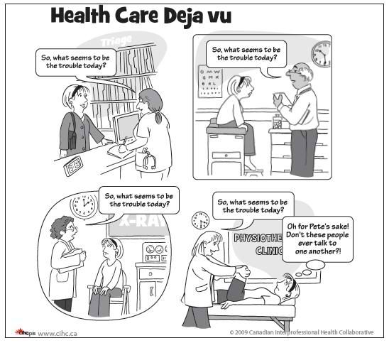
Definition of interprofessional Education (IPE)
Learners from two or more professions learn about, from, and with each other to enable effective collaboration. (WHO 2010)
We lead
Medicine
Without me you wouldn't know a benzodiazepine from a barbiturate
Common competencies Across the disciplines
Physical therapy
USCF IPE competencies :
Pharmacy
✓ Understanding teams
✓ Knowledge of rules & responsibilities
✓ Effective Delegation & follow up
✓ Usual & crisis communication
✓ Conflict management
✓ Continuous learning
We work directly with patients
Systemic
thinking
Patient engagement
When you get to the mouth call us
Nursing
Continuous improvement
Dentistry
All the sentences in the callouts are wrong! We must all work in a patient-centered fashion to measure the core outcome of interprofessional
Definition of interprofessional Collaboration (IPC)
from different professional backgrounds
work together with patients, families, careers & communities
When multiple health workers
to deliver the highest quality of care.

Slide 4





IPE/IPC is NOT a new fashion
1987
2003
2009
UK center for the advancement of interprofessional education (CAPIE)
Health professionals education: A bridge to quality (IOM)
Interprofessional education collaboration (IPEC)
Education
for the health team (IOM)
Crossing the quality chasm: A new health system for the 21st century (IOM)
Canadian international health group
Framework for action on IPE/IPC (WHO)
1972
2001
2005
2010
IPE/C competencies
Integrated enactment of knowledge, skills, and values/attitudes
that define working together across the professions, with other healthcare workers, patients, families, and communities as appropriate
to improve health outcomes in specific care contexts.
Interprofessional Education Competencies Domains
Values/Ethics for interprofessional practice
Roles/Responsibilities
Interprofessional communication
Teams and teamwork

Slide 5

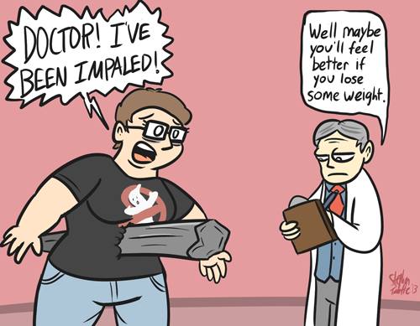
Competency Domain 1: Values/Ethics for Interprofessional Practice
Definition
Work with individuals of other professions to maintain a climate of mutual respect and shared values
Specific Values and Ethics Competencies
Place the interests of patients and populations at the center of interprofessional health care delivery.
Respect the dignity and privacy of patients while maintaining confidentiality in the delivery of team based care.
Embrace the cultural diversity and individual differences that characterize patients, populations, and the health care team.
Respect the unique cultures, values, roles/responsibilities, and expertise of other health professions.
Work in cooperation with those who receive care, those who provide care, and others who contribute to or support the delivery of prevention and health services.
Develop a trusting relationship with patients, families, and other team members.
Demonstrate high standards of ethical conduct and quality of care in one’s contributions to team-based care.
Manage ethical dilemmas specific to interprofessional patient/ population centered care situations.
Act with honesty and integrity in relationships with patients, families, and other team members.
Maintain competence in one’s own profession appropriate to scope of practice.

Slide 6
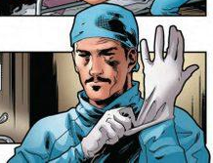
Competency Domain 2: Roles/Responsibilities
Definition
Use the knowledge of one’s own role and those of other professions to appropriately assess and address the health care needs of the patients and populations served
Specific Roles and Responsibilities Competencies
Communicate one’s roles and responsibilities clearly to patients, families, and other professionals.
Recognize one’s limitations in skills, knowledge, and abilities
Engage diverse healthcare professionals who complement one’s own professional expertise, as well as associated resources, to develop strategies to meet specific patient care needs.
Explain the roles and responsibilities of other care providers and how the team works together to provide care.
Use the full scope of knowledge, skills, and abilities of available health professionals and healthcare workers to provide care that is safe, timely, efficient, effective, and equitable.
Communicate with team members to clarify each member’s responsibility in executing components of a treatment plan or public health intervention.
Forge interdependent relationships with other professions to improve care and advance learning.
Engage in continuous professional and interprofessional development to enhance team performance.
Use unique and complementary abilities of all members of the team to optimize patient care.

Slide 7






Student Interaction:
What do you know about the scope of practice of your own profession and other health profession? You as a physician what exactly you’re supposed to do
From the video assignment what do you think about the roles/responsibilities of each member?
What was the Roles & Responsibilities of the professionals in the assigned video?
1- perform history & physical to determine differential Dx
2- make diagnosis -> treats and mange a variety of condition
3- callobrative with health care team (e.g. referral)
4- Provide education
5- Advocate for patient and families
Physician
1- Ongoing assessment of patient health differential Dx status
2- Manage care to meet patients needs
3- Collaborate with healthcare team
4- Provide education
5- Advocate for patient and families
01
02
03
Registered Nurse
1-Medication expert to assure Safe and effective use of medication
2- Assess patient for medication related issues
3- Collaborate with healthcare team
4- Provide education
5- Advocate for patient and families
Clinical pharmacist
First three tasks for each professional is representing his/her scope of practice while the last three tasks are common for all of them which represent interprofessional collaboration (IPC)

Slide 8

Competency Domain 3: Interprofessional Communication
Definition
Communicate with patients, families, communities, and other health
professionals in a responsive and responsible manner
Specific Interprofessional Communication Competencies
Choose effective communication tools and techniques, including information systems and communication technologies, to facilitate discussions and interactions that enhance team function.
Organize and communicate information with patients, families, and healthcare team members in a form that is understandable, avoiding discipline-specific terminology when possible.
Express one’s knowledge and opinions to team members involved in patient care with confidence, clarity, and respect, working to ensure common understanding of information and treatment and care decisions.
Listen actively, and encourage ideas and opinions of other team members.
Give timely, sensitive, instructive feedback to others about their performance on the team, responding respectfully as a team member to feedback from others.
Use respectful language appropriate for a given difficult situation, crucial conversation, or interprofessional conflict.
Recognize how one’s own uniqueness, including experience level, expertise, culture, power, and hierarchy within the healthcare team, contributes to effective communication, conflict resolution, and positive interprofessional working relationships.
Communicate consistently the importance of teamwork in patient-centered and community focused care.

Slide 9
interpersonal communication
Importance
In 2006, the Joint Commission on Accreditation of Health Care Organization reported that: 70% of medical errors were caused by lack of communication between team members.
Best Practices in Interprofessional Communication
1
2
3
The lifeline of care team
Process by which information is exchanged between individuals, departments, or organizations
Should be: Complete, Clear, Brief & Timely
Information Exchange Strategies
SBAR
Call out
Check-Back
Handoffs
to effectively communicate information to one another
Situation –
What is going on with the patient?
EX. "I'm calling about Mrs. Joseph in room 251. Chief complaint is
shortness of breath of new onset"
Background –
What is the clinical background or context?
EX. "Patient is a 62-years old female post-op day one from abdominal surgery. no prior history of cardiac or lung disease."
Assessment –
What do I think the problem is?
EX. "Breath sounds are decreased on the right side with acknowledgement of pain. Would like to rule our pneumothorax."
Recommendation –
What would I recommend?
EX. "I feel strongly the patient should be assessed now. can you come to
room 251 now?."
to communicate important or critical information. Ex. During emergency, codes, etc
Informs all team members simultaneously
Helps team members anticipate next steps
Direct responsibility to a specific individual for carrying out the task.
EX.
Leader: Airway status?
Resident: Airway clear
Leader: Breath sounds?
Resident: Breath sounds decreased on right.
Leader: Blood pressure?
Resident: BP is 96\62
to ensure that message is received
include 3 STEPS
1 Sender Initiates the message
2 Receiver accepts the message provides feedback.
3 Sender double-check to ensure that the message was received.
EX.
Doctor: Give 25 mg Benadryl IV push
Nurse: 25 mg Benadryl IV push
Doctor: correct
to transfer information during transitions in care across the continuum
Includes an opportunity to ask questions, clarify, and confirm
“I PASS THE BATON”
I Introduction
Introduce yourself and your role\job (include patient)
P Patient
Name, identifiers, age ,sex, location
A Assessment
present chief complaint, vital signs, symptoms, and diagnosis.
S Situation
code state, level of (un)certainty, recent changes and response to treatment.
S Safety concerns
critical lab values\report, socio-economic factors, allergies, and alerts (falls isolation, ets.)
THE
B Background
comorbidities, previous episodes, current medications and family history.
A Actions
Explain what actions were taken or required. Provide rationale.
T Timing
level of urgency and explicit timing and prioritization of actions.
O Ownership
identify who is responsible (person\team), include patients family members.
N Next
What will happen next? anticipation changes? what is the plan? are there contingency plans?

Slide 10
Interprofessional Communication
Language barrier
Shift change
Distractions & Conflict
Lack of information verification
Challenges/ Barriers
Physical proximity
Varying communication styles
Personalities
Workload
Competency Domain 4: Teams & Teamwork
Definition
apply relationship-building values and the principles of team dynamics to perform effectively in different teams roles.
Specific Teams and Teamwork Competencies
Describe the process of team development and the roles and practices of effective teams
Develop consensus on the ethical principles to guide all aspects of patient care and teamwork.
Engage other health professionals in shared patient-centered problem-solving
Integrate the knowledge and experience of other professions, appropriate to the specific care situation to inform care decisions, while respecting patient and community values and priorities/preferences for care
Engage self and others to constructively manage disagreements about values, roles, goals, and actions that arise among healthcare professionals and with patients and families
Apply leadership practices that support collaborative practice and team effectiveness
Share accountability with other professions, patients, and communities for outcomes relevant to prevention and health care
Reflect on individual and team performance for individual, as well as team, performance improvement
Use available evidence to inform effective teamwork & team-based practices.
Use process improvement strategies to increase the effectiveness of interprofessional teamwork and team-based care.
Perform effectively on teams and in different team roles in various settings

Slide 11
Importance of IPE/IPC
SATISFACTION
FRAGMENTATION
Enhance job satisfaction and ease stress and create a more flexible workforce
Overcome fragmentation and cost. The burden exceeds the capacity of any one profession.
CARE
COMMUNICATION
Increase access to care. Improves quality and safety of care
Remedy failures in trust, respect and communication between professions
Benefits of IPE/IPC
Patients | Health care organizations | Health care providers
• Shorter wait times for care • Improved patient care and safety • Greater access to a broad range of comprehensive health care services for care • Increased satisfaction with care provided • Better health outcomes • A more active role in health care | • Greater efficiency and capacity/ability to provide • Care for more people, enhancing patient satisfaction. • Decreased staff turnover with enhanced staff morale. • Improved recruitment and retention. • Increased patient safety and fewer treatment errors. • Enhanced opportunities to develop ongoing quality improvement and accountability measures in health care delivery. | • Greater job satisfaction • Less stress and burnout • The opportunity to work within the full scope of practice and contribute to enhanced patient outcomes. • An improved professional environment that supports clinical practice, provides access to peers for support and advice, and ensures greater predictability within the interprofessional workplace environment

Slide 12
Opportunities for incorporating IPE/C
Patient Care Outcomes
Population Health Outcomes
Teamwork
Clinical Placements/Experiences
Practice
Practice
Simulations
Integration
Project-Based Learning
Communication
Immersion
Case Exercises
Active learning
Immersion
Roles
Exposure
Values
Shadowing
Service Learning
Exposure
Student growth
Example of IPE Activities
Clinical Sessions during internship
Experiential training programs
Interprofessional clinical rounds
Interprofessional ambulatory clinics: Students team up and assigned a real patient from outpatient clinic
Case presentations, Case studies
Journal clubs, Ethic cases
Service learning: Students teams up and identify a community partner (nursing home, Rehab center, etc) and conduct a community project
Health campaigns
Community-based related activities
Screening programs
Free- or Mobile clinic (e.g. in Hajj)
Extracurricular activities

Slide 13


Team leaders
Abdulrahman Bedaiwi Amirah Al-Zahrani
Team members
Abdullah Alassaf
Abdullah Alasmari
Abdulrahman Almezaini
Khalid Alkwai
Mohammed Alhamad
Deema Almaziad
Elaf Almusahel
Rema Almutawa
Renad Almutawa
Shahd Alsalamah
Taif Alotaibi
Tarfah Alkaltham
Say cheese :)
THANK YOU!
Give us your feedback!

