Slide 1
Professionalism in Different Cultural Context
Editing file
Objectives:
Define culture
Describe the importance of culture/religion in people lives
Discuss the possible ways that culture may impact patient care
Discuss and contrast the different models of the
doctor/patient relationship with regards to the role of the physician in each model and patient autonomy “the different consultation models”
Understand the importance of Respect to others’ beliefs
Describe how can doctors deal with traditional views and beliefs in the clinical setting
PEARLS concept
important
original content
only in girls slides
only in boys slides
extra notes
Doctors’ notes

Slide 2
Cultural Context In Under-graduate Medical Education Curriculum
The goal of the curriculum should be to prepare students to care for patients from diverse social and cultural backgrounds including racial, ethnic and gender biases
Characteristics of Professionalism
Competency
Responsibility
Attitude
Conduct on the job
Medical Professionalism Three fundamental principles:
1. Patient welfare 2. Patient autonomy 3. Social justice
لصالح المريض
استقلالية المريض
Patient Welfare Including Autonomy
Professional competence
Honesty with patients → integrity
Patient confidentiality
Caring attitude
Scientific knowledge
Maintaining trust
Setting and maintaining professional standards
Social Justice
A fair distribution of resources
Managing conflict of interest
Improving quality and
access to care
Respect for colleagues

Slide 3
What is Culture? How things are done in a certain place
Culture can mean many things.
Culture has been defined as the beliefs, customs, habits, & language shared by people living in particular time & place.
Culture is the different ways of living exhibited by a particular group of people, that are transmitted from one generation to the next and which distinguish that group from others
Cultural variation
Cultural differences transcend geographical regions, ethnicity & nationality.
Cultural variation may exist within people that share similar ethnic background and nationality and are influenced by:
Religion
Social class
Region
Why is it important to think about cultural differences at work?
Culture is directly related to health promotion, disease prevention, early detection, access to health care, trust and compliance.
Religion & Culture in our society
Are potential sources of moral purpose and
personal strength
Offer support and structure to cope with life’s
stressful events.
Enhance positive experiences such as optimism
and hope
Tell us how to behave, and what is right and wrong

Slide 4
However!
Sometimes certain popular cultural practices or folk medicine may have a negative impact on the patient’s well being.
The doctors unfamiliarity of certain cultural or religious beliefs may cause unnecessary harm to the patients.
Special Cultural Issues In Professional Care In Different Parts Of The World
eye contact
Uncovering of face for females
Undressing of female patients
Sharing of confidential information
History taking of female adults from parents or husbands
Giving information to patients in a way they can understand
Physicians must not exploit patient’s vulnerability or lack of medical knowledge
In Research
• Research should not be contrary to the patient’s interest e.g. exploitation of developing countries patients.
• Research protocol should be approved by a research ethics committee.
• This committee may be non existent in many settings.
• Your conduct in the research must not be influenced by payments or gifts.
• Record your research results truthfully
Accepting gifts or other inducements
• You should not ask for or accept any material rewards, except those of insignificant value from representatives of pharmaceutical companies.
• Help with conferences and educational activities may be acceptable
Cultural competency
Cultural competency refers to possessing knowledge, awareness, and respect for other cultures

Slide 5
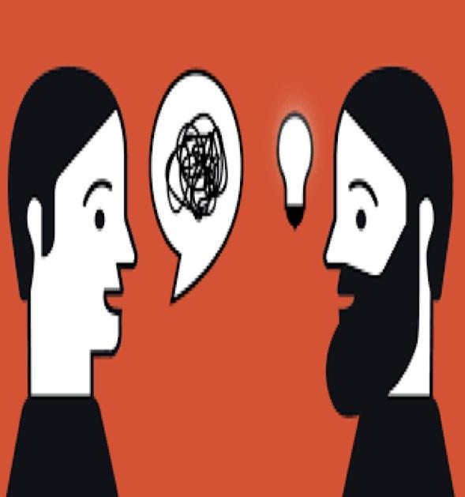
Focusing On Knowledge In Cultural Context
It is important for a medical student or postgraduate trainee to learn about the surrounding community in which he/she practices or trains.
E.g. Socio economic status, patterns of housing nutritional habits, healing practices and disease incidence and prevalence.
The knowledge taught has specific evidence based impact on health care delivery.
E.g. How Ramadan fasting affects Muslims who are diabetic.
It is crucial to understand health beliefs of those who come from different cultures or have different health care experiences.
The Doctor-Patient Relationship
• Doctor-patient relationship & communication is central to effective patient care.
• The clinical reality has been formulated in a way that puts the physician in a dominant role in this relationship.
Confidentiality
• Confidentiality concept may not be the same in the East as in the West.
• However its principles are applicable in most settings.
Physician Dominance in Patient Care
• Doctor dominance introduces bias due to the doctor’s personal background, values and social class
• Formal medical training creates a sense of “doctor knows best”.
The doctor
(Physician Dominance in Patient Care)
describes the diagnostic and therapeutic actions.
determines what material is significant and what is not.
organizes the discussion.
molds the patient responses into recognizable patterns.
asked to help, diagnose and treat the patient in a socially acceptable way.

Slide 6
Problem description; as you see in the picture each person has a different view but if they all took a step back they would all agree on one thing (that it’s an elephant)
Problem description
• A doctor’s view of “what is wrong” may differ from the patient’s view.
• The goals of problem description should be directed at finding a balanced management of biological & psychosocial issues rather than merely the classic diagnostic and therapeutic end point.
Plans for care
Biomedical management may greatly differ from traditional management that have been put by a folk healer.
There is no simple formula for establishing plans in such a setting.
The physician may compare illness explanations with the patient and try to mold therapeutic plans to accommodate special beliefs.
Negotiation with the patient and his/her family over issues related to how both see the illness.
Follow up
• Assessment of outcome varies among cultures, e.g.:
Therapy works because none of the patients came back.
Therapy works because his patient always come back.
• Listen nonjudgmentally when patients and families ascribe treatment success to a traditional therapy.

Slide 7
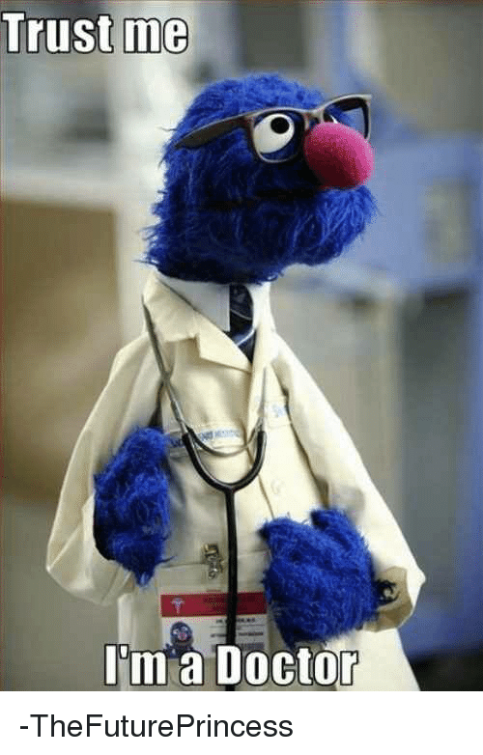
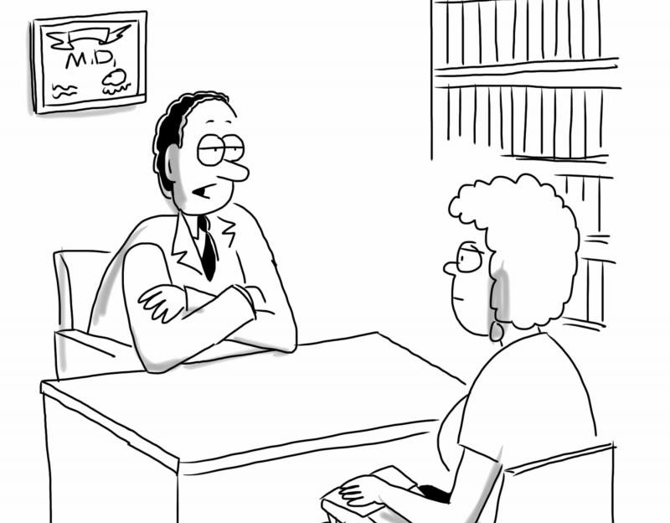
IMPORTANT!
Models of Doctor-Patient Relationship
“Dependent on community’s social values and moral norms”
Paternalistic
informative
interpretive
deliberate
The Paternalistic model
• The physician acts as the patient’s guardian
• The physician uses his/her skills to determine what is wrong with the patient and implements the best course of management for him/her. “Physicians are in the best position to judge what is best for their patients. In a strong form of this, physicians authoritatively order patients to assent
• Patient is expected to agree on what the physician has decided for him/her.
• Excludes the patient from the decision-making process.
• Culturally applicable in Chinese culture and partially in other Far East and South Asian cultures.
The Informative Model “engineering model”
• The physician acts as the technician
• The physician informs the patient to fall the medical facts related to his/her disease and the available interventions to deal with it. ( The patient takes decisions independently based on personal values (total patient autonomy)
• The Patient Decides What Medical Intervention he / she wants
• The Physician Executes The Selected Intervention
• Physicians treat diseases rather than patients and sick persons are “Consumers”.
• Excludes the doctors values from the decision making process
• Culturally applicable To certain sections of Western and relatively less eastern population.

Slide 8
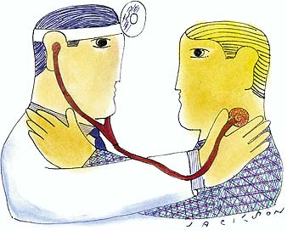
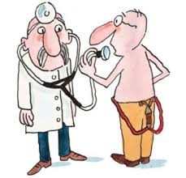
IMPORTANT!
The Interpretive/ Collegial Model
• The physician acts as the counselor,advisor or friend
• The physician tries to understand the patient’s values and what he/she actually wants and help him/her choose the intervention that fulfills these values.
• The patient ultimately decides the intervention to be taken
• Physician’s medical facts and patients personal values contribute to balanced and shared medical decision- making.
• Upholds patient autonomy without undermining the physician’s duty of beneficence.
• Culturally popular in the West & Increasingly accepted in the East.
The Deliberative Model
• The physician acts as the mentor, teacher
• Physician objectively knows and prioritizes patient’s personal and medical values.
• The physician discusses with the patient what course of action would be best.
• The physician not only Discusses What The Patient Could Do, but acting to the benefit of the patient, he/she will also discuss what should the patient do.
“The physician mentor’s grip on decision making is more relaxed than the physician / parent model but autonomy- conscious patients find it unsatisfactory.”
Summary
 | Paternalistic | Informative | Interpretive | Deliberative
Physician obligation | Promoting patient’s well-being independent of the patient’s preference | Provide relevant facts & information to the patient and executes the patients wishes | Provides relevant facts and information to the patient while trying to understand the patient's values to help the patient choose the intervention that suits his/her values | Informs guides the patient to the intervention that is best suited for his clinical situation
Patient autonomy | Consents to the doctors choice | Patient controls the decision making | Patient understands him/herself better to help her in making the choice | Self-development
Physician role | A guardian, parent | A technical expert | Counselor or advisor | Friend or teacher
Epidemiology | -in Chinese culture -partially in Far East & South Asian | -in Western -less in Eastern | -in West -increase acceptance in East

Slide 9
IMPORTANT!
How Should Doctors Approach Differences in Cultural Context?
Good doctors will have an awareness of their own beliefs and an understanding of the beliefs and commitments of others.
Conflicts between clinical judgement and culture or beliefs should be approached sensitively and nonjudgmentally.
Doctors should treat patients fairly and with respect whatever their life choices and beliefs.
A doctor’s own religion, culture or beliefs should not adversely affect patients’ well being.
While providing professional care physician must not impose his / her view on a patient’s Life style, culture, beliefs, race, Sex, age / sexuality, Social status economic worth
Physicians must be prepared to explain and justify his / her actions and decisions
A doctor should approach cultural differences with :
1
Competency كفاءة
5
Sensitivity حساسية
2
Humility تواضع
6
Curiosity فضول
3
7
Awareness of possible external influences
Empathy عطف
4
Respect احترام

Slide 10
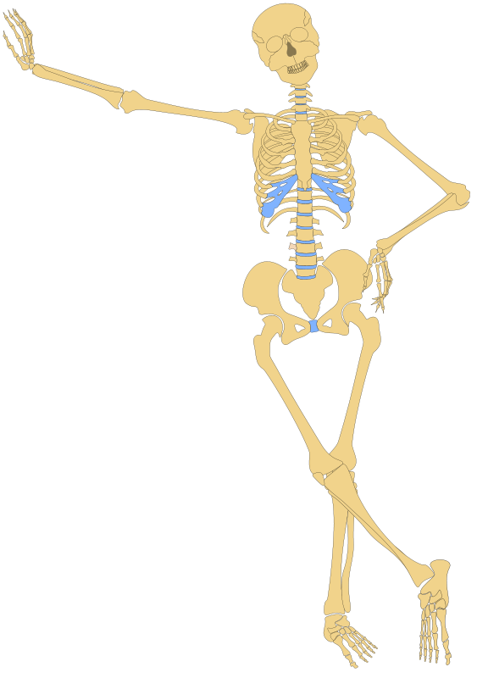
Partnership
P
S
Support
working with the patient to accomplish a shared outcome.
Expressing willingness to care and be helpful to the patient however you can
PEARLS concept
Empathy
E
L
Legitimization
Recognizing and comprehending another’s feelings or experience.
Accepting Patients Feeling So Reactions Whether or not you agree with their perceptions.
Analogy
A
R
Respect
Willingness to acknowledge or express regret for contributing to the patient’s discomfort or distress.
Non-judgmental acceptance of each patient as a unique individual.
Conclusion
Patients are entitled to good standards of professional practice
and care in all cultural settings.
The essential elements of this medical professionalism are:
Professional competence
Good relationship with patients and colleagues
Observance of professional ethical obligations
Medical teachers should be a role model’ in application of these essentials

Slide 11
Team leaders
Abdulrahman Bedaiwi Amirah Al-Zahrani
Team members
Abdullah Alassaf
Abdullah Alasmari
Abdulrahman Almezaini
Khalid Alkwai
Mohammed Alhamad
Deema Almaziad
Elaf Almusahel
Rema Almutawa
Renad Almutawa
Shahd Alsalamah
Taif Alotaibi
Tarfah Alkaltham
Say cheese :)
THANK YOU!
Give us your feedback!

