Slide 1
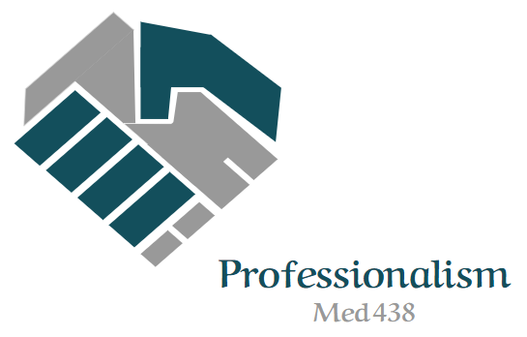
The Concept of Communication Skills in Medicine
Editing file
Objectives:
Define communication, its theory and types
Describe the importance of communication in medicine
Demonstrate effective communication in day to day practice
Overcome barriers to effective communication
Apply the principles of communication and collaboration skills in PBL sessions
important
original content
only in girls slides
only in boys slides
extra notes
Doctors’ notes

Slide 2
Communication
The act by which information is shared.
The process by which we relate and interact with other people.
includes listening & understanding with passion & respect as well as expressing views, ideas & passing information to others in a clear manner.
Communication Theory
(It is a learned skill based on 3 pillars)
Accuracy
Efficiency
Supportiveness
(All of the above combine to contribute to the effectiveness of good communication)
Communication Skills
There is a substantial evidence indicating that communication skills are crucial in the development of satisfactory health care provider-patient relationship.
In 21st century, teaching and assessment of communication skills in medical schools are well recognized.
effective communication is considered to be one of the most important skills of a physician.
ONLY IN MALES SLIDES!
Communication
(an essential competency)
Process of communication
Channel
Sender
SaudiMEDS
GMC
AAMC
Feedback
Message
WFME
ACGME
ABMS
Receiver
Channel
SaudiMEDS: Saudi MEDS framework, GMC: General Medical Council, AAMC: Association of American Medical Colleges, WFME: World Federation for Medical Education, ACGME: Accreditation Council for Graduate Medical Education, ABMS: American Board of Medical specialties.

Slide 3
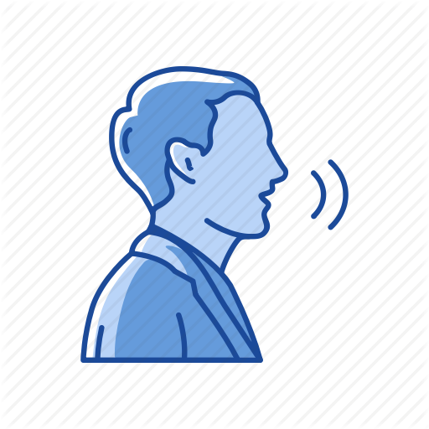
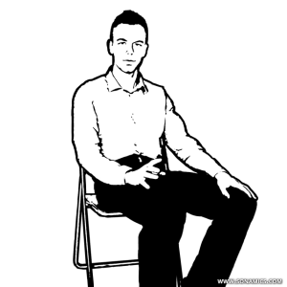
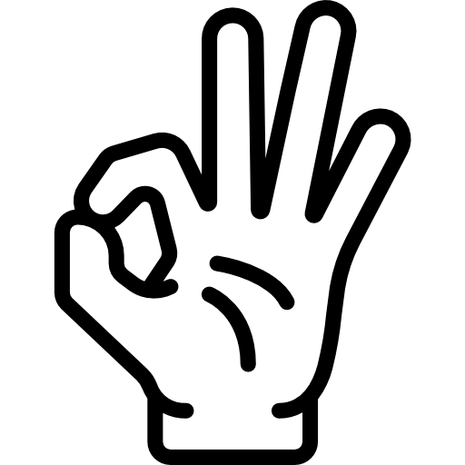
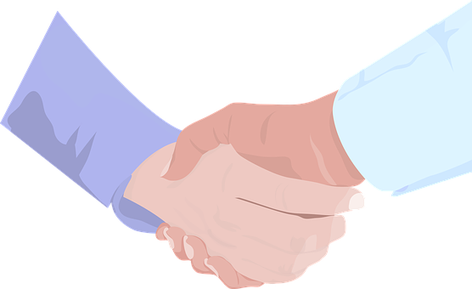
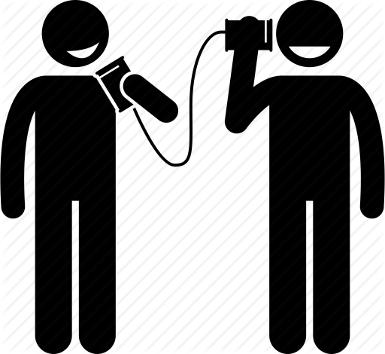
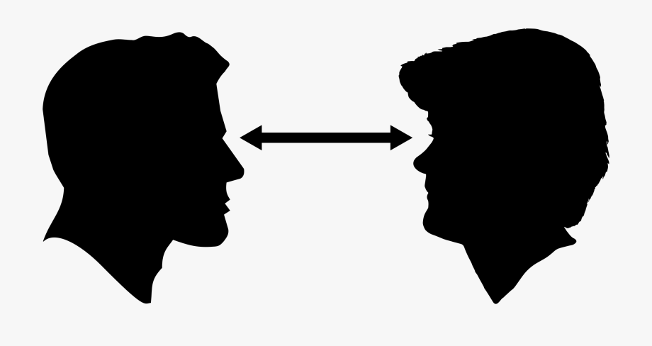
Types of communication
Verbal
(Most common)
Non-Verbal
Written
Visualization
Sharing of information between individuals by using speech
Done by sending and receiving wordless clues
Messages or information is exchanged or communicated within sender and receiver through written form
Transmission of information and ideas using symbols and imagery
Verbal Communication
Open
Broad - gives control to respondent, allows disclosure.
eg. How you felt 1st day in college?
focused - gives control to respondent within a given area, encourages disclosure of feelings
eg. Did you have a good day at school?
Closed
control is with interviewer, checks information.
eg. Do you smoke? “Yes” or “No”
Leading
control with the interviewer, suggests a desired response.
eg. What year in the 15th century did columbus arrive in the Americas?
Speaking to the person:
Look straight in the eye.
Make eye contact.
Show respect.
Clear message:
Relevant.
Use understandable language.
Support by illustration if needed.
Good listener:
Allow others to understand the message and reply.
Listen carefully.
Make a dialogue and not a one way instruction.
Non-Verbal Communication
Facial expression
Posture
Hand Gestures
Touch
Listening (active & passive)
Silence
Eye contact

Slide 4
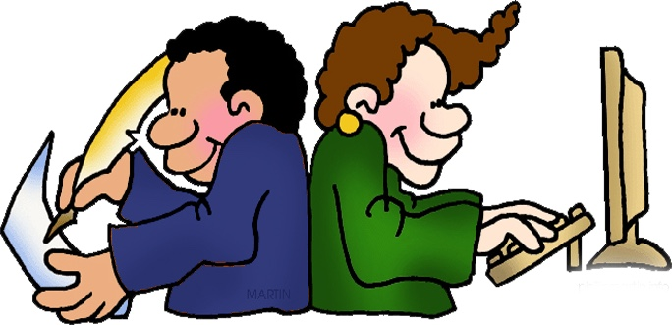
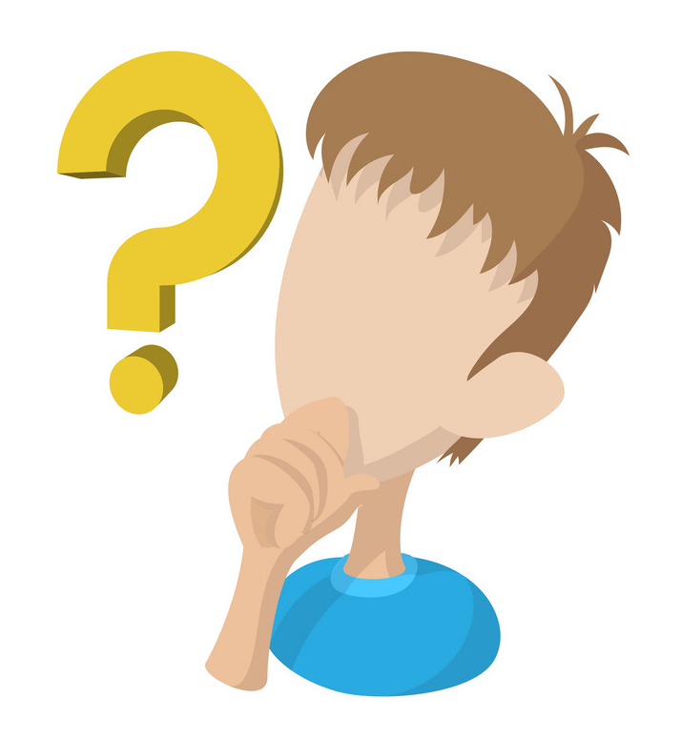
Written Communication
Clarify your thoughts and the purpose.
Identify the key points, facts and themes.
Decide on a logical order.
Use short paragraphs and sentences.
Compose a strong introduction and ending.
Why visual communication is important?
ONLY IN MALES SLIDES!
1
2
Complements verbal communication: For making verbal communication more effective and meaningful, it is always helpful to use visual tools and techniques e.g. a graph or picture. Short films and television advertisements are perfect examples of this combination.
Helps in maintaining interest and retaining information: The larger the audience, the lesser the opportunity to interact one-on-one. The use of visual aids is what can save the day by helping you grab the attention of everyone amongst the audience, ensure that they remain engaged, and make them retain the delivered information.
Effective Communication
Specifically, effective communication skills have been shown to improve providers’ interviewing skills, facilitate information-gathering, and decrease malpractice claims.
Communication: Why?
Effective communication is the basis of mutual understanding & trust.
Poor communication causes a lot of misunderstanding & hinders work & productivity.
Good communication is needed to:
Increase our knowledge.
Makes our feelings and thoughts known.
Find out about people.
Find out information.
Develop relationships.

Slide 5
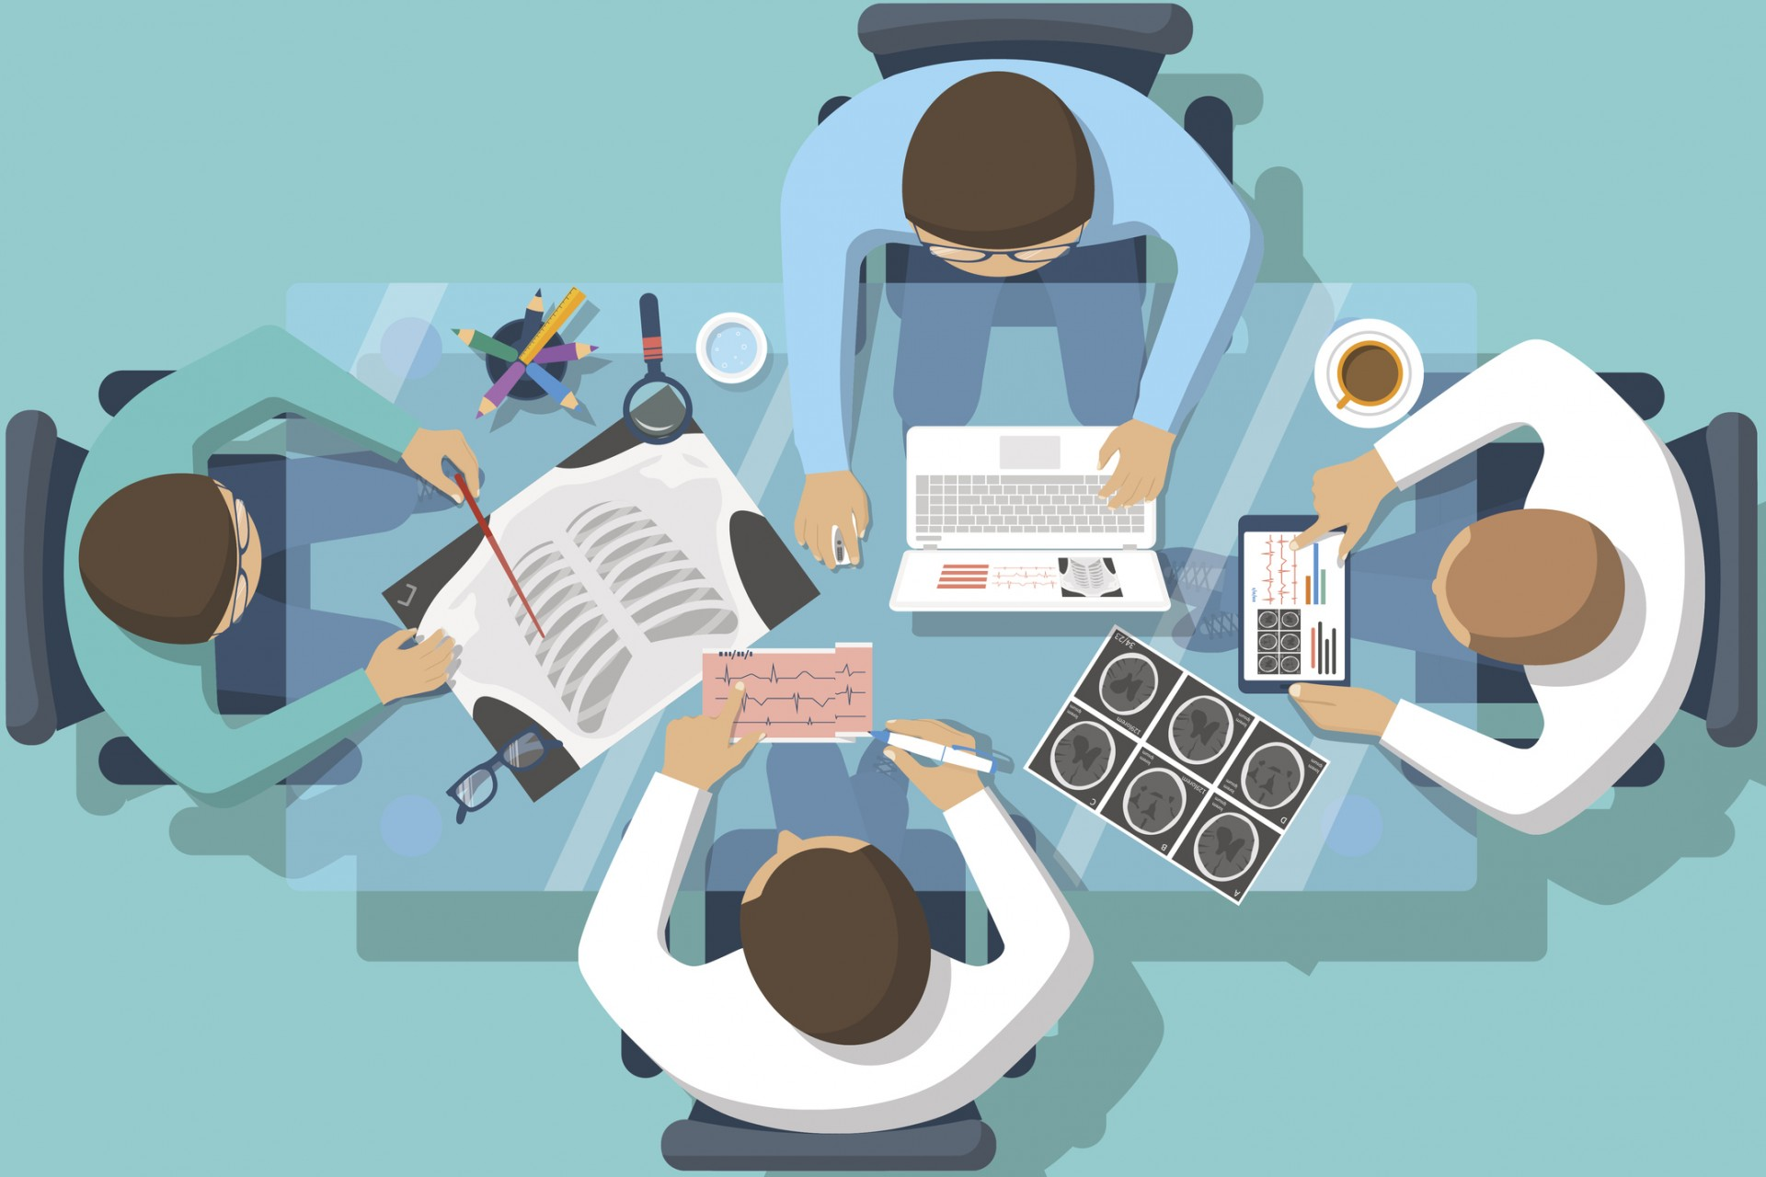
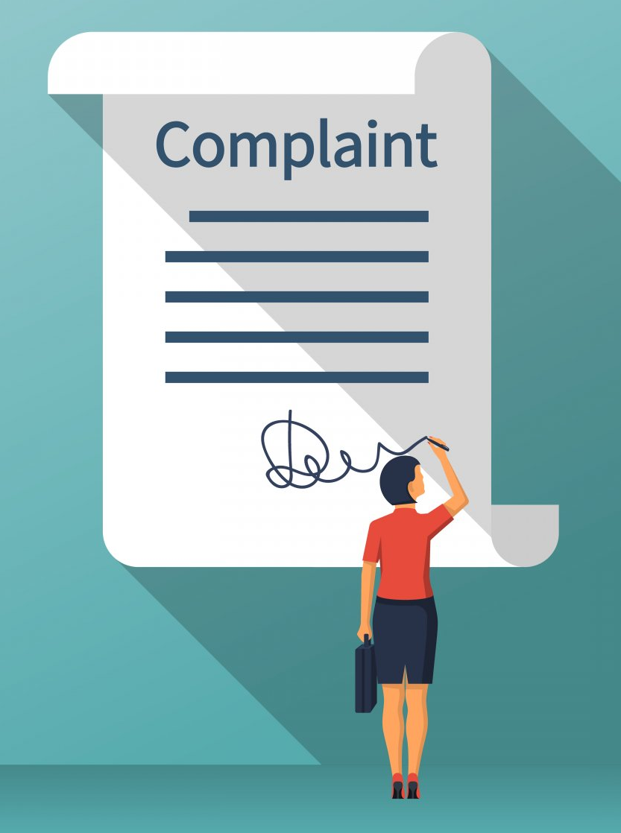
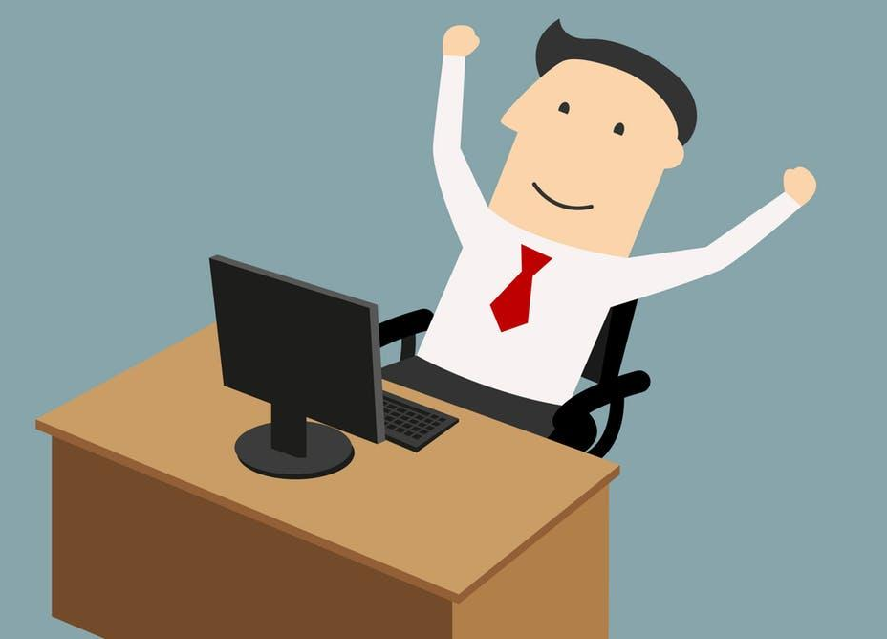
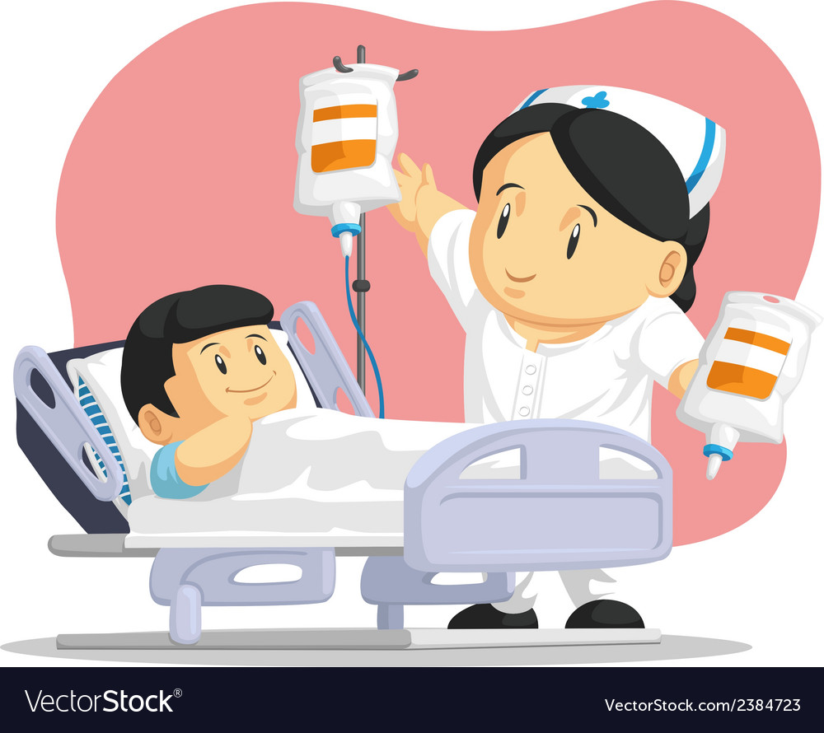
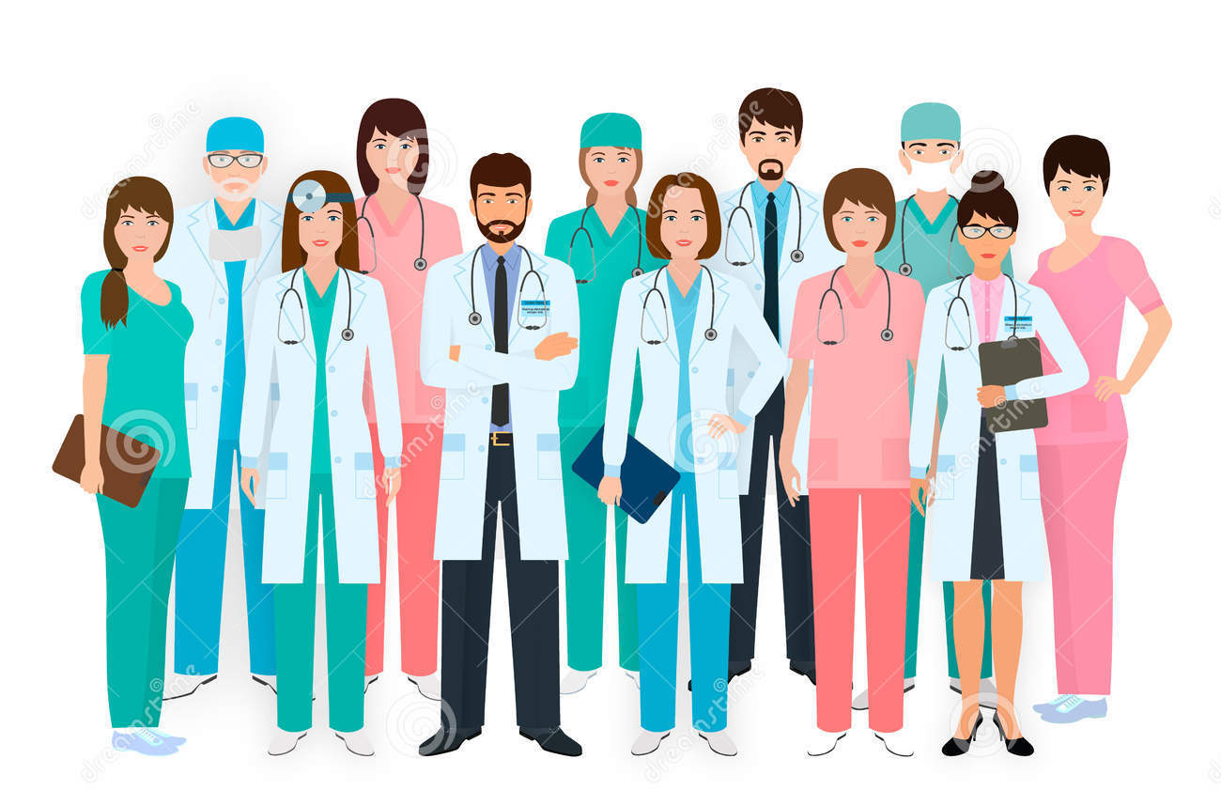
Communication & Medicine
Historically the emphasis was on the biomedical model in medical training which places more value on technical proficiency than on communication skills.
Recently learning communication skills & evidence-based practice become the cornerstones of modern medicine.
Communication in Medicine
Reduces the risk of complaint and litigation
Higher levels of job satisfaction
Increases patient satisfaction and health outcomes
WHAT IS REQUIRED FROM DOCTORS?
Toward patients | Toward colleagues
Listen to patients and respond to their concerns and preferences. Give patients information in way they can understand. Taking patient’s views into consideration when assessing their condition. Respond to patients questions, keep them informed & share information. You must make sure, wherever practical, that arrangements are made to meet patient’s language and communication needs. You must be considerate to relatives, carers and partners in providing information & support. | Communicate effectively with colleagues within and outside the team. Understanding the role and responsibilities in the team and each aspect of patient care. Treat them fairly & with respect.

Slide 6
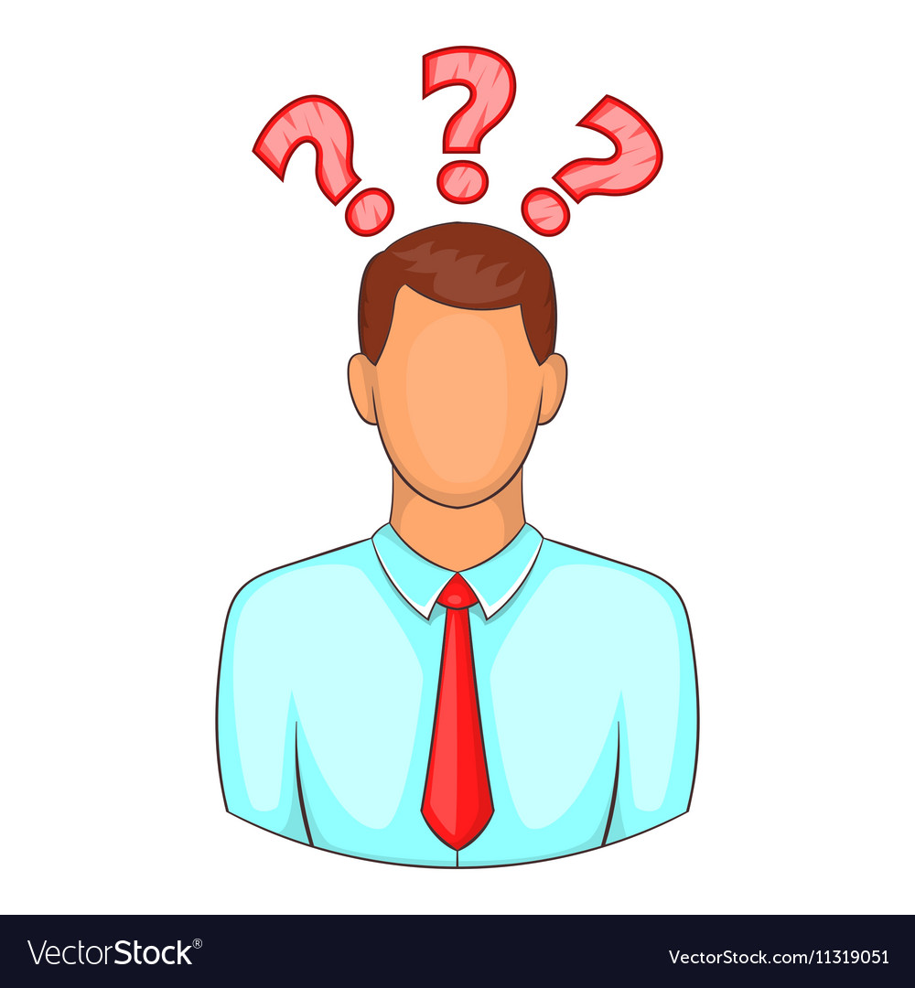
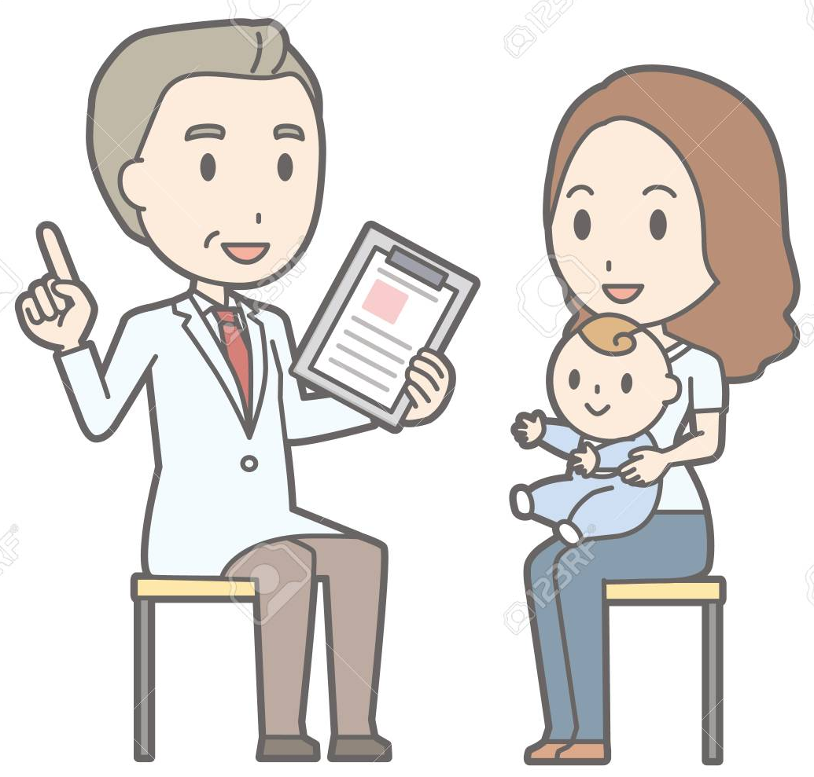
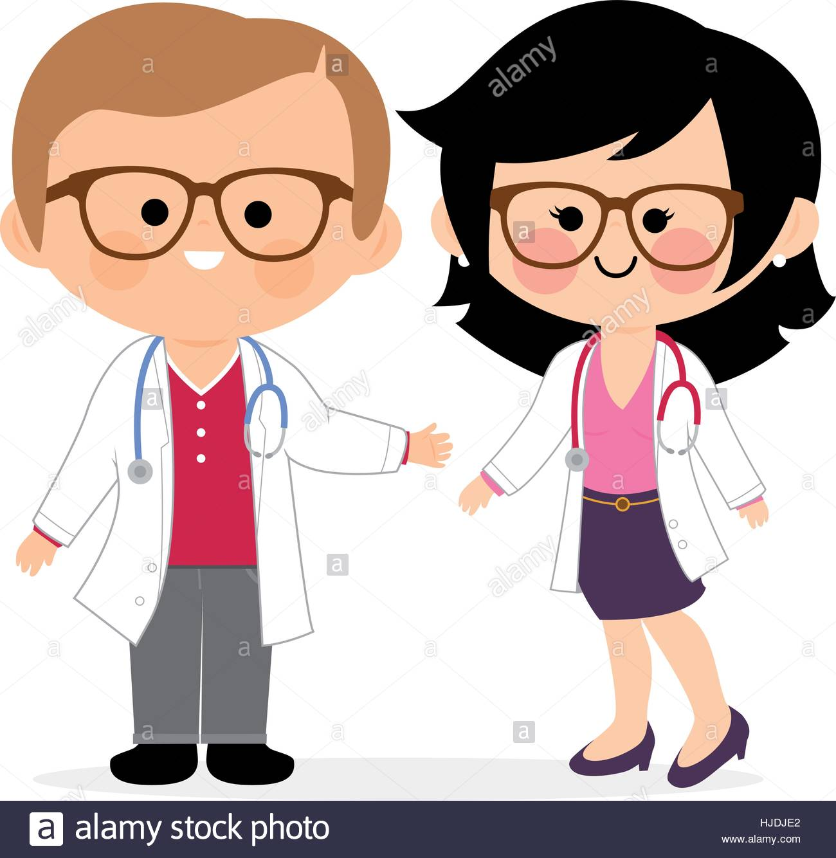
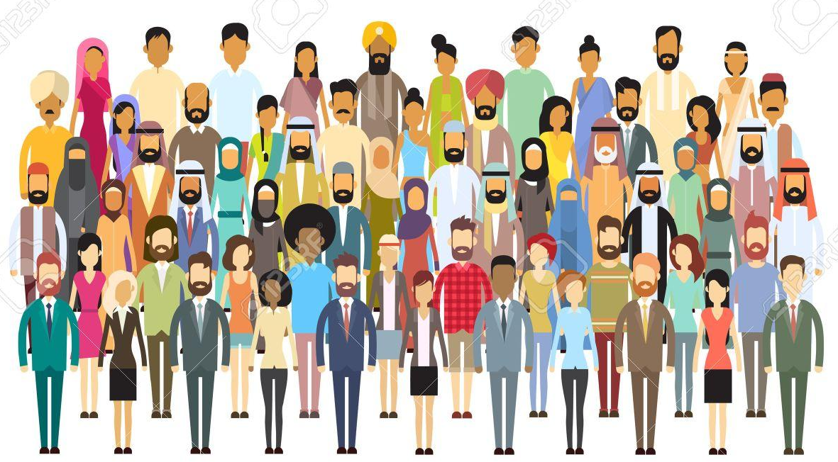
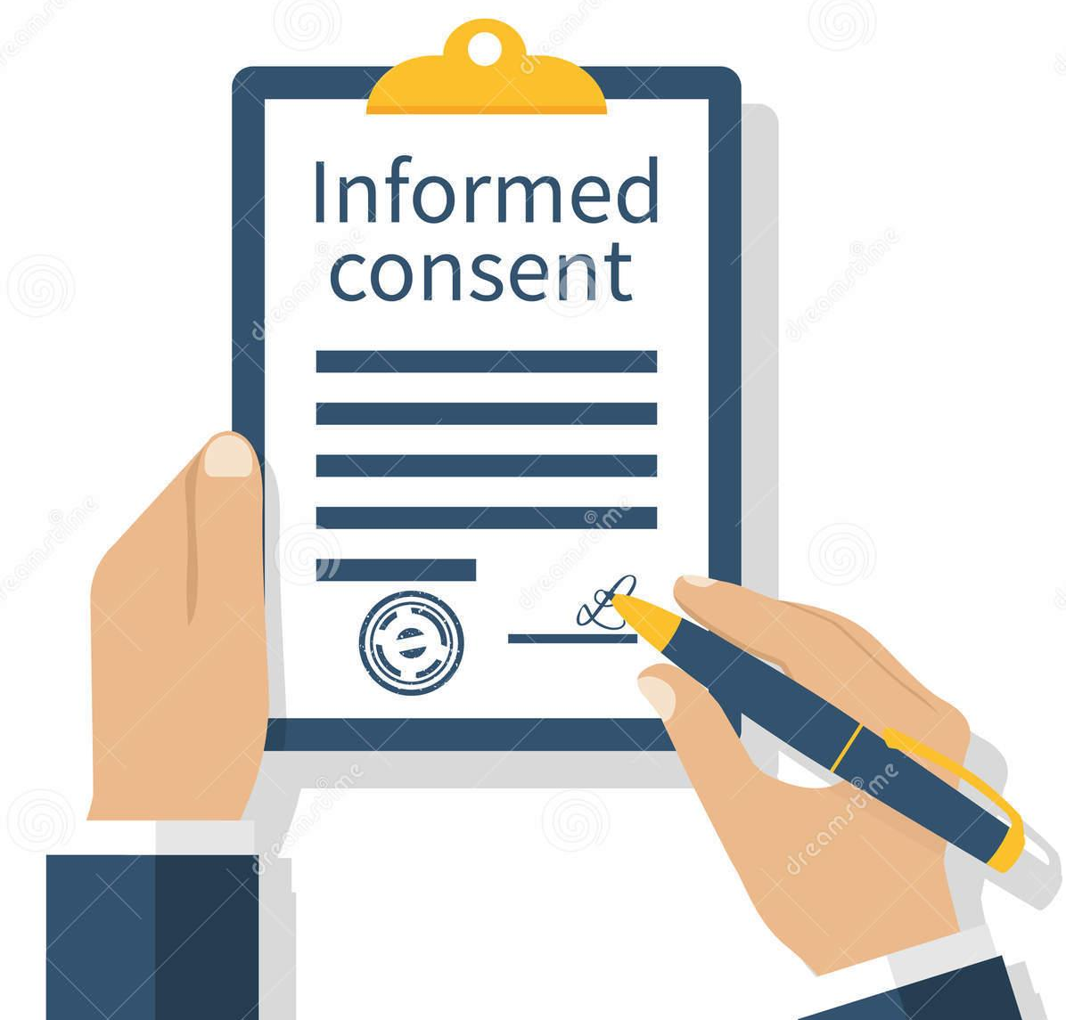
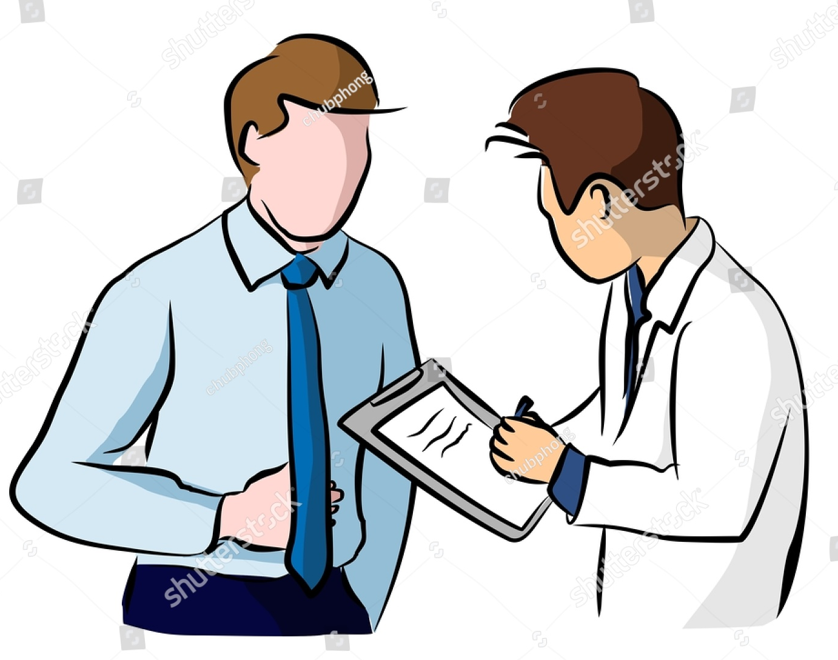
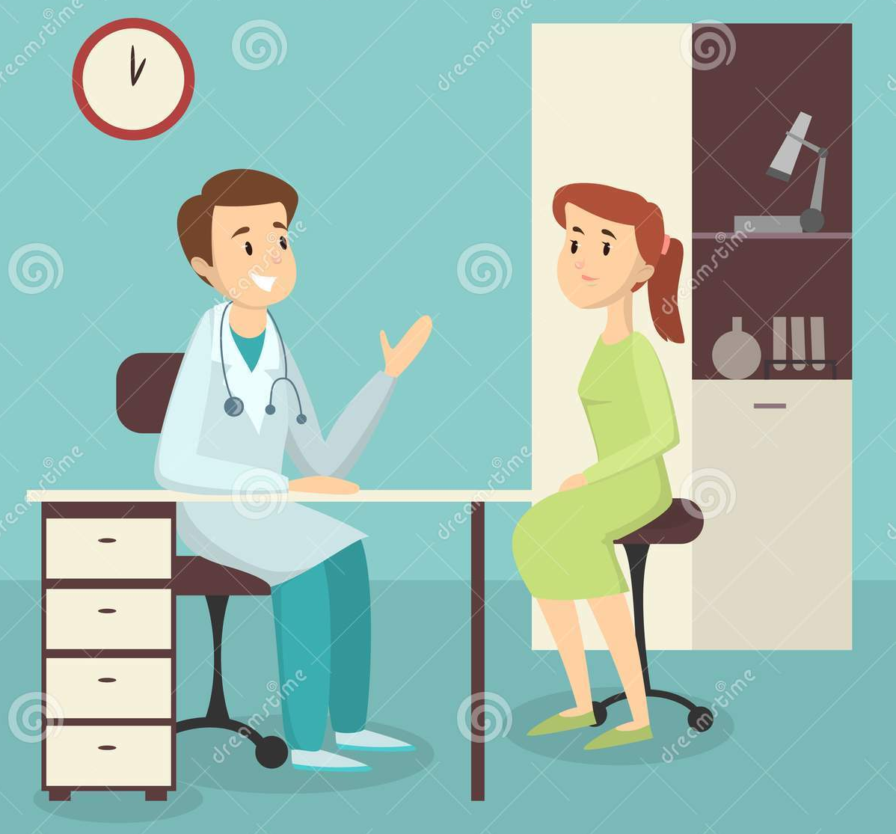
Why do the doctors need to practice good communication?
1
Because patients are human with sensitive need.
2
Doctors cannot practice medicine without effective communication skills.
3
Poor communication cause a lot of medico-legal & ethical problems.
Communication: with whom?
Patients &
caregivers
Administrators
Nurses & auxiliary staff
Report research findings
Colleagues
Talking to the media
Public & legislature
Where to apply our Communication skills?
The medical interview between the doctor and the patient, and it can be classified into 4 types according to the purpose:
History taking
Consultation
Obtaining Informed Consent
Breaking Bad News

Slide 7
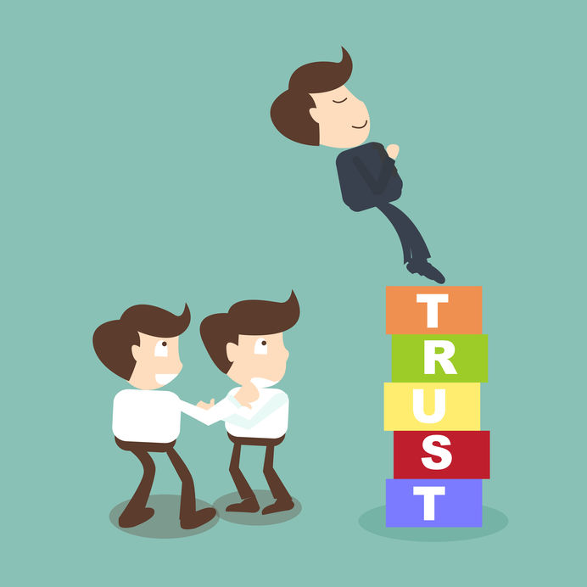
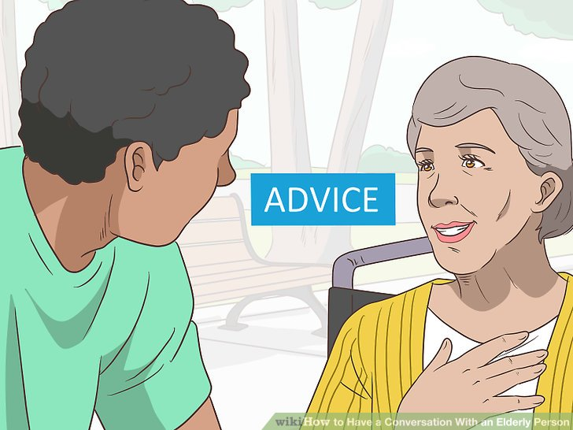
Effective communication
Principles of effective communication
Ensures good work relationships
Increases patients satisfaction
Planning
interaction rather than a direct transmission
Increases understanding of illness and management
Improve patients compliance with treatment
flexibility in relation to different individuals & context
Reduce medico-legal problems
ability to handle emotional outbreaks
Reduce uncertainty or doubt
Communication with peers:
Mutual trust & respect
Exchange
information
Ask your seniors
Communication & Medical care:
Good communication should be established between: the patient, the family and the treating multidisciplinary team.
Patient & family should be encouraged to participate and verbalize in the ward round discussion about:
Offered medical care & treatment.
Rehabilitation.
Follow-up/re-admission plans.
Doubts & worries.
Proper information to patient and family regarding services available and how they can utilize them.
Communication skills: Some techniques
PRACTICE- fluent dialogue with patient.
ENCOURAGE- patients with your supportive words.
USE- silence effectively, allowing patient enough time to express thoughts or feelings.
UTILIZE -non-verbal communication.

Slide 8
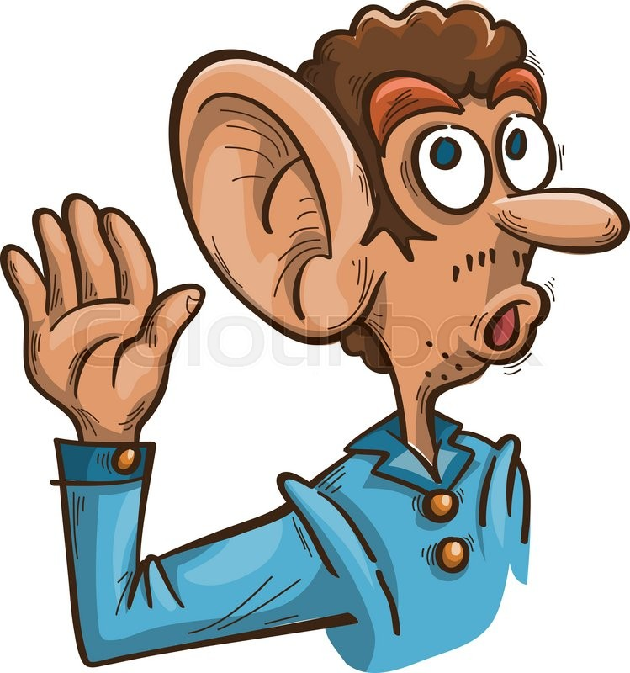
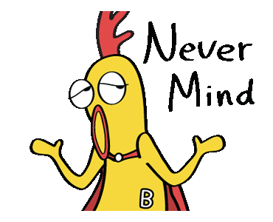
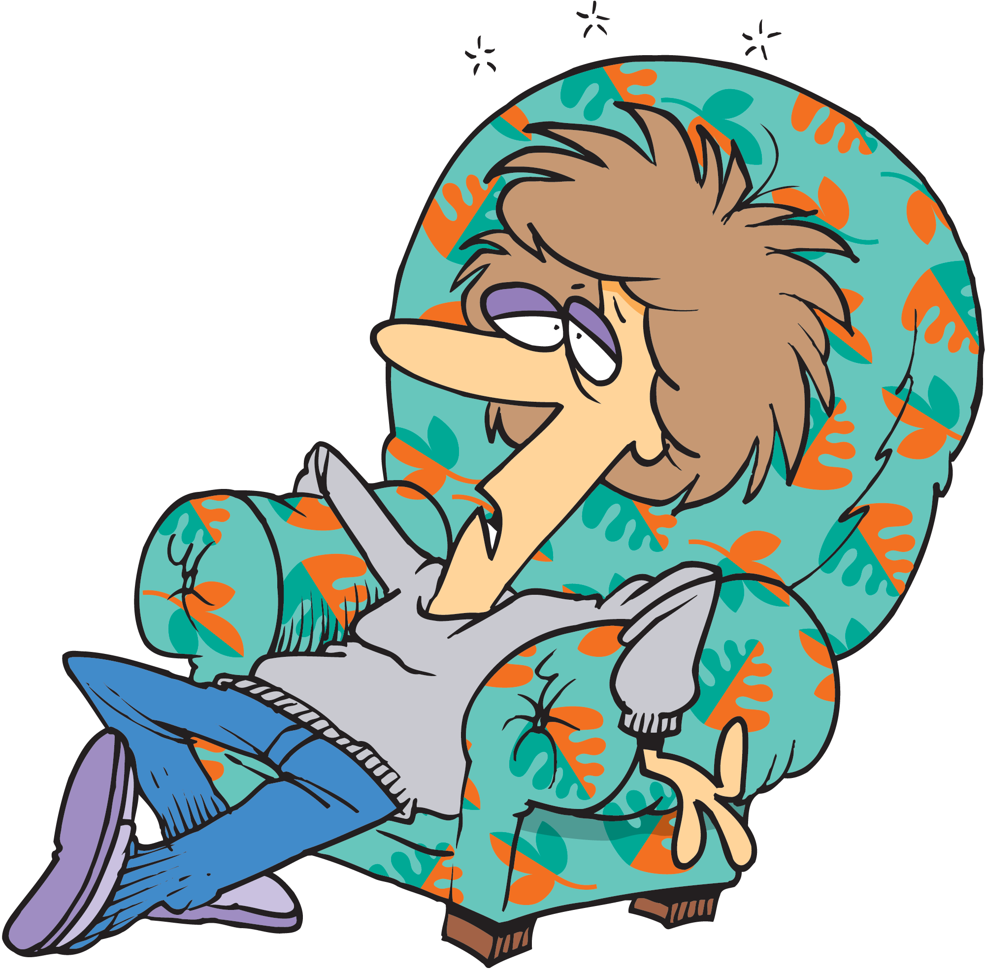
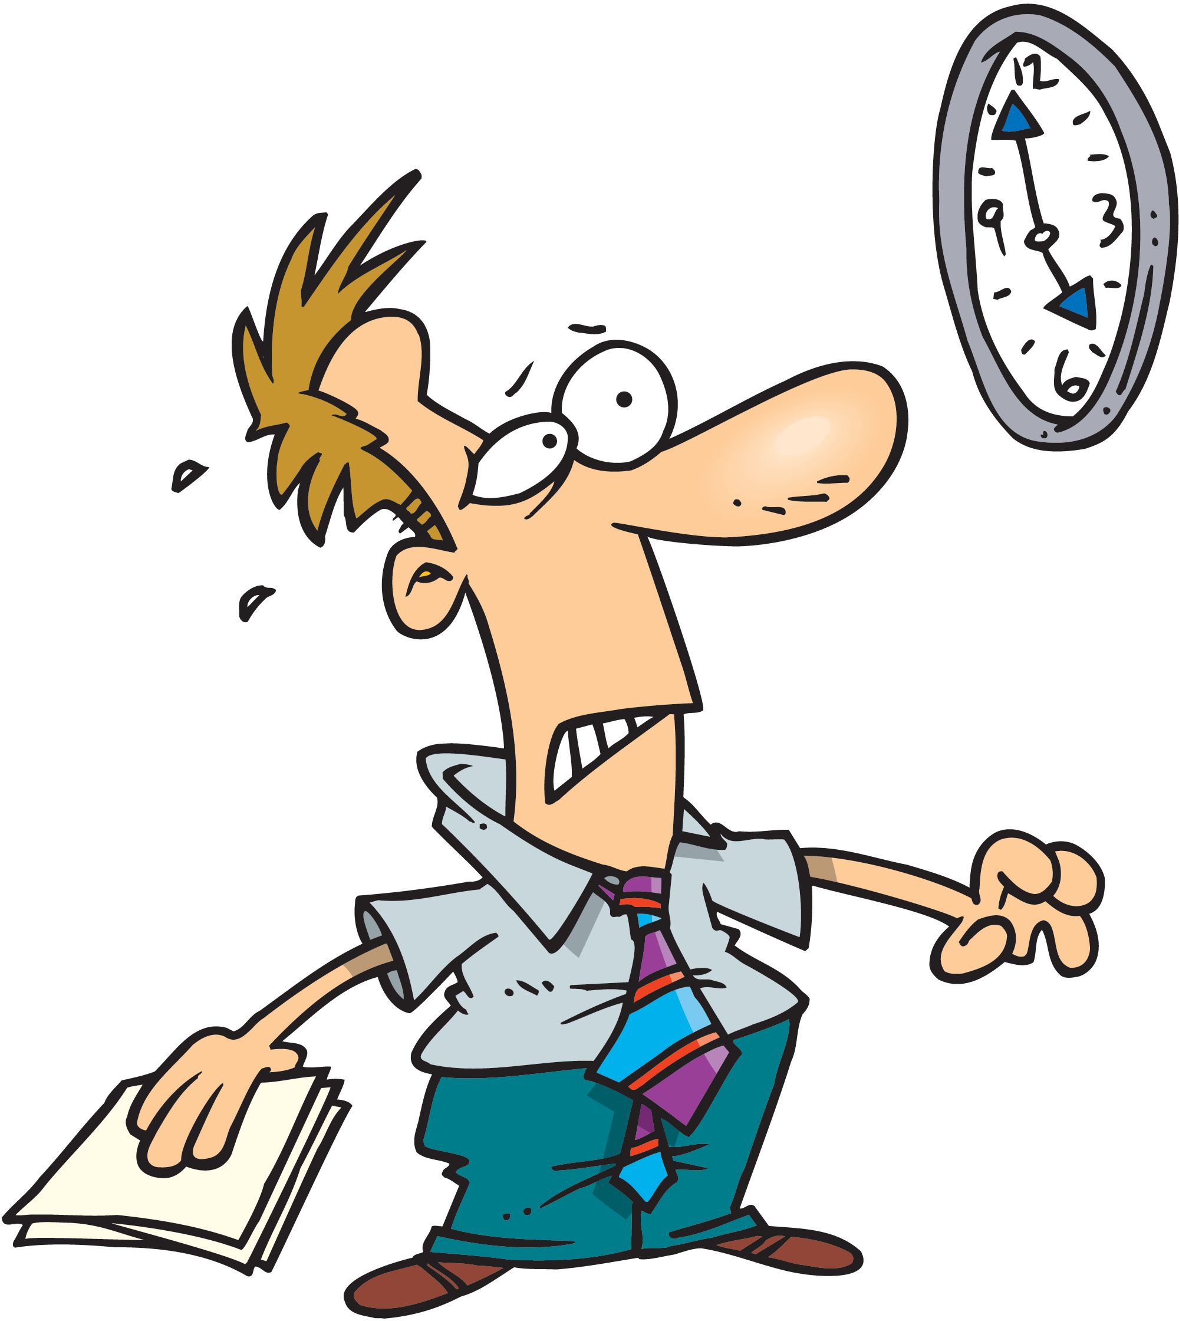
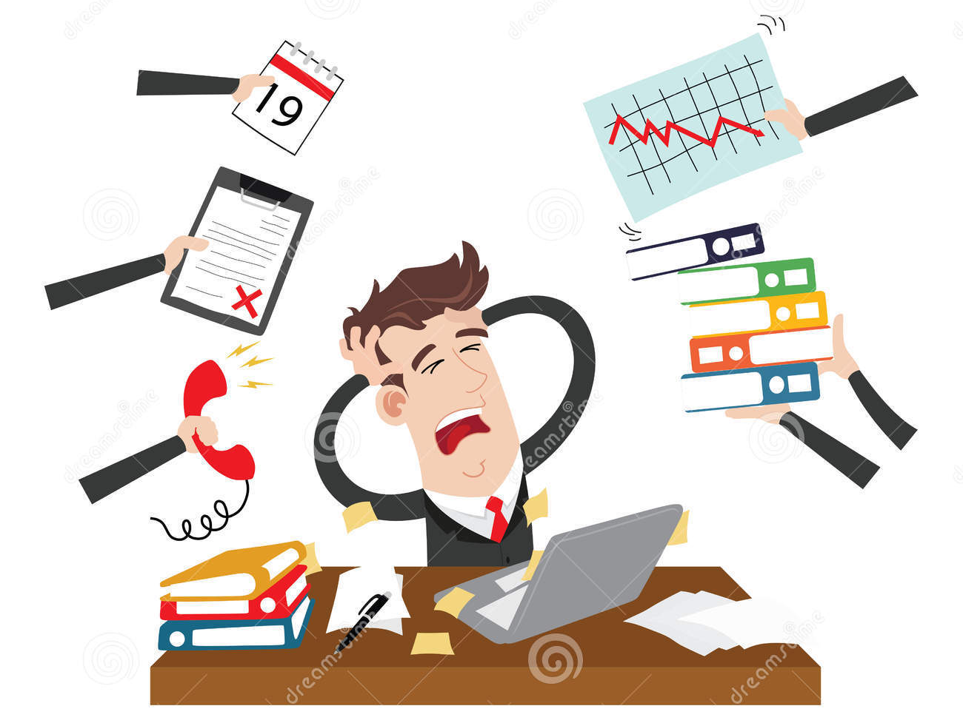
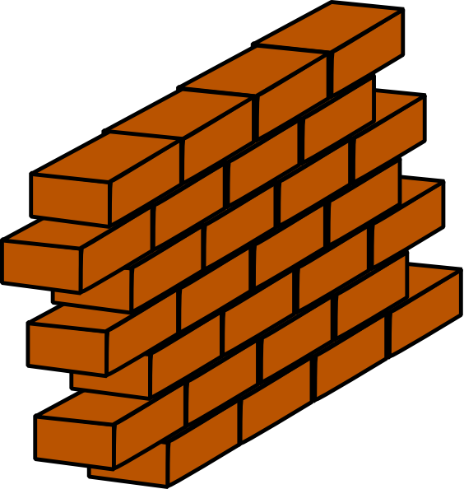
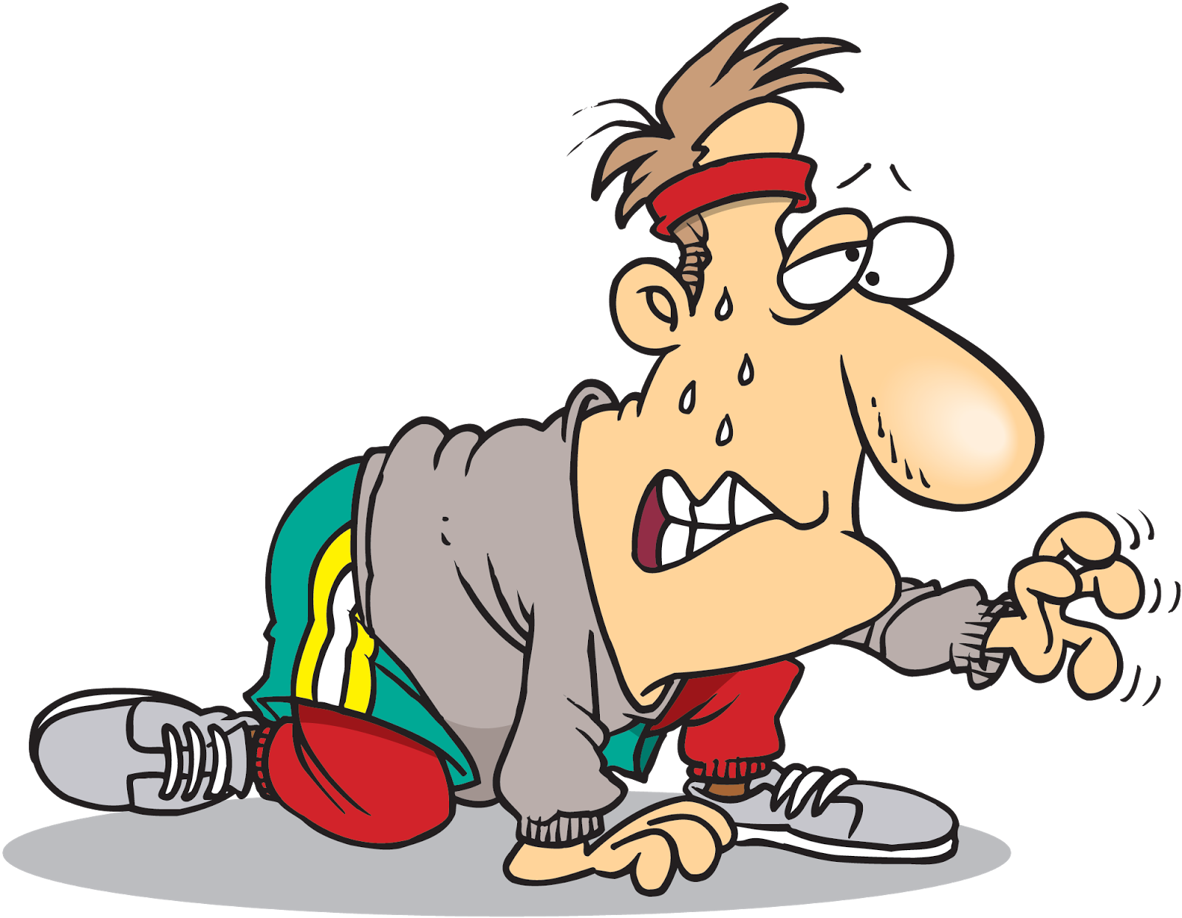
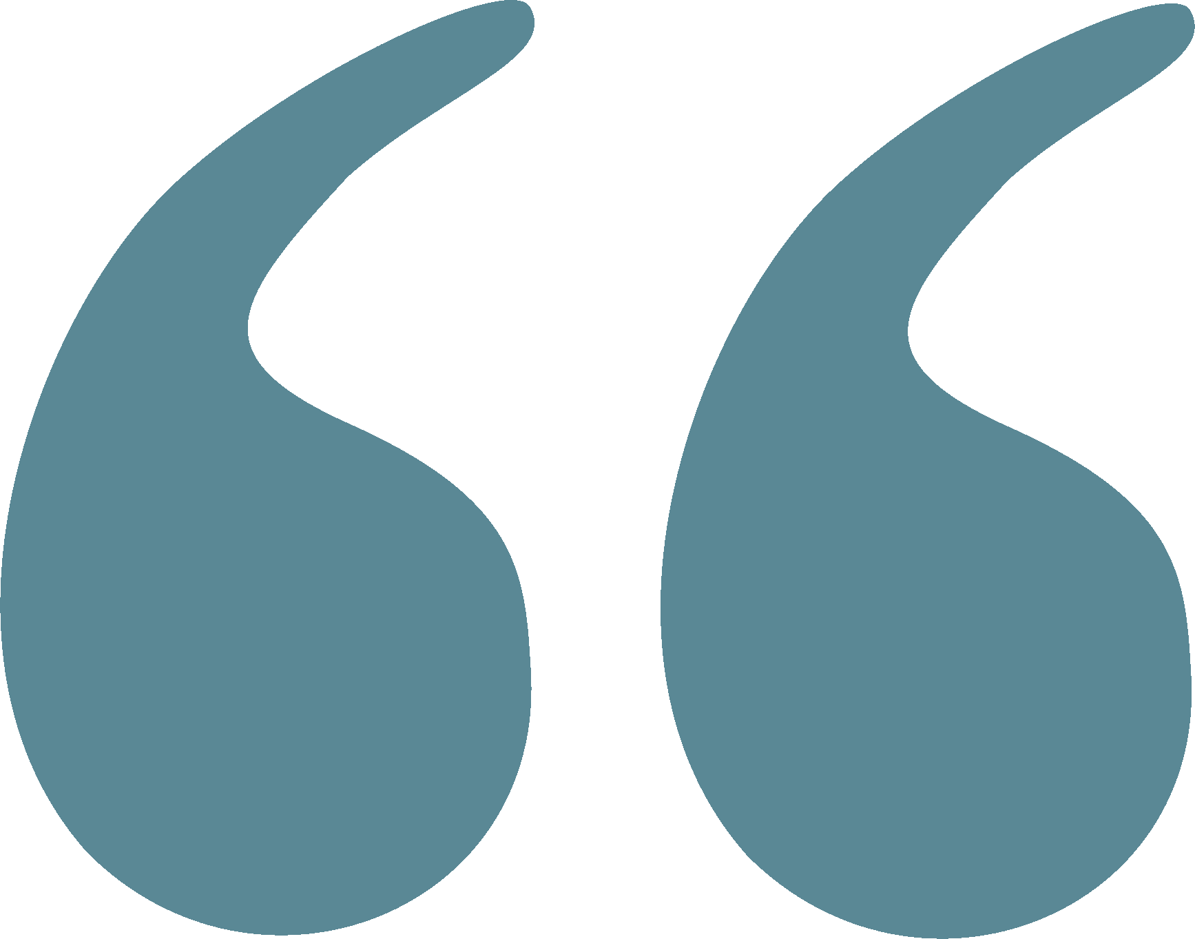
Listening
VS
Hearing
Attention.
Active involvement.
Full understanding.
Takes time and effort.
Passive activity; no effort.
Barriers to effective
communication
Personal attitudes
Ignorance
Human failings (tiredness, stress)
Cultural & language barriers
Poor time
management
Strenuous working environment
Physical, Environmental & Biological barriers
Conclusion
Effective communication is the key to success in professional career.
Good communication is essential for proper doctor-patient relationship and help avoids problems of misunderstanding.

Slide 9
Team leaders
Abdulrahman Bedaiwi Amirah Al-Zahrani
Team members
Abdullah Alassaf
Abdullah Alasmari
Abdulrahman Almezaini
Khalid Alkwai
Mohammed Alhamad
Deema Almaziad
Elaf Almusahel
Rema Almutawa
Renad Almutawa
Shahd Alsalamah
Taif Alotaibi
Tarfah Alkaltham
Say cheese :)
THANK YOU!
Give us your feedback!

