Slide 1
Volunteering works & the role of medical professionals in serving the community
Editing file
Objectives:
Describe the spectrum of volunteering works
Discover the aims of volunteering works
Describe the steps of preparation of volunteers
Identify the expectations of volunteers
Demonstrate how to act along the social, public and community responsibilities as a professional
Recognize opportunities in the volunteering
Apply the ethics of volunteering
Practice as a volunteer
important
original content
only in girls slides
only in boys slides
extra notes
Doctors’ notes

Slide 2
Volunteering is promoted as a way of enhancing students’ career prospects, at the same time as getting involved in community activities.
Students are increasingly exalted to build up their CV profiles in the pursuit of enhancing employability.
VOLUNTEERING
Volunteering work
What is volunteering?
Who is the volunteer?
Why do you want to be a volunteer (benefits)?
What difficulties stop you becoming a volunteer?
How to be a volunteer?
How to start an awareness campaign?
Report writing and presentation of volunteering work?
What is volunteering?
“any activity which involves spending time, unpaid, doing something which aims to benefit someone (individuals or groups) other than or in addition to close relatives, or to benefit the environment.”
Volunteering as an education activity
Informal
Formal
Non-Formal

Slide 3
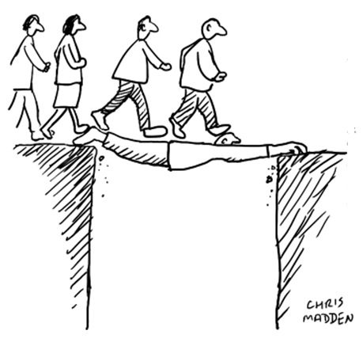
Volunteering as an education activity
1
Non-formal Education (NFE) is any organized educational activity that takes place outside the formal educational system. Usually it is flexible, learner-centered, contextualized and uses a participatory approach. There is no specific target group for NFE; it could be kids, youth or adults.
2
Informal Education, can be defined as
‘‘a process throughout life, by which every person acquires and accumulates knowledge, abilities, attitudes’’ through everyday experiences, at work or during leisure activities
In some universities & colleges, volunteer activities are part of the curriculum. These activities are often organized like other curricular programs; students are given a set number of hours’ work to complete, followed by assessments.
Volunteering can be a part of non-formal and informal learning.
Volunteer motivation
Expectancy Motivation Theory | B. Altruistic Motivation
this theory suggests that behavior is caused by a belief that it will result in a desired reward or goal. | altruism is an aspect of human motivation that is present to the degree that the individual derives intrinsic satisfaction or psychic rewards for attempting to optimize the intrinsic satisfaction of one or more other persons without the conscious expectation of participating in an exchange relationship.
Three factors affect behavior: The need for achievement, which is defined as the capacity for taking pride in accomplishment. The need for affiliation, defined as the concern for one’s relationships with others. The need for power, or wanting to have an influence or impact on others.

Slide 4
Factors favor volunteering
Internal | External
Self esteem Generosity Social responsibility Personal satisfaction Social status Family traditions Identification with organization/college Personal obligation | Professional image Recognition from society Organizational/college image Organizational/college reputation Holidays Natural disasters Being invited C.Vs differentiation Identification with other volunteers (friend/family)
Principles of Volunteering
1
Mutually beneficial
Independently chosen
& freely given
2
To individual & organisation
Has a community or social benefit
Enabling & flexible
4
3
wherever possible
Offered to not-for-profit activities
5
Ethics of volunteering
Trustworthiness
Respect
Justice & fairness
Compassion & generosity
Responsibility

Slide 5
Who is the volunteer?
Someone who does work
without being paid for it
because they want to do it
Someone who offers to do a particular task or job without being forced to do it
Why do you want to be a volunteer (benefits)?
1
Volunteers live longer & healthier
During later life, volunteering is even more beneficial for one’s health than exercising and eating well.
2
Volunteering establishes strong relationships
study reported that prevalence of loneliness is at an all time high, with about one in three adults age 45 or older categorized as lonely.
Dedicating your time as a volunteer helps you make new friends, expand your network, and boost your social skills
3
Volunteering is good for your career
Volunteering has long been viewed as a way to create new “weak tie” connections that lead to career opportunities
4
Volunteering is good for society
5
Volunteering gives you a sense of purpose
Although it is not well-understood why volunteering provides such a profound health benefit, a key factor is assumed to be that volunteering serves to express and facilitate opportunities to carry out one’s sense of purpose
Volunteering helps counteract the effects of stress, anger, and anxiety
Volunteering combats depression.
Volunteering increases self-confidence
Volunteering helps you stay physically healthy

Slide 6
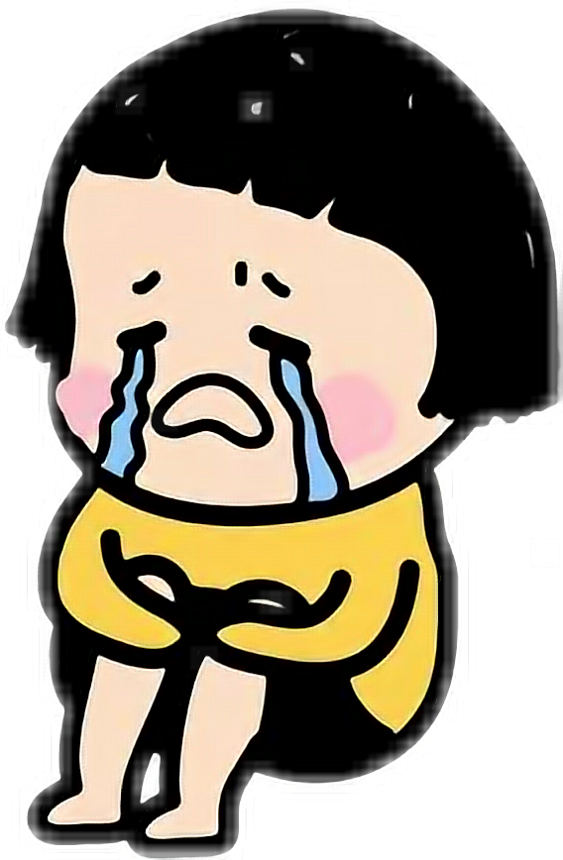
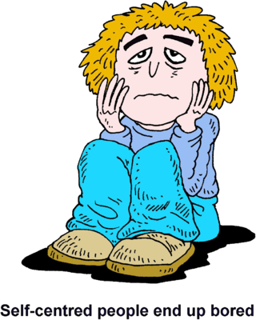
What difficulties/obstacles stop you becoming a volunteer?
People Can’t | People don’t want to | Nobody asked
Lack of time Physical boundaries Lack of skills | Lack of benefits Non-accountable social boundaries Stress from volunteering | Lack of opportunities
Preconceptions & attitudes within the organization/ college
Inadequate community communication
Limited experience
History of being ignored
Resistant leaders
Sense of powerlessness
Lack of time
Lack of transportation
Lack of child care
Overcommitted leaders or citizens
Too many involved
Poor organization of existing action groups
History of unproductive meetings

Slide 7
How to be a volunteer?
Tips for getting started
First, ask yourself if there is something specific you want to do.
For example do I want:
...to make it better around where I live
...to meet people who are different from me
...to try something new
...to do something with my spare time
...to see a different way of life and new places
...to have a go at the type of work I might want to do as a full-time job
...to do more with my interests and hobbies
...to do something I’m good at
The best way to volunteer is to match your personality and interests
Having answers to these questions will help you narrow down your search
How to find the right volunteer opportunity?
Ask yourself the following:
Would you like to work with adults, children, or remotely from home?
Do you prefer to work alone or as part of a team?
Are you better behind the scenes or do you prefer to take a more visible role?
How much time are you willing to commit?
What skills can you bring to a volunteer job?
What causes are important to you?

Slide 8
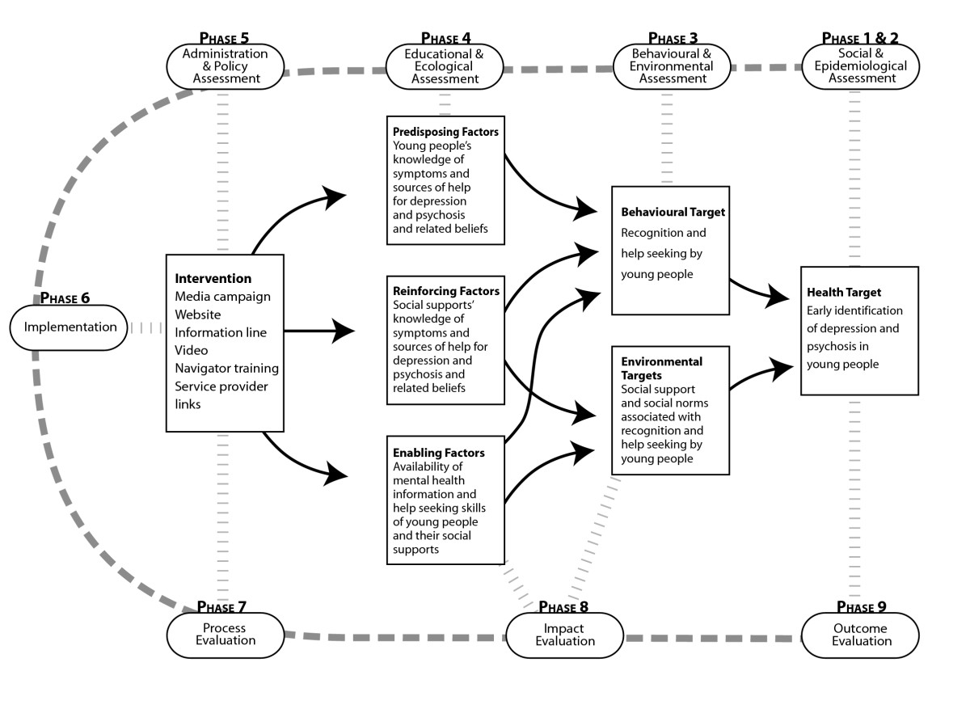
IMPORTANT!
Awareness Campaign
How to start an awareness campaign?
The Precede-Proceed Model
The model involves nine phases is based on the premise that a thorough assessment (Precede) should be made before planning a health promotion intervention, and evaluation (Proceed) is built in to the process to enable measurement of the effectiveness of interventions.
Priority targets for intervention are established through each phase of the assessment process (phases 1–5) on the basis of causal importance in the chain of health determinants, their prevalence and their changeability.
The results of this assessment process guide the development of the intervention (phase 6)
The evaluation (phases 7–9) then tracks the impact of the intervention on factors identified as important targets in the assessment process.
Application of the Precede-Proceed Model to the Company Strategy

Slide 9
Active Participation
Education & Awareness
Leadership
Spectrum of volunteer engagement
Report writing and presentation of volunteering work
Awareness campaign topic
Why did you choose this topic? (importance)
How did you plan for the community awareness campaign ? (phases 1-5)
How did you do in the day of the community awareness campaign day? (phase 6)
What did you learn during this activity? (phases 7,8,9)
What difficulties did you have during this activity? (phases 7,8,9)
How will you improve same/another community awareness campaign activity?
Attach photos and working schedules of the community awareness campaign (details name and task of each participant).

Slide 10
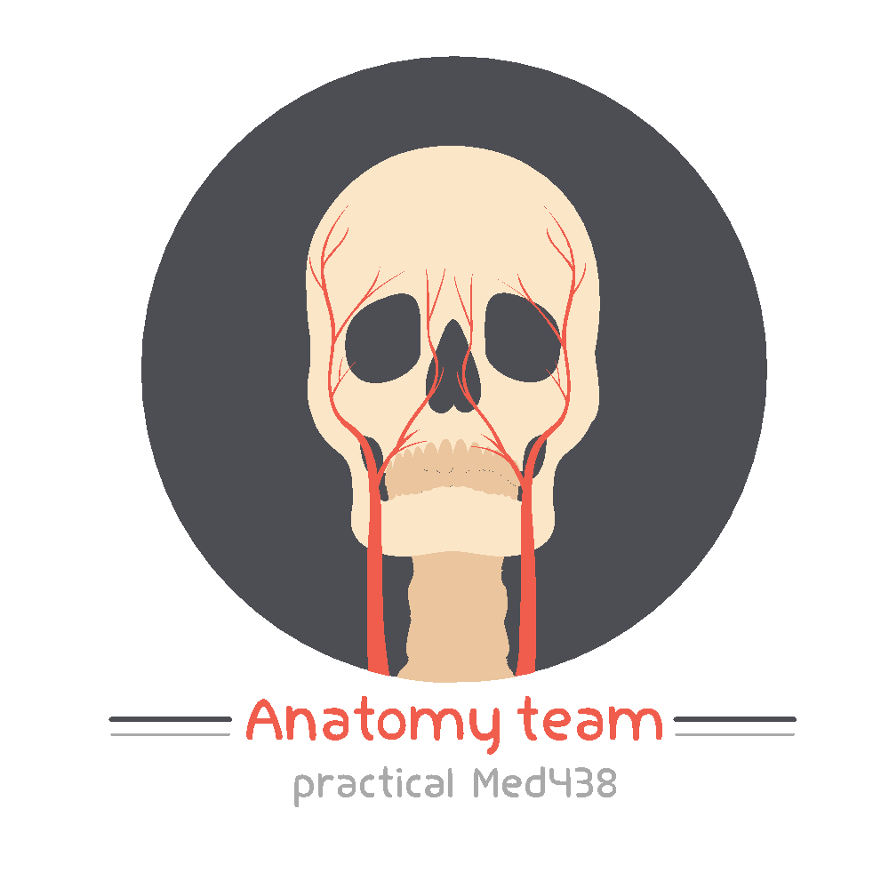
A SHOUTOUT TO ALL TEAMWORKS
This is a THANK YOU letter for each Team Leader & Member
Thank you for volunteering & giving some of your time & effort to make life easier for us
The fact that you are doing this out of your free well shows how a great person you are :)
We will always be in your debt
Please keep up your GREAT work
All love & appreciation 🙏🏼💕
Professionalism Team
Superheroes behind it all
Family & Community
Medicine
Hematology
438 teamwork

Slide 11
Team leaders
Abdulrahman Bedaiwi Amirah Al-Zahrani
Team members
Abdullah Alassaf
Abdullah Alasmari
Abdulrahman Almezaini
Khalid Alkwai
Mohammed Alhamad
Deema Almaziad
Elaf Almusahel
Rema Almutawa
Renad Almutawa
Shahd Alsalamah
Taif Alotaibi
Tarfah Alkaltham
Say cheese :)
THANK YOU!
Give us your feedback!

