Slide 1
Continuous professional development, lifelong learning & professionalism through mentoring
Editing file
Objectives:
Describe Competence
Identify different levels of competence
Recognize essential elements of continuous Professional development
Apply the reflective learning in day to day learning
Describe the concept of Mentoring
Identify the roles of Mentor and Mentee
Recognize what is to be expected from Mentoring
Practice the professionalism through Mentoring
important
original content
only in girls slides
only in boys slides
extra notes
Doctors’ notes

Slide 2
What is Continuous Professional Development (CPD)?
CPD refers to any activity, formal or informal, that helps you develop your skills and knowledge, and enhances your professional practice.
CPD has been defined as “a process of lifelong systematic learning for all individuals and teams which meets the needs of patients and delivers the health outcomes and healthcare priorities of the institute and which enables professionals to expand and fulfil their potential”.
Examples of CPD
Training courses & workshops
Observation (as either observer or person being observed)
Studying for a qualification or accreditation
Peer group exchange, eg via TeachMeets/ Twitter groups/Google groups/professional exchange
Online courses/webinars/podcasts
Visiting other schools/colleges
Self-reflection, personal reading or research
International visits & exchanges
Mentoring
Attending exhibitions & conferences
Who is responsible for CPD?
personal
institute
Responsibility to keep up to date
Has a responsibility to ensure that our team keeps up to date

Slide 3
Why CPD? (Importance)
Health system cannot deliver high quality patients' care without a well-trained health workforce of sufficient capacity & competencies/ capabilities
Features of effective CPD
Personalised – i.e. built on individual identified needs and requirements.
Relevant – relates to your teaching theory and/ or subject specialism and the needs of learners.
Collaborative –with your fellow teachers and colleagues.
Supported – by coaching or mentoring from experienced colleagues.
Sustained – New skills and ideas need time to take hold; experimentation and refinement is the best way to embed new ideas into your classroom practice.
“stay-up-to date with technical advances and new clinical approaches. This is to ensure safe and effective practice.”

Slide 4
COMPETENCE
Knowledge
“The ability to perform a specific task in a manner that yields desirable outcomes”.
Competence
Skill
Attitude
Different Aspects of Competence:
Knowledge
2
Skills
Abilities
1
3
Competence develops over time and is nurtured by reflection on experience
How is competence acquired:
It is gained in the healthcare professions through:
▫ pre-service education
▫ in-service training
CPD
▫ work experience
How can we achieve CPD?
Lecture programs
Conferences
Workshops
CME (Continuing Medical Education) courses
Others
Many methods have been tried in the past
Currently, Reflective Practice/Learning is the most favoured

Slide 5
Core competencies
The national competence framework that has been developed by medical schools in the Kingdom of Saudi Arabia (SAUDI MEDS)
Saudi Meds: A competence specification for Saudi medical graduates
Saudi Meds
Competency - based curriculum
Patient Care and Social accountability
Approach to practice
Dr and patient
Professionalism
Dr and community
Dr and information technology
Communication skills
Dr and research
Levels of competence
We are sadly here 💔

Slide 6
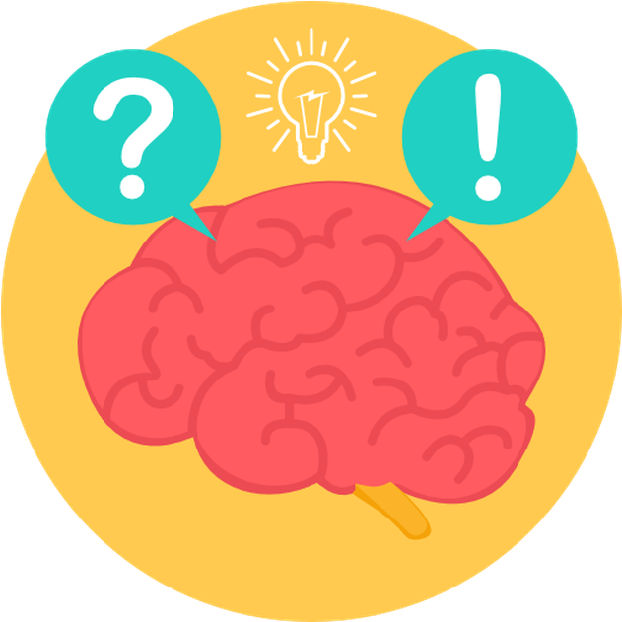
REFLECTION
Reflective practice concept is a practice-based professional learning in which students, trainees, and doctors learn from their own professional experience rather than just knowledge transfer.
Reflection is a metacognitive process that creates greater understanding of both the self and the situation so that future actions can be informed by this understanding.
Metacognition:
Cognition about cognition
Thinking about thinking
Knowing about knowing
It is an awareness and understanding of one's own thought process.
Reflection relates to a complex and deliberate process of thinking about and interpreting experience, in order to learn from it.
Reflection stages: e.g.
An awareness of uncomfortable feeling
Examination of situation
Exploration of alternative actions
Reflective thoughts results in action
1
Reflective Learning
2
Systematic revisiting of a learning
experience with a view to learning from it
Why reflection? (Importance)
Key to become a lifelong learner – if not most learning opportunities are lost

Slide 7
Reflective log: a simplified version
1. What is the learning event?
2. What did I learn?
3. What more do I have to learn?
4. How can I learn it?
5. Evidence for further learning /
change of practice?
A scenario:
A 55 year old man came to clinic with complaint of low back pain (LBP).
You have examined his back which was ok. His height was 160 cm, and weight is 100 kg.
You would like to manage this patient’s LBP contributed due to his excess body weight.
Example (LBP):
1. Learning experience – This obese person who needed to reduce weight.
2. What did I learn? Learned how the patient’s activities have been affected by obesity.
3. What do I have to learn more? Did not know the advice that should be given to the patient with a given BMI. Are there guidelines for interpreting BMI?
4. How do I learn it? Refer a book/article. Talk to the dietician.
5. Evidence / change of practice – BMI was accurately interpreted. Patient was advised about the dietary/lifestyle changes and referred to an obesity clinic. References of books referred.

Slide 8
Reflective practice:
1. Reflection in action
2. Reflection on action
Evidence for learning/change of practice
01
Concrete experience
What’s the event?
05
KOLb’s Cycle
02
What did I learn?
Active experimentation
Reflective observation
How can I learn?
04
03
What more do I have to learn?
Abstract conceptualisation
Experiential Learning:
1
Experience
2
Reflect
3
Make sense
4
Plan for action

Slide 9
Life Long Learning (LLL)
It’s voluntary, rather than compulsory, and is completely
self motivated – with the main goal being to improve
personal or professional development.
Medical students need to be effective lifelong learners in order to continue to develop personally and practice professionally.
This demands an encouragement of diverse learning styles.
It means applying adult learning principles, student autonomy, self-learning, experiential learning reflective learning, computer assisted learning, distance learning, e-learning, use of skill learning laboratories.
How is it learned?
Lifelong learning can be through formal training, or something less structured.
By instruction or coaching, but also includes any form of self-taught learning.
Our daily interactions with our colleagues, and the knowledge and behaviors we learn both inside and outside of work, can be classified as lifelong learning.
Examples of LLL
Internships
Learning to use new pieces of technology
Professional courses
Playing a new game or sport
Teaching yourself a new language
Adding to your skillset during employment
Studying a new subject
Gaining knowledge and learned behaviors from your environment

Slide 10
Benefits of LLL
1
To gain a new qualification.
To add to your transferable skills.
2
3
To increase your employability and promotion prospects.
4
To earn more money.
5
To fill a skills gap.
6
To broaden your knowledge.
7
Personal & professional satisfaction
8
To better contribute to the community.
9
Mental stimulation.
Tips of Lifelong Learning (LLL)
Utilise technology –online resources, eBooks, distance learning course, join forums to continue your development.
Ask your employer – for personal development planning.
Stay motivated.
Add some structure – Try setting aside the same amount of time for studying each night, or each week, make sure you stick to it, and try and write down a goal for each session. Take your learning seriously, and you’re far more likely to stick to it.
Take every opportunity – It isn’t just a new certification you can gain from lifelong learning. There are plenty of opportunities out there to add to your knowledge, from taking a class in the local community centre, to joining reading groups or even watching webinars.
Don’t make excuses – there are no barriers to lifelong learning. Free courses, nothing stopping you simply picking up a book and learning about a new subject. So, no matter how young or old you are, and no matter how much time you have, there’s something out there for you.

Slide 11
What’s Mentoring?
Off-line help by one person to another in making significant transitions in knowledge work or thinking.
OR
To help and support people to manage their own learning in order to maximise their potential, develop their skills, improve their performance and become the person they want to be.
RATIONALE
“To support the professional growth of the individual
who is in the early stage of their career and to promote
excellence in teaching & learning, research and academic
leadership”.
Mentoring can help mentees to:
Address the issues and concerns of their daily working life and find solutions that work for them.
Improve their level of performance and satisfaction levels.
Build relationships with colleagues and feel part of the community.
Manage the integration of job, career and personal goals.
Mentoring Principles
Engagement is on a voluntary basis for both the Mentor and the Mentee.
The Mentoring relationship is confidential.
Mentoring is non-directive in its approach.
It is a relationship built upon trust and mutual respect.
The Mentor empowers the Mentee to take responsibility for their own learning and career development.
The relationship places no obligation on either party beyond its developmental intent.

Slide 12
The Mentoring Cycle
1. Rapport-building – Developing mutual trust and comfort.
2. Contracting/Ground Rules – Exploring Learned how the patient’s activities have been affected by obesity.
3. Direction-setting – Agreeing initial goals for the relationship.
4. Progress making – Experimentation and learning proceed rapidly.
5. Maturation – Relationship becomes mutual in terms of learning and mentee becomes increasingly self-reliant.
6. Closure – Formal relationship ends, an informal one may continue.
Phase 1:
Clarifying Expectations
1. Building Rapport
2. Contracting
3. Direction setting
6. Closure
Phase 2:
Productive phase
5. Maturation
4. Progress making
Phase 3:
Maturation & Closure
Skills Required By Mentors:
1
Ability to build rapport with the mentee.
2
Communication skills.
3
Feedback skills.
4
Questioning skills.
5
Listening skills.
6
Interpersonal skills.

Slide 13
How Mentors Help Others Learn?
‘The Guide’
Hands on guidance, explaining how and why; creating opportunities to learn.
‘The challenger’
Making Waves’; challenging, stimulating, questioning, probing.
‘The role model’
Unseen, largely unfelt. The Mentee unconsciously adopts aspects of the mentor’s thinking behaviours and/or style.
Summary
(Competence)
Acquired through
(Continuous Professional Development)
Acquired through
(Reflection & Reflective Practice)

Slide 14
Team leaders
Abdulrahman Bedaiwi Amirah Al-Zahrani
Team members
Abdullah Alassaf
Abdullah Alasmari
Abdulrahman Almezaini
Khalid Alkwai
Mohammed Alhamad
Deema Almaziad
Elaf Almusahel
Rema Almutawa
Renad Almutawa
Shahd Alsalamah
Taif Alotaibi
Tarfah Alkaltham
Say cheese :)
THANK YOU!
Give us your feedback!

