Slide 1
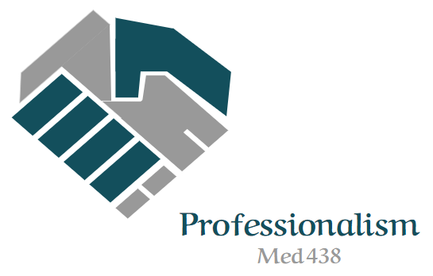
Leadership & management skills
Editing file
Objectives:
Define leadership
Explain the concepts of leadership and management
Understand leadership theories
Identify the traits and skills of an effective leader
Explain the major approaches to leadership
Describe the various types/styles of leadership
Recognize the many challenges ahead facing leaders in modern healthcare systems
important
original content
only in girls slides
only in boys slides
extra notes
Doctors’ notes

Slide 2
Leadership
A function of knowing yourself, having a vision that is well communicated, building trust among colleagues, and taking effective action to realize your own leadership potential (Warren Bennis 1997).
Often considered as the ability to influence a group of people towards the achievement of goals.
CONCEPTS OF LEADERSHIP AND MANAGEMENT
Both leadership and management involve influence, working with people, and working to achieve common goals. However, there are some differences:
Leadership | Management
Multi-directional influence relation | Unidirectional authority relationship
Focus on people motivation and inspiration | Focus on system and structure; Processes, policy, procedures
Long-term view and goals | Short-range perspectives
Create trust among people | Relies on control of people
Leaders does right things | Managers does things right
Vision-oriented | Task–oriented
Relies on envision and innovation | Administration
Role-models/do right things | Model roles / Do things right
Develop power with people | Exercise power over people
Empowers and inspires people | Ensures that rules are followed

Slide 3
LEADERSHIP THEORIES
01
Great Man Theory
02
Trait Theory
Leaders are exceptional people, born with innate qualities, destined to lead.
Qualities associated with leadership e.g. Honesty
03
Functional Theory
04
Behaviorist Theory
Interaction of task, team, and individuals
Leaders behavior and actions, rather than their traits and skills , e.g. Persuasive, consultative , democratic.
05
Situational/ Contingency Theory
06
Transformational Theory
Leaders inspire individuals, develop trust, and encourage creativity and personal growth. Individuals develop a sense of purpose to benefit the group, organization or society. This goes beyond their own self-interests and an exchange of rewards or recognition for effort or loyalty.
Leadership style changes according to the ‘situation’ and in response to the individuals being managed - according to their competency and motivation.
LEADERSHIP TRAITS AND SKILLS
Traits | Skills
Adaptable to situations Alert to social environment Ambitious and achievement orientated Assertive Cooperative Decisive Dependable Dominant (desire to influence others) Energetic (high activity level) Persistent Self-confident Tolerant of stress Willing to assume responsibility | Clever (intelligent) Conceptually skilled Creative Diplomatic and tactful Fluent in speaking Knowledgeable about group task Organized (administrative ability) Persuasive Socially skilled

Slide 4
APPROACHES TO LEADERSHIP
1- The Trait Approach
6
1
The ability to be surrounded and supported by good people
Links a number of qualities to effective leadership
The ability to retain good people
5
Content
Here
2
The ability to build effective learning
4
3
The capability to make own decision
The ability to listen
2- Attitudinal Approach
Consideration, showing concern for members of the group
E.G. Giving recognition, nurturing self-esteem, developing mutual trust, inviting participation, etc.
Initiation of structure
Initiation of structure:
1
3
5
a behavior that organizes the group to define relationship
emphasize the need to hit deadlines
define lines of responsibilities
2
4
6
specify task and how it is to be done
emphasize the need to maintain qualities
clarify roles

Slide 5
TYPES/STYLES OF LEADERSHIP
Visionary Leader
Transactional Leader
Has a long-term perspective form: mission statements,
vision and value.
Sets clear goals, understand needs of employees, motivates and rewards.
Integration Leader
Transformational Leader
Has medium term perspective. Focus on own
organization.
Involves mutual trust and relationship, shared values and shared vision
Fulfillment Leader
Charismatic Leader
Has short-term perspective.
Attractive character(s) that he/she is distinguished with! e.g. Attractive when he/she talks
Is there a best style of leadership?
Answer: Those who are able to adapt their style to fit the requirement of situations encountered are best leaders.
RECOGNIZING THE CHALLENGES OF LEADERSHIP
When are the challenges of leadership most obvious?
When something new is about to start
When something is about to end
When times are tough
During transitions

Slide 6
CHALLENGES TO LEADERSHIP
External
VS
Internal
Public criticism
Flare-ups of others' interpersonal issues
Crises
Opposition and/or hostility from powerful forces
A financial or political windfall
Collaboration failures
Insecurity
Defensiveness
Lack of decisiveness
Inability to be direct when there's a problem
Inability to be objective
Impatience - with others and with situations
HOW CAN LEADERS COPE WITH THESE CHALLENGES?
Be proactive
Be creative
Face conflict squarely
Always look for common ground
Retain your objectivity
Look for opportunities to collaborate
Listen
Ask for 360-degree feedback...and use it
Look at what's going on around you?
Reach out for help in facing internal challenges
Create mechanisms to revisit your vision
Share the burden
Find an individual or group with whom you can discuss the realities of leadership
Make sure you have personal time

Slide 7
Team leaders
Abdulrahman Bedaiwi Amirah Al-Zahrani
Team members
Abdullah Alassaf
Abdullah Alasmari
Abdulrahman Almezaini
Khalid Alkwai
Mohammed Alhamad
Deema Almaziad
Elaf Almusahel
Rema Almutawa
Renad Almutawa
Shahd Alsalamah
Taif Alotaibi
Tarfah Alkaltham
Say cheese :)
THANK YOU!
Give us your feedback!

