Slide 1
Summary of Professionalism Course
(SAQs)

Slide 2
Lecture 1: Professionalism
Q1 : Define Professionalism?
-It is term which embodies numerous qualities of physicians as public servants. -(ABIM definition): Constituting those attitudes and behaviors that serve to maintain others interest above physician Self-interest.
Q2 : Enumerate six key elements that embodies the character of professional physician?
Altruism (giving priority to patient rather than self interest ). Accountability. Excellence (perform beyond ordinary expectation). Duty (free acceptance of commitment to service). Honor and integrity. Respect for other.
Q3 : Enumerate 3 meanings of accountability?
-Responsibility. -Standard setting. -Explain and give reason for actions.
Q4 : What is the difference between professionalism and ethics?
Professionalism are (skills, competence and conduct) displayed by an individual at certain profession.
Ethics are guides for an individual which clearly states the dos and don’t’s.
Q5 : How can the physician apply professionalism in his career?
Appreciate his role ( as a doctor) within the health service. Personal Development.

Slide 3
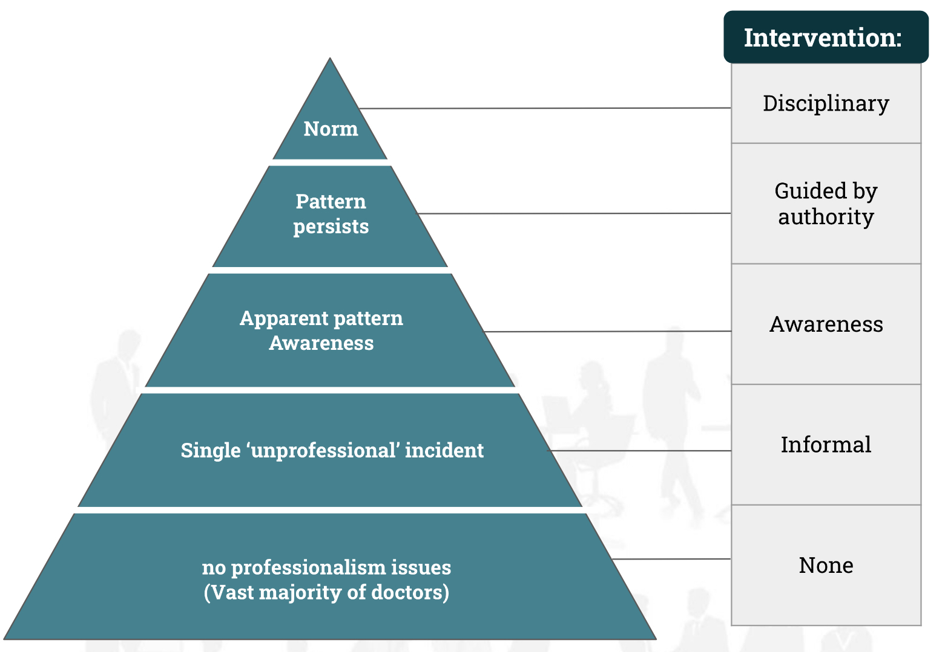
Lecture 2: Unprofessional behavior
Q1 : Define Unprofessionalism?
-Not pertaining to the characteristic of a profession.
Q2 : What are the possible consequences of unprofessional behavior?
Increased workplace difficulties. Decline in patient care.
Decreased morale in other staff.
Q3 : Enumerate the signs and symptoms (characteristics) of the unprofessional behavior?
Abuse of power. Arrogance. Greed. Conflicts in interests.
Misrepresentation (Laying).
Impairment (disability).
Lack of conscientiousness.
Q4 : Enumerate the main five categories for unprofessional acts?
Illegal or criminal acts. Business related acts. Plagiarism (unethical usage of others work).
Immoral acts.
Negligent practices.
Q5 : What are the types of plagiarism?
Direct copying. Working with others (on individual assignment). Buying assignments.
Word switching.
Concealing sources (Hiding the sources).
Self plagiarism (Re-using part of an old assignment).
Q6 : How to deal with the unprofessional behavior?
Take a look at the disruptive behavior pyramid →
Q7 : Formalizing a response to unprofessional behavior need ...
Cost and time.

Slide 4
Lecture 3: IPE & IPC
Q1: Define interprofessional education (IPE)?
Learners from two or more professions learn about, from, and with each other.
Q2: Define interprofessional collaboration (IPC)?
When multiple health workers from different professional work together.
Q3: Enumerate and define the 4 domains (in order) of IPE and IPC competencies, and give examples on each domain?
Values/Ethics: Work with others to maintain a climate of mutual respect. ex: Act with honesty and integrity with others. Roles/Responsibilities: Use the knowledge of one’s own role and those of other professions for the best health service. ex: Recognize the roles and responsibilities of other care provider. Interprofessional Communication : Communicate with others in the profession in a responsive and responsible manner. ex: Use understandable language and listen actively. Teams & Teamwork: Apply relationship-building values to perform effectively in teams. ex : Integrate the knowledge and experience of others.
Q4 : List the 4 Information Exchange Strategies in Interprofessional communication?
SBAR, focusing in (Situation – Background – Assessment – Recommendation ) for effective communication. Call-Out, while communicating important information (ex: emergency). Check-Back, to ensure that message is received. Handoffs, to transfer information during transitions in care across the continuum.
Q5 : Give some of tools/methods to implement IPE/IPC?
Experiential Training Programs. Community-based related activities.

Slide 5
Lecture 4: Cultural Context
Q1 : List the three fundamental principles in medical professionalism, explain each one?
Patient welfare: Physician should be (competent, characterized by caring attitude, extra ..) to achieve patients welfare. Patient autonomy: Physician should be ( honest, respect the confidentiality of the patient , extra.. ) to achieve patient autonomy. Social justice: Physician should (respect colleagues, Manage the conflict of interest) to achieve social justice.
Q2 : Define culture?
Culture has been deﬁned as the beliefs, customs, habits, & language shared by people living in particular time & place.
Q3 : list 3 influences in Cultural variation
Religion. Social class. Region.
Q4 : list the four Models of Doctor-Patient Relationship , explain each one .
Paternalistic (physician acts as the patient’s guardian). Physicians are in the best position to judge what is best for their patients (no patient autonomy). Applicable in Chinese culture. Informative (physician acts as technician). The physician informs the patient to fall the medical facts , and patient takes decisions (total patient autonomy). applicable To certain sections of Western Culture. Interpretive/ Collegial (physician acts as the patient’s friend/advisor ). Physician’s medical facts and patients personal values contribute medical decision. Culturally popular in the West. Deliberative (physician acts as a mentor/teacher). The physician mentor’s grip on decision making is more relaxed than paternalistic model. In Eastern countries.
Cont in the next slide

Slide 6
Q5 : List 4 cultural Issues In Professional Care that may differ from culture to culture?
Special Cultural Issues: (female related issues, eye contact). Research Related cultural issues. Accepting gifts or other inducements. Conﬁdentiality.
Other question can be in form of :
give examples of research related issues,
when it is ok to accept gifts.
(Read the original slides for it)
Q6 : Define cultural competency?
Refers to possessing knowledge, awareness, and respect for other cultures.
Q7 : How to maintain professionalism in different Cultural context? OR What is PEARLS concept?
Partnership: Working with the patient. Empathy: Recognizing another’s feelings. Analogy: willing to acknowledge or express regret for contributing to a patient’s discomfort, distress. Respect: Non-judgmental acceptance of each patient. Legitimization: Accepting patient’s feelings or reactions . Support: Be helpful to the patient.

Slide 7
Lecture 5: Communication Skills
Q1 : Define communication?
The act by which information is shared.
Q2 : What is the communication theory? OR Enumerate the three pillars of communication?
Communication is a learned skill based on 3 pillars: Accuracy. Efficiency. Supportiveness.
Q3 : What are the types of communication?
Non-Verbal (ex: Hand gestures, Eye contact, facial expression). Verbal (ex: open or closed conversation). Written.
Q4 : How to practice verbal communication effectively ?
Make eye contact and Show respect while speaking. Clear message. Be a Good listener.
Q5 : What is required from doctors towards: (Mention 2 in each ) Patients Colleagues
Patients: Listen to patients. Give patients information in way they can understand. Colleagues: treat your colleagues fairly. Make sure your colleagues understand your role and their roles.
Cont in the next slide

Slide 8
Q6 : Why do the doctors need to practice good communication?
Doctors cannot practice medicine without effective communication skills. Poor communication causes a lot of medico-legal and ethical problems.
Q7 : Give 3 examples of people that doctors communicate with?
Patients. Nurses. Colleagues.
Q8 : The medical interview can be classified into 4 types, enumerate them?
History taking. Consultations. Obtaining informed consent. Breaking bad news.
Q9 : What are the principles of effective communication?
Planning. Interaction rather than a direct transmission. Flexibility in relation to different individuals and contexts. Ability to handle emotional outbreaks.
Q10 : What is the difference between Listening and Hearing?
Hearing Passive activity; no effort.
Listening With Attention and Active involvement.
Q11 : Enumerate 4 barriers to effective communication?
Ignorance. Human failings (tiredness, stress). Language. Strenuous working environment.

Slide 9
Lecture 6: Volunteering works
Q1 : Define Volunteering?
Any activity which involves spending time, unpaid, doing something which aims to benefit someone.
Q2 : What is the difference between non-formal and informal education? (Or : define non-formal or informal education)
Non-formal Any organized educational activity that takes place outside the formal educational system.
Informal A process throughout life by which the person acquires the knowledge through everyday experiences.
Q3 : What is the Expectancy Motivation Theory?
-Theory suggests that the behavior of volunteering is caused by a belief that it will result in a desired reward or goal.
Q4 : What is the Altruistic Motivation Theory?
-theory suggests that the individual derives intrinsic satisfaction for volunteering without the conscious expectation of participating in an exchange relationship. (ALTRUISM)
Q5 : What are the types of factors that favors volunteering, give 3 examples on each type?
Internal factors , ex :(Self esteem , Generosity , Personal satisfaction). External factors ,ex : (Recognition from society , C.Vs differentiation , Holidays).
Q6 : What difficulties/obstacles stop you becoming a volunteer?
(You can’t): Lack of time, physical boundaries, lack of skill. (Don’t want): Lack of benefits. (Nobody asked): Lack of opportunities.
Q7 : List 3 principles of volunteering?
Independently chosen. Has a community or social benefit Offered to not-for-profit activities

Slide 10
Lecture 7: Continuous Professional Development
Q1 : Define Continuous Professional Development (CPD)?
Lifelong systematic learning which meets the needs of patients. Or Refers to any activity that helps you develop your skills and knowledge to enhances your professional practice.
Q2 : Give 3 examples of CPD? (Or : How can we achieve CPD)
Training courses. Studying for a qualification. Self-reflection. “Is the most favoured” (look at Q9)
Q3 : Who is responsible for CPD?
Personal (myself). Institution.
Q4 : List 3 Features of effective CPD?
Personalised (built on individual needs). Relevant to the profession. Sustained.
Q5 : Define competence
The ability to perform a specific task in a manner that yields desirable outcomes.
Q6 : What are the levels competence in medical profession ?
1-Medical student (Novice) | 2-Intern (Advanced beginner) | 3-Resident (Competent) | 4-Registrar (Proficient) | 5-Consultant (Expert)
Q7 : What are the different Aspects of Competence?
• Knowledge. •Skills. • Abilities.
Cont in the next slide

Slide 11
Q8 : How is competence acquired?
By Continuous Professional Development: Pre-service education. In-service training. Work experience.
Q9 : What is the most favoured way to achieve CPD?
Reflective Practice/Learning.
Q10 : Define Reflection?
Is a metacognitive process that creates greater understanding of both the self and the situation.
Q11 : Define Metacognition?
It is an awareness and understanding of one's own thought process. (Cognition about cognition)
Q12 : Define Reflective Learning?
Systematic revisiting of a learning experience with a view to learn from it.
Q13 : List the steps (components) of kolb's cycle?
Concrete experience. Reflective Observation. Abstract conceptualisation. Active experimentation.
I think the question in that point will be in form of scenario, and ask you to apply kolb’s cycle (or reflective log)
There is a scenario in the original slides (important)
Q14 : Define lifelong learning?
Voluntary, self-motivated Learning with the main goal to improve personal or professional development.
Cont in the next slide

Slide 12
Q15 : Define mentoring?
Help and support people to manage their own learning.
Q16 : List 3 mentoring principals ?
Engagement is on a voluntary basis for both the Mentor and the Mentee. The relationship is confidential. The Mentor empowers the Mentee to take responsibility.
Q17 : List the steps (components) of mentoring cycle?
Rapport-building: Developing mutual trust and comfort. Contracting/Ground Rules: Exploring each other’s expectations of mentoring. Direction-setting: Agreeing initial goals for the relationship. Progress making: learning proceed rapidly. Maturation: mentee becomes increasingly self-reliant. Closure: Formal relationship ends, an informal one may continue.
Q18 : Mention 3 skills required by mentors?
Communication skills. Feedback skills. Questioning skills.
Q19 : How Mentors Help Others Learn? OR List the three models of a mentor?
-The Guide: Hands on guidance, explaining how and why; creating opportunities to learn. -The Challenger: Making Waves (challenging, stimulating, questioning ). -The Role model: The Mentee unconsciously adopts aspects of the mentor’s thinking behaviours and/or style.

Slide 13
Lecture 8: Leadership
Q1 : Define Leadership?
The ability to influence a group of people towards the achievement of goals.
Q2 : List 3 differences between Leadership and management?
Leadership Multi-directional influence relation. Vision-oriented. Develop power with people.
Management Unidirectional authority relationship. Task–oriented. Exercise power over people.
Q3 : Mention 2 leadership theories?
Great Man Theory : leaders are born to lead. Contingency Theory :Leadership style change according to the situation.
They might ask you about specific theory
(There are many leadership theories in original slides)
Q4 : Enumerate 3 leader traits and 3 leadership skills?
Traits (you can acquire it ): Cooperative, Decisive and Dependable. Skills (you born with ): Clever, Creative and Socially skilled.
Q5 : How to approach to leadership?
Trait Approach. Attitudinal Approach.
They might ask you to mention the trait approach
Read the original slides for it
Q6 : List 3 types/styles of leadership?
Visionary Leader. Integration Leader. Charismatic Leader.
Q7 : When are the challenges of leadership most obvious?
When something new is about to start. When something is about to end. When times are tough. During transitions.

Slide 14
Q8 : What are the types of challenges to leadership, give 2 examples of each type?
External challenges: Public criticism. Crises. Internal challenges: Insecurity. Impatience.
Q9 : How leaders cope with leadership challenges? (list 3)
Be proactive. Be creative. Face conflict squarely.

Slide 15
Team leaders
Done by
Abdulrahman Bedaiwi Amirah Al-Zahrani
Abdulrahman Bedaiwi Abdullah Alassaf
Thank you!
Give us your feedback!

