Slide 1
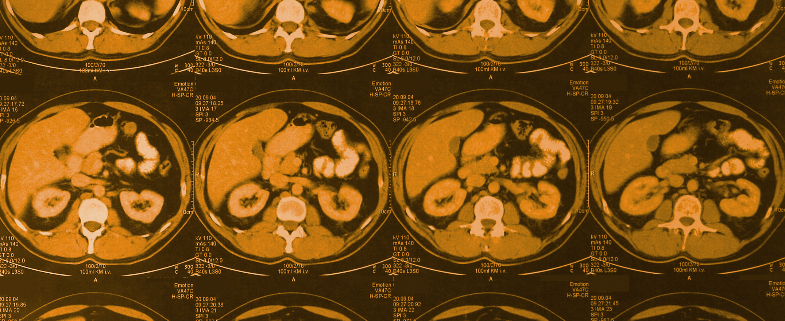
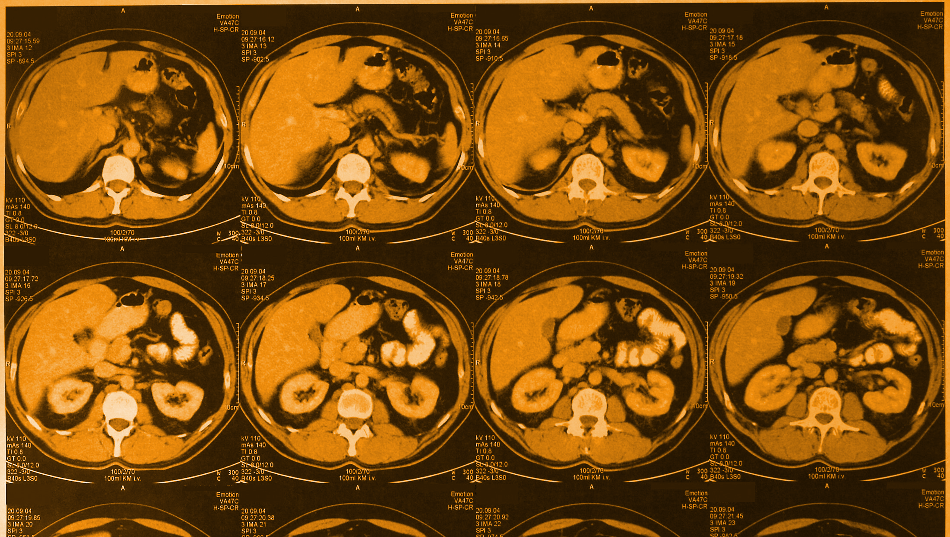
Radiology
Editing File
Color index:
Black: main text
Gray: Extra info
Pink : girls slides
Blue: boys slides
Red: important
gastrointestinal block
Team 438
RADIOLOGY OF THE ABDOMEN
Team leaders:
Nouran Arnous
Omar Aldosari
Team members:
Lina Alosaimi Faisal Alqifari
Rawan Alzayed Bassam Alkhuwaitir
Moh Al-Huqbani
Objectives
To know radiology modalities used in abdomen imaging mainly GI tract.
To know advantages and disadvantages of each modality.
To know indications and contraindications of each modality.
Overview on normal abdomen appearance and common pathologies including:
Pneumoperitoneum
Peptic ulcer
Bowel obstruction
Large bowel masses/malignancies
Inflammatory bowel disease

Slide 2
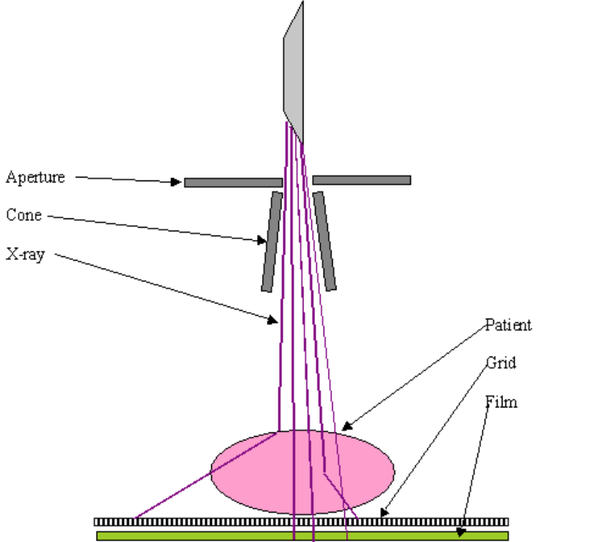
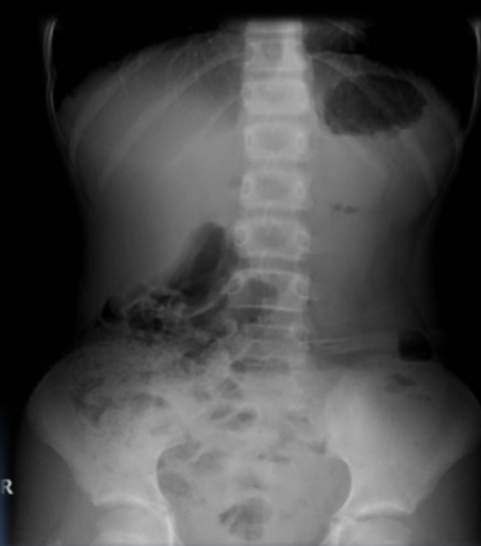
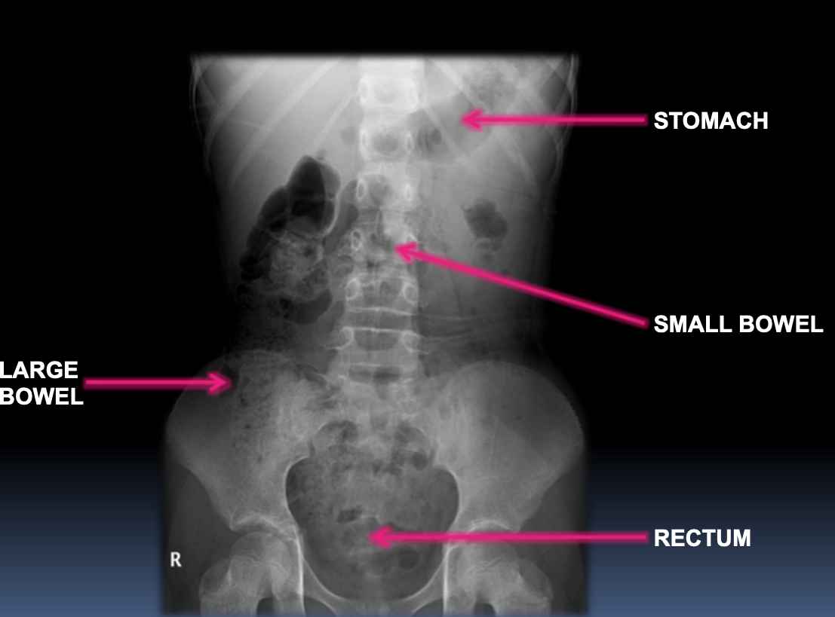
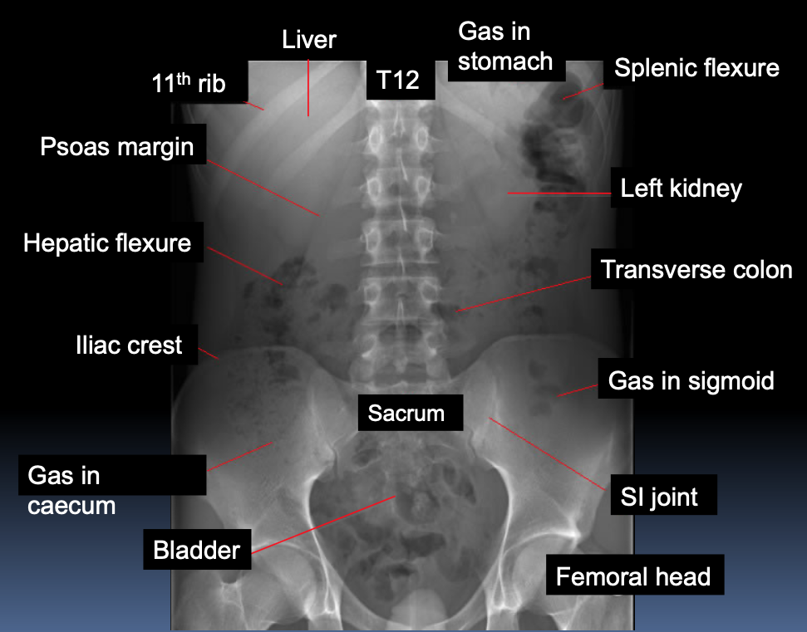
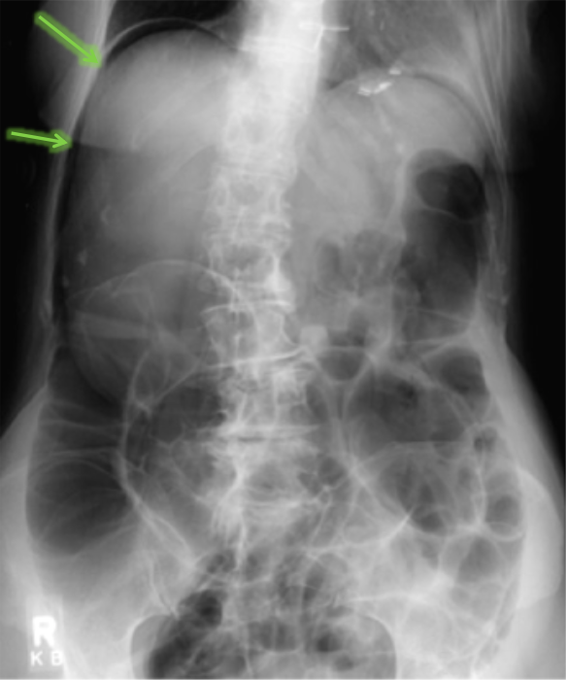
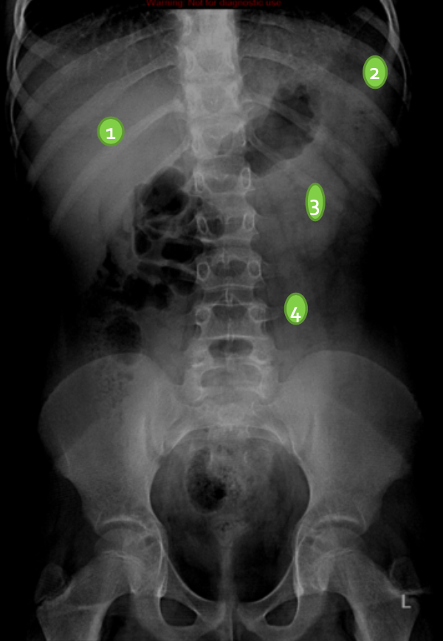
What radiological modalities are good in imaging the Abdomen mainly Stomach and Bowel loops:
CT scan | MRI | Fluoroscopy | X-ray
Ultrasound for solids organs only (liver, spleen)
Abdominal X Ray
X-ray is a form of radiation, that are focused into a beam
X-ray can pass through most objects including the human body.
When X-rays strike a piece of photographic film, they make a picture.
Advantages:
Widely available
Cheap
Excellent in diagnosing free air in the abdomen
Good in diagnosing bowel obstruction
Good in diagnosing stones & calcifications
Interpretation
White | Bone and calcification
Grey | Soft tissue
Black | Air
Contraindications
Pregnancy
Disadvantages:
Radiation
Poor soft tissue details
Indications
Abdominal pain | foreign body
Bowel obstruction | Trauma
Stones | Masses
supportive lines
Normal Abdominal X Ray
Standing
Supine
What are the normal X-ray findings:
Stomach:
Almost always air in stomach
Small bowel:
Usually small amount of air in 2 or 3 loops
Large bowel:
Almost always air in rectum and sigmoid
Varying amount of gas in rest of large bowel
3,6,9 RULE
Maximum Normal Diameter of bowel
Small bowel | 3cm
Large bowel | 6cm
Caecum | 9cm
Abnormal Abdominal X Ray
Soft Tissue
1 | Liver
2 | Spleen
3 | Kidneys
4 | Psoas muscles
Dilated bowel loops
Air fluid levels
Bowel Obstruction
Air outside the bowel loops
2) pneumoperitoneum

Slide 3
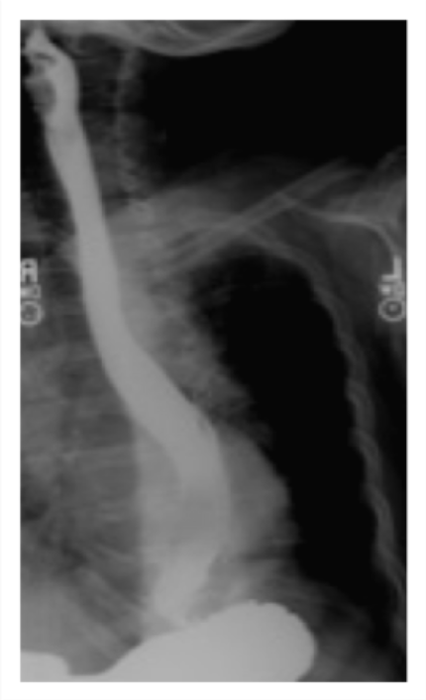
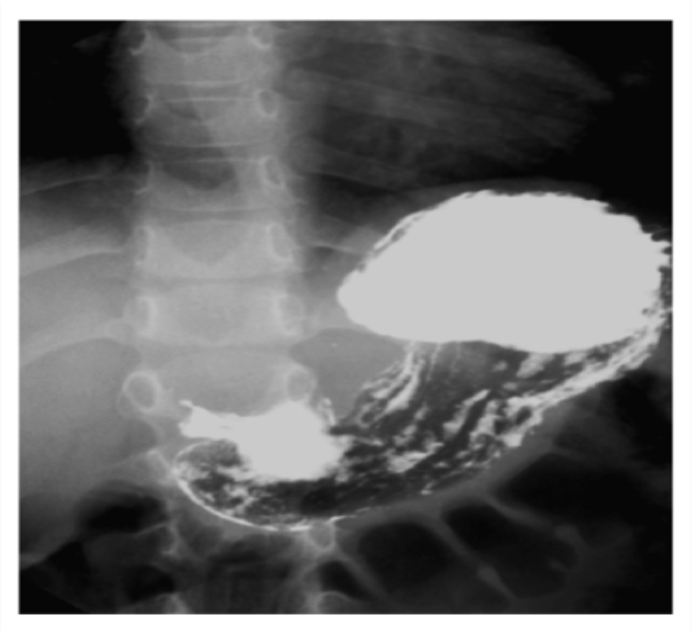
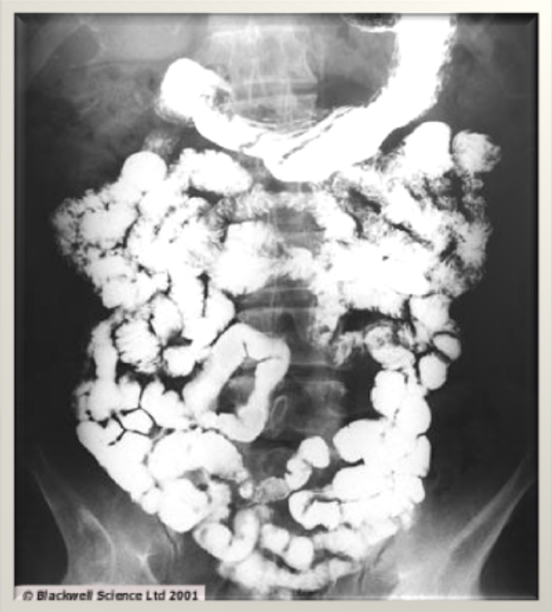
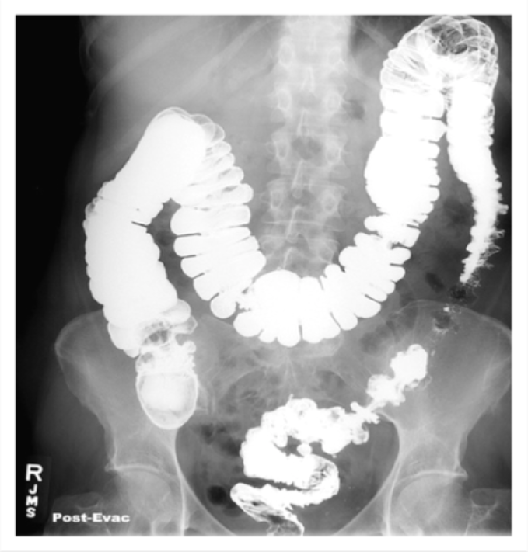
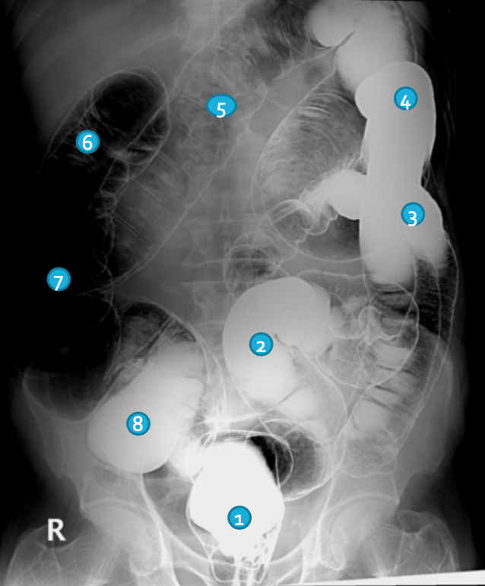
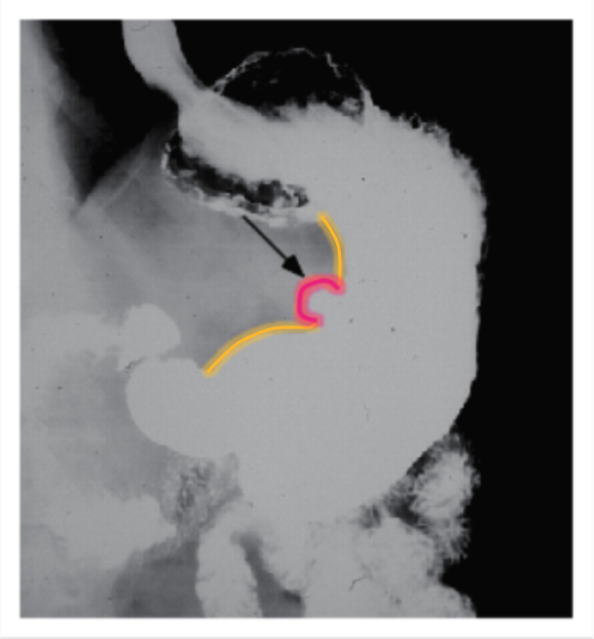
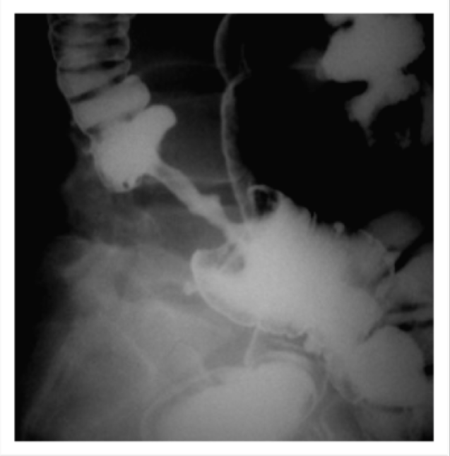
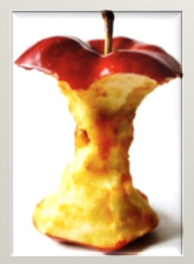
Fluoroscopy (X Ray + contrast)
Advantages:
Available
Relatively Cheap
Excellent in evaluation the bowel lumen and mucosa
Types
Barium swallow | Esophagus
Barium meal | Stomach
Barium follow through | Small bowel
Barium enema | Large bowel
Disadvantages:
Radiation
Poor in evaluating extra luminal pathologies
Contraindications of barium
Pregnancy
Bowel obstruction
Bowel perforation (with barium type of contrast)
Indications
Assessing the mucosal outline | Abdominal pain
Gastroesophageal reflux | Masses
Inflammatory bowel diseases | Post surgical, leak
BARIUM SWALLOW
BARIUM MEAL
BARIUM FOLLOW THROUGH
BARIUM ENEMA
BARIUM ENEMA
“ rectum is really clear”
Abnormality
1 | Rectum
2 | Sigmoid colon
3 | Descending colon
4 | Splenic flexure
5 | Transverse colon
6 | Hepatic flexure
7 | Ascending colon
8 | cecum
barium enema
Peptic ulcer disease
Colon mass/malignancy
(Apple core appearance)

Slide 4
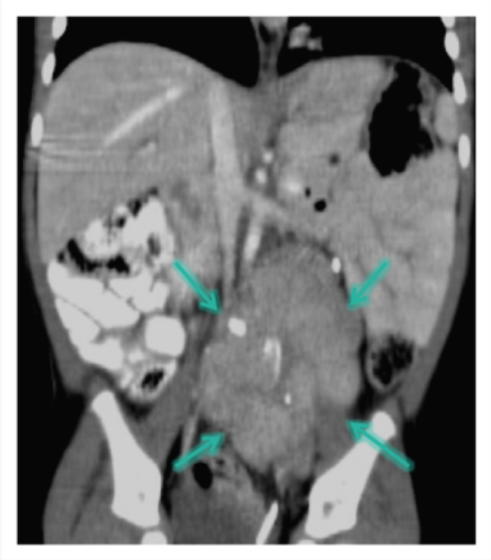
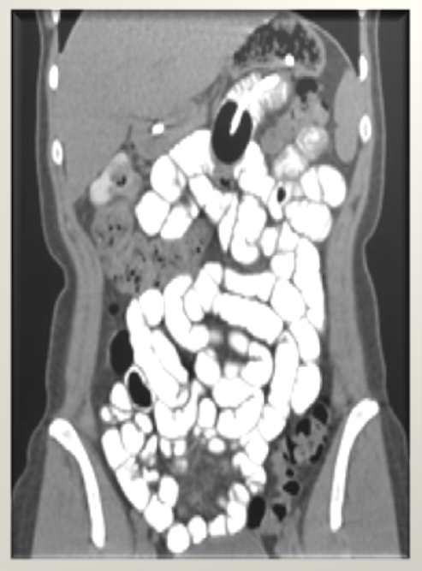
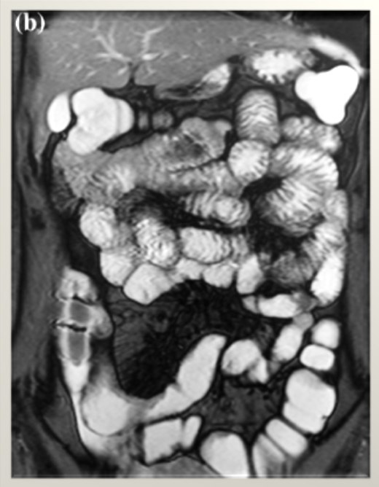
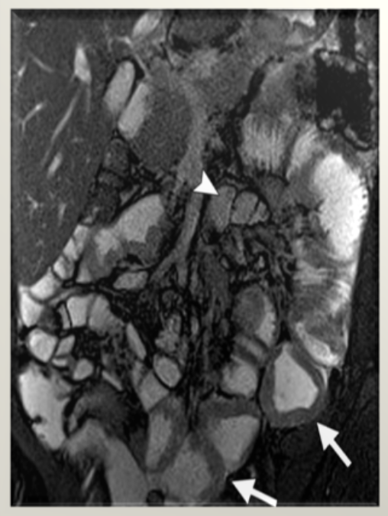
CT scan
Abnormality
Advantages:
Available
Short scan time
Much more soft tissue and bone details
Excellent in diagnosing extra-luminal lesions
Excellent in diagnosing the Cause of bowel obstruction
Disadvantages:
Radiation
Sometimes need intravenous contrast (renal disease)
Relatively expensive
Mass outside the bowel loops, causing mass effect.
Contraindications
Pregnancy
No IV contrast in renal failure
Unstable patients (severe trauma/ICU)
Indications
To look for bowel obstruction cause | Abdominal pain
To diagnose intra-abdominal masses | Trauma
MRI
Advantages:
Relatively safe in pregnancy (no radiation)
Give much more soft tissue details.
Excellent in diagnosing abdominal solid organ lesion: liver, spleen, kidneys.
But best modality to examine solid structures in the abdomen is Ultrasound
Disadvantages:
Expensive
Long scanning time
Sensitive to motion
Contraindications
uncooperative patients
Early pregnancy (relative contraindication)
No IV contrast renal failure (relative contraindication)
Indications
Abdominal solid organ masses | Inflammatory bowel disease
Normal
CT
Normal
MRI
Abnormality
Inflammatory bowel disease
Bowel wall thickening

Slide 5
Summary
Abdominal X Ray
Advantages:
Excellent in diagnosing free air in the abdomen
Good in diagnosing bowel obstruction
Abnormal Abdominal X Ray
3,6,9 RULE
Maximum Normal Diameter of bowel
Small bowel | 3cm
Large bowel | 6cm
Caecum | 9cm
Dilated bowel loops
Air fluid levels
Bowel Obstruction
Note: that any value above these would be abnormal
Air outside the bowel loops
2) pneumoperitoneum
Fluoroscopy (X Ray + contrast)
Abnormality
Advantages:
Excellent in evaluation the bowel lumen and mucosa
Types
Barium swallow | Esophagus
Barium meal | Stomach
Barium follow through | Small bowel
Barium enema | Large bowel
Colon mass/malignancy
(Apple core appearance)
CT scan
Abnormality
Advantages:
Excellent in diagnosing extra-luminal lesions
Excellent in diagnosing the Cause of bowel obstruction
Mass outside the bowel loops, causing mass effect.
MRI
Advantages:
Excellent in diagnosing abdominal solid organ lesion: liver, spleen, kidneys.
The modality of choice to examine solid structures in the abdomen is Ultrasound
Abnormality
Inflammatory bowel disease
Bowel wall thickening

Slide 6
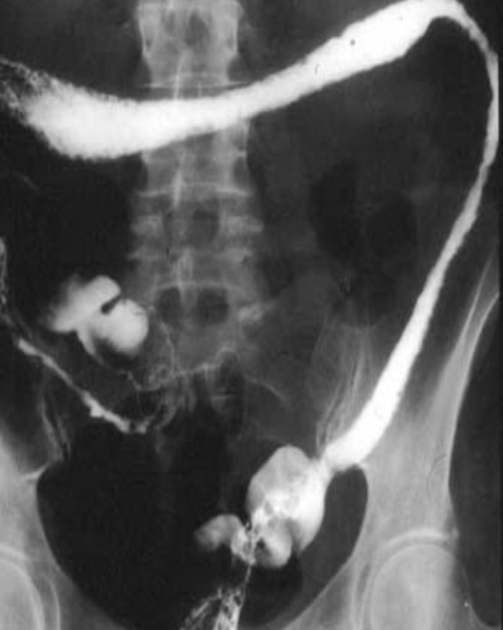
Cases
CASE 1 :
A patient complains from severe abdominal pain. The doctor suspected bowel obstruction, what is the best modality that can be used to confirm that?
X-RAY
Note: Initially, first is X-ray. To know the cause and the site of obstruction CT with WATER soluble contrast. Barium is non water soluble and it’s contraindicated.
CASE 2 :
An abdominal X-ray was taken for a patient showed free air under the diaphragm “extra Luminar Gas ”, what is the most likely diagnosis?
Pneumoperitoneum
CASE 3 :
A patient complains from constipation, what shall we use first to evaluate his bowel?
X-RAY
CASE 4 :
An abdominal X-ray was taken for a patient showed Dilated bowel loops with Air and fluid levels, what is probably the diagnosis?
Bowel Obstruction
CASE 5 :
A patient complains from diarrhea for the last week so that doctor wanted to evaluate the bowel lumen and mucosa, what is the suitable modality to be used?
Fluoroscopy
CASE 6 :
Ahmed complains from chronic constipation, X-Ray showed A mass in the colon so the doctor requested Barium enema (Fluoroscopy) which showed Apple core appearance of that segment of the colon, what is the most likely diagnosis?
Colon Malignancy
CASE 7 :
A patient came to the ER with Abdominal cramps, pain, bloody diarrhea, and Fever. The MRI showed Bowel wall Thickening, what is the most likely diagnosis?
Inflammatory bowel disease
CASE 8 :
A patient came to the ER complaining from Diarrhea that was bloody,
Rectal pain and Inability to defecate despite urgency. After the
Fluoroscopy was taken it showed featureless colon with lead pipe
Appearance. What is the most likely diagnosis?
Ulcerative Colitis

Slide 7
Quiz :
1 -Which of the following will be first “initial” modality used for diagnosing
pneumoperitoneum?
A - X-ray
B - CT scan
C - MRI
D - Barium swallow
6 -Which of the following is the best to diagnose the Cause of bowel obstruction?
A - Fluoroscopy
B - MRI
C - X-Ray
D - CT scan
2 - Which ONE of the following may appear as a sign in small bowel obstruction?
A - Rigler’s sign
B - Bowel wall thickening
C - Air fluid level
D - Apple core appearance
7 - Which of the following is the best diagnostic procedure to evaluate the lumen and mucosa of the Stomach?
A - Barium follow through
B - Barium swallow
C - Barium meal
D - Barium enema
3 - Which of the following is the best diagnostic procedure to evaluate the lumen and mucosa of the Small bowel ?
A - CT scan
B - Barium follow through
C - MRI
D - Ultrasound
8 - Which of the following will be first modality of choice to examine the Liver?
A - X-Ray
B - Ultrasound
C - MRI
D - CT scan
4 - A 66 year old man presented to GIT clinic with intermittent per rectum bleeding. Barium enema revealed irregular narrowed descending colon with apple core appearance. What is the most likely diagnosis?
A - Bowel Obstruction
B - pneumoperitoneum
C - Colon malignancy
D - Inflammatory bowel
9 - A patient came to the ER with Abdominal cramps, pain, bloody diarrhea, and Fever. The MRI showed Bowel wall Thickening, what is the most likely diagnosis?
A - Bowel Obstruction
B - Colon malignancy
C - pneumoperitoneum
D - Inflammatory bowel
5 -A 66 year old man presented to GIT clinic. Abdominal X-ray was taken for that patient. which of the following is considered abnormal Diameter of the Caecum?
A - 10 cm
B - 9 cm
C - 8 cm
D -7 cm
10 - A 34 year old man presented to GIT clinic with Abdominal pain. X-Ray revealed Dilated bowel loops with Air fluid levels. What is the most likely diagnosis?
A - Bowel Obstruction
B - Pneumoperitoneum
C - Colon malignancy
D - Inflammatory bowel
1.A 2.C 3.B 4.C 5.A 6.D 7.C 8.B 9.D 10.A

