Slide 1
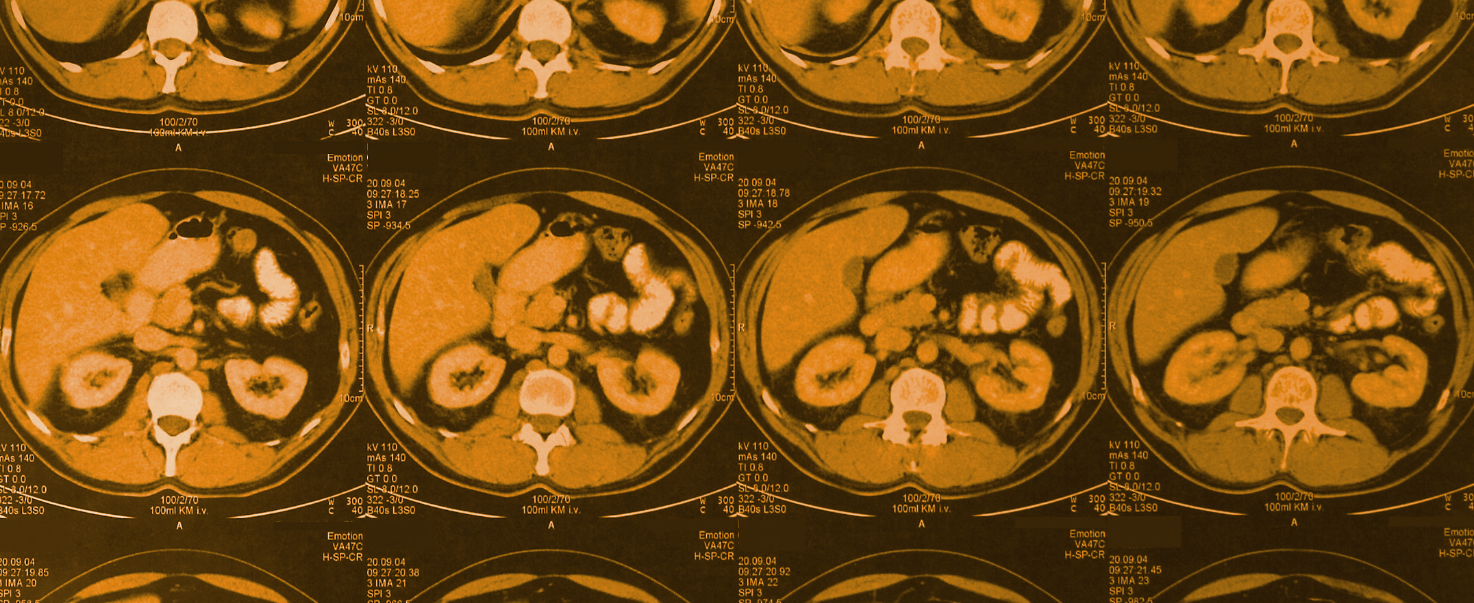
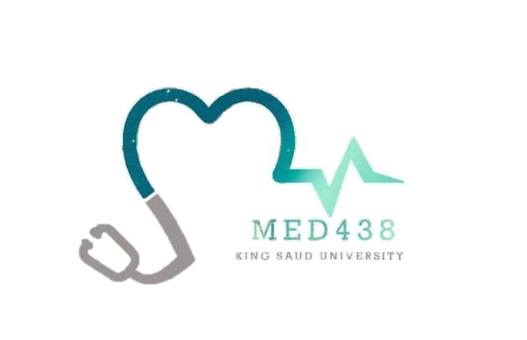
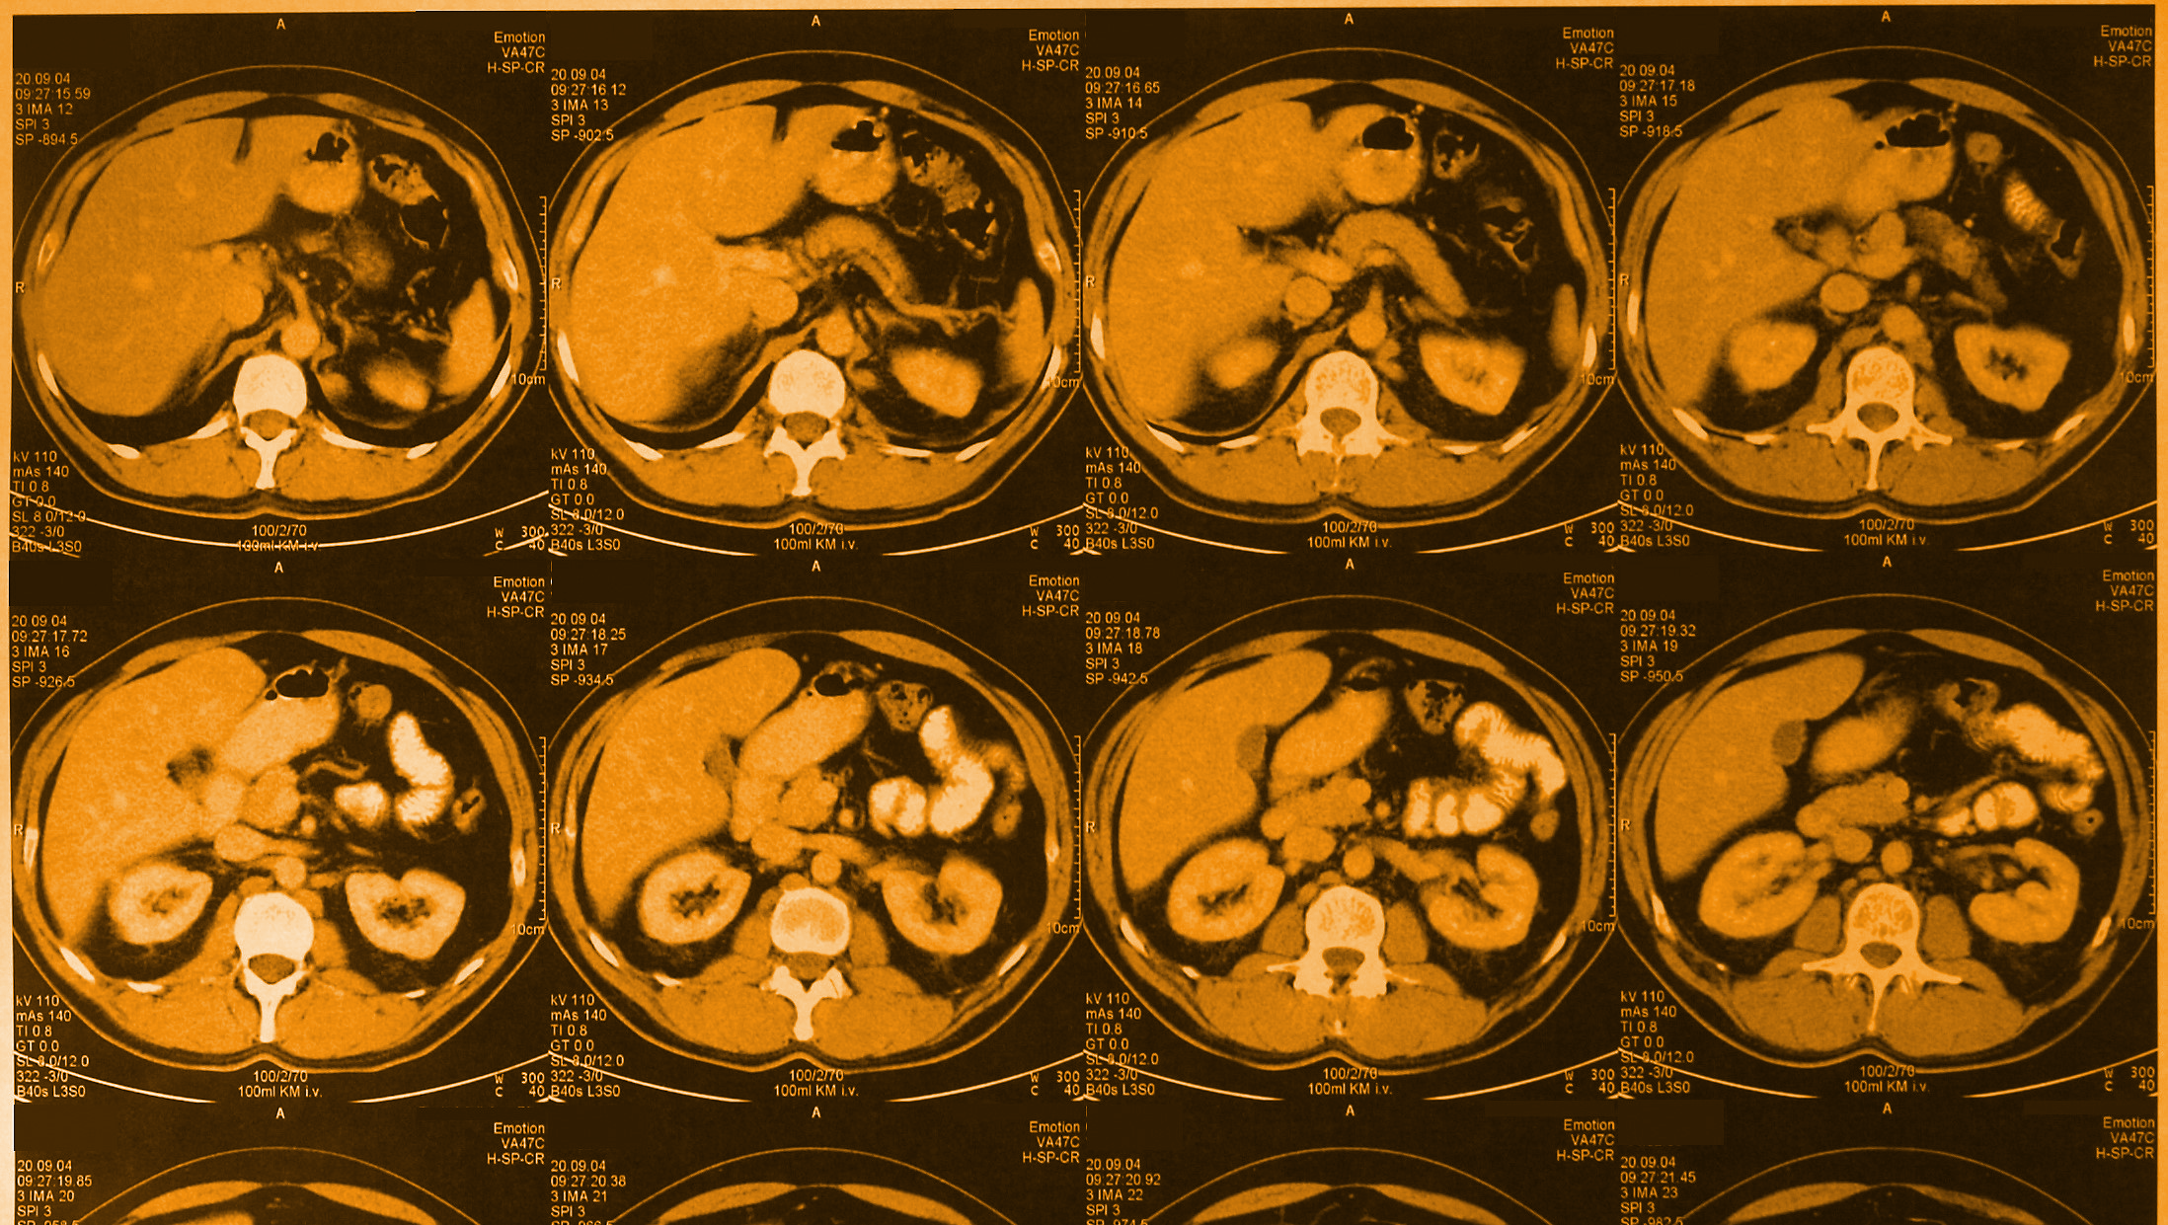
Radiology
Editing File
Color index:
Black: main text
Gray: Extra info
Pink : girls slides
Blue: boys slides
Red: important
gastrointestinal block
Team 438
US of liver and gall stone
Team leaders:
Nouran Arnous
Omar Aldosari
Team members:
Lina Alosaimi Faisal Alqifari
Rawan Alzayed Bassam Alkhuwaitir
Moh Al-Huqbani
🖤
Special thanks for MAHA ALNAHDI
Objectives
Introduction to US.
Indications of liver and gallbladder US.
Normal anatomy and radiological appearance.
Pathology of liver and gallbladder.
Common pathological cases.

Slide 2
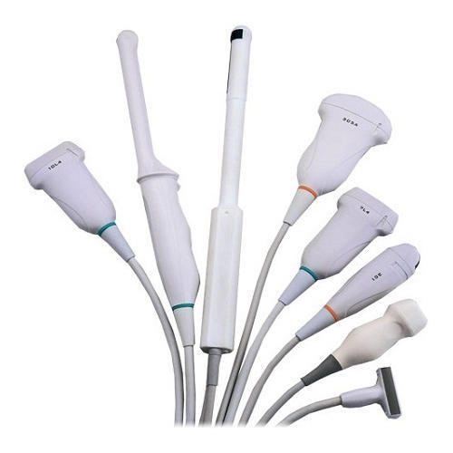
Introduction to US
a diagnostic technique in which ULTRA=high-frequency
sound waves penetrate the body, bounce around, and produce
multiple echoes; these echo patterns can be viewed as an
image on a computer screen.
( Solid abdominal organs: Spleen, liver, pancreas. and extra abdominal: thyroid lymph nodes)
Frequency ranges used in medical Ultrasound imaging are 2 - 20 MHz
Definition
Advantages of US
non-invasive
inexpensive
easy and available
safe
non-ionizing, no radiation
Disadvantages of US
inability to penetrate gas or bone
operator dependant
less sensitive in some situation
MACHINE PROBES
Standing
Modes of Ultrasound
B-mode |  | used to assess the anatomy/structures the normal 2D
M-mode |  | used to assess Motions for examples we use it to assess the motion of blood in the blood vessels M= motion (eg. Vascular movements) like in DVT.
Duplex |  | Deeper assessment of both structure and motion of Vessels. -as we can see there’s 2 images not one that’s why if gives more details To asses the diastolic and systolic blood pressure.
Color Doppler |  | used to assess Vascularity. can study any vascularity such as artery,capillary,veins, it also assess the structure of vessels for any increased vascularity in the case of inflammation. B mode + coloring, to assess the internal vasculature. The color in the pic depend on the direction of blood flow.

Slide 3
Boys Only
Ultrasound Uses
Cardiology:
Echocardiography is an essential tool in cardiology, valvular heart disease.
Emergency Medicine:
for Trauma patient and acute abdomen.
Gastroenterology:
In abdominal sonography, the solid organs of the abdomen such as the pancreas, aorta, inferior vena cava, liver, gallbladder, bile ducts, kidneys, spleen and appendix.
Gynecology:
to assess female pelvic organs, uterus ovaries.
Obstetrics:
sonography is commonly used during pregnancy to check on the development of the fetus.
Neurology:
for assessing blood flow and stenoses in the carotid arteries (Carotid ultrasonography)
Neonatology:
for basic assessment of intracerebral structural abnormalities, bleeds, ventriculomegaly or hydrocephalus.
Urology:
to study a patient's bladder, prostate or testes.
Musculoskeletal:
For assessing tendons, muscles, nerves, ligaments, soft tissue masses, and bone surfaces
vascular system:
To assess patency and possible obstruction of arteries Arterial doppler, diagnose DVT venous doppler and determine extent and severity of venous insufficiency

Slide 4
Normal anatomy and radiological appearance:
Hepatic Veins draining to IVC
Interpretation
fluids | Black
Tissue | Gray
Denser Tissue | Brighter than normal
Lights Tissue | Darker than normal
Probe anterior
Up
down
Indications of liver and gallbladder US
Right upper quadrant pain Gallstone and cholecystitis | Jaundice Evaluate liver and pancreatic head cancer (+ weight loss).
High liver function test | Fever work up
Screening for metastasis
Pathology of the liver:
-Size -Diffuse liver disease -Focal liver disease -Hepatic vascularity -Biliary system obstruction / pathology
SIZE ABNORMALITY
1-Hepatomegaly
infective eg: viral hepatitis
neoplastic eg: metastasis
degenerative eg: Early cirrhosis
raised venous pressure eg: congestive cardiac failure
storage disorder eg: amyloidosis
myeloproliferative eg: polycythaemia rubra Vera
2-Small shrunken liver:
Late cirrhosis
Shrunken liver with irregular outline
Ascites
Portal hypertension
+/- focal lesion

Slide 5
Key: indicates normal image
Hepatomegaly
Normal liver size: 15 cm at Midclavicular line It is important to know that : -In Early Cirrhosis Liver enlargement -In Late Cirrhosis shrunken liver how can we know if the liver is shrunken or enlarged? check the top of the ultrasound picture if you see any space separating the liver from the anterior side of the abdomen you know it's shrunken.
Liver cirrhosis late stage
Diffuse abnormality::
1-Diffuse increased parenchymal echogenicity (whiter than normal)
Diffuse fatty infiltration
Other infiltrative: Malignant, infectious, or Glycogen storage disease
2-Diffuse decrease in parenchymal echogenicity (darker than normal)
Acute hepatitis
Other : Malignant infiltration.
It can also be called hyperechogenic when it is bright or hypoechogenic when it is dark.
Diffuse abnormality Fatty infiltration
Diffuse abnormality Malignant infiltration

Slide 6
Focal liver lesions :
Benign tumor: hemangioma
Formed by a collection of excess blood vessels, and it may be visible through the skin as a birthmark, known colloquially as a “strawberry mark”
Malignant tumor:
Primary eg:
hepatocellular carcinoma
Secondary metastasis from:
colon breast
Infective:
Abscess
Hydatid cyst
Congenital: hepatic cyst
Cysts containing fluid that’s why it’s Black
Hemangiomas
Hyperechoic
Metastasis
Hypoechoic
Hepatocellular carcinoma (HCC)
Liver abscess
Hydatid cyst
distal acoustic enhancement (fluid signal)
Vascular abnormality:
portal venous system:
thrombosis \ portal hypertension
Hepatic venous system:
thrombosis \ Budd Chiari syndrome*
*A very rare condition, affecting 1 in a million adults. The condition is caused by occlusion of the hepatic veins that drain the liver. It presents with the classical triad of abdominal pain, ascites, and. liver enlargement.
Thrombus
Hepatic vein thrombosis

Slide 7
Biliary abnormality:
1-Intra-hepatic biliary radicals:
Less than 3mm
2-Extra-hepatic”common bile duct”:
Less than 8mm More than this is considered dilatation.
Causes of dilatation & obstruction:
Intraluminal:
Stone & mass.
Mural:
stricture
benign(such as transplantation)
malignant
Extrinsic:
Compression mass & Lymph node
PV thrombosis
Biliary abnormality - Intrahepatic
Pathology of gallbladder:
Intra-luminal pathology
Gall stone :
acoustic shadowing
Why shadowing occurs? because waves can’t penetrate the stones and it will be reflected as a shadow.
Polyps :
No acoustic shadowing
Intraluminal :
Mass lesion
+\- invasion
gall bladder carcinoma
Mural pathology (Mural thickening)
Primary :
cholecystitis
Abnormalities \ Ultrasound findings:
thickening of the wall of the gallbladder wall, +\- Stone (cholecystitis can be calcular or acalcular)
Secondary:
Cardiac failure.
Cirrhosis.
ascites.
Hypoalbuminemia.
Renal failure.
How did we know?
the whole gallbladder should appear black since it’s holding fluid which is anechoic, in this case we can see some tissue inside the gallbladder which appear
stricture of the bile duct
Biliary abnormality - Extrahepatic
Gallstones
Intraluminal Mass
Polyps
cholecystitis

Slide 8
Cases from the slides
CASE 1 :
Middle age women presented to ED with fever RUQ ( Right upper quadrant ) pain
On exam: She looks ill, febrile and on pain
Abdomen: Right upper quadrant tenderness ، Lab high LFTs & WBC.
Diagnosis: Acute calculous cholecystitis.
Differential diagnosis: Hepatitis.
Case 2 :
Middle age women presented to surgical outpatient clinic with 2 years history of recurrent RUQ pain mild to moderate in severity radiated to the right shoulder aggravated by fatty meal.
On exam:obese lady well not distressed, febrile or jaundiced.
Lab LFTs normal.
Diagnosis: GB stones.
Case 3 : This case is advanced
Middle age man presented to ER with severe RUQ pain and yellowish discoloration of skin and sclera.
On exam: he looks ill, jaundiced and on pain but not febrile
Lab high LFTs.
Diagnosis: common bile duct stone causing biliary obstruction.
Case 4 :
Old man recently discovered to have colonic cancer presented to primary health care clinic with vague upper abdominal pain
On exam:he was thin, ill not febrile or jaundiced. Mild abdominal tenderness enlarged liver with irregular outline.
Lab mildly elevated LFTs.
Diagnosis: Metastatic liver lesions.
Case 5 :
Middle age man known case of HCV+ for 10 years presented to GI outpatient clinic with history of weight loss, indigestion and mild abdominal pain. No fever.
On exam: he was ill, slim ,mildly jaundice not febrile.
Abdomen: bulging flanks, dilated tortuous vessels around umbilicus. Mild diffuse abdominal tenderness.
Lab high LFTs.
Diagnosis: Cirrhotic liver with HCC Hepatocellular carcinoma.
Case 6 :
Young man known IV drug addict presented to ER with high fever, chills, upper abdominal pain and vomiting
On exam: He looks very ill, febrile and on pain. Abdomen: RUQ tenderness.
Lab high LFTs & WBC.
Diagnosis: Liver abscess.

Slide 9
Summary
Ultrasound
Advantages of US
non-invasive
inexpensive
easy and available
safe
non-ionizing, no radiation
Disadvantages of US
inability to penetrate gas or bone
operator dependant
less sensitive in some situation
Pathology of gallbladder:
Intra-luminal pathology
Gall stone :
acoustic shadowing
Why shadowing occurs? because waves can’t penetrate the stones and it will be reflected as a shadow.
Polyps :
No acoustic shadowing
Intraluminal :
Mass lesion
+\- invasion
gall bladder carcinoma
Mural pathology (Mural thickening)
Primary :
cholecystitis
Abnormalities \ Ultrasound findings:
thickening of the wall of the gallbladder wall, +\- Stone (cholecystitis can be calcular or acalcular)
Secondary:
Cardiac failure.
Cirrhosis.
ascites.
Hypoalbuminemia.
Renal failure.
How did we know?
the whole gallbladder should appear black since it’s holding fluid which is anechoic, in this case we can see some tissue inside the gallbladder which appear
Don’t
Wait
For
The
Opportunity
Create
it !

Slide 10
Cases from the Doctor
1- Patient presented to the emergency with severe abdominal pain (right upper quadrant pain) and fever . They are suspecting gallstones, what is the first modality to start with ?
Ultrasound
2- Patient complaining of abdominal pain, we did an US for him and we found multiple echogenic structures with posterior Acoustic shadowing, what is the most likely diagnosis?
Gallstones
3- Patient complaining of abdominal pain, we did an US for him and we found multiple echogenic structures with NO posterior Acoustic shadowing, what is the most likely diagnosis?
Polyps
4- Patient complaining of abdominal pain, we did an US for him and we found diffuse thickening of the gallbladder wall with pericholecystic fluid, what is the most likely diagnosis?
Acute cholecystitis
5- Patient complaining of abdominal pain, US showed diffuse thickening of the gallbladder wall with pericholecystic fluid and posterior Acoustic shadowing, what is the most likely diagnosis ?
Acute cholecystitis with gallstones
6- Mention one of the disadvantages of the US ? Operator dependent
Don’t quit ! suffer now and live the rest of your life as a champion

Slide 11
Quiz :
1 - what is the advantage of using ultrasound?
A - Ionizing
B - Less sensitive
C - Operator dependant
D - Non invasive
5 - Which of the following is considered a disadvantage of ultrasound?
A - Operator dependent
B -Inexpensive
C -Easy
D -Safe
2 - which of the following can cause small shrunken liver?
A - viral Hepatitis
B - Tumors
C - Late cirrhosis
D - Congestive heart failure
6 - patient complaining from abdominal pain and we found diffuse thickening wall of gallbladder with pericholecystic fluid on US , what’s the diagnosis ?
A - Gallstones
B - Acute cholecystitis with gallstones
C - Acute cholecystitis
D - None of the above
3 - Which one of the following modes is used to asses the anatomy and Structures of the liver ?
A - M Mode
B - A Mode
C - B Mode
D - E Mode
7- patient complaining from abdominal pain and we found multiple structures without shadowing
What’s the diagnosis ?
A - Liver enlargement
B - Cholecystitis
C - Gallstones
D - Polyps
4 - A diagnostic technique in which high-frequency sound waves penetrate the body, bounce around, and produce multiple echoes; these echo patterns can be viewed as an image on a computer screen is the definition of ?
A - CT
B - MRI
C - X RAY
D - Ultrasound
8 - which of the following shows acoustic shadowing ?
A - Polyps
B - Liver
C - Spleen
D - gallstones
1.D. 2.C 3.C 4.D 5.A 6.C. 7.D 8.D

