Slide 1
DRUGS USED IN HYPERTHYROIDISM

Slide 2
Learning objectives
By the end of this lecture, students should be able to:
Describe different classes of drugs used in hyperthyroidism and their mechanism of action
Understand their pharmacological effects, clinical uses and adverse effects
Recognize treatment of special cases such as hyperthyroidism during pregnancy, Graves' disease and thyroid storm

Slide 3
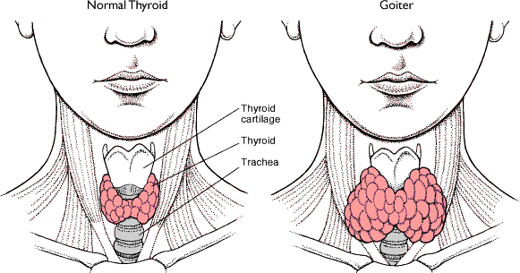
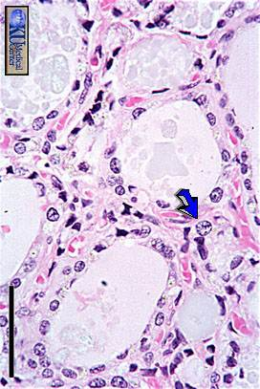
Thyroid Gland

Slide 4
Thyroid function
Normal amount of thyroid hormones are essential for normal growth and development by maintaining the level of energy metabolism in the tissue.
Either too little or too much thyroid hormones will bring disorders to the body.

Slide 5
Thyroid function
Important functions are:
Growth & development, especially in the embryo & brain
Thermoregulation: increase basal metabolic rate (BMR)
Helps maintain metabolic energy balance
CVS: increase HR & cardiac output which increase oxygen demand

Slide 6
Thyroid function
Iodine Importance:
Thyroid hormones are unique biological molecules in that they incorporate iodine in their structure
Adequate iodine intake (diet, water) is required for normal thyroid hormone production
Major sources of iodine:
- iodized salt
- iodated bread
- dairy products
- shellfish
Minimum requirement: 75 micrograms/day

Slide 7
Iodine Metabolism
Dietary iodine is absorbed in the GI tract, then taken up by the thyroid gland (or removed from the body by the kidneys)
Iodide taken up by the thyroid gland is oxidized by peroxidase in the lumen of the follicle:
Peroxidase
I⁻ I₂
Iodide
iodine
Oxidized iodine can then be used in the production of thyroid hormones

Slide 8
Thyroid Regulation
Hypothalamus secretes Thyrotropin-Releasing Hormone (TRH) which stimulates synthesis & release of thyrotropin (Thyroid Stimulating Hormone or TSH) by the anterior pituitary
TSH then stimulates the thyroid gland to uptake iodine, synthesize & release T4 & T3
T4 & T3 levels feedback to both hypothalamus & pituitary affecting the release of TRH & TSH
-
Hypothalamus
TRH
+
Anterior
Pituitary
TSH
+
Thyroid Gland
Adenylyl Cyclase
TSH Receptor
cAMP
-
T3/T4

Slide 9
Thyroid Regulation
TSH release is influenced by hypothalamic TRH, and by thyroid hormones themselves.
Thyroid hormones exert negative feedback on TSH release at the level of the anterior pituitary.
- Inhibition of TSH synthesis
- Decrease in pituitary receptors for TRH

Slide 10
Thyroid Regulation
TRH (Thyrotropin Releasing Hormone)
TSH (Thyroid Stimulating Hormone or Thyrotropin)

Slide 11
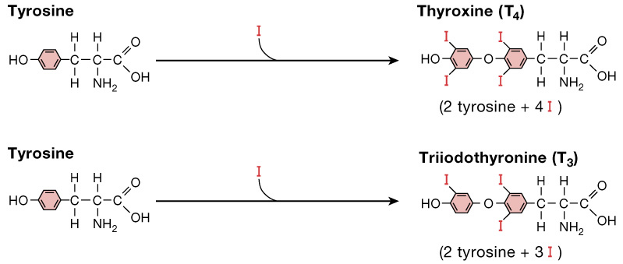
Thyroid Hormones
There are two biologically active thyroid hormones:
- Tetraiodothyronine (T4; thyroxine)
- Triiodothyronine (T3)

Slide 12
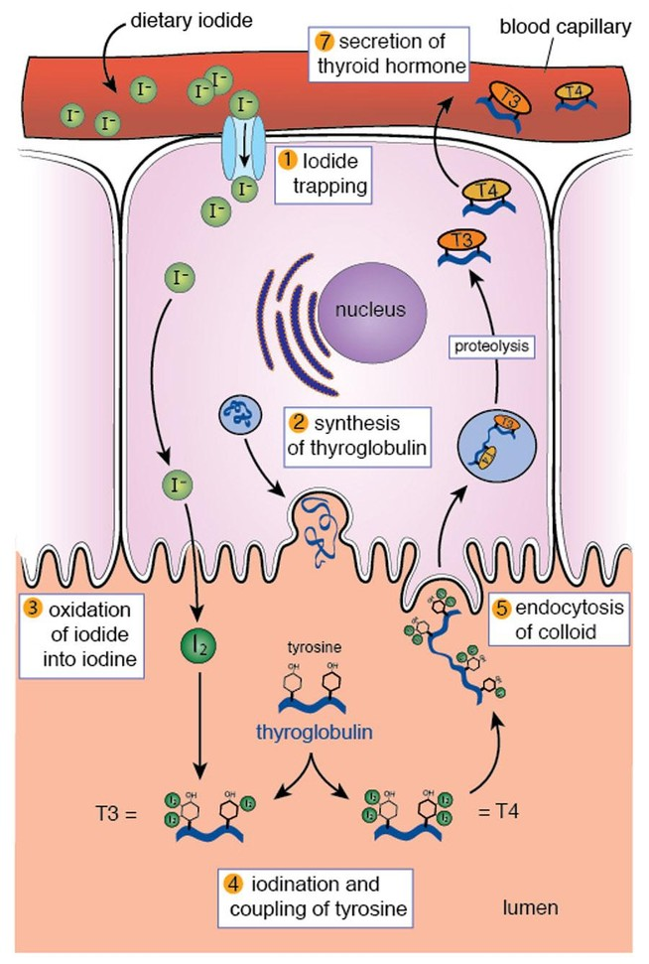

Slide 13
Thyroid Hormones Synthesis
Iodide trapping: uptake of iodide by the thyroid gland
2. Oxidation of iodide: (to its active form)
thyroid peroxidase (key enzyme of the synthesis)
3. Iodine organification : the iodination of tyrosyl groups
of thyroglobulin into monoiodotyrosine (MIT),
and diiodotyrosine (DIT).
4. Formation of T4 and T3 from MIT and DIT :
thyroid peroxidase (TPO)

Slide 14
Thyroid Hormones Disorders
THYROTOXICOSIS :
Is the term for all disorders with increased levels of circulating thyroid hormones
HYPERTHYROIDISM :
Refers to disorders in which the thyroid gland secretes increased amounts of hormones
HYPOTHYROIDISM:
Refers to disorders in which the thyroid gland secretes decreased amounts of hormones
Thyroid neoplasia
Benign enlargement or malignancies of the gland

Slide 15
THYROTOXICOSIS is : Hypermetabolic state caused by thyroid hormone excess at the tissue level
While HYPERTHYROIDISM is : Increased thyroid hormones synthesis and secretion
- All patients with hyperthyroidism have thyrotoxicosis
- Not all patients with thyrotoxicosis have hyperthyroidism

Slide 16
Causes of thyrotoxicosis
With high RAIU
- Graves’ disease (60-80%)
- Multinodular goitre (14%)
- Adenomas / carcinomas
With low RAIU
- Thyroiditis
- Iodine-induced thyrotoxicosis:
Drugs (e.g. Amiodarone)
Radiografic contrast media
Notes:
Amiodarone causing a subacute thyroiditis with release of preformed thyroid hormones into the circulation.

Slide 17
Features of Graves' Disease
(Diffuse Toxic Goiter)
- Caused by thyroid stimulating immunoglobulins that stimulate TSH receptor, resulting in sustained thyroid over activity
- Mainly in young adults aged 20 to 50
- 5 times more frequent in women
- Swelling and soft tissues of hands and feet
- Clubbing of fingers and toes
- Half of cases have Exophthalmos (not seen with -
other causes of hyperthyroidism)
- 5% have pretibial myxedema (thyroid dermopathy)

Slide 18
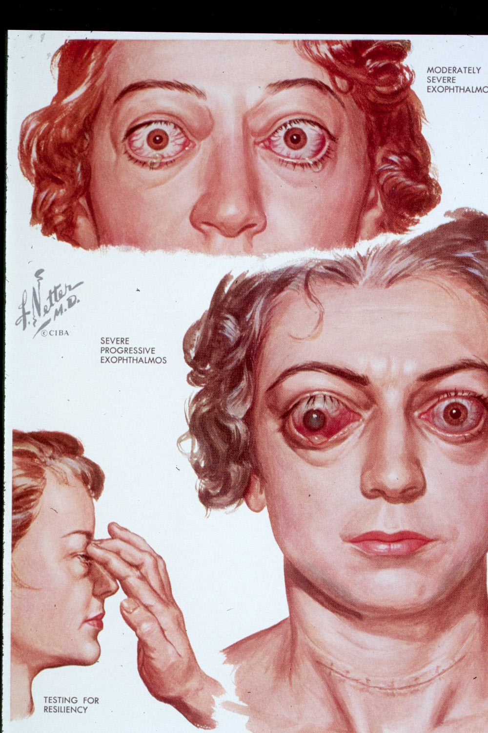

Slide 19
Pretibial myxedema

Slide 20
Features of Toxic Multi-nodular Goiter
- Second most common cause of hyperthyroidism
- Most cases in women in 5th to 7th decades
- Often have long standing goiter
- Symptoms usually develop slowly

Slide 21
THYROTOXICOSIS
Symptoms:
Irritability
Dysphoria
Heat intolerance & sweating
Palpitations
Fatigue & weakness
Weight loss
Diarrhea
Signs:
Arrhythmias
Thyroid enlargement
Warm, moist skin
Exophthalmus
Pretibial myxedema

Slide 22
Treatment of Hyperthyroidism
Thioamides ( antithyroid drugs)
Iodides
Radioactive iodine
Beta blockers
Surgery

Slide 23
THIOAMIDES
Propylthiouracil ( PTU )
Methimazole
Carbimazole
( prodrug converted to the active metabolite methimazole)

Slide 24
Mechanism of Action
Inhibit synthesis of thyroid hormones by inhibiting the peroxidase enzyme that catalyzes the iodination of tyrosine residues
- Propylthiouracil ( but not methimazole )
blocks the conversion of T4 to T3 in
peripheral tissues

Slide 26
Pharmacokinetic comparison between Propylthiouracil and Methimazole
 | Propylthiouracil | Methimazole
Absorption | Rapidly absorbed | Rapidly absorbed
Protein binding | 80-90% | Most of the drug is free
Accumulation | in thyroid | in thyroid
Excretion | Kidneys as inactive metabolite within 24 hrs | Excretion slow, 60-70% of drug is recovered in urine in 48 hrs

Slide 27
Pharmacokinetic comparison between Propylthiouracil and Methimazole
 | Propylthiouracil | Methimazole
Half life | 1.5 hrs ( short ) | 6 hrs ( long )
Administration | Every 6-8 hours | Every 8 hours
Pregnancy | Crosses placenta Recommended in pregnancy ( Crossing placenta is less readily as it is highly protein bound ) | Concentrated in Thyroid & crosses placenta Not recommended in pregnancy
Breast feeding | Less secreted in breast milk Recommended | secreted Not recommended

Slide 28
Adverse Effects Thioamides
Adverse Effect | Frequency | comments
Skin reactions | 4–6% | Urticarial or macular reactions
Arthralgia | 1–5%
Polyarthritis | 1–2% | So-called anti-thyroid arthritis
GIT effects | 1–5% | gastric distress and nausea

Slide 29
Adverse Effects (cont.)
Adverse Effect | Frequency | comments
Immunoallergic hepatitis | 0.1–0.5% | Almost exclusively in patients taking propylthiouracil
Agranulocytosis | 0.1–0.5% | Seen in patients with Graves’ disease; occurs within 90 days of treatment
ANCA-positive vasculitis (Anti-neutrophil cytoplasmic antibodies) | Rare | With propylthiouracil
Abnormal sense of taste or smell | Rare | With methimazole only
Notes:
ANCAs, (Anti-Neutrophilic Cytoplasmic Autoantibodies)

Slide 30
IODINE (Lugol's solution, potassium iodide)
Mechanism of action
Inhibit thyroid hormone synthesis and release
Block the peripheral conversion of T4 to T3
The effect is not sustained ( produce a temporary remission of symptoms )

Slide 31
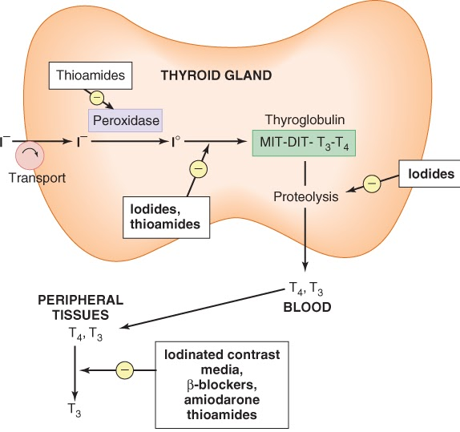

Slide 32
Therapeutic uses
Prior to thyroid surgery to decrease vascularity &
size of the gland
Following radio active iodine therapy
Thyrotoxicosis
Examples
Organic iodides as : iopanoic acid or ipodate
Potassium iodide

Slide 33
Precautions / toxicity
Should not be used as a single therapy
Should not be used in pregnancy
May produce iodism ( Rare, as iodine is not much used now)
Iodism Symptoms:
(skin rash , hypersalivation, oral ulcers,
metallic taste, bad breath).

Slide 34
RADIOACTIVE IODINE ( RAI )
¹³¹ I isotope ( therapeutic effect due to emission of β rays )
Accumulates in the thyroid gland and destroys parenchymal cells, producing a long-term decrease in thyroid hormone levels.
Clinical improvement may take 2-3 months
Half -life 5 days
Cross placenta & excreted in breast milk
Easy to administer, effective, painless and less expensive

Slide 35
Radioactive Iodine ( con.)
Available as a solution or in capsules
Clinical uses :
Hyperthyroidism mainly in old patients (above 40)
Graves, disease
Patients with toxic nodular goiter
As a diagnostic

Slide 36
Disadvantages
High incidence of delayed hypothyroidism
Large doses have cytotoxic actions ( necrosis of the follicular cells followed by fibrosis )
May cause genetic damage
May cause leukemia & neoplasia
Notes:
Radiotracer may cause oxidative DNA damage in non-target cells and tissues

Slide 37
ADRENOCEPTOR BLOCKING AGENTS
Adjunctive therapy to relief the adrenergic symptoms of hyperthyroidism such as tremor, palpitation, heat intolerance and nervousness.
E.g. Propranolol, Atenolol, Metoprolol
Propranolol is contraindicated in asthmatic patients

Slide 38
Thyrotoxicosis during pregnancy
Better to start therapy before pregnancy with ¹³¹I or subtotal thyroidectomy to avoid acute exacerbation during pregnancy
During pregnancy radioiodine is contraindicated.
Propylthiouracil is the drug of choice during pregnancy.

Slide 39
THYROID STORM
A sudden acute exacerbation of all of the symptoms of thyrotoxicosis, presenting as a life threatening syndrome.
There is hyper metabolism, and excessive adrenergic activity, death may occur due to heart failure and shock.
It is a medical emergency .

Slide 40
Management of thyroid storm
Should be treated in an ICU for close monitoring of vital signs and for access to invasive monitoring and inotropic support
Correct electrolyte abnormalities, Treat cardiac arrhythmia ( if present ) & Aggressively control hyperthermia by applying ice packs
Promptly administer antiadrenergic drugs (e.g. propranolol) to minimize sympathomimetic symptoms

Slide 41
Management of thyroid storm ( cont..)
High-dose Propylthiouracil (PTU) is preferred because of its early onset of action ( risk of severe liver injury and acute liver failure )
Administer iodine compounds (Lugol's iodine or potassium iodide) orally or via a nasogastric tube
Hydrocortisone 50 mg IV every 6 hours to prevent shock.
Rarely, plasmapheresis has been used to treat thyroid storm
Notes:
extracorporeal separation of blood components results in a filtered plasma product.

Slide 42
Management of Hyperthyroidism due to Graves’ disease
Severe Hyperthyroidism
⬇
[ markedly elevated serum T4 or T3
very large goiter, > 4 times normal ]
⬇
Definitive therapy with radioiodine preferred in adults
⬇
Normalization of thyroid function with anti-thyroid drugs before surgery in elderly patients and those with heart disease
Notes:
Radioactive iodine ablation is often used in older adults because of its efficacy, safety and cost-effectiveness. An appropriate dose is calculated from the previous thyroid uptake scan. A drawback to this management approach is that hyperthyroidism is reversed gradually over months.
In regards to antithyroid medications, methimazole is preferred. However, older adults may be at greater risk of recurrence of hyperthyroidism after drug therapy and for medication side effects. There are data that older adults taking propylthiouracil or high doses of methimazole may be at greater risk for side effects. Agranulocytosis is the major adverse event in this population, occurring in 0.5% of those treated. Rash, arthralgias and myalgias also occur more frequently.

Slide 43
Management of Hyperthyroidism due to Graves’ disease
Mild/moderate hyperthyroidism
⬇
[ small or moderately enlarged thyroid; children or pregnant or lactating women ]
⬇
Primary anti-thyroid drug therapy
should be considered
⬇
Start methimazole, 5–30 mg/day,
(PTU preferred in pregnant women)
⬇
Monitor thyroid function every 4–6 wk
until euthyroid state achieved
⬇

Slide 44
Management of Hyperthyroidism due to Graves’ disease
Mild/moderate hyperthyroidism
⬇
Discontinue drug therapy after 12–18 mo
⬇
Monitor thyroid function every 2 mo for 6 mo,
then less frequently
⬇ ⬇
Relapse Remission
⬇ ⬇
Definitive radioiodine Monitor thyroid function
therapy in adults every 12 mo indefinitely
(Second course of anti-thyroid
drug therapy in children)
Notes:
Young people get rid of radioactive iodine faster than older adults.

Slide 45
THYROIDECTOMY
Sub-total thyriodectomy is the treatment of choice in very large gland or multinodular goiter

Slide 46
Good Luck

