Slide 1
δΑم ௌ اϟر ϦϤΣاϟرϴΣم

Slide 2
ENDOCRINOLOGY
The Adrenal Gland
Glucocorticoids
Dr. Abeer Al-Ghumlas

Slide 3
Objectives
At the end of this lecture student should be able to:
 Describe the metabolism and physiological effects of glucocorticoids.
 Describe the mechanisms that regulate secretion of glucocorticoids
 Describe the main features of the diseases caused by excess or deficiency of each of the
hormones of the adrenal gland.

Slide 4
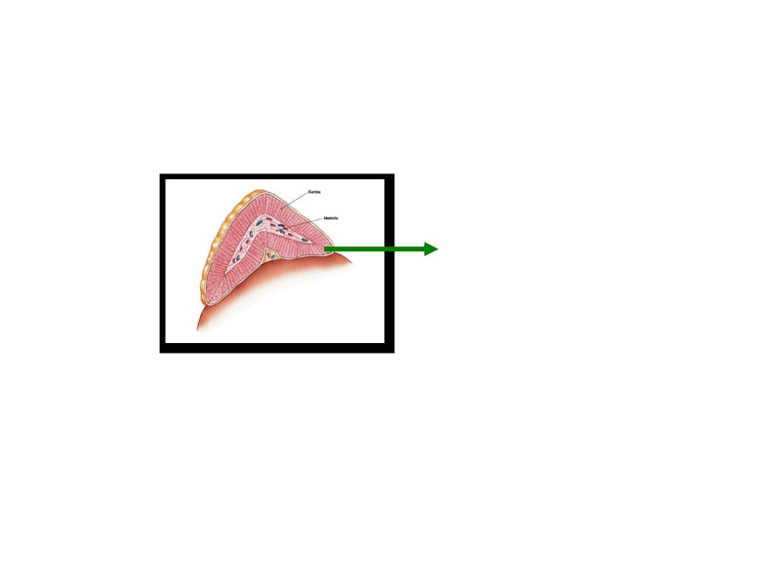
Cortisol

Slide 5
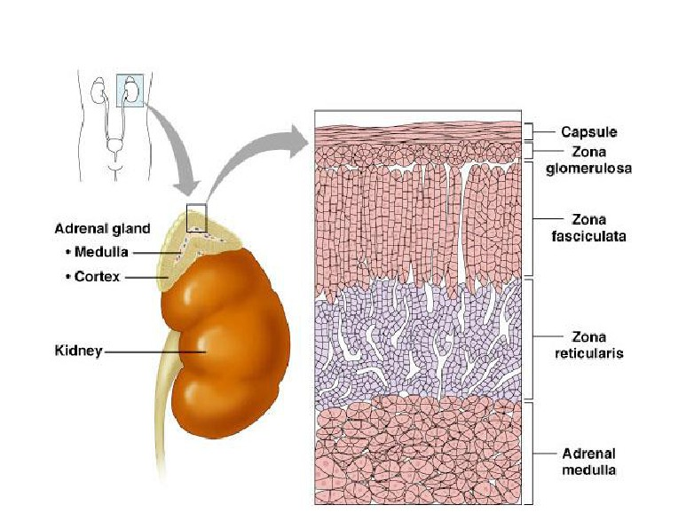
Adrenal Cortex
Cortisol

Slide 6
Glucocorticoids
Main glucocorticoids in humans: ¾ Cortisol:
¾ very potent
¾ Account for 95% of glucocorticoid activity ¾ Corticosterone:
¾ account for about 4% of total glucocorticoid activity
¾ Less potent than cortisol
¾ Cortisol:corticosterone produced in humans
in a ratio of 10:1

Slide 7
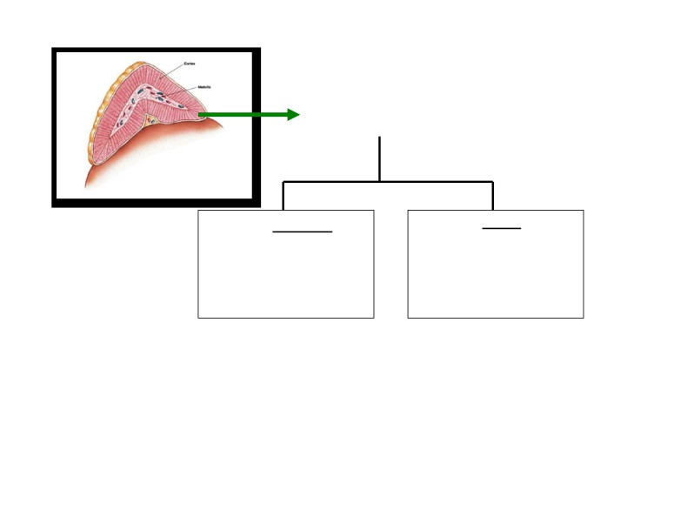
Cortisol…. Transport
Bound Free
90-95%
Mostly to transcortin
6%
(Cortisol Binding Globulin)
Active
y Albumin
 Half life =60-90 minutes
 Metabolized in liver by reductases & conjugated to
glucuronides and excreted via kidney
 Free cortisol is excreted into urine.

Slide 8
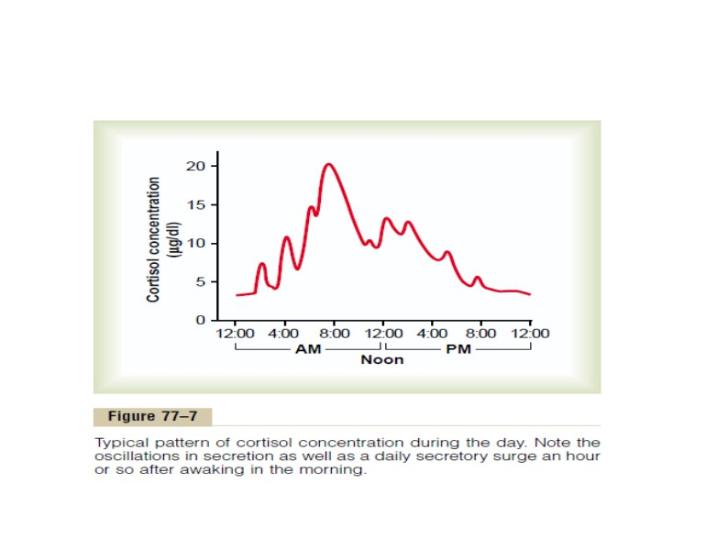
Circadian rhythm of cortisol secretion

Slide 9
Circadian rhythm of cortisol secretion
`The secretory rates of CRF,ACTH, and cortisol:
o high in the early morning:
the plasma cortisol level ranges between a high of about 20 µg/dl an hour before
arising in
the morning
o low in the late evening:
low of about 5 µg/dl around midnight.
` This effect results from a 24-hour cyclical alteration in the signals from the hypothalamus that cause cortisol secretion.
` When a person changes daily sleeping habits, the
cycle
changes
correspondingly.
Therefore,
measurements of blood cortisol levels are meaningful only when expressed in terms of the time in the cycle at which the measurements are made.

Slide 10
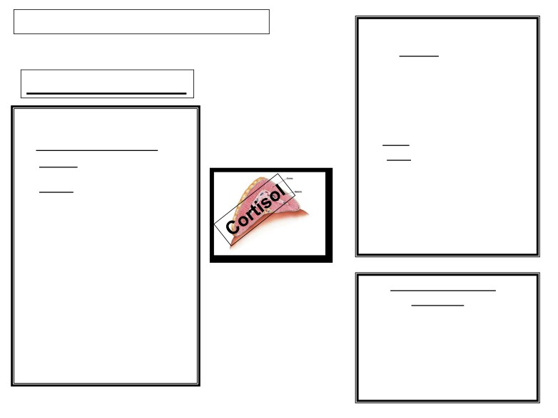
Physiological actions of cortisol
On protein metabolism:
1. ĻĻProtein stores in all
body (except the liver).
1. On metabolism
(increase catabolism of
protein and decrease protein
On carbohydrate metabolism:
synthesis)
ĹĹGlucose level in the
2. ĹLiver and plasma proteins
blood:
3. a.a: - ĹĹ Amino acid level
in the blood.
1. Liver:
-Ļ a.a transport into
extra hepatic cells
- Stimulates gluconeogenesis (6-10 fold)
- Ĺa.a transport into
hepatic cells
- Increase glycogen storage by the liver.
2. ĻĻGlucose utilization by the cells.
On Fat metabolism (lipolytic):
1. Mobilization of fatty acid
3. Ļ the sensitivity of tissues to insulin.
from adipose tissue
2. ĹĹ The concenWraWion of
free fatty acids in the
³Adrenal Diabetes´.
blood.
3. ĹĹ Their XWili]aWion for
energy.

Slide 11
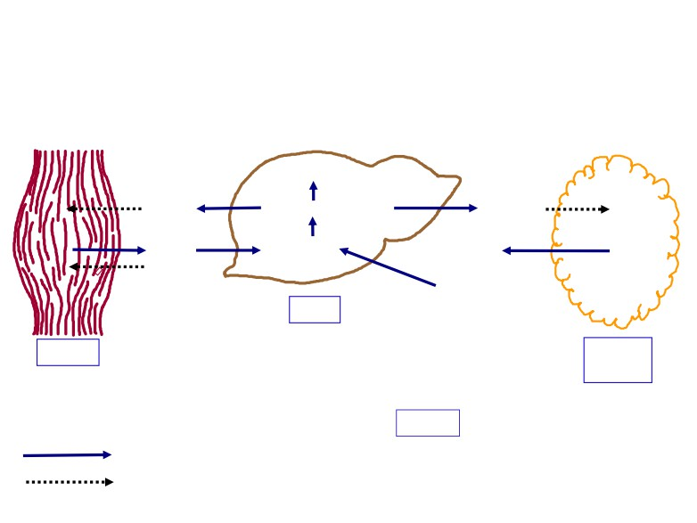
Metabolic Effects of Cortisol
Glycogen
Glucose
Glucose-P
Glucose
Amino
Glucose
Free fatty acids
Protein
acids
precursors
+
Glycerol
Liver
Muscle
Adipose
tissue
Plasma
Stimulate
Glucose
Free fatty acids
Inhibit
Amino acids

Slide 12
2. Cortisol is important in resisting stress and inflammation.
y On Stress:
Without GCs, the body cannot cope with even mild
stressors
Stress include (trauma, infection, surgery, any
debilitating disease, increase heat or cold).
Cortisol causes rapid mobilization of amino acids and FFA
from their cellular stores, making them immediately
available both for energy & synthesis of other compounds, including glucose, needed by the different tissues in the body.
BP, glycogen, prevents stress induced reaction from becoming excessive.
Effects on CNS

Slide 13
Physiological actions of cortisol cont..
3. On inflammation
Damage to the tissues by trauma/infection almost
always leads to inflammation.
Inflammation can be more damaging than the
trauma or disease itself.
Cortisol has anti-inflammator\ effects«.HoZ?
y Cause stabilization of the intracellular lysozomal
membranes ĺ more difficult for these membranes to
rupture ĺ less release of proteolytic enzymes that cause inflammation.
y Reduces all aspects of the inflammatory process.

Slide 14
Physiological actions of cortisol cont..
3. On inflammation:
Anti-inflammatory:
Reduces all aspects of the inflammatory process.
(1)Block the early stages of the inflammation process before
inflammation even begin
(2) If inflammation begun: It cause rapid resolution of the inflammation and increase rapidity of healing
(3) Resolution of inflammation

Slide 15
Anti-inflammatory Effect of cortisol:
 Stabilizes lysosomal membrane.
 Reduces degree of vasodilatation.
 Decreases permeability of capillaries.
 Decreases migration of white blood cells.  Suppresses immune system.

Slide 16
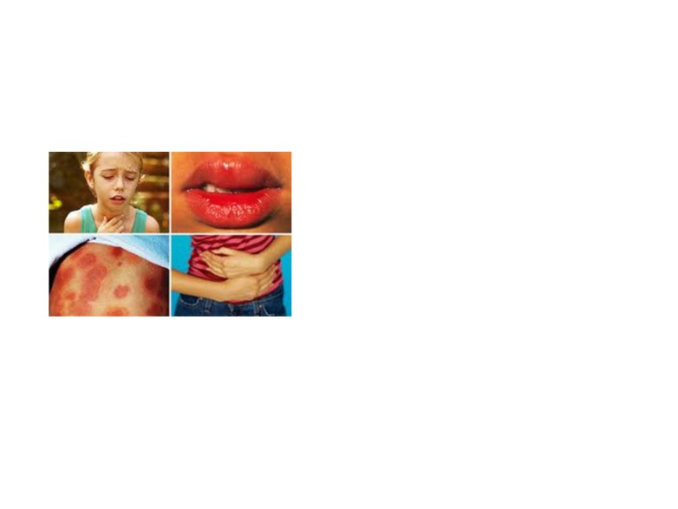
4. Cortisol blocks the inflammatory response to Allergic reactions
Anaphylactic shock
Cortisol
prevent shock and death

Slide 17
5. On blood cells:
` Increases RBC production
` Decreases lymphocyte, eosinophils count
` Large doses of cortisol
administration: Suppresses
lymphoid tissue systemically
therefore decrease T cell and
antibody production
decreasing immunity.
` This effect is useful in
transplantation surgery in
reducing organ rejection.
Decreases

Slide 18
6. anti-allergic effects
(In pharmacological doses):
 It decreases fibroblastic activity
and local swelling

phospholipase A2
 Stabalizes lysosomal membrane
 Inhibits collagenase from
breaking down proteins
 Inhibits histamine release (anti-
allergic)

Slide 19
7. Effect on circulation
¾ Excrete water load:
Cortisol levels vary with water intake
¾ Mineral metabolism:
Cortisol has mineralocorticoid effect:
Na+ reabsorption and K+ secretion
Not as potent as aldosterone. ¾ Vascular Effect:
¾ Maintains body fluid volumes & vascular integrity ¾ BP regulation & cardiovascular function:
Sensitizes arterioles to action of noradrenaline (Permissive
effect).
¾ Increase in GFR (vasodilatation of afferent arterioles which increases renal Blood flow)

Slide 20
Functions - CNS
¾8.Effect on CNS:
y Decreases REM sleep
y Increase slow-wave sleep y Increases awake time

Slide 21
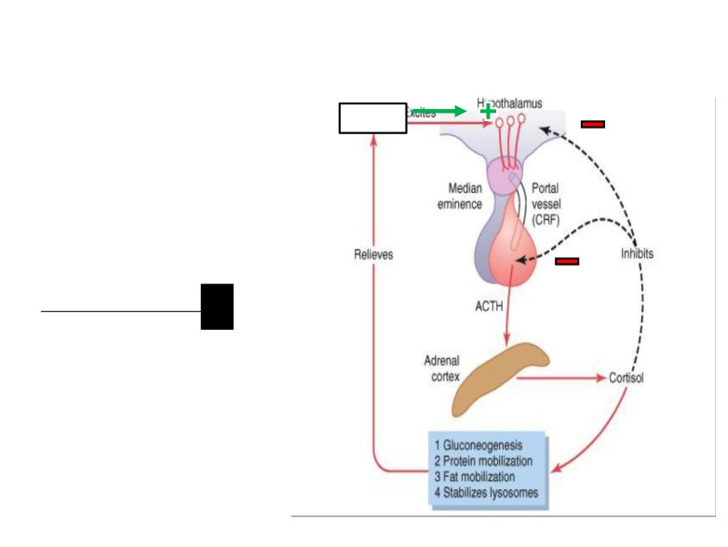
Regulation of Cortisol Secretion
Stress
y Stress stimulates CRH secretion by the
hypothalamus.
y Cortisol has a direct
negative feedback effect on both the
hypothalamus and ant.
pituitary.

Slide 22
Abnormalities
(Increase secretion of corticosteroid)
(Decrease secretion of glucocorticoids
and mineralocorticoids)
Cushing’s Syndrome
(Addison's disease)

Slide 23
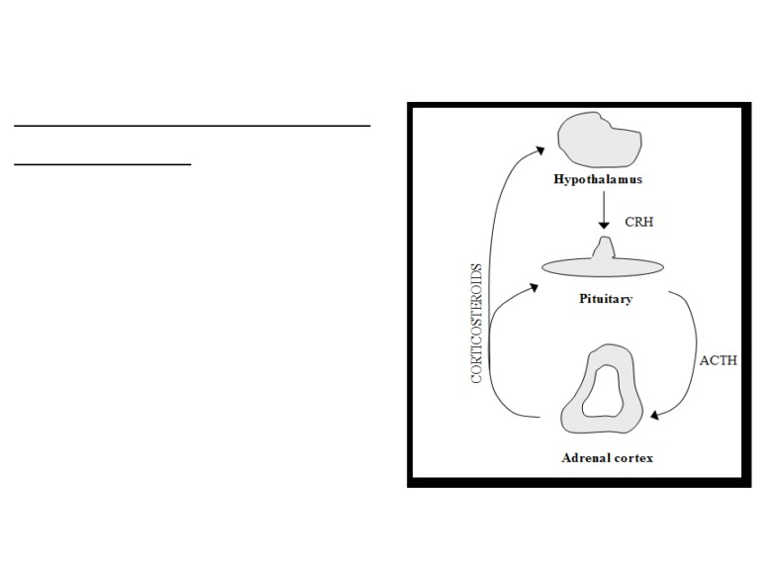
Cushing’s Syndrome
Cushing syndrome: (Hypercortisolism)
Causes and types:
2
(1) adenomas of the anterior pituitary →n ACTH.
(2) abnormal function of the hypothalamus ĺn CRH.
1
(3) "ectopic secretion" of ACTH by a
tumor elsewhere in the body, such as
4
an abdominal carcinoma.
(4) adenomas of the adrenal cortex.
3
When Cushing's syndrome is secondary to n ACTH by the anterior pituitary = Cushing's disease.

Slide 24
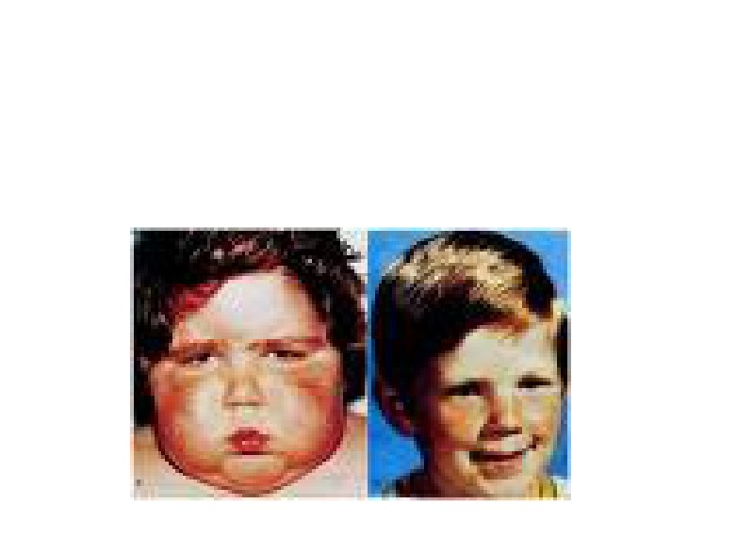
(5) Cushing's syndrome may occur when large amounts
of glucocorticoids are administered over prolonged
periods for therapeutic purposes.
e.g. patients with chronic inflammation associated with diseases such as rheumatoid arthritis.

Slide 25
Cushing’s Syndrome
On carbohydrate
On protein metabolism:
metabolism:
 p tissue proteins almost
n blood glucose level (n gluconeogenesis and
everywhere in the body
(except liver).
 Protein loss from the
muscles in particular
p glucose utilization by the tissues).
causes severe
weakness.
 protein collagen fibers in
the s.c.(loss of CT)
 Thining of the skin
Abnormal fat redistribution  mobilization of fat from
 severely p protein
deposition in bones → severe osteoporosis.  suppressed immune
the lower part of the
body, with concomitant
extra deposition of fat in the thoracic and
system.
upper abdominal
regions, giving rise to a buffalo torso (truncal
80% of patients have hypertension (because of the mineralocorticoid
obesity).
effects of cortisol).
 The appearance of the
face described as a "moon face"

Slide 26
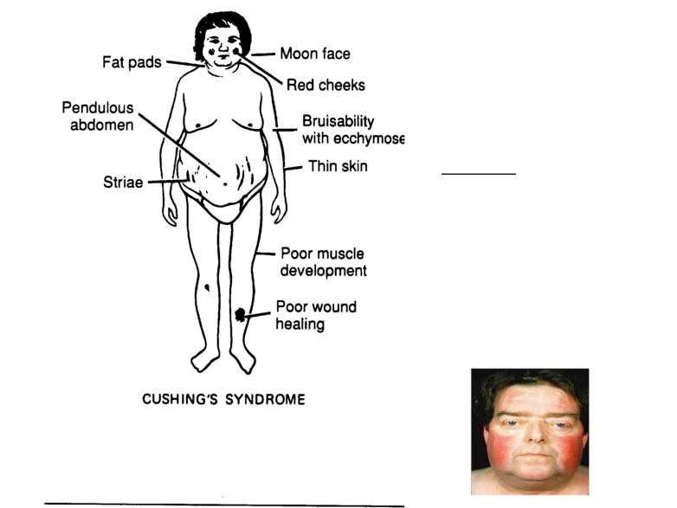
Cushing’ s Syndrome
Many people with
excess cortisol secretion
develop a peculiar type
of obesity, with excess deposition of fat in the
chest and head regions
of the body, giving a
buffalo-like torso and a rounded face, a “moon-
face”.

Slide 27
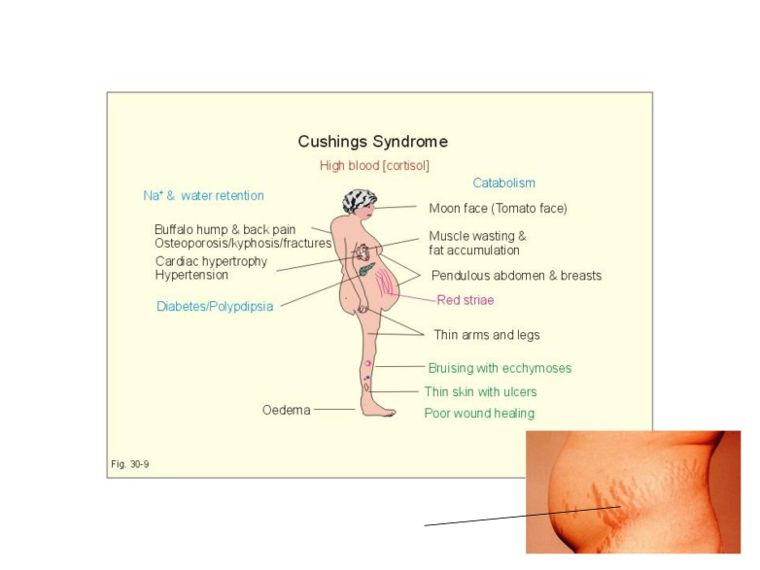
Features of Cushing’s Syndrome
striae

Slide 28
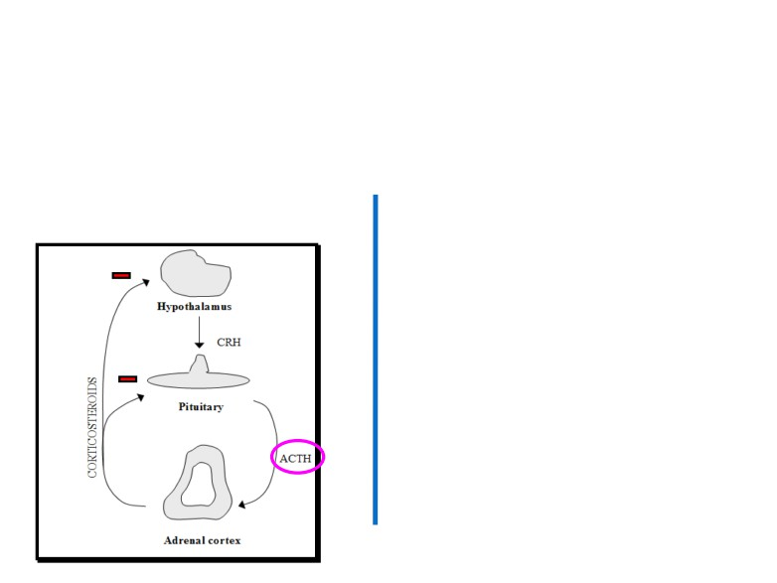
How to differentiate between ACTH-dependent and ACTH-
Independent Cushing's syndrome?
 By administrating large doses of cortisol (dexamethasone).
In patients with n ACTH → no
patients with primary adrenal
suppression of ACTH secretion.
overproduction of cortisol
(ACTH-independenW) ĺ p levels of
ACTH.

Slide 29
Abnormalities
(Increase secretion of corticosteroid)
(Decrease secretion of glucocorticoids
and mineralocorticoids)
Cushing’s Syndrome
(Addison's disease)

Slide 30
Adrenocortical insufficiency
y primary causes, ie. Addionǯ dieae
y autoimmune disease, tumors, infection, hemorrhage,
metabolic failure, ketoconazole (glucocorticoid antagonist activity) y secondary causes
y hypopituitarism, suppression by exogenous steroids

Slide 31
Adrenal insufficiency: (Addison's disease)
• Increased excretion of sodium and water.
• Reduction in ECF volume.
• Tendency toward low blood pressure.
• Complete absence of aldosterone, the
volume depletion may be severe.
•Hypoglycemia
•Skin pigmentation
The person is allowed to eat large amounts of salt and drink large amounts of water to balance the increased urine output of salt and water.

Slide 34
