Slide 1
بسم ا الرحمن الرحيم

Slide 2
ENDOCRINOLOGY
The Adrenal Gland
Adrenal Androgens
Dr. Abeer Al-Ghumlas

Slide 3
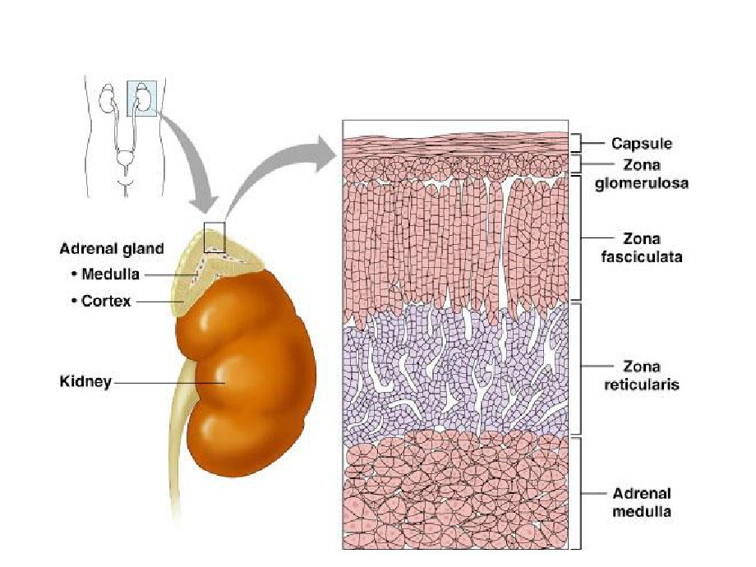
Adrenal Cortex

Slide 4
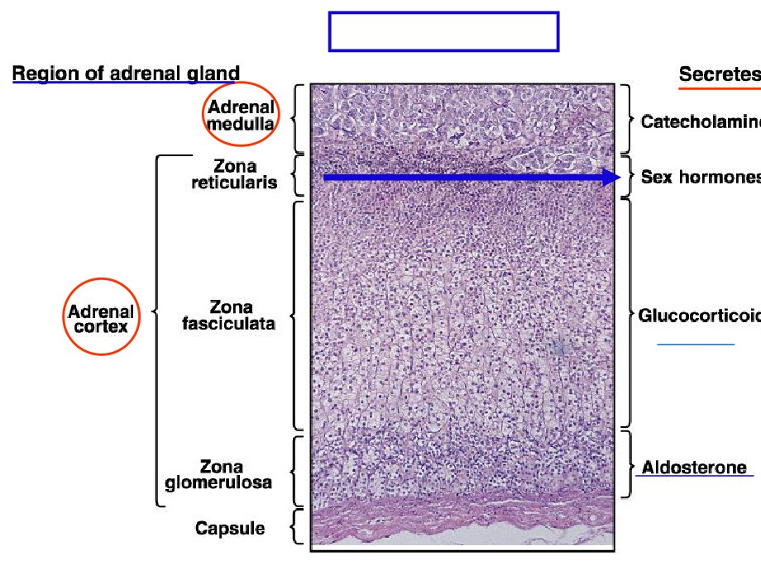
The Adrenal Gland
√
(Cortisol)
Mineralocortico
√
( )

Slide 5
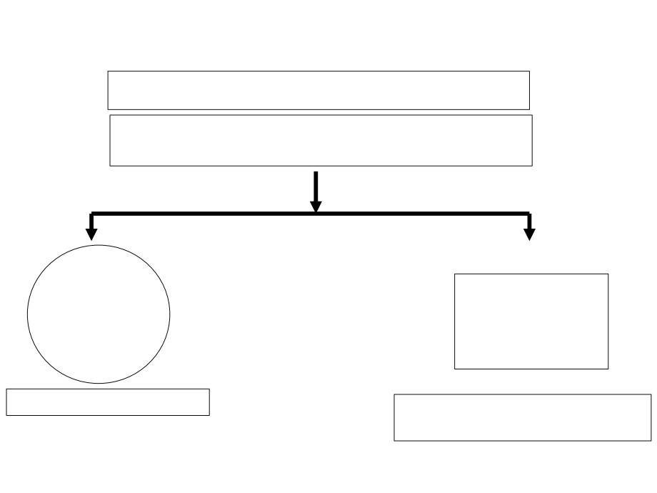
Androgens
Androgens are the hormones that exert masculinizing
effects and they promote anabolism and growth.
Testosterone (Testis)
adrenal
androgens
(Adrenal Gland)
the major active androgen
have less than 20% of testosterone activity.

Slide 6
Adrenal cortex
Male sex hormones
Female sex hormones
(Androgens)
• Estrogens
• Adrenal androgens
includes :
- dehydroepiandrosterone (DHEA),
• Progesterone
- Androstenedione.
• The adrenal cortex in both sexes produces small amounts of sex hormone of the opposite sex.

Slide 7
adrenal androgens (Adrenal Gland)
• Produced from Zona reticularis in small amounts
• Control of secretion of adrenal androgens is by ACTH ➢ dehydroepiandosterone (DHEA):
• It is the most abundant adrenal androgen
• DHEA is the primary precursor of natural estrogens.
• Normally they exert very little masculinizing effect (weak) when secreted in normal amount (mild effect in female). ➢ Androstenedione:
• An androgenic steroid produced by the testes, adrenal cortex, and ovaries
• Androstenediones are converted metabolically to testosterone and to estrogens in the fat and other peripheral tissues. It is an important source of estrogen in men and postmenopausal
women.
• Androstenedione were used as an athletic or body building supplement.

Slide 8
Role of Androgens
Males
Females
 Spermatogenesis
 growth of pubic and axillary hair.
 Inhibition of fat deposition  Muscle mass
 pubertal growth spurt development
 Brain: Androgen levels have been implicated in
the regulation of
 Androgens have potential roles in relaxation of
human aggression and
libido.
the myometrium preventing
 masculinization of the developing male fetus
premature uterine
contractions in pregnancy
(including penis and
scrotum formation).

Slide 9
Adrenogenital syndrom
Excessive adrenal androgens secretion
• Cause:
❑ Adrenocortical tumors
❑ Congenital adrenal hyperplasia
• inherited as autosomal recessive diseases
• affect both boys and girls.
• Due to deficiency of one of the enzymes of the cortisol synthesis (21-hydroxylase) and steroids are 'diverted' to becoming androgens.
• Lead to increase ACTH leading to excessive production of adrenal androgens
• Tt: glucocorticoids

Slide 12
Adrenogenital syndrom
Excessive adrenal androgens secretion
After birth  Male
Before birth
 Psudohermaphrodite
 Female

Slide 13
Adrenogenital syndrom
Before birth (female)
After birth (Male)  Precocious puberty  Early appearance of
After birth (Female)  Virilization
 Psudohermaphroditism:
 Before 12 weeks in female fetus
❑ Development of male characters in
male characters
 XX true female with external male
 Increase musculature  Development of
females:
 Increase bulk of muscles
genitalia
external genitalia
 Cause: exposure of the mother to
organ to adult size  No spermatogenesis
 Hoarseness
 Increase body hair  Increase facial hair  Atrophy of the breast  Amenorrhea
excessive androgens

Slide 14
Adrenogenital Syndrome
Adrenocortical tumor secretes excessive quantities of androgens that cause intense masculinizing effects throughout the body.
In a female:
she develops virile characteristics, including: growth of a beard, a much deeper
voice, occasionally baldness, masculine distribution of hair on the body.
In prepubertal male: a virilizing adrenal tumor causes the same characteristics as in the female plus rapid development of the male sexual organ.
In the adult male: the virilizing characteristics of adrenogenital syndrome are usually obscured by the normal virilizing characteristics of the testosterone
secreted by the testes.
It is often difficult to make a diagnosis.
However, the excretion of 17-ketosteroids (derived from androgens) in urine
may be 10 to 15 times normal, used in diagnosing the disease.

