Slide 1
بسم ا الرحمن الرحيم

Slide 2
Adrenal Medulla

Slide 3
Learning outcomes
After reviewing the PowerPoint presentation, lecture notes and associated material, the student should be able to:
▪ Summarize the actions of adrenal androgens.
▪ Describe the causes and major manifestations of hyperadrenocorticism and Hypoadrenocorticism ▪ Describe circumstances in which catecholamines
are released from the adrenal gland.
▪ List the major actions of catecholamines.

Slide 4
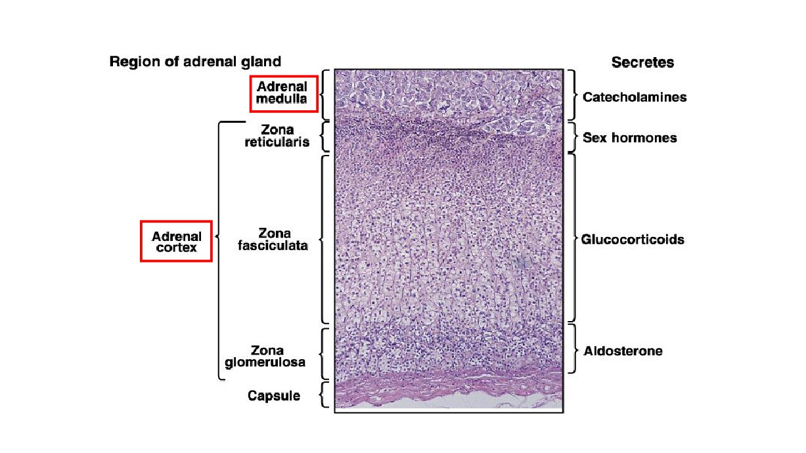

Slide 5
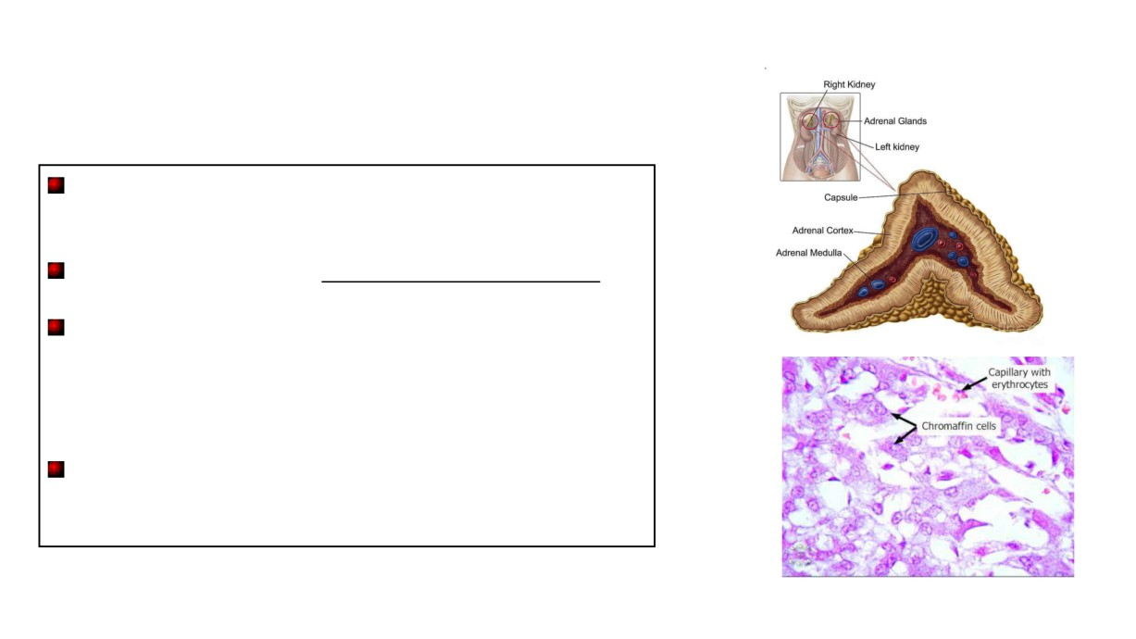
Adrenal medulla
The adrenal medulla is the inner part or core of each adrenal gland.
It is considered as part of sympathetic nervous system.
It secretes catecholamines:
-Adrenaline (epinephrine) -- 80% of the secretion.
-Noradrenaline (norepinephrine)-- 20 % of the secretion.
-small amount of dopamine
They are released from chromaffin cells

Slide 6
of the sympathetic system .تعتبر جزء ل يتجز The adrenal medulla is, functionally , integral part
●
80% of its secretion is
Epinephrine ( EP) and 20% of its secretion is
Norepinephrine (NE ).
● EP in the bloodstream comes
solely from the adrenal medulla
● NE in blood comes from BOTH adrenal medulla and
postganglionic sympathetic nerves
● This is because postganglionic sympathetic nerves can not
synthesize EP from its
precursor NE , because they lack the enzyme ( PNMT) needed for conversion of NE
into EP .

Slide 7
Adrenal medulla
• Secretion of these hormones causes:
➢ Blood to be diverted to the brain, heart, and skeletal muscle
➢ Epinephrine is the more potent stimulator of the heart and metabolic activities
➢ Norepinephrine is more influential on peripheral vasoconstriction and blood
pressure

Slide 8
Role of the adrenal medullary hormones
1. Enhance the effects of the
sympathetic nervous system.
2. Prepare the body for a
stressful event.
The response is known as the
“fight or flight” response.

Slide 9
Effects of Catecholamines
1- Glycogenolysis in liver and skeletal muscle (can lead to hyperglycemia) which increases blood glucose level
2- Increase heart rate and blood pressure
3- Cause vasoconstriction of blood vessels
4- Mobilization of free fatty acids
5- Increase metabolic rate 6- Increase O2 consumption

Slide 10
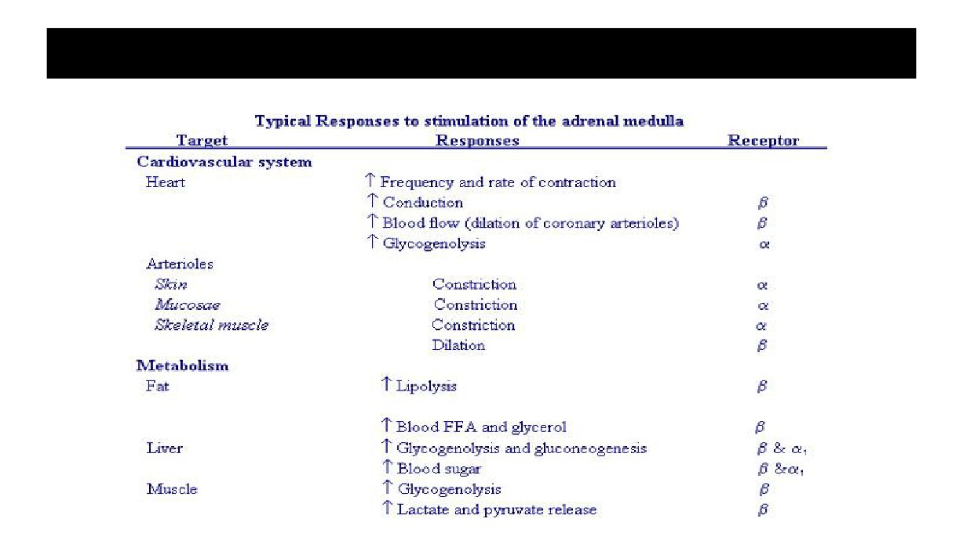
Actions of adrenal medullary hormones

Slide 11
Actions of adrenal medullary hormones
The effects of the adrenal medullary hormones underlie the role of these hormones in preparation of body for fight or flight.
The overall effect is to ensue that all requirements for increased muscle activity are available. What are these?

Slide 12
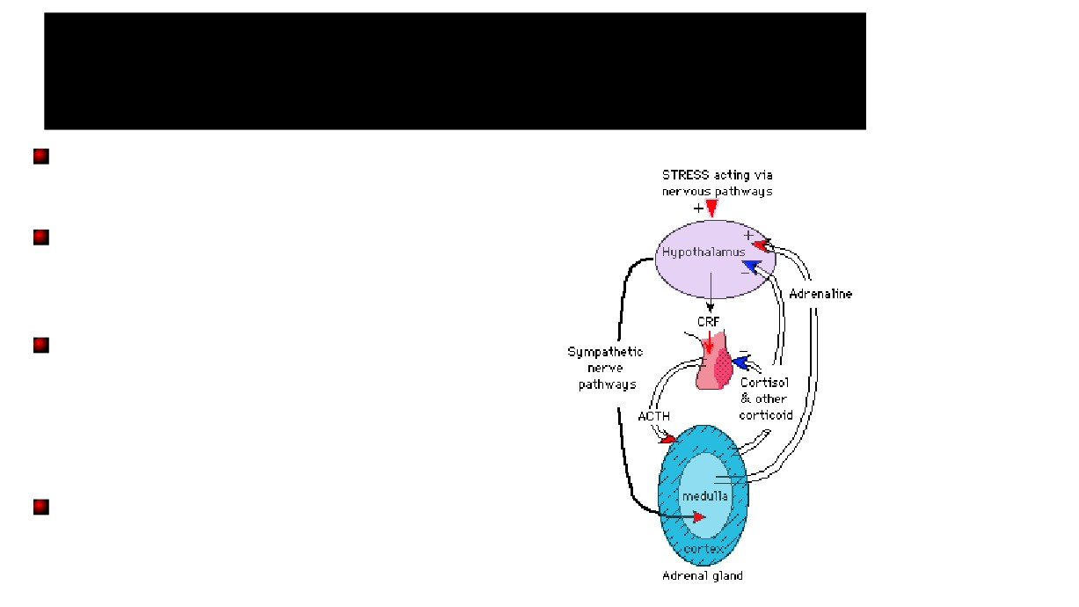
Control of secretion of
adrenal medullary hormones
The adrenal medulla is innervated by the
sympathetic nervous system.
Adrenal hormones are released from the medulla in response to signals from the sympathetic nervous system.
The sympathetic nervous system is activated in
response to stress also know as the “fight or flight”
response. Stress can be physical (exercise),
physiological (hypoglycemia, hemmorhage), or
emotional,
Cortisol, when secreted from the adrenal cortex in response to stress, causes release of these hormones from the medulla.

Slide 13
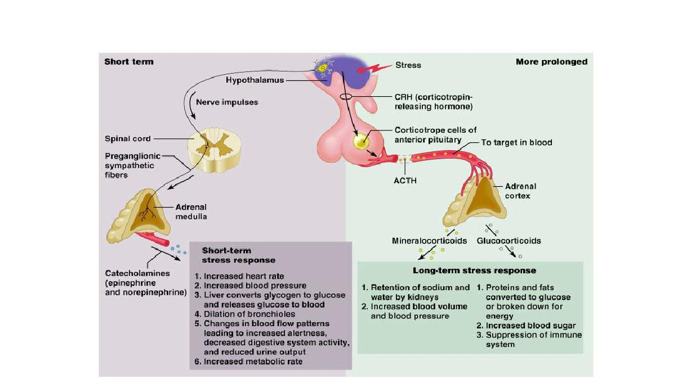
Stress and the Adrenal Gland

Slide 14
A case study?
“James” a 35-year-old husband and father of
three children, has been experiencing
headaches and palpitations of increasing
frequency and severity over the past six
months.
In addition, he has had periods of intense anxiety
and panic attacks.

Slide 15
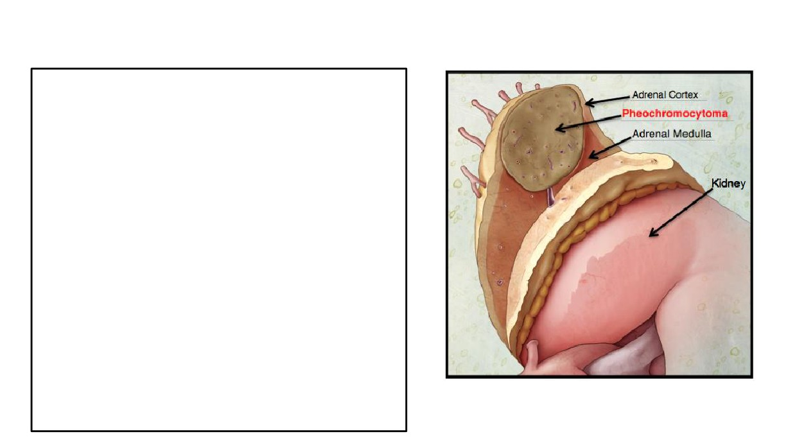
Pheochromocytoma
• Pheochromocytoma is a tumor of adrenal medulla .
• derived from chromaffin cells (arise from neural crest).
• Most often occurs in middle age.
• It can be life threatening if not recognized & not treated.
• Most tumors secrete epinephrine, NE, and dopamine and can cause episodic
hypertension.
• Associated with neurofibromatosis.

Slide 16
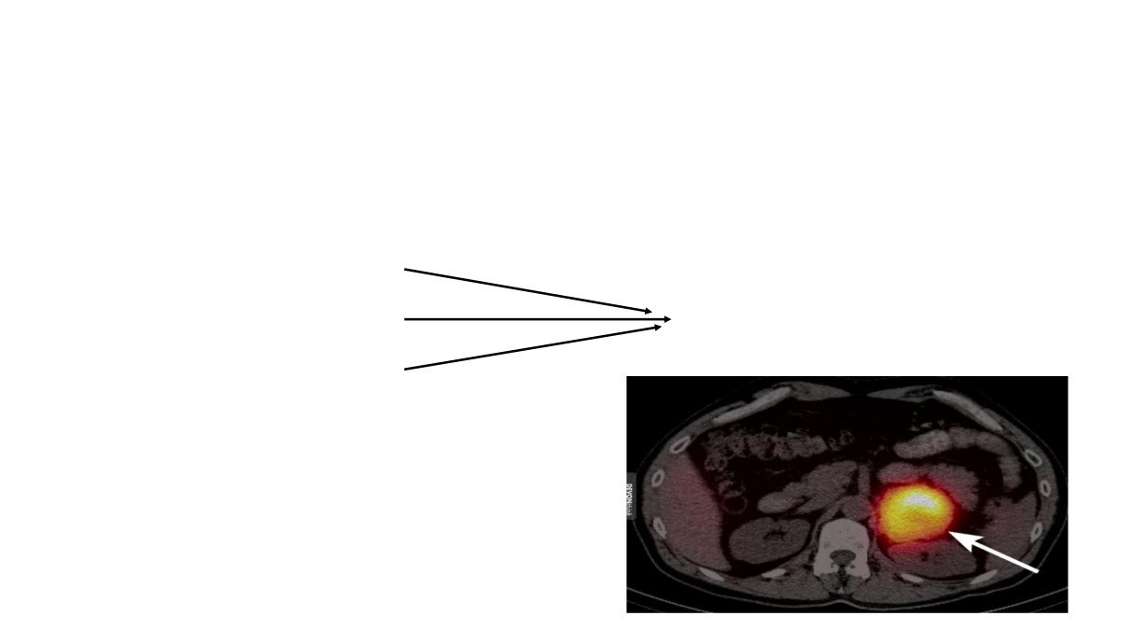
Signs and Symptoms of Pheochromocytoma
• resistant hypertension (95%)
• headache
• sweating
classic triad
• palpitations
• chest pain
• anxiety
• glucose intolerance
• increased metabolic rate

Slide 17
Pheochromocytoma
•
Urinary vanillylmandelic acid, VMA
(a
breakdown products of norepinephrine) and
Metanephrines:
•
Plasma catecholamines:
•
Treatment is surgical resection

