Slide 1
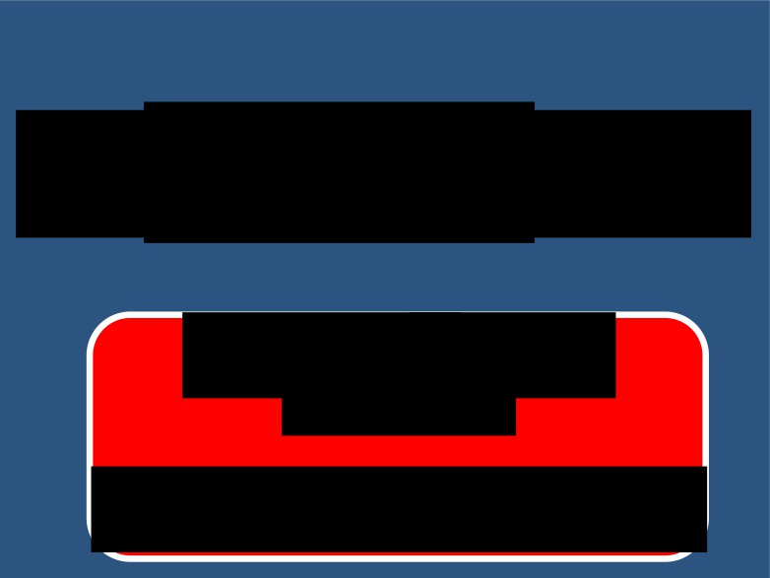
TH THYROID GLAND
DR. Nervan Bayoumy
M.D. PhD (UK)
Associate Professor of Physiology

Slide 2
Thyroid Gland
Lecture 1;
Objectives:
1- Describe the synthesis of thyroid hormones. 2- Diagram the control over the thyroid gland.
3- Compare between the hormones released by the thyroid gland.
4- Discus the actions of the thyroid hormones.

Slide 3
Thyroid Gland (Hypo and hyperthyroidism)
Lecture 2;
Objectives:
1- Identify the terms goiter, hypo and hyperthyroidism.
2- List the causes and types of goiter, hypo and hyperthyroidism.
3- Discusses the clinical picture of hypo and hyperthyroidism.
4- Explain the laboratory tests to diagnose hypo and hyperthyroidism.
5- Outline management regimen for hypo and hyperthyroidism.

Slide 4
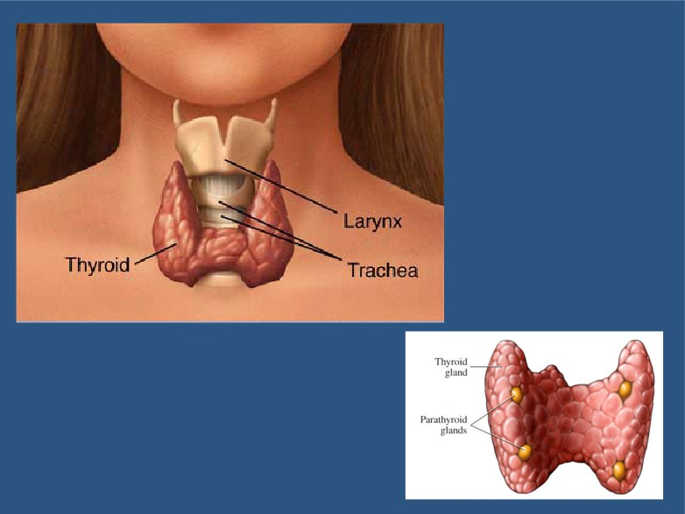

Slide 5
It is located below the larynx on either sides and anterior to the trachea.
The first recognized endocrine gland.
n
20g in adult.

Slide 6
HORMONES
T4 tetraiodothyronin ) thyroxin ) 90%.
T3 Triiodothyronin )10%.
Reverse T3
Calcitoni

Slide 7
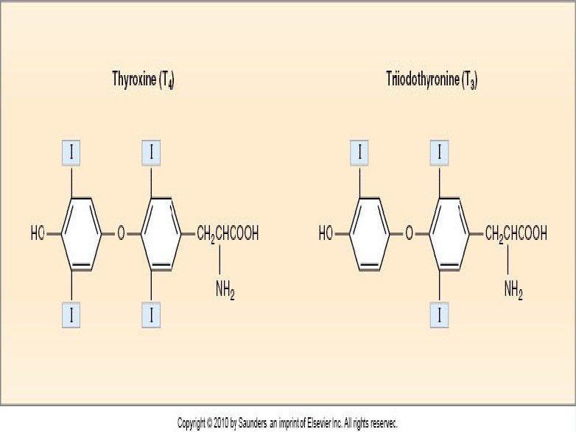

Slide 8
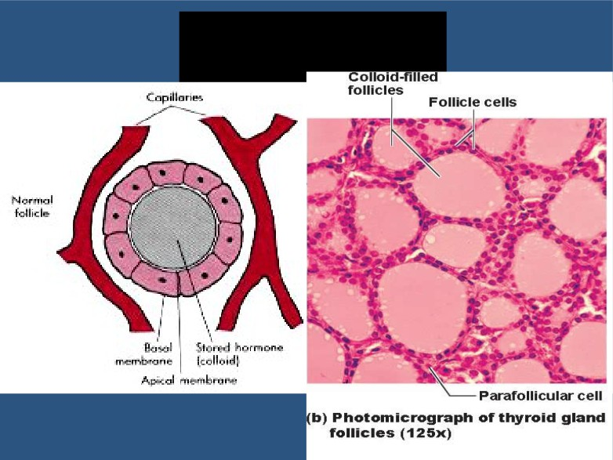
SYNTHESIS

Slide 9
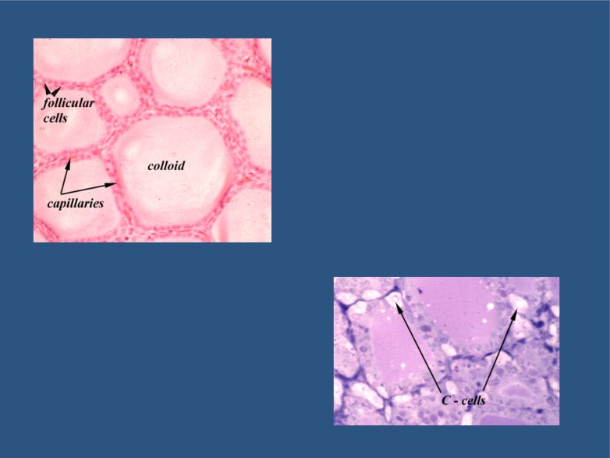
T3, T4
Calcitonin

Slide 10
THREE UNIQUE FEATURES
Contains a large amount of iodine.
supplied in diet.
1mg/week.

Slide 11
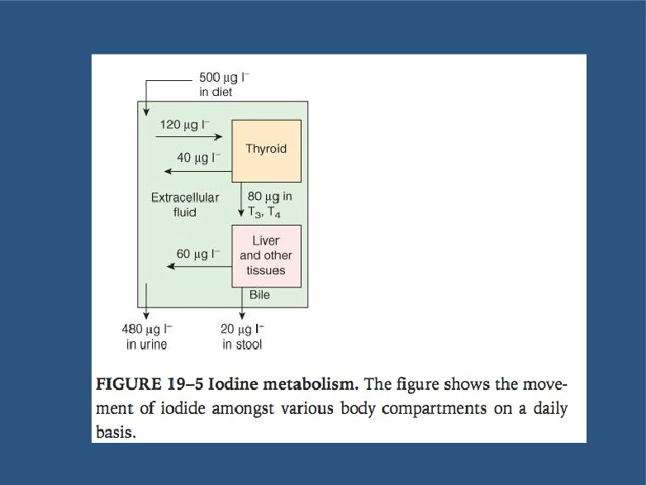

Slide 12
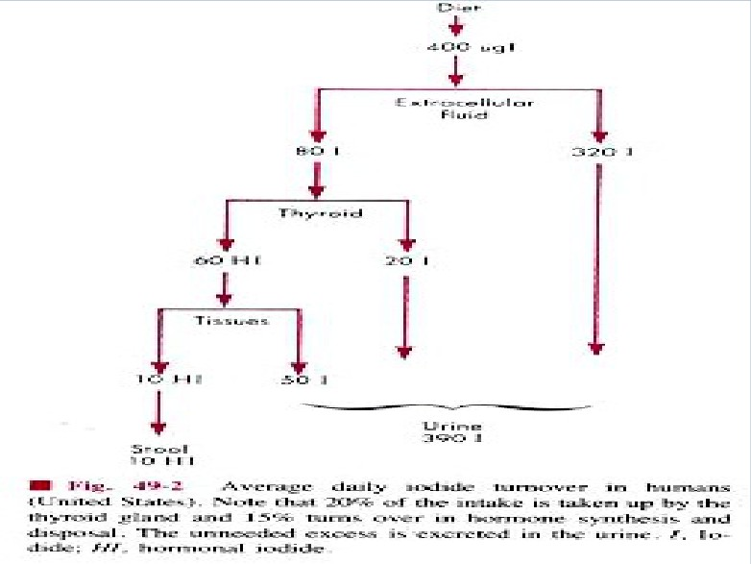

Slide 13
Synthesis is partially intracellular and partially extracellular.
T4 is the major product.

Slide 14
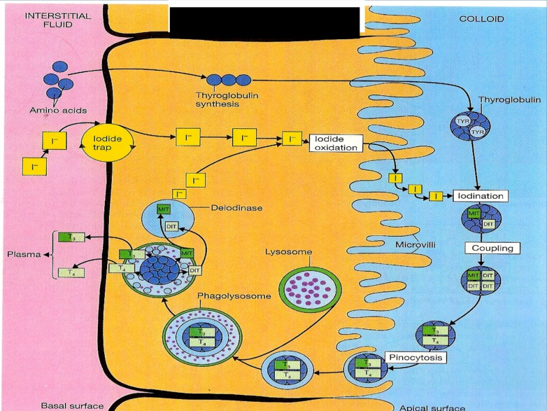
STEPS of BIOSYNTHESIS

Slide 15
Thyroid Hormones [T3 - T4]
Biosynthesis:
by the follicular cells
1- Iodide pump.
2- Thyroglobulin synthesis.
3- Oxidation of iodide to iodine.
4- Iodination of tyrosine, to form mono-iodotyrosine (MIT) & di-iodotyrosine (DIT).
5- Coupling; MIT + DIT = Tri-iodothyronine, ( T3).
DIT + DIT = Tetra-iodothyronine, (T4)/ Thyroxine.
6- Release.

Slide 16
STEPS IN BIOSYNTHESIS
THYROGLOBULIN FORMATION AND TRANSPORT:
Glycoprotein. Tyrosine.
- Rough endoplasmic reticulum and Golgi apparatus.

Slide 17
IODIDE PUMP OR IODIDE TRAP:
- Active transport.
- It is stimulated by TSH.
- Wol chaikof effect
(A reduction in thyroid hormone levels caused by administration of a large amount of iodine).
Ratio of concentration from 3 250 times.

Slide 18
OXIDATION OF IODIDE TO IODINE:
- Thyroid peroxidase.
- It is located in or attached to the apical membrane.

Slide 19
ORGANIFICATION OF THYROGLOBULIN
- Binding of iodine wit thyroglobuli
Catalyzed by thyroi peroxidas , to form MIT/DIT
Remain attached t thyroglobuli until the gland stimulated to secret.

Slide 20
COUPLING REACTION:
DIT
+ DIT
4 (faster)
DIT
+ MIT
3
Catalyzed by thyroi peroxidas .
It is stored as colloid.
Is sufficient for
3 months.

Slide 21
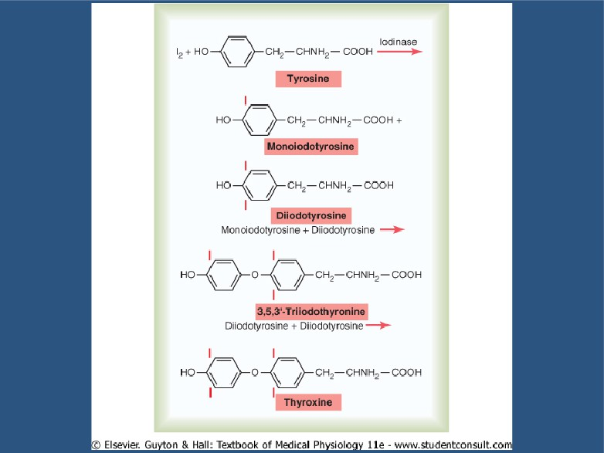

Slide 22
Endocytosis of thyroglobulin.
Fusion of lysosomes immediately with the vesicles.
Hydrolysis of the peptide bond to release DIT+MIT+T4+ 3 from the thyroglobulin.

Slide 23
Delivery of T4 and T3 to the systemic circulation.
1
Deiodinatio of DIT and MIT by thyroid
deiodinas
(recycling).

Slide 24
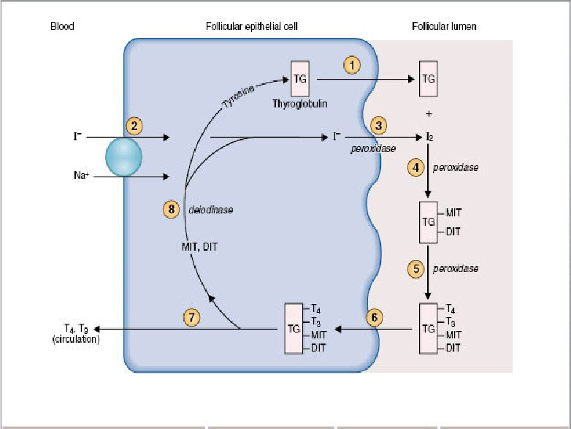

Slide 25
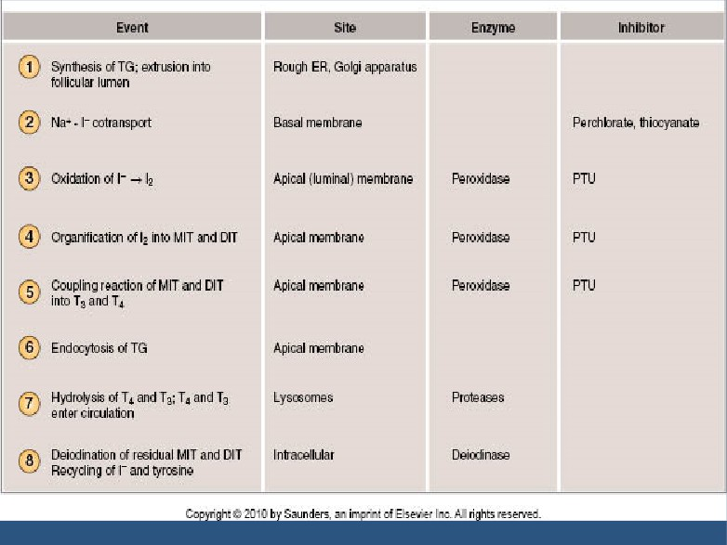

Slide 26
THYROID HORMONES IN THE CIRCULATION
Bound:
- 7
80% bound t thyroxin binding globulin
(TBG) synthesized in the liver.
-
The reminder is bound to albumin.
Unboun (Free):
0.03% of 4
0.3% of 3.

Slide 27
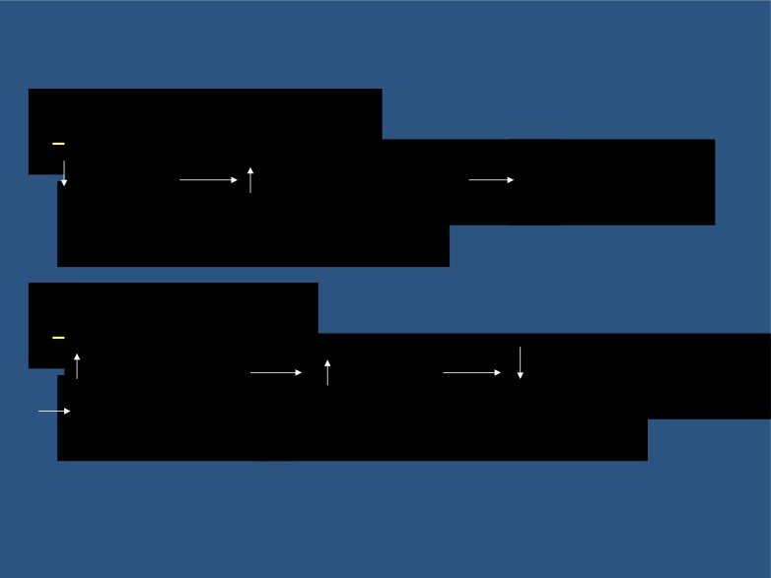
In hepatic failure:
TBG
free T3/T4
inhibition
of thyroid secretion.
In pregnancy:
estrogen
TBG
freeT3/T4
stimulatio of thyroid secretion.

Slide 28
RELEASE OF T4 AND T3 TO THE TISSUES

Slide 29
RELEASE OF T4 AND T3 TO THE TISSUES
The release is slow because of the high affinity of the plasma binding proteins.
1.
½ of T4 in the blood is released every
6 days.
- ½ of T3 in the blood is released every one day.

Slide 30
- T4 & T3 readily diffuse through the cell membrane.
Stored in the targeted tissues (days to weeks).
Most of T4 i deionize to T3 b iodinase enzyme.
In the nucleus, T3 mainly binds to
“thyroid hormone receptor” and influence transcription of genes.

Slide 31
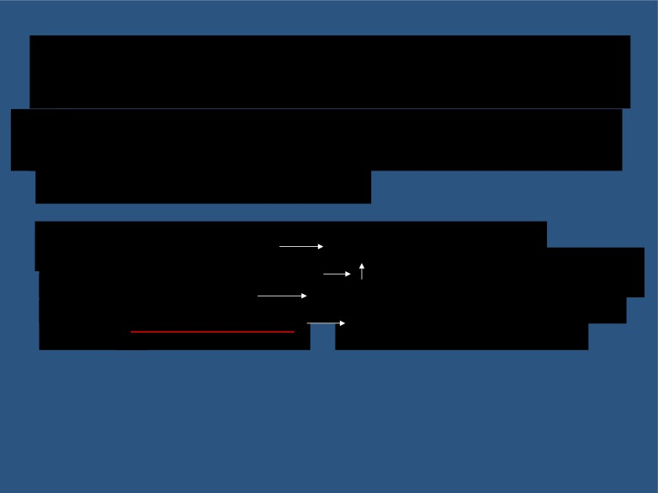
ACTION OF THYROID HORMONES
Before binding to the nuclear receptors 90% of T4 is converted to T3.
[T3 + nuclear receptor
activation of thyroid
regulating element on DNA
DN transcription
formation of mRNA
translation of mRNA
specifi protein synthesis
(target tissue specific)]

Slide 32
ACTION OF THYROID HORMONES cont.
Basal Metabolic Rate (BMR):
Is the energy requirement under basal condition (mental and physical rest 118 hours after a meal).
Complete lake of thyroid hormones
4
50% in
BMR.
- Extreme increase of thyroid hormones
6
100%
in BMR.

Slide 33
Metabolism
A) Effect on carbohydrate metabolism:
increase glucose uptake by the cells. increas glycogenolys
increas gluconeogenes
increase absorption from the GIT.

Slide 34
B) Effects on fat metabolism:
increas lipolys
decrease plasma cholesterol by increase loss in feces.
increase oxidation of free fatty acids.
C) Effect on protein metabolism:
overall effect i cataboli leading to decrease in muscle mass.

Slide 35
The metabolic effects are due to the induction of metabolic enzyme :
cytochrom oxidas .
NAPDH cytochrom reductas .
alph glycerophosphat dehydrogenas . mali enzymes.
severa proteolyti enzymes

Slide 36
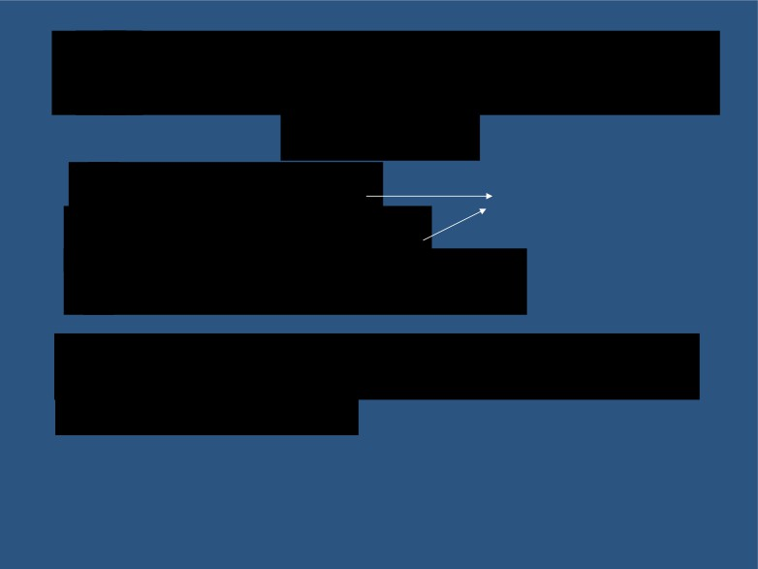
Effects on the Cardiovascular system:
increase heart rate. increase stroke volume. decrease peripheral resistance.
Cardiac output up to 60%
*end result is increase delivery of oxygenated blood to the tissues.

Slide 37
The cardiovascular effects are due to:
Thyroid hormones potentiate the effect of catecholamin in the circulation activation oadrenergic receptors.
Direct induction of:
a) myocardia adrenergic receptors. b sarcoplasmi reticulum.
c) C+ ATPas .
d myosin .

Slide 38
Effects on the CNS:
A Pe natal period:
Thyroid hormones are essential for maturation of the CNS.
decrease of hormones secretion
irreversibl mental retardation
Screening is necessary to introduce hormone replacement .

Slide 39
Effects on the CN :
cont.
B) In adult:
Increas i thyroid hormone secretion: hyperexcitability.
irritability.
Decreas in thyroid hormones secretion: slow movement.
impaired memory. mental capacity.

Slide 40
Effects on bone:
a) promote bone formation.
b) promote ossification.
c) promote fusion of bone plate.
d) promote bone maturation.

Slide 41
Effects on Respiration:
increase ventilation rate.
increase dissociation of oxygen from H by increasing RBC 2, DPG (2,3
diphosphoglycerat ).

Slide 42
Effects on the GIT:
increas appetit and food intake. increase of digestive juice secretio
increase of G.I trac motilit .
excess secretion
diarrhea.
lake of secretion
constipation.

Slide 43
1 Effects on Autonomic nervous
system:
Produced the same action a catecholamine via adrenergic receptors including:
a) increase BMR.
b) increase heat production.
c) increase heart rate.
d) increase stroke volume.
i.e
blocker propranol
) is used in treatment
of hyperthyroidism.

Slide 44
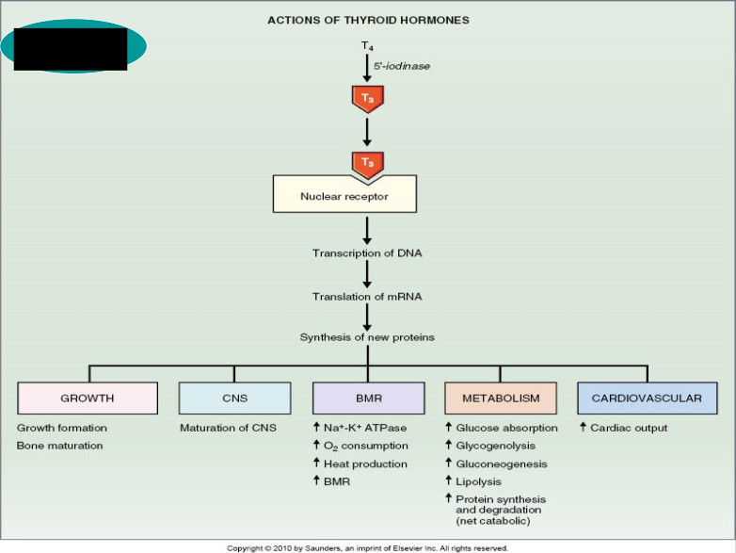
Summary

Slide 45
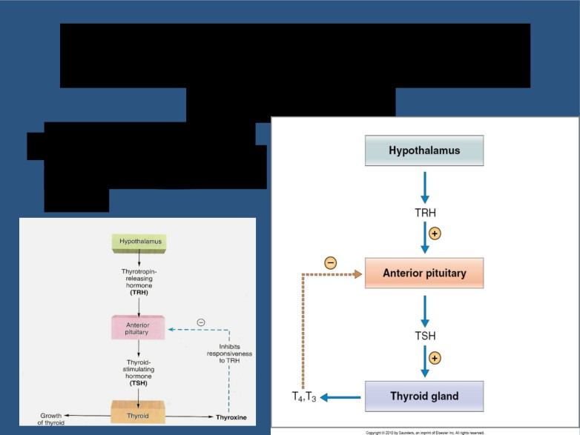
REGULATION OF HORMONES SECRETION
n It is regulated by the hypothalam pituitary axis.

Slide 46
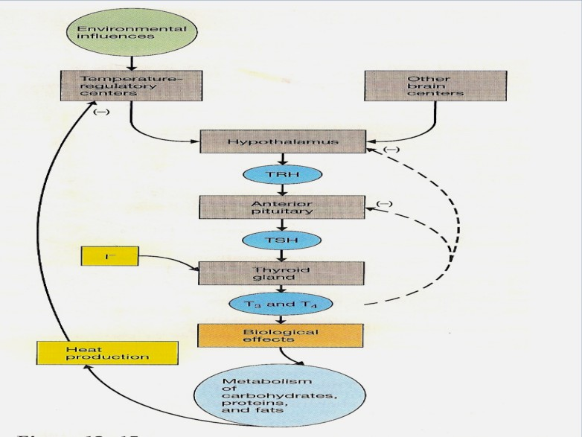

Slide 47
Thyrotropi releasing hormone (TRH):
Tripeptide.
- Paraventricular nuclei of the hypothalamus.
Act on the thyrotrophs of the anterior pituitary Transcription and secretion of TSH. Phospholipid second messenger system.

Slide 48
Thyroi stimulating hormone (TSH):
Glycoprotein.
Anterior pituitary.
- Regulate metabolism , secretion and
growth of thyroid gland (trophic effect).

Slide 49
Action of TSH
Increase proteolysis of the thyroglobulin. Increase pump activity.
Increase iodination of tyrosine. Increase coupling reaction. Trophic effect.

Slide 50
- TSH secretion started at 1 12 of gestational weeks.
- TSH + receptor activation of adenyly cyclas via Gs protein
cAMP
activation of protei kinase
multipl phosphorylation
secretion
and thyroid growth.

Slide 51
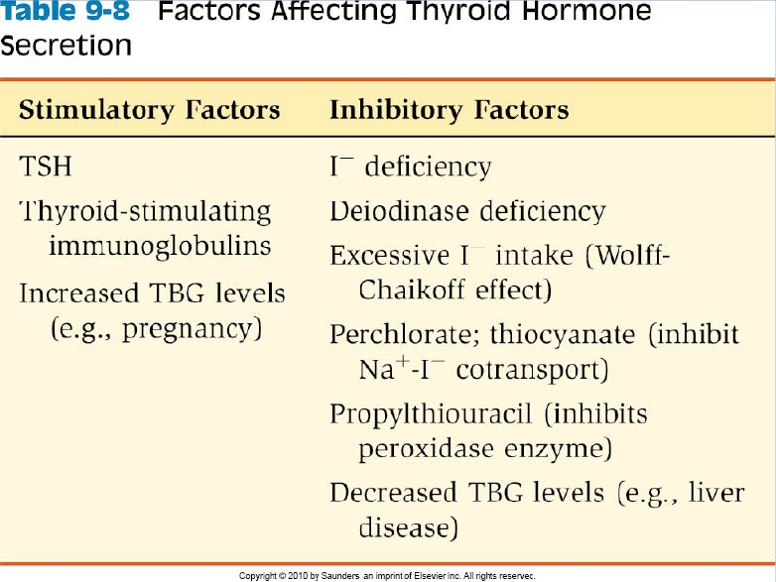

Slide 52
DISEASES OF THE THYROID GLAND
DR ABDULMAJEED A DREES

Slide 53
HYPERTHYROIDISM
Over activity of the thyroid gland.
Women : men ratio (8:1).
activity of gland :
a
10 times increase in secretion.
b
3 times increase in size.

Slide 54
CAUSES
Graves’ disease :
an autoimmune disorder.
increased circulating level of thyroi
-
stimulatin immunoglobulin
( TSI).
95%.
8 times more common in women than men.

Slide 55
Thyroid gland tumor:
95% is benign.
5% is malignant.
history of head and neck irradiation and family history.
Exogenous T3 and T4:
( rarely cause)

Slide 56
Excess TSH secretion:
diseases of the hypothalamus ( TRH). diseases of the pituitary ( TSH).

Slide 57
DIAGNOSIS
Symptoms:
Goiter in 95%.
skin:
smooth, warm and moist.
heat intolerance, night sweating.

Slide 58
muscul skeletal:
Muscle atrophy.
Neurological:
tremor.
enhanced reflexes. irritability.

Slide 59
Cardiovascular:
increase heart rate.
increase stroke volume. arrhythmias.
hypertension.
G.I tract:
weight loss. diarrhea.

Slide 60
Renal function:
- glomerula filtration rate.
Exophthalmo :
anxious staring expression. protrusion of eye balls.
Others:
menstrual cycle disturbance.

Slide 61
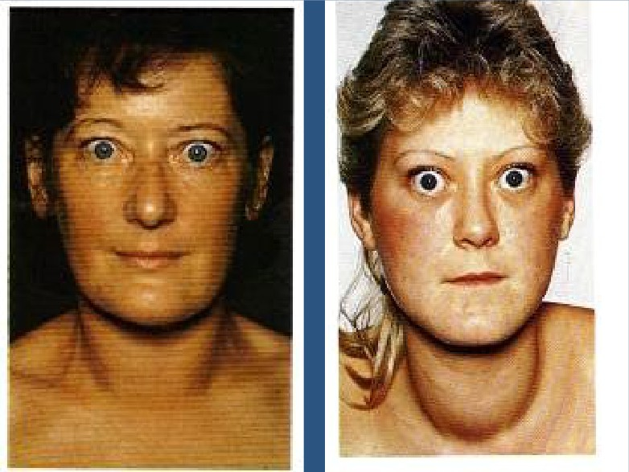

Slide 62
INVESTIGATIONS
Serum T3, T4 measurement.
In primary hyperthyroidism:
high T3, T4 and low TSH .
In secondary hyperthyroidism:
high T3, T4 and high TSH.

Slide 63
TREATMENT
Medical therapy:
e.g propylthiourcal
usually for 1
18 months course.
with
4 monthly monitoring.

Slide 64
Surgery:
Subtota thyroidectom .
Indication for surgery:
a Relapse after medical treatment. b Drug intolerance.
Cosmetic.
d Suspected malignancy.

Slide 65
HYPOTHYROIDISM
Under activity of the thyroid gland more in woman ( 360 years).

Slide 66
CAUSES
inherited abnormalities of thyroid hormone synthesis :
peroxidas defect.
Iodide trapping defect. thyroglobuli defect.

Slide 67
Endemic Colloid Goiter:
before table salt.
iodide
hormone formation
TSH
Thyroglobulin
size ( > 10 times)

Slide 68
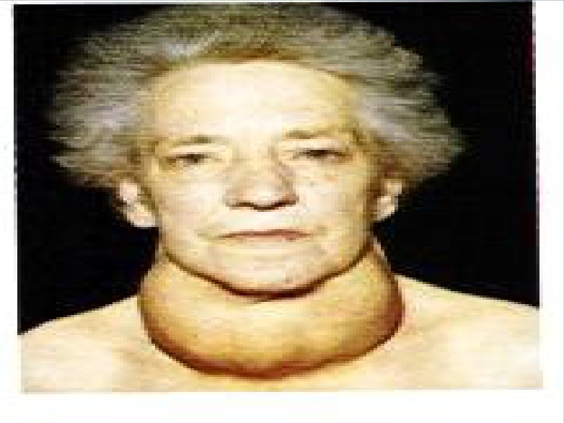

Slide 69
Idiopathic Nontoxic Colloid Goiter:
I in take is normal.
- thyroidit
?
inflammation
cell damage
hormone secretion
TSH
of activity of normal cells
size

Slide 70
Gland destruction (surgery).
Pituitary diseases or tumor.
Hypothalamus diseases or tumor.

Slide 71
DIAGNOSIS
skin :
dry skin.
cold intolerance.
Muscul skeletal:
- muscle bulk.
- in skeletal growth.
- muscle sluggishness
- slow relaxation after contraction.

Slide 72
Neurologic
:
slow movement.
- impaired memory.
decrease mental capacity.
Cardiovascular:
- blood volume.
- heart rate
- stroke volume.

Slide 73
G.I tract:
constipation
increase weight.
Renal function:
decreas glomerula filtration rate.

Slide 74
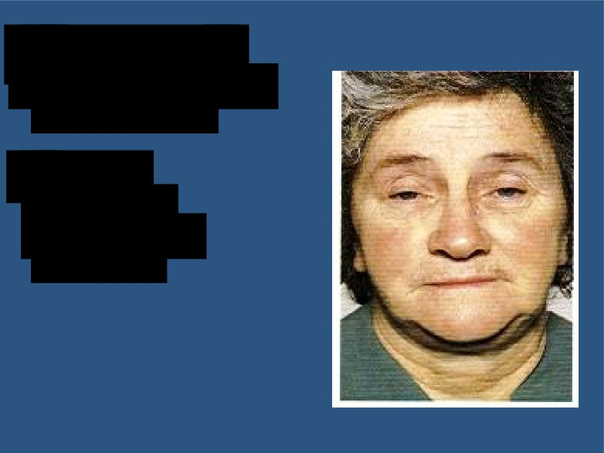
Myxoedem :
An edematous appearance through out body.
others:
loss of libido.
menstrual cycle disturbance.

Slide 75
INVESTIGATIONS
Serum T3,T4 are low.
TSH is elevated in primary.
TSH is low in secondary hypothyroidism.

Slide 76
TREATMENT
thyroxine
Starting dose is 2 50 µg. Increase to 200 µg.
At
4 weeks period.
The first response seen is the weight loss.

Slide 77
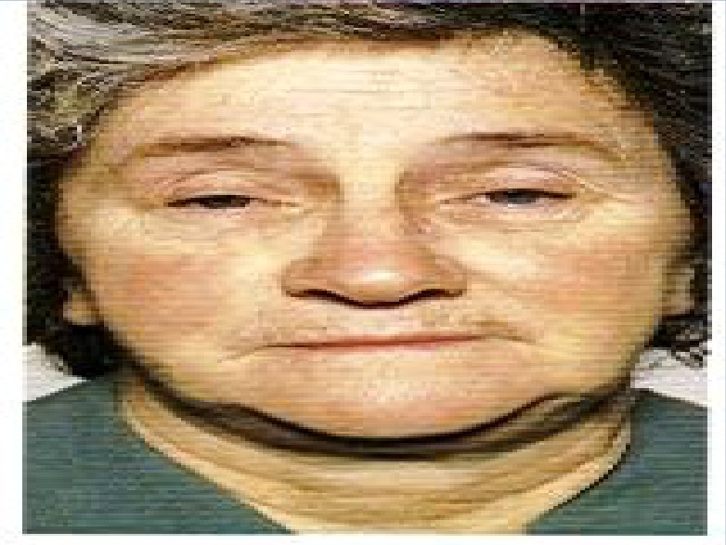

Slide 78
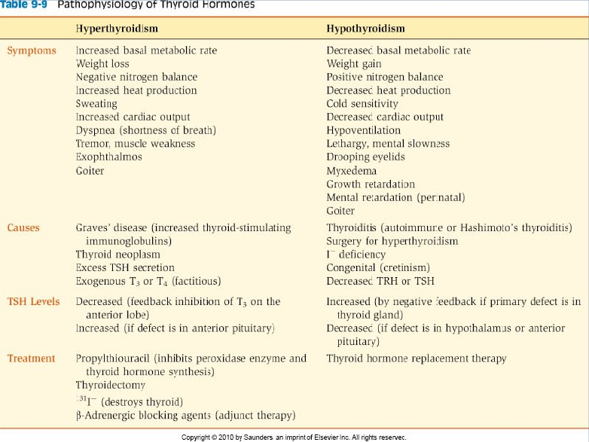

Slide 79
CRETINISM
Extreme hypothyroidism during infancy and child hood (failure of growth).

Slide 80
CAUSES
Congenital lake of thyroid gland (congenital cretinism).
Genetic deficiency leading to failure to produce hormone.
Iodine lake in the diet (endemic cretinism).

Slide 81
SYMPTOMS
Infant is normal at birth but abnormality appears within weeks.
Protruding tongue.
Dwarf with short limbs. Mental retardation. Often umbilical hernia. teeth.

Slide 82
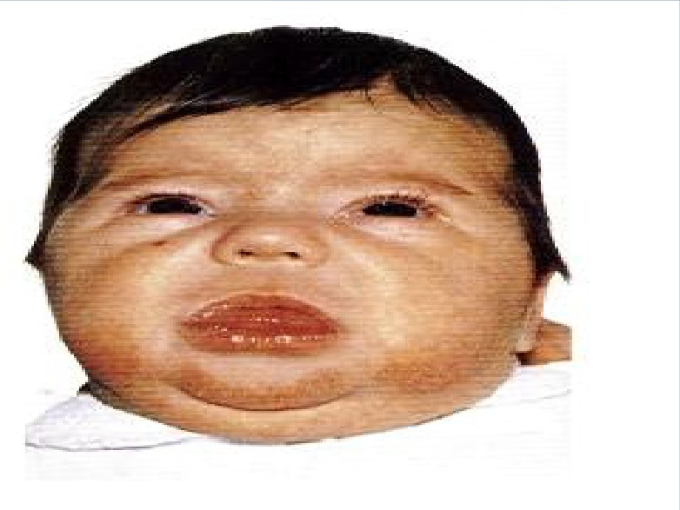

Slide 83
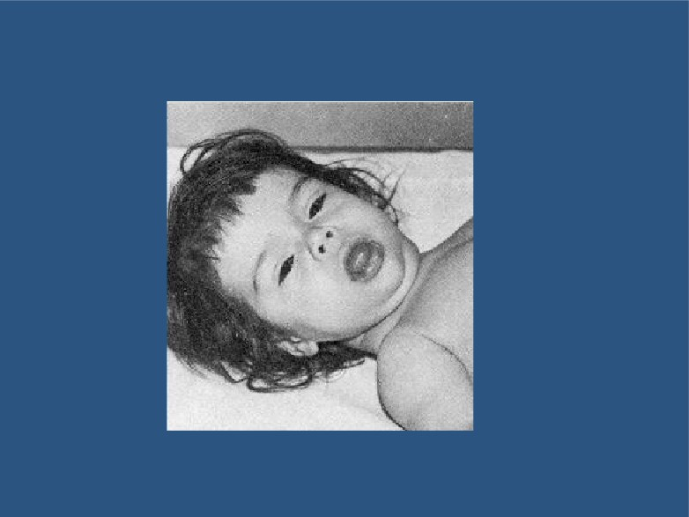
Cretinism (dwarf + mental retardation)

Slide 84
TREATMENT
Changes are irreversible unless treatment is given early.

Slide 85
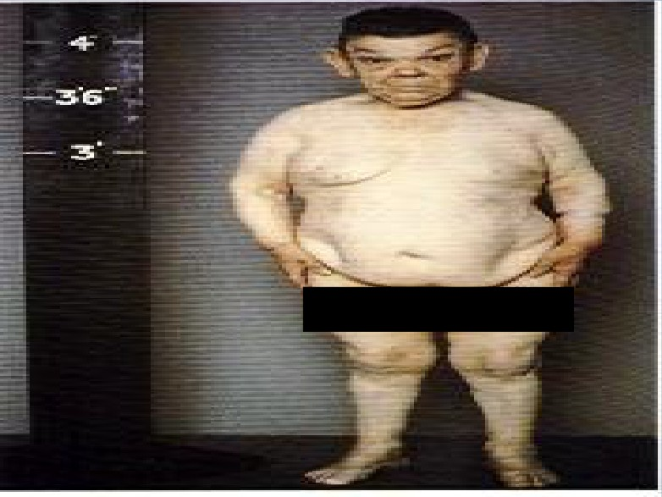

Slide 86
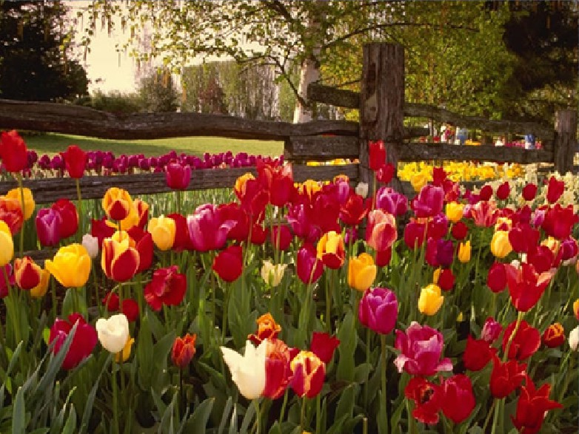

Slide 87
Calculate your BMR:
Men: BMR = 66 + (13.7 X wt in kg) + (5 X ht in cm) - (6.8 X age in years)
Women: BMR = 655 + (9.6 X wt in kg) + (1.8 X ht in cm)
- (4.7 X age in years)
Example:
You are female
You are 30 years old
You are 5' 6 " tall (167.6 cm) You weigh 120 lbs. (54.5 kilos)
Your BMR = 655 + 523 + 302 - 141 = 1339 calories/day

