Slide 1

ميحرلا نمحرلا الله مسب

Slide 2


Slide 3
ENDOCRINOLOGY
Calcium Homeostasis Hypo and hyper-parathyroidism
Dr. Abeer Al-Ghumlas M.B.B.S., MSc. Physiology Ph-D. Physiology

Slide 4
Objectives
At the end of this lecture you should be able to:
List the functions of calcium
Describe calcium metabolism
Describe physiology of bone
Understand and explain hormonal regulation of
calcium metabolism
  Parathyroid hormone
  Calcitonin
  Vitamine D₃
Understand hypo and hyper-parathyroidism

Slide 5
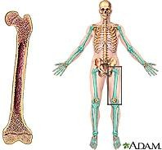
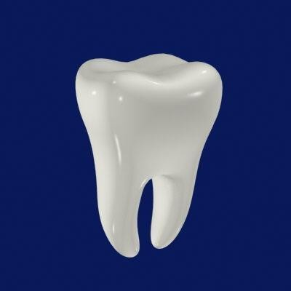
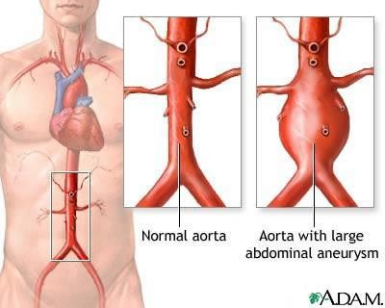
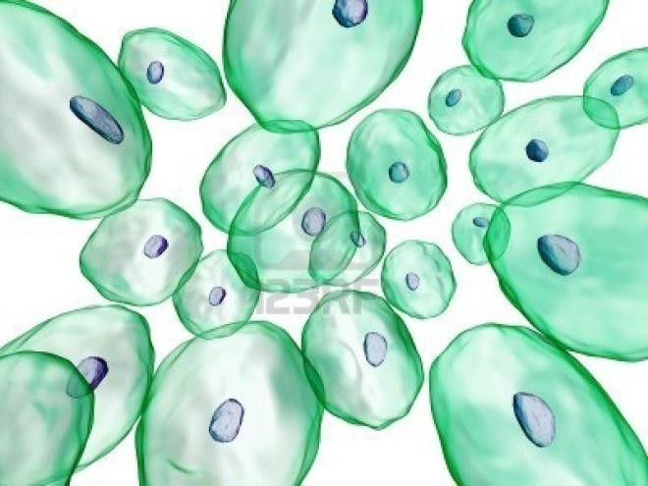
99%
1%
0.1%

Slide 6
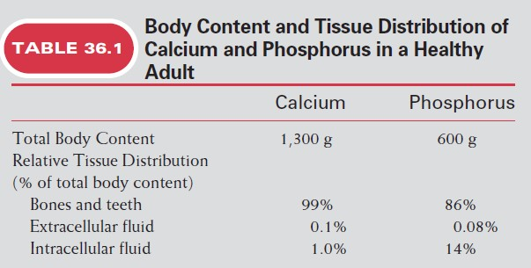
Distribution of Ca⁺⁺ in Body
Skeleton & Teeth
ICF (Endoplasmic Reticulum)
ECF

Slide 7
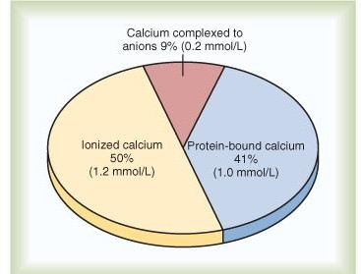
Distribution of Ca⁺⁺ in ECF
Total plasma calcium= 9-10.5 mg/dl
Diffusible
calcium
Non- diffusible
calcium
Total conc of calcium in ECF= 10 mg/dl
5m mEq/L
2.5 mmol/L

Slide 8
Protein-bound calcium:
Most of this calcium is bound to albumin & much
smaller fraction is bound to globulin
Binding of calcium to albumin is pH-dependent
Acute respiratory alkalosis increases calcium
protein thereby decreases ionized calcium level
binding to
Alkalosis
Ionized Ca²⁺
Acidosis
Ionized Ca²⁺

Slide 9
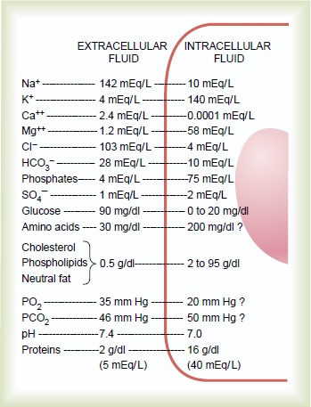

Slide 10
Plasma Calcium
9-10.5 mg/dl
Diffusible
calcium
Non Diffusible = 41%
Non- diffusible calcium
Diffusible = 59%
Complexed 9 %
  Ionized 50%

Slide 11
Physiological importance of Calcium
Calcium salts in bone provide structural integrity of the
skeleton
Calcium ions in extracellular and cellular fluids is essential to normal function for the biochemical processes
  Neuoromuscular excitability
  Hormonal secretion
  Enzymatic regulation
  Blood coagulation
  Second messenger.

Slide 12
Phosphate
Phosphorous is an essential mineral necessary:
for ATP and cAMP second messenger systems
Phosphate plasma concentration is around 4 mg/dL.
Forms:
  Ionized (diffusible) → around 50% of total
  un-ionized (non-diffusible ) and protein- bound (50%)
Calcium is tightly regulated with Phosphorous in the body.

Slide 13
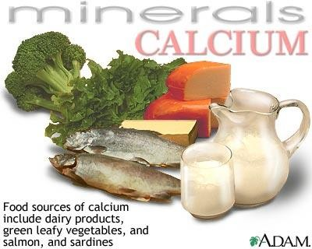
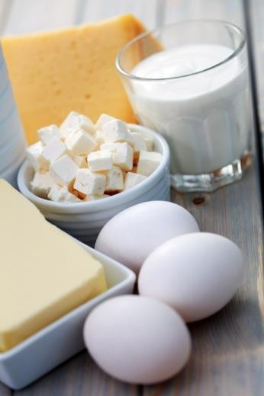
Source
Calcuim metabolism cont…
Daily requirements
Absorption
Infants & adults:
  -25 mmol/day
    Duodenum:
active transport
small intestine:
concentration gradient
Pregnancy,
lactation
after menopause:
25-35 mmol/day
Milk
dairy products
Fish

Slide 14
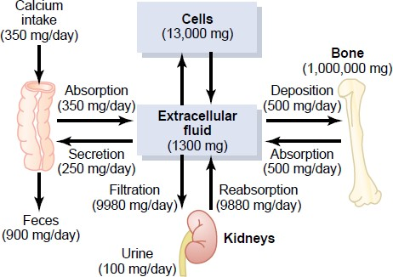
Calcium Metabolism in an adult human
1000 mg/day
1000-350=650

Slide 15
Bone composition
Organic Matrix
  Collagen Fibers (95%)
  Ground Substance (5%)
    ECF
    Proteoglycans
Bone Salts
  Salts of Ca++ & PO4⁻
  In the form of
Hydroxyapatite crystals (99%)
Ca₁₀(PO₄)₆(OH)₂
Mg, Na, K, Carbonate ions
Tensile force
Compressional force

Slide 16
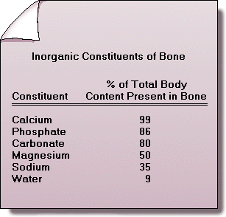
Composition of bones

Slide 17


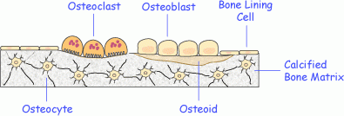
Bone Cells
Calcuim metabolism cont…
Osteoblasts
(bone forming cells)
Osteocytes
(osteoblasts surrounded by calcified matrix)
Osteoclasts bone eroding Cell (resorping)

Slide 18
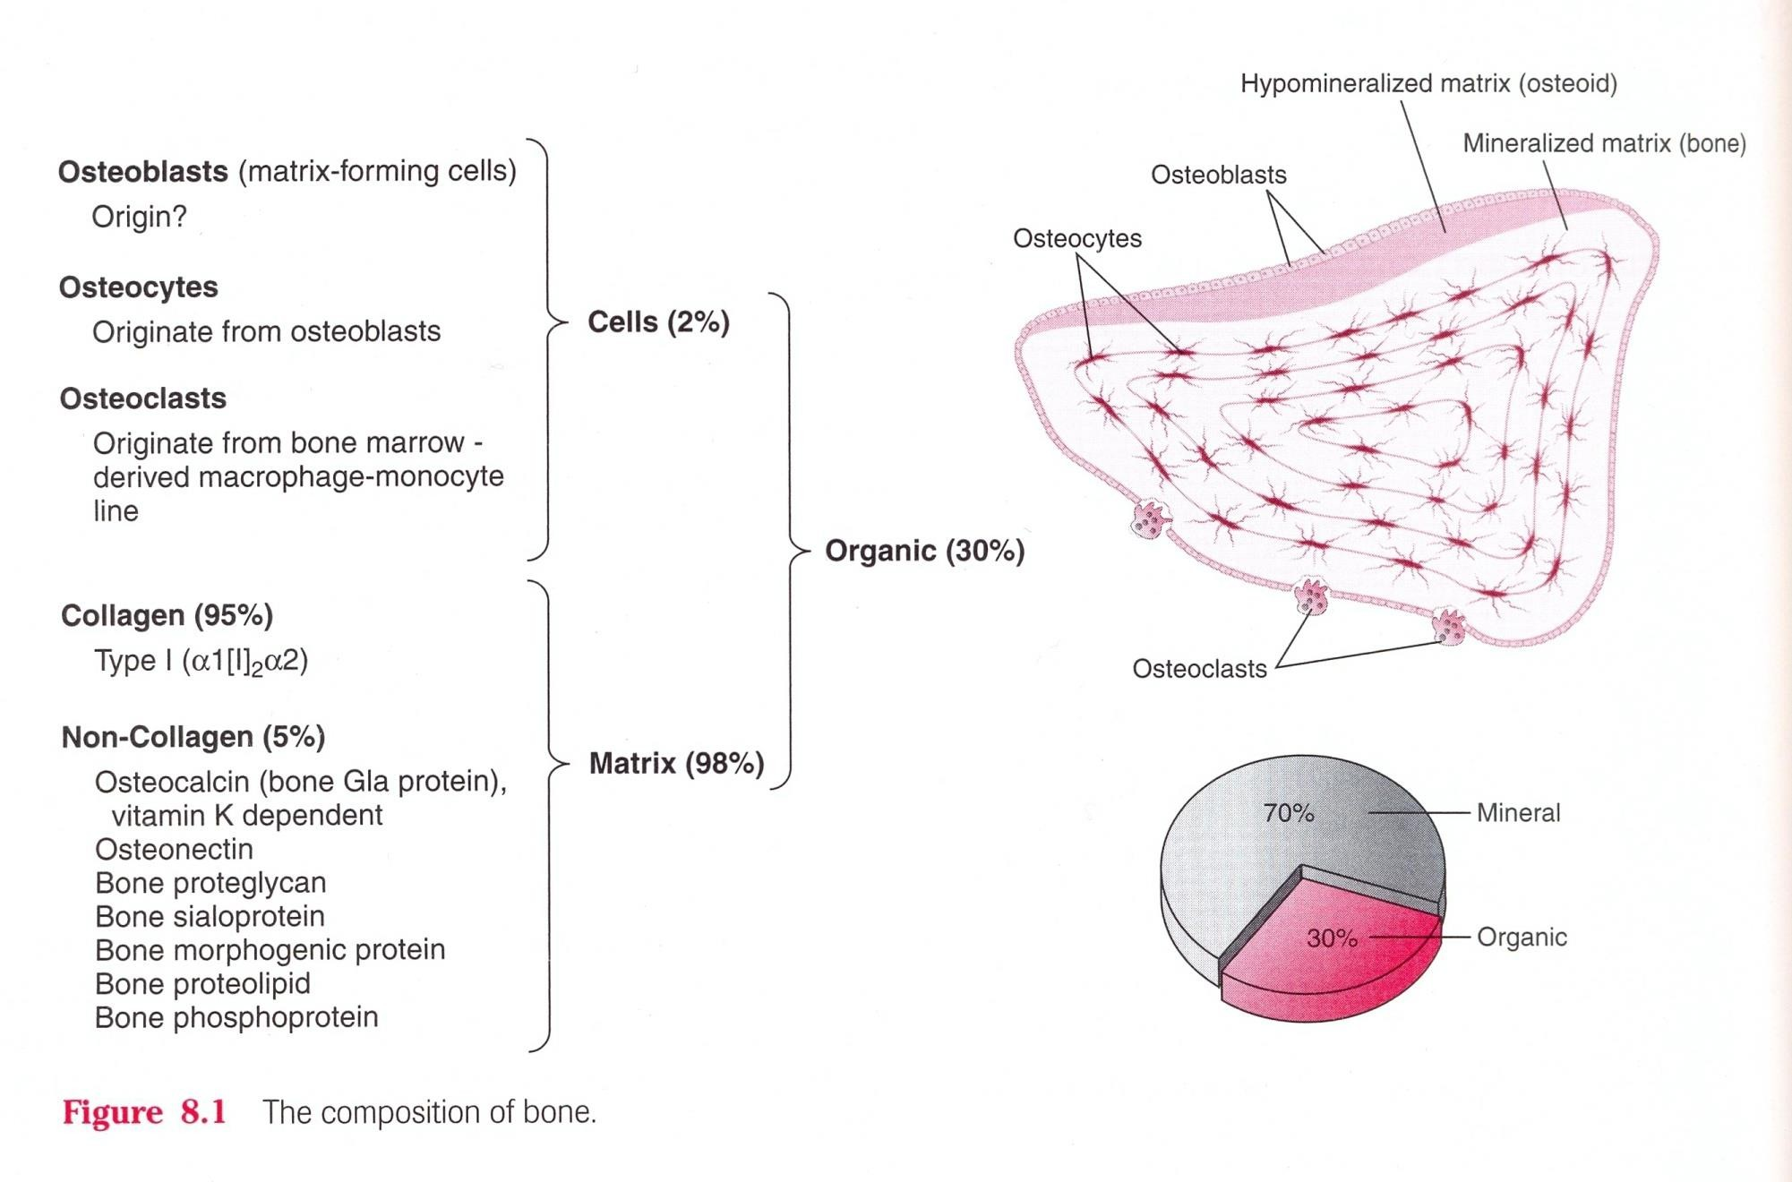

Slide 19


Slide 20
Regulation of Calcium level

Slide 21
REGULATION OF PLASMA CALCIUM AND PHOSPHATE CONCENTRATIONS
Nonhormonal Mechanisms Can Rapidly Buffer Small Changes in Plasma Concentrations of Free Calcium
Hormonal Mechanisms Provide High-Capacity, Long-Term Regulation of Plasma Calcium and Phosphate Concentrations

Slide 22
Tetany
9-10.5 mg/dl
Renal stone

Slide 23

Calcium Metabolism in an adult human

Slide 24
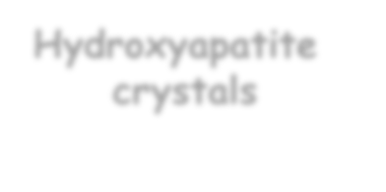


Composition of bones
Organic matrix
Mineral salts
1. Collagen fibers
Hydroxyapatite
crystals
amorphous salts
2. Ground substances
99%
of total Ca++
salt
0.4-1%
of total Ca++
salt

Slide 25
Bone composition
Bone Salts
  Hydroxyapatite crystals
[In the form of Hydroxyapatite crystals Ca₁₀(PO₄)₆(OH)₂ ]
  Mg, Na, K, Carbonate ions
  Amorphous salts:
- A type of exchangeable calcium
    Play role in rapid regulation of ionized Ca++ level in ECF
      0.4-1% of total bone Ca++
      always in equilibrium with Ca²+ in ECF

Slide 26
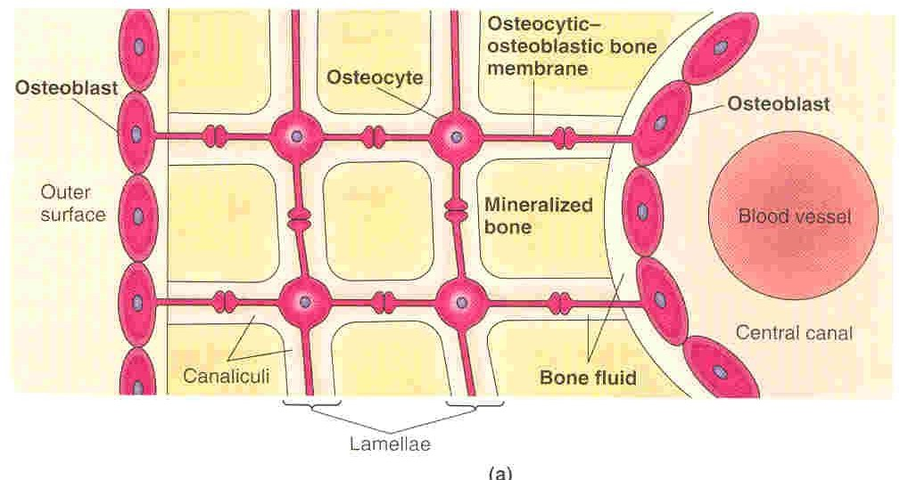
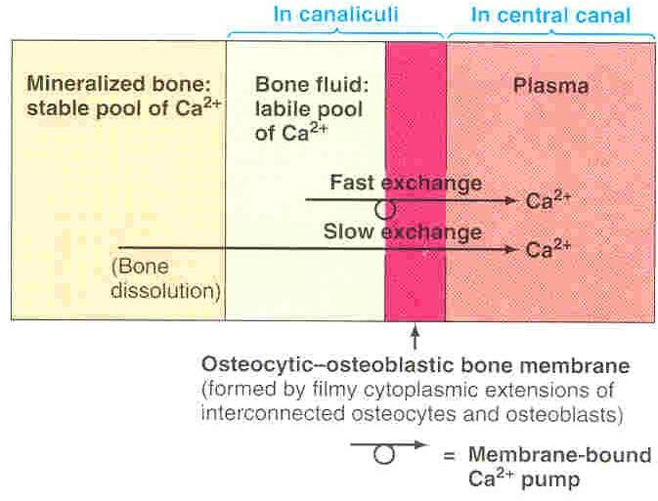

Slide 27
Hydroxyapatite crystals
Amorphous salt

Slide 28
Three Hormones
Vit D
Parathyroid
hormone
Calcitonin
Ca++ level

Slide 29



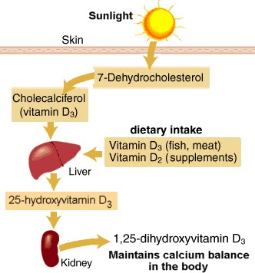
 | Vitamin D
1,2 | 5 Dihydroxycholecalciferol
(Vit D)
1α-hydroxylasde

Slide 30
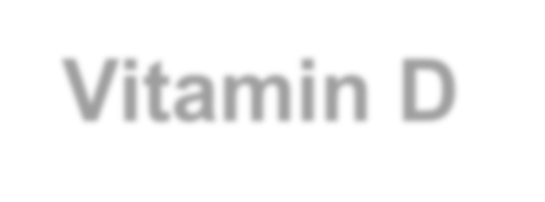

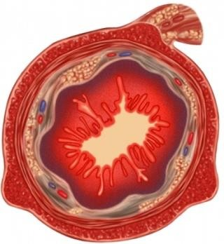
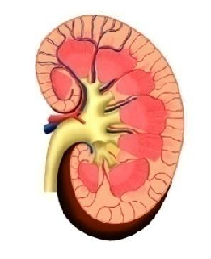
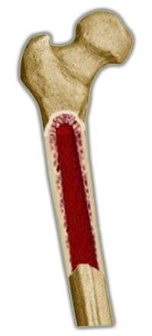
Vitamin D
1.Intestinal tract.
2.Renal
3.Bone
Has a potent effect to increase calcium & phosphate absorption
Increases Renal
calcium
and Phosphate
absorption
Bone absorption
Increase calcium blood level

Slide 31
-Vitamin D in smaller quantities :
- promotes bone calcification (by ↑ calcium and
Effects of Vitamin D on Bone & Its Relation to Parathyroid Hormone Activity.
phosphate absorption from the intestine and enhances the mineralization of bone.
- The administration of extreme quantities of vitamin D causes absorption of bone:
by facilitating PTH action on bones.
number & activity of esteoclasts.

Slide 32
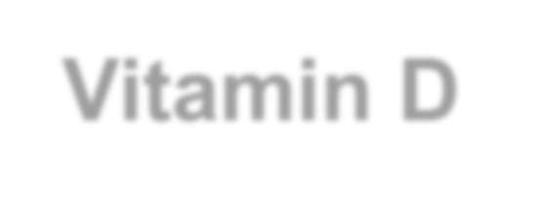

Vitamin D
4- stimulates differentiation of immune cells.

Slide 33
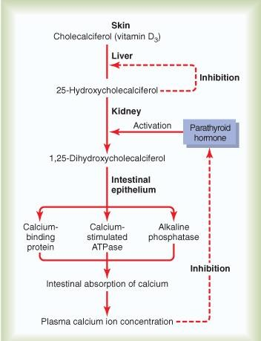
Control of Vit D:
1- low Ca++ ions 2- prolactin
3- PTH
All stimulate renal 1,alpha hydroxylase.

Slide 34
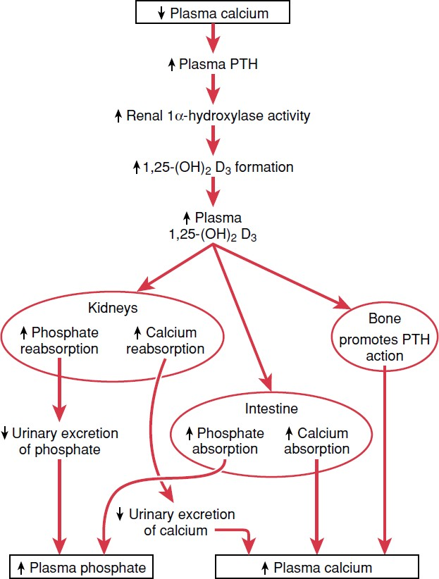
Regulation of Calcium level

Slide 35


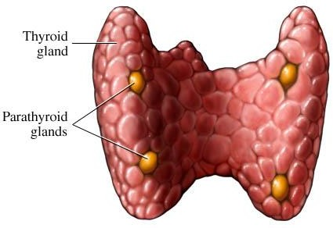

Parathyriod gland
Parathyroid hormone (PTH)

Slide 36

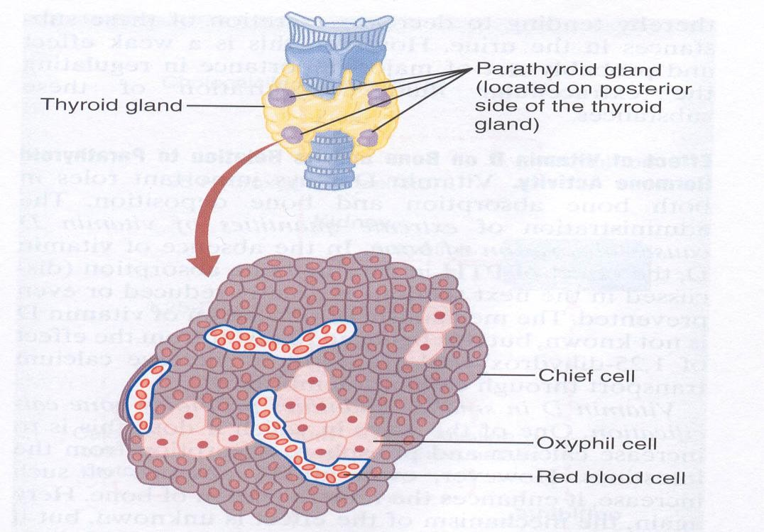
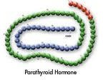
Parathyroid hormone (PTH)
Source: Parathyroid gland
Polypeptide hormone: (84
aa)
Molecular Weight: 9500
Half Life: 10 min
Mechanism of action: acts via 2nd messenger mechanism
utilizing cAMP
Actions: Bone
Kidney
Intestine

Slide 37
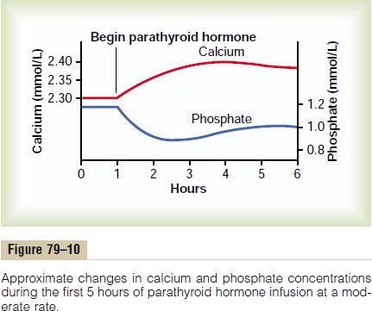

Slide 38


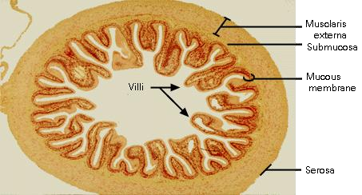
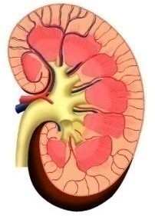
Parathyroid hormone (PTH)
Increase plasma Ca⁺⁺ level
Bone
Intestine
Kidney

Slide 39
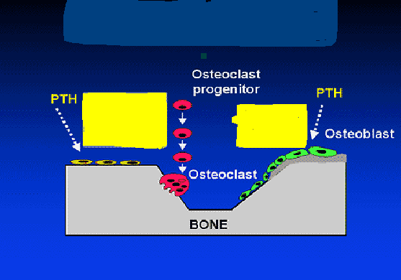
1. Effects on bones
Depression of osteoblastic activity
Stimulates the
formation of new osteoclasts
Activation of osteoclasts
Increase calcium resorption from the bone

Slide 40
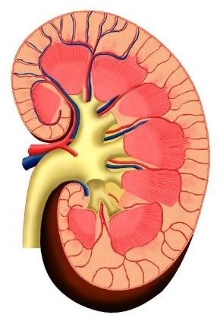
2. Effects on Kidneys
1. ↓ phosphate reabsorption from the proximal convoluted tubules (phosphaturic action).
Phosphate excretion in the urine
plasma phosphate concentration
(PTH)
↑ Ca++ & Mg ions reabsorption from the distal convoluted tubules, collection ducts and ascending loop of Henle.
↑ Formation of 1,25 vit D3 in the
kidney.

Slide 41
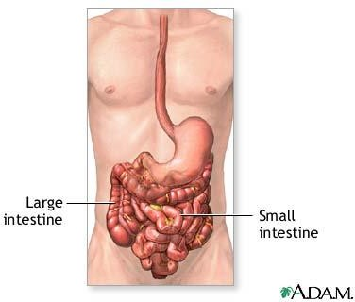
3. Effects on intestine
(PTH)
↑ absorption of calcium and phosphate indirectly through stimulating formation of
1,25 – (OH)₂-D₃ in
kidney

Slide 42



Parathyroid hormone (PTH)
Increase plasma Ca++ level Decrease phosphate level
Bone
Kidney
Intestine

Slide 43
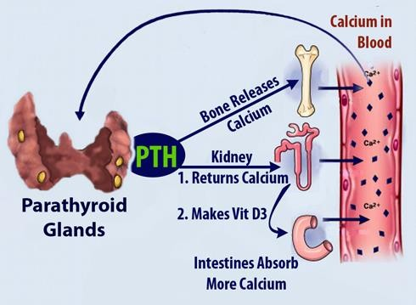

Slide 44
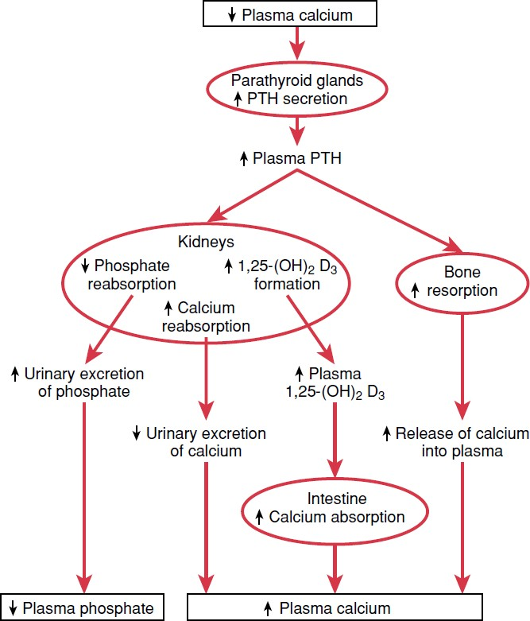
Effect of Calcium level on PTH

Slide 45


Parathyriod gland
It is essential for life

Slide 46


Calcitonin
Calcitonin
Parathyroid hormone (PTH)

Slide 47

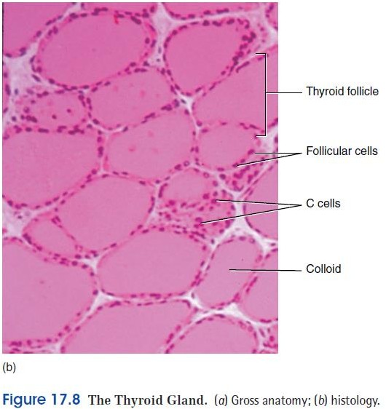
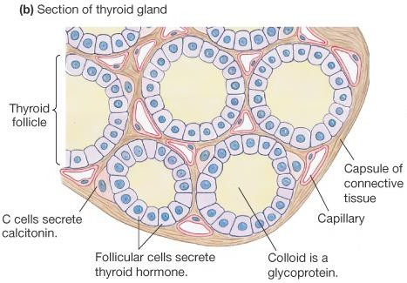
Calcitonin
Source: Secreted by the parafollicular cells
(C cells) of the thyroid gland.
Nature: 32 amino acid peptide.
Function:
  Decrease blood Ca++ level very
rapidly within minutes.
  Opposite effect to PTH
Stimulus for secretion:
Increased plasma calcium concentration

Slide 48


Actions:
Calcitonin
On bone
[1]↑Ca++ deposition of bone
Plasma calcium concentration
[2] Inhibits Bone resorption:
inhibition of osteoclasts
↓ formation of osteoclasts
On kidney
↓↓ Ca++ reabsorption
↑↑ Ca++ excretion (in addition to phosphate)

Slide 49
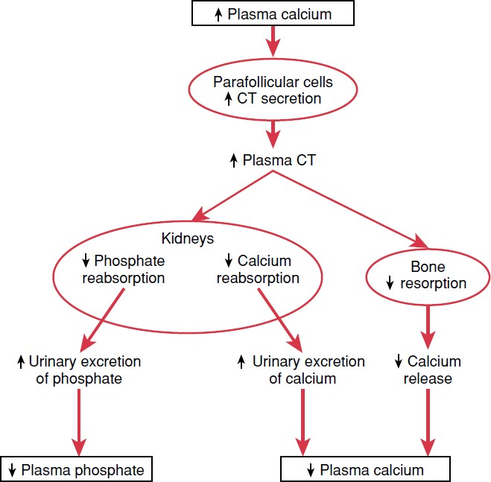
Effect of Calcium
level on calcitonin

Slide 50
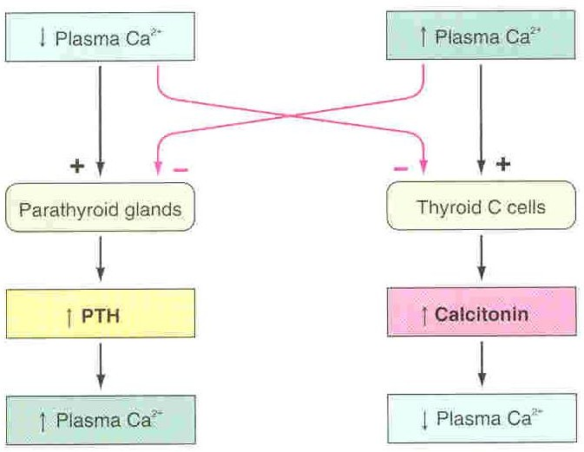

Slide 51
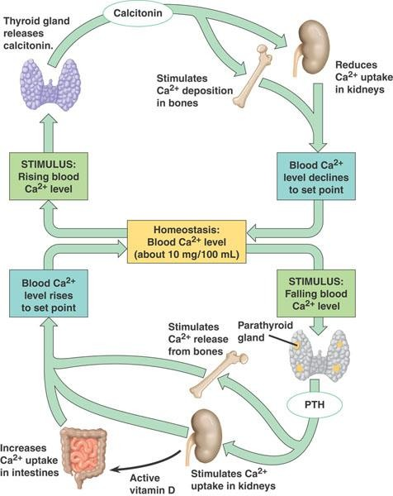

Slide 52
Abnormalities:
Rickets
Osteomalacia
Osteoporosis
Hypo/hyperparathyroidism

Slide 53
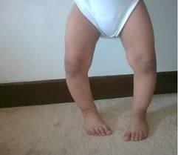
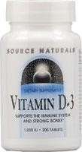
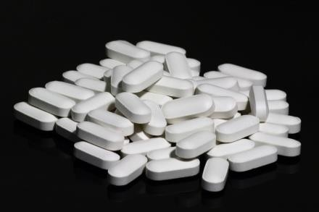
Rickets (In children)
Cause:
lack of vitamin D leading to
calcium/phosphate deficiency in ECF
Occur in the spring???
Features:
-Low plasma calcium and phosphate
-Weak bones
-Tetany
Treatment of Rickets:
supplying adequate calcium and phosphate in the diet and, administering large amounts of vitamin D.

Slide 54
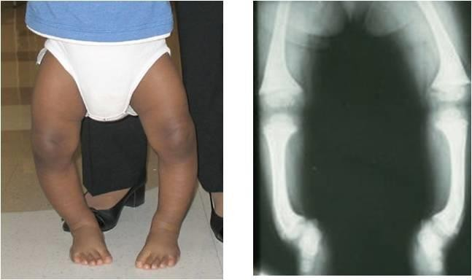

Slide 55
Tetany in Rickets
early stages:
no tetany
(PTH stimulate osteoclastic absorption
of bone)
ECF Calcium level is normal
When the bones finally become exhausted of calcium
blood level of calcium falls below 7 mg/dl
→ signs of tetany:
(positive Chvostek's sign)
→
→Death:
tetanic respiratory spasm
Calcium level falls rapidly.

Slide 56
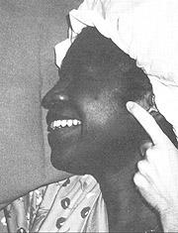
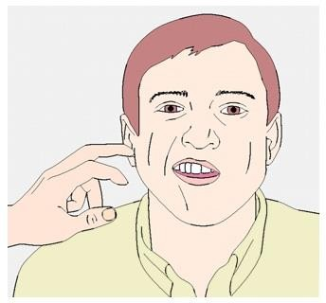
positive Chvostek's sign is facial nerve irritability/spasms elicited by tapping the nerve

Slide 57
Osteomalacia-"Adult Rickets".
(rare).
serious deficiencies of both vitamin D and calcium occasionally occur as a result of steatorrhea (failure to absorb fat).
Poor absorption of vitamin D and calcium
almost never proceeds to the stage of tetany but often is a cause of severe bone disability.
  Osteomalacia-“Renal Rickets".
It is a type of Osteomalacia due to prolonged
kidney disease
Failure of the damaged kidney to form…..

Slide 58

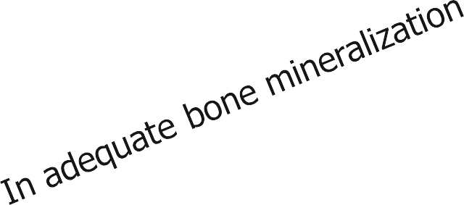
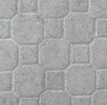
Bone composition
Organic Matrix
  Collagen Fibers (95%)
  Ground Substance (5%)
    ECF
    Proteoglycans
Bone Salts
– Salts of Ca++ & PO4⁻
Rickets
Osteomalacia
– In the form of Hydroxyapatite crystals Ca₁₀(PO₄)₆(OH)₂
Mg, Na, K, Carbonate ions

Slide 59
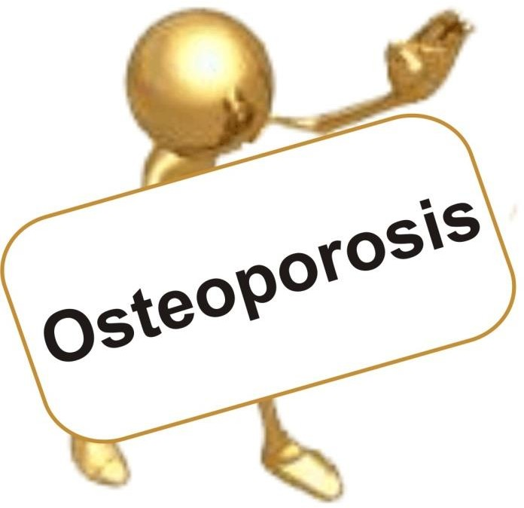
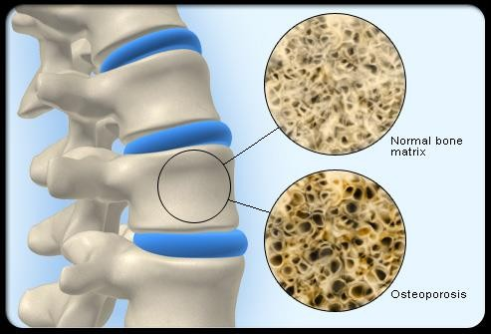


Slide 60
Osteoporosis
Osteoporosis is the most common of all bone diseases in adults, especially in old age.
results from equal loss of both organic bone matrix and minerals resulting in loss of total bone mass and strength
the cause of the diminished bone:
  the osteoblastic activity in the bone is usually less than normal so the rate of bone osteoid deposition is depressed.
  excess osteoclastic activity.

Slide 61


Osteoporosis

Slide 62
Osteoporosis
causes of osteoporosis:
lack of physical stress
malnutrition
lack of vitamin C
postmenopausal lack of estrogen
old age
Cushing’s syndrome

Slide 63



symptoms of osteoporosis

Slide 64

Osteoporosis

Slide 65

Bone composition
Organic Matrix
  Collagen Fibers (95%)
  Ground Substance (5%)
    ECF
    Proteoglycans
Osteoporosis
Bone Salts
  Salts of Ca++ & PO4⁻
  In the form of Hydroxyapatite crystals Ca₁₀(PO₄)₆(OH)₂
Mg, Na, K, Carbonate ions

Slide 66
Disorders of parathyroid hormone secretion

Slide 67


Hyperparathyroidism (PTH Excess)
Primary
Manifestations:
CNS depressed
Peripheral nervous system depressed
muscle weakness
Constipation
Abdominal pain
Peptic ulcer
Decrease appetite
Depressed relaxation of the heart
during systole.
Calcium containing stones in kidney
Parathyroid poisoning:
Precipitation of calcium in soft tissues occur when Ca²⁺ > 17mg/dl death
Manifestations:
Hypercalcemia ↑ Ca²⁺
Hypophosphemia ↓PO⁻₄
Hypercalciuria
Demineralisation of bone
multiple bone cysts (osteitis fibrosa cystic)
Broken bones
↑ Alkaline phosphatase

Slide 68
Hyperparathyroidism (PTH Excess)
Primary
Secondary
(compensatory)
Hyperparathyroidism
Manifestations:
Hypercalcemia ↑ Ca²⁺
Hypophosphemia ↓PO⁻₄
Hypercalciuria
Demineralisation of bone
multiple bone cysts (osteitis fibrosa cystic)
Calcium containing stones in kidney
Precipitation of calcium in soft tissues
occur when Ca²⁺ > 17mg/dl.
(due to ↓ Ca²⁺ in ECF)
Causes:
Low calcium diet
Pregnancy
Lactation
Rickets
Osteomalcia
Chronic renal failure
↓ 1,25(OH) – D3
synthesis

Slide 69


Hypoparathyroidism (rare)
causes
- Injury to the parathyroid glands (surgery).
-Autoimmune.
symptoms (due to hypocalcaemia)
Tingling in the lips, fingers, and toes
Dry hair, brittle nails, and dry, coarse skin
Muscle cramps and pain in the face, hands, legs, and feet
Cataracts on the eyes
Malformations of the teeth, including weakened tooth enamel.
Loss of memory
Headaches

Slide 70
Signs of Hypoparathyroidism
Tetany can be overt or latent
Chvostek's sign: Tapping the facial nerve as it emerge from the parotid gland in front of the ear → causes contraction of facial muscles.
Trousseau’s sign :
Arresting (stopping ) blood flow to the forearm for few minutes ( e.g., by sphygmomanometer ) →  causes flexion at the wrist, thumb and metacarpophalangeal joints.

Slide 71
Signs of Hypoparathyroidism
Positive Chvostek’s sign(facial muscle twitch)
Positive Trousseau’s sign(carpal spasm)
Delayed cardiac repolarization with prolongation of the QT interval
Paresthesia
Tetany: can be overt or latent
  Treatment:
Calcium carbonate and vitamin D supplements

Slide 72



Trousseau Sign
When an occlusion of brachial artery with a blood pressure cuff:
carpal spasms occur. (metacarpophalangeal and wrist joints are flexed, fingers are adducted)
(This is due to enhanced neuromuscular excitability)

Slide 73


Summary

Slide 74
Three Hormones
Summary
Vit D
Parathyroid
hormone
Calcitonin
Ca++ level

Slide 75
VITAMIN D
Actions:
Calcium
  Absorption from Bone
  Renal Excretion
  Absorption from GIT
Phosphate
  Absorption from Bone
  Renal Excretion

Slide 76
PARATHORMONE
Targets are Bones & Kidneys
Actions:
Calcium
  Absorption from Bone
  Renal Excretion
Phosphate
  Absorption from Bone
  Renal Excretion

Slide 77
CALCITONIN
Actions
 | Immediate effect Osteoclastic Activity Prolonged Effect Formation of new Osteoclasts Calcium Phosphate

Slide 78




Save your bones

Slide 79


Dr. Abeer Al-Ghumlas

