Slide 1
δΑم ௌ اϟر ϦϤΣاϟرϴΣم

Slide 2
ENDOCRINOLOGY
The Adrenal Gland
Mineralocorticoids
Dr. Abeer Al-Ghumlas

Slide 3
Objectives
At the end of this lecture student should be able to know:
 The cellular arrangements and functional components of the adrenal gland.
 The hormones secreted by the medulla and cortex of the adrenal gland.
 The synthesis of the adrenocortical steroids.  The physiological actions of aldosterone.  The regulation of aldosterone secretion.  The major stimuli for aldosterone secretion.

Slide 4
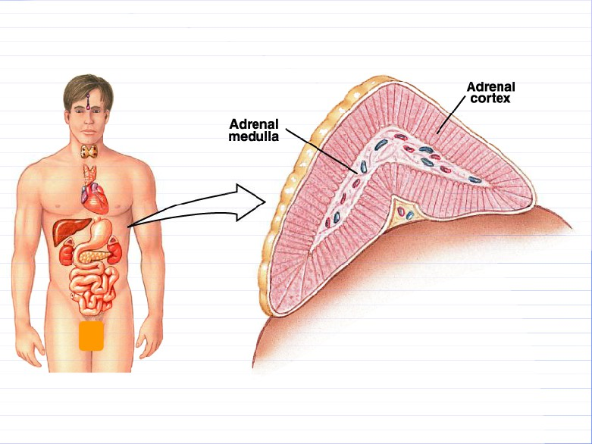
Adrenal Gland

Slide 5
The Adrenal Gland
y There are two adrenal
(suprarenal)
glands
that lie at the superior pole of the two kidneys
y Small, pyramid-shaped y Weigh 6-10 g

Slide 6
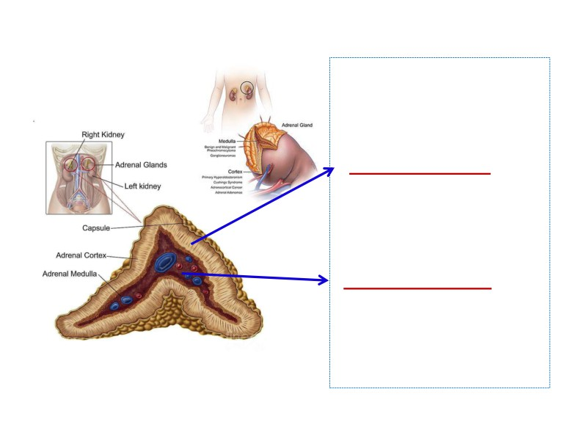
Adrenal Gland
• Divided into two morphologically and distinct regions:
-Adrenal cortex:
• Secrete group of hormones
called corticosteroids
• All synthesized from the
steroid cholesterol
•
Have different functions.
-Adrenal medulla:
• It is the central region
•
20% of the gland
•
Secretes EPN and NEPN
(related to sympathetic nervous system).

Slide 7
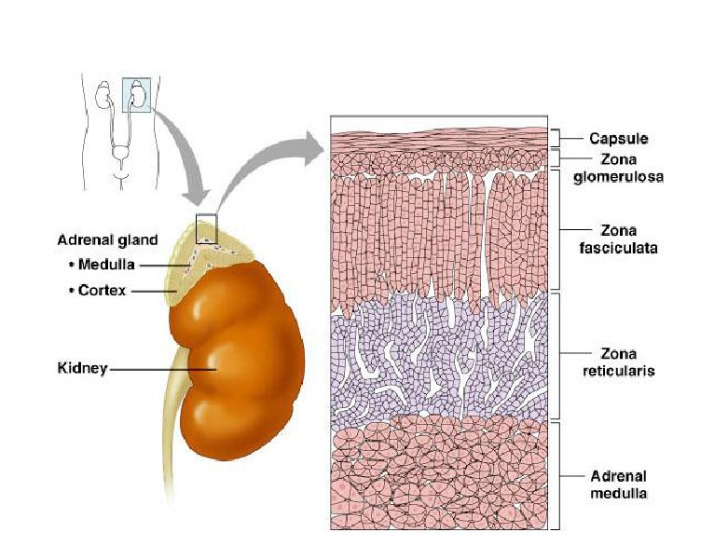
Adrenal Cortex

Slide 8
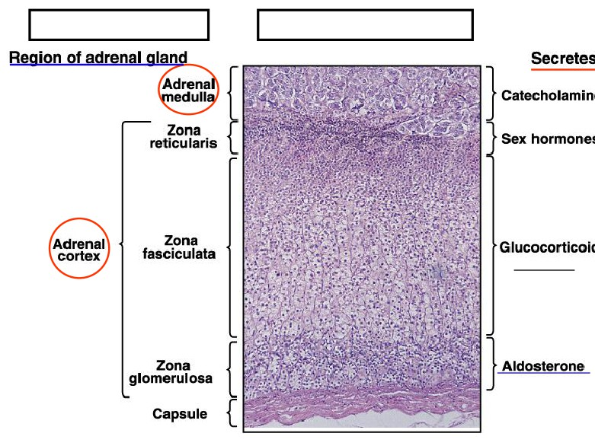
The Adrenal Gland
Corticosteroid hormones
(Cortisol)
Mineralocortico
(
)

Slide 9
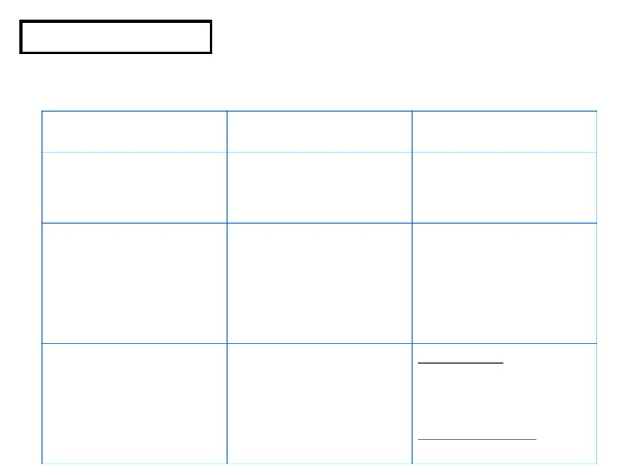
The Adrenal Gland
• Adrenal Cortex:Synthesizes and releases steroid hormones (corticosteroids)
• Different corticosteroids are produced in each of the three layers.
Region
Types
Hormones
Zona glomerulosa
Mineralocorticoids
Aldosterone
Zona fasciculata
Glucocorticoids
Cortisol
(mainly)
Corticosterone
Androgens
(small amount)
Estrogens
(small amount)
Zona reticularis
Gonadocorticoids
Androgens: DHEA
Androstenedione Estrogen (small amount)
Glucocorticoids

Slide 10
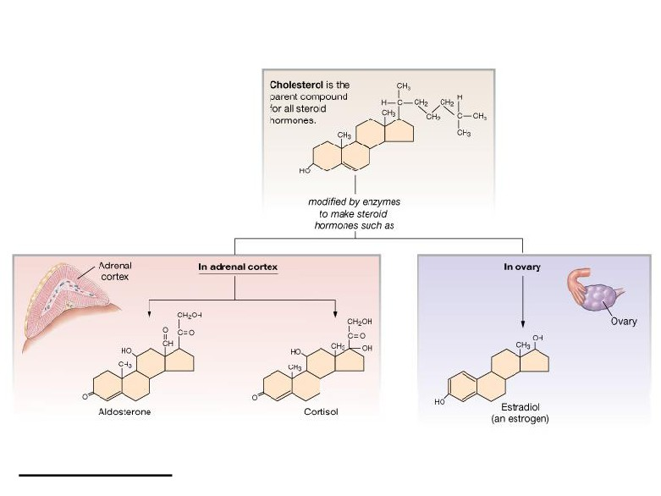
Steroid Hormones: Structure
Guyton and Hall

Slide 12
Aldosterone
Aldosterone
The main mineralocorticoid
produced by the adrenal gland

Slide 13
Mineralocorticoids: Aldosterone
• A steroid hormone.
ͻEssential for life.
ͻSynthesized in zona glomerulosa
ͻ Aldosterone exerts 90% of all the
mineralocorticoid activity.
ͻTarget cells are called ͞pƌincipal
(P) cell͟.
ͻ60% of aldosterone bound to
plasma protein͙40% is free form.
ͻHalf life: 20 min
ͻMuch of secreted aldosterone is metabolized by the liver and
converted to tetrahydroglucuroind
derivative.

Slide 14
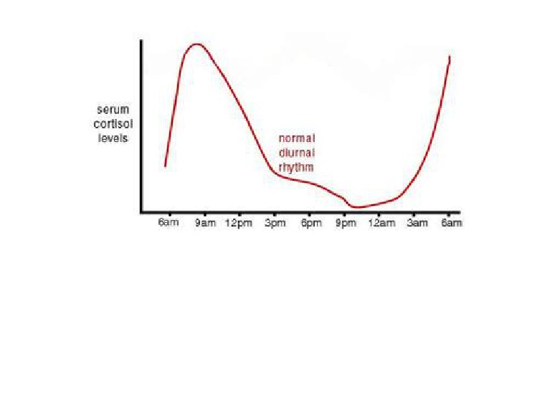
• Aldosterone levels fluctuate diurnallyͶhighest concentration being at8 AM, lowest at 11 PM, in
parallel to cortisol rhythms.

Slide 15
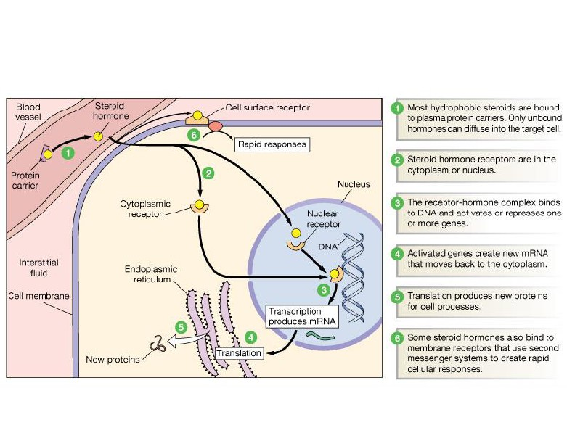
Steroid Hormones: Action

Slide 16
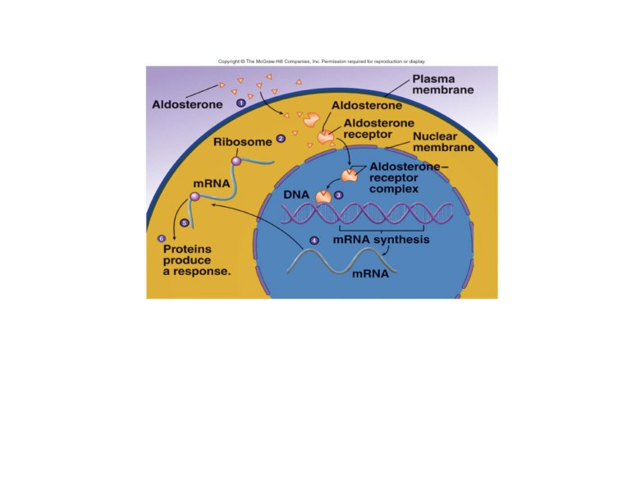
Steroid Hormones: Action
y Increases transcription of
Na+/K+ pump
y Increases the expression of apical Na+ channels and Na+ /K+ /Cl- cotransporter

Slide 17
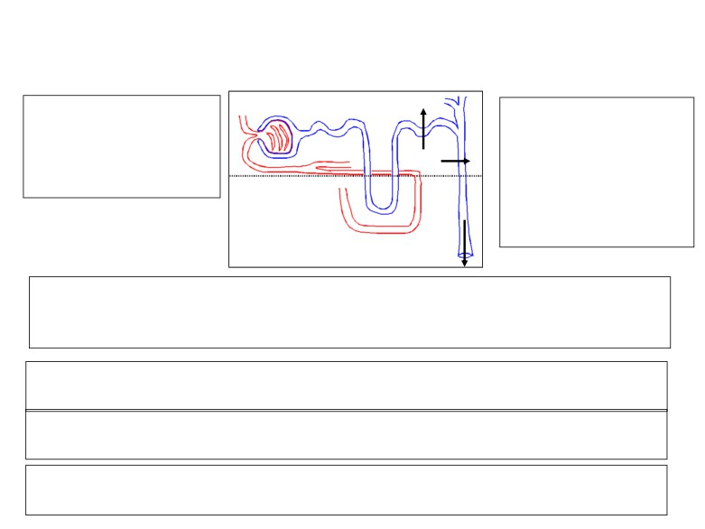
Actions of aldosterone
Na+
Acts mainly on the
Increases Renal Tubular
cells of the
collecting ducts and distal tubules.
Na+ Reabsorption of
Na+ and
Secretion of K+ and H +
K+
1. Renal action:
Aldosterone causes sodium to be conserved in the ECF while increasing potassium excretion in the urine.
2. Circulatory Actions of Aldosterone:
Increases ECF volume and Arterial Pressure.
3. Causes secretion of H+ in exchange for Na+ in the intercalated cells of the collecting tubules
4. It also affects Na+ reabsorption by sweat, salivary and intestinal cells. (Stimulates synthesis of more Na/K-ATPase pumps)

Slide 18
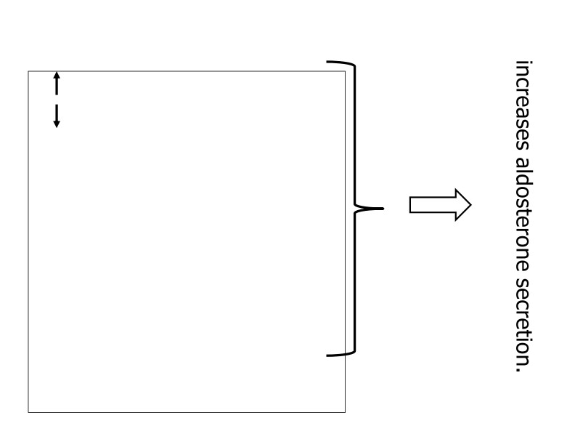
Control of Aldosterone Secretion
¾ K+ concentration in the ECF ¾ Na+ concentration in the ECF
¾ Increased activity of the renin- angiotensin system
(increased levels of angiotensin II)
¾ Hypovolemia
¾ Hypotention
¾ ACTH:ACTH also stimulates aldosterone
synthesis. However the ACTH stimulation is more transient than the other stimuli and is diminished
within several days
¾stress, surgery,«.

Slide 19
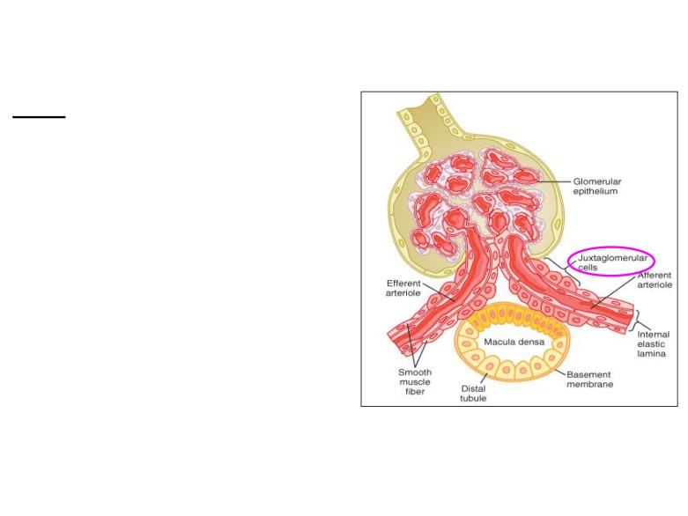
Control of Aldosterone Secretion
Renin :
•is a enzyme released by the kidneys
when the arterial pressure falls.
•Renin is synthesized and stored in in the juxtaglomerular cells (JG cells) of the kidneys.
•The JG cells are modified smooth
muscle cells located in the walls of the afferent arterioles immediately proximal to the glomeruli.
•Renin acts on another plasma protein (angiotensinogen), to release angiotensin I which is converted to angiotensin II (in the lungs).

Slide 20
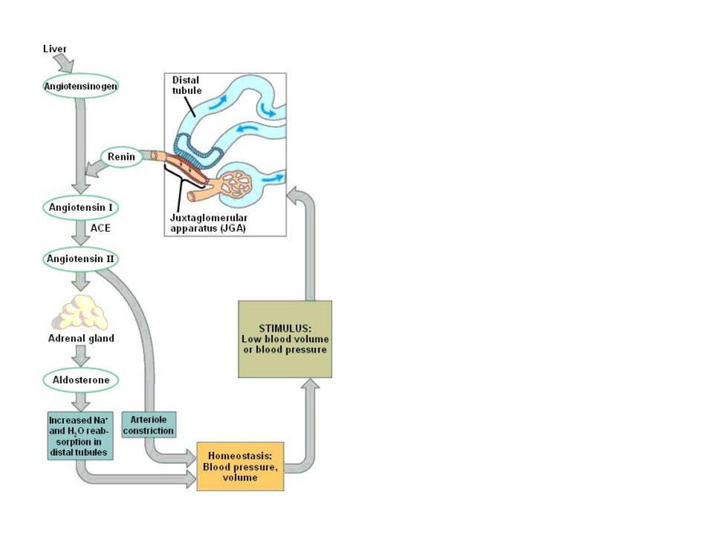
Control of Aldosterone Secretioncont…
Angiotensin II increases the blood pressure through:
1- Vasoconstriction occurs intensely in the
arterioles & much less so in the veins.
Constriction of the arterioles increases the
total peripheral resistance, thereby raising
the arterial pressure.
2- decrease excretion of both salt and
water by the kidneys.
This slowly increases ECF volume, which
then increases the arterial pressure during
subsequent hours and days.
Angiotensin II acts on the zona
glomerulosa to stimulate aldosterone
synthesis.
Angiotensin II acts via increased intracellular cAMP to stimulate
aldosterone synthesis.

Slide 21
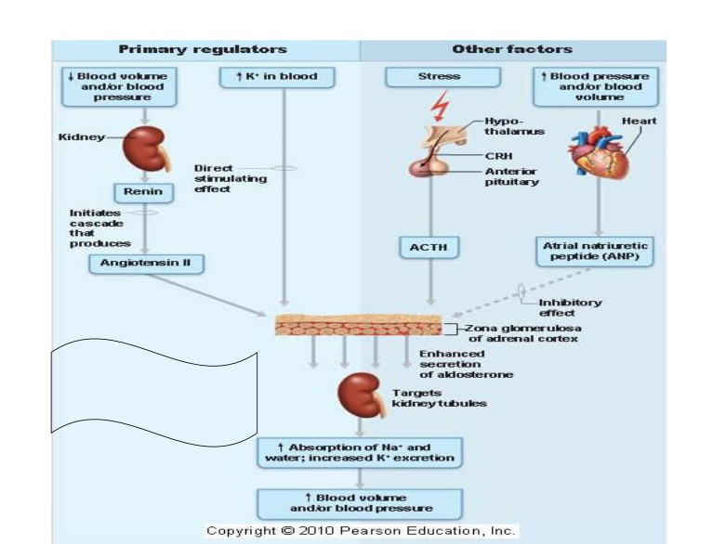
Regulation of Aldosterone secretion
It is essential for life

Slide 22
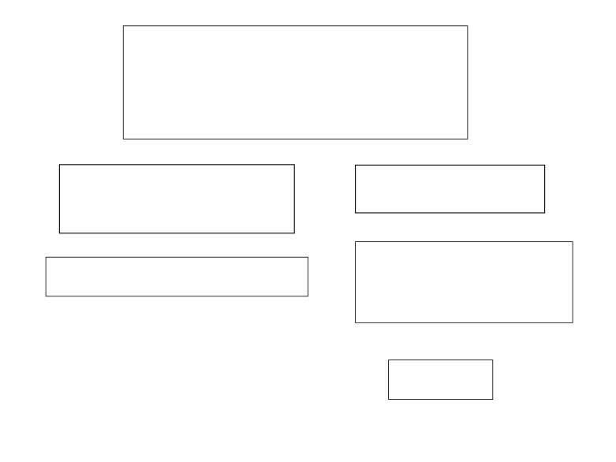
Abnormalities
Primary hyperaldosteronism
Complete failure to secrete aldosterone
(increase secretion of mineralocorticoids)
y Dehydration
Conn¶s Syndrome
y Low blood volume y Low blood pressure
DEATH

Slide 23
Primary Aldosteronism (Conn's Syndrome)
¾Cause: tumor of the zona glomerulosa cells (adenoma) → secretes large amounts of aldosterone.
¾Effects:
The most important effects are:
• hypokalemia.
• slight increase in ECF volume and blood volume.
• very slight increase in plasma sodium concentration.
• almost always, hypertension.
•There are occasional periods of muscle paralysis caused by the
hypokalemia.
•decreased plasma renin concentration (from feedback suppression of renin secretion caused by the n aldosterone) or by the excess ECF volume and arterial pressure.
¾ Treatment: usually surgical removal. Spironolactone

Slide 24
Primary Aldosteronism
Hypertension.
Hypokalemia and hypernatremia Nocturnal polyuria & polydipsia
Increased tubular (intercalated cells) hydrogen ion secretion, with resultant mild alkalosis.
Neuromuscular manifestations  weakness, paresthesia
 intermittent paralysis

