Slide 1
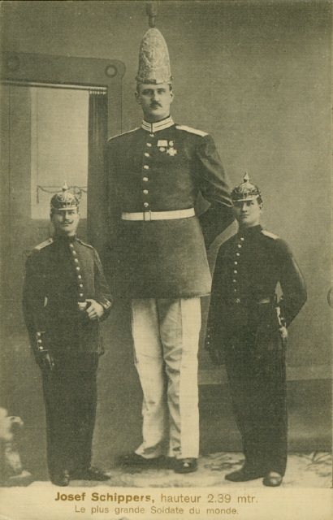
ANATOMY OF THE PITUITARY GLAND
Who suffer (s) from pituitary disturbances?
Soldier # 1
Soldier # 2
Soldier # 3
Soldiers # 1 & 3
2
1
3
Prof. Ahmed Fathalla Ibrahim

Slide 2
OBJECTIVES
At the end of the lecture, students should be able to:
Describe the position of the pituitary gland.
List the structures related to the pituitary gland.
Differentiate between the lobes of the gland.
Describe the blood supply of pituitary gland & the hypophyseal portal system.

Slide 3
PITUITARY GLAND (HYPOPHYSIS CEREBRI)
It is referred to as the master of endocrine gland.
It is a small oval structure of 1 cm in diameter.
It doubles its size during pregnancy.

Slide 4
PITUITARY GLAND (POSITION)
Optic chiasma
Mammillary body
Body of sphenoid
It lies in the hypophyseal fossa of the body of sphenoid bone, between optic chiasma (anteriorly) & mammillary bodies (posteriorly).

Slide 5
PITUITARY GLAND (POSITION)
It lies in the middle cranial fossa
It is well protected in sella turcica of body of sphenoid
Sella turcica

Slide 6
PITUITARY GLAND (POSITION)
Infundibulum
A fold of dura mater (Diaphragma sellae) covers the pituitary gland & has an opening for passage of infundibulum (pituitary stalk) connecting the gland to hypothalamus.

Slide 7
PITUITARY GLAND
X-RAY SKULL: LATERAL VIEW
SAGITTAL SECTION OF HEAD & NECK
Pituitary
gland
Hypophyseal fossa
Sphenoidal air sinus

Slide 8
IMPORTANT RELATIONS
SUPERIOR: Diaphragma sellae
INFERIOR: Sphenoidal air sinuses
LATERAL: Cavernous sinuses

Slide 9
SUBDIVISIONS OF PITUITARY GLAND
Hypothalamo-hypophyseal
tract
The gland is subdivided into:
1) Anterior lobe (adenohypophysis): true gland, secretes hormones
2) Posterior lobe (neurohypophysis): connected to hypothalamus through hypothalamo-hypophyseal tract, stores hormones secreted by hypothalamic nuclei

Slide 10
BLOOD SUPPLY OF PITUITARY GLAND
Cavernous sinuses
ARTERIES: Superior & inferior hypophyseal arteries (branches of internal carotid artery)
VEINS: hypophyseal veins drain into cavernous sinuses.

Slide 11
ARTERIES OF PITUITARY GLAND
Infundibulum
a hypothalamo-
hypophseal
portal vessel
The inferior hypophyseal: supplies posterior lobe of pituitary gland.
The superior hypophyseal: supplies infundibulum & forms a capillary network from which vessels pass downward & form sinusoids into the anterior lobe of pituitary gland (hypophyseal portal system).

Slide 12
ANTERIOR LOBE OF PITUITARY
Hormone-releasing & inhibiting factors produced by hypothalamus use hypophyseal portal system of vessels to reach the anterior lobe of pituitary gland
Hypophyseal portal
system

Slide 13
POSTERIOR LOBE OF PITUITARY
Axons of supraoptic & paraventricular cells of hypothalamus send their secretion (neurosecretion) to posterior lobe of pituitary gland through hypothalamo-hypophyseal tract
Hypothalamo-
hypophyseal tract

Slide 14
QUESTIONS

Slide 15
QUESTION 1
Which one of the following structures is superior to the pituitary gland?
Optic chiasma
Diaphragma sellae
Mammillary bodies
Sphenoidal air sinuses

Slide 16
QUESTION 2
Which one of the following venous sinuses drains hypophyseal veins?
Superior sagittal
Cavernous
Transverse
Sigmoid

Slide 17
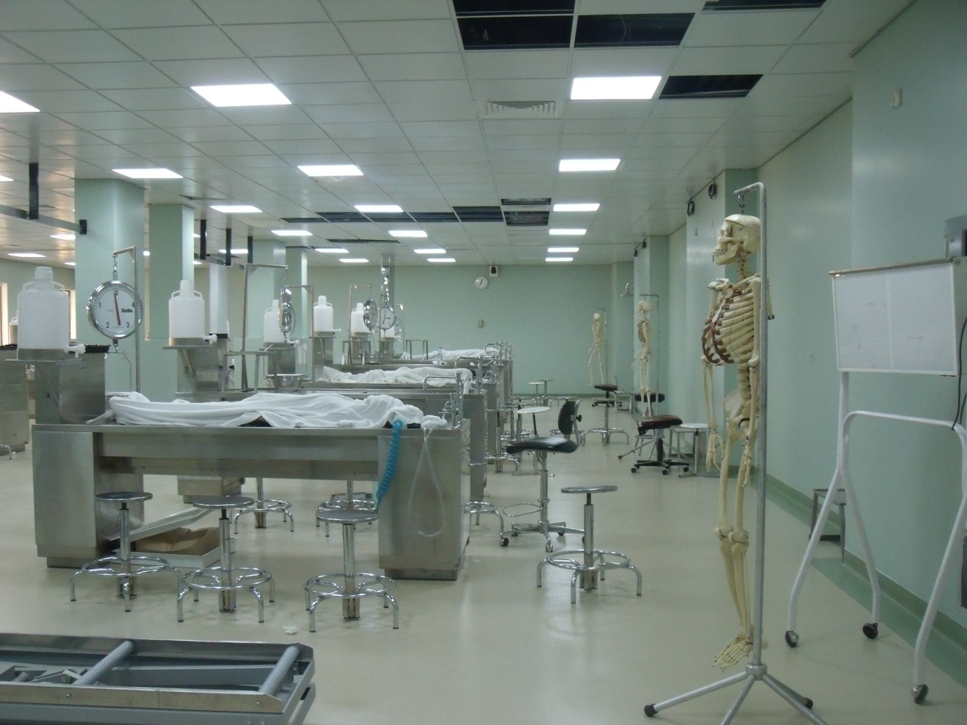
THANK YOU
&
BEST WISHES

