Slide 1

PANCREAS
Objectives
The student should be able to describe:
1. The endocrine part of the pancreas within the exocrine part.
2. The histological features of the cells of islet of Langerhans.
3. The function of different cells of islets of Langerhans.

Slide 2
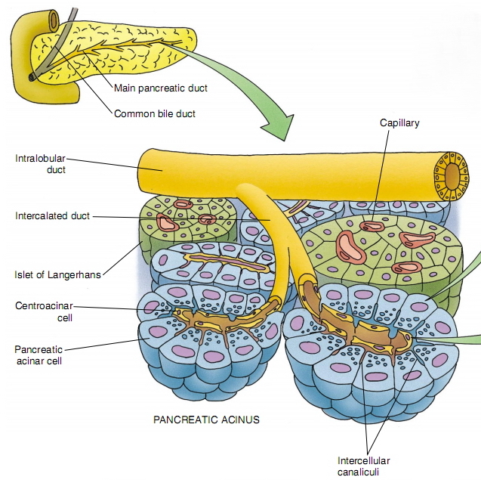
PANCREAS
Stroma: capsule, septa & reticular fibers.
Parenchyma: Pancreas is a mixed gland:
  Exocrine part (acini & ducts): produces digestive pancreatic enzymes.
  Endocrine part (islets of Langerhans): produces hormones.
Notes:
Its thin connective tissue capsule forms septa, which subdivide the gland into lobules. The vascular and nerve supply of the pancreas, as well as its system of ducts, travels in these connective tissue septa.

Slide 3
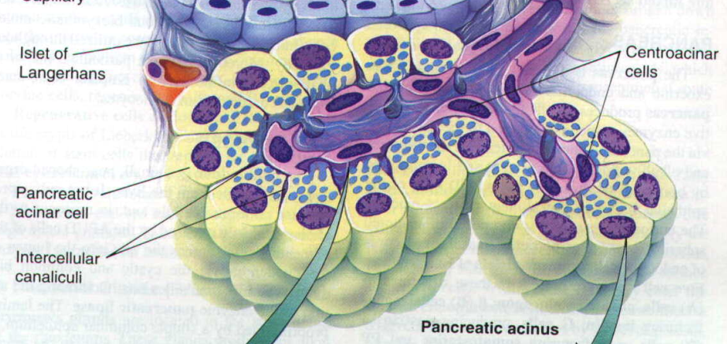
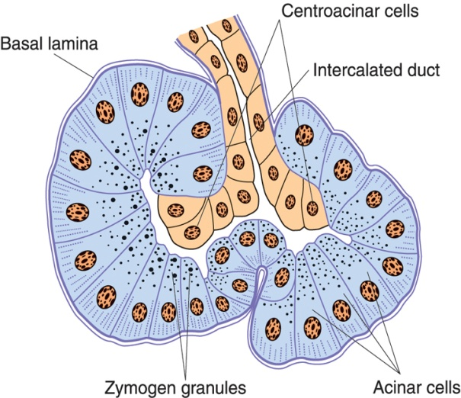
Exocrine Pancreas
Pancreatic Acini:
They are serous acini: secreting a thin fluid rich in digestive pancreatic enzymes.
Centroacinar cells:
Their nuclei appear in the center of the acini. They represent the beginning of the ducts.
No myoepithelial cells around the acini.
Notes:
Why are myoepithelial cells absent?: pancreatic secretions are mostly achieved by hormonal stimulation (cholecystokinin, secretin, gastrin, somatostatin, pancreatic polypeptide), whereas other glandular organs with myoepithelial cells achieve their secretory functions by effect of contraction.

Slide 4
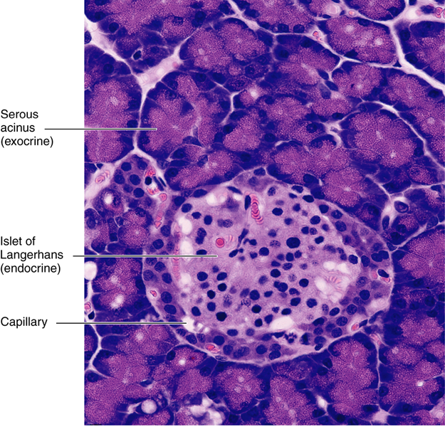
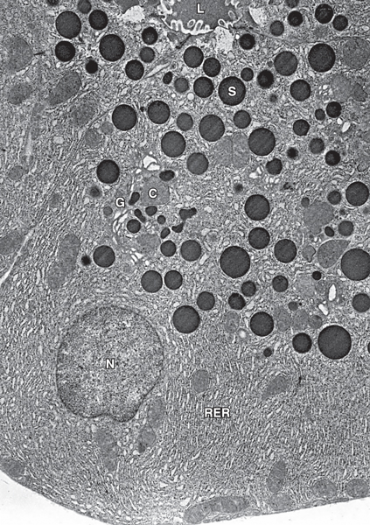
Exocrine Pancreas
Pancreatic Acinar Cells:
Pyramidal in shape.
Nuclei are basal, rounded and vesicular.
Cytoplasm:
  Basal part basophilic (due to abundant rER).
  Apical part acidophilic (due to secretory granules).

Slide 5
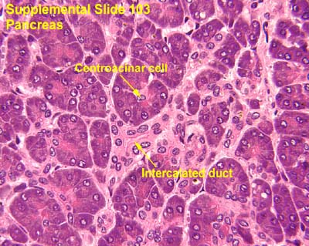
Exocrine Pancreas
Duct System:
Centroacinar cells.
Intercalated ducts (low cuboidal).
Intralobular ducts (NOT prominent).
Interlobular ducts.
Main pancreatic duct.
Notes:
Centroacinar cells line the initial portion of the intercalated duct.
After branching from an interlobular duct and entering the lobule the intralobular duct branches almost immediately into much smaller intercalated ducts which are long and also branched. So, unlike salivary glands, intralobular ducts are small and difficult to discern.
Interlobular ducts are lined by columnar epithelium. Main pancreatic duct is lined by tall columnar epithelium.

Slide 6
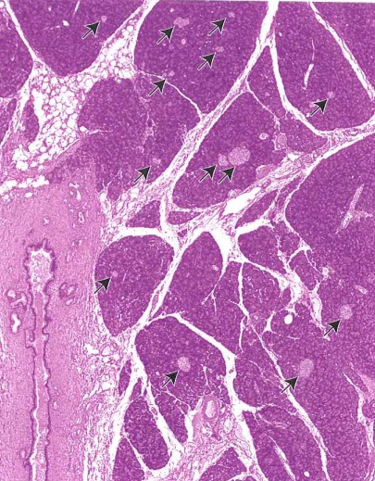
Endocrine Pancreas
Islets of Langerhans:
Pale-staining spherical collections of endocrine cells, scattered among the acini.
Richly vascularized by fenestrated capillaries.
Each islet is surrounded and supported by reticular fibers.
1 million islets in human pancreas.
Most numerous in the tail of pancreas.

Slide 7
Endocrine Pancreas
Cells of the Islets:
5 types of cells in each islet:
  β (B) cells: secrete insulin.
  α (A) cells: secrete glucagon.
  δ (D) cells: secrete somatostatin.
  G cells: secrete gastrin.
  PP cells: secrete pancreatic polypeptide.
Cannot be differentiated from one another by routine stains.

Slide 8
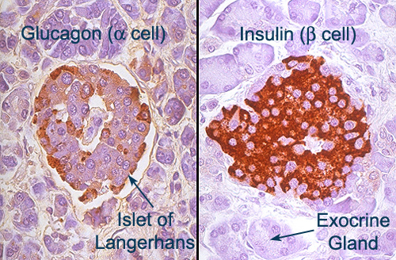
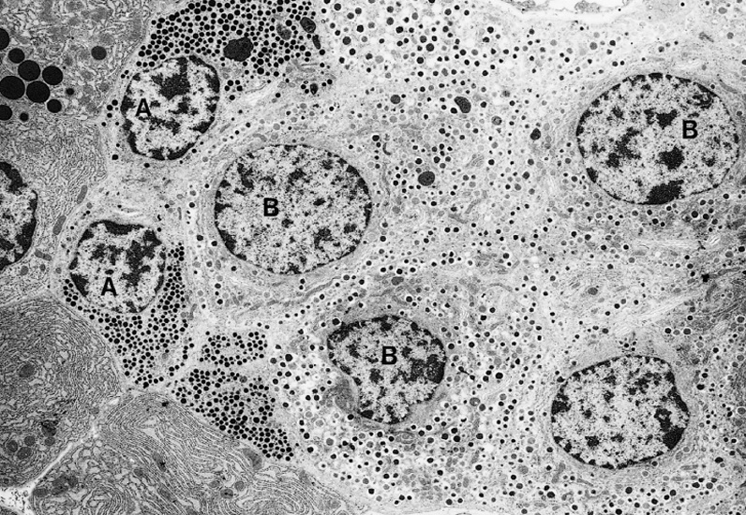
Endocrine Pancreas
Cells of the Islets:
β (B) cells:
  Constitute 70% of islet cells.
  Concentrated in islet center.
  Function: secrete insulin which ↓ blood sugar.
α (A) cells:
  Constitute 15-20%.
  Concentrated in islet periphery.
  Granules are much more numerous, more tightly packed, smaller, and denser than those of β cells.
  Function: secrete glucagon which ↑ blood sugar.

Slide 9
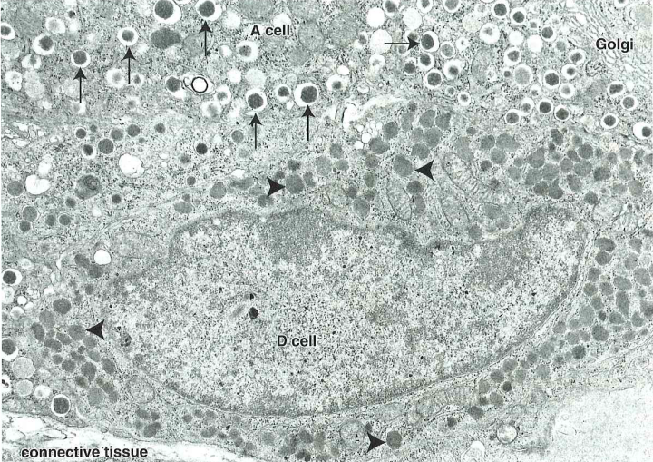
Endocrine Pancreas
Cells of the Islets:
δ (D) cells:
  Constitute 5-10% of islet cells.
  Scattered throughout the islet.
  Granules are less dense than those of β and α cells.
  Function: secrete somatostatin which ↓ release of hormones from endocrine pancreas and enzymes from exocrine pancreas.

Slide 10
Endocrine Pancreas
Cells of the Islets:
G cells:
  Constitute 1% of islet cells.
  Scattered throughout the islet.
  Function: secrete gastrin which ↑ production of HCl by parietal cells of the stomach.
PP cells:
  Constitute 1% of islet cells.
  Scattered throughout the islet.
  Function: secrete pancreatic polypeptide which ↓ exocrine secretions of pancreas.

Slide 11
Best wishes

