Slide 1
Diabetes Mellitus

Slide 2
Objectives
Understand the structure of the pancreas and have a basic understanding of its function.
The student should have an understanding of the pathogenesis and major histopathological changes seen in diabetes mellitus type 1 and type 2.
The student should recognize the major complications of diabetes mellitus.

Slide 3
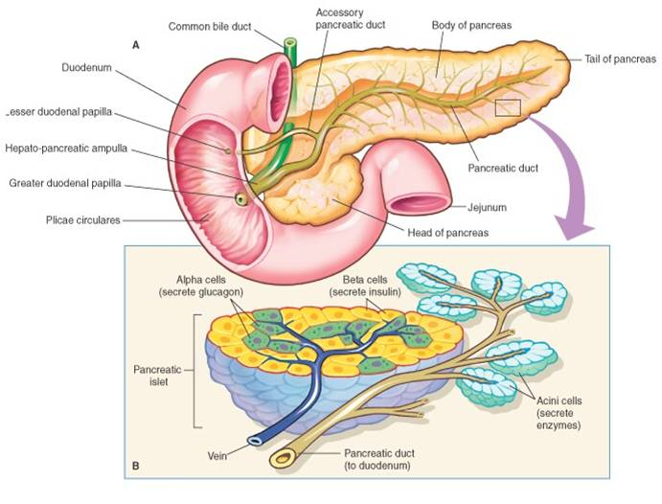

Slide 4
THE ENDOCRINE PANCREAS
islets of Langerhans, contain four major cell types :β, α, δ, and PP (pancreatic polypeptide) cells.
The β cell produces insulin
The α cell secretes glucagon .
δ cells contain somatostatin
PP cells contain a unique pancreatic polypeptide. VIP, that exerts several gastrointestinal effects, such as stimulation of secretion of gastric and intestinal enzymes
Notes:
- PP cells exerts several gastrointestinal effects, such as stimulation of secretion of gastric and intestinal enzymes and inhibition of intestinal motility.
D1 cells elaborate vasoactive intestinal polypeptide (VIP), a hormone that induces glycogenolysis and hyperglycemia; it also stimulates gastrointestinal fluid secretion and causes secretory diarrhea.
Enterochromaffin cells synthesize serotonin and are the source of pancreatic tumors that cause the carcinoid syndrome .

Slide 5
Diabetes Mellitus (DM)
*Diabetes mellitus is not a single disease entity but rather a group of metabolic disorders sharing the common underlying feature of hyperglycemia.
*Hyperglycemia in diabetes results from defects in insulin secretion, insulin action, or, most commonly, both.
*Diabetes is the leading cause of end-stage renal disease, adult-onset blindness, and nontraumatic lower extremity amputations

Slide 6
Diabetes Mellitus (DM)
Prediabetes, defined as elevated blood sugar that does not reach the criterion accepted for an outright diagnosis of diabetes ;
persons with prediabetes have an elevated risk for development of frank diabetes

Slide 7
Diagnosis of DM
Blood glucose levels normally are maintained in a very narrow range, usually 70 to 120 mg/dL.
The diagnosis of diabetes is established by elevation of blood glucose by any one of three criteria:
1) A random blood glucose concentration of 200 mg/dL or higher, with classical signs and symptoms
2) A fasting glucose concentration of 126 mg/dL or higher on more than one occasion
3 )An abnormal oral glucose tolerance test (OGTT), in which the glucose concentration is 200 mg/dL or higher 2 hours after a standard carbohydrate load (75 g of glucose).
Notes:
Those with fasting glucose concentrations greater than 100 mg/dL but less than 126 mg/dL, or OGTT values greater than 140 mg/dL but less than 200 mg/dL, are considered to have impaired glucose tolerance, also known as "pre-diabetes.“
Pre-diabetic individuals have a significant risk of progressing to overt diabetes over time, with as many as 5% to 10% advancing to diabetes mellitus per year. In addition, pre-diabetics are at risk for cardiovascular disease.

Slide 8
those with serum fasting glucose greater than 110 but less than 126 mg/dL, or OGTT values of greater than 140 but less than 200 mg/dL, are considered to have impaired glucose tolerance, also known as prediabetes.
Persons with impaired glucose tolerance have a significant risk for progression to overt diabetes over time

Slide 9
Classification of DM

Slide 10
Type 1 DM
Type 1 diabetes (T1D) is characterized by an absolute deficiency of insulin secretion caused by pancreatic beta cell destruction, usually resulting from an autoimmune attack.
Type 1 diabetes accounts for approximately 10% of all cases.

Slide 11
Type 2 DM
Type 2 diabetes (T2D) is caused by a combination of peripheral resistance to insulin action and an inadequate compensatory response of insulin secretion by the pancreatic beta cells (relative insulin deficiency).
Approximately 80% to 90% of patients have type 2 diabetes.

Slide 12
Pathogenesis
Type 1 diabetes is an autoimmune disease in which islet destruction is caused primarily by immune effector cells reacting against endogenous beta cell antigens.
The classic manifestations of the disease occur late in its course, after more than 90% of the beta cells have been destroyed. The fundamental immune abnormality in type 1 diabetes is a failure of self-tolerance in T cells.
autoantibodies against a variety of beta cell antigens, are detected in the blood of 70% to 80% of patients.
90% and 95% of white patients with type 1 diabetes have HLA-DR3, or DR4
environmental factors, especially infections, may be involved in type 1 diabetes.

Slide 13
PATHOGENESIS
Type 2 diabetes is a prototypical complex multifactorial disease.
*Environmental factors, such as a sedentary life style and dietary habits.
*Genetic factors are also involved in the pathogenesis,
recent large-scale genome-wide association studies, have identified more than a dozen susceptibility loci called “diabetogenic” genes.

Slide 14
The two metabolic defects that characterize type 2 diabetes are
a decreased ability of peripheral tissues to respond to insulin (insulin resistance)
beta cell dysfunction that is manifested as inadequate insulin secretion in the face of insulin resistance and hyperglycemia

Slide 15
Insulin resistance is defined as the failure of target tissues to respond normally to insulin. It leads to decreased uptake of glucose in muscle, reduced glycolysis and fatty acid oxidation in the liver, and an inability to suppress hepatic gluconeogenesis.

Slide 16
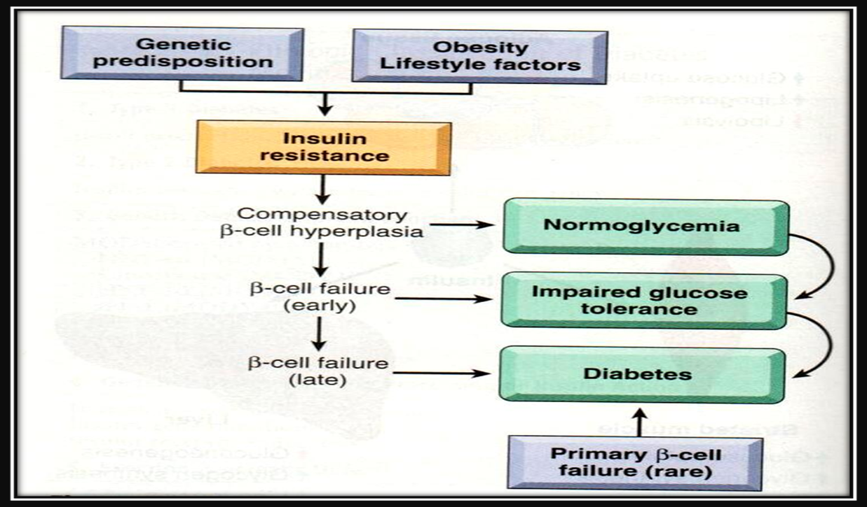
Obesity and Insulin Resistance

Slide 17
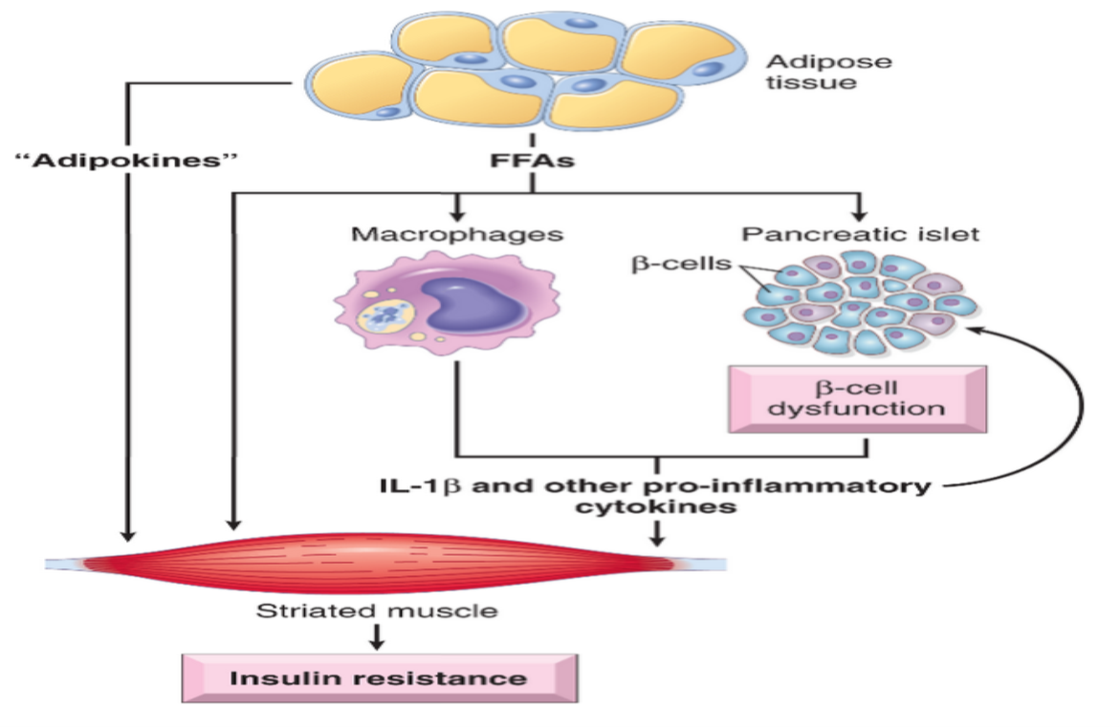

Slide 18
Monogenic Forms of Diabetes
Type 1 and type 2 diabetes are genetically complex ,no single-gene defect (mutation) can account for predisposition to these entities.
By contrast, monogenic forms of diabetes are uncommon examples of the diabetic phenotype occurring as a result of loss-of-function mutations within a single gene.
The largest subgroup of patients in this category traditionally was designated as having maturity-onset diabetes of the young (MODY). This disorder is more like type 1 but can be confused with either type.
MODY can be the result of inactivating mutations in one of eleven genes

Slide 19
Morphology
Lesions in the pancreas are inconstant and rarely of diagnostic value. One or more of the following alterations may be present:
Reduction in the number and size of islets. This change most often is seen in type 1 diabetes.
Leukocytic infiltration of the islets, which are principally composed of mononuclear cells (lymphocytes and macrophages). it is typically more in Type1 DM.
Amyloid replacement of islets in long-standing type 2 diabetes, appearing as deposition of pink, amorphous material. At advanced stages fibrosis also may be observed

Slide 20
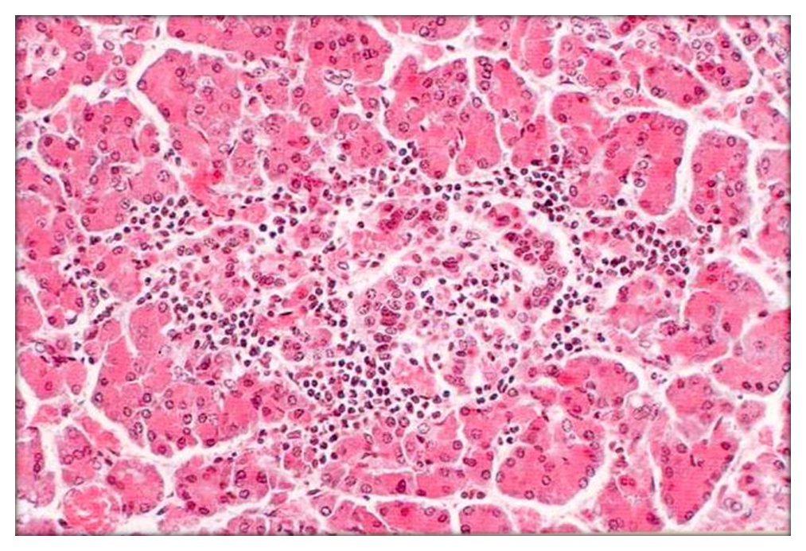
Insulitis

Slide 21
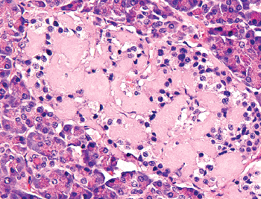
Amyloidosis

Slide 22
Clinical manifestations

Slide 23
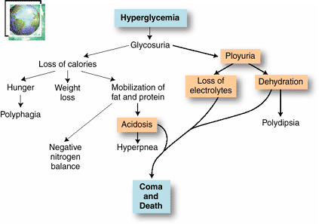

Slide 24
Type 1 DM
the classic triad of diabetes: polyuria, polydipsia, and polyphagia. Despite the increased appetite, catabolic effects prevail, resulting in weight loss and muscle weakness.
In patients with type 1 diabetes, deviations from normal dietary intake, unusual physical activity, infection, or any other forms of stress may rapidly influence the metabolic balance, predisposing the affected person to diabetic ketoacidosis.
The plasma glucose usually is in the range of 500 to 700 mg/dL
The marked hyperglycemia causes an osmotic diuresis and dehydration characteristic of the ketoacidotic state.

Slide 25
Type 2 DM
Type 2 diabetes mellitus also may manifest with polyuria and polydipsia, but unlike in type 1 diabetes, patients often are older than 40 years and frequently are obese.
In the decompensated state, patients with type 2 diabetes may develop hyperosmolar nonketotic coma. This syndrome is caused by severe dehydration resulting from sustained osmotic diuresis and urinary fluid loss due to chronic hyperglycemia. Typically, the affected person is an elderly diabetic who is disabled by a stroke or an infection and is unable to maintain adequate water intake.

Slide 26
Diabetic complications: Macrovascular Disease.
The hallmark of diabetic macrovascular disease is accelerated atherosclerosis affecting the aorta and large and medium-sized arteries.
Myocardial infarction, caused by atherosclerosis of the coronary arteries, is the most common cause of death in diabetics
Gangrene of the lower extremities, as a result of advanced vascular disease
The larger renal arteries also are subject to severe atherosclerosis, but the most damaging effect of diabetes on the kidneys is exerted at the level of the glomeruli and the microcirculation.

Slide 27
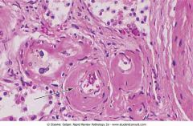
Hyaline arteriolosclerosis, the vascular lesion associated with hypertension , is both more prevalent and more severe in diabetics than in nondiabetics
It takes the form of an amorphous, hyaline thickening of the wall of the arterioles, which causes narrowing of the lumen

Slide 28
Diabetic complication: Microangiopathy.
One of the most consistent morphologic features of diabetes is diffuse thickening of basement membranes. The thickening is most evident in the capillaries of the skin, skeletal muscle, retina, renal glomeruli, and renal medulla
the basal lamina separating parenchymal or endothelial cells from the surrounding tissue is markedly thickened by concentric layers of hyaline material composed predominantly of type IV collagen . Of note, despite the increase in the thickness of basement membranes, diabetic capillaries are more leaky than normal to plasma proteins.
The microangiopathy underlies the development of diabetic nephropathy, retinopathy, and some forms of neuropathy.

Slide 29
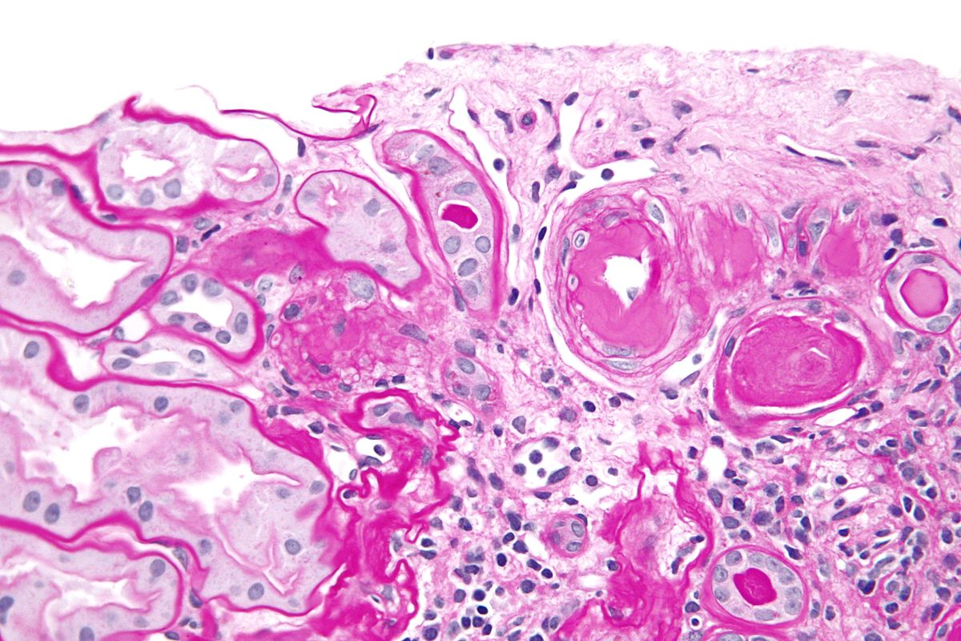

Slide 30
Diabetic complication: Nephropathy
Renal failure is second only to myocardial infarction as a cause of death from this disease. Three lesions are encountered:
(1) glomerular lesions;
(2) renal vascular lesions, principally arteriolosclerosis
(3) pyelonephritis, including necrotizing papillitis.

Slide 31
Diabetic complication: Nephropathy
The most important glomerular lesions are capillary basement membrane thickening, diffuse mesangial sclerosis, and nodular glomerulosclerosis.
The glomerular capillary basement membranes are thickened along their entire length.
Diffuse mesangial sclerosis consists of a diffuse increase in mesangial matrix along with mesangial cell . When glomerulosclerosis becomes marked, patients manifest the nephrotic syndrome, characterized by proteinuria, hypoalbuminemia, and edema

Slide 32
Diabetic complication: Nephropathy
Nodular glomerulosclerosis : ball-like deposits of a laminated matrix situated in the periphery of the glomerulus . These nodules are PAS-positive . This distinctive change has been called the Kimmelstiel-Wilson lesion.
Nodular glomerulosclerosis is encountered in approximately 15% to 30% of persons with long-term diabetes. It is essentially pathognomonic of diabetes.
Both the diffuse and the nodular forms of glomerulosclerosis induce sufficient ischemia to cause scarring of the kidneys, manifested by a finely granular-appearing cortical surface

Slide 33
Ocular Complications of Diabetes.
The ocular involvement may take the form of retinopathy, cataract formation, or glaucoma.
Retinopathy, the most common pattern
The lesion in the retina takes two forms: **nonproliferative (background) retinopathy
** proliferative retinopathy.

Slide 34
Nonproliferative retinopathy:
hemorrhages, retinal exudates (cotton wool sots), microaneurysms, edema, thickening of the retinal capillaries (microangiopathy).
The microaneurysms are discrete saccular dilations of retinal choroidal capillaries that appear through the ophthalmoscope as small red dots.
Proliferative retinopathy is a process of neovascularization and fibrosis.
This lesion leads to serious consequences, including blindness, especially if it involves the macula and retinal detachment

Slide 35
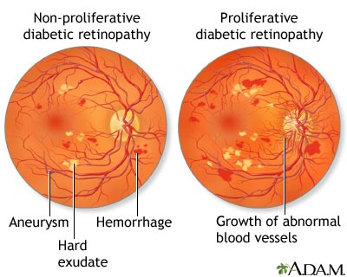

Slide 36
Diabetic Neuropathy.
The central and peripheral nervous systems are not spared by diabetes.
The most frequent pattern of involvement is that of a peripheral, symmetric neuropathy of the lower extremities affecting both motor and sensory function, particularly the latter.
Other forms include autonomic neuropathy, which produces disturbances in bowel and bladder function and diabetic mononeuropathy, which may manifest as sudden footdrop or wristdrop .
Microvasculopathy involving the small blood vessels of nerves contributes to the disorder.

Slide 37
Diabetic patients have an enhanced susceptibility to infections of the skin, as well as to tuberculosis, pneumonia, and pyelonephritis.
Such infections cause about 5% of diabetes-related deaths.
In a person with diabetic neuropathy, a trivial infection in a toe may be the first event in a long succession of complications (gangrene, bacteremia, pneumonia) that may ultimately lead to death

Slide 38
Infections
Bacterial and Fungal Infections Occur in Diabetic Hyperglycemia if Poorly Controlled
Renal papillary necrosis may be a devastating complication of bladder infection.
Mucormycosis: A dangerous infectious complication of poorly controlled diabetes is often fatal fungal infection tends to originate in the nasopharynx or paranasal sinuses and spreads rapidly to the orbit and brain.

Slide 39
Gestational diabetes
Diabetes occurring during pregnancy.
Fetus at risk of macrosomia.
Develops in only a few percent of seemingly healthy women during pregnancy.
It may continue after parturition in a small proportion of these patients.
These women highly susceptible to overt T2DM later in life.

