Slide 1
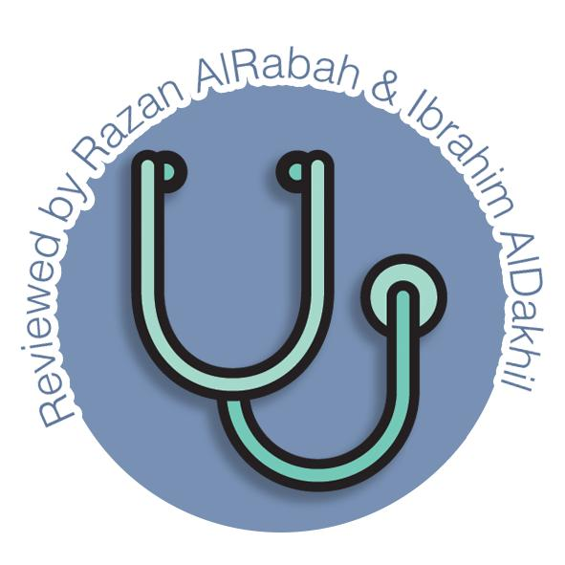
Anatomy Of The Pituitary Gland
Endocrine block-Anatomy-Lecture 1
Editing file

Slide 2
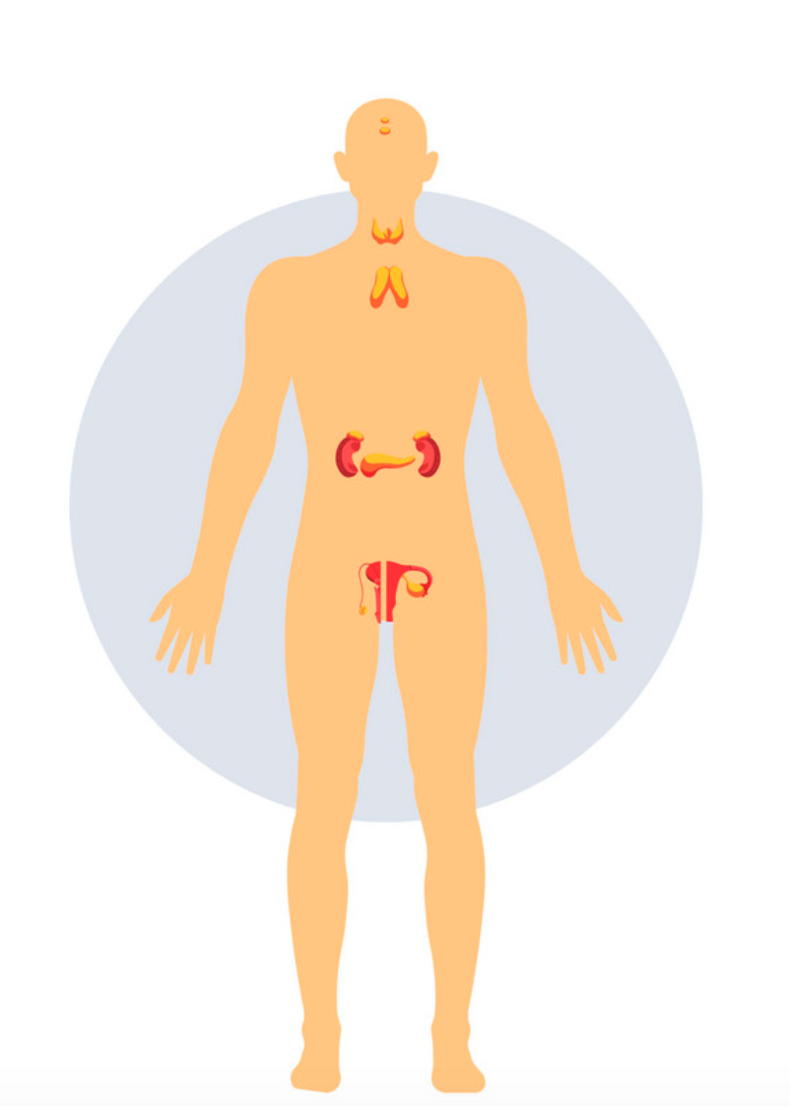
Color guide :
Only in boys slides in Green
Only in girls slides in Purple
important in Red
Notes in Grey
Objectives
At the end of the lecture, students should be able to:
Describe the position of the pituitary gland.
List the structures related to the pituitary gland.
Differentiate between the lobes of the gland.
Describe the blood supply of pituitary gland & the hypophyseal portal system

Slide 3
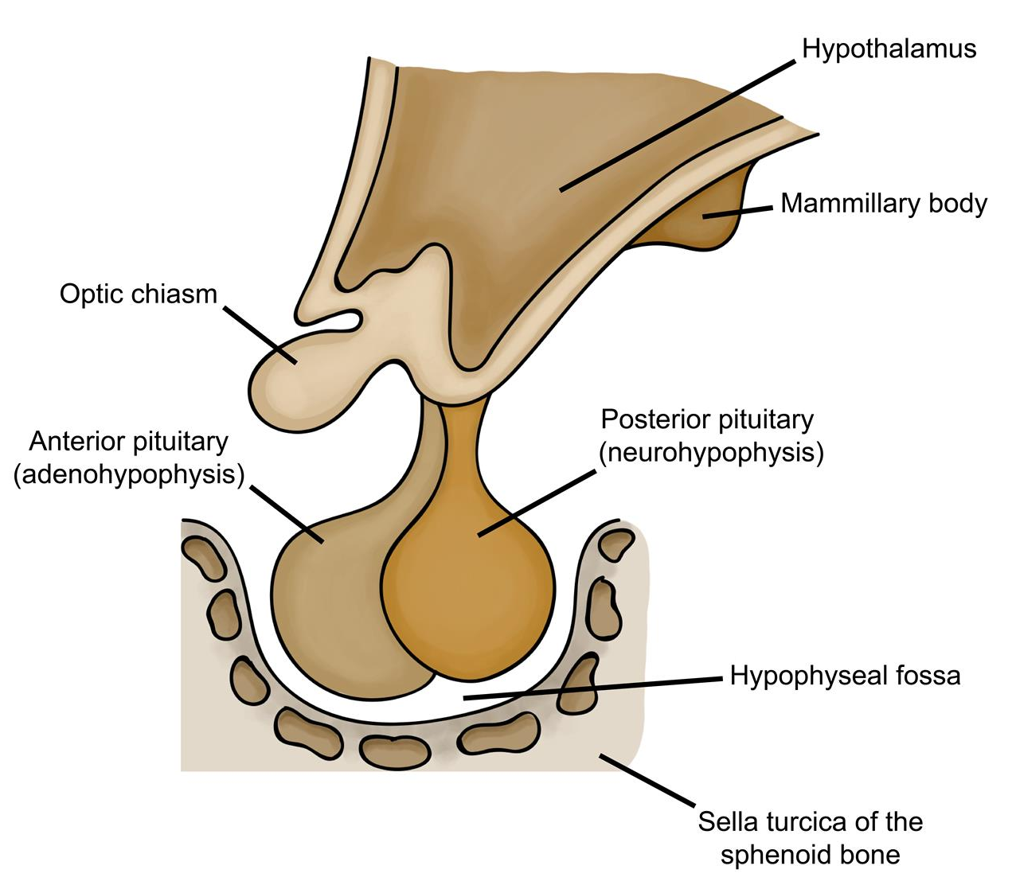
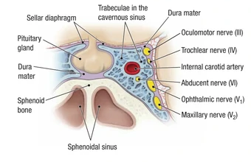
Pituitary Gland (Hypophysis Cerebri)
It is referred to as the master of endocrine gland.
It is a small oval structure of 1 cm in diameter.
It doubles its size during pregnancy.
Position:
1
lies in the middle cranial fossa in the hypophyseal fossa of the body of sphenoid bone
2
It is well protected in sella turcica of body of sphenoid
3
A fold of dura mater (Diaphragma sellae) covers it & has an opening for passage of infundibulum (pituitary stalk) connecting the gland to hypothalamus.
Relations:
Anterior
Posterior
Superior
Inferior
Lateral
It is important to know cavernous’ content
optic chiasma
mammillary bodies
Diaphragma sellae
Sphenoidal air sinuses
Cavernous sinuses
O: oculomotor nerve . T: trochlear nerve. O: ophthalmic branch of 5th. M: maxillary branch of 5th. C: internal carotid artery. A: Abducens nerve. T: trochlear nerve
O Tom cat

Slide 4
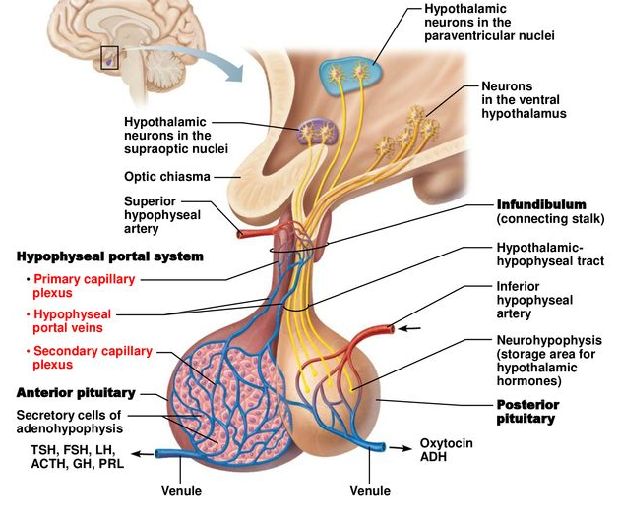
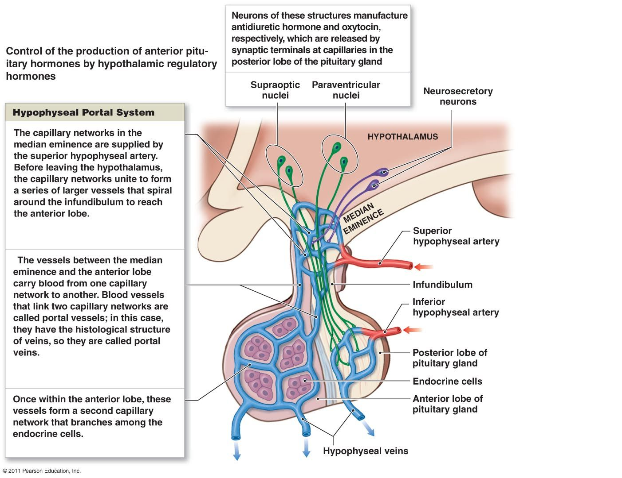
Pituitary Gland : Parts and Supply
Parts:
The gland is subdivided into:
Anterior lobe (adenohypophysis):
Posterior lobe (neurohypophysis):
true gland, secretes hormones
Hormone-releasing & inhibiting factors produced by hypothalamus use hypophyseal portal system of vessels to reach the anterior lobe of pituitary gland
Receives a nerve supply from some of the hypothalamic nuclei (supraoptic & paraventricular)
connected to hypothalamus through hypothalamo -hypophyseal tract, stores hormones secreted by hypothalamic nuclei
Axons of these nuclei convey their neurosecretion to posterior lobe through hypothalamo-hypophyseal tract then it will pass into the bloodstream.
Supply:
Arterial Supply
Branches of internal carotid artery:
Superior hypophyseal artery : supplies infundibulum & forms a capillary network from which vessels pass downward & form sinusoids into the anterior lobe of pituitary gland (hypophyseal portal system).
inferior hypophyseal artery: supplies posterior lobe of pituitary gland
Venous Drainage
hypophyseal veins drain into cavernous sinuses.

Slide 5
QUIZ
Q1 | Q2 | Q3 | Q4 | Q5 | Q6 | Q7 | Q8
B | B | A | B | C | C | D | B
Q1: Which one of the following structures is superior to the pituitary gland?
A. Optic chiasma
B. Diaphragma sellae
C. Mammillary bodies
D. Sphenoidal air sinuses
Q2: Which one of the following venous sinuses drains hypophyseal veins? A.Superior sagittal B. Cavernous
C. Transverse D. Sigmoid
Q3: which of the following forms the hypophyseal portal system
A. Superior hypophyseal artery
B. inferior hypophyseal artery
C. hypophyseal veins
D. secondary capillary network
Q4: the Pituitary gland lie in ?
A. anterior cranial fossa
B. middle cranial fossa
C. posterior cranial fossa
D. inferior area of the skull
Q5: Which one of the following structures is inferior to the pituitary gland?
A. Paranasal sinuses
B. maxillary sinuses
C. Sphenoidal sinuses
D. ethmoidal air sinuses
Q6: Which of the following is a store and releasing centre of neurohormone? A. Hypothalamus.
B. Anterior lobe of pituitary gland C. Posterior pituitary gland D. Intermediate lobe of pituitary
Q7: Which of the following gland is regarded as master gland?
A. Adrenal gland
B. Thyroid
C. Hypothalamus
D. Pituitary gland
Q8: The pituitary gland doubles its size during :
A. menstruation
B. pregnancy
C. menopause
D. all of the above

Slide 6
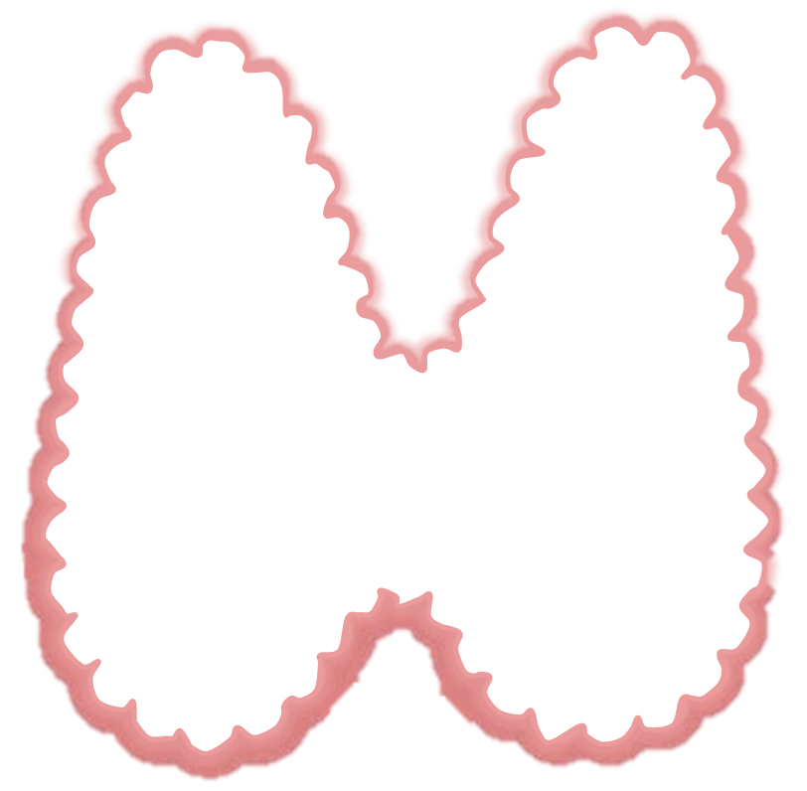
Members board
Team leaders
Abdulrahman Shadid
Ateen Almutairi
Boys team:
Mohammed Al-huqbani
Salman Alagla
Ziyad Al-jofan
Ali Aldawood
Khalid Nagshabandi
Sameh nuser
Abdullah Basamh
Alwaleed Alsaleh
Mohaned Makkawi
Abdullah Alghamdi
Girls team :
Ajeed Al Rashoud
‏Taif Alotaibi
‏Noura Al Turki
‏Amirah Al-Zahrani
‏Alhanouf Al-haluli
‏Sara Al-Abdulkarem
‏Renad Al Haqbani
‏Nouf Al Humaidhi
Jude Al Khalifah
Nouf Al Hussaini
Danah Al Halees
Rema Al Mutawa
Maha Al Nahdi
Razan Al zohaifi
Ghalia Alnufaei
Contact us:
Editing file

