Slide 1
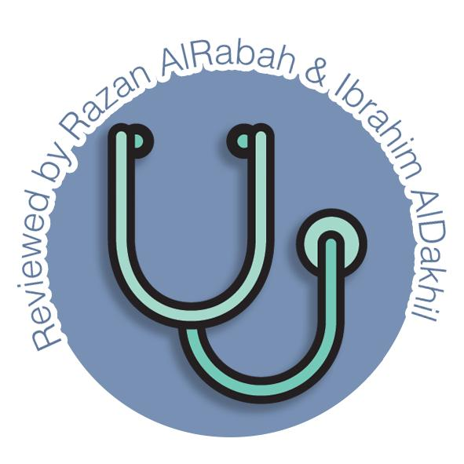
Anatomy & Embryology of Thyroid and Parathyroid glands
Endocrine block-Anatomy-Lecture 2
Editing file

Slide 2
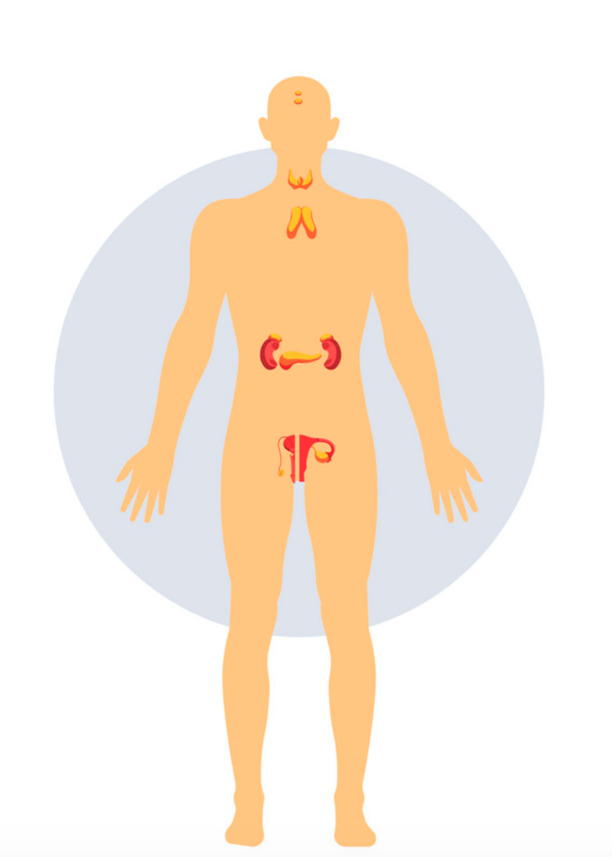
Color guide :
Only in boys slides in Green
Only in girls slides in Purple
important in Red
Notes in Grey
Objectives
At the end of the lecture, students should be able to:
Describe the shape, position, relations and structure of the thyroid gland.
List the blood supply & lymphatic drainage of the thyroid gland.
List the nerves endanger with thyroidectomy operation.
Describe the shape, position, blood supply & lymphatic drainage of the parathyroid glands.
Describe the development of the thyroid & parathyroid glands.
Describe the most common congenital anomalies of the thyroid gland.

Slide 3
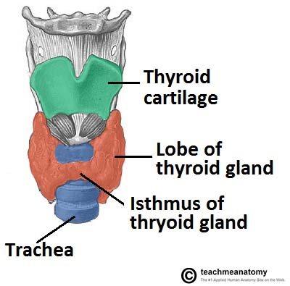
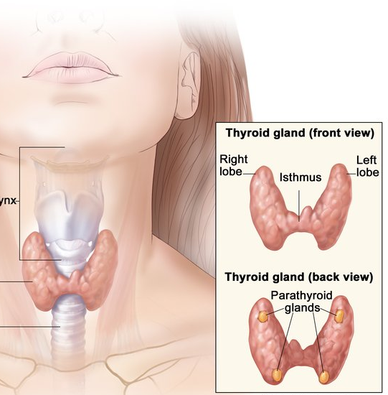
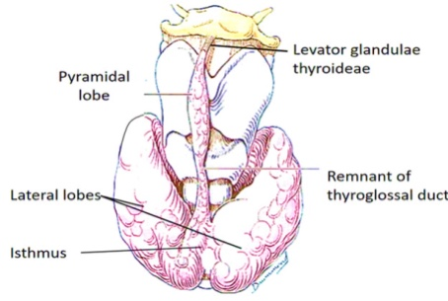
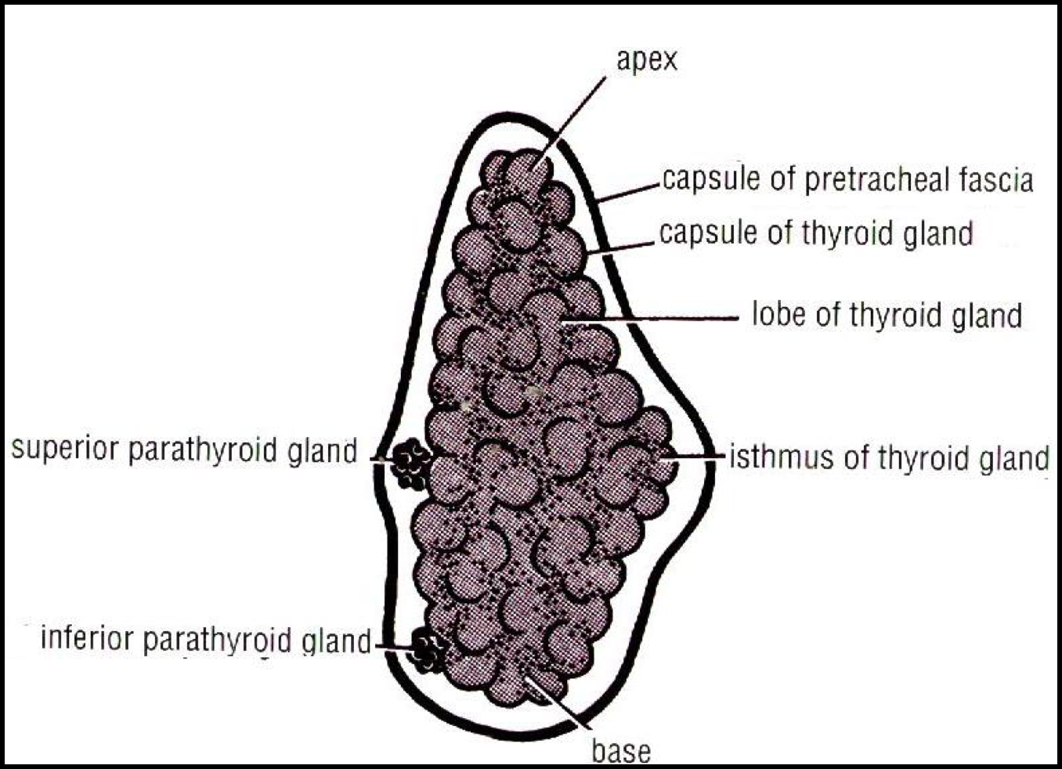
Anatomy of the thyroid and Parathyroid
Deep fascia or deep cervical fascia of the neck is divided mainly into 3 layers:
01
Investing layer.
surrounds sternocleidomastoid anterolaterally and trapezius posterolaterally
carotid sheath is also a part of deep cervical fascia of the neck.
04
01
02
03
04
Pretracheal layer.
Surrounds the trachea and thyroid gland
Prevertebral layer.
Surrounds prevertebral muscles
02
Thyroid gland
Endocrine, butterfly shaped gland.
It is surrounded by another C.T capsule a facial sheath derived from the pretracheal layer of the deep cervical fascia So, it s surrounded by 2 membranes.
03
superfual facisa
lobes
Consists of right & left lobes, they are connected to each other by a narrow isthmus, which overlies the 2nd ,3rd & 4th tracheal rings.
Each lobe is pear-shaped.
its apex reaches up to the oblique line of thyroid cartilage
Its base lies at the level of 4th or 5th tracheal rings.
Pyramidal lobe
A 3rd small pyramidal lobe is often present (in 50% of people) which projects from the upper border of the isthmus usually to left of middle line, it’s connected to the hyoid bone by a fibrous or muscular band called levator glandulae thyroideae, which represents the fibrosed & obliterated thyroglossal duct.

Slide 4
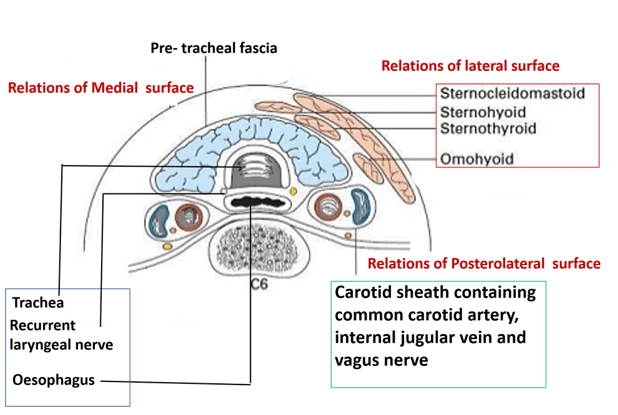
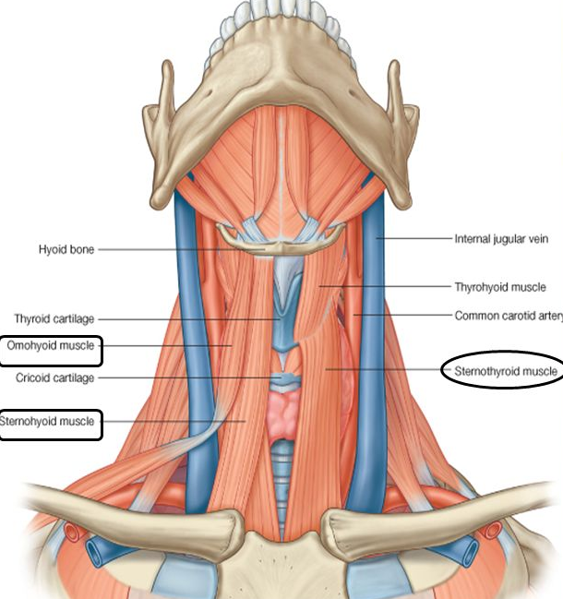
Thyroid gland: Relations
Surfaces
Anterolaterally | Posteriorly | Medially (Above) | Medially (Below)
Sternothyroid Sternohyoid Superior belly of omohyoid Sternomastoid | Carotid sheath & its contents. | Larynx pharynx . Cricothyroid muscle external laryngeal nerves | Trachea esophagus. Recurrent laryngeal nerve in between. Cricothyroid muscle external laryngeal nerves
border
posterior
Rounded Related to the superior & inferior parathyroid glands. Also related to the anastomosis between superior & inferior thyroid arteries.

Slide 5
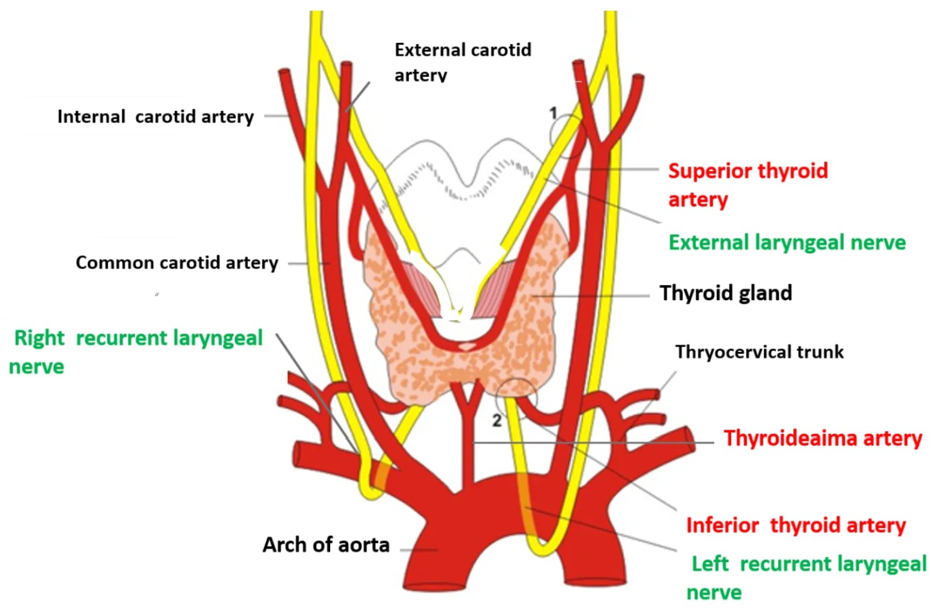
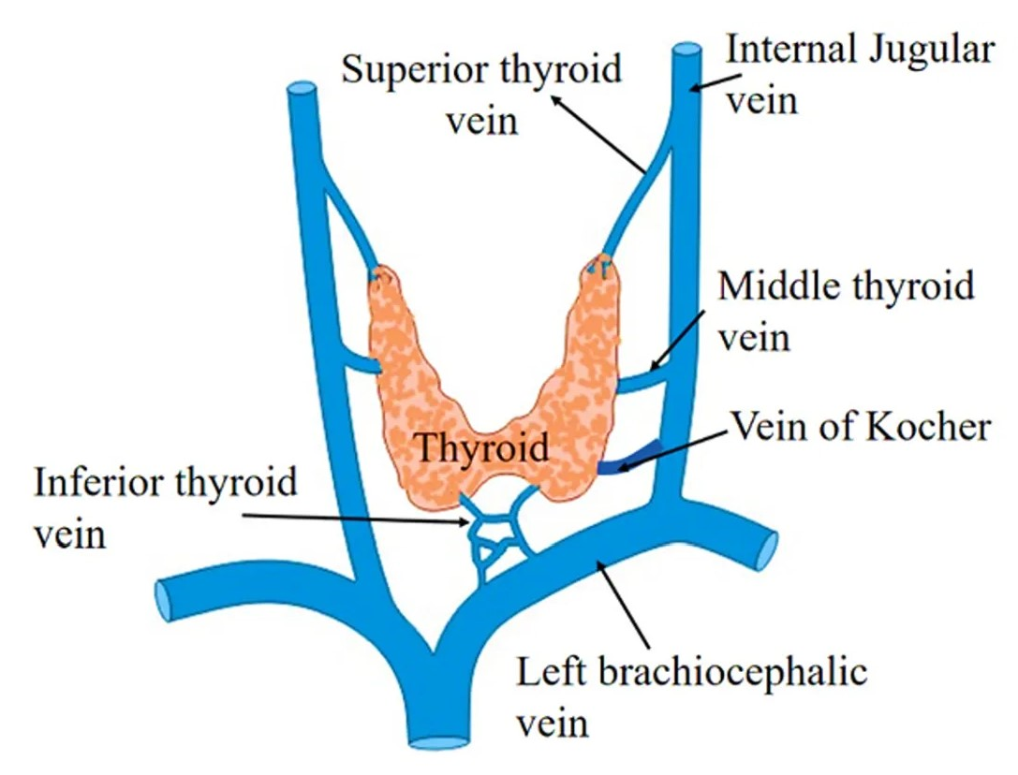
Thyroid gland: Supply
Arterial Supply
1. Superior thyroid artery : (2 arteries)
It is a branch from the external carotid artery .
It descends to the upper pole of the lobe, with the external laryngeal nerve. (supplies the cricothyroid
It runs along the upper border of the isthmus to anastomosis with its fellow
2. Thyroidea ima artery:
If present, it arises from aortic arch or from brachiocephalic artery.
It ascends in front of the trachea to reach the isthmus (supplies it)
3. Inferior thyroid artery: (2 arteries)
From the thyrocervical trunk of 1st part of subclavian artery, It ascends behind the gland to the level of cricoid cartilage ( at level of C6 vertebra).
Then it curves medially behind the carotid sheath.
Then it reaches the posterior aspect of the gland and descends downward
The recurrent laryngeal nerve crosses either in front or behind it.
males doctors note: how many arteries supply the thyroid gland? 5 arteries
Venous Drainage
Superior thyroid vein drains into internal jugular vein
Middle thyroid vein drains into internal jugular vein
Inferior thyroid vein drains into left brachiocephalic vein
Lymphatic
Innervation
Deep cervical lymph nodes.
paratracheal lymph nodes.
Sympathetic: Cervical Sympathetic Trunk.
Parasympathetic: Branches of Vagus

Slide 6
Parathyroid glands:
Structure
4 small ovoid bodies, about 6 mm. long.
2 superior parathyroid has a constant position at the middle of the posterior border of the gland.
2 inferior parathyroid usually at the level of the inferior pole.
They lie within the facial capsule of the gland, (between the 2
membranes).
They lie within the thyroid tissue or sometimes outside the facial capsule.
Supply:
Arterial Supply
Venous Drainage
Lymphatic
Innervation
Superior thyroid artery
Inferior thyroid artery
Superior thyroid vein
Middle thyroid vein
Inferior thyroid vein
Deep cervical lymph nodes.
paratracheal lymph nodes.
Sympathetic Trunk : Superior & middle cervical sympathetic ganglia (vasomotor).

Slide 7
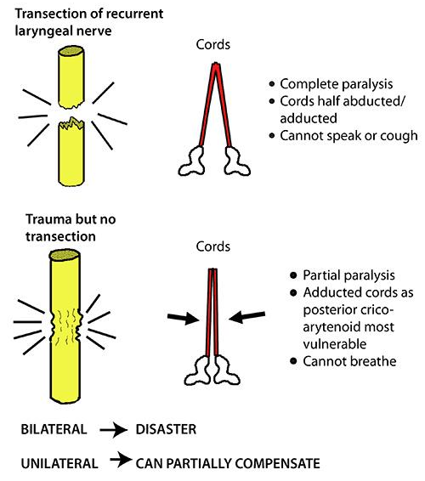
Clinical notes
1
during thyroidectomy, we should have consideration of the nerves and their branches that pass around the thyroid gland
The External laryngeal nerve runs close to the superior thyroid artery before turning medially to supply the cricothyroid muscle. High ligation of the superior thyroid artery during thyroidectomy places this nerve at risk of injury, so it should be ligated within the upper pole of the gland. Its lesion will cause hoarseness of voice.
2
3
The inferior thyroid artery is closely associated with the recurrent laryngeal nerve. This nerve can be found , in a triangle bounded laterally by the common carotid artery, medially by the trachea, and superiorly by the base of the thyroid lobe.
recurrent laryngeal nerve lesion may result in impaired breathing & speech.
The relationship of the recurrent laryngeal nerve and the inferior thyroid artery is highly variable in that the nerve can lie deep or superficial to the artery, or between the branches of the artery, and be different on either side of the neck.
4
5
Damage Of The Laryngeal Nerves Or Semon’s Law indicates the different effect between damage (surgical trauma) and transection of the recurrent laryngeal nerve due to surgery in region of the neck (e.g. thyroidectomy or parathyroidectomy).
if the injury was complete transection : patient CANT speak but CAN breath
if the injury was a trauma there are two possibilities:
unilateral: other side can compensate
bilateral: =disaster , patient CANT breath nor speak

Slide 8
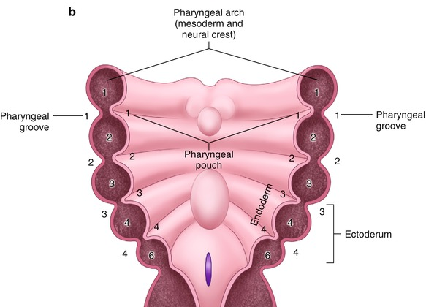
Embryology of the thyroid and Parathyroid
Pharyngeal Apparatus
The head & neck region develops from the pharyngeal apparatus and it’s formed of:
Pharyngeal membranes.
1
Pharyngeal Arches: the mesoderm in the head and neck regions divided into 6 cubical masses called the 6 pharyngeal or branchial arches, each arch is formed of a core of mesoderm. (the fifth pairs of arches disappear without giving any organ)
2
Each arch is covered externally by ectoderm and the space between 2 arches from outside is called Pharyngeal Groove or Clefts
Each arch is lined internally by endoderm and the space between the 2 arches from inside is called Pharyngeal Pouches.
There are four pairs of pharyngeal pouches
The first pair of pouches lies between the first and second pharyngeal arches.
The fifth pair of pouches is absent or rudimentary.
3
Males doctors note:
1st arch gives Muscle of mastication
1st cleft gives external acoustic meatus
1st pouch gives eustachian tube
1st membrane gives ear drum
2nd pouch gives palatine tonsil
2nd cleft: the ectoderm and endoderm join and the cleft disappears, giving the smooth contour of the neck., If not disappeared, a cyst will appear in the neck
4
Pharyngeal membranes. the narrow area between cleft and pouches, meeting of endoderm and ectoderm

Slide 9
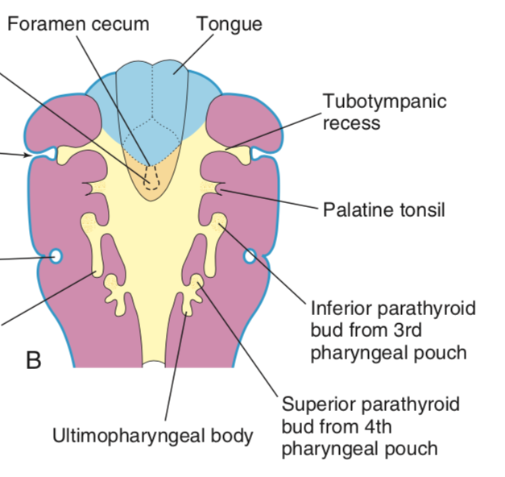
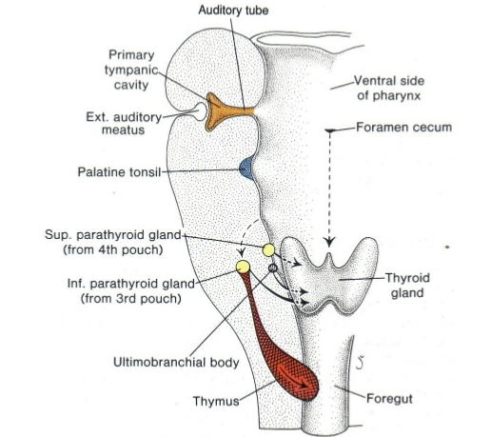
Development of Parathyroid glands
1
Each of the 3rd & 4th pharyngeal pouch develops into dorsal and ventral parts.
By the 6th week :
The dorsal part of the 3rd pouch develops into inferior parathyroid bud,
The dorsal part of the 4th pouch develops into the superior parathyroid bud.
2
The ventral part of the 3rd pouch gives the thymus gland primordium
The ventral part of the 4th pouch forms what is called Ultimopharyngeal body (an embryological structure that gives rise to parafollicular cells of thyroid that secrete calcitonin hormone which lowers the blood calcium level).
3
As the thymus primordium develops, it descends downward to the thorax, behind the sternum in superior mediastinum.
It draws the inferior parathyroid bud to a lower level than the superior parathyroid.
Both parathyroid glands lie behind the thyroid gland.
4

Slide 10
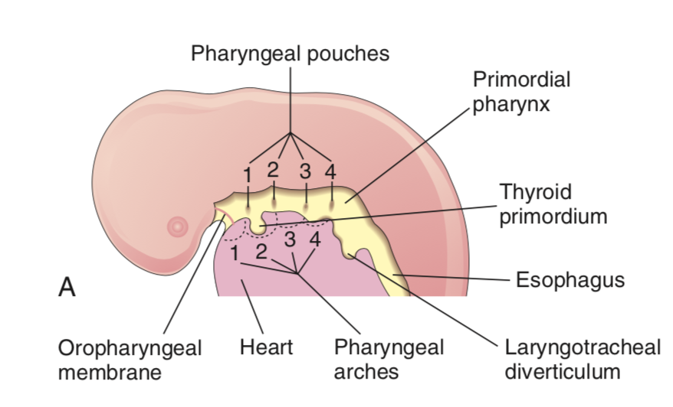
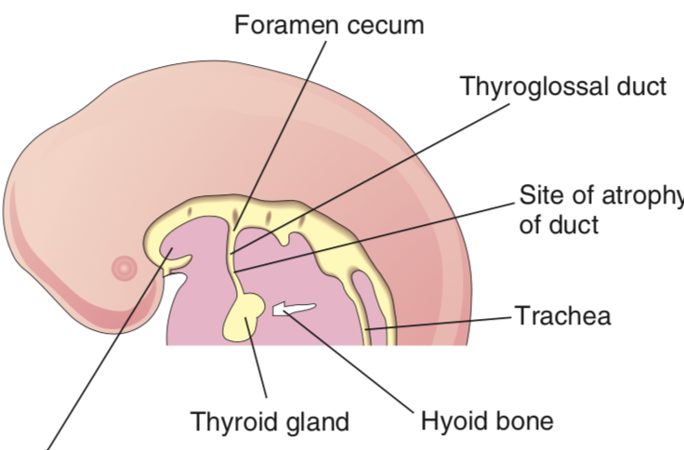
Development of thyroid gland
The upper end of duct persists in the dorsum of the tongue as the foramen cecum.
The distal part of the duct may persists in 50% of people to form the pyramidal lobe.
it may be attached to the hyoid bone by fibrous or smooth muscle Levator glandulae thyroideae
1
As the tongue grows, the developing thyroid gland descends downward in the neck.
It descends anterior to the developing hyoid bone & laryngeal cartilages through the thyroglossal duct.
G
Picture
3
2
4
Picture
The thyroid is connected to the developing tongue by a narrow tube,called the thyroglossal duct.
At first the thyroid primordium is hollow, but soon it becomes solid & divided into 2 lobes and an isthmus.
By 7th week (50th day) the gland takes its final shape & position, and the thyroglossal duct begins to fibrose and degenerate.
J
By the 24th day after fertilization, the thyroid gland begins its development.
It is the first endocrine gland to develop.
it develops from the endoderm of the floor of the primitive pharynx at the junction of the anterior 2/3rd & posterior 1/3rd of the developing tongue, (foramen cecum → apex of sulcus terminalis)
it develops from the thyroid primordium

Slide 11
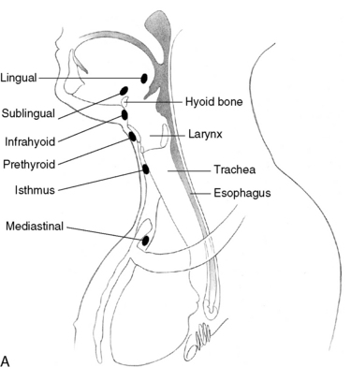
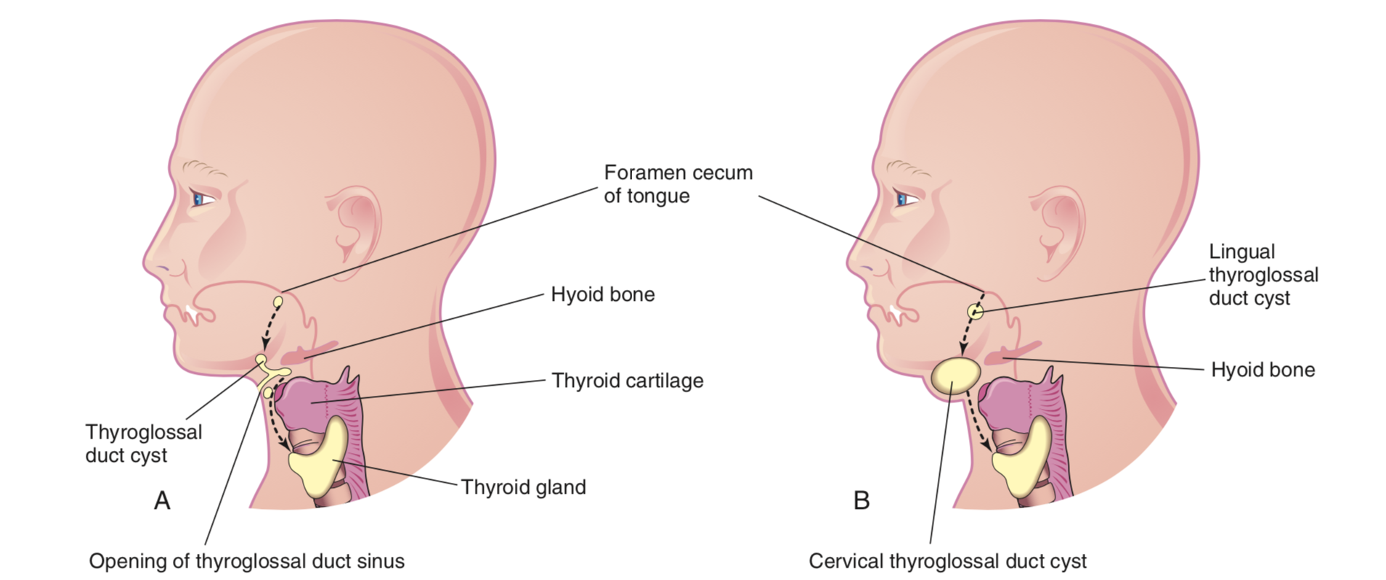
Congenital Anomalies of Thyroid gland
1
Cervical thyroglossal duct cyst
3
Ectopic thyroid tissue
Normally, thyroglossal duct undergo fibrosis and degenerated after the thyroid gland takes its final position. In case of the thyroglossal cyst, the duct does not completely close, forming a cyst. When the cyst get infected, it may rupture and open to the external environment forming a sinus.
Most of thyroglossal duct cysts are located just anterior & inferior to hyoid bone.
Normally:
The thyroid glands develops high up close to foramen cecum of the developing tongue.
Then it descends along the thyroglossal duct to reach its final position by the 7th week.
Ectopic:
Descent of the thyroid could be arrested at any point, or extends down behind the sternum (lead to formation of a retrosternal goiter) in the thorax.
4
Accessory thyroid tissue
uncomplete margination of thyroid gland, which lead to form other small gland usually in the posterior of the tongue
Pic A: showing the possible locations of thyroglossal duct cysts through the broken line indicating the course of the duct. A thyroglossal duct sinus is illustrated.
Pic B: illustrating lingual & cervical thyroglossal duct cysts.
5
Agenesis of thyroid gland
Thyroid gland didn’t form
2
Persistence of thyroglossal duct
6
Congenital hypothyroidism
Thyroglossal duct didn’t fibrous
Thyroid gland formed but doesn't function well

Slide 12
QUIZ
Q1 | Q2 | Q3 | Q4 | Q5 | Q6 | Q7 | Q8
A | D | D | C | A | B | D | A
Q1: Which of the following nerves is endangered in ligation of the superior thyroid artery ?
A. External laryngeal.
B. Recurrent laryngeal.
C. Internal laryngeal..
Q2: Which of the following structures lies anterior to the thyroid lobe? A. Inferior belly of omohyoid.
B. Internal jugular vein.
C. Vagus nerve.
D. Sternohyoid .
Q3: which of the following is branch if the thyrocervical artery ?
A. External carotid
B. Thyroidea ima artery
C. Superior thyroid artery
D. Inferior thyroid artery
Q4: A surgeon will perform an incision in the lower neck below the thyroid gland. Which artery will he most likely encounter?
A. Recurrent laryngeal
B. External laryngeal
C. Thyroidea ima artery
D. internal laryngeal
Q5: What is the origin of the inferior parathyroid gland?
A. Dorsal part of the 3rd pouch
B. Ventral part of the 3th pouch
C. Dorsal part of the 4rd pouch
D. Ventral part of the 4th pouch
Q6: When does the thyroid gland takes its final position? A.6th week B. 7th week C. 4th week D. 3rd week
Q7: Origin of the thyroid gland?
A. 3rd and 4th pharyngeal pouch
B. 2nd pharyngeal arch
C. foramen cecum
D. Endoderm of the floor of the pharynx
Q8: What is the common location for thyroglossal duct cyst? (IMPORTANT)
A. Anterior to hyoid bone
B. Superior to hyoid bone
C. Lateral to hyoid bone
D. posterior to hyoid bone

Slide 13
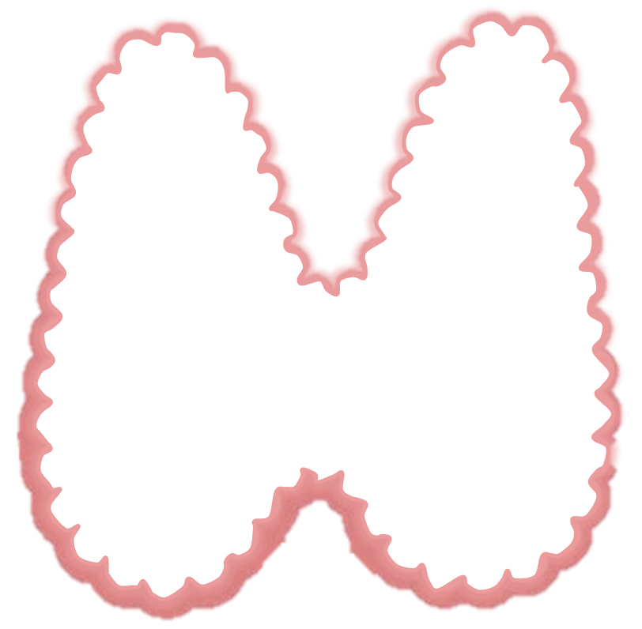
Members board
Team leaders
Abdulrahman Shadid
Ateen Almutairi
Boys team:
Mohammed Al-huqbani
Salman Alagla
Ziyad Al-jofan
Ali Aldawood
Khalid Nagshabandi
Sameh nuser
Abdullah Basamh
Alwaleed Alsaleh
Mohaned Makkawi
Abdullah Alghamdi
Girls team :
Ajeed Al Rashoud
‏Taif Alotaibi
‏Noura Al Turki
‏Amirah Al-Zahrani
‏Alhanouf Al-haluli
‏Sara Al-Abdulkarem
‏Renad Al Haqbani
‏Nouf Al Humaidhi
Jude Al Khalifah
Nouf Al Hussaini
Danah Al Halees
Rema Al Mutawa
Maha Al Nahdi
Razan Al zohaifi
Ghalia Alnufaei
Contact us:
A huge thanks for pharma’s queen: May Babeer
Editing file

