Slide 1
Anatomy & Embryology of Adrenal Glands
Endocrine block-Anatomy-Lecture 3
Editing file

Slide 2
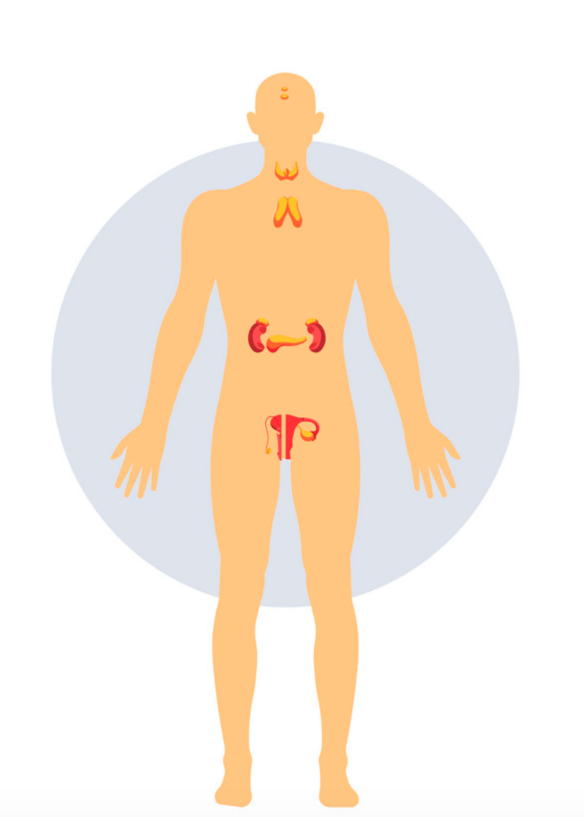
Color guide :
Only in boys slides in Green
Only in girls slides in Purple
important in Red
Notes in Grey
Objectives
At the end of the lecture, students should be able to:
Location, shape and relations of the right and left adrenal glands.
Blood supply, lymphatic drainage and nerve supply of right and left adrenal glands
Parts of adrenal glands and function of each part.
Development of adrenal gland and common anomalies.

Slide 3
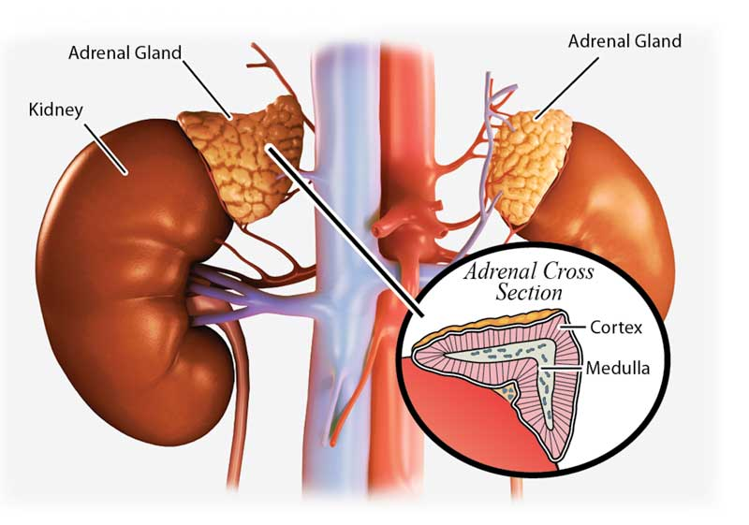
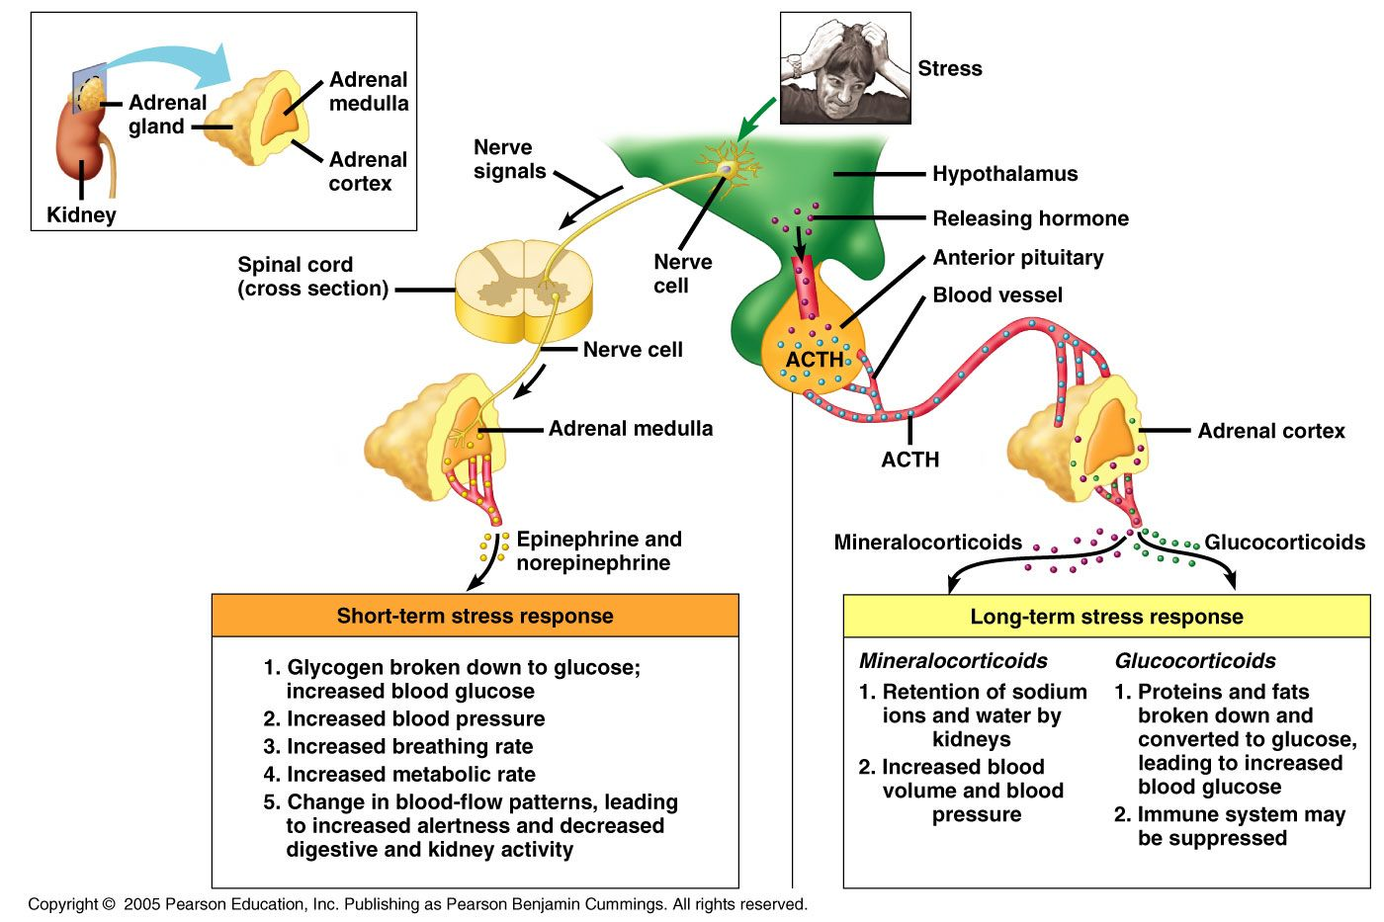
Suprarenal Glands
Structure
They are yellowish retroperitoneal organs located at the upper poles of each kidney at the level of T12
They are surrounding by renal fascia with kidney and separated from the kidney by perirenal fat (kidney is covered by 4 layers: capsule, perirenal fat, renal fascia and pararenal fat.)
Each gland is composed of an outer yellow cortex and an inner dark brown medulla
Function
It is a component of the hypothalamic-pituitary-suprarenal axis that is responsible for coordinating stress response and metabolism
The cortex secretes hormones that include:
mineralocorticoids: concerned in fluid and electrolyte balance
glucocorticoids: concerned in metabolism of carbohydrates, fats, and proteins
sex hormones: Small amounts, play a role in the prepubertal development of the sex organs
The medulla secretes the catecholamines: epinephrine and norepinephrine

Slide 4
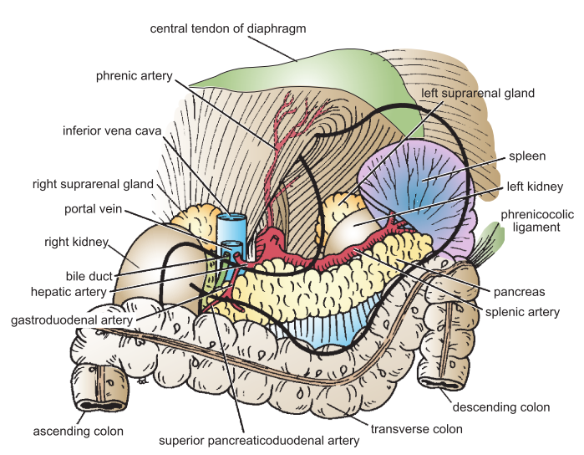
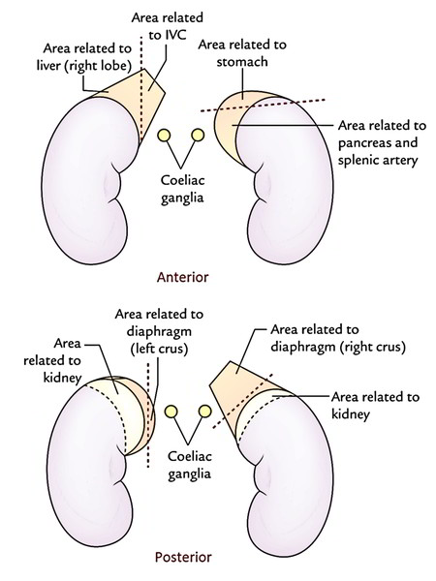
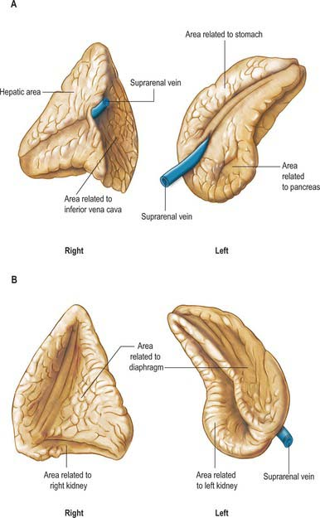
Suprarenal Glands: Shape, location and Relations
1
Shape: Pyramidal or triangular
Location: caps the upper pole of the right kidney
Relations:
Anterior: right lobe of the liver and IVC
Posterior: diaphragm
Medial: celiac plexus and ganglia
Right Suprarenal Gland
2
Left Suprarenal Gland
Shape: crescentic or semilunar
Location: Extends along the medial border of the left kidney from the upper pole to the hilum
Relations:
Anterior: pancreas, stomach and lesser sac
Posterior: diaphragm
Medial: celiac plexus and ganglia
Left Suprarenal Gland

Slide 5
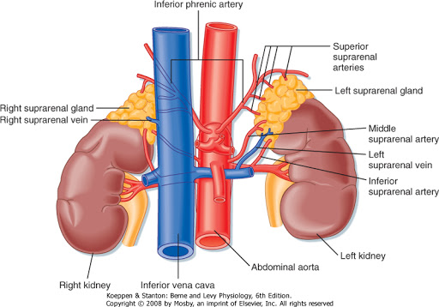
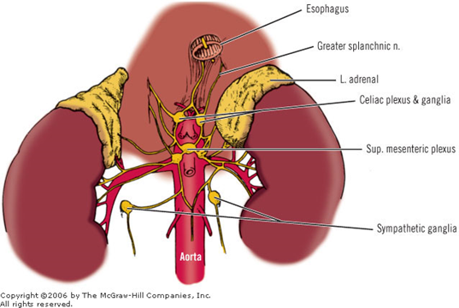
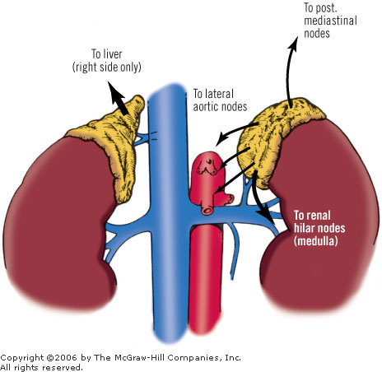
Suprarenal Glands: Supply
Arterial Supply
Venous Drainage
Each gland is supplied by three arteries
Superior suprarenal artery
origin: inferior phrenic a branch from abdominal aorta
Middle suprarenal artery
origin: abdominal aorta single branch
Inferior suprarenal artery
origin: renal arteries
A single vein emerges from the hilum of each gland
Right Suprarenal vein
drain into: inferior vena cava
Left suprarenal vein
drain into: left renal vein
Nerve Supply
Lymph Drainage
drains into: lateral aortic lymph nodes
Sympathetic: preganglionic sympathetic fiber
derived from: splanchnic nerves
Most of the nerves end (postganglionic) in the medulla

Slide 6
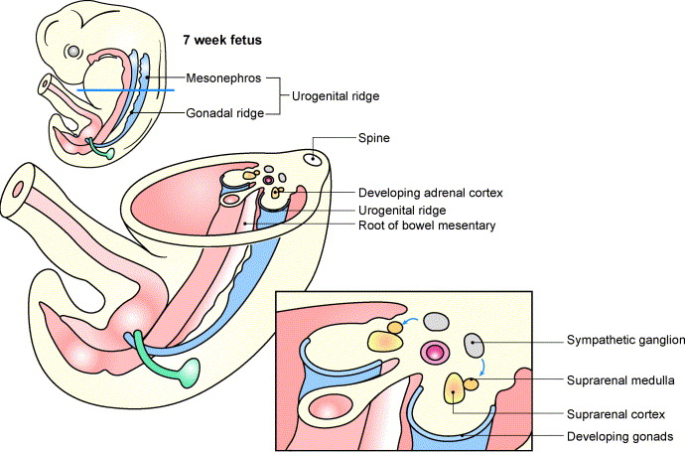
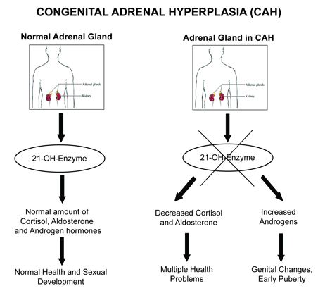
Origin of Adrenal Glands
Adrenal Glands
The two parts of the adrenal gland develop from two different origins
Adrenal Cortex:
is mesodermal in origin
Develops from the coelomic epithelium from the posterior abdominal wall
1
2
Adrenal Medulla:
is ectodermal in origin
Develops from the neural crest cells (chromaffin cells)
Congenital Disorders
Congenital Adrenal Hyperplasia (CAH)
Abnormal increase in cortical cells resulting in excessive androgen production during fetal period
In females, it may lead to → muscularization of external genitalia and enlarged clitoris
In males, it may remain undetected in early infancy
In both sexes, later in childhood, this may lead to → rapid growth and accelerated skeletal maturation

Slide 7
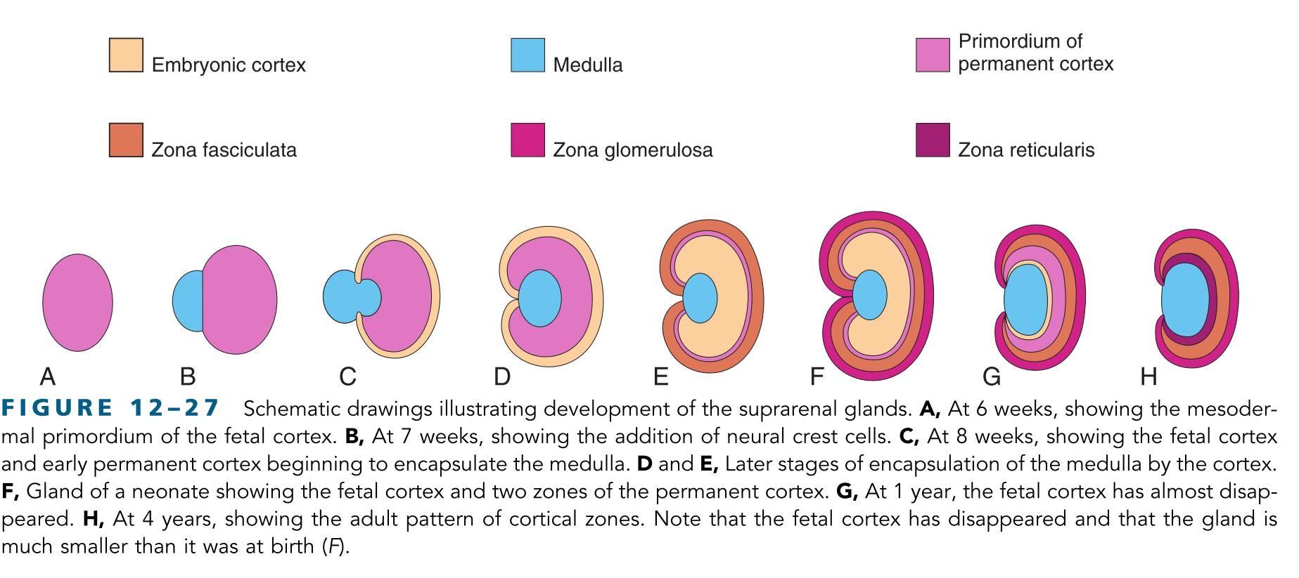
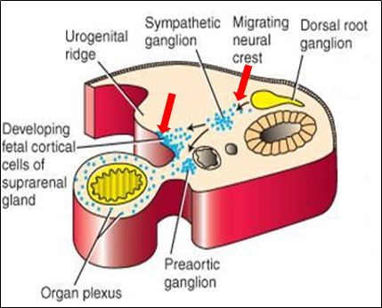
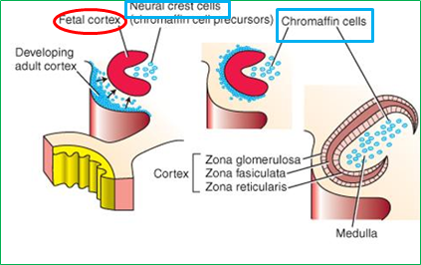
Development of Adrenal Gland
Derived from the neural crest cells of the adjacent sympathetic ganglia
it forms a mass medial to the fetal cortex (fetal cortex is C-shaped)
The Medulla
title
During 6th week of development, mesenchymal tissue aggregate forming the fetal cortex
The fetal cortex is derived from mesothelium tissue between the developing gonads (gonadal ridge) and the dorsal mesentery
The cortex
Permanent cortex
Differentiation
A second wave of mesenchymal cells arise from the mesothelium
This encloses the fetal cortex forming a thinner permanent (definitive) cortex
Differentiation begins mainly during the late fetal period
The cortex differentiate into 2 zones:
Zona glomerulosa
Zona fasciculata
These 2 zones are presented at birth while a 3rd zone appears at the end of the third year called:
Zona reticularis
is not recognizable until the end of 3rd year

Slide 8
Clinical notes
The suprarenal gland is enclosed within the renal fascia with the kidney but in a separate compartment
This allows the two organs to be separated easily during surgery
1
The suprarenal gland of the fetus is 10-20 times larger than the adult’s glands relative to the body weight, and are large compared with the kidneys
This is due to the extensive size of the fetal cortex (The medulla remains relatively small until after birth)
The glands size rapidly decreases during the first 2-3 weeks after birth due to the regression of the fetal cortex
2
3
It’s involution (shrinkage) is largely completed in the first year of life
During this process, the cortex is very susceptible to trauma at birth leading to severe hemorrhage

Slide 9
QUIZ
Q1 | Q2 | Q3 | Q4 | Q5 | Q6 | Q7 | Q8
B | A | B | D | B | A | C | D
Q1: Which of the following structures lies anterior to the Right Adrenal gland ?
A. abdominal aorta
B. Right lobe of the liver
C. diaphragm
D. superior vena cava
Q2: Nerve fibers that are supplying the adrenal gland are? A. Preganglionic sympathetic B. Postganglionic parasympathetic
C. Preganglionic parasympathetic D. Postganglionic sympathetic
Q3: The suprarenal gland is separated from the kidney by:
A. Adrenal fascia
B. Perirenal fat
C. Peritoneal fat
D. renal fascia
Q4: Adrenal gland is derived from ________
A. Endoderm
B. Mesoderm
C. Endoderm ,Ectoderm and mesoderm
D. Ectoderm and mesoderm
Q5: postganglionic fiber that supply adrenal gland end in
A. coeliac gangila
B. medulla
C. cortex
D. the hilum of the adrenal
Q6: Which of the following structures lies posterior to the Left Adrenal gland ? A. diaphragm B. lumbar vertebra C. right lobe of the liver D. celiac plexus and ganglia
Q7: Adrenal Medulla Develops from
A. posterior abdominal wall
B. coelomic epithelium
C. neural crest
D. neural tube
Q8: adrenal gland supplied by
A. supraspinatus arteries
B. superior phrenic
C. splenic artery
D. abdominal aorta

Slide 10
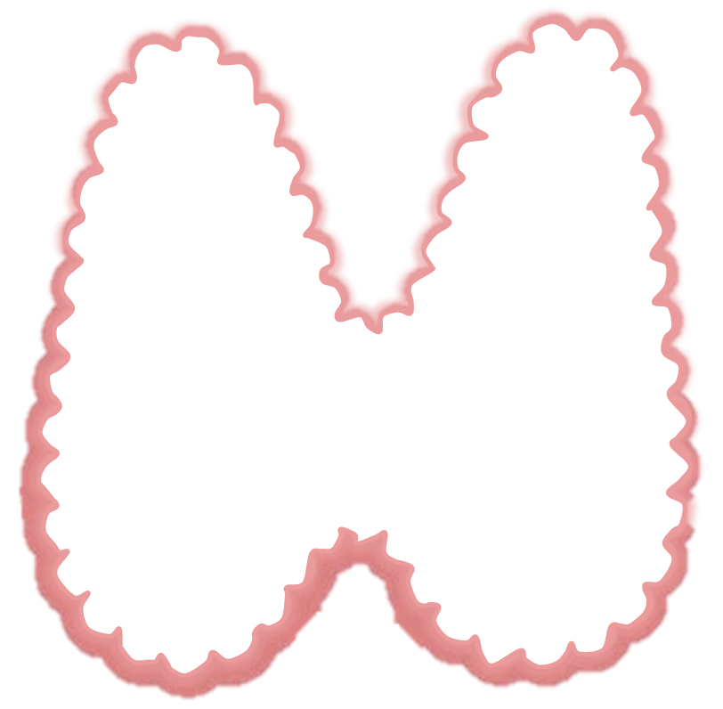
Members board
Team leaders
Abdulrahman Shadid
Ateen Almutairi
Boys team:
Mohammed Al-huqbani
Salman Alagla
Ziyad Al-jofan
Ali Aldawood
Khalid Nagshabandi
Sameh nuser
Abdullah Basamh
Alwaleed Alsaleh
Mohaned Makkawi
Abdullah Alghamdi
Girls team :
Ajeed Al Rashoud
‏Taif Alotaibi
‏Noura Al Turki
‏Amirah Al-Zahrani
‏Alhanouf Al-haluli
‏Sara Al-Abdulkarem
‏Renad Al Haqbani
‏Nouf Al Humaidhi
Jude Al Khalifah
Nouf Al Hussaini
Danah Al Halees
Rema Al Mutawa
Maha Al Nahdi
Razan Al zohaifi
Ghalia Alnufaei
Contact us:
Editing file

